Slide 2
Securing Your MCP Server
Don’t Forget When Securing AI Agents
Frank Vukovits / Alex Meyer

Slide 3

Frank Vukovits
Chief Security Scientist
Fastpath – now a part of Delinea
Email: frank.vukovits@delinea.com
Twitter: @fvukovits
LinkedIn: Frank Vukovits, CISA, CIA | LinkedIn
Background:
35+ years ERP, Audit, and Security Experience
Co-founder AXUG
Certified Internal Auditor (CIA)
Certified Information Systems Auditor (CISA)
Passed CISSP examination in 2002
Frequent speaker at user group, audit, and security events

Slide 4
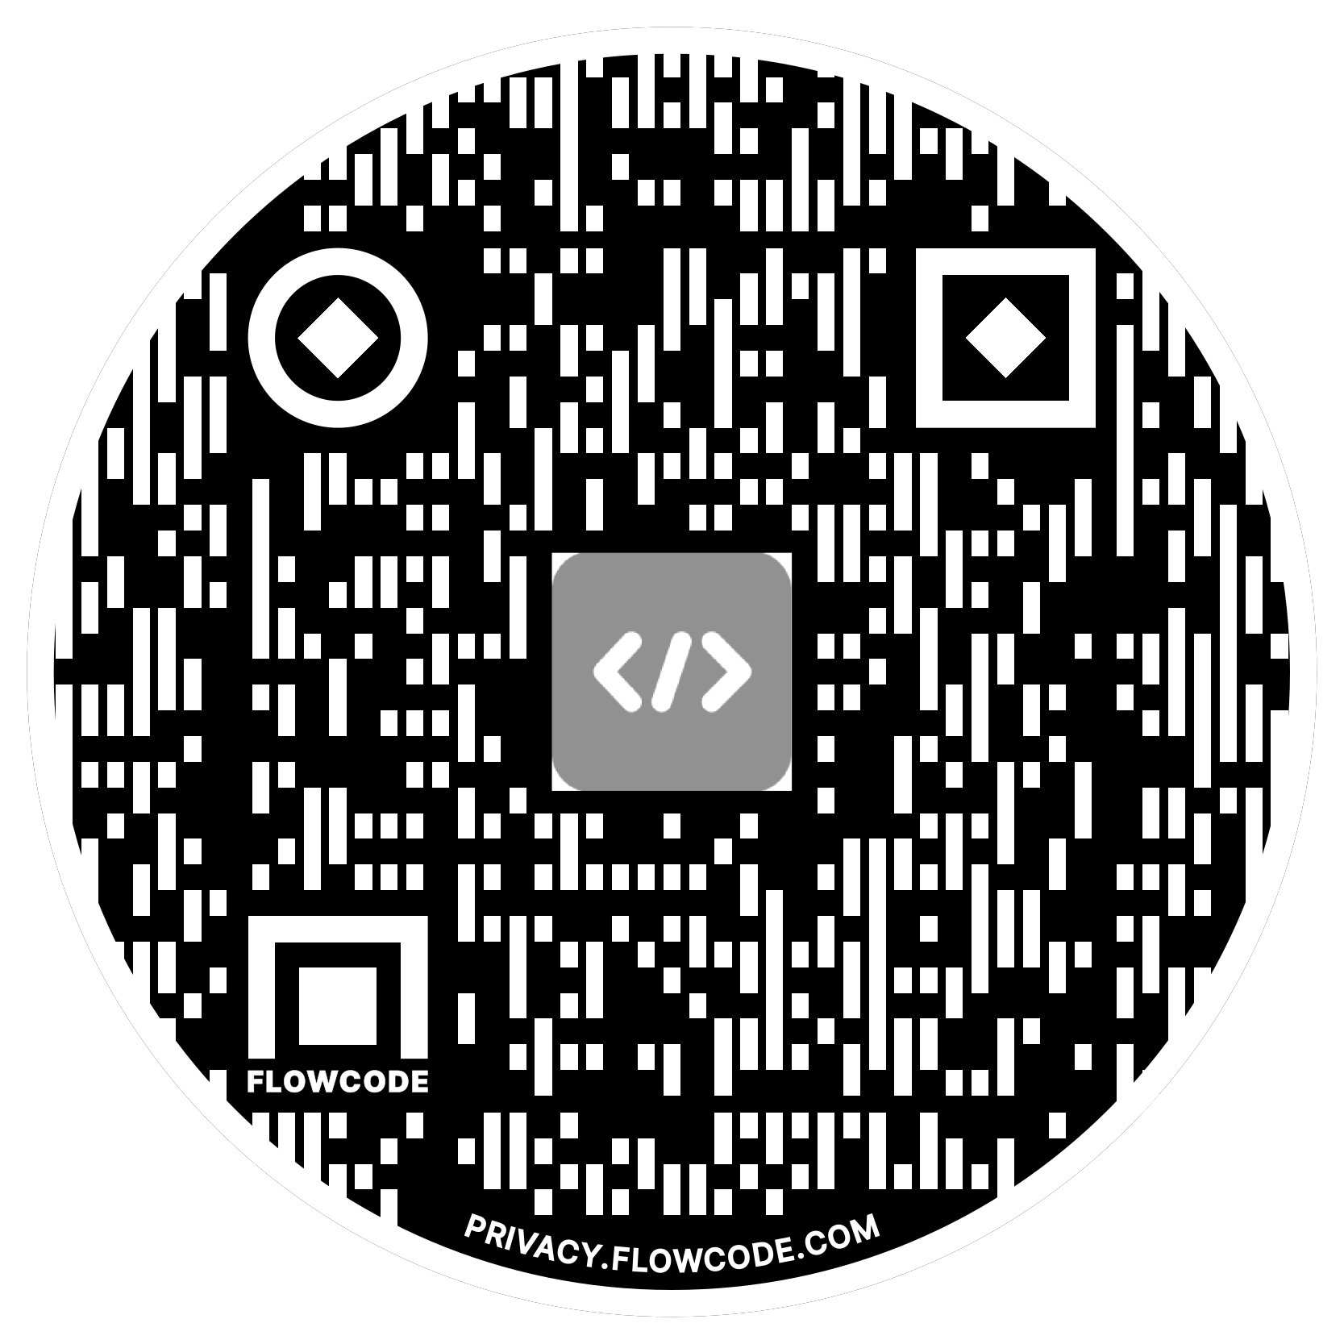

Alex Meyer
Principal Software Engineer
Delinea / Fastpath
Email: alex.meyer@delinea.com
Blogs:
  http://d365fscblog.com
  http://msftcloudblogs.com
  No Null Points Blog
Security Class: http://d365fosecurity.com
LinkedIn
Microsoft MVP Profile
Background:
Awarded Microsoft MVP in Business Applications since 2019
Been working with AX since 2013 and D365FO since 2016
Have spoken at Summit (US & Europe), Focus, and local chapters around AX/D365FO security and have done webinars around native controls in both versions

Slide 5
Agenda
What is a MCP Server
What Changed in the Last 12 Months
Shared Responsibility, Third Party Risk, and Regulatory
The Microsoft Dynamics 365 MCP Landscape
Secure Coding and Security Assumptions
Let’s Get Technical
How This Actually Goes Wrong
Where to Start – and Your First 90 Days
Q & A / References

Slide 6
Quick Poll
Current job role (IT/finance/operations/other)
Current Dynamics product (D365 F&SC/D365 BC/D365 CE/GP)
Do you currently deploy agents inside Dynamics?
Is your company using MCP server(s) currently?
Have you built your own MCP servers?

Slide 7
What is MCP
Model Context Protocol (MCP) is an open standard that enables AI models to securely connect to external data sources, tools, and services.
It standardizes how AI systems connect to data and actions, compressing integration time and unlocking richer AI assistance inside IDEs, chat interfaces, and agentic workflows.
Exposes tools, resources, and prompts to the AI
Provides the critical security boundary
Sounds easy, let’s see how easy it is technically…..

Slide 8
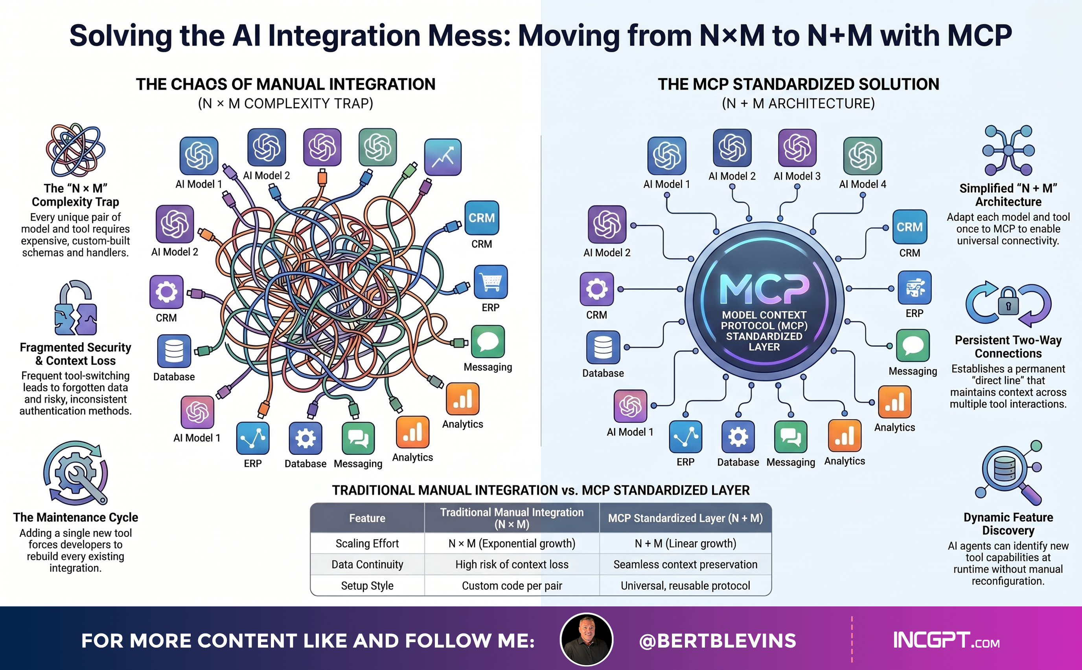
MCP – Universal Connector

Slide 9
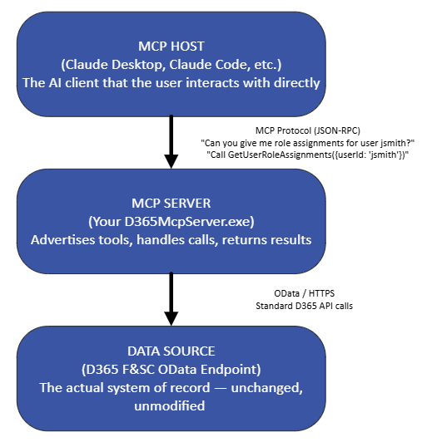
MCP High Level Overview
Standardized way for AI models to talk to external data sources
Not just about data, but also context
  What data do I need to answer this question?
Allows you to converse with AI without having to know the technical under pinning’s
  API endpoint, OData entity, etc

Slide 10
A LOT Has Changed
Everything in this next section did not exist 12 months ago…
Notes:
Transition beat. If you saw a version of this talk last year, the threat model is the same but the ground under it moved twice: Microsoft shipped production MCP servers across the Dynamics family, and the MCP spec itself had two revisions with breaking changes. Both matter to how you secure this.

Slide 11
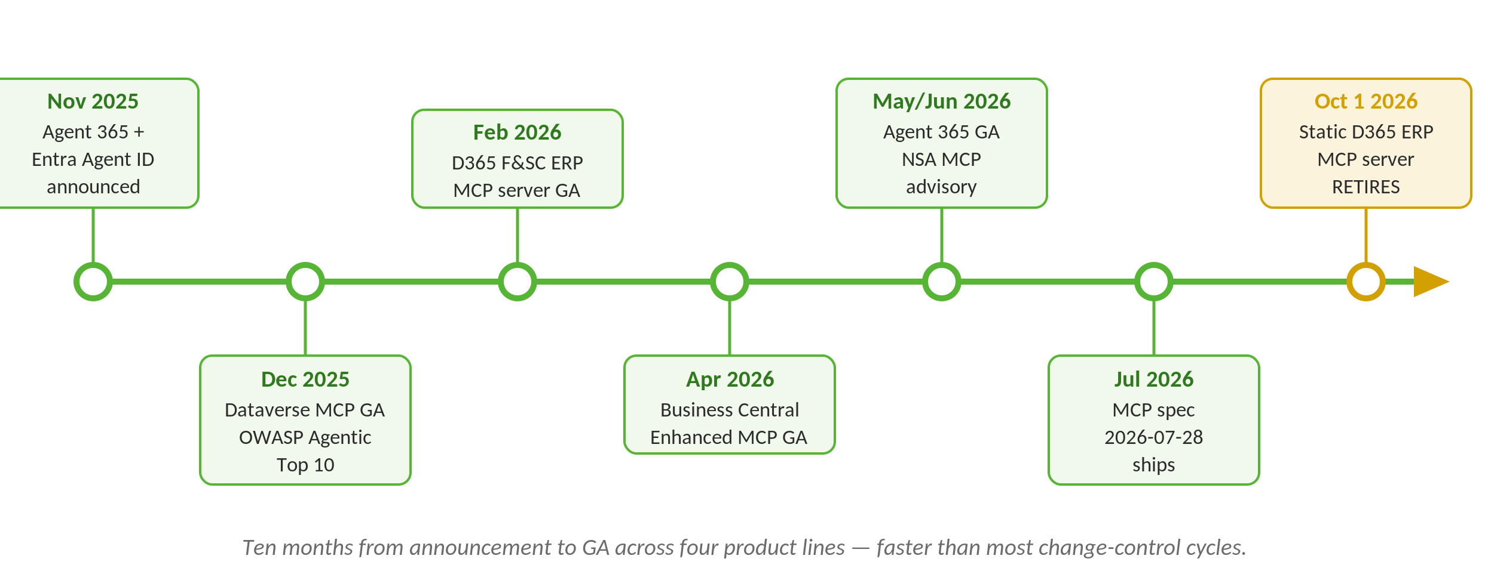
12 Months That Changed Everything
Notes:
The point of this slide is pace, not detail. Ten months from announcement to GA across four product lines. Security review cycles in most Dynamics shops are longer than that. Land the line: 'the capability shipped faster than your change control.' Also flag the Oct 1 retirement – if anyone in the room piloted the static ERP MCP server, they have a migration on the clock.

Slide 12
Built Your Own? The Spec Moved
Stateless core – the initialize handshake and Mcp-Session-Id header are gone
  Session-hijacking as an attack class is eliminated: there is no session ID to steal
Dynamic Client Registration deprecated → Client ID Metadata Documents (client ID is now an HTTPS URL)
Issuer validation now required (RFC 9207) – closes the authorization-server mix-up attack
Credentials must be bound to the issuer that produced them; no reuse across authorization servers
12-month deprecation window; MCP servers remain OAuth 2.1 resource servers only
Notes:
This is the 'if you built your own, read this' slide. Two takeaways for a security audience. First, the protocol removed a whole vulnerability class by deleting sessions – that is a real win, and it means older CVEs about session takeover stop applying once you migrate. Second, the header routing change is the one your network team will care about: for the first time you can put a standard gateway in front of MCP and write policy on tool name without deep packet inspection.

Slide 13
Built Your Own? What To Do Now
If you built your own MCP server: you have ~12 months, not forever to migrate to new spec
If you buy your MCP server: this becomes a vendor question, not a code question
  Which spec revision are you on today, and what is your migration date?
~89% of internet-facing MCP servers were still on the March 2025 spec (Censys, May 2026)
Notes:
The Censys number is the one to sit on. Nearly nine in ten servers on a spec revision that predates the resource-server separation entirely. If a vendor cannot answer the revision question in one sentence, that is your answer.

Slide 14
So What Does All This Mean?
MCP is the new QB for AI
And all teams know you must protect the QB at all times!

Slide 15
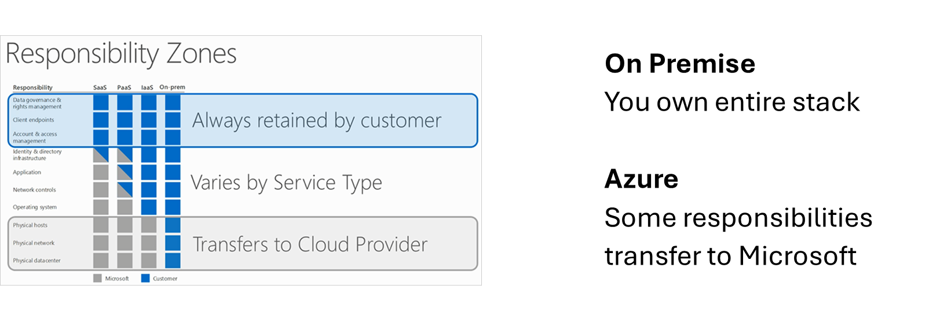
Shared Responsibility Model

Slide 16
Third Party Risk Management
Inventory MCP servers you are using
Vet external MCP servers
Ask security questions of MCP servers you don’t own
  Similar to questions you ask your cloud and software vendors
Don’t assume all vendors follow strong security frameworks – verify!

Slide 17
Regulatory Update – What’s Actually Changed
EU AI Act: the high-risk obligations did NOT take effect on 2 Aug 2026
  The Digital Omnibus on AI postponed Annex III high-risk to Dec 2027 and Annex I to Aug 2028
  Live today: prohibited practices, AI literacy, GPAI duties, and Article 50 transparency
OWASP Top 10 for Agentic Applications (ASI01–ASI10) – published Dec 2025, the one to test against
  ASI02 Tool Misuse and ASI04 Agentic Supply Chain Vulnerabilities map directly to MCP
NSA Cybersecurity Information Sheet on MCP – published Jun 2026, vendor-neutral, quotable
NIST CAISI AI Agent Standards Initiative – launched Feb 2026; agent identity is a named pillar
CSA AI Controls Matrix v1.1 – 247 controls, mapped to ISO 42001 and the EU AI Act
Notes:
Correct the record deliberately here – a lot of decks still say August 2026 for EU high-risk. It slipped. Do not let anyone use that as a reason to stop work: the delay is on the compliance deadline, not on the risk. Note for the room: ISO 42001 certification does NOT confer presumption of conformity with the EU AI Act – only harmonised European standards do, and none exist yet.

Slide 18
Security Assumptions are Never Good
It runs in Microsoft Azure, so it’s secure
AI / AI Agents / MCPs are secure
Developers never have admin access, or always need it
SOC 1 and SOC 2 reports are clean, so we are good
If we had a security problem, we would know it

Slide 19
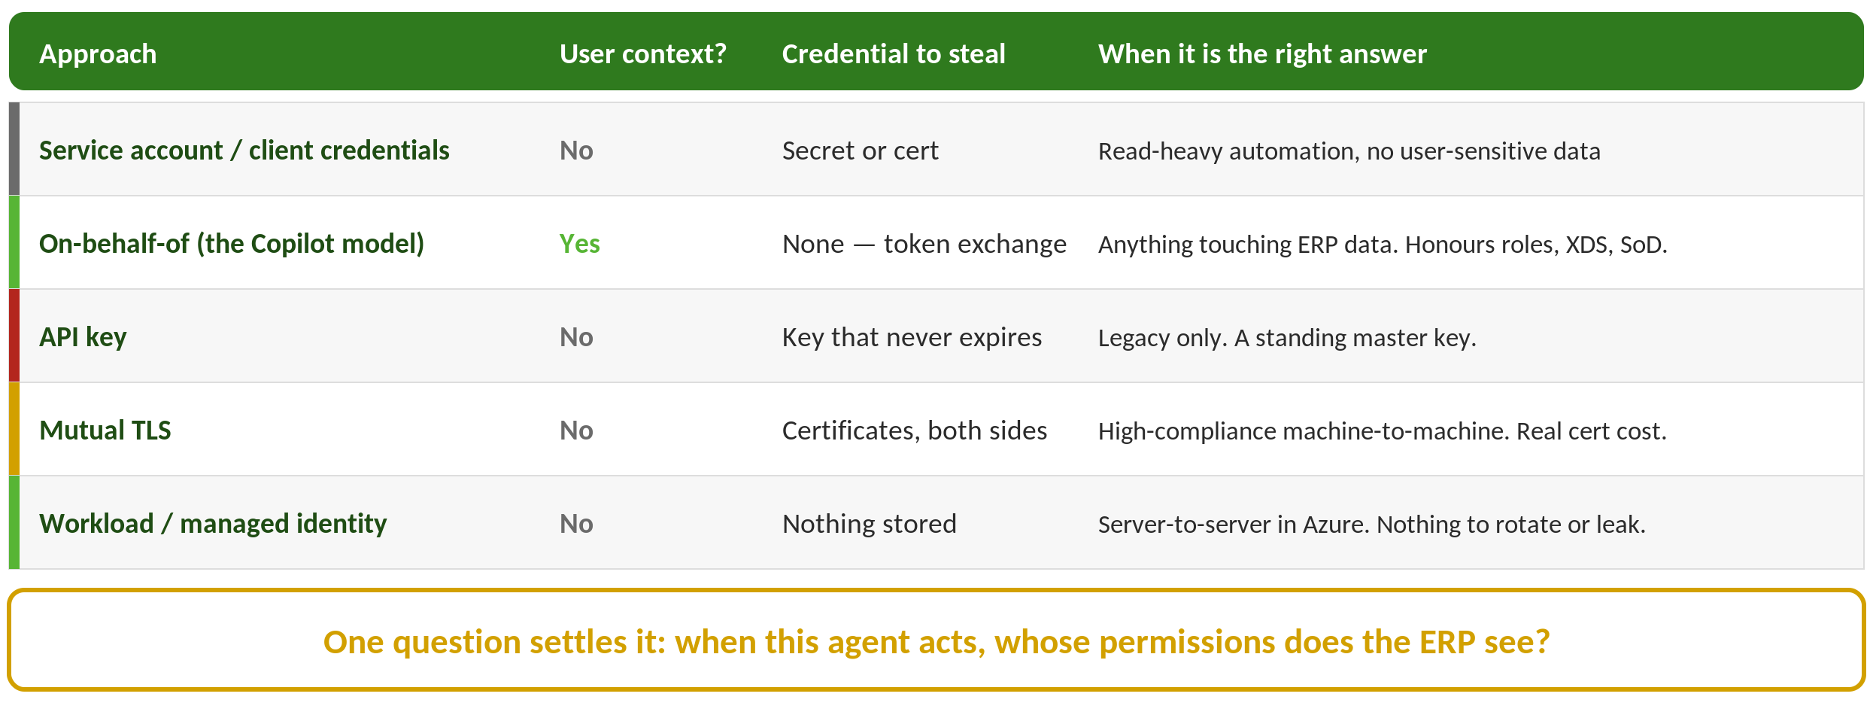
MCP Authentication

Slide 20
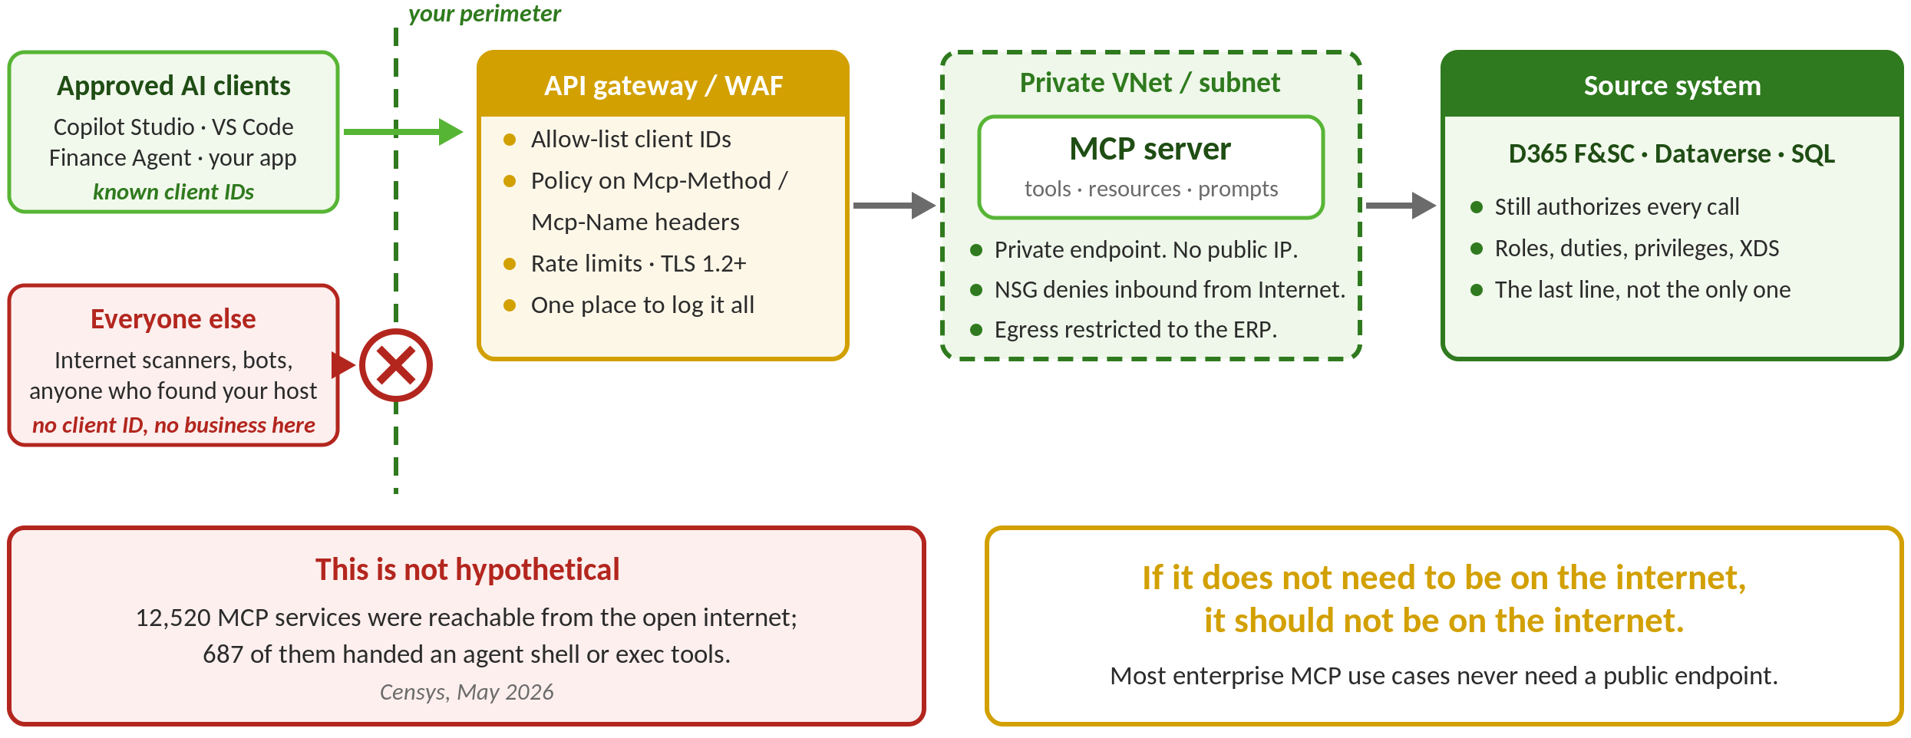
Keep the MCP Server Off the Internet
Notes:
The diagram makes the argument, so do not read the boxes. Walk the two arrows on the left: approved clients come in through one door you control, and everything else gets nothing. Then land the three specifics people can act on — private endpoint so the server has no public IP, an NSG that denies inbound from the internet, and egress restricted to the ERP.
The gateway box is the payoff from the spec slide: the 2026-07-28 revision added the Mcp-Method and Mcp-Name headers, which is the first time a standard WAF or API gateway can write policy on which tool is being called without parsing JSON-RPC. Your network team can enforce this with tooling they already own.
Say the last box out loud: the ERP still authorizes every call. Network segmentation is not a substitute for roles and record-level security — it is the layer that stops a stranger ever reaching the point where those get tested.
Censys number for the close: 12,520 MCP services reachable from the open internet as of the May 2026 scan, 687 of them exposing shell or exec tools. Nobody meant to publish those.

Slide 21
Logging and Observability
Log every tool invocation with:
  Caller identity
  Tool name
  Parameters(sanitized)
  Response code
  Timestamp
Don't log PII or sensitive field values — but do log enough to reconstruct "what did the AI do?“
Feed MCP server logs into your existing SIEM/audit pipeline for analysis (and review the output!)

Slide 22
Microsoft Already Shipped You MCP Servers
The question is no longer whether
you will run one – it is what it inherits

Slide 23
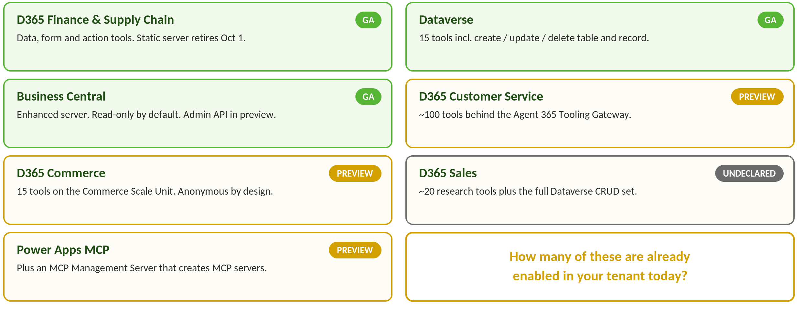
The Microsoft D365 MCP Inventory – August 2026
Notes:
Read this as an inventory exercise, not a feature list. Ask the room: how many of these are already enabled in your tenant and you do not know it? Several are on by default – the ERP MCP server is enabled by default in Feature Management on 10.0.47. Also flag the last line: there is now a Microsoft MCP server whose job is to create MCP servers. That is a governance object, not a feature.

Slide 24
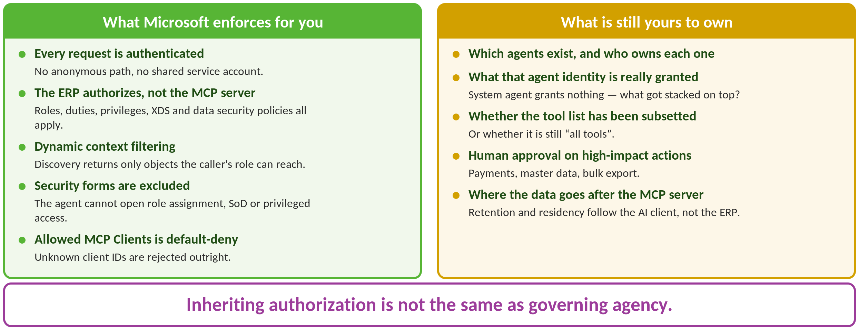
D365 MCP — What Microsoft Got Right
Notes:
This is the good-news slide, and you should give Microsoft credit for it – the authorization model is genuinely sound. Then set up the turn: inheriting authorization is not the same as governing agency. The last two bullets are the ones auditors will chase: your data governance boundary is now the AI client, which may not be a Microsoft product at all.

Slide 25
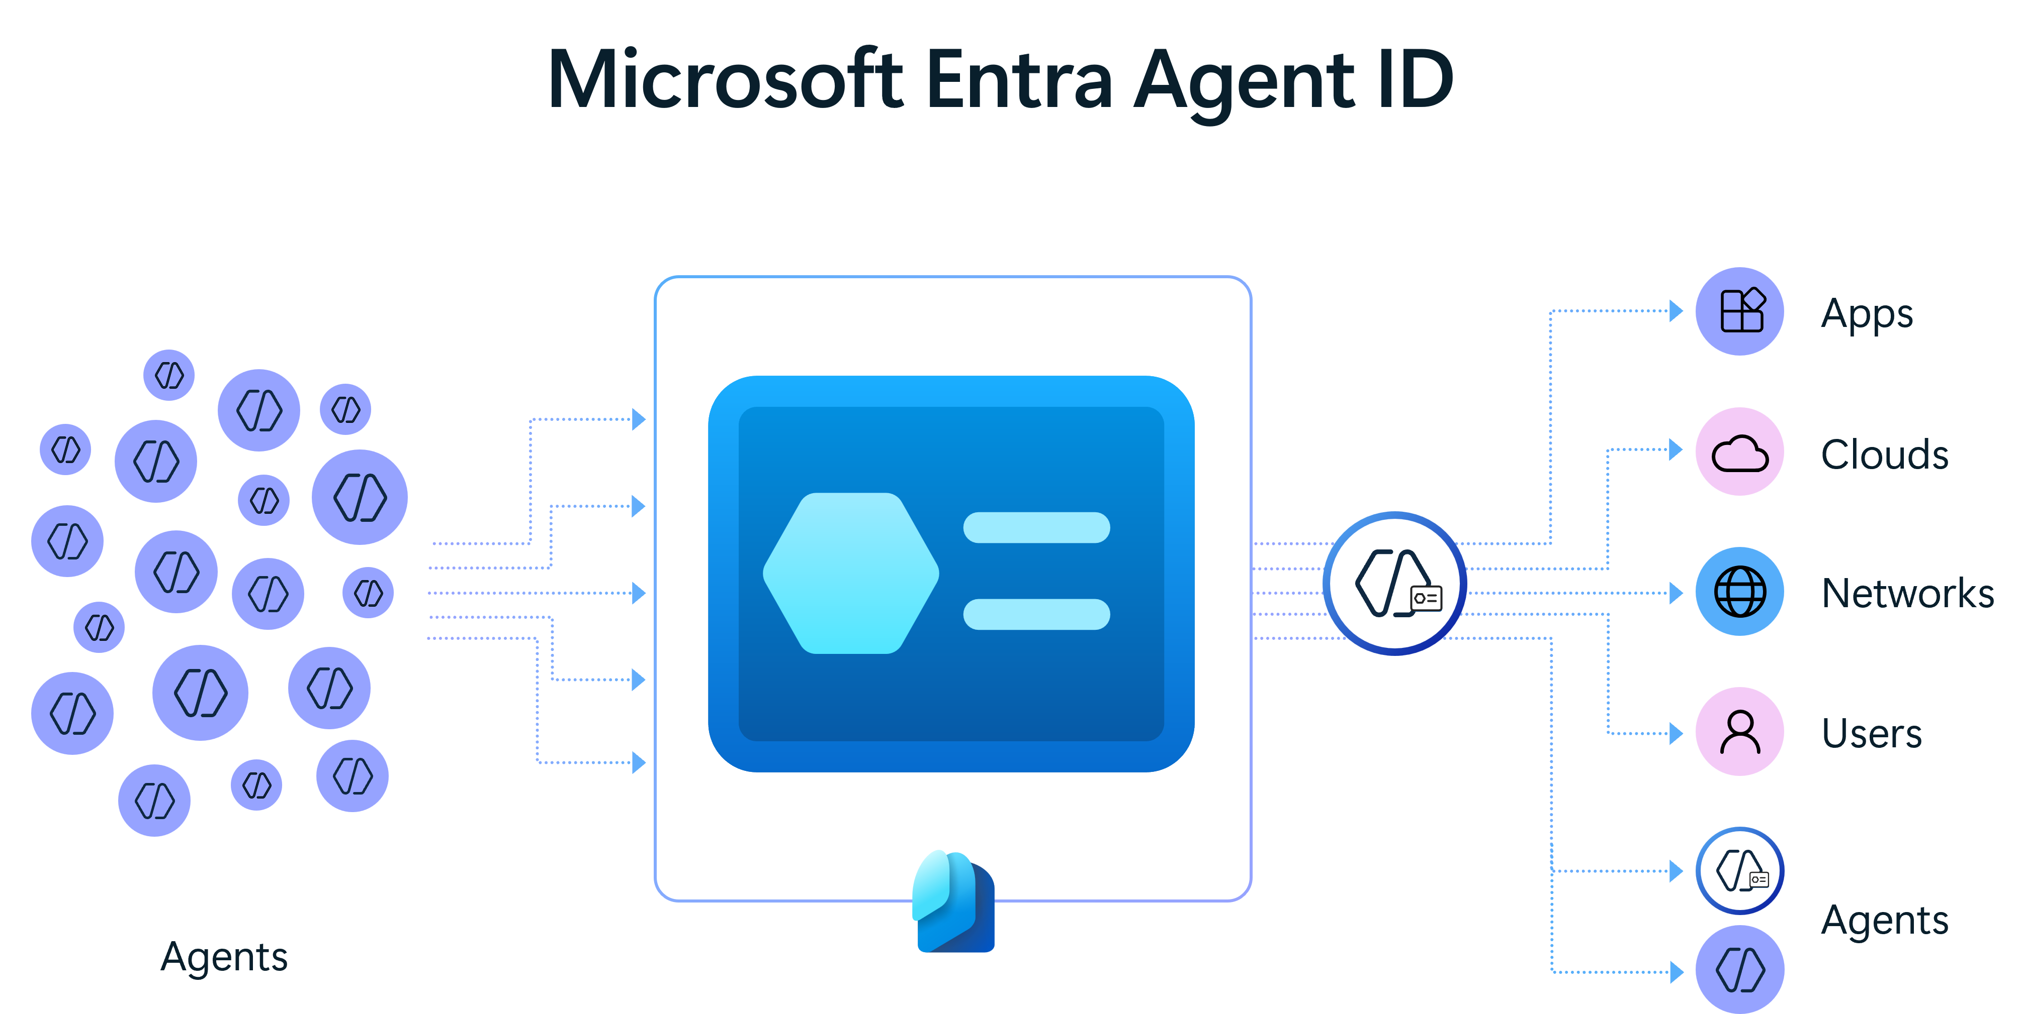
Entra Agent ID – Your Agents Now Have Identities
Three constructs, and the difference matters for policy:
  Agent identity – the agent’s own principal, created from an agent identity blueprint
  Agent’s user account – an optional paired directory user with mailbox, calendar and Teams presence
  On-behalf-of – the human is the token subject; the agent is just the calling app
An agent’s user account does not replace the agent identity – both must exist
Blueprints let you disable an entire class of agents in one operation
Notes:
This is the single most important structural change for an identity audience. Agents are no longer service principals hiding in a corner – they are first-class directory objects with owners, sponsors and access reviews. The blueprint concept is the sleeper feature: policy at the class level means you can govern agents you have not built yet. Push the room on the obvious question: who in your org owns joiner-mover-leaver for a non-human?

Slide 26
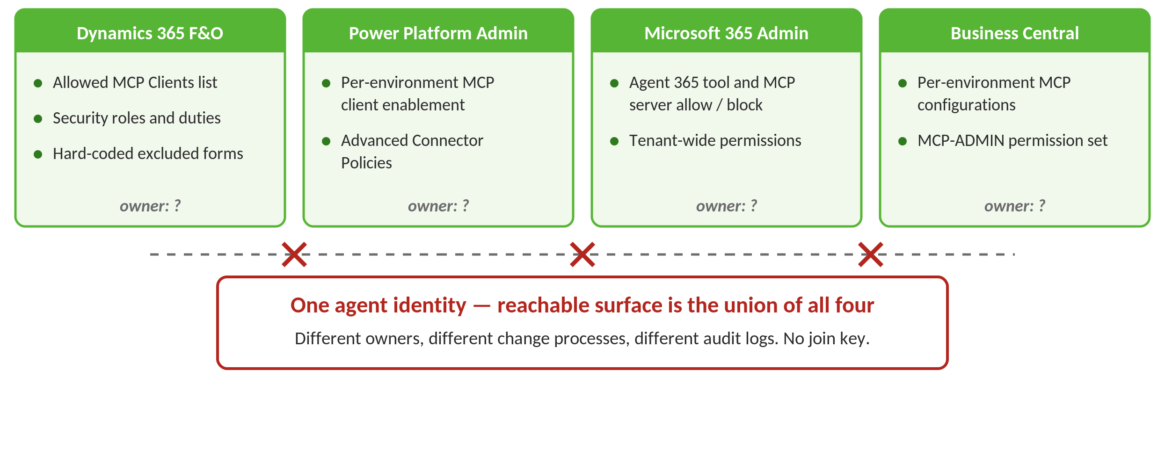
Four Admin Planes, One Blast Radius
Notes:
This is the operational reality slide and it usually gets nods. Four consoles, four owners, and no join key between them. If you take one action item from this session, make it this: write down which team owns each plane and what the approval gate is. In most shops nobody owns plane three yet.

Slide 27
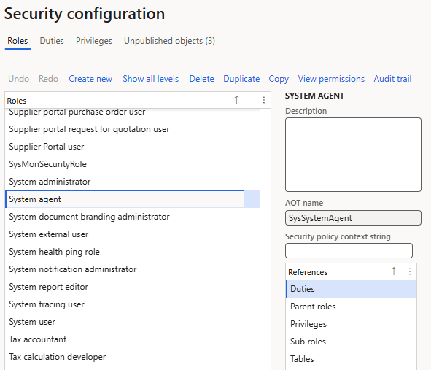
The D365FSC ‘System Agent’ Role Trap
F&O exempts agent identities from user licensing when assigned the System agent security role
That role deliberately grants nothing – no duties, no privileges, and you should not add any
  Every functional role stacked on top is the real, SoD-relevant grant
Expect to find agent identities carrying System agent PLUS something more broad
The licensing incentive and the least-privilege incentive point in opposite directions
Audit ask: list every identity holding System agent and enumerate what else it holds
These identities sit outside your joiner-mover-leaver process by default
Notes:
This is a Fastpath-shaped finding and it is a good one to own. A licensing construct is about to become the marker for 'this is a non-human identity.' That is useful – it gives you a query. Run it. The pattern to look for is System agent plus a broad functional role that a human would never be granted unattended.

Slide 28
How This Actually Goes Wrong
Not theory – these are documented,
reproduced, and in some cases CVE-numbered

Slide 29
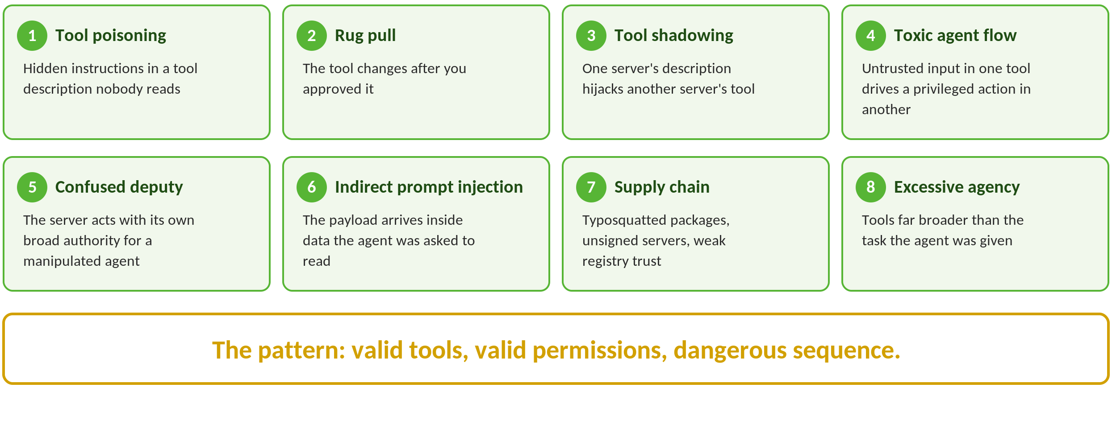
The MCP Attack Taxonomy
Notes:
Land the closing line hard – it is the thesis of the whole talk and it echoes Frank's existing takeaway slide. None of these require a broken tool. Every one of them uses tools that are working exactly as designed, in an order nobody authorised. Traditional appsec testing looks at one call at a time; this threat model lives between the calls.

Slide 30
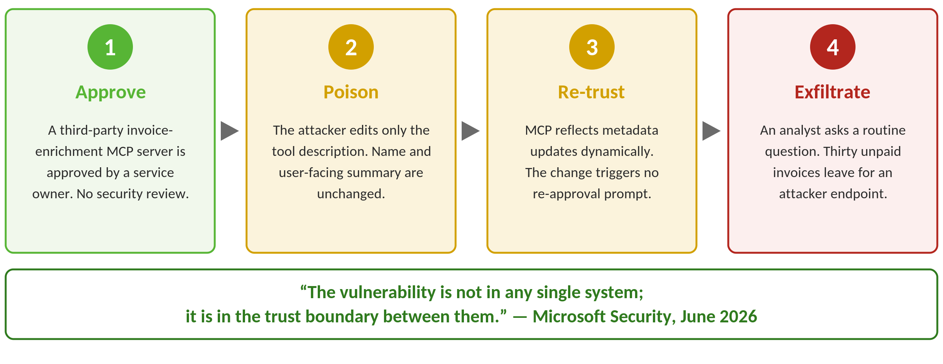
Case Study – Poisoning a D365 Finance Agent
Notes:
Walk this one slowly – it is the most persuasive slide in the deck because it is Microsoft's own write-up, on Microsoft's own stack, against Dataverse. Say clearly that Microsoft is describing an attack pattern, not disclosing a named customer incident – that distinction will be asked. Microsoft's diagnosis is the quote to use: 'the vulnerability is not in any single system; it is in the trust boundary between them.' MCP blends instructions and data, and the agent cannot tell an instruction written by its owner from one inserted by an upstream maintainer. Nobody was breached at the perimeter. Nothing was misconfigured.

Slide 31
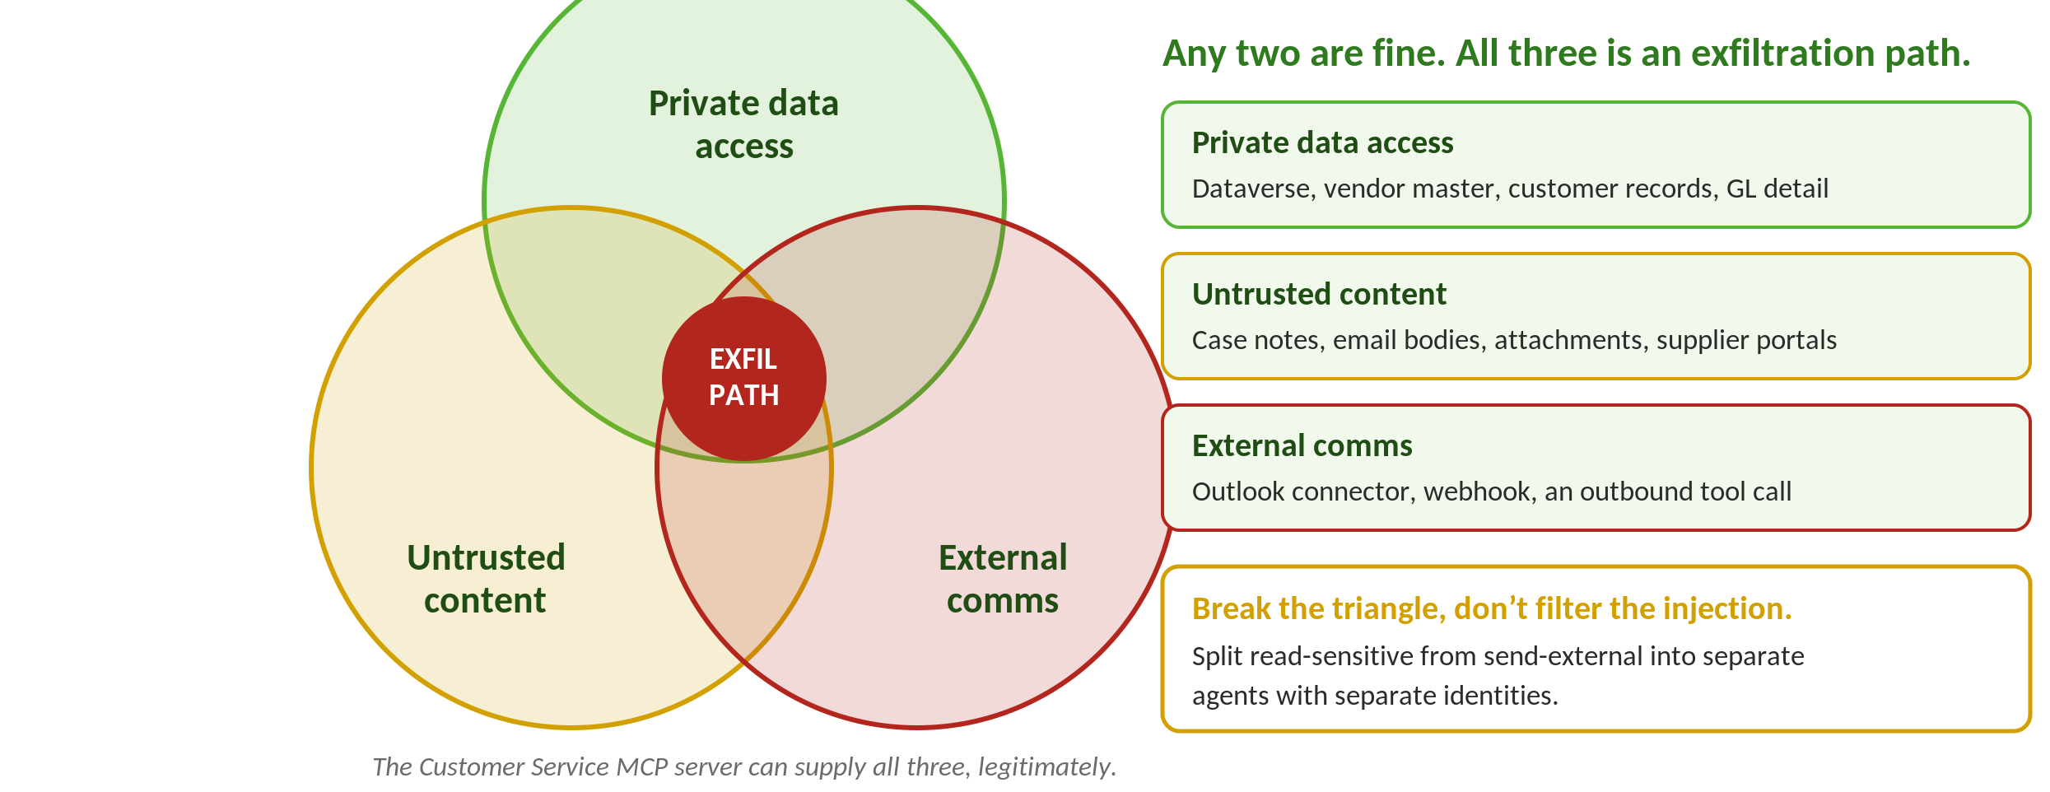
The Lethal Trifecta – Dynamics Edition
Notes:
Simon Willison's framing, and it is the most useful mental model you can hand a Dynamics architect. The reason it works is that it turns an unsolvable filtering problem into a solvable architecture problem. You cannot reliably detect prompt injection. You can reliably decide that the agent reading supplier email is not the agent with the send permission.

Slide 32
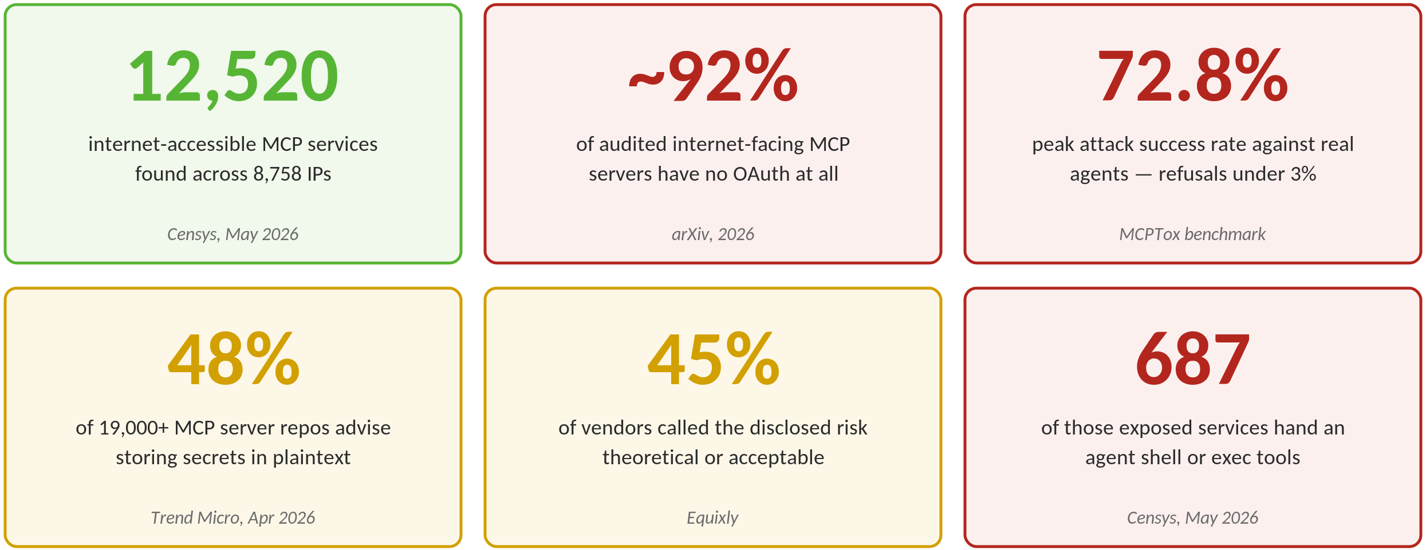
MCP By the Numbers
Notes:
Pick two or three, do not read all eight. The 45%-never-fixed number is the best one for an audit audience because it is about vendor behavior, not code. The 'more capable models were more susceptible' finding is the one that surprises people – a smarter model follows the poisoned instruction more faithfully. Cite dates out loud; these move fast – and note the Gartner line is a 2024-vintage prediction, so attribute it as a forecast, not as observed data.

Slide 33
WOW – That’s a Lot
Where do you start to secure
MCP servers and their use?

Slide 34
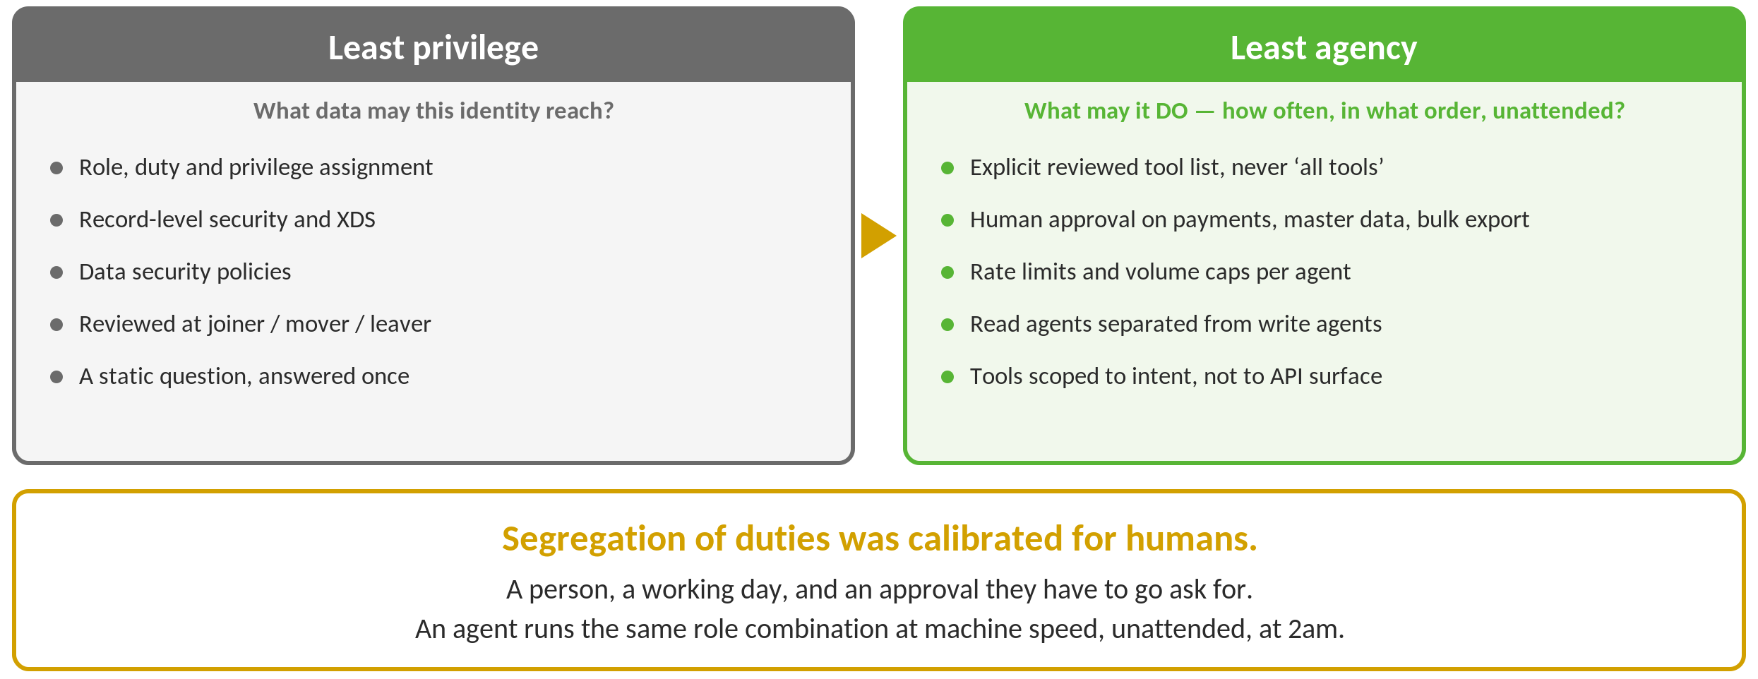
Least Agency, Not Just Least Privilege
Notes:
Microsoft's own phrase, and it deserves to become standard vocabulary. Privilege is a static question; agency is a behavioral one. The rate-limit bullet usually lands – every ERP person in the room can picture the four hundred journal entries.

Slide 35
Segregation of Duties Was Designed for Humans
Classic SoD assumes a person, a working day, and an approval they have to go ask for
An agent runs the same combination at machine speed, unattended, at 2am
A role that is SoD-clean for a human may be unacceptable for an autonomous identity
Rethink the analysis for agents:
  Include the agent identity in your SoD ruleset – do not exempt it as a service account
  Treat the tool list as part of the access profile, not as configuration
  Look at sequences across servers, not just conflicts within one role
Re-run access reviews on agent identities on the same cadence as privileged humans

Slide 36
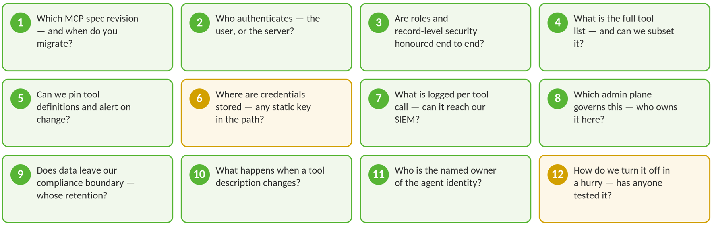
12 Questions Before You Turn One On

Slide 37
Your First 90 Days
Days 1–30 – find out what you already have
Inventory MCP servers and agent identities across all four admin planes
Query F&O for identities holding the System agent role and enumerate what else they hold
Confirm which D365 MCP servers are enabled by default in your environments
Days 31–60 – put a boundary around it
Named owner per agent; agent identities into access reviews and the SoD ruleset
Tool allow-lists, human approval on high-impact actions, tool logs into the SIEM
Days 61–90 – test it like an attacker
Red-team against OWASP ASI01–ASI10; scan servers; rehearse the emergency shut-off

Slide 38
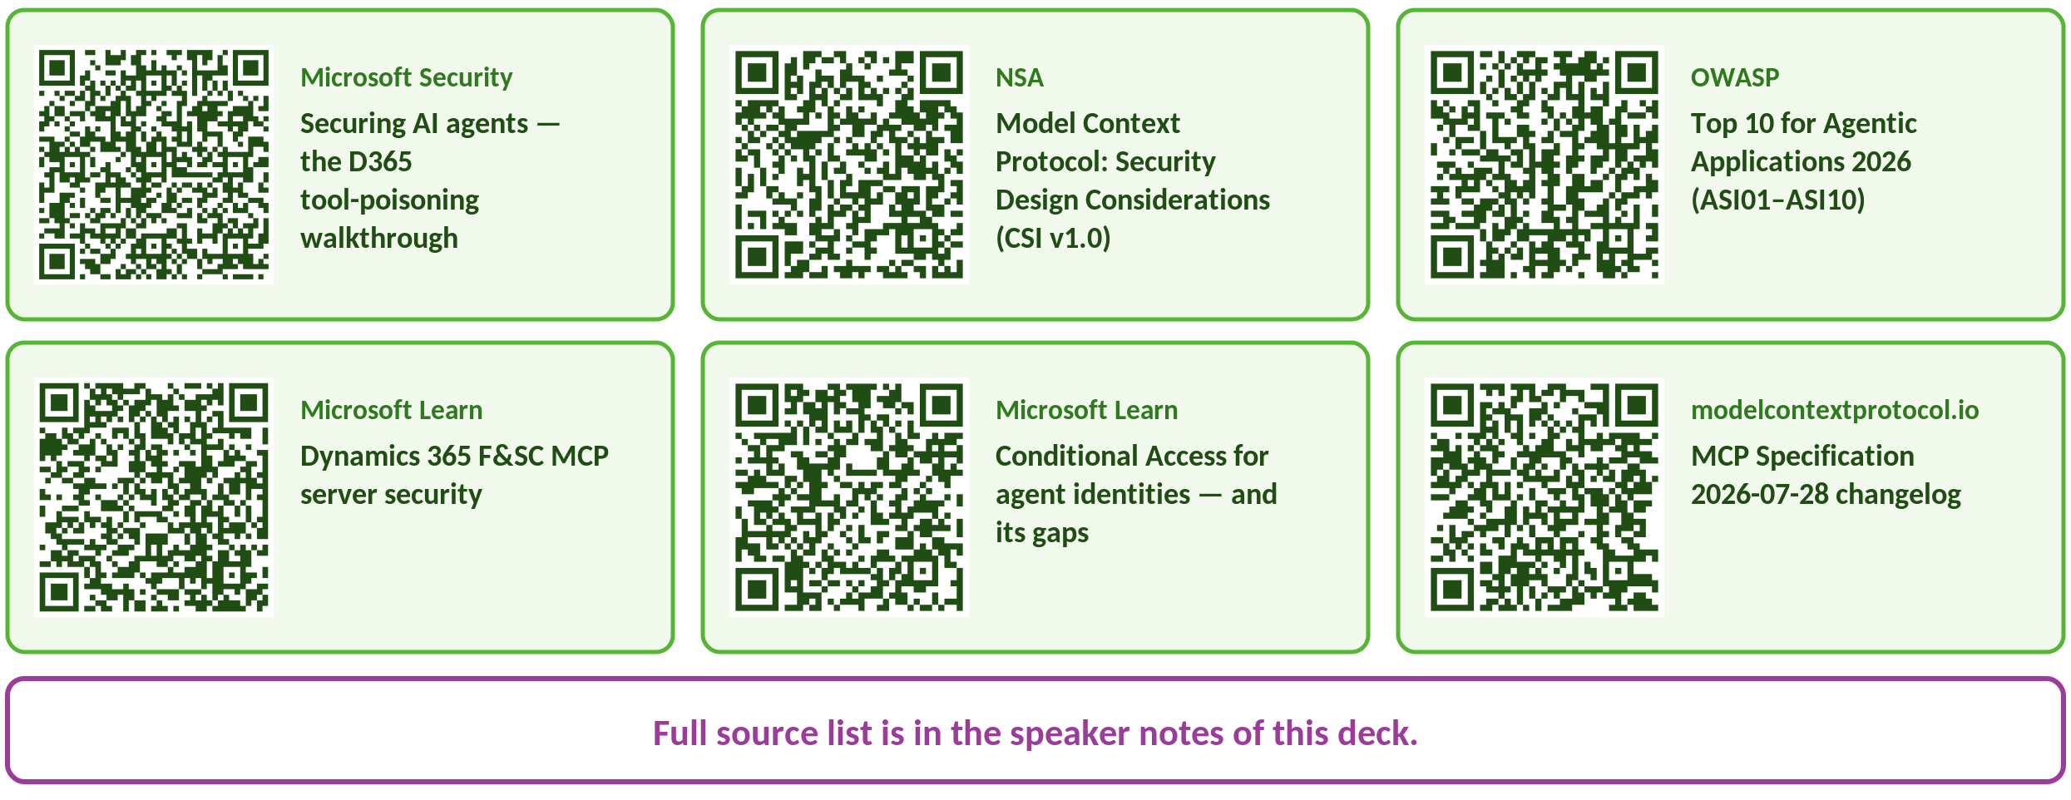
References — Scan These
Notes:
Microsoft Security — Securing AI agents — the D365 tool-poisoning walkthrough: https://www.microsoft.com/en-us/security/blog/2026/06/30/securing-ai-agents-ai-tools-move-from-reading-acting/
NSA — Model Context Protocol: Security Design Considerations (CSI v1.0): https://media.defense.gov/2026/Jun/02/2003943289/-1/-1/0/CSI_MCP_SECURITY.PDF
OWASP — Top 10 for Agentic Applications 2026 (ASI01–ASI10): https://genai.owasp.org/resource/owasp-top-10-for-agentic-applications-for-2026/
Microsoft Learn — Dynamics 365 F&SC MCP server security: https://learn.microsoft.com/en-us/dynamics365/fin-ops-core/dev-itpro/copilot/mcp/mcp-security
Microsoft Learn — Conditional Access for agent identities — and its gaps: https://learn.microsoft.com/en-us/entra/identity/conditional-access/agent-id
modelcontextprotocol.io — MCP Specification 2026-07-28 changelog: https://modelcontextprotocol.io/specification/2026-07-28/changelog
Full list:
MCP Specification 2026-07-28 changelog and Security Best Practices — modelcontextprotocol.io
NSA — Model Context Protocol: Security Design Considerations (CSI v1.0, May 2026)
OWASP Top 10 for Agentic Applications 2026 (ASI01–ASI10) — genai.owasp.org
CSA AI Controls Matrix v1.1
European Commission — safer and more transparent AI (2 Aug 2026)
Dynamics 365 F&SC MCP server security, tools, excluded forms and allowed clients — Microsoft Learn
Dataverse MCP server: overview, FAQ and governance — Microsoft Learn
D365 Customer Service MCP + Agent 365 Tooling Gateway setup — Microsoft Learn
Business Central MCP server: overview and configuration — Microsoft Learn
Microsoft Entra Agent ID; Conditional Access for agent identities — Microsoft Learn
Agent 365 tooling overview; Purview data security for Agent 365 — Microsoft Learn
Securing AI agents: when AI tools move from reading to acting — Microsoft Security, Jun 2026
The state of MCP security in 2026 — Microsoft Security Blog
Invariant Labs — MCP tool poisoning attacks; GitHub MCP toxic agent flow
Trail of Bits — jumping the line: MCP servers can attack before you use them
Censys — MCP servers on the internet (May 2026)
Trend Micro — update on exposed MCP servers (Apr 2026)
MCPTox benchmark — arXiv:2508.14925
Equixly — MCP servers, the new security nightmare
Koi Security — postmark-mcp npm backdoor

Slide 39
Thank You!
alex.meyer@delinea.com
frank.vukovits@delinea.com
www.delinea.com
www.delinea.com/fastpath

