Slide 1

Buried Treasure: Mining D365 F&SC Data with AI for Admin Wins
Uncovering Hidden Optimization Goldmines in D365FSC Data
Alex Meyer · Principal Software Engineer, Delinea / Fastpath
DUG24 — GOING GLOBAL JULY 21–22, 2026 · DUG24.COM

Slide 2
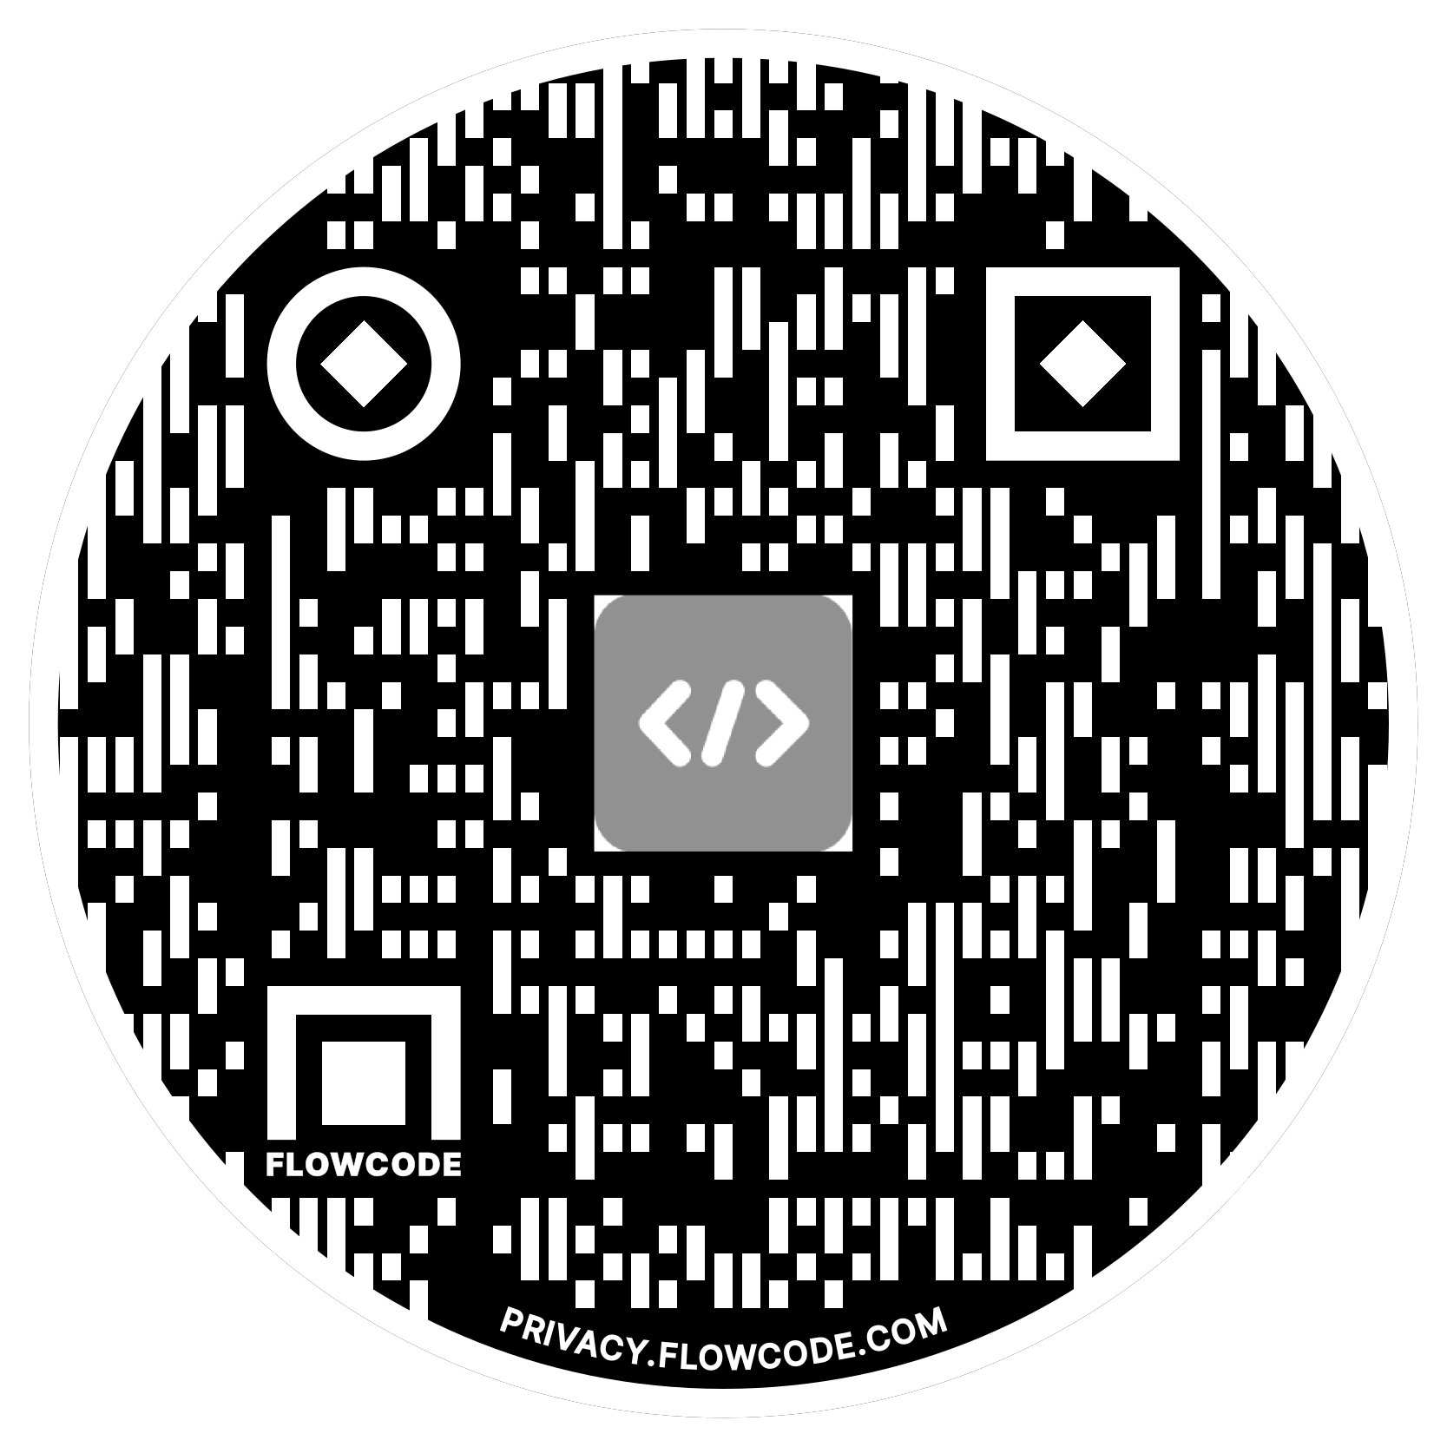

About me
Alex Meyer
Principal Software Engineer · Delinea / Fastpath
Microsoft MVP in Business Applications / AI ERP since 2019.
Working with AX since 2013 and D365FO since 2016.
Spoken at Summit (US & Europe), Focus, and local chapters on AX / D365FO security — plus webinars on native controls.
Ask me about: D365 security, licensing, and putting AI to work on real ERP data.
linkedin.com/in/alexdmeyer · @alexmeyer_ITGuy
DUG24 · GOING GLOBAL · JULY 21–22, 2026

Slide 3
What we'll cover
01
AI & LLM overview — what is (and isn't) AI
02
Prompt creation best practices
03
Data analysis scenario — Manual, API & MCP
04
Real-world D365FSC optimization scenarios
05
Takeaways & resources
DUG24 · GOING GLOBAL · JULY 21–22, 2026

Slide 4
What you'll leave with
Three things you can use in your environment today
A working understanding of key AI terms — what is and isn't AI, large language models, and Model Context Protocol.
Tips for writing a good AI prompt for analyzing your data.
Three different ways to connect AI to your D365 data and analyze it.
Two real-world D365 optimization scenarios you can take back and run yourself.
DUG24 · GOING GLOBAL · JULY 21–22, 2026

Slide 5
AI & LLM Overview
The concepts before the clicks

Slide 6
What is — and isn't — AI?
WHAT ISN'T AI
WHAT IS AI
Anything that follows a rule-based process.
For every input, you get the same output.
Example: a workflow that runs every day, makes an API call, gets data, analyzes it against fixed rules, and returns a result.
Any system that requires reasoning and/or planning and interprets the response data.
It weighs context instead of following fixed rules.
Example: "Should I bring an umbrella to work today?" — it reasons over the forecast, your location, and the time.
DUG24 · GOING GLOBAL · JULY 21–22, 2026

Slide 7
What are large language models?
The underlying 'brain' of AI
Use billions — even trillions — of parameters that are then 'weighted’.
Analyze relationships between words / processes and predict the next word / process in a sequence.
AI doesn't have 'intelligence' — it predicts the output you want based on the prompt you supply.
AI is non-deterministic: the same prompt can produce different answers.
DUG24 · GOING GLOBAL · JULY 21–22, 2026

Slide 8


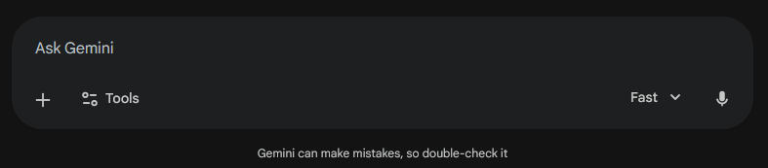
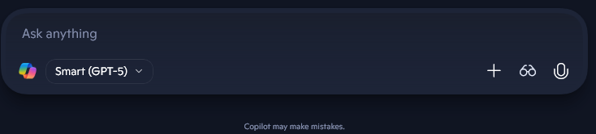
Why hasn't AI taken over ERP yet?
Always keep a ‘human in the loop’ because AIs can make mistakes.
Copilot
Claude
ChatGPT
Gemini
DUG24 · GOING GLOBAL · JULY 21–22, 2026

Slide 9
Why hasn't AI taken over ERP yet?
Always keep a ‘human in the loop’ because AIs can make mistakes.
Copilot
Claude
ChatGPT
Gemini
DUG24 · GOING GLOBAL · JULY 21–22, 2026

Slide 10
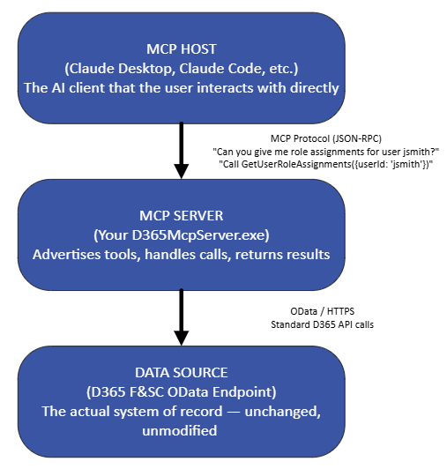
What is Model Context Protocol (MCP)?
A standardized way for AI models to talk to external data sources.
Not just about the data — also about context.
  It answers: "What data do I need to answer this question?"
Lets you converse with AI without having to know the technical underpinnings.
DUG24 · GOING GLOBAL · JULY 21–22, 2026

Slide 11
AI best practices — keep a human in the loop
All output should be reviewed by a human — keep a 'human in the loop.'
Beware the 'AI hammer' — not every problem should be solved with AI.
  Data-generation tasks (drafting an email, building a deck) → great for AI.
  Posting to your GL → not great for AI.
Don't jump to AI if you don't have to — most business cases need a repeatable process.
For automation: use AI to help build the workflow; don't let AI be the workflow.
DUG24 · GOING GLOBAL · JULY 21–22, 2026

Slide 12
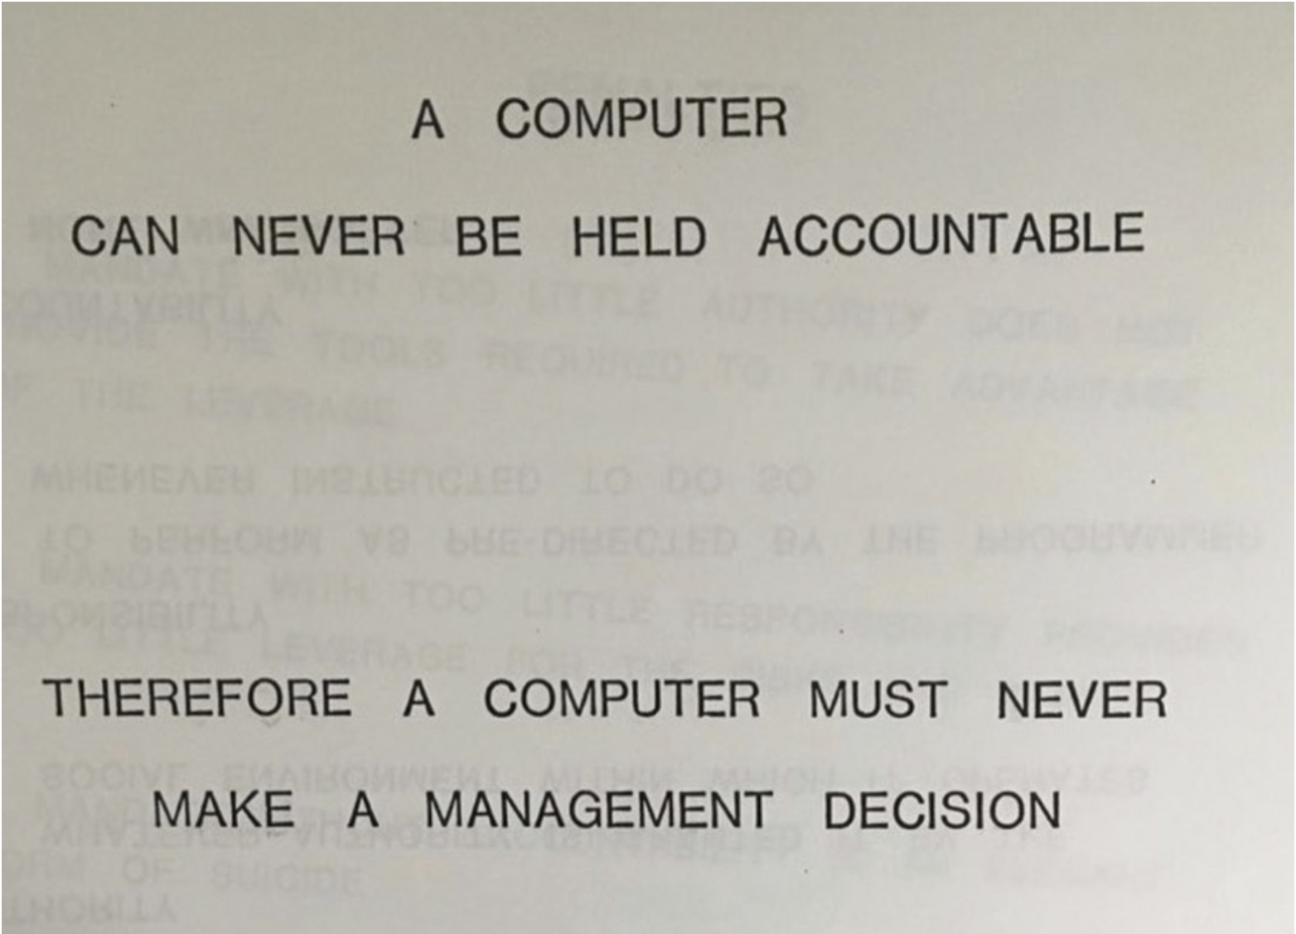
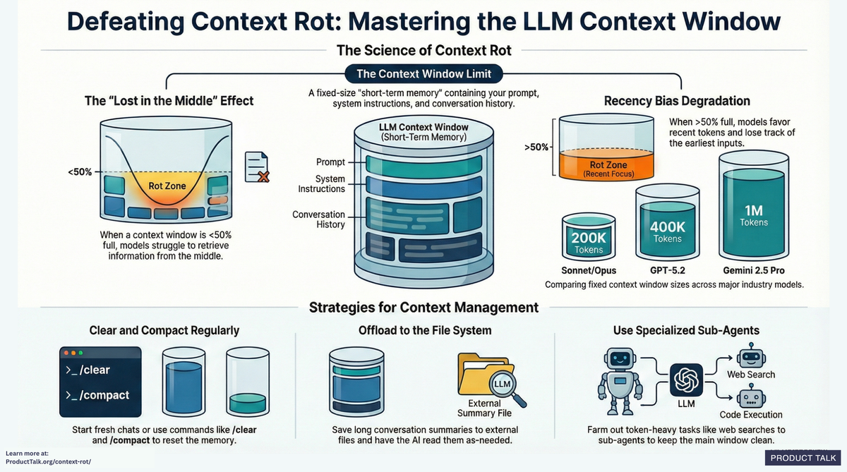
AI best practices — two cautions
AVOID 'CONTEXT ROT'
ACCOUNTABILITY — IBM, 1979
Every message sends the whole chat back so the AI keeps 'context.'
The longer a chat runs, the more of the context window you burn.
Clear or restart conversations regularly.
DUG24 · GOING GLOBAL · JULY 21–22, 2026

Slide 13
Prompt Creation Best Practices
Vague prompts get vague answers

Slide 14
The anatomy of a good prompt
Five ingredients worth including
Persona — the tone you want the AI to respond in.
Context — background about the task or the data you'll provide.
Task — what you actually want the AI to do.
Constraints — guardrails or edge cases to account for.
Output format — how the results should be returned.
DUG24 · GOING GLOBAL · JULY 21–22, 2026

Slide 15
From vague to specific
PROMPT #1 — VAGUE
PROMPT #2 — SPECIFIC
"Analyze the attached data to look for optimizations.“
No context, no format, no guardrails — so you get a vague answer back.
"I'm analyzing data from Microsoft Dynamics 365 for Finance & Supply Chain. The attached Excel file contains the following data…"
"I'd like to look for the following scenarios… Output the results in an Excel file."
"If you need more information or have questions about the data, please ask before analyzing.“
Data context and format provided, example scenarios described – more detailed answers returned.
DUG24 · GOING GLOBAL · JULY 21–22, 2026

Slide 16
Explain the data before you ask
If you supply data, explain what it means
Tell the AI what each tab and column represents.
Example — the Excel file has two tabs:
  Tab A: UserId (string id), Enabled (yes/no enum — only analyze enabled users), RecId (big-int unique key).
  Tab B: User (string id, maps to Tab A's UserId), VendorId (big-int, maps to Tab A's RecId).
Spelling out the relationships prevents the AI from guessing wrong.
DUG24 · GOING GLOBAL · JULY 21–22, 2026

Slide 17
Take an iterative approach
Break complex tasks into smaller segments.
  Validate each step before moving to the next.
  Correct the AI early if it starts to drift off course.
Provide examples of the output you want — "I'm looking for optimizations like: x, y, z."
Ask the AI to improve your prompt:
  "What additional information do you need to give the best output?"
  "How could I improve future prompts like this?"
DUG24 · GOING GLOBAL · JULY 21–22, 2026

Slide 18
Data Analysis Scenario
Finding optimization goldmines in real D365FSC data

Slide 19
The scenario
Identify the problem you want AI to help with
Goal: validate whether AI could help analyze D365FSC data and surface optimizations for administration and user management.
Specifically, I wanted to look at:
  Users who hadn't logged in and could be disabled.
  Cleaning up / optimizing user role assignments.
  Optimizing user / role license assignments.
Then source the data three different ways: manual export, OData API, and an MCP server.
DUG24 · GOING GLOBAL · JULY 21–22, 2026

Slide 20
Choosing the data sources
Give the AI the data it needs to do the analysis
First, determine where the form data is stored in D365FSC.
  Determine Where Form Data is Stored in D365FSC
For this use case, the data sources are these D365 entities:
  User Information (SystemUser).
  System Security Role (SecurityRole).
  Security User Role Association (SecurityUserRole).
Plus telemetry from Application Insights for each user's last login date.
DUG24 · GOING GLOBAL · JULY 21–22, 2026

Slide 21
Method 1 — Manual Data Extraction
One-off exploration, no setup required

Slide 22
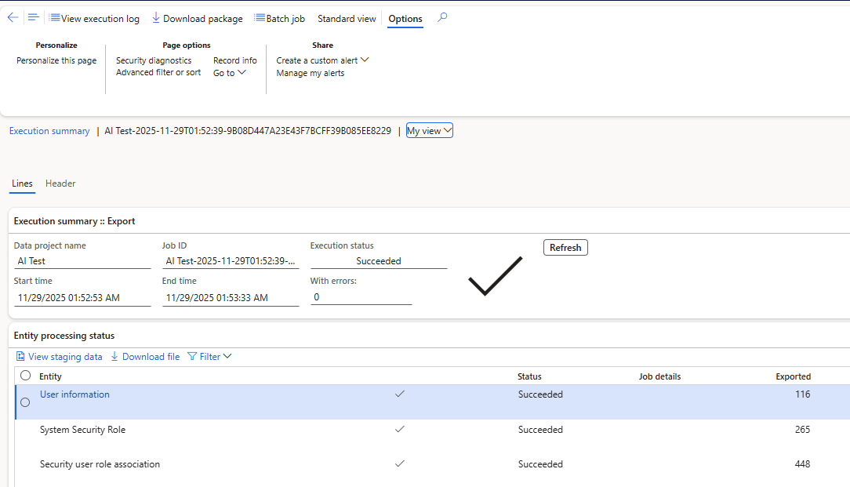
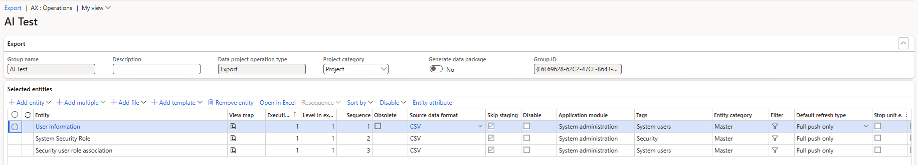
D365FSC Data Management
Export the security entities to Excel
DUG24 · GOING GLOBAL · JULY 21–22, 2026

Slide 23
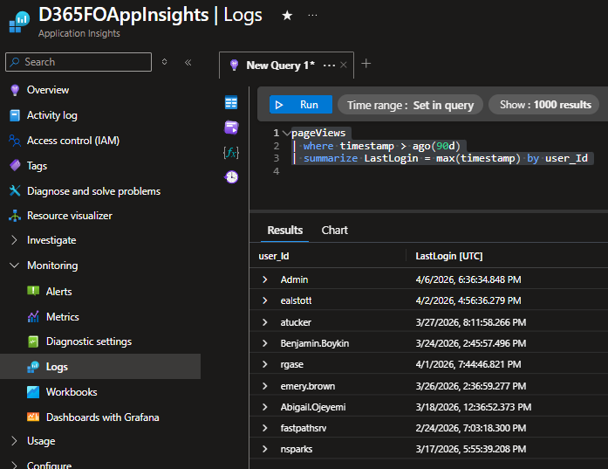
Application Insights
Pull each user's last login date from telemetry
DUG24 · GOING GLOBAL · JULY 21–22, 2026

Slide 24
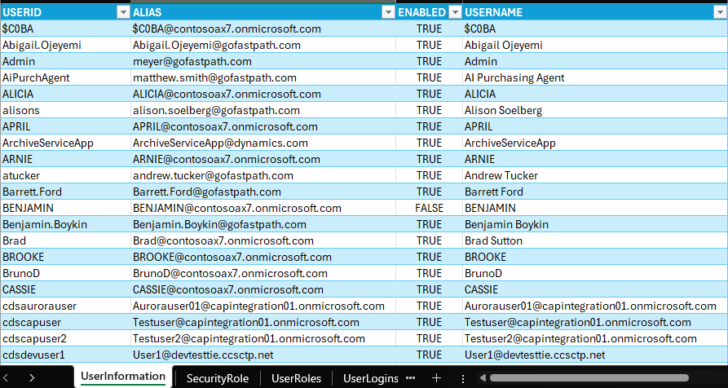
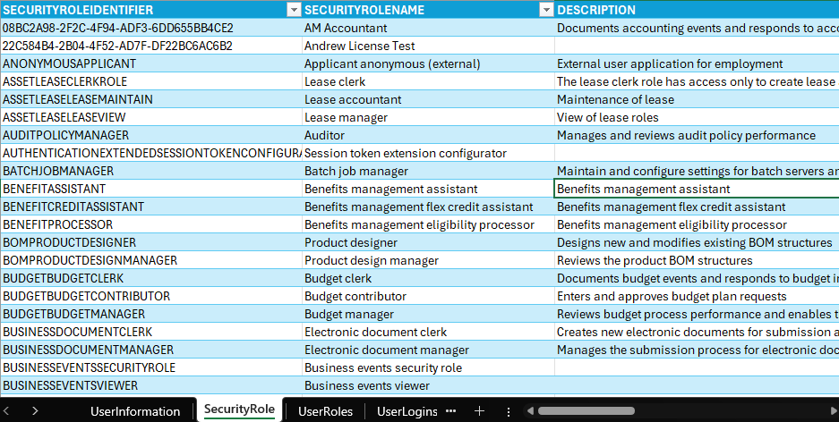
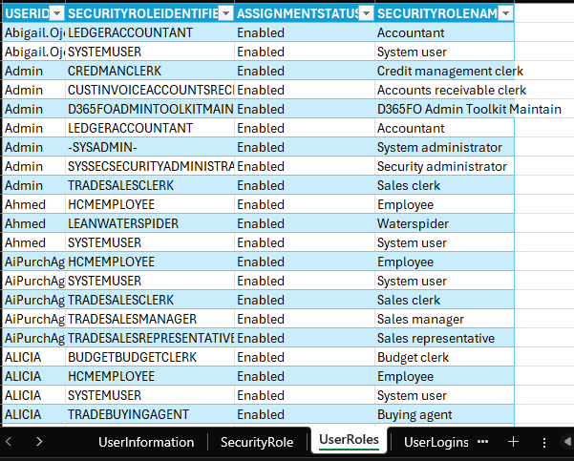
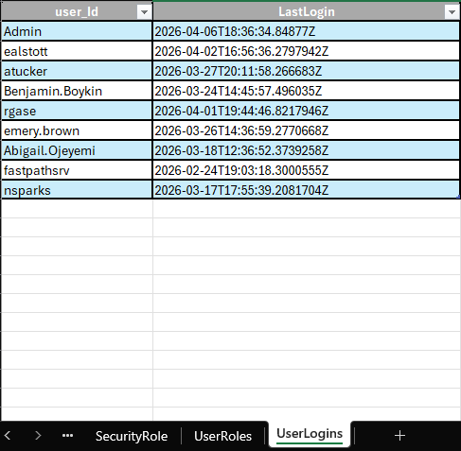
Combining the Data
Consolidate data into one Excel workbook
DUG24 · GOING GLOBAL · JULY 21–22, 2026

Slide 25
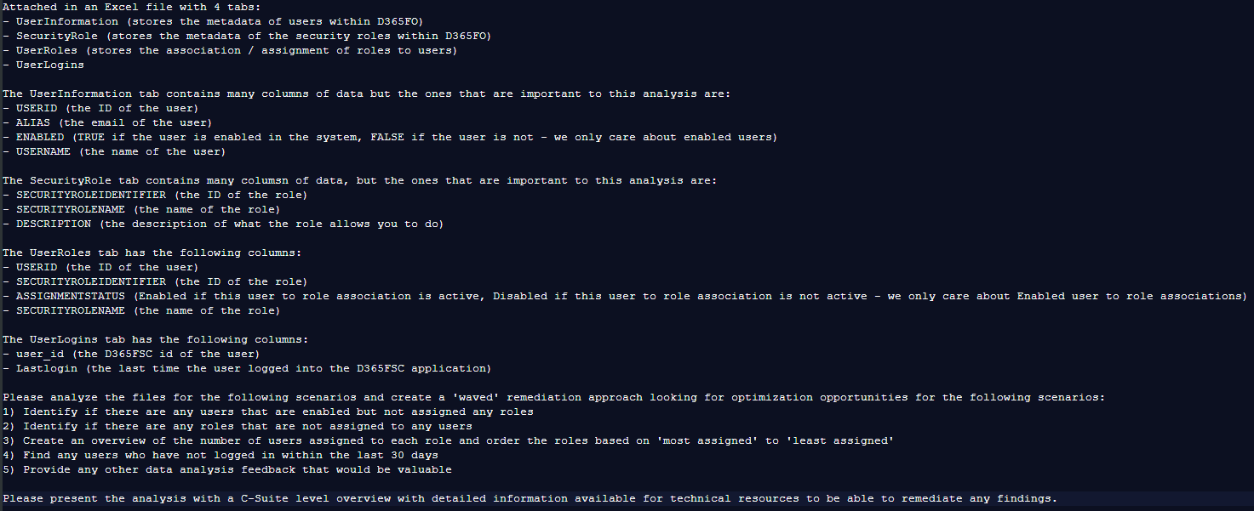
Generating the prompt
Combine the exports, then hand the AI a well-framed prompt
DUG24 · GOING GLOBAL · JULY 21–22, 2026

Slide 26
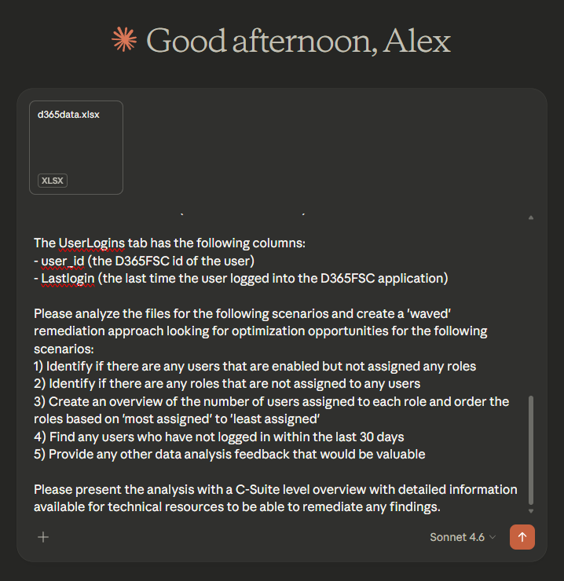
Let's get analyzing
Upload the data and let the AI go to work
DUG24 · GOING GLOBAL · JULY 21–22, 2026

Slide 27
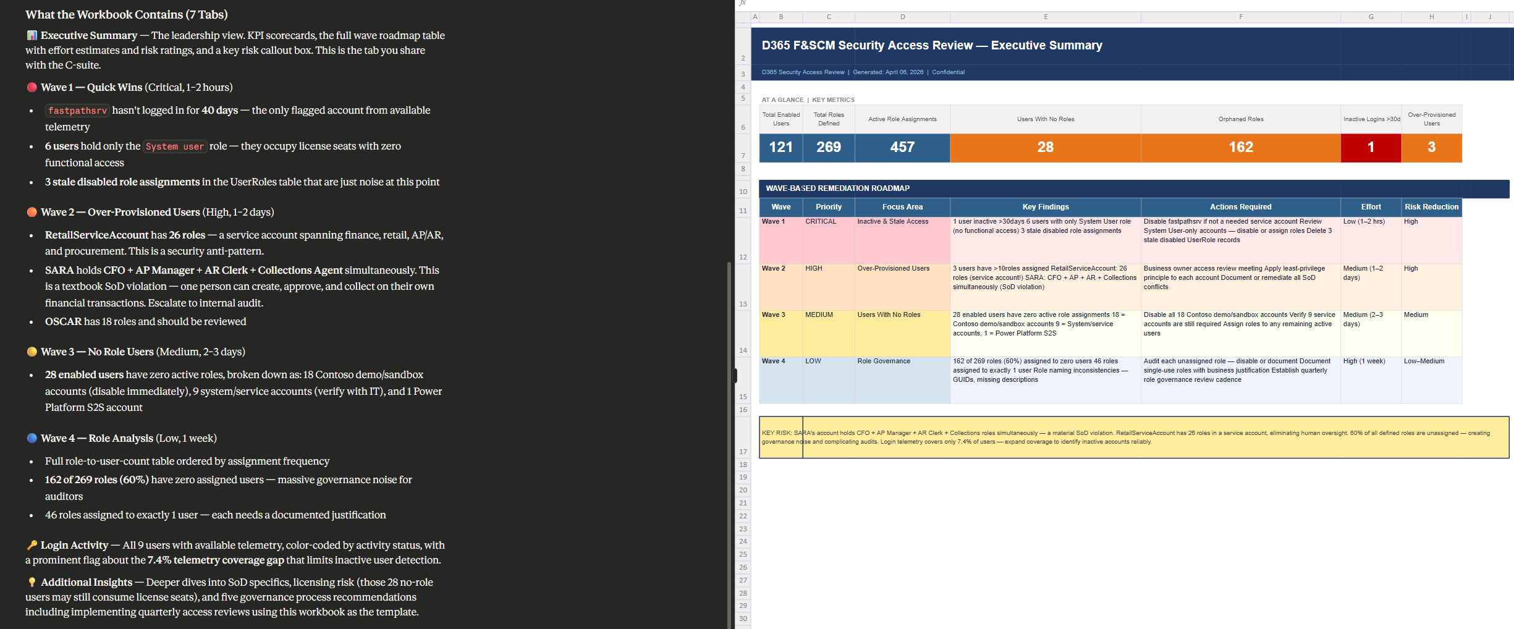
Results
AI analysis output
DUG24 · GOING GLOBAL · JULY 21–22, 2026

Slide 28
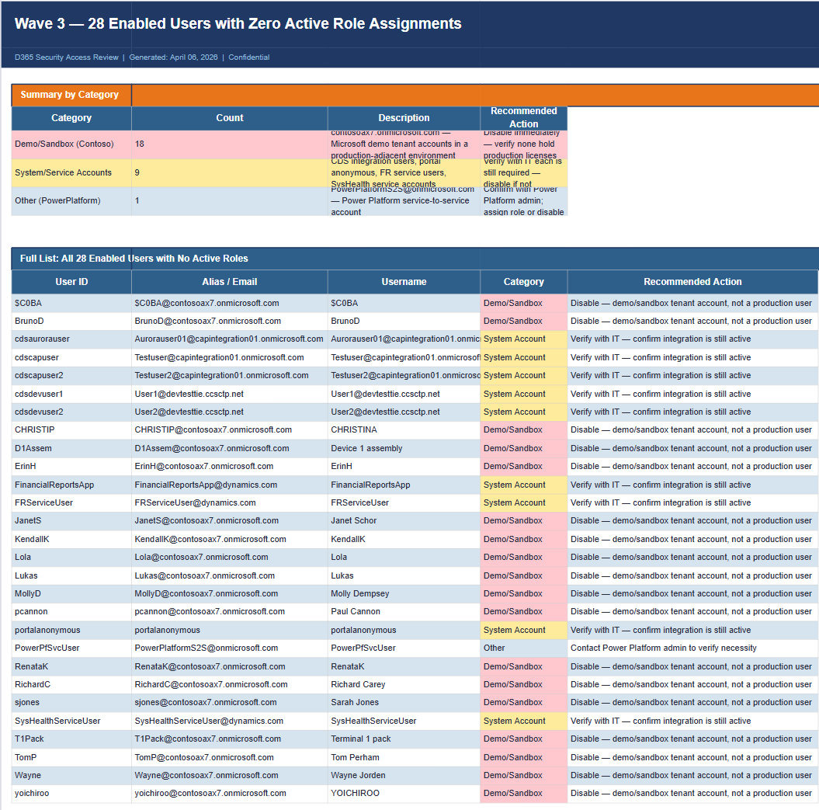
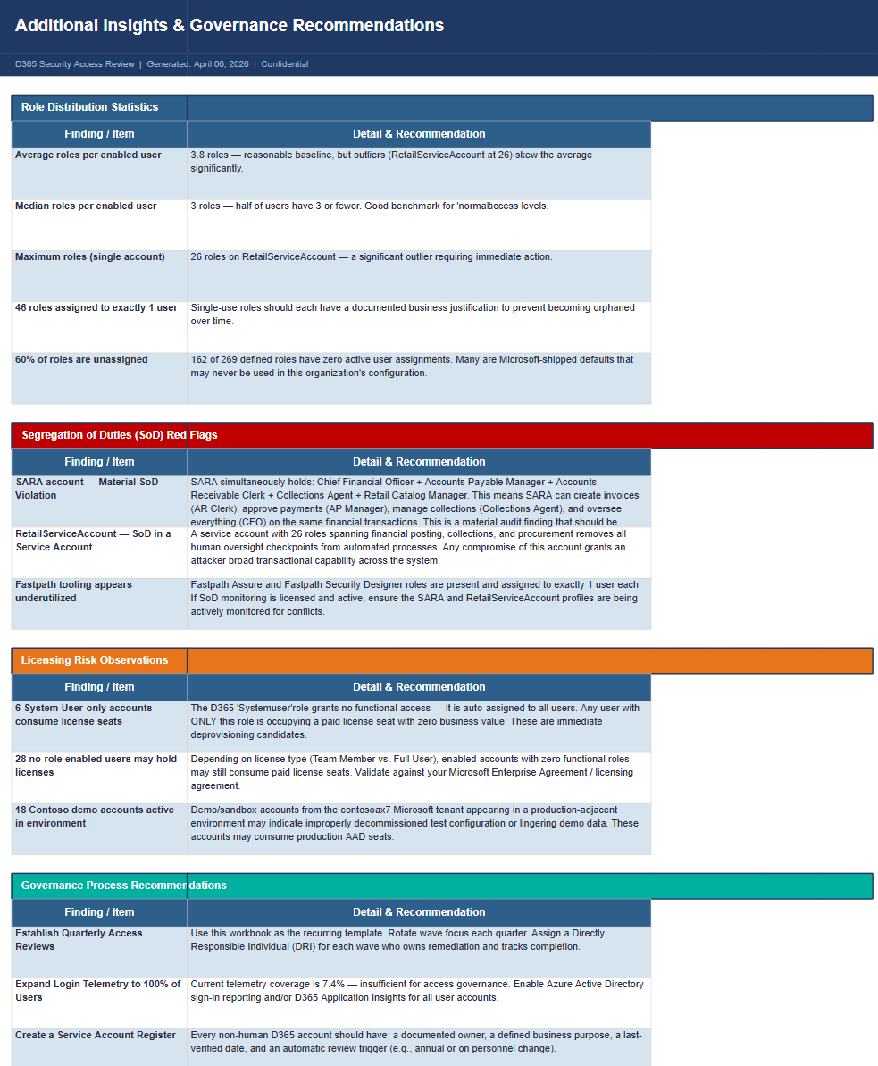
Results
Role and license optimization opportunities
DUG24 · GOING GLOBAL · JULY 21–22, 2026

Slide 29
Key considerations — manual
No additional cost above your normal subscription.
Keep usage limits in mind.
  This example ran against a personal Claude 'Pro' plan.
Best for: quick, one-off exploration on a point-in-time snapshot of your data.
DUG24 · GOING GLOBAL · JULY 21–22, 2026

Slide 30
Method 2 — Automating via API
Scheduled, repeatable pipelines

Slide 31
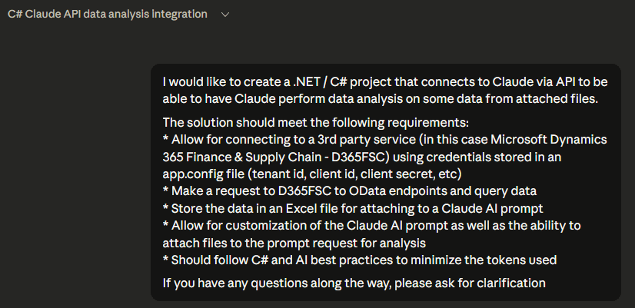
API connection setup
Automate the same analysis end-to-end
Goal: automate the same data-analysis process.
Prerequisites:
  Azure app registration to connect to D365 / Application Insights.
  An AI API key — API usage is billed separately from your subscription.
Built a solution to make API requests to D365, App Insights, and the AI itself.
DUG24 · GOING GLOBAL · JULY 21–22, 2026

Slide 32
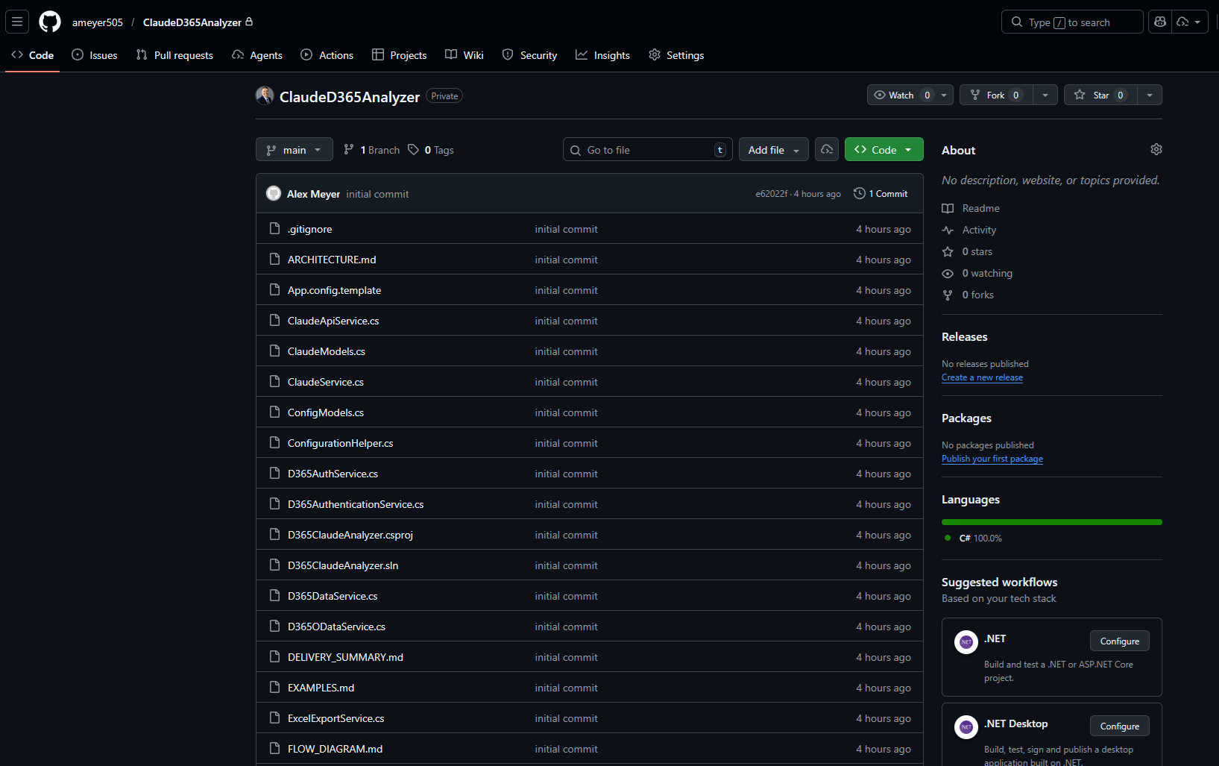
D365ClaudeAnalyzer
GitHub: ameyer505/ClaudeD365Analyzer
DUG24 · GOING GLOBAL · JULY 21–22, 2026

Slide 33
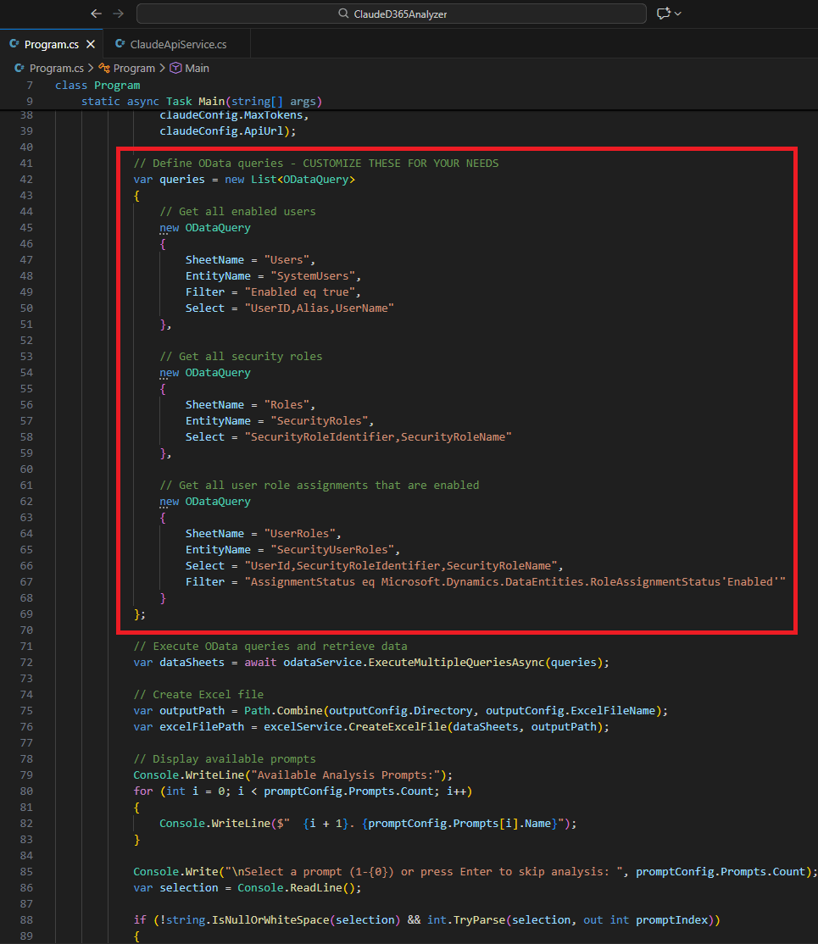
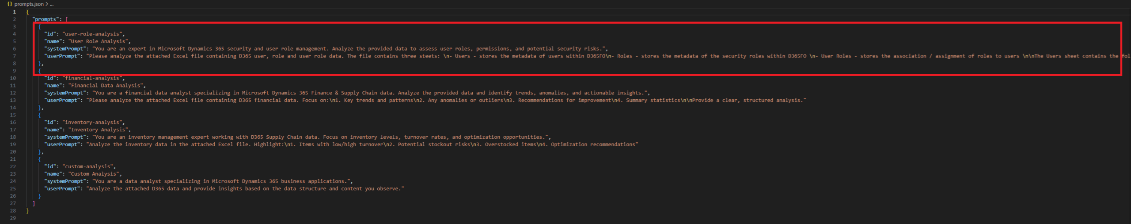
Configuring queries & prompts
Point it at your OData queries, then define the prompts
DUG24 · GOING GLOBAL · JULY 21–22, 2026

Slide 34
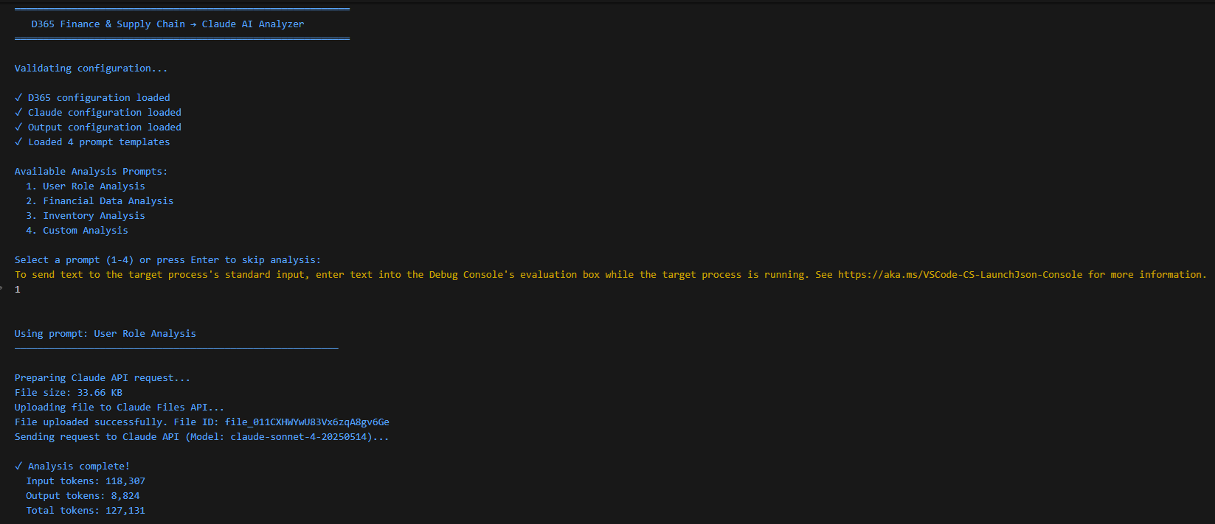
Running the analysis
Uploading files required Claude's 'code-execution' skill
DUG24 · GOING GLOBAL · JULY 21–22, 2026

Slide 35
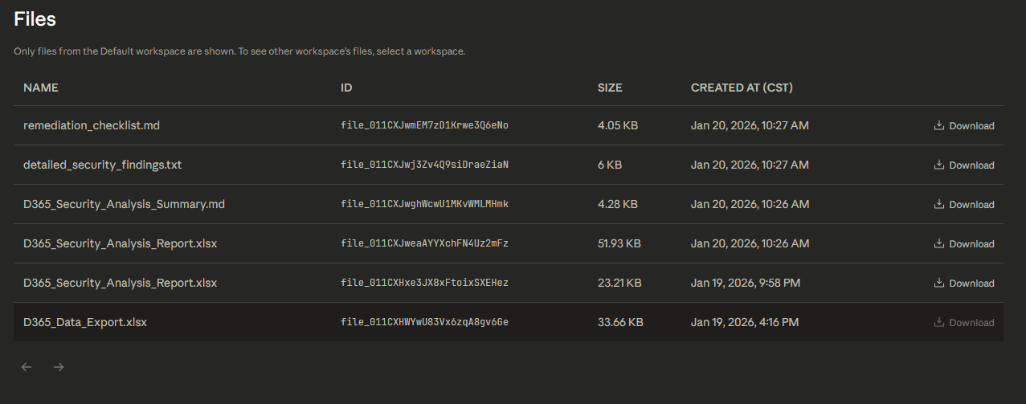
Results
Same insights — now fully automated
DUG24 · GOING GLOBAL · JULY 21–22, 2026

Slide 36
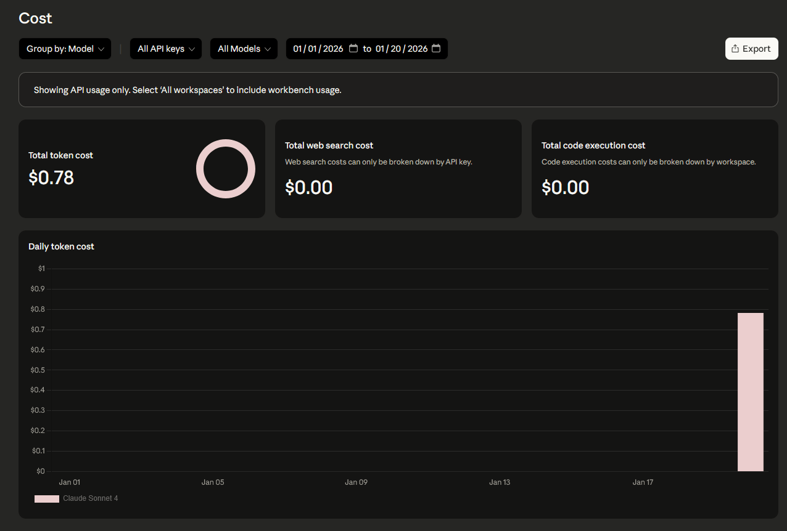
Cost considerations — API
Using the AI API to analyze data means every interaction has a cost.
In this case, each analysis ran roughly $0.75 – $1.50, depending on the data size.
You pay for both input and output tokens.
Best for: scheduled pipelines you run again and again.
DUG24 · GOING GLOBAL · JULY 21–22, 2026

Slide 37
Method 3 — Automating via MCP
Interactive analysis, in plain language

Slide 38
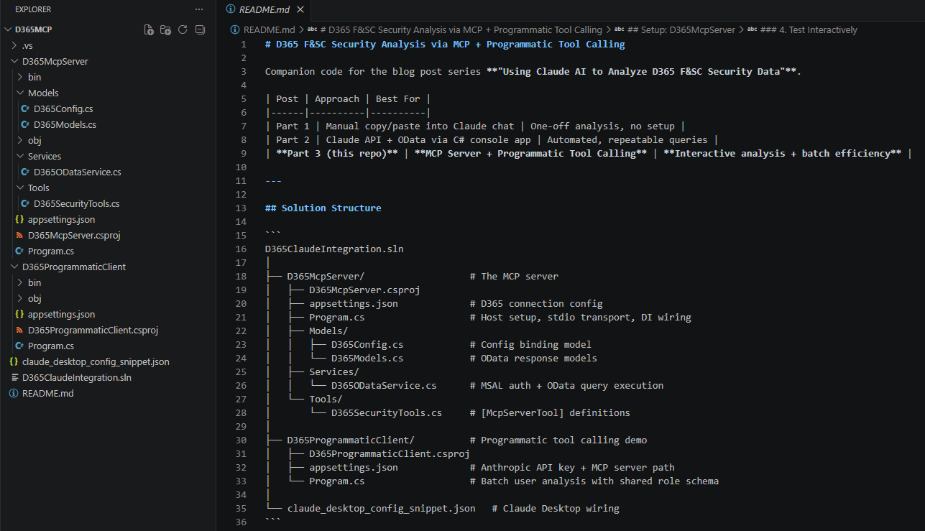
Creating the MCP server
Asked Claude to build an MCP server for D365FSC with customizable tools
DUG24 · GOING GLOBAL · JULY 21–22, 2026

Slide 39
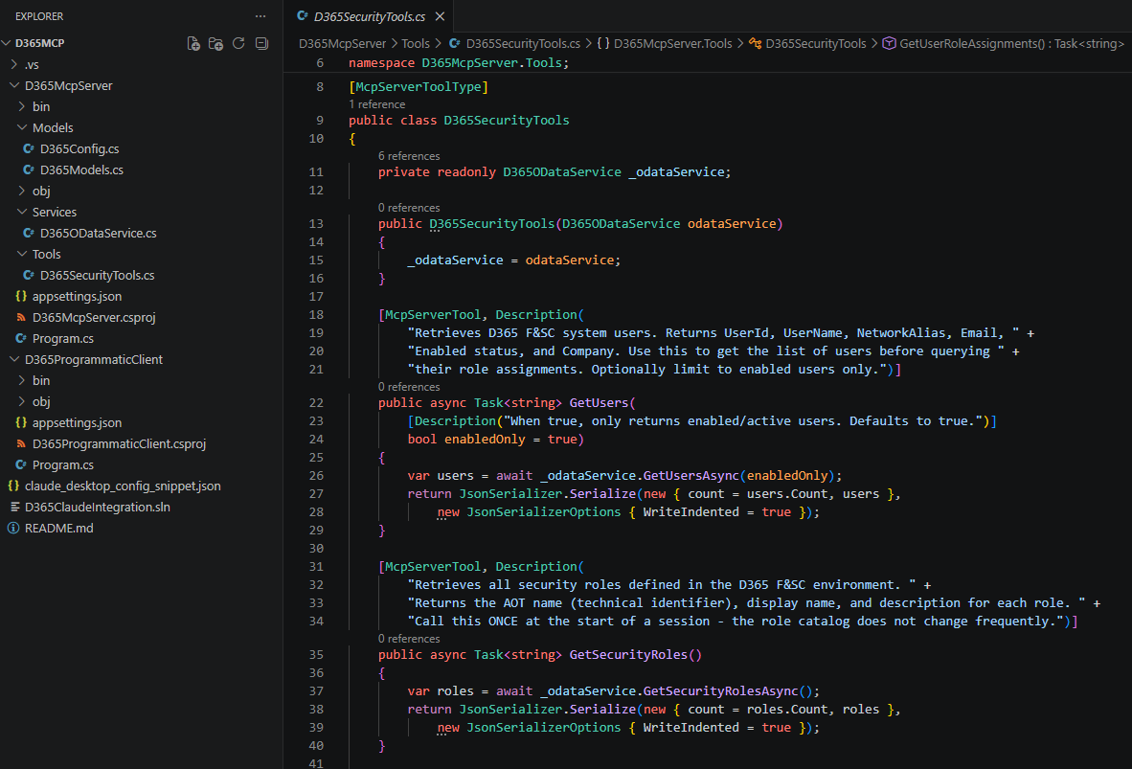
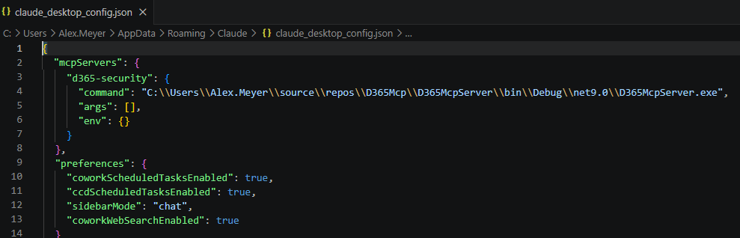
Tool creation & Claude Desktop config
Define the tools, then register the server in Claude Desktop
DUG24 · GOING GLOBAL · JULY 21–22, 2026

Slide 40
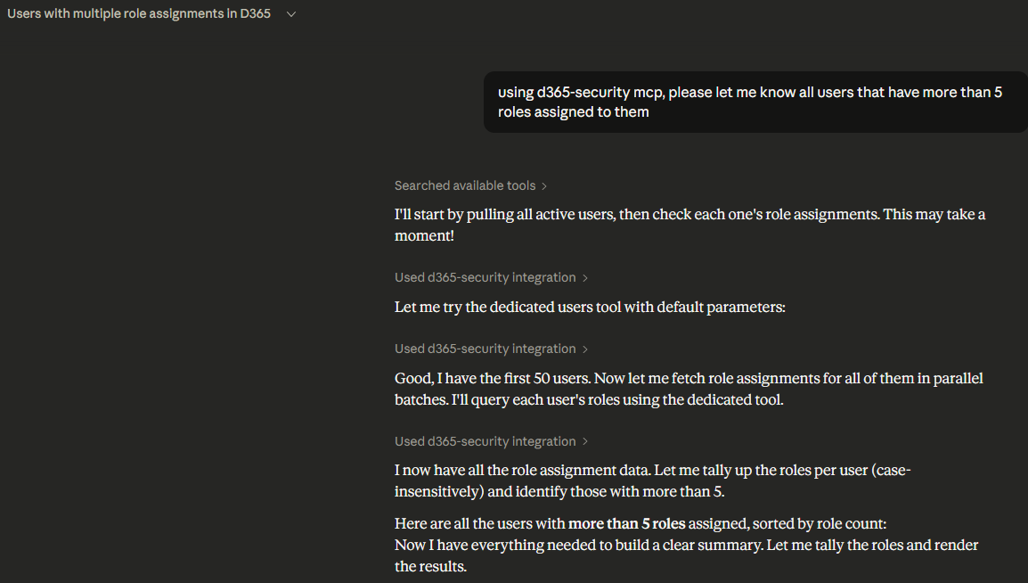
Using the MCP tool
Ask questions in plain language — the tool fetches and analyzes
DUG24 · GOING GLOBAL · JULY 21–22, 2026

Slide 41
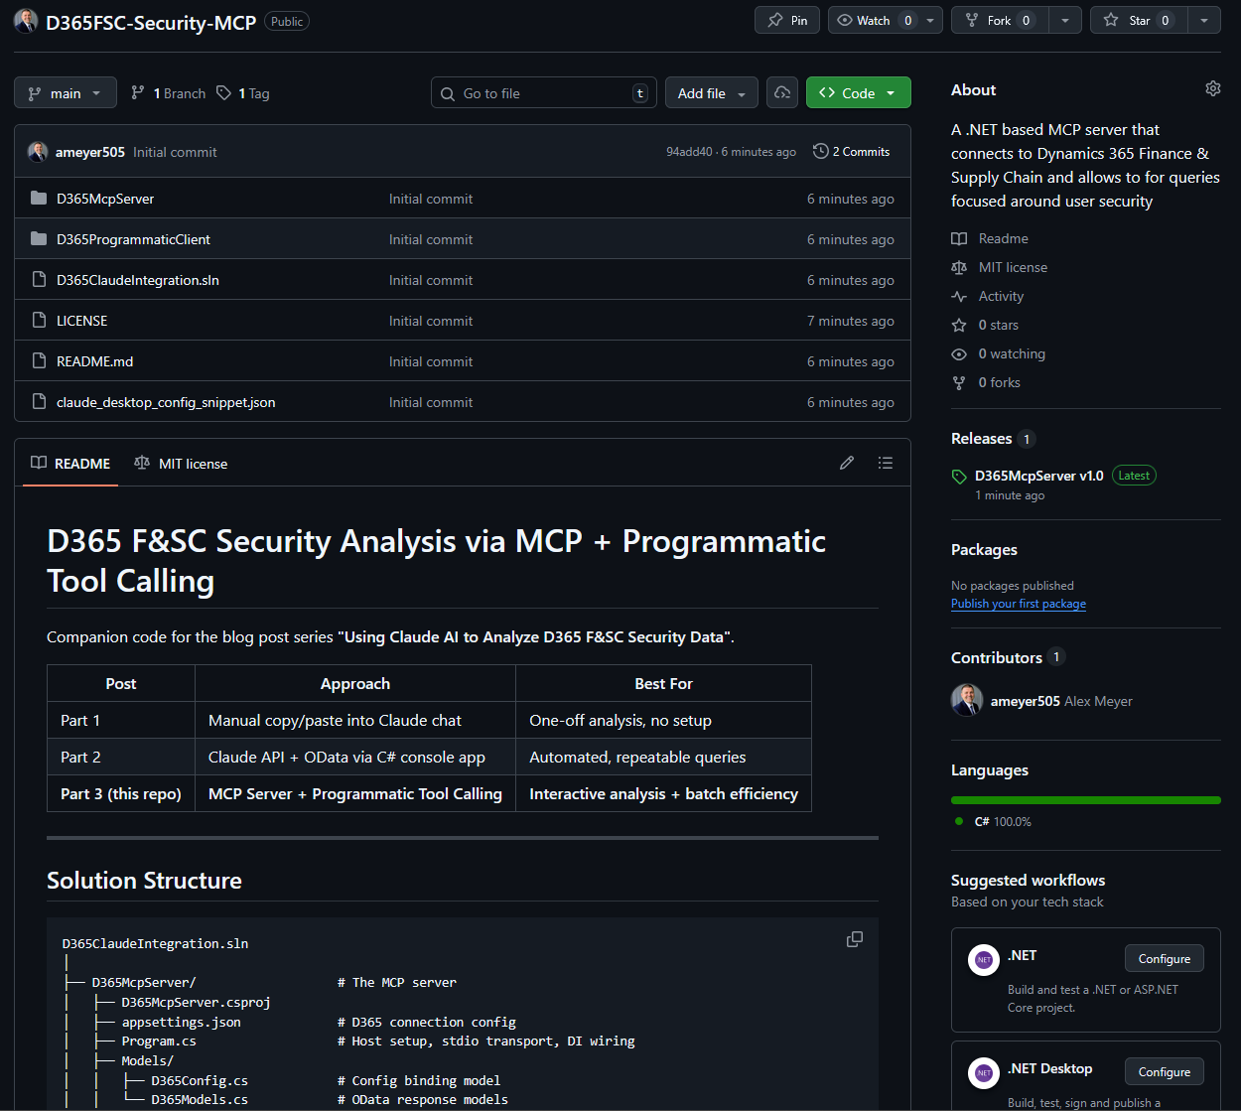
D365FSC-Security-MCP
Open source on GitHub:
github.com/ameyer505/D365FSC-Security-MCP
A ready-to-use MCP server for D365FSC security data.
Customize the tools to fit your own entities and scenarios.
Drop it into Claude Desktop and start asking questions.
DUG24 · GOING GLOBAL · JULY 21–22, 2026

Slide 42
Side-by-side comparison
 | Manual Gathering | Direct API | MCP Server
Setup effort | None | Medium | Medium
Data freshness | Snapshot | Real-time | Real-time
Interactivity | None | None | High
Repeatability | None | High | Medium
Flexibility | Low | Low | High
Best for | One-off exploration | Scheduled pipelines | Interactive analysis
DUG24 · GOING GLOBAL · JULY 21–22, 2026

Slide 43
Other Scenarios
License optimization, powered by the same playbook

Slide 44
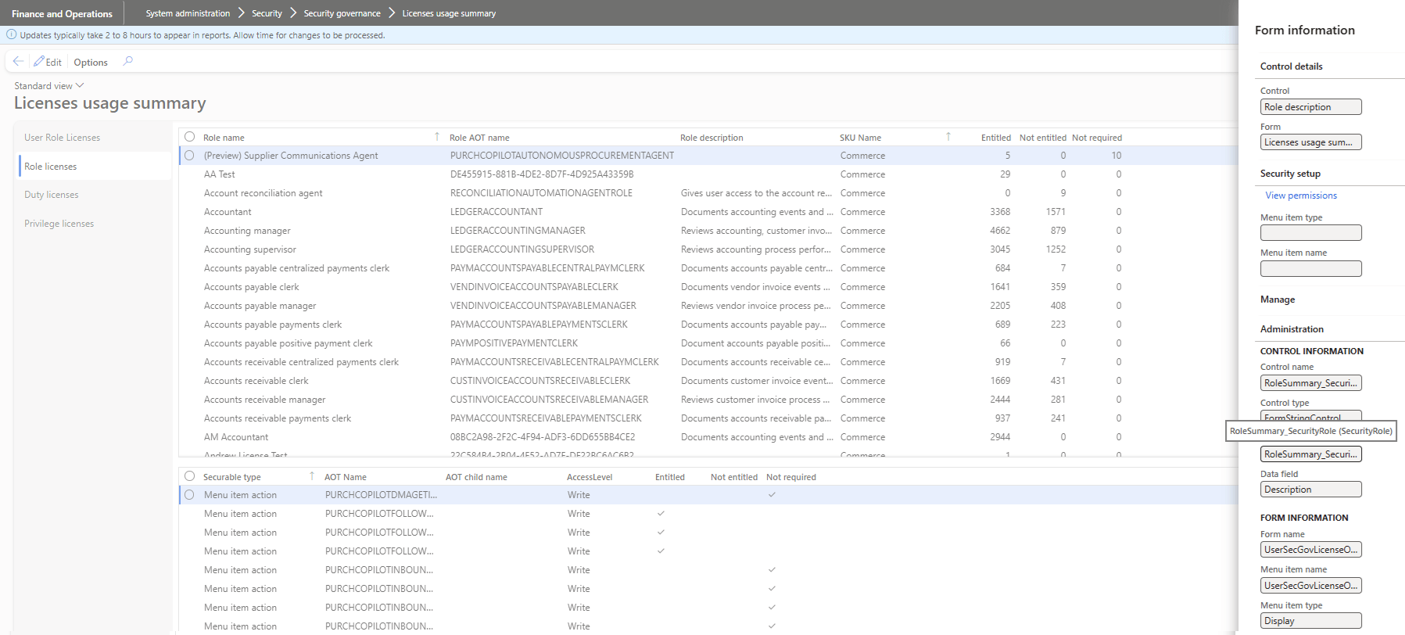
D365FSC license optimization
Start from the License Usage Summary report
DUG24 · GOING GLOBAL · JULY 21–22, 2026

Slide 45
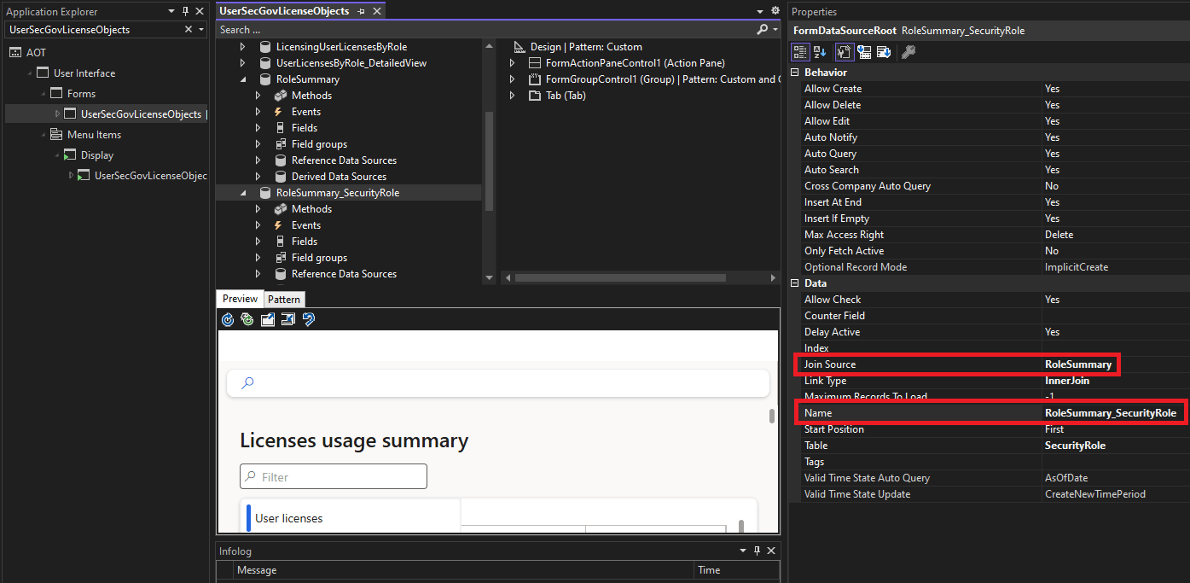
Find the form's data source
Use Application Explorer to locate where the data lives
DUG24 · GOING GLOBAL · JULY 21–22, 2026

Slide 46
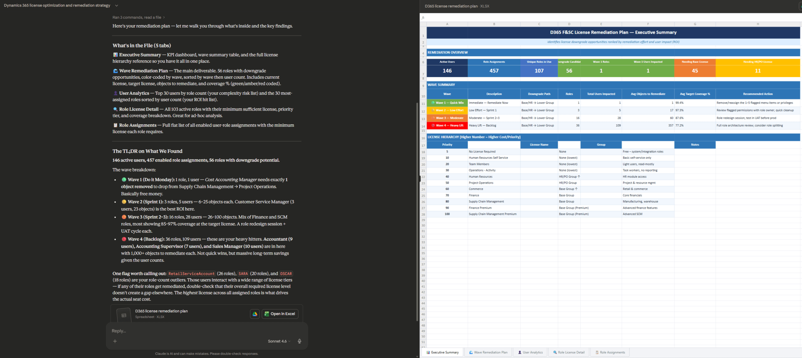
License optimization results
Surface over-licensed users and right-sizing opportunities
DUG24 · GOING GLOBAL · JULY 21–22, 2026

Slide 47
Three things to remember
1
2
3
Always verify results
Avoid the 'AI hammer'
Start small, then scale
AI isn't magic — but it's excellent at pattern matching. Keep a human in the loop and check every output.
If a workflow or automation fits better, use AI to help build it — don't force AI to be the whole solution.
You're not locked into Copilot for D365, and you don't need to be an AI expert. Validate the process, then grow it.
DUG24 · GOING GLOBAL · JULY 21–22, 2026

Slide 48
A few more takeaways
ALWAYS VERIFY RESULTS – Keep a human in the loop
Vague prompts get vague answers - explain the data before asking the AI to analyze it.
You don't need to be a computer or AI expert to use AI to find optimizations.
Start small, validate the process, then take on more complex scenarios.
The best time to clean up your D365 data was at go-live, the next best time is today.
DUG24 · GOING GLOBAL · JULY 21–22, 2026

Slide 49
Resources
BLOGS & ARTICLES
PROMPTING BEST PRACTICES
Using AI to Analyze D365FSC Data
Automating AI Data Analysis in D365FSC
Context Rot: Why AI Gets Worse the Longer You Chat
AI Context Windows: Why Bigger Isn't Always Better
Best practices for prompt engineering with the OpenAI API
Getting started with prompts for text-based generative AI tools
Effective Prompts for AI: The Essentials
DUG24 · GOING GLOBAL · JULY 21–22, 2026

Slide 50
Thank you!
Questions? Let's talk.
Email alex.meyer@delinea.com
Blog d365fscblog.com
GitHub github.com/ameyer505
Security course d365fosecurity.com
Slides alexdmeyer.com/resources/downloads
DUG24.COM · DYNAMICSUSERGROUP.COM · JULY 21–22, 2026

