Slide 2



USING AI TO HELP ANALYZE YOUR D365 USER LICENSES

Slide 3

Alex Meyer
Principal Software Engineer
Delinea / Fastpath
Email: alex.meyer@delinea.com
Blogs:
  http://d365fscblog.com
  http://msftcloudblogs.com
  No Null Points Blog
Security Class: http://d365fosecurity.com
LinkedIn
Microsoft MVP Profile
Background:
Awarded Microsoft MVP in Business Applications since 2019
Been working with AX since 2013 and D365FO since 2016
Have spoken at Summit (US & Europe), Focus, and local chapters around AX/D365FO security and have done webinars around native controls in both versions

Slide 4
Agenda
01
The Native License Usage Summary Report
Where to find it, what's in it, how to read it
02
Gaps in the Native Reporting
What the report doesn't tell you
03
AI-Driven Waved Remediation
Pull the underlying data and let AI build a plan
04
Going Deeper at DynamicsCon
Join the AI Detective session

Slide 5

Why This Matters?
Licensing Optimization Hiding in Plain Sight
Visible spend
License costs are one of the largest line items in your D365 budget
Constant change
Roles, duties, and license requirements shift with every release
Hidden in plain sight
Hidden waste
The data you need to optimize licenses already lives inside D365 — it just isn't surfaced where you'd expect to find it.
The data needed to optimize already exists — it's just hard to read

Slide 6
AI Overview

Slide 7
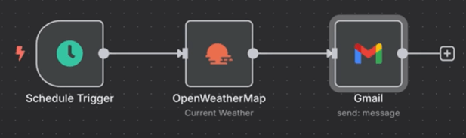
What isn’t AI?
Anything that follows a rule-based process
  For every input, you get the same output
Workflow that is triggered everyday, makes an API call and gets some data, analyzes it and gives you the results

Slide 8
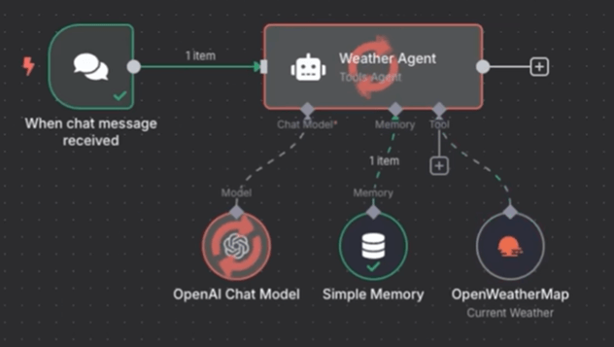
What is AI?
Any system which requires reasoning and/or planning and interprets response data
Prompt ‘Should I bring an umbrella to work today?’

Slide 9
What are Large Language Models?
The underlying ‘brain’ of AI
  Use billions / trillions of parameters which then are ‘weighted’
Analyze relationships between words / processes and predicting the next word / process in a sequence
  AI does not have ‘intelligence’, it predicts the output you want based on the prompt supplied
AI is non-deterministic

Slide 10
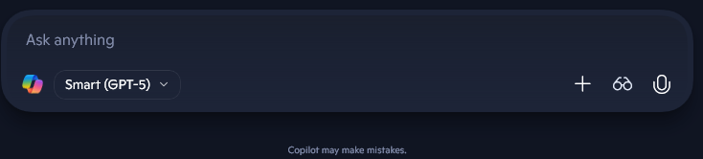


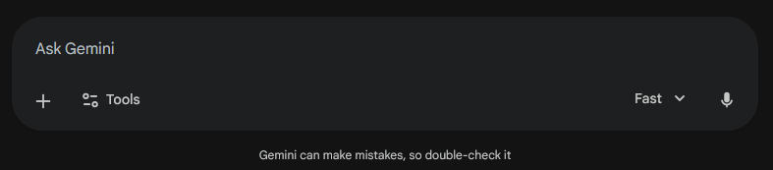
Why Hasn’t AI Taken Over ERP Yet?
Copilot
Claude
ChatGPT
Gemini

Slide 11
AI Best Practices
All output should be reviewed by a human
  Keep a ‘human in the loop’
The ‘AI Hammer’
  Not every problem should be solved using AI
    Data generation tasks (helping edit an email, creating a PPT) -> great for AI
    Posting to your GL -> not great for AI
  Don’t immediately jump to using AI if you don’t have to
  Most business cases need a repeatable process
    Automation workflows -> Use AI to help create the workflow, don’t let AI be the workflow

Slide 12
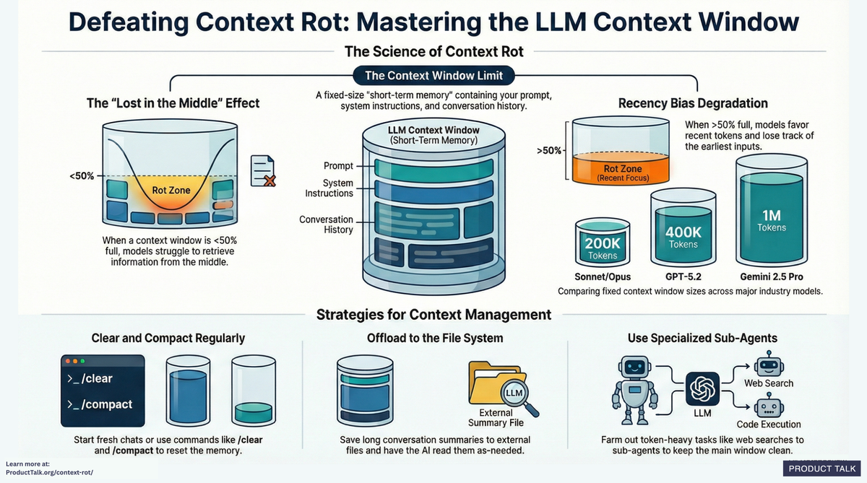
AI Best Practices
Avoid ‘context rot’
  Every time you interact with an AI the entire chat is sent back to the AI so it can keep a ‘context’ of the conversation
  The longer the individual chat is, the more of this ‘context window’ you are consuming
  Either clear or restart conversations regularly to avoid
Source: https://www.producttalk.org/context-rot/

Slide 13
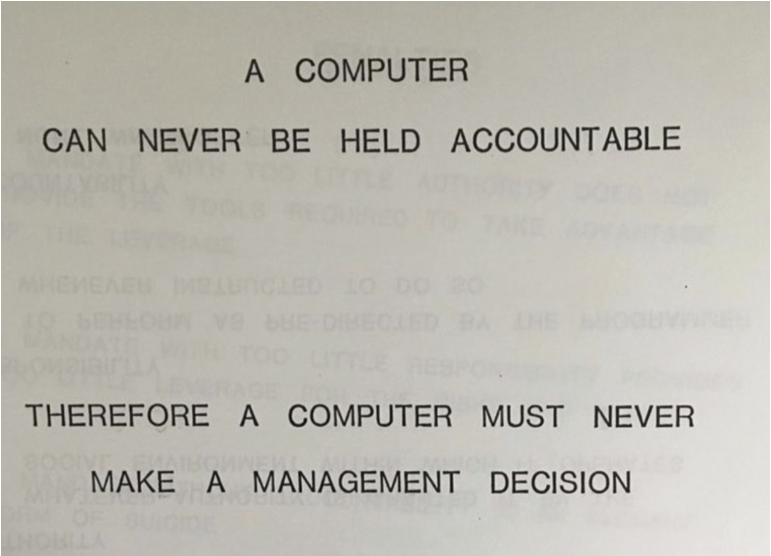
AI Best Practices
IBM Training Manual - 1979

Slide 14
Prompt Creation
Best Practices

Slide 15
How to Create a Prompt?
Anatomy of a good prompt
  Persona (tone for the AI response)
  Context (provide background information about the task or data you will be providing)
  Task (what do you want the AI to do?)
  Constraints (are there guardrails or edge cases that need to be accounted for?)
  Output format (how should this data be returned?)

Slide 16
How to Create a Prompt?
Prompt #1: Analyze the attached data to look for optimizations
Prompt #2: I am trying to analyze the attached data from Microsoft Dynamics 365 for Finance & Supply Chain, the attached Excel file contains the following data… I would like to look for the following scenarios… Please output the format in an Excel, if you need any additional information or have questions about the data, please ask before analyzing the data

Slide 17
How to Create a Prompt?
If you are supplying data, explain what that data means
In the Excel file I am attaching, there are two tabs. The first tab is named ‘tab A’ and it has the following columns:
  UserId (is a string value of the id of the user)
  Enabled (is an enum value that corresponds to whether the user is enabled or not, the available options include: yes or no. Only consider enabled users in your analysis)
  RecId (is a big int that is a unique identifier for a particular record)
Tab B has the following columns:
  User (is a string value of the id of the user, maps to UserId column in tab A)
  VendorId (is a big int that is the ID of the vendor, maps to RecId in tab A)

Slide 18
How to Create a Prompt?
Take an iterative approach
  Break down complex tasks into smaller segments
    This allows for you to validate each step before moving on to the next
    Allows for correcting AI if it starts to go off course
Provide examples of output if possible
  I’m looking for optimization scenarios like: xyz
Ask the AI
  What additional information do you need from the following prompt to be able to supply the best output?’
  How could I improve future prompts like this?

Slide 19
D365FSC License Usage Summary Report

Slide 20

Where To Find It?
System Administration → Security Governance
Four reports are available
Navigation Path
System Administration
User Role Licenses
Role Licenses
Per user, per role
Per security role
Security
Security Governance
Duty Licenses
Privilege Licenses
License Usage Summary
Per duty
Per privilege

Slide 21
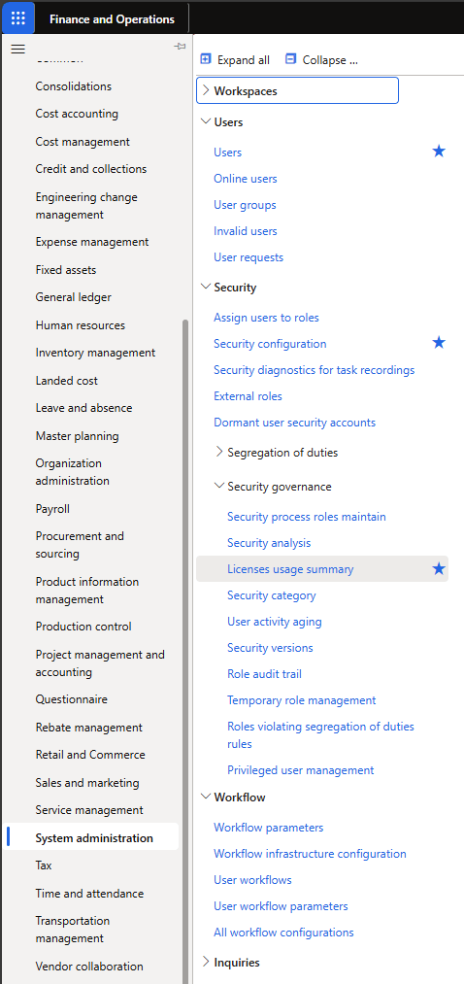
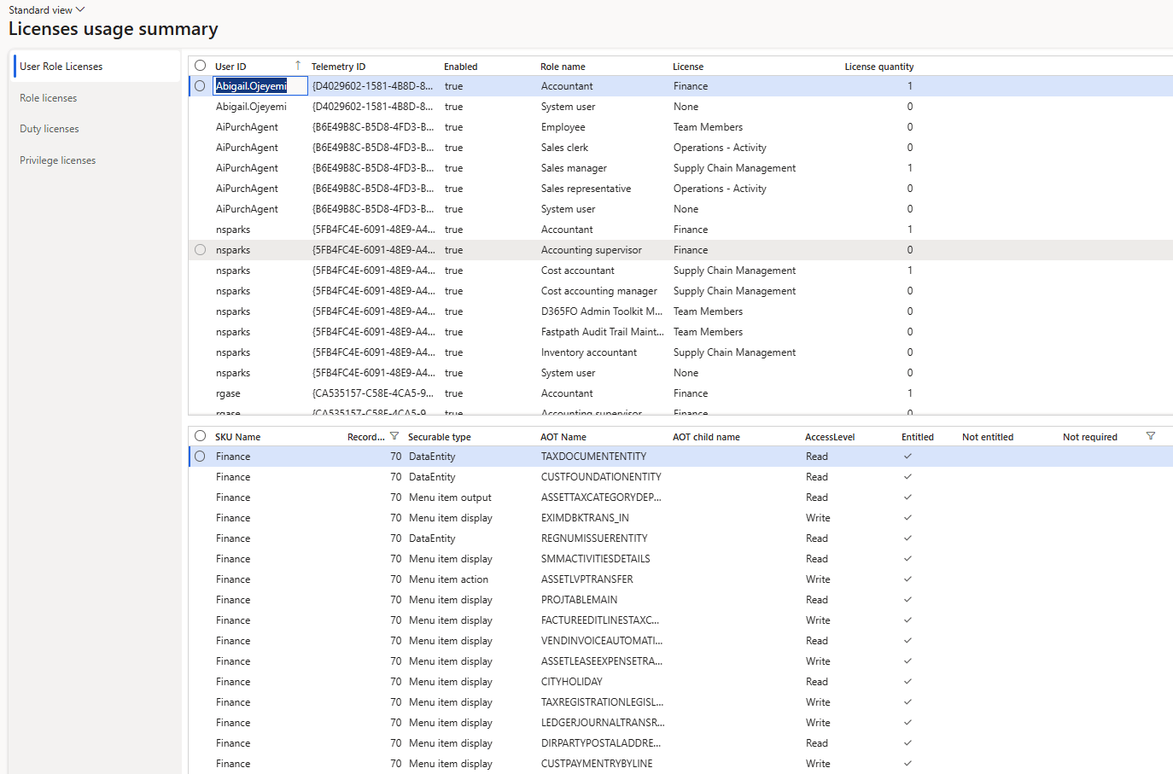
License Usage Summary Report

Slide 22



Key Report Terminology
Microsoft ties each object + access type to a specific license. These three terms describe whether the assigned license meets that requirement.
Entitled
Not Entitled
Not Required
The current license DOES meet the license requirement for that object at that access level.
The current license DOES NOT meet the license requirement for that object at that access level.
The object does NOT have a license requirement at all.

Slide 23
User Role Licenses Report
EXAMPLE
User: nsparks
Accountant role → requires Finance
Cost Accountant role → requires SCM
Result
nsparks needs BOTH the Finance AND SCM licenses to be compliant.

Slide 24


Role / Duty / Privilege License Reports
These three reports share the same layout and the same gotcha.
THE GOTCHA
THE FIX
There are multiple rows for each security layer
Unfiltered, you see multiple rows per role, one per license SKU.
Filter to a specific role, duty, or privilege.
That's the report comparing the role against every license to show how many objects each one would or wouldn't cover.
Then look for any license with a 0 in the "Not Entitled" column. That's your minimum required license.

Slide 25
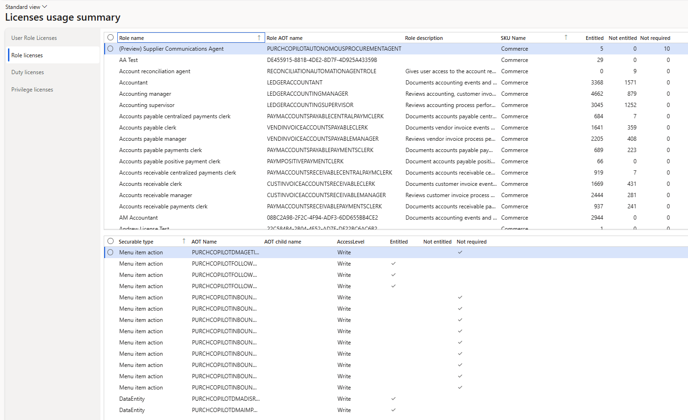
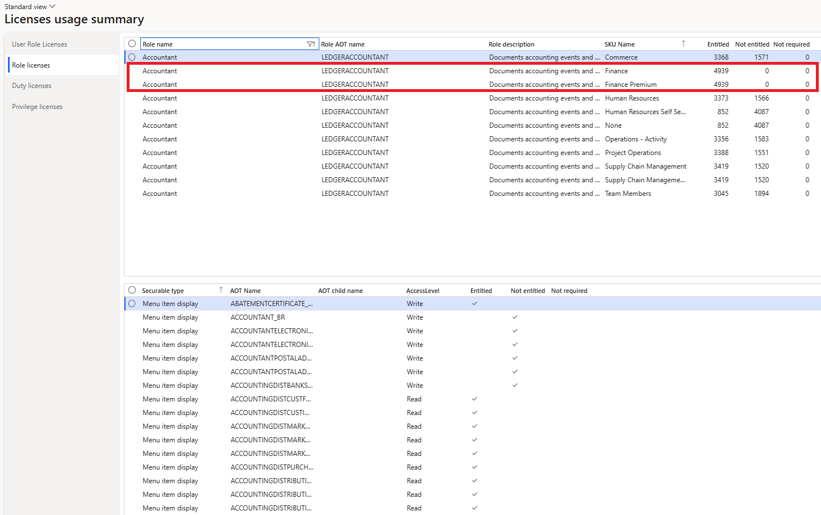
Role / Duty / Privilege License Reports
Unfiltered Filtered

Slide 26
License Usage Summary Gaps
01
02
03
No intermediary path
No actual usage data
No monetary value
The reports jump from security layer → object. They don't show which duty or privilege grants the object, so you can't see WHERE in the role to remediate.
Reports show what's assigned, not what's used. There is no native way to tie license requirements back to D365 telemetry / actual user activity.
License $ values were available when Security Governance launched but were removed. Hard to prioritize remediation without ROI numbers.
If you are curious on how to address these gaps, stop by the Fastpath booth 313.

Slide 27
Using AI to Build a Waved Licensing Remediation Plan

Slide 28





Data Pipeline Setup
STEP 01
STEP 02
STEP 03
STEP 04
Source
Extract
Analyze
Plan
LicensingRole-
RequirementsSummaryView
SQL query +
DMF user roles → Excel
Prompt your AI of
choice with the workbook
Waved license
remediation plan
Tip: Stick to the Summary view for AI input. The Detailed view returned 1.4M+ rows in a demo environment — that’s too many tokens.

Slide 29
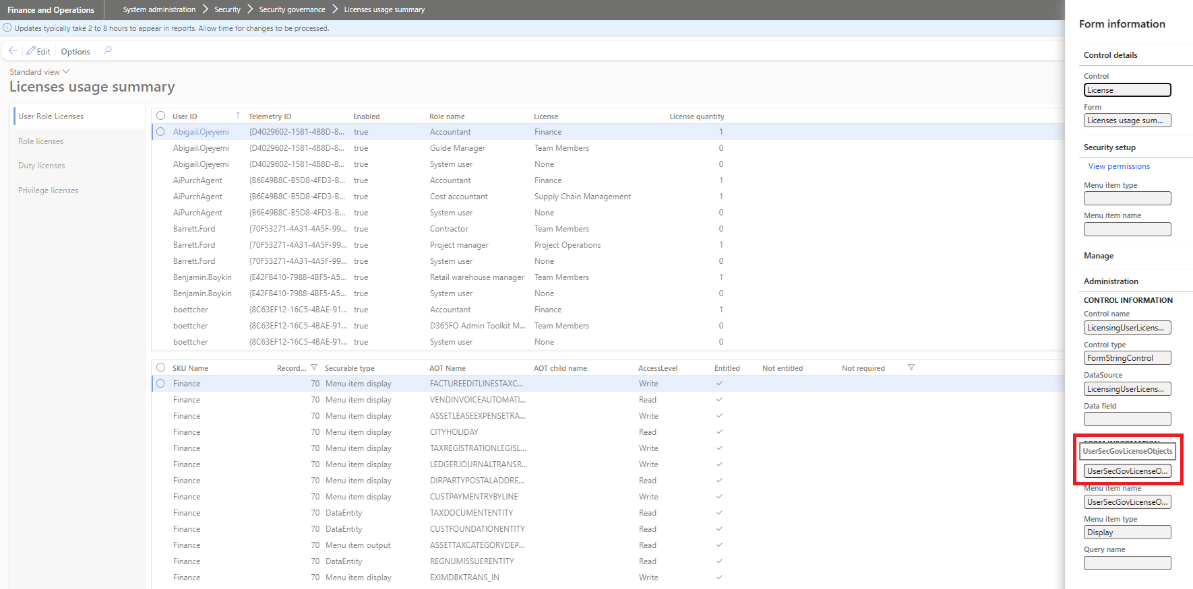
Using AI to Help Analyze Licensing Data

Slide 30
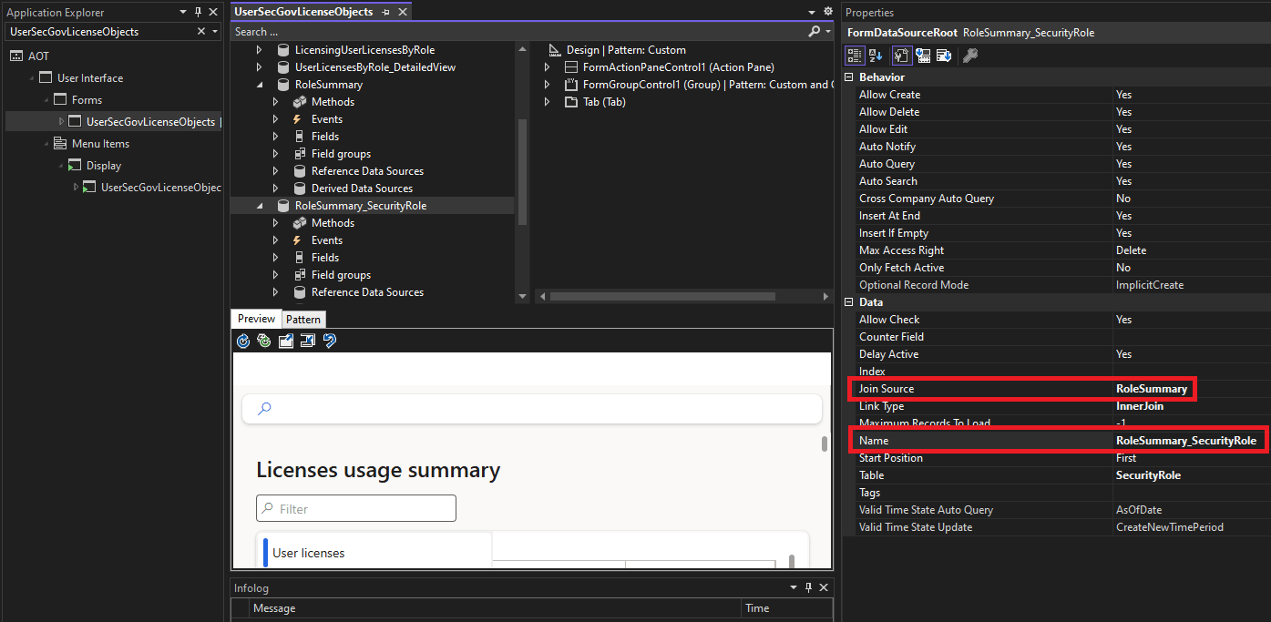
Using AI to Help Analyze Licensing Data

Slide 31
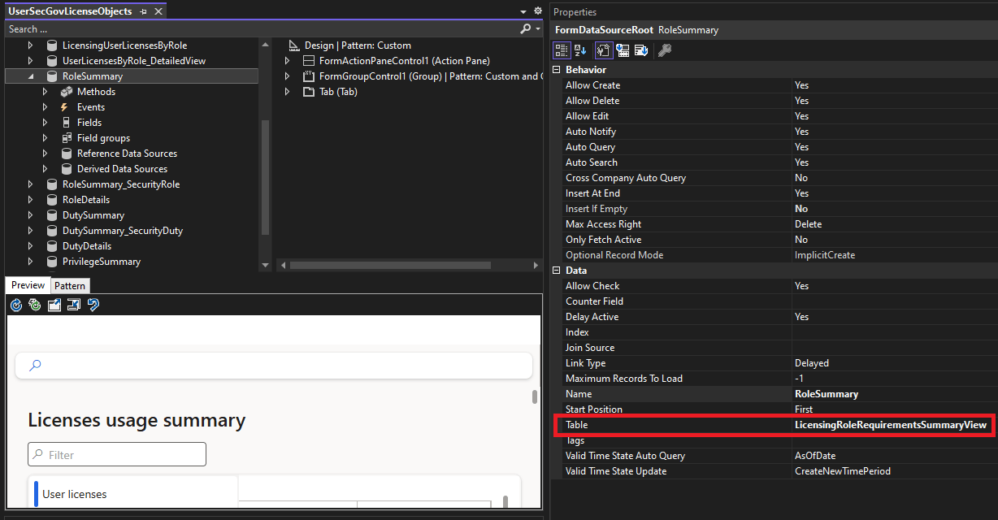
Using AI to Help Analyze Licensing Data

Slide 32
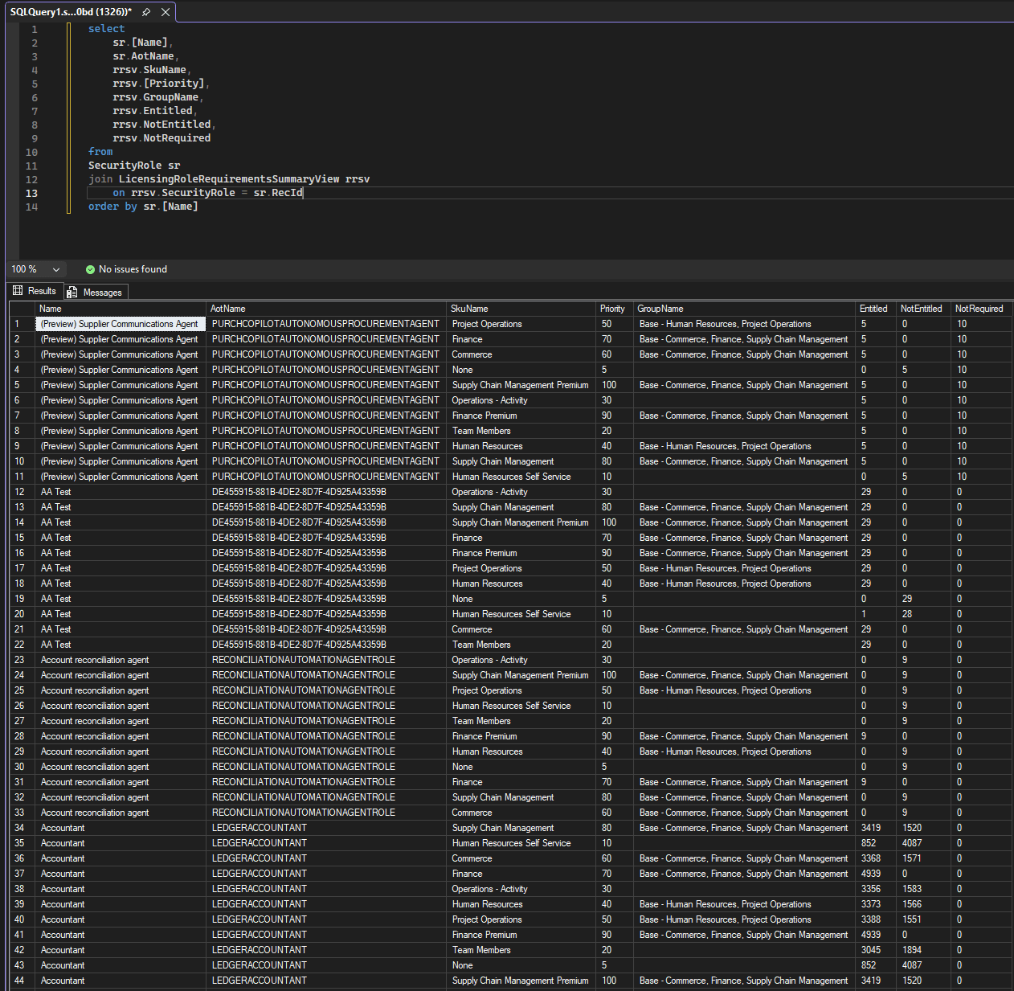
Using AI to Help Analyze Licensing Data

Slide 33
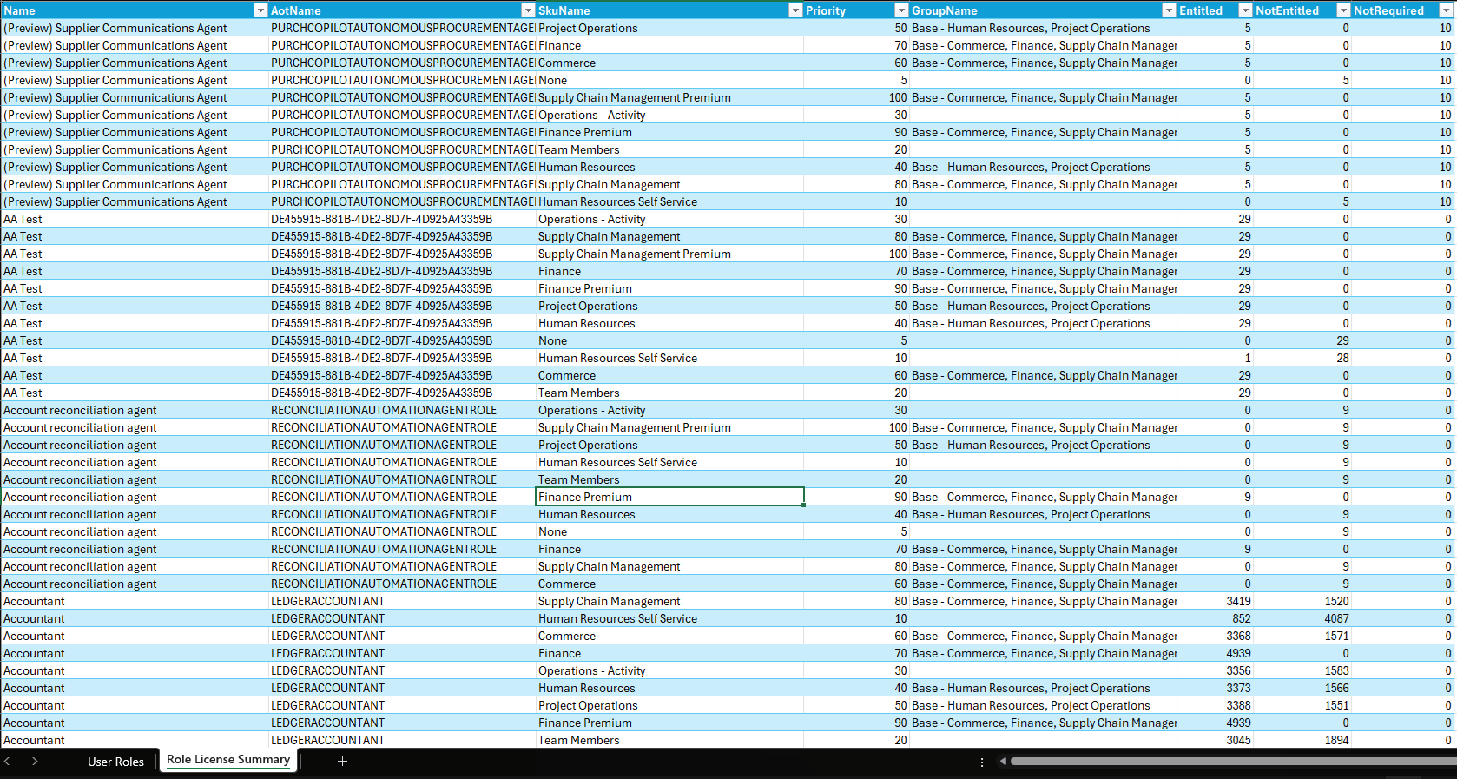
Using AI to Help Analyze Licensing Data

Slide 34
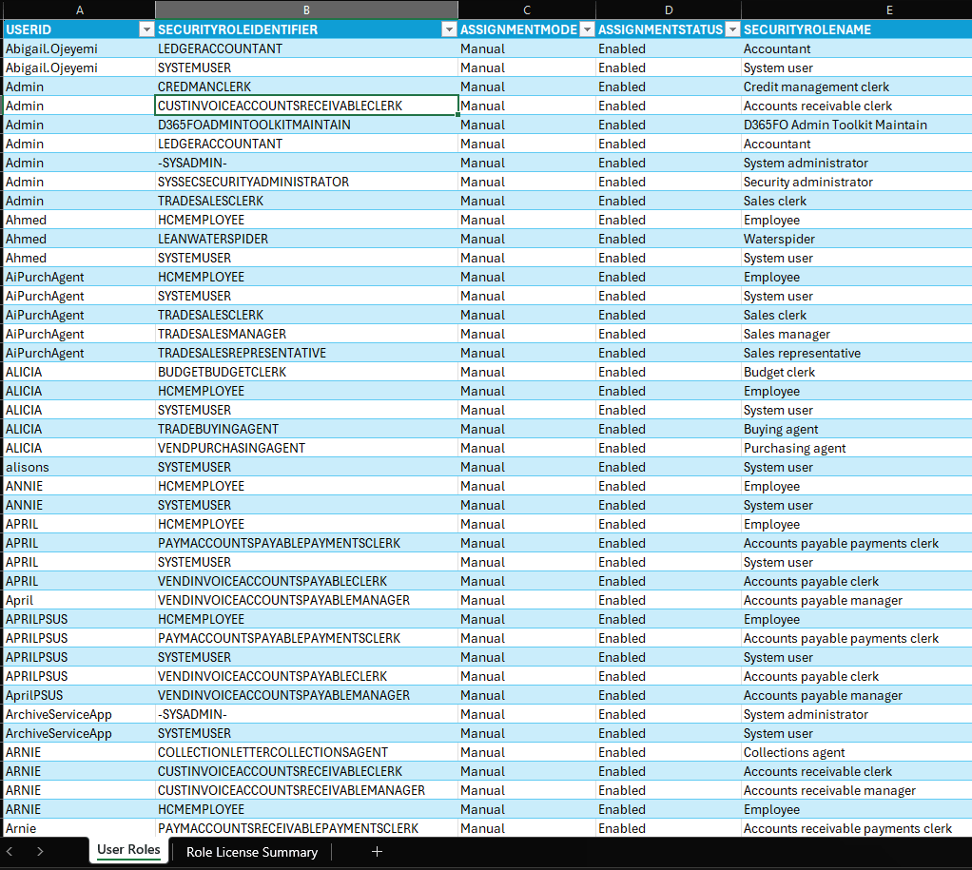
Using AI to Help Analyze Licensing Data

Slide 35
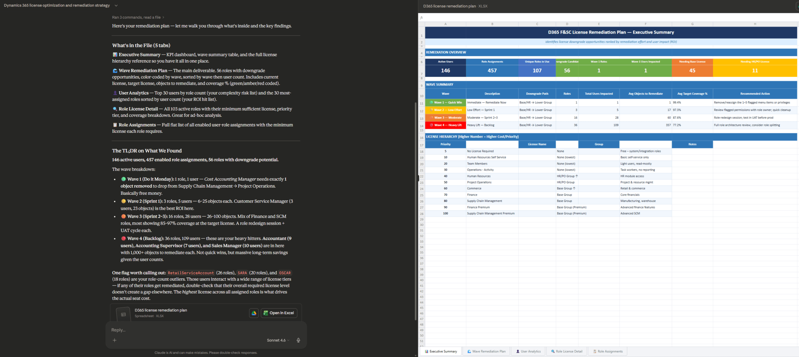
Using AI to Help Analyze Licensing Data

Slide 36
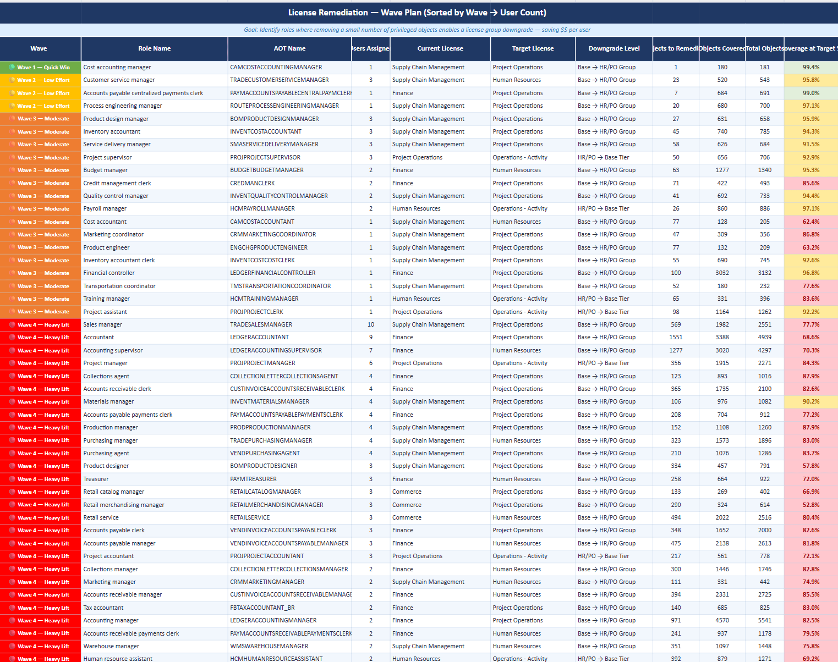
Using AI to Help Analyze Licensing Data

Slide 37
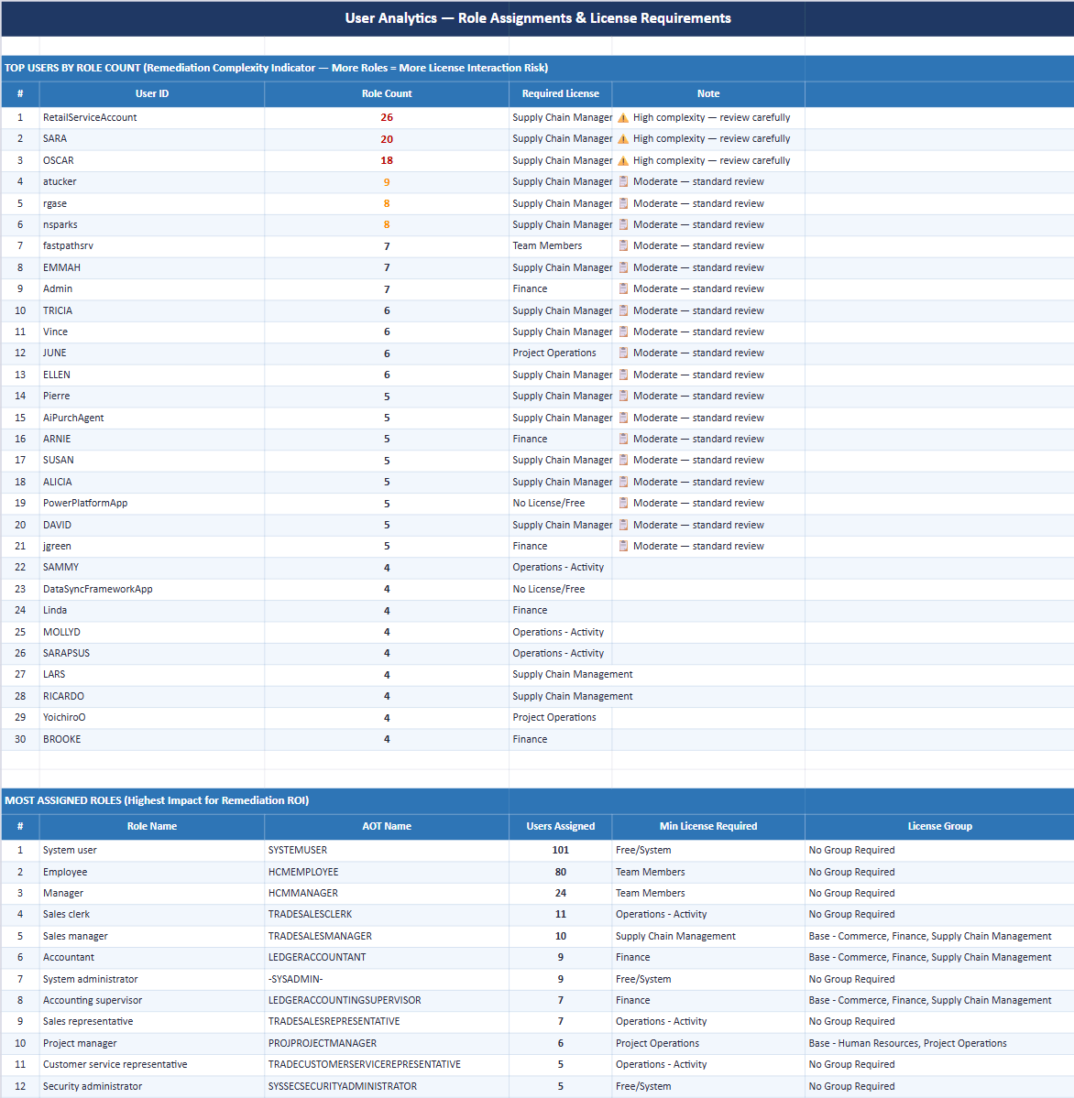
Using AI to Help Analyze Licensing Data

Slide 38
Waved License Remediation Plan
Ask the AI to group remediation actions into waves so the team has an executable roadmap, not a 500-row spreadsheet.
WAVE 1
WAVE 2
WAVE 3
Quick Wins
Targeted Adjustments
Structural Changes
Users with no role assignments
Right-size users with low utilization
Refactor custom roles to reduce license footprint
Obvious over-licensed accounts
Consolidate duplicate role assignments
Address base + attach mismatches
Inactive / disabled users still licensed
Move users to lower-tier license SKUs
Reassess privileged role assignments

Slide 39
AI Best Practices
ALWAYS VERIFY RESULTS – Keep a human in the loop
AI isn’t magic – but it is extremely good at pattern matching (which works great for data analysis)
Don’t get caught by the ‘AI hammer’
  If a workflow or automation fits better – use AI to help create it
You are not locked into Copilot to be your AI if you are using D365
Vague prompts = vague answers
  Explain the data before asking an AI to analyze it
You don’t need to be a computer / AI expert to use AI to help find optimizations
  Start small, validate process, then get more complex
The best time to clean up your D365 data was during go-live, the next best time is today

Slide 40
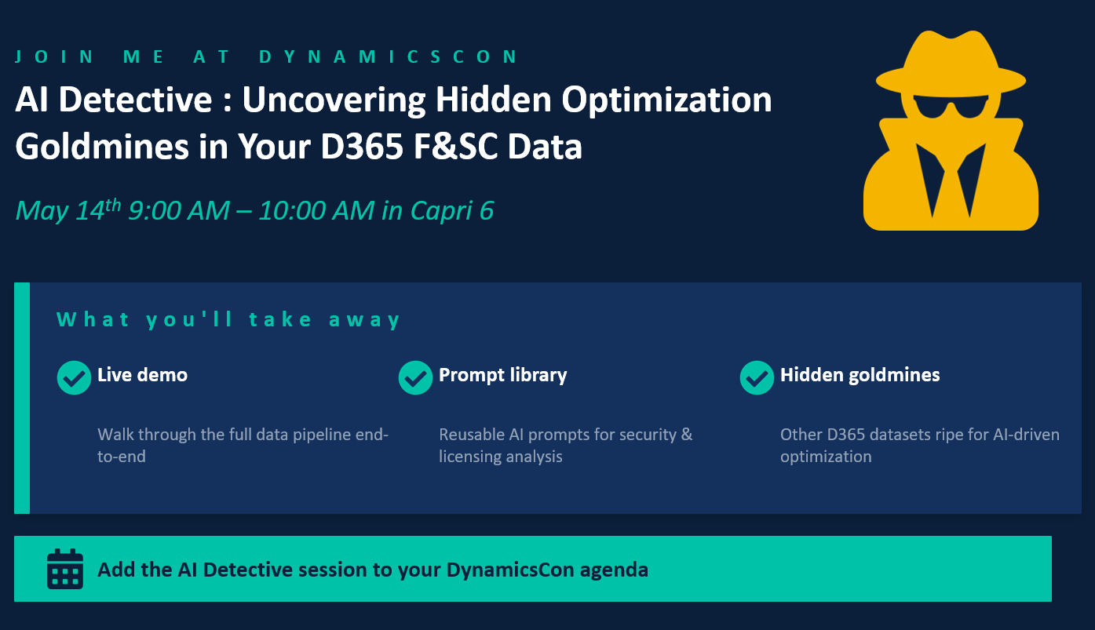

Slide 41






Other Fastpath Events at DynamicsCon
Booth: Fastpath - 313
Event Title | Speaker | Date / Time | Location
Demo Station – D365FSC Licensing w / AI | Alex Meyer | Wed 11:30 AM – 12:00 PM | Demo Station Kiosk
Donut Station |  | Wed 2:00 PM – 4:00 PM | Fastpath Booth
Demo Station – Fastpath Solution | Alex Meyer | Wed 4:15 PM – 5:15 PM | Demo Station Kiosk
AI Detective: Uncovering Hidden Optimization Goldmines in Your D365FSC Data | Alex Meyer | Thurs 9:00 AM – 10:00 AM | Capri 6
Securing Your MCP Server – Don’t Forget it When Securing AI Agents | Frank Vukovits | Thurs 1:30 PM – 2:30 PM | Capri 8
Fastpath Partner Showcase | Fastpath | Thurs 11:45 AM – 12:15 PM | Capri 1
The MVP War Room : Saving a D365FO Process Live | Alex Meyer | Thurs 4:00 PM – 5:00 PM | Capri 6
D365BC Security Tips & Tricks | Nick Sparks | Fri 9:00 AM – 10:00 AM | Lazuli 6
D365 Licensing Therapy: Group Session for Confused Admins | Alex Meyer | Fri 12:15 PM – 1:15 PM | Capri 6

Slide 42
Questions?
Email: alex.meyer@delinea.com
Blog: http://d365fscblog.com
GitHub: https://github.com/ameyer505
Twitter: https://twitter.com/alexmeyer_ITGuy
D365FO Security Course: http://d365fosecurity.com
PowerPoint available at: https://alexdmeyer.com/resources/downloads/

