Slide 1
Securing Data, Users, and AI Agents in Dynamics and Beyond with Fastpath Solutions from Delinea
May 14th, 2026
Notes:
Frank

Slide 2

Frank Vukovits
Chief Security Scientist
Fastpath – now a part of Delinea
Email: frank.vukovits@delinea.com
Twitter: @fvukovits
LinkedIn
Background:
30+ years ERP, Audit, and Security Experience
Co-founder AXUG
Certified Internal Auditor (CIA)
Certified Information Systems Auditor (CISA)
Passed CISSP examination in 2002
Frequent speaker at user group, audit, and security events
Notes:
Frank

Slide 3

Nick Sparks
Manager of Sales Engineering
Delinea
Delinea
Email: nick.sparks@delinea.com
LinkedIn: https://www.linkedin.com/in/nicksparks1/
Background:
5+ years managing the Fastpath SE team helping hundreds of customers with access governance
Champions the company’s identity governance and access control solutions, translating technical depth into customer value
Have spoken at DynamicsCon, Summit and other events regarding application security
Notes:
Frank transition to Nick, who then passes to Alex for his intro

Slide 4
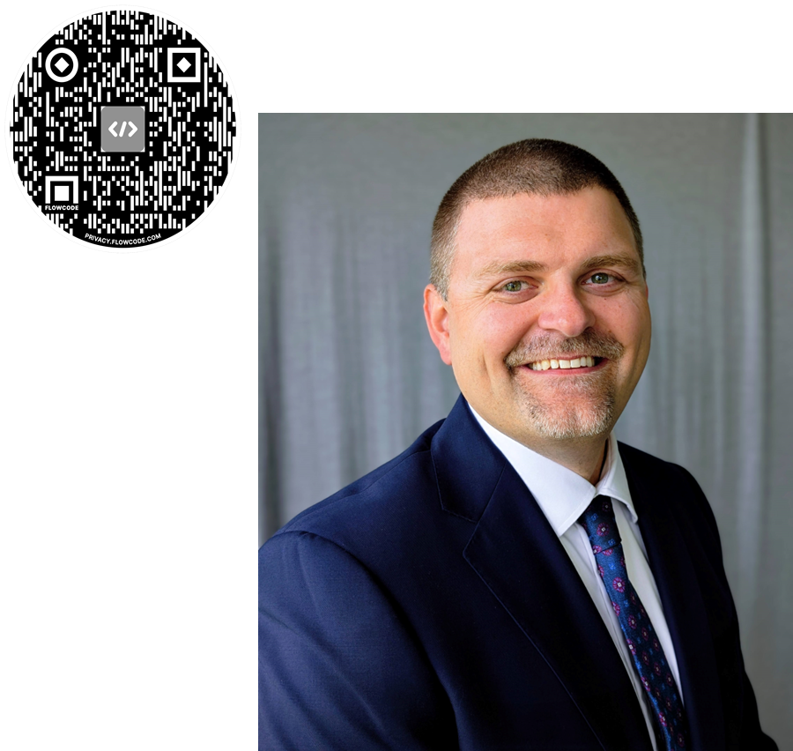
Alex Meyer
Principal Software Development Engineer
Delinea
Email: alex.meyer@delinea.com
Blog: http://d365foblog.com
Security Class: http://d365fosecurity.com
LinkedIn / Microsoft MVP Profile
Background:
Awarded Microsoft MVP in Business Applications since 2019
Been working with AX since 2013 and D365FO since 2016
Have spoken at Summit (US & Europe), Focus, and local chapters around AX/D365FO security and have done webinars around native controls in both versions
Notes:
Alex transitions back to Frank

Slide 5
Agenda
Introduction
Brief History of Fastpath, now part of Delinea
Audience Poll
Diving into the Fastpath Solutions
New Functionality Coming to Fastpath Solutions
Let’s Talk AI Agents
Final Thoughts
Notes:
Frank will cover agenda

Slide 6
Brief History of Fastpath, now part of Delinea
Notes:
Frank

Slide 7
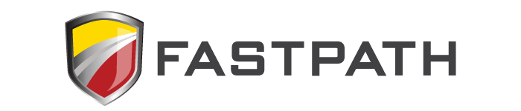


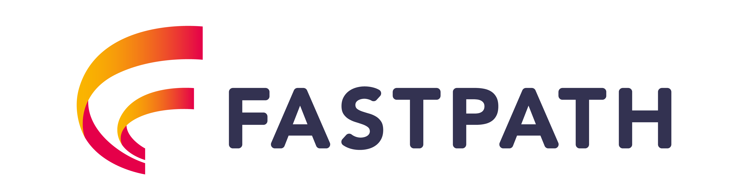
Evolving to Meet the Needs of the Community
2004 – Fastpath Founding
2016 – Cross Application & Cloud
2022 – ideiio Acquisition
2024 – Acquired by Delinea
Notes:
Frank

Slide 8
Identity security needs a control plane that delivers visibility, posture, and control…
Visibility
Illuminate YOUR identities
Analysis & Remediation
Discovery & Inventory
Automation & Protection
The Delinea Platform
Powered by Iris AI
Posture
Quantify
YOUR Risk
Control
Accelerate YOUR Business
Notes:
Talk Track:
The old question was: 'Did they have the right password?' The new question is: 'Should this action be happening, right now, given everything we know?'
And here's the hard truth: Most organizations can't answer that question. Not because their teams aren't capable. Because their architecture wasn't designed for it.
Delinea approaches identity security differently. Where security teams don't just know who is acting, they know what they're doing, why they're doing it, and what data they're touching. Where discovery is continuous, not a quarterly audit, but a living map of every identity and every connection.
Instead of isolated tools, we deliver a unified platform built around three pillars.
1. First, visibility — knowing every identity, privilege, and connection across your environment as soon as it exists.
2. Second, posture — understanding risk in context: stale accounts, misconfigurations, over-permissioning, shadow AI, and abnormal behavior.
3. And third, control — enforcing policy and access decisions in real time, based on current risk, not static assumptions.
This entire platform is powered by Delinea Iris AI, which correlates with identity, behavior, and risk signals so decisions can be automated and explainable.
****
Emotional Takeaway: Let it sink in and help them agree. Let them lead you into in the question – How is this done by Delinea
****

Slide 9

…across all identities and use cases…
IT Admin
Machine
AI
Workforce
Visibility
Illuminate YOUR identities
Developer
Analysis & Remediation
Cloud
Discovery & Inventory
Automation & Protection
On-premise
The Delinea Platform
Modern stack
Powered by Iris AI
Posture
Quantify
YOUR Risk
Control
Accelerate YOUR Business
Stale accounts
Vault accounts
Misconfigurations
Just-in-time privilege everywhere
Shadow AI
Reduce, refactor, remove permissions
Over-permissioned identities
Dynamically enforce policy
Notes:
Talk Track:
This control plane spans all identities and all environments. Such as, Human identities like workforce users and IT admins. Non-human identities like service accounts, machines, DevOps pipelines, and AI agents. Across cloud, on-prem, and modern hybrid stacks
Let me bring this to life with concrete examples of how this control plane operates.
1. For VISIBILITY and discovery, we're talking about comprehensive coverage—IT Admin accounts with elevated privileges, Machine identities like service accounts and API keys, Workforce identities across your organization, AI agents operating autonomously, and Developer identities accessing production systems.
2. For POSTURE and analysis, we identify stale accounts that should have been deactivated, misconfigurations that create security gaps, shadow AI operating outside governance, and over-permissioned identities that violate least-privilege principles.
3. For CONTROL and action, we vault sensitive accounts, reduce or eliminate standing privilege, refactor permissions to align with actual job requirements, and enforce policy and governance consistently across your entire environment.
This comprehensive approach ensures that no identity—regardless of type—operates outside your security framework.
Importantly, Delinea doesn’t treat these as separate problems. Everything is modeled in a single view, so posture and policy are consistent no matter where access happens. This is how you eliminate blind spots — not by adding tools, but by unifying understanding.
*****
Emotional takeaway: Reassure — don’t overwhelm
Easier way to communicate as you move to the next slide - We’re not asking you to rethink identity from scratch.This control plane spans the identities you already manage * human, machine, service, AI * across cloud and on-prem without forcing a rip-and-replace. The key difference is that these identities are understood, and governed, not in silos.
Important: Do not list products here. Keep it conceptual.
*****

Slide 10
…through differentiated capabilities and services
Hybrid environment visibility
Universal identity coverage
Access relationship mapping
Visibility
Illuminate YOUR identities
Analysis & Remediation
Cloud
Discovery & Inventory
Automation & Protection
On-premise
The Delinea Platform
Modern stack
Powered by Iris AI
Posture
Quantify
YOUR Risk
Control
Accelerate YOUR Business
Continuous monitoring
Continuous protection
Posture checks
Real-time authorization
Risk and exposure analysis
Unified, policy-based governance
Identity baselining
Session-aware enforcement
Notes:
Talk Track:
Up to this point, we’ve talked about what the control plane is. This slide is really about how Delinea delivers that control in a way point solutions simply can’t.
1. First, continuous discovery and visibility. Delinea continuously discovers every identity — human, machine, service, and AI — across cloud, on-prem, and identity providers. We don’t just see permissions in isolation; we correlate cloud access with identity data so you always know who has access, how they got it, and whether it still makes sense.
2. Second, posture and risk intelligence. The platform continuously monitors identity configurations and behavior, establishes baselines, and highlights the risks that actually matter — over-permissioning, stale access, shadow admins, and abnormal behavior — so teams focus on prioritized risk, not noise.
3. Third, real-time control. Instead of standing access and static credentials, Delinea enforces context-aware authorization at the moment access is used. That enables zero standing privilege and just-in-time access without slowing teams down.
You’ll also see this control-plane strategy extended with our intent to acquire StrongDM. By combining Delinea’s leadership in enterprise identity security, privilege management, and threat detection with StrongDM’s runtime access model, we’re building a unified platform that continuously evaluates identity, context, and policy at the moment access is requested and used.
The outcome is a world where access to sensitive resources is never standing. It’s always on-demand, always justified, and always temporary. Together, we’re not just talking about zero standing access; we’re building it as a foundational element of the identity security control plane, designed for modern engineering, DevOps, and AI-driven environments.
What makes this different is that these capabilities aren’t separate tools. Discovery feeds risk. Risk informs policy. Policy is enforced automatically. It’s a closed-loop system that continuously adapts as your environment and AI usage evolves.
******
Emotional Takeaway:
Individually, these are powerful. Together, they creatFor CISOs and IAM leaders, the outcome is simple: less ie continuous control without slowing the business.
dentity risk, faster operations, and control that actually scales with modern enterprise complexity.
Spend time in understanding their gaps around discovery and visibility, posture and control -
******

Slide 11
The Delinea Portfolio
Delinea Platform
Secure Credentials
Identify & Vault Secrets
Zero-Trust Secure Access
VPN-Less Remote Access
Privilege & Entitlements
Granular Real-time Controls
Vaulting
Machine
Secrets
Service
Accounts
Remote Access
ZTNA
Vendor PAM
Servers
Workstation
Cloud
Identity Threat Detection and Response
Detect Identity Threats and Over Privilege
Respond
Remediate
Platform Services
Continuous Discovery
Audit and Analytics
AI Driven
MFA
Ecosystem

Slide 12

A comprehensive application access governance platform for mid-market and enterprise
Automate Segregation of Duties (SoD) risk analysis, User Access Reviews (UAR), compliant user provisioning, and tracking tracking changes to critical, sensitive data
Access Control
Analyze access risk across enterprise applications, report on SoD conflicts and get early sight of potential issues
Access Provisioning
Compliant user provisioning, modification, and deprovisioning
Access Review
Automated User Access Reviews and certifications, rapidly detect issues and prove to auditors that the right users have access to the right resources
Change Tracking
Track changes to both transaction and master data, identify the source of the change, the user initiating the change, as well as the before/after values
Telemetry Data
Gain visibility into actual
D365 F&SC license usage
Security Designer
Create, modify, test and evaluate security in a model environment prior to implementing in your ERP
Notes:
Frank
Microsoft Dynamics 365 Finance & Supply Chain version, with Telemetry Data and Security Designer included

Slide 13












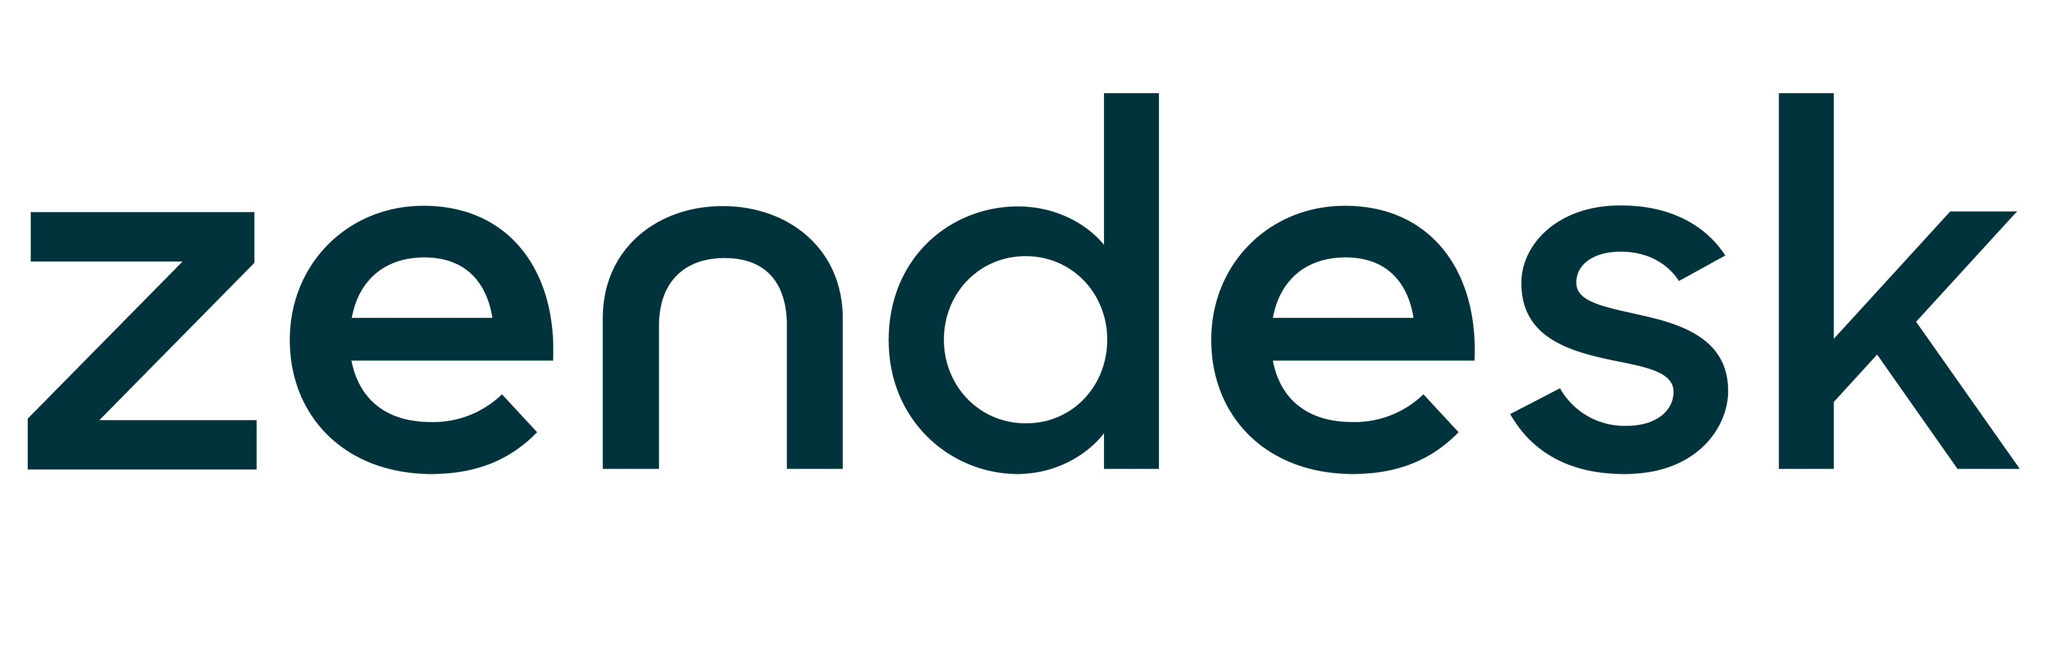


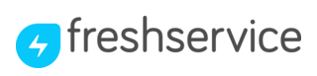







Fastpath Solutions offers unrivalled integrations and cross-application functionality
Direct integrations to 50+ popular ERP, CRM, and HCM applications, plus Fastpath Universal Product Integration (UPI)
Integrations
Plug-ins
Ticketing systems
GRC platforms
D365 Finance & Supply Chain
D365 Business Central
D365 Customer Engagement
Dynamics GP
HCM sources
Fastpath Universal Product
Integration Data Sources
Microsoft SQL
Oracle SQL
SFTP
Flat File Import
Notes:
Frank
Fastpath works across across multi-application environments and custom-made software to deliver insight into security risks. The suite comes with pre-configured integration packs including Separation of Duties (SoD) rulesets specific to each system working across a variety of ERP/CRM/HCM/P2P and other integrations, including Microsoft Dynamics, Workday, Oracle, NetSuite, SAP, Coupa, PeopleSoft, Salesforce, as well as custom applications. ​
​
In addition, Fastpath connects with complementary solutions such as ServiceNow, Workiva, Jira, and others. ​
​
Fastpath includes 50+ direct, out-of-the-box integrations to popular ERP, HCM and CRM applications. This means no custom coding, so you can report on security in these applications within a matter of hours. Plus, with the Fastpath Universal Product Integration (UPI) you can extend this cross-platform capability to all of your in-scope applications, giving you the ability to see all of your access risks from a single dashboard.​
​

Slide 14
Easy to implement
Quick time to value
Easy to use
Notes:
Frank, passes to Nick after this slide
Valuepath includes:​
Dedicated Customer Success Manger​
On-demand and instructor-led training​
Technical support health check​
Access to our partner network​
​
Fastpath provides on-demand training as part of Valuepath at no extra cost. It’s delivered via self-service, easy-to-digest modules so you can work it around your schedule. We also help you train-the-trainer so you can get new starters up and running quickly.​
​
Advanced Training can be provided on request. Designed to meet your exact needs, Advanced Training is intended to assist advanced configuration in the system, and usage beyond our out-of-the-box practice templates. ​
​
We also provide unlimited support and maintenance.​
​

Slide 15
Audience Poll
Notes:
Frank

Slide 16
Diving into the Fastpath Solutions
Nick Sparks
Notes:
Nick

Slide 17
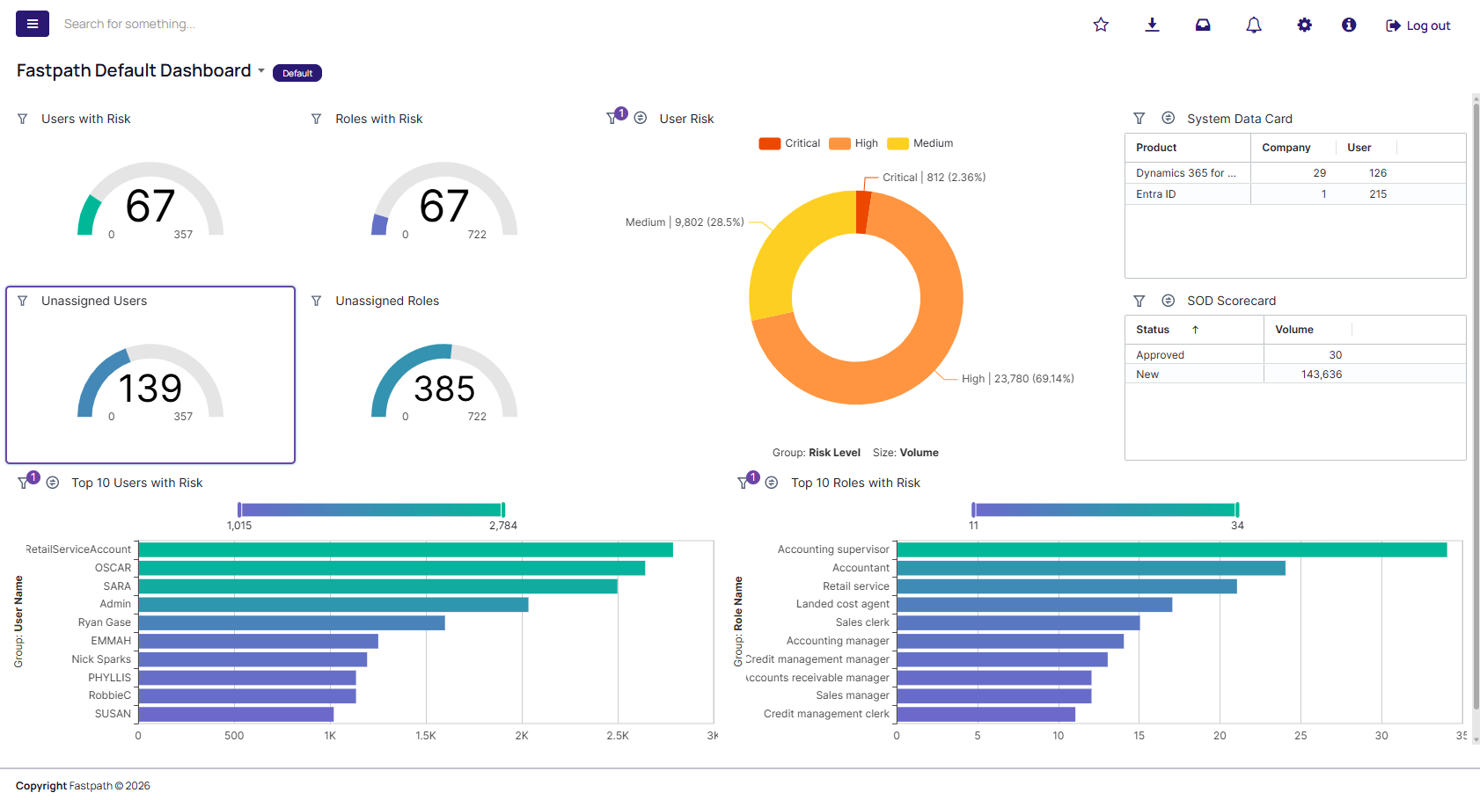
New Functionality Available for Fastpath Solutions
Improved Data Analytics for all Fastpath Solutions
Notes:
Next set of slides need to be quick, more for reference than detailed information sharing

Slide 18
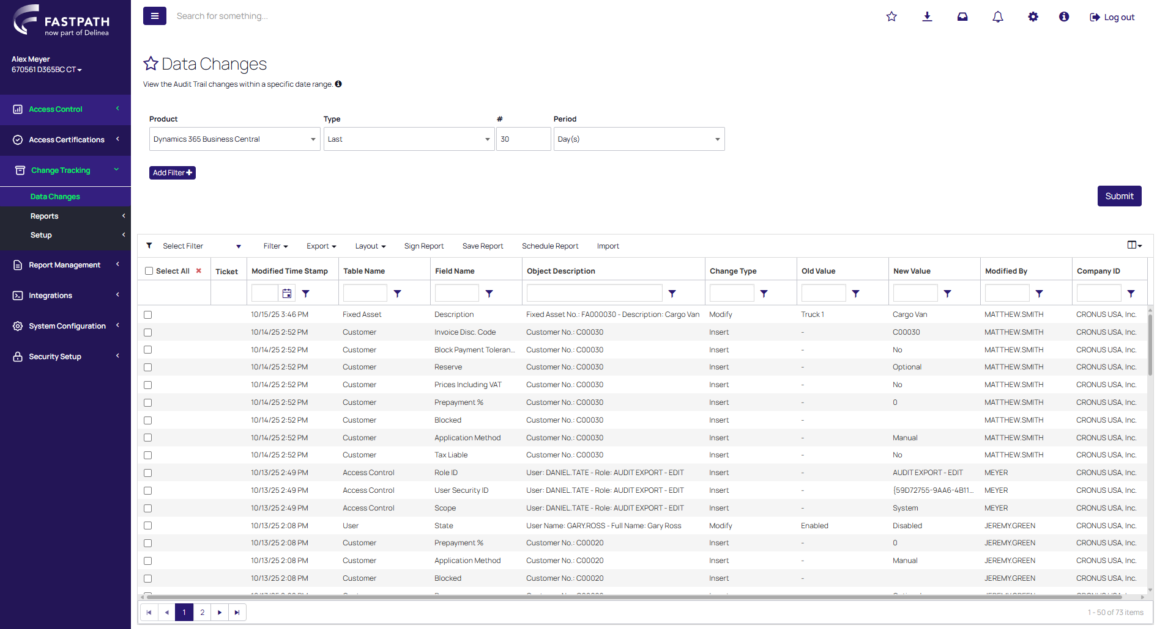
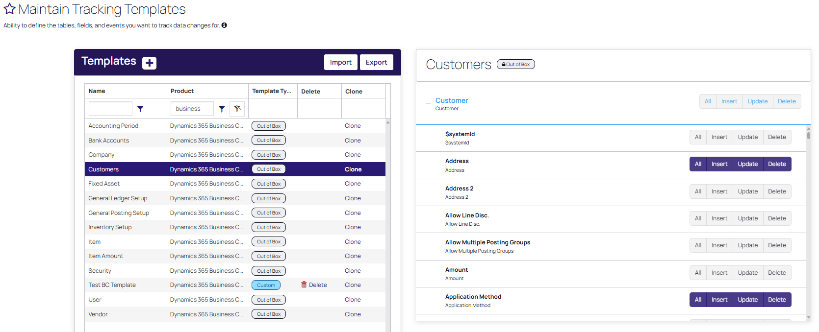
New Functionality Available for Fastpath Solutions
Updated Change Tracking Module for Dynamics 365 Business Central
Notes:
Next set of slides need to be quick, more for reference than detailed information sharing

Slide 19
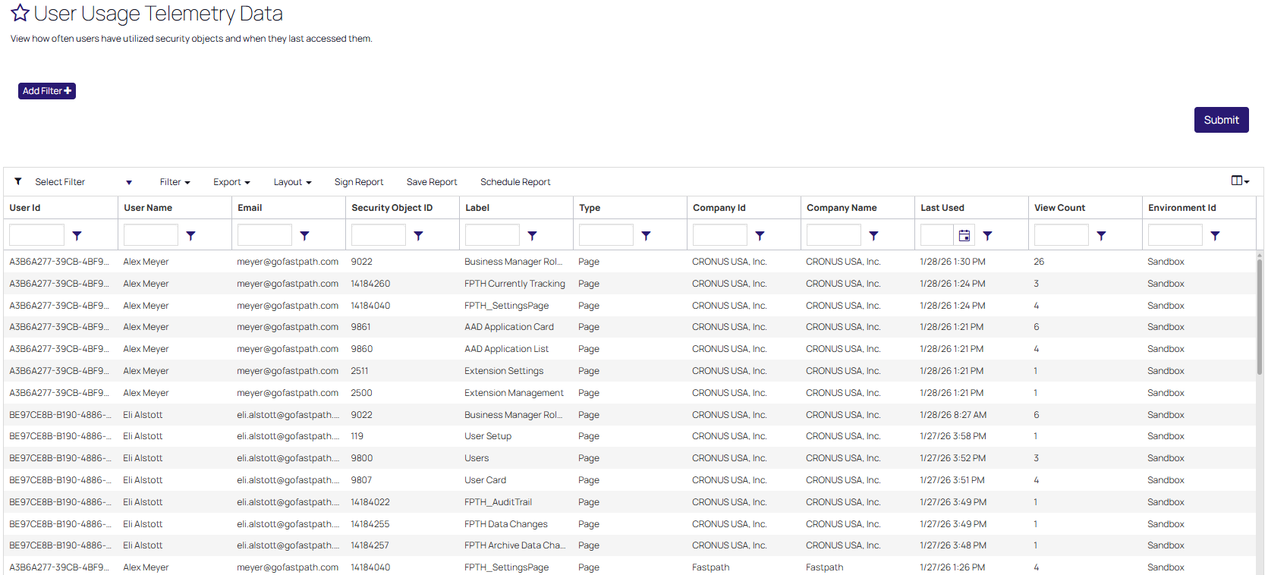
New Functionality Available for Fastpath Solutions
Telemetry reporting for Dynamics 365 Business Central
Notes:
Next set of slides need to be quick, more for reference than detailed information sharing

Slide 20
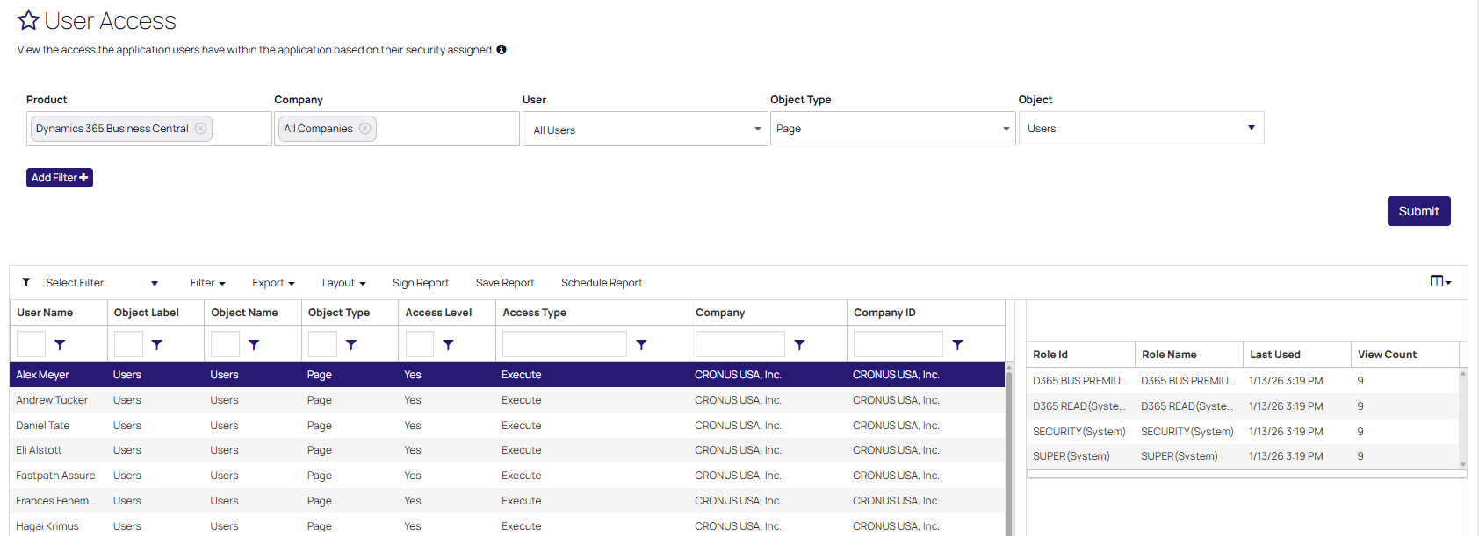
New Functionality Available for Fastpath Solutions
Telemetry reporting for Dynamics 365 Business Central
Notes:
Next set of slides need to be quick, more for reference than detailed information sharing

Slide 21
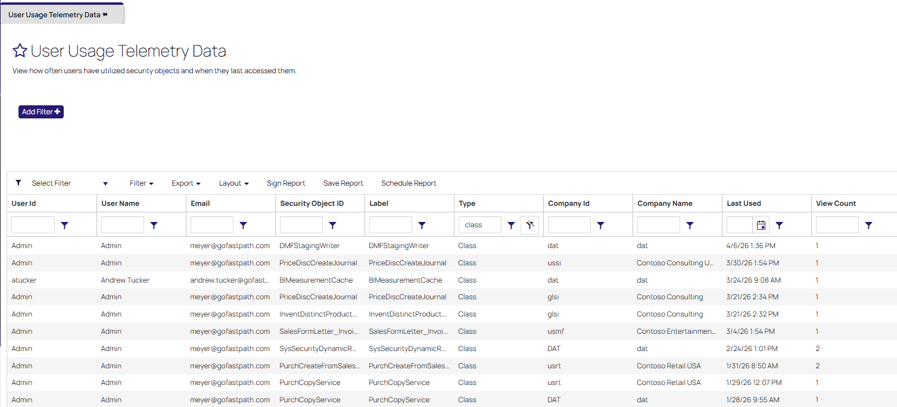
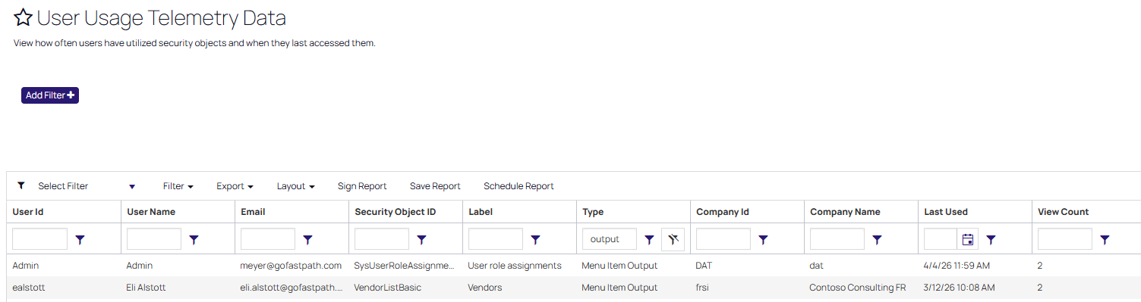
New Functionality Available for Fastpath Solutions
Advanced telemetry available for Dynamics 365 FSC
Notes:
Next set of slides need to be quick, more for reference than detailed information sharing

Slide 22
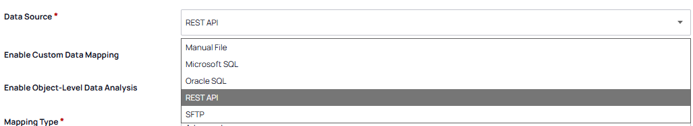
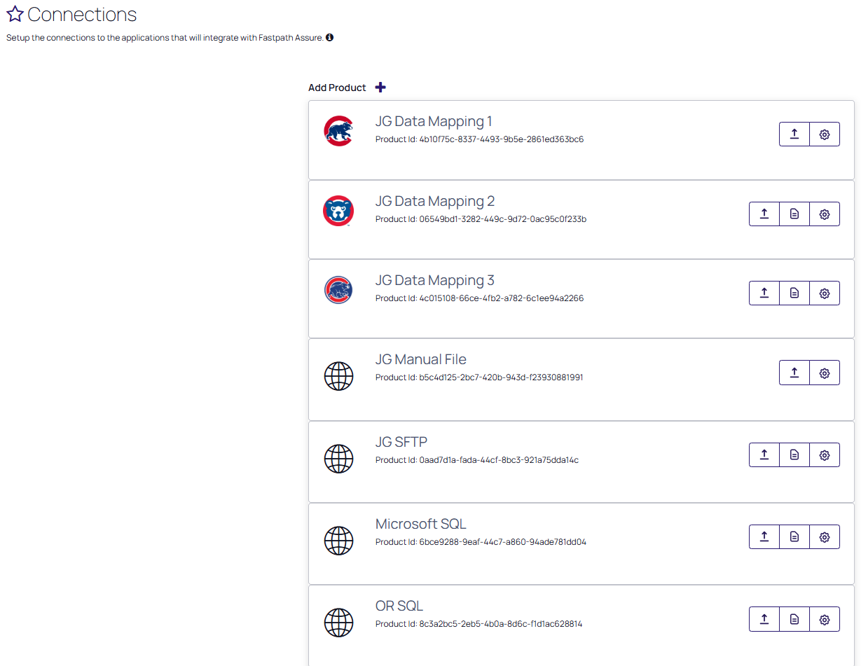
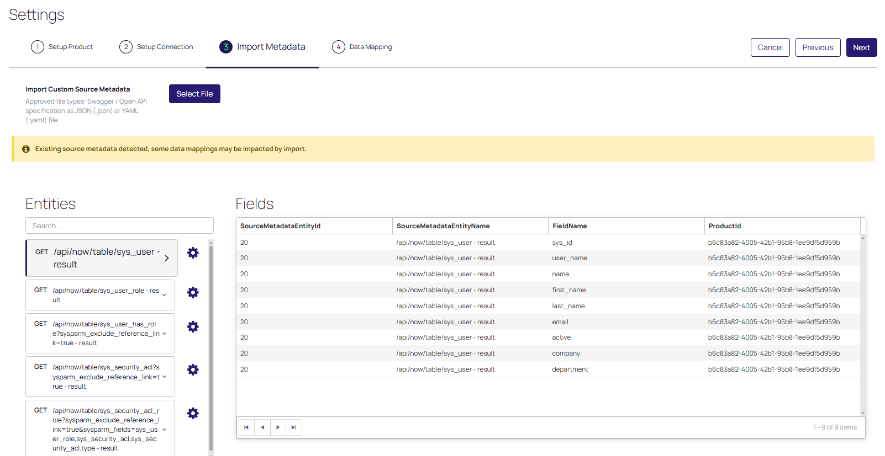
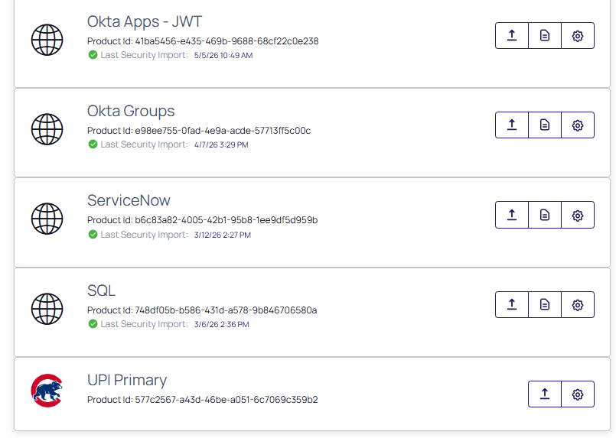
New Functionality Available for Fastpath Solutions
Additional and Updated Connections Via Universal Product Integration (UPI) Tool
Notes:
Next set of slides need to be quick, more for reference than detailed information sharing

Slide 23
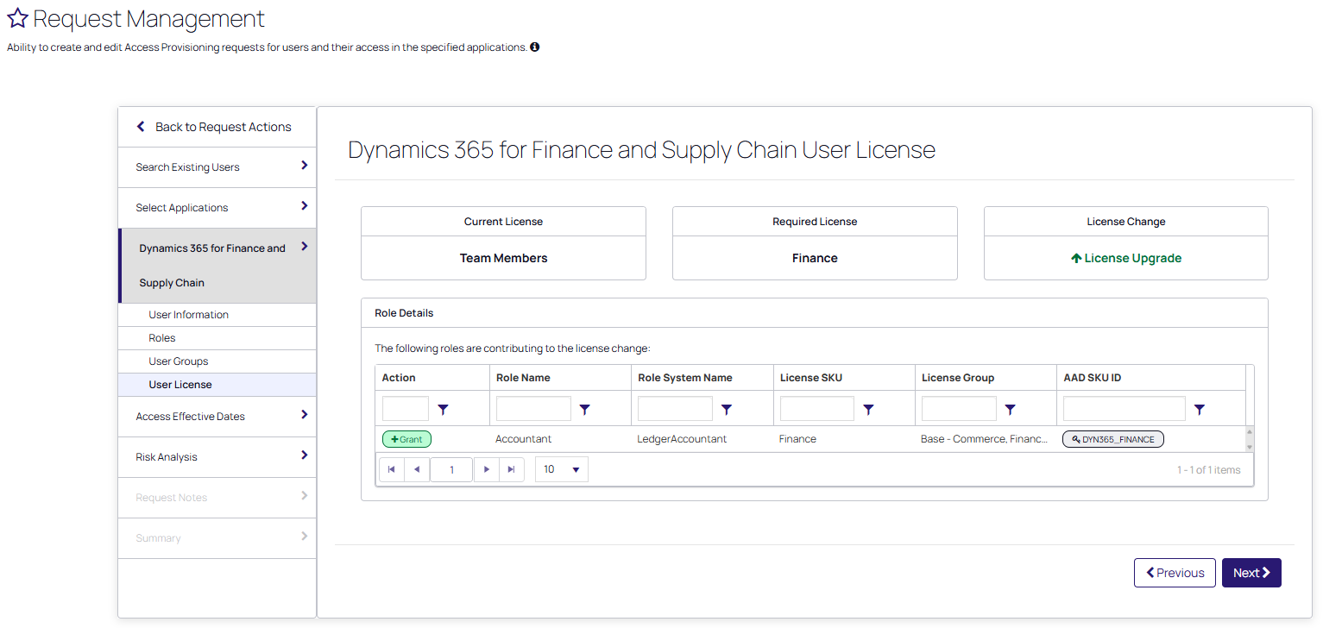
New Functionality Available for Fastpath Solutions
D365FSC Access Provisioning License Analysis
Notes:
Nick passes to Alex after this slide/his demo is complete. Next set of slides need to be quick, more for reference than detailed information sharing

Slide 24
New Functionality Coming to Fastpath Solutions
Alex Meyer
Notes:
Alex, should we have a slide that shows the three items coming?

Slide 25
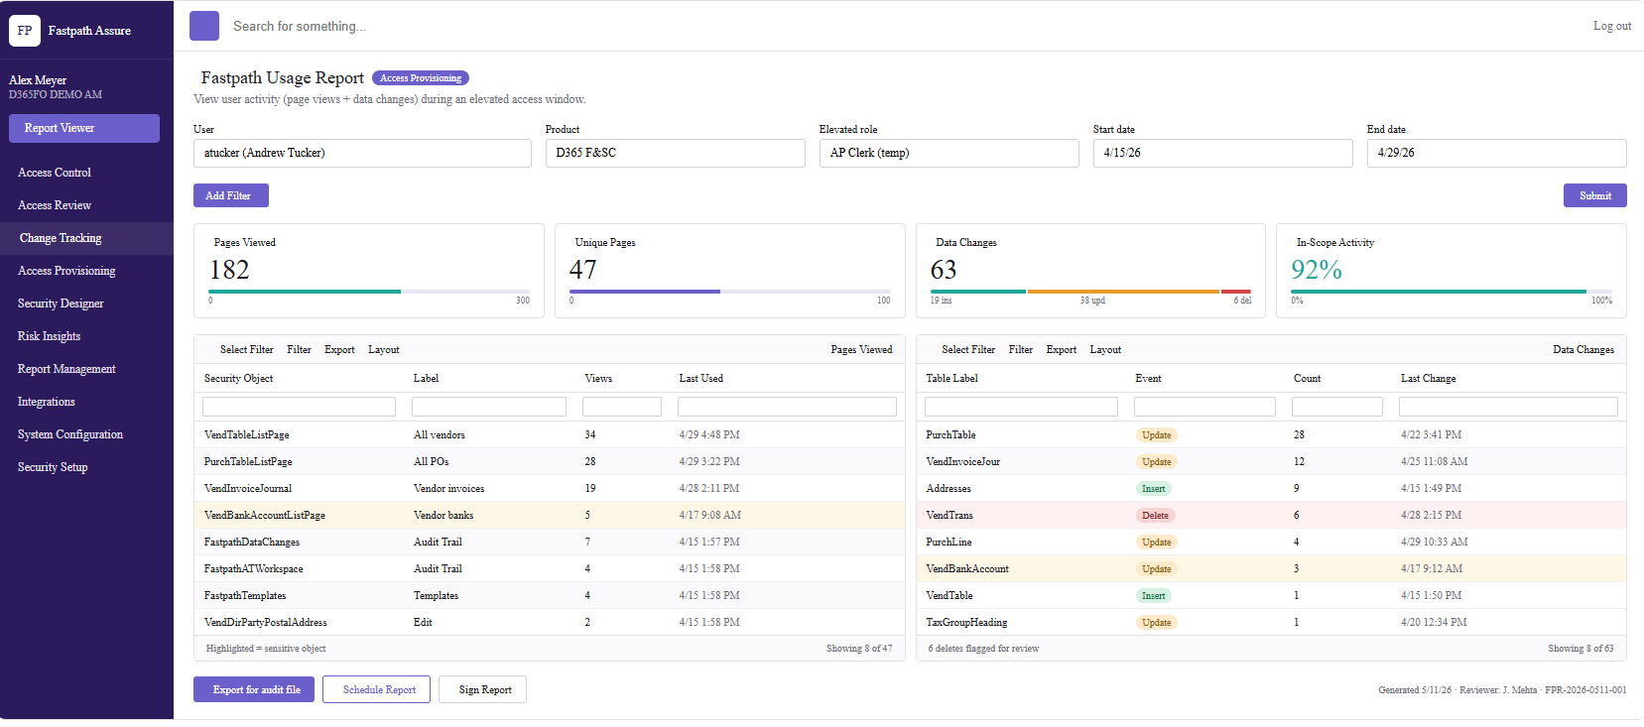
Fastpath Usage Reporting
For Access Provisioning Requests that have an ‘end date’ – add ability to see Change Tracking and telemetry data used while assigned access
  ‘Firefighter access reporting’
Ability to review and sign off on usage
Notes:
Alex

Slide 26
Fastpath Assure MCP – NEW!!!
Ask questions of your Fastpath data
  Currently supports Access Control and Access Review data
  Change Tracking and Security Designer are next
Completely optional – opt in vs opt out
  No LLM / AI will be utilized within your Fastpath instance without your consent
BYO-AI (Bring your Own AI)
  Demo will be shown with Anthropic Claude, but same idea would also work for Microsoft Copilot, OpenAI ChatGPT, Google Gemini, etc
Notes:
Alex

Slide 27
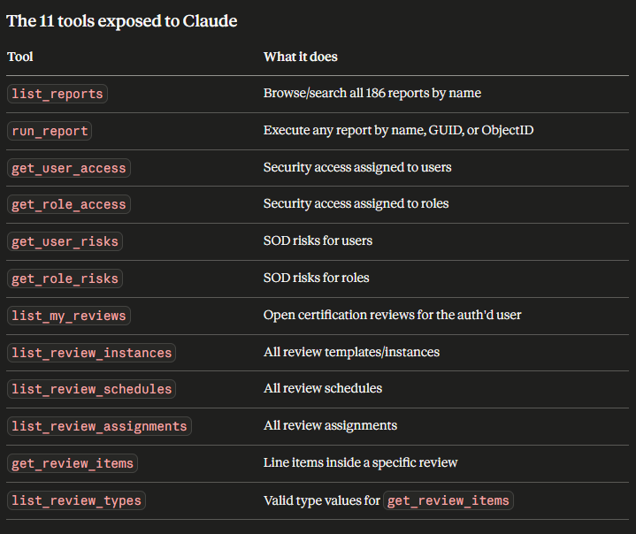
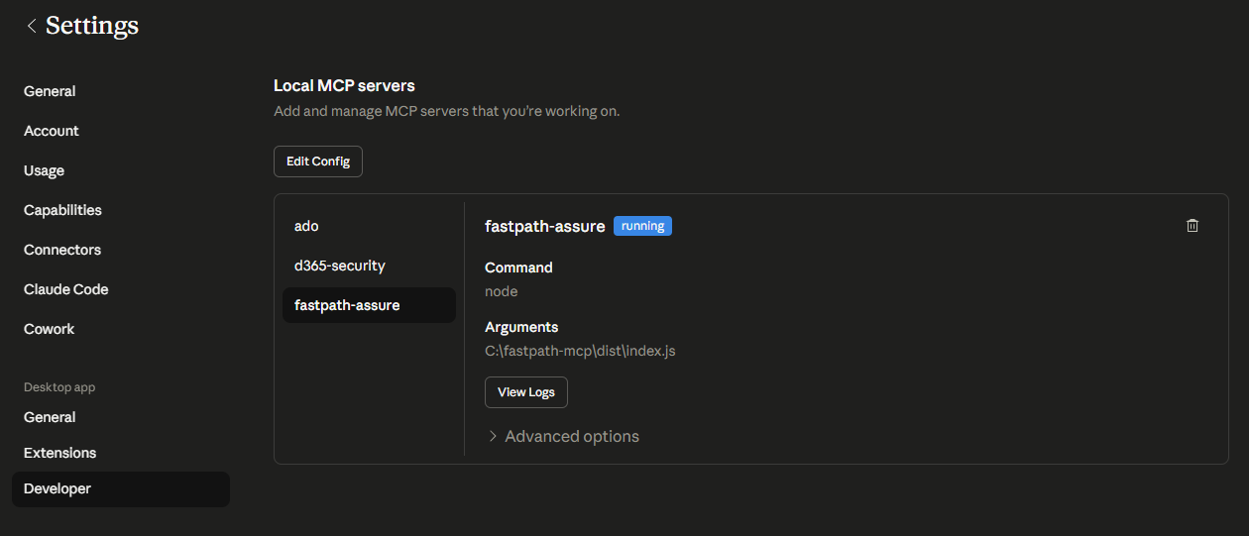
Assure MCP
Notes:
Alex

Slide 28
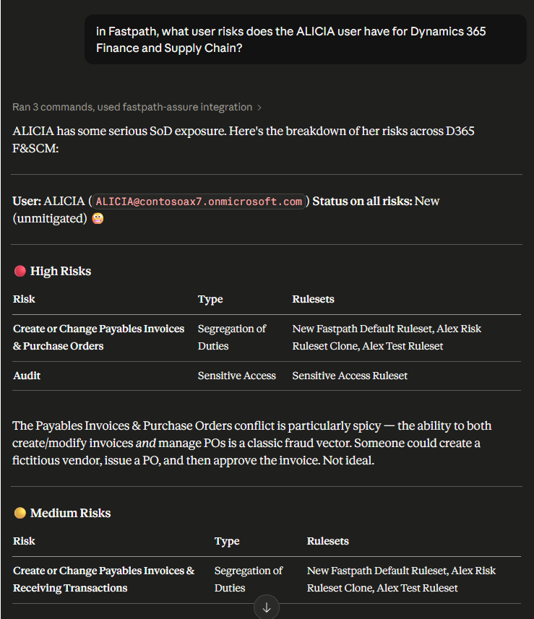
Assure MCP
Notes:
Alex

Slide 29
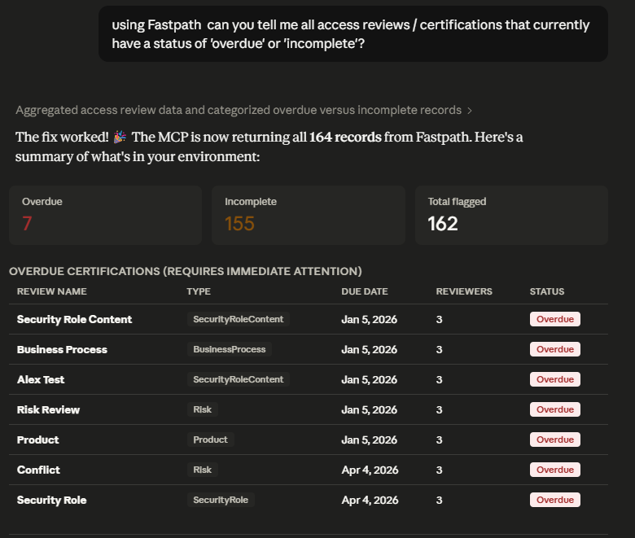
Assure MCP
Notes:
Alex

Slide 30
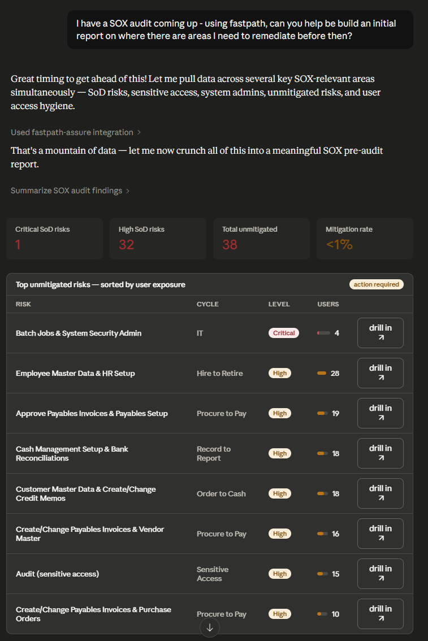
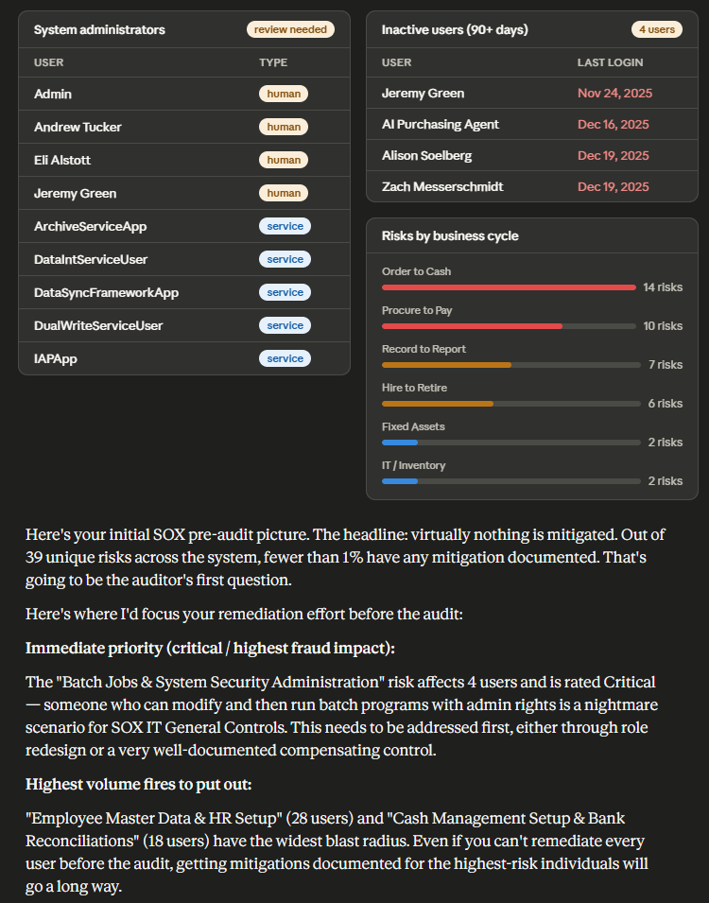
Assure MCP
Notes:
Alex

Slide 31
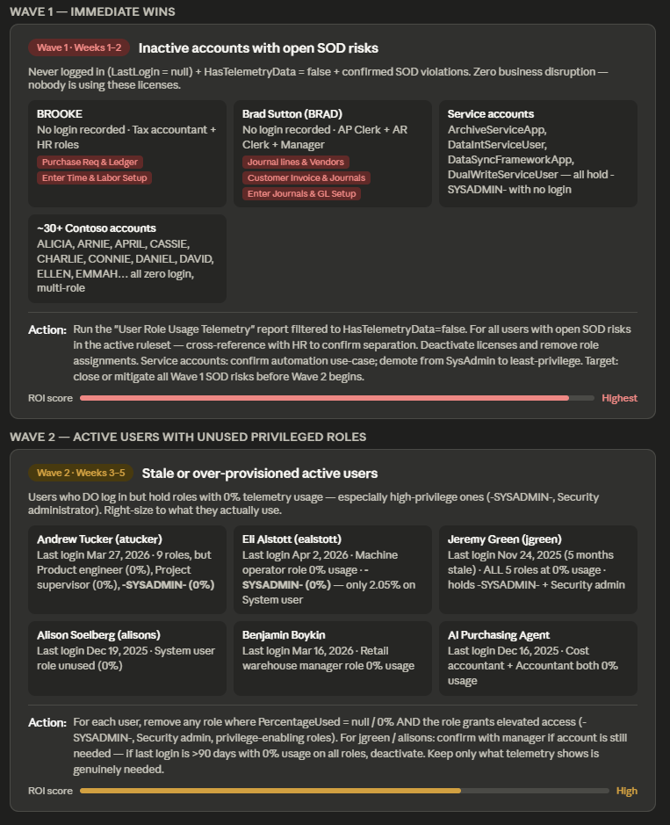
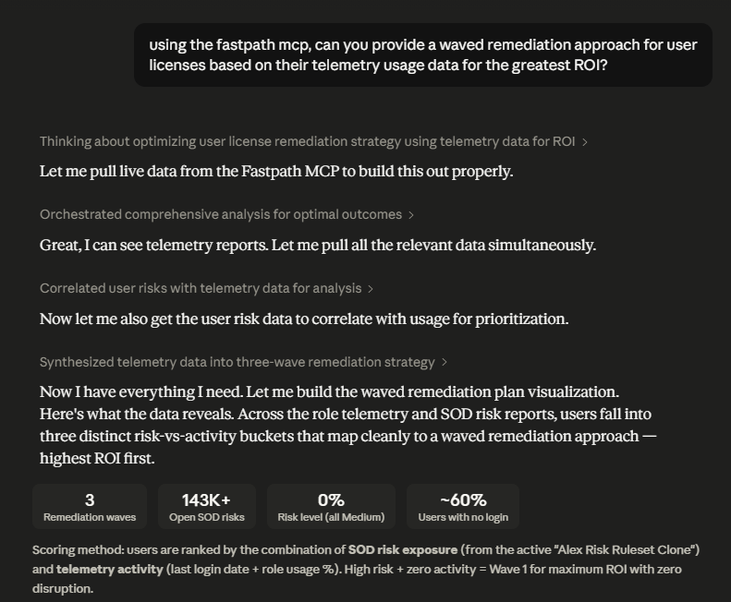
Assure MCP
Notes:
Alex

Slide 32
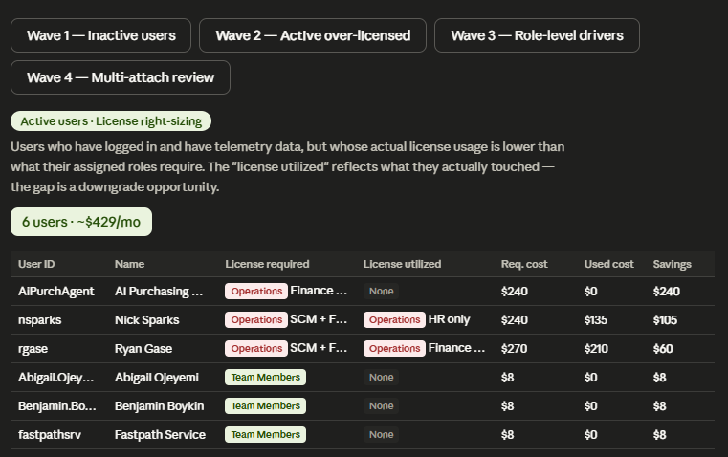
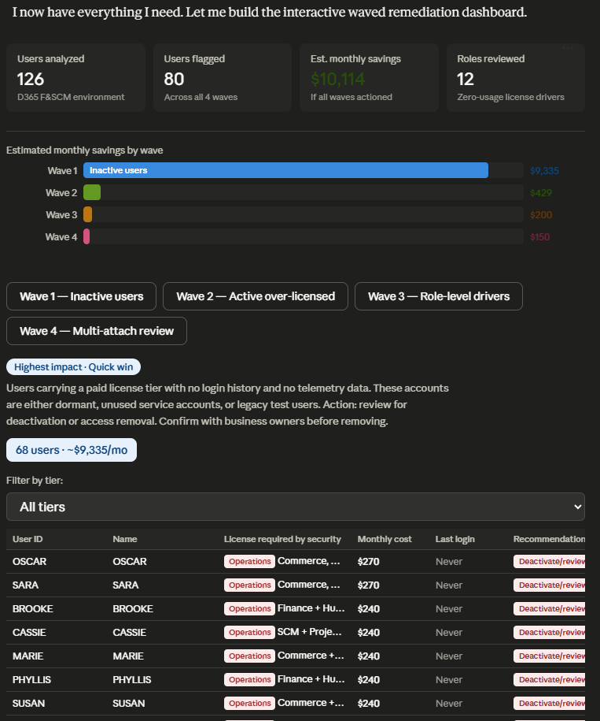
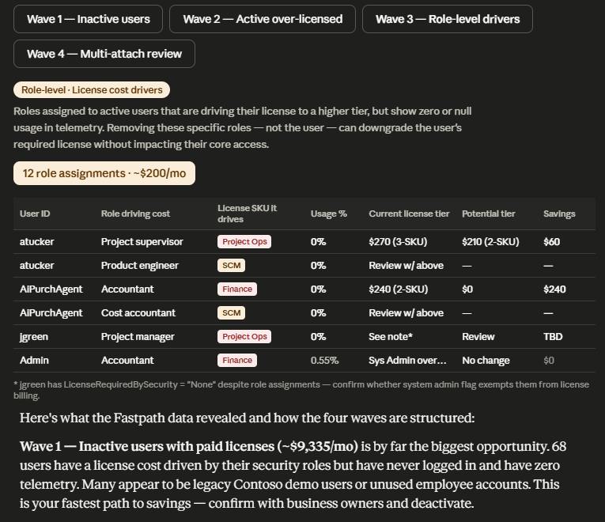
Assure MCP
Notes:
Alex

Slide 33
Let’s Talk AI Agents
Frank Vukovits and Alex Meyer
Notes:
Frank and Alex

Slide 34
AI Agents Are Next Wave of ERP
Mundane or Repetitive Tasks are Being Replaced by AI Agents
ERP Users will Have a 'Team' of Agents a Their Disposal
Agentic AI Agents Have no Human Involvement
  Can execute and complete tasks
  Work in concert with other AI agents, including those outside your domain
Currently Not Used in Mass
  Generative AI adoption still in it's infancy
  Agentic AI adoption is even less
AI Agents will Continue to be Added at Rapid Pace into ERP
Notes:
Next set of slides need to be quick, more for reference than detailed information sharing

Slide 35
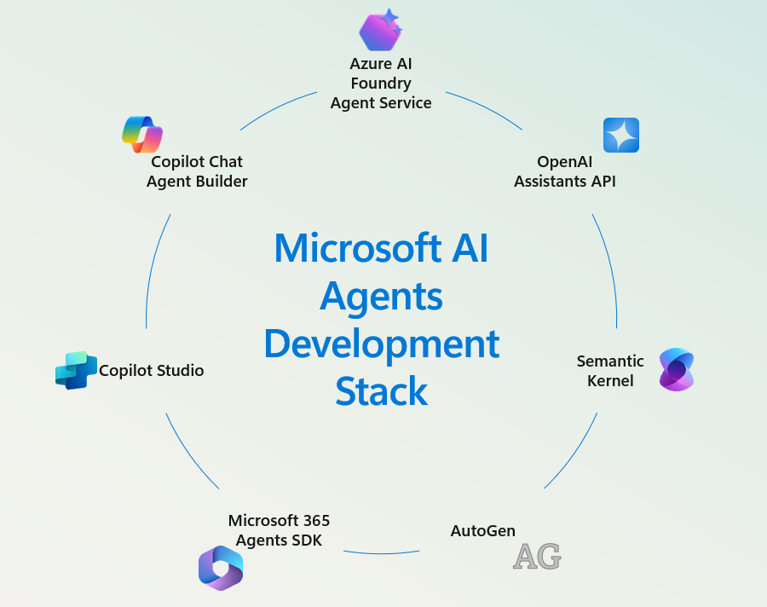
What are AI Agents in Microsoft Dynamics?
AI agents are non-human entities performing business tasks
  Automate tasks
  Provide insights
  Streamline operations
Examples include:
  Copilot
  Power Automate bots
  Azure OpenAI integrations

Slide 36
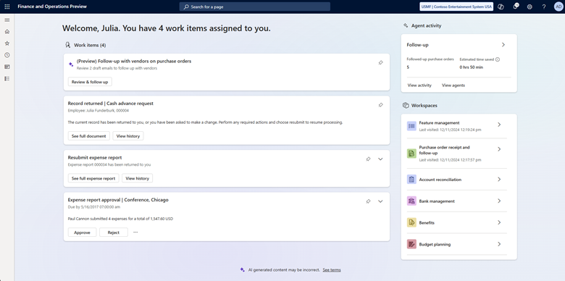
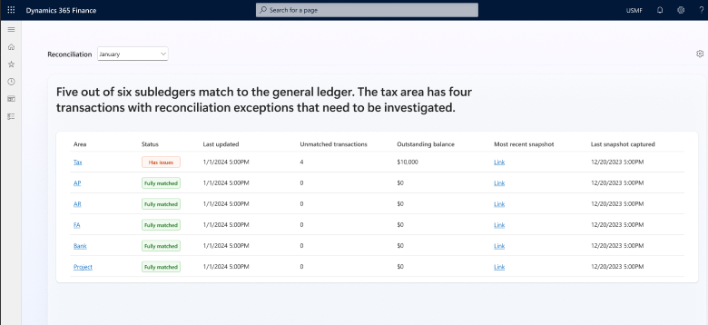
Examples of AI Agents in Dynamics 365
Supplier Communications Agent
Account Reconciliation Agent

Slide 37
Why AI Agents Pose Unique Risks?
Elevated Access Privileges
  Elevated or admin access is powerful and must be limited
  Least privilege access should still be followed for non-human identities
Lack of Human Accountability
  Need to include non-human identities in access reviews
Agent-to-agent autonomous execution with no human review/approval
Potential for misuse (intentional) or misconfiguration (unintentional)
  Eg: AI agent given access to sensitive data (misconfiguration), bad actor uses this flaw to gain access to data they otherwise would not know about / would not have access to
  ‘Security by obscurity’ is not a valid compliance technique

Slide 38
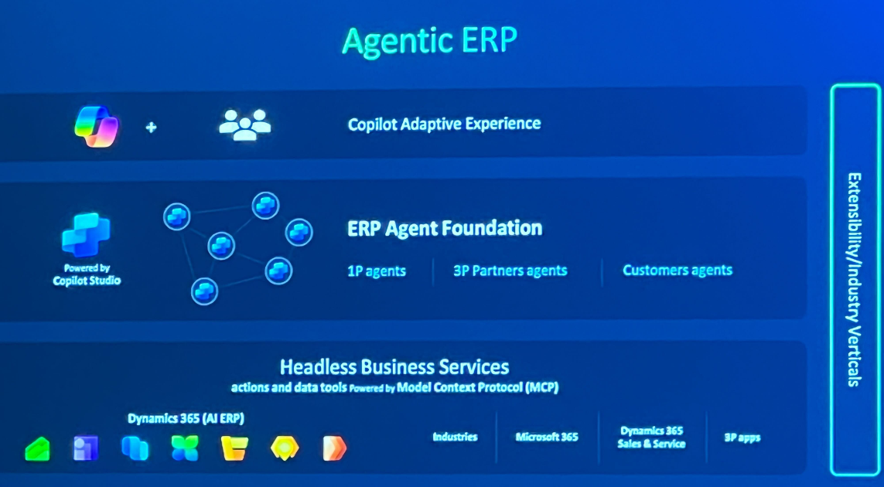
Next Wave of AI Agents
Do you want your security to be ‘headless’?

Slide 39
Rethinking Identities: AI Agents = Users
Why AI agents should be treated like users in Microsoft Dynamics
  AI agents perform actions within the application – just like users do
Access should align with least privilege and Zero Trust principals
  Over provisioning access can expose potentially sensitive information or business processes
Actions should be audited
  What data did they modify / access?
  Can turn into ‘blind spots’ for audit and compliance
  MUST HAVE AN ACCURATE INVENTORY OF ALL USERS AND AGENTS, AND THE ACCESS THEY HAVE IN DYNAMICS

Slide 40
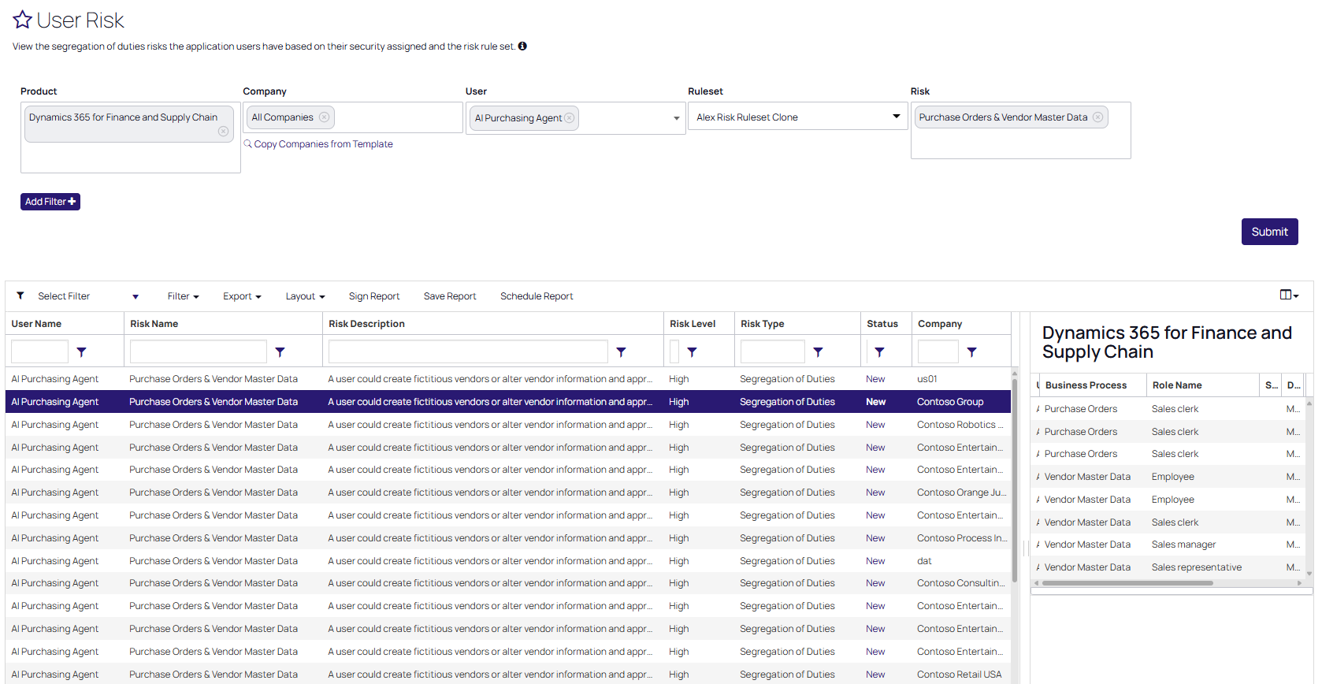
AI Agent Access Reviews
Fastpath analyzes SoD risks across users – including AI agents
  If your AI agent can create a vendor and approve a payment, that’s an SoD risk – even if it’s not wearing an employee badge

Slide 41
Fastpath + Delinea Integration Possibilities
Unified Application Access Governance
Automated Control Enforcement
Enhanced Audit Reporting
Inventory and Secure All Identities Across Your Company
Scenario: If an AI agent was given too much access how would Delinea and Fastpath be able to detect, prevent, and respond to this?
Capability | Fastpath | Delinea
Detection | SoD violations, audit logs | AI risk scoring, behavior analysis
Prevention | Role design, access certification | Inventory, PAM, policy enforcement
Response | Incident logs, remediation flows | ITDR, automated access revocation
Notes:
Frank

Slide 42
Final Thoughts
Notes:
Frank

Slide 43
Final Thoughts
Securing Dynamics has never been more important
  ALL Users, human and machine
Automating IT General Controls eliminates manual errors and increases efficiencies
A strong security posture requires strong internal controls across ALL critical business applications
Delinea is the only company positioned to allow companies to secure all identities across all technologies, with every interaction
Stop by the Fastpath, now part of Delinea booth (#313) to learn more
Notes:
Frank

Slide 44
Speaking Session – Breakout, Still Some Left!
Event Title | Speaker | Date / Time | Location
Demo Station – D365FSC Licensing w / AI | Alex Meyer | Wed 11:30 AM – 12:00 PM | Demo Station Kiosk
Donut Station |  | Wed 2:00 PM – 4:00 PM | Fastpath Booth
Demo Station – Fastpath Solution | Alex Meyer | Wed 4:15 PM – 5:15 PM | Demo Station Kiosk
AI Detective: Uncovering Hidden Optimization Goldmines in Your D365FSC Data | Alex Meyer | Thurs 9:00 AM – 10:00 AM | Capri 6
Securing Your MCP Server – Don’t Forget it When Securing AI Agents | Frank Vukovits | Thurs 1:30 PM – 2:30 PM | Capri 8
Fastpath Solutions from Delinea Partner Showcase | Fastpath | Thurs 11:45 AM – 12:15 PM | Capri 1
The MVP War Room : Saving a D365FO Process Live | Alex Meyer | Thurs 4:00 PM – 5:00 PM | Capri 6
D365BC Security Tips & Tricks | Nick Sparks | Fri 9:00 AM – 10:00 AM | Lazuli 6
D365 Licensing Therapy: Group Session for Confused Admins | Alex Meyer | Fri 12:15 PM – 1:15 PM | Capri 6
Notes:
Frank

Slide 45
THANK YOU!
Stop by Booth #313
Contact Us
Website: www.delinea.com/fastpath
Emails:
frank.vukovits@delinea.com
alex.meyer@delina.com
nick.sparks@delinea.com
Notes:
Frank
Expo open till 3:45, come visit us!

