Slide 2



AI DETECTIVE : UNCOVERING HIDDEN OPTIMIZATION GOLDMINES IN D365FO DATA

Slide 3

Alex Meyer
Principal Software Engineer
Delinea / Fastpath
Email: alex.meyer@delinea.com
Blogs:
  http://d365fscblog.com
  http://msftcloudblogs.com
  No Null Points Blog
Security Class: http://d365fosecurity.com
LinkedIn
Microsoft MVP Profile
Background:
Awarded Microsoft MVP in Business Applications since 2019
Been working with AX since 2013 and D365FO since 2016
Have spoken at Summit (US & Europe), Focus, and local chapters around AX/D365FO security and have done webinars around native controls in both versions

Slide 4
Agenda
AI / LLM Overview
Prompt Creation Best Practices
Optimization Scenarios
Data Gathering Scenarios
  Manual method
  Connecting via API
  Model Context Protocol (MCP)
Analyzing Results
Questions

Slide 5
Session Takeaways
Understand key AI terms
  What is and isn’t AI
  Large language models
  Model Context Protocol
Tips for generating a good AI prompt for analyzing data
Three different options for using AI to connect to and analyze D365 data
Two real life D365 optimization scenarios you can take and use in your environment today

Slide 6
Before We Begin
1
What’s AI?
3
Have used it but want to use it more
4
Use AI every day
2
Heard of it but haven’t really used it
What’s your level of comfort with AI?

Slide 7
Before We Begin
What’s your level of comfort with AI?
Regardless of where you are at, this session is for YOU!

Slide 8
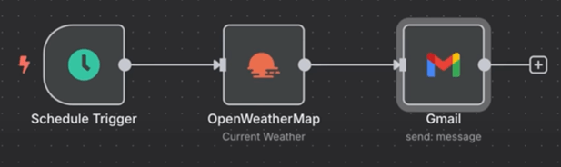
What isn’t AI?
Anything that follows a rule-based process
  For every input, you get the same output
Workflow that is triggered everyday, makes an API call and gets some data, analyzes it and gives you the results

Slide 9
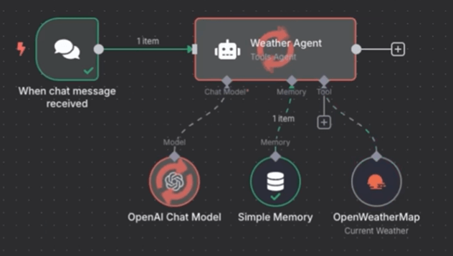
What is AI?
Any system which requires reasoning and/or planning and interprets response data
Prompt ‘Should I bring an umbrella to work today?’

Slide 10
What are Large Language Models?
The underlying ‘brain’ of AI
  Use billions / trillions of parameters which then are ‘weighted’
Analyze relationships between words / processes and predicting the next word / process in a sequence
  AI does not have ‘intelligence’, it predicts the output you want based on the prompt supplied
AI is non-deterministic

Slide 11
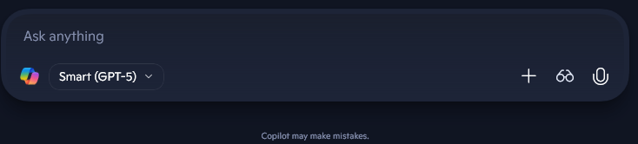


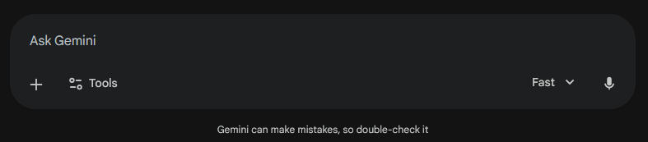
Why Hasn’t AI Taken Over ERP Yet?
Copilot
Claude
ChatGPT
Gemini

Slide 12
Why Hasn’t AI Taken Over ERP Yet?
Copilot
Claude
ChatGPT
Gemini

Slide 13
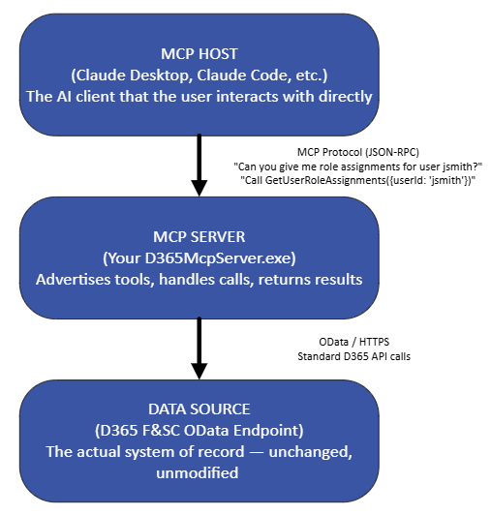
What is Model Context Protocol?
Standardized way for AI models to talk to external data sources
Not just about data, but also context
  What data do I need to answer this question?
Allows you to converse with AI without having to know the ‘technical under pinning's’

Slide 14
AI Best Practices
All output should be reviewed by a human
  Keep a ‘human in the loop’
The ‘AI Hammer’
  Not every problem should be solved using AI
    Data generation tasks (helping edit an email, creating a PPT) -> great for AI
    Posting to your GL -> not great for AI
  Don’t immediately jump to using AI if you don’t have to
  Most business cases need a repeatable process
    Automation workflows -> Use AI to help create the workflow, don’t let AI be the workflow

Slide 15
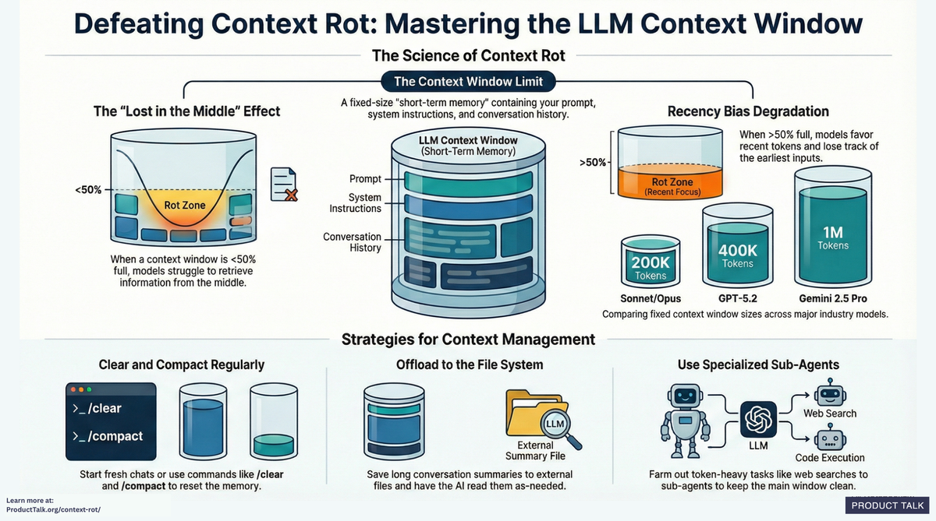
AI Best Practices
Avoid ‘context rot’
  Every time you interact with an AI the entire chat is sent back to the AI so it can keep a ‘context’ of the conversation
  The longer the individual chat is, the more of this ‘context window’ you are consuming
  Either clear or restart conversations regularly to avoid
Source: https://www.producttalk.org/context-rot/

Slide 16
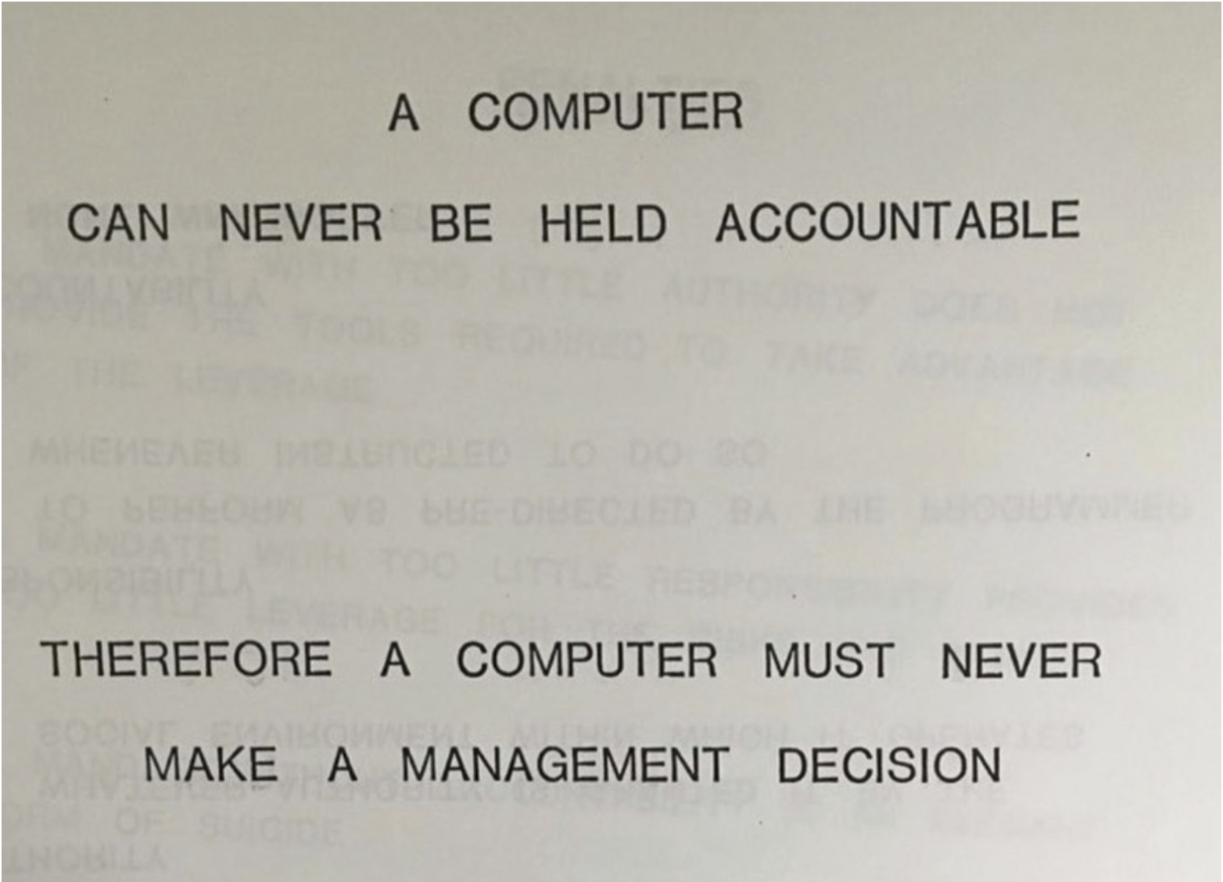
AI Best Practices
IBM Training Manual - 1979

Slide 17
Prompt Creation
Best Practices

Slide 18
How to Create a Prompt?
Anatomy of a good prompt
  Persona (tone for the AI response)
  Context (provide background information about the task or data you will be providing)
  Task (what do you want the AI to do?)
  Constraints (are there guardrails or edge cases that need to be accounted for?)
  Output format (how should this data be returned?)

Slide 19
How to Create a Prompt?
Prompt #1: Analyze the attached data to look for optimizations
Prompt #2: I am trying to analyze the attached data from Microsoft Dynamics 365 for Finance & Supply Chain, the attached Excel file contains the following data… I would like to look for the following scenarios… Please output the format in an Excel, if you need any additional information or have questions about the data, please ask before analyzing the data

Slide 20
How to Create a Prompt?
If you are supplying data, explain what that data means
In the Excel file I am attaching, there are two tabs. The first tab is named ‘tab A’ and it has the following columns:
  UserId (is a string value of the id of the user)
  Enabled (is an enum value that corresponds to whether the user is enabled or not, the available options include: yes or no. Only consider enabled users in your analysis)
  RecId (is a big int that is a unique identifier for a particular record)
Tab B has the following columns:
  User (is a string value of the id of the user, maps to UserId column in tab A)
  VendorId (is a big int that is the ID of the vendor, maps to RecId in tab A)

Slide 21
How to Create a Prompt?
Take an iterative approach
  Break down complex tasks into smaller segments
    This allows for you to validate each step before moving on to the next
    Allows for correcting AI if it starts to go off course
Provide examples of output if possible
  I’m looking for optimization scenarios like: xyz
Ask the AI
  What additional information do you need from the following prompt to be able to supply the best output?’
  How could I improve future prompts like this?

Slide 22
Data Analysis Scenario

Slide 23
AI Data Analysis Example
1) Identify the problem / issue you would like the AI to help with
  I wanted to validate if AI could help analyze D365FSC data
  Wanted to generate a prompt to find optimization scenarios to help with administration and user management processes
  Specifically, I wanted to look at:
    Looking for users who had not logged in and could be disabled
    Cleaning up / optimizing user role assignments
    Optimizing user / role license assignments
2) Sourcing the data
  Defined three separate ways to source this data
    Manual export
    Programmatically via OData endpoint
    Creating an MCP server to act as a ‘middleman’

Slide 24
Choosing Data Sources
Need to provide the data it will need to perform the analysis
  Determine Where Form Data is Stored in D365FSC
For this use case my data sources will be the following D365 data entities
  User Information (SystemUser)
  System Security Role (SecurityRole)
  Security User Role Association (SecurityUserRole)
I also added in some telemetry data from Application Insights specifically to get the user last login date

Slide 25
Manual Data Extraction

Slide 26
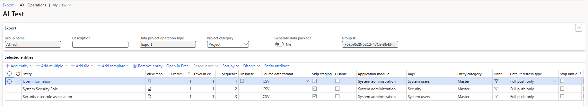
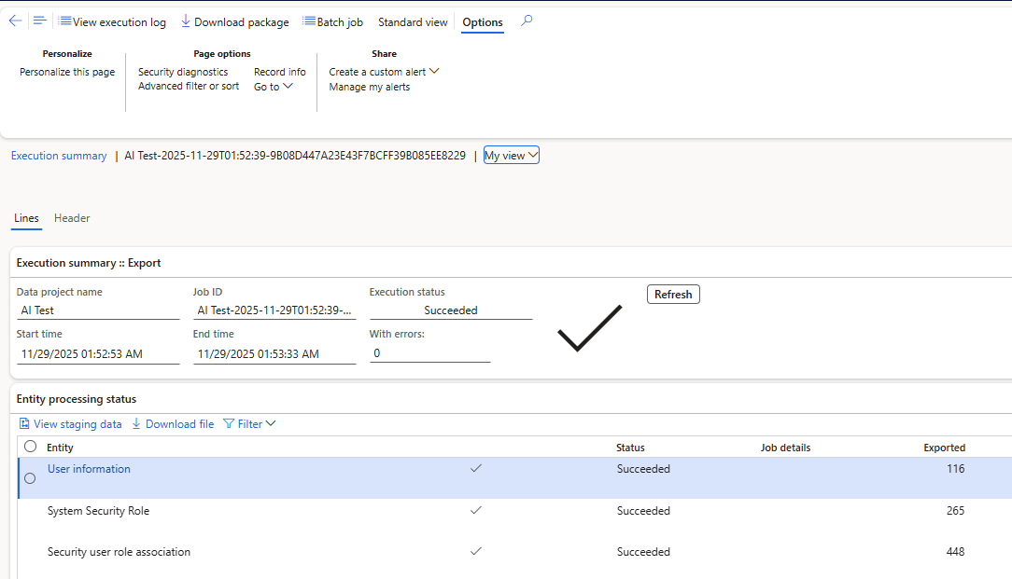
D365FSC Data Management

Slide 27
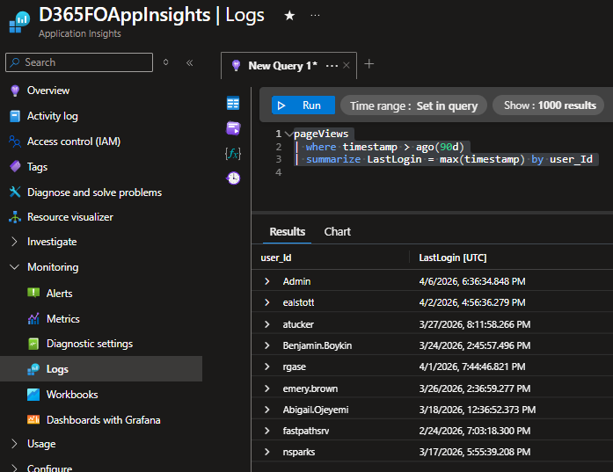
App Insights

Slide 28
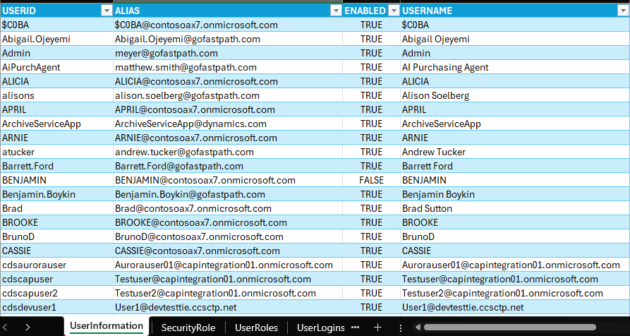
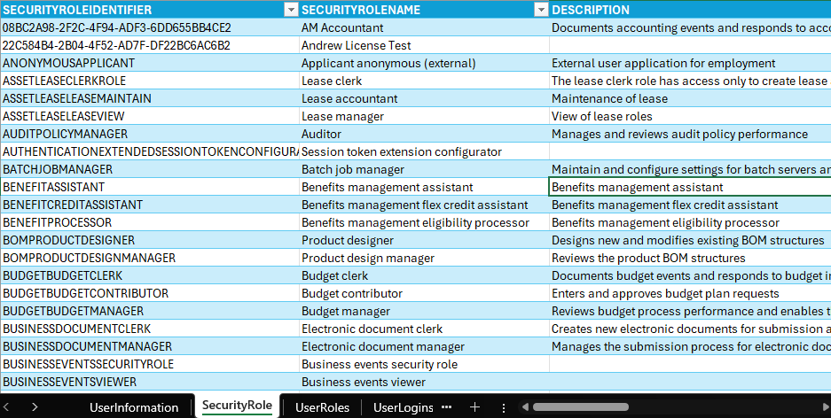
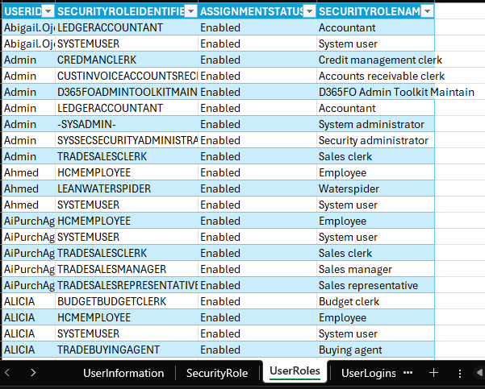
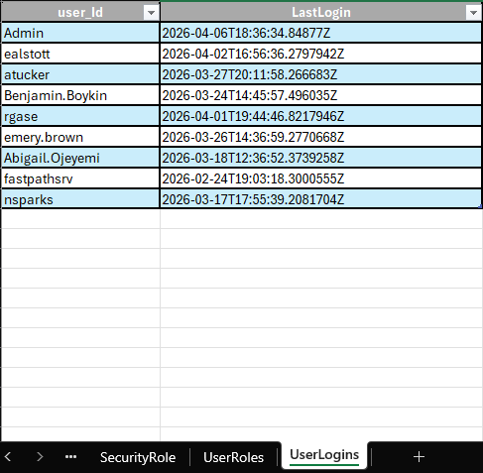
Combining the Data

Slide 29
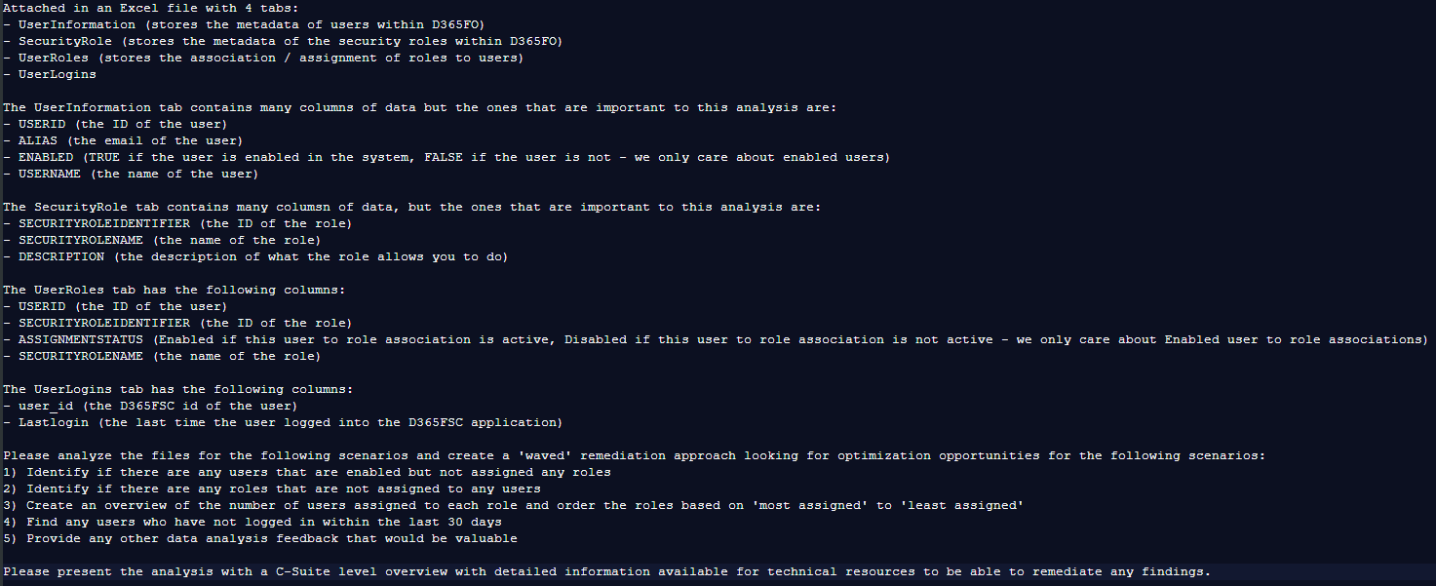
Generating the Prompt

Slide 30
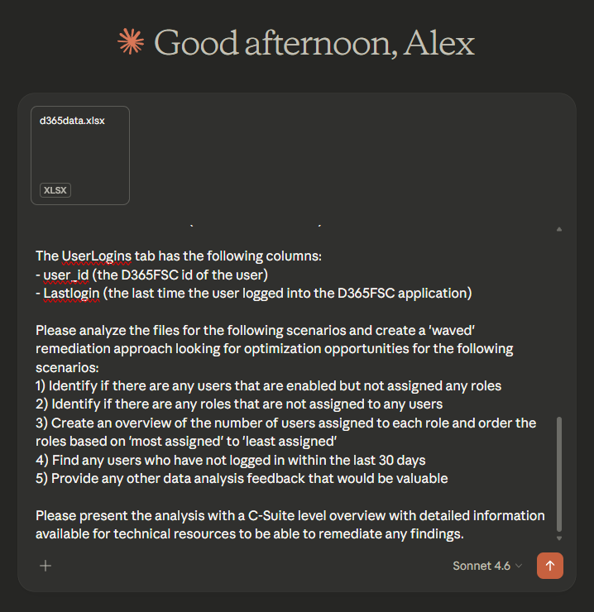
Let’s Get Analyzing…

Slide 31
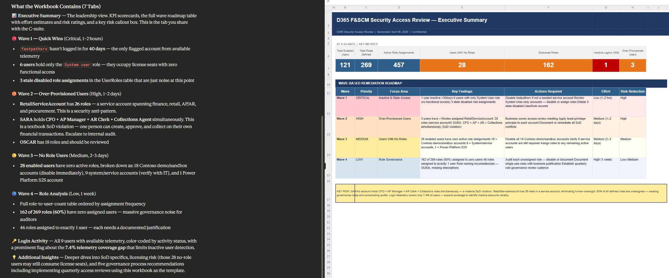
Results

Slide 32
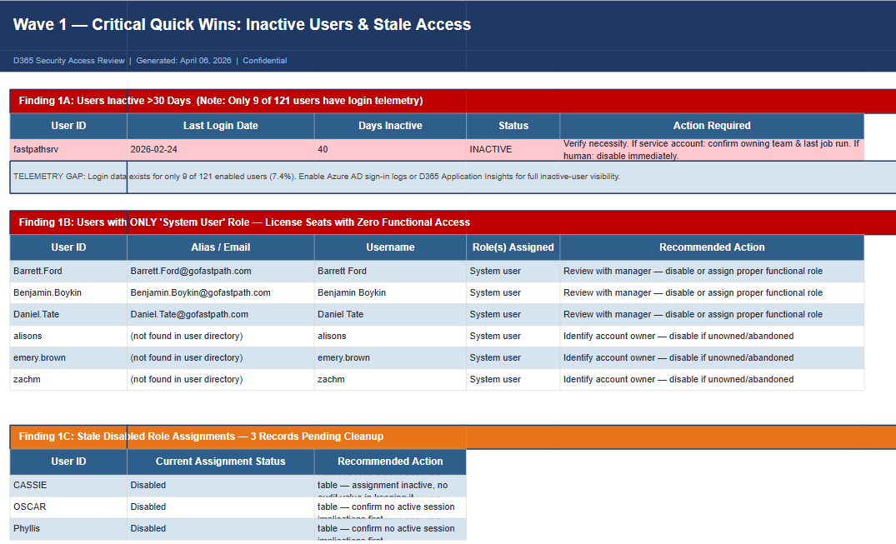
Results

Slide 33
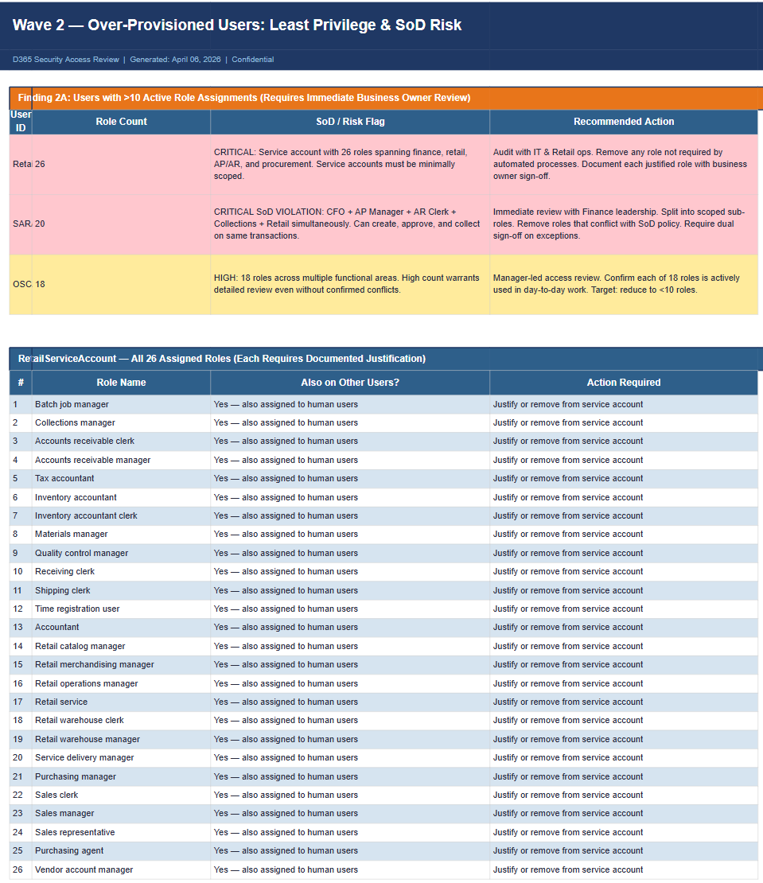
Results

Slide 34
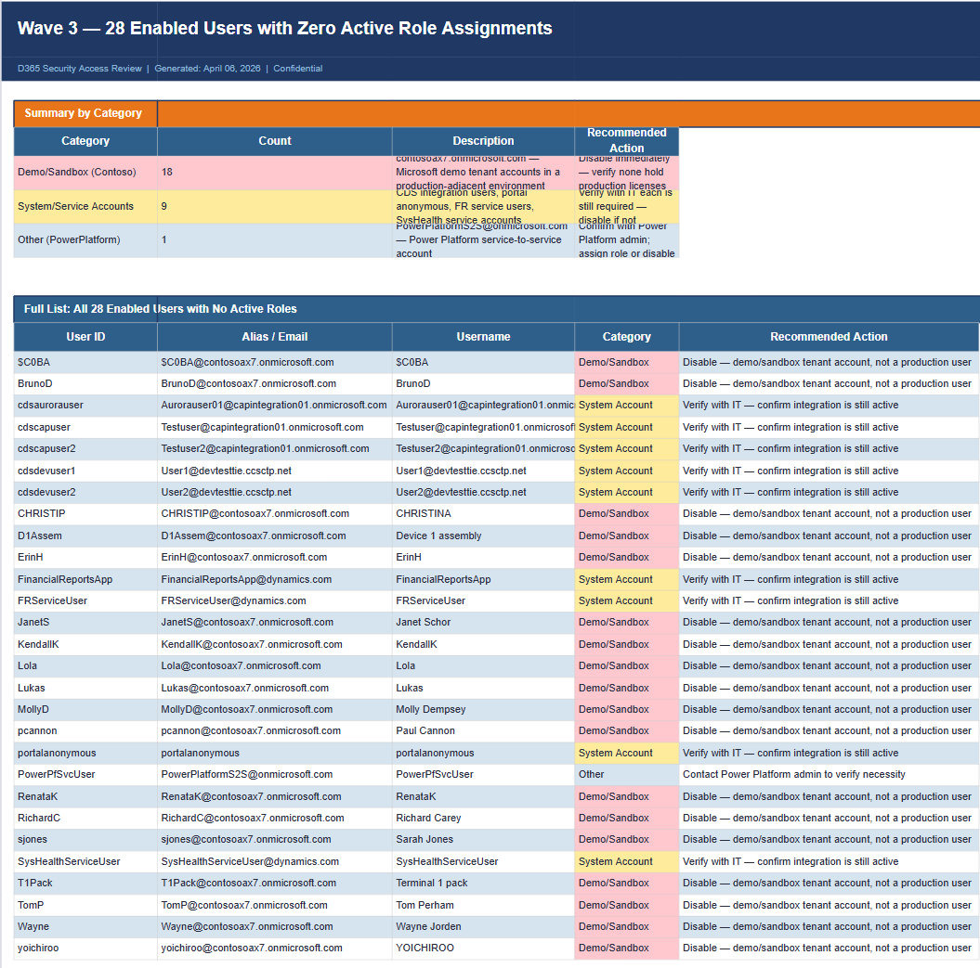
Results

Slide 35
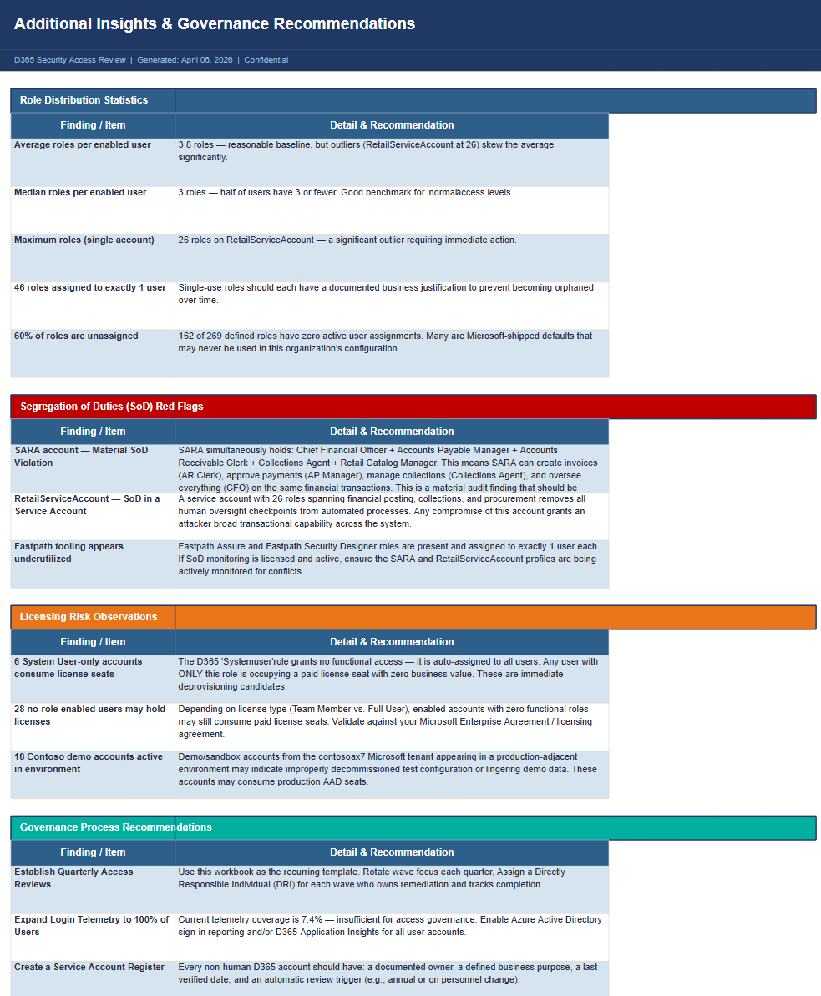
Results

Slide 36
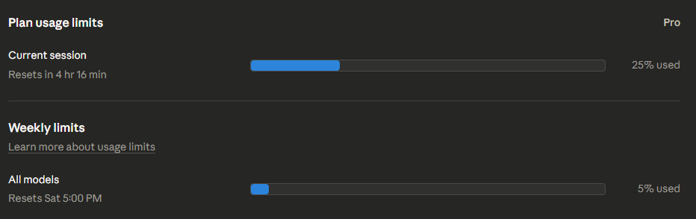
Key Considerations
No additional cost above normal subscription
Need to keep in mind ‘usage limits’
  Ran this against my personal ‘Pro’ plan in Claude

Slide 37
Automating Data Analysis via API

Slide 38
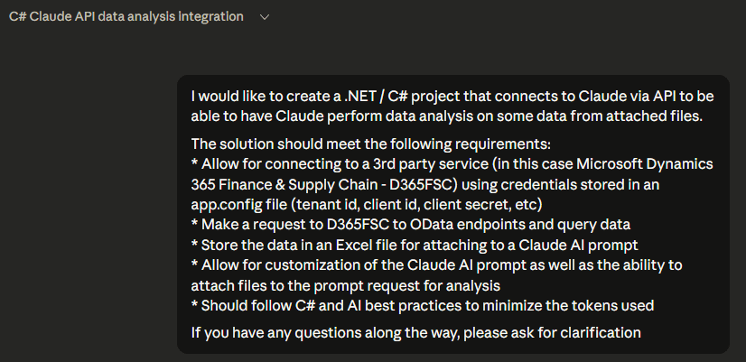
API Connection Setup
Wanted to automate the same data analysis process
Prerequisites
  Azure Application Registration for connecting to D365 / Application Insights
  AI API key – AI API usage is billed separately from your subscription
Needed to create a solution to execute API requests both to D365 / App Insights as well as the AI itself

Slide 39
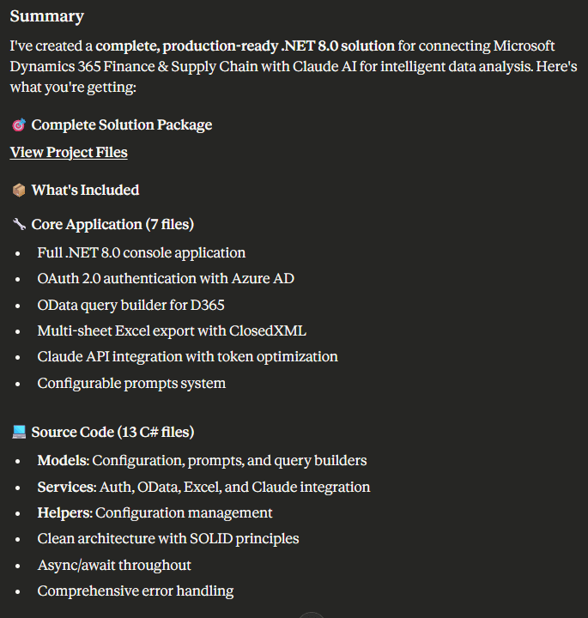
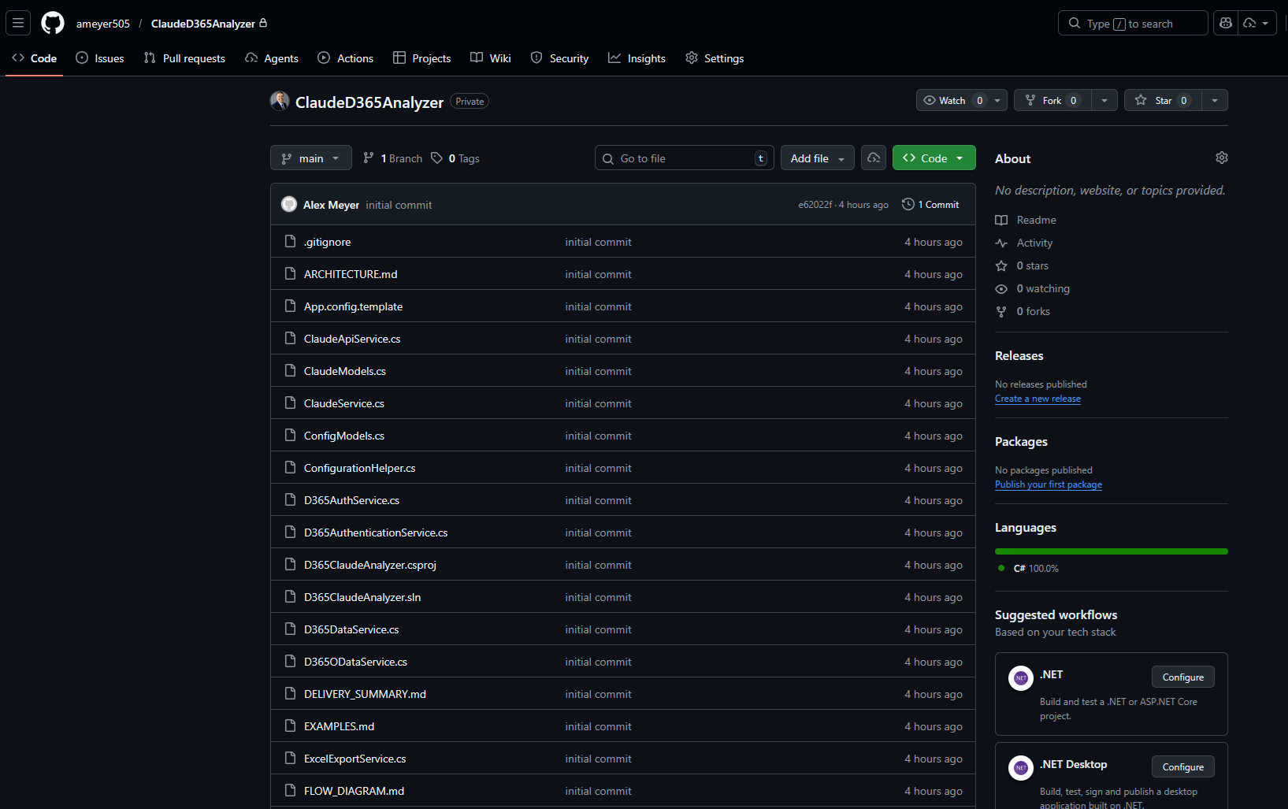
D365ClaudeAnalyzer
GitHub Link: ClaudeD365Analyzer

Slide 40
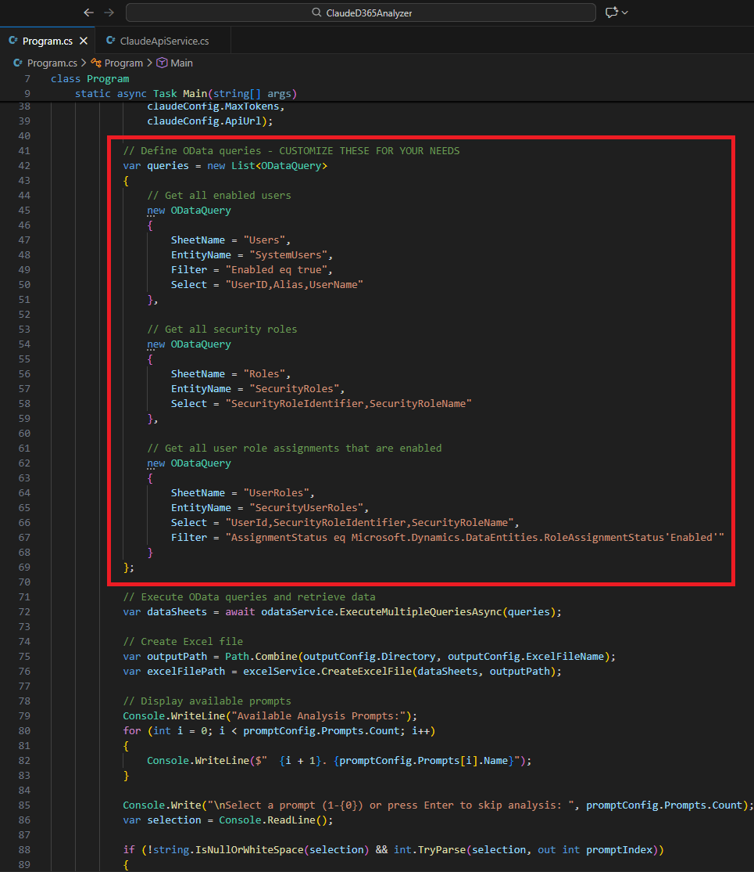
D365ClaudeAnalyzer
Configuring the OData queries

Slide 41
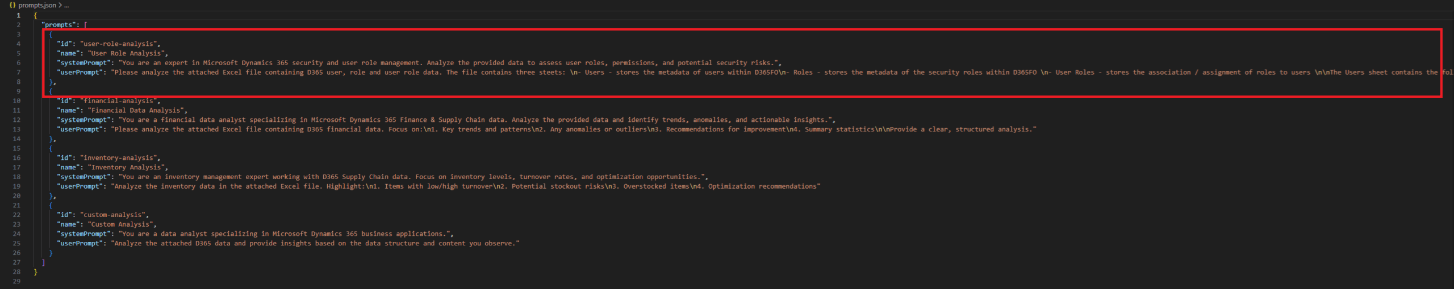
D365ClaudeAnalyzer
Configuring the prompts

Slide 42
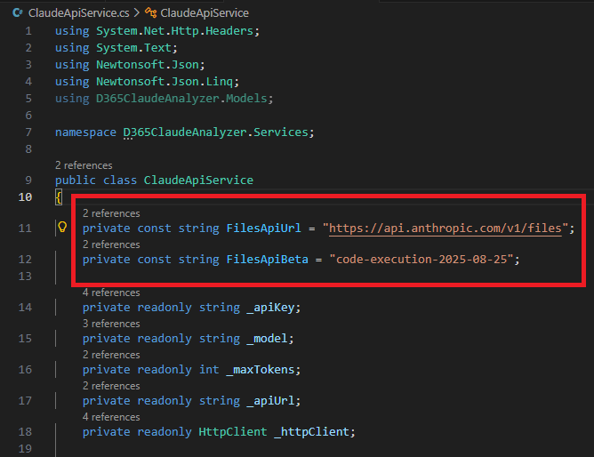
D365ClaudeAnalyzer
Some Claude specific setup
  Had to add the ability to upload files to Claude for it to analyze
  Required the ‘code-execution’ skill / endpoint

Slide 43
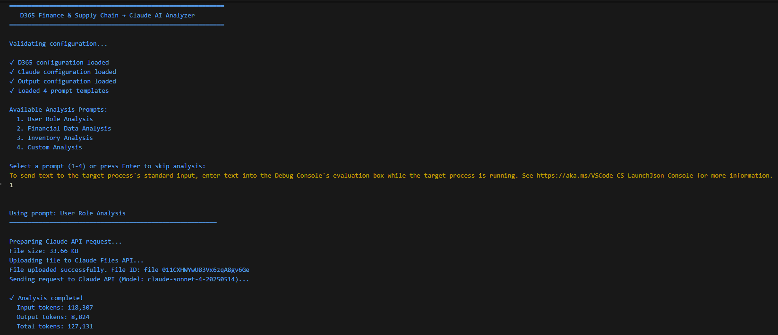
Analyzing Data

Slide 44
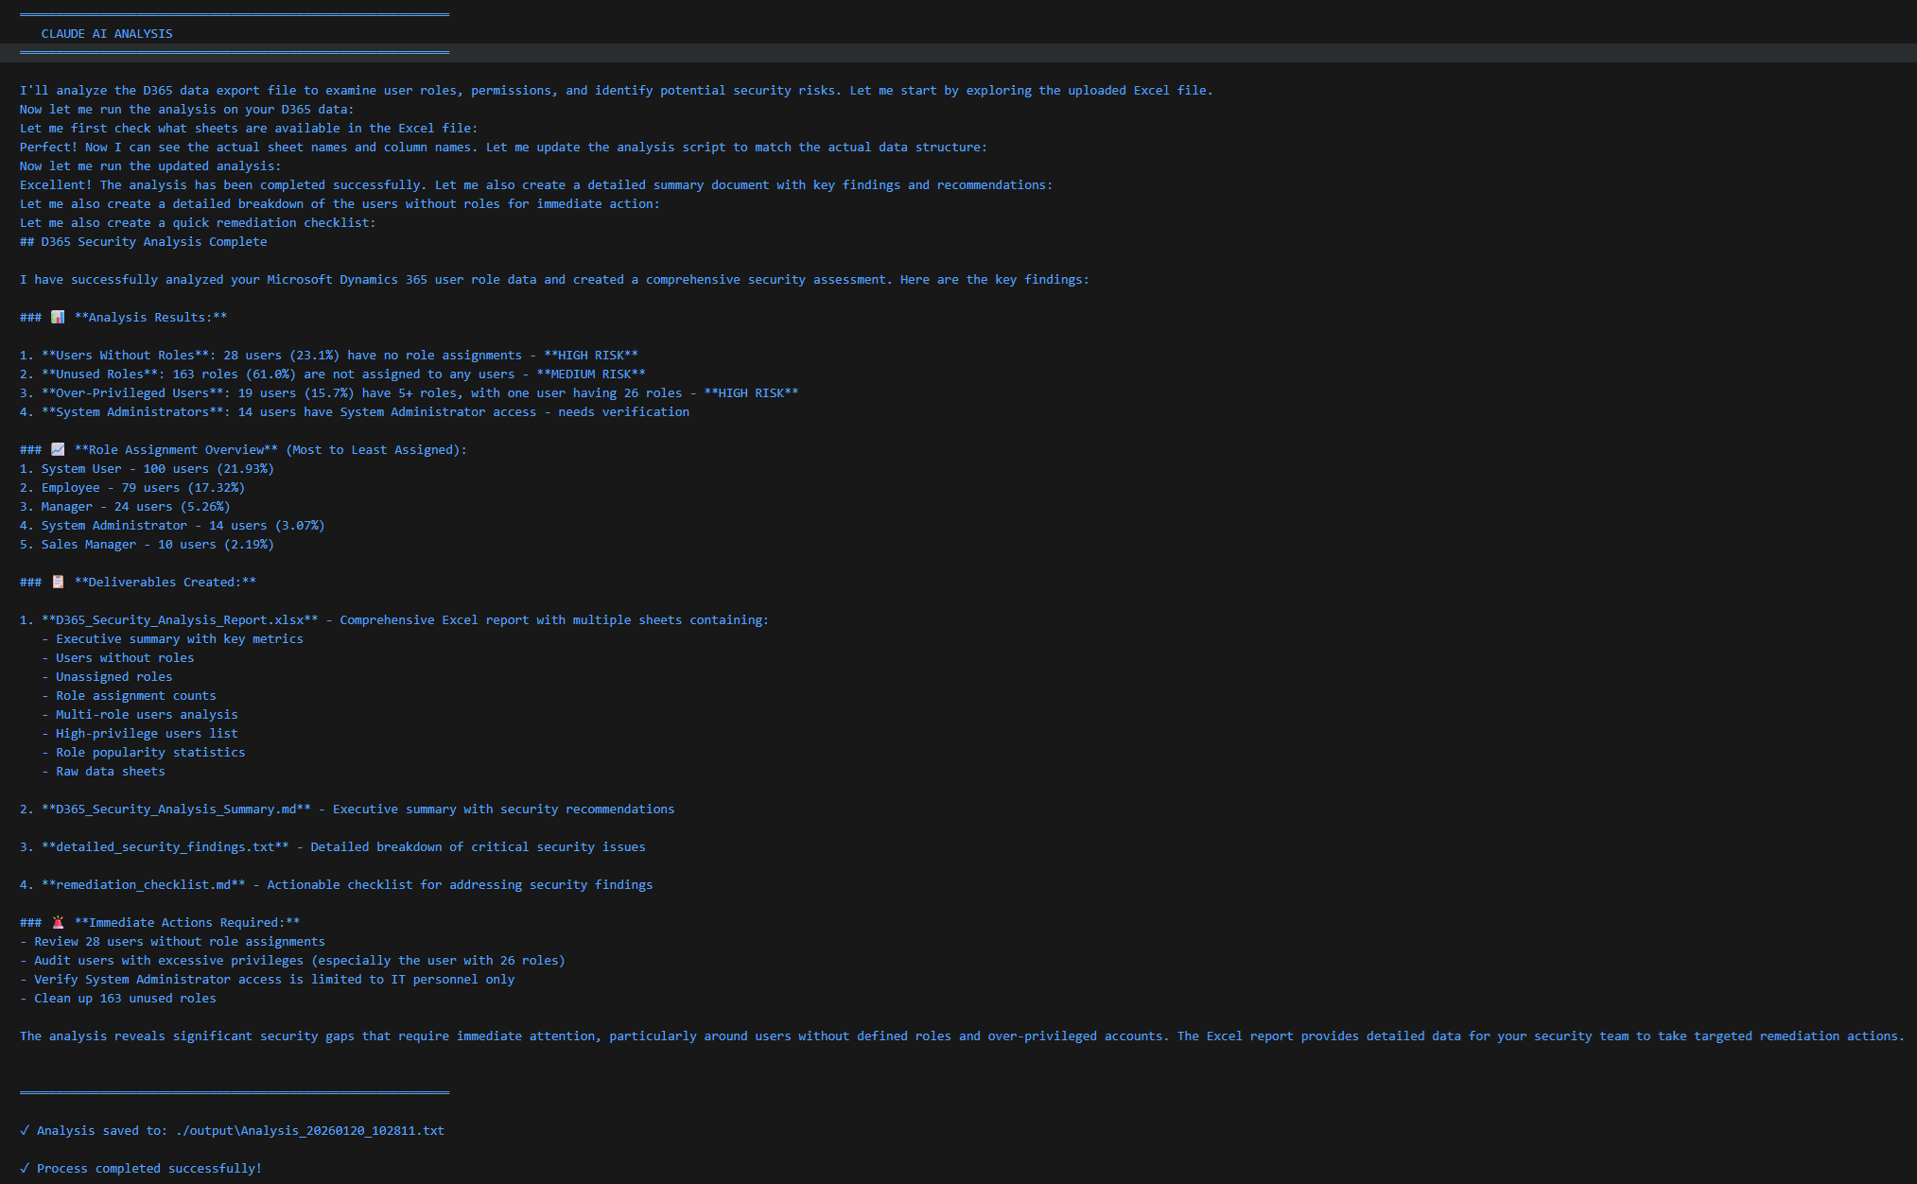
Results

Slide 45
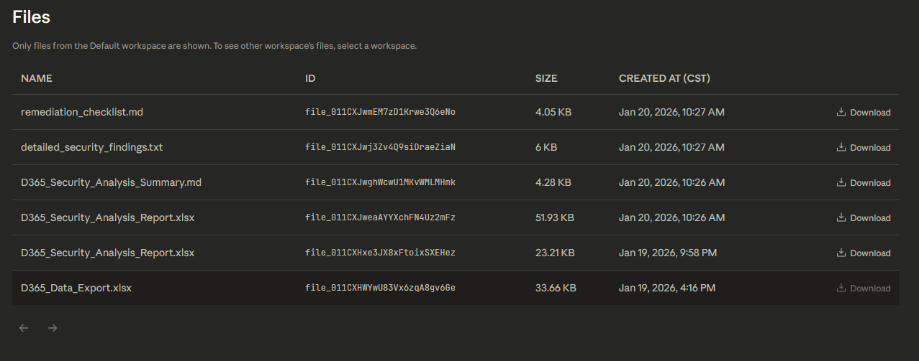
Results

Slide 46
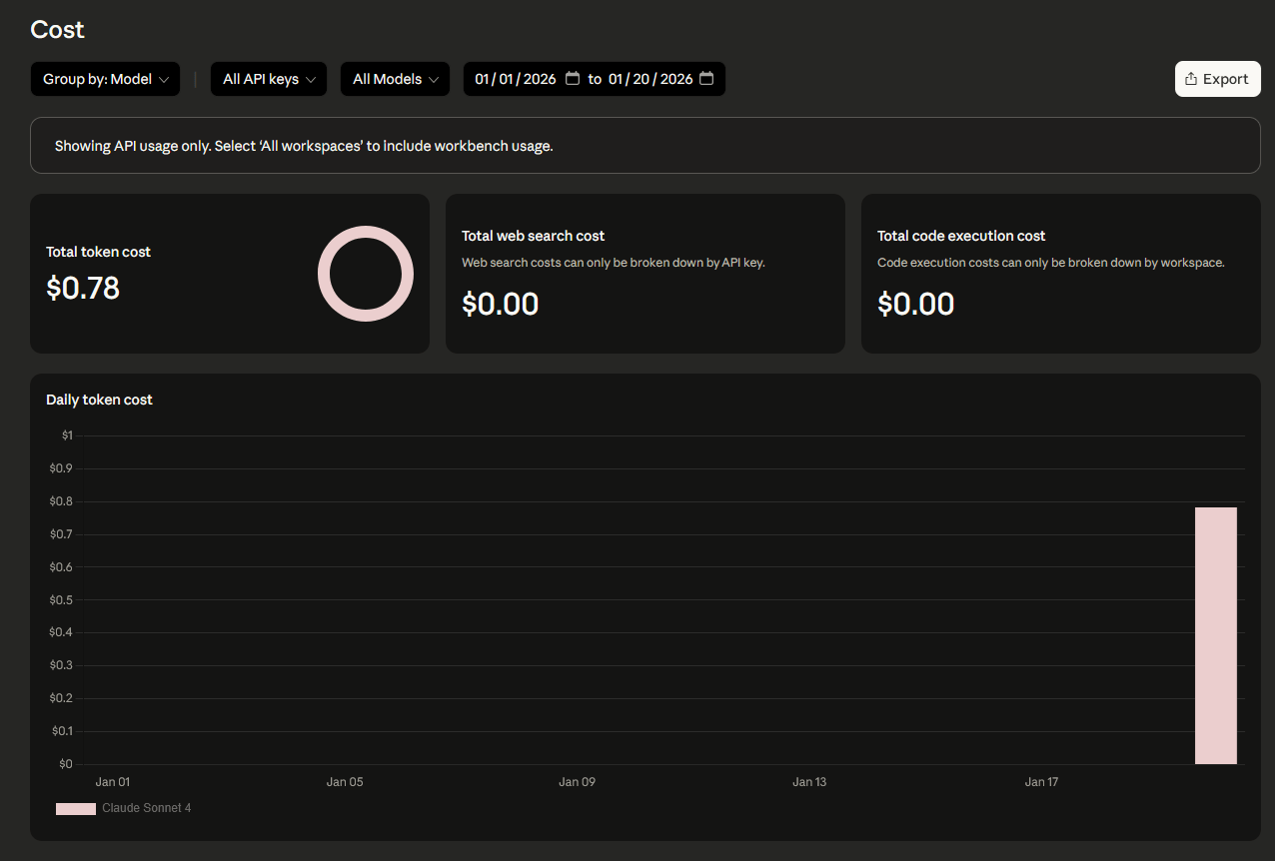
Cost Considerations
Because we are using the AI API to analyze this data, each interaction has a cost associated
In our case, each analysis was approximately $0.75 - $1.50 depending on the size of the data involved
  You pay for both input and output tokens

Slide 47
Automating Data Analysis via MCP

Slide 48
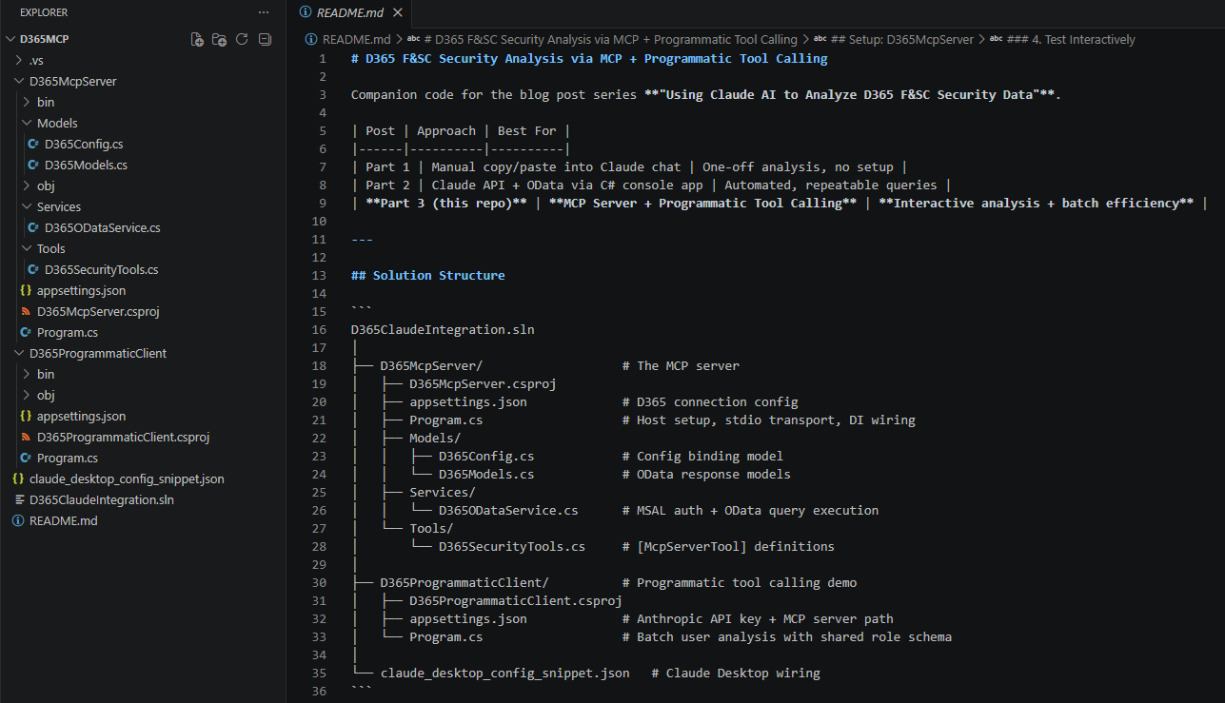
Creating the MCP Server
Asked Claude to create MCP server for D365FSC
Created a solution that allows for MCP tool customization

Slide 49
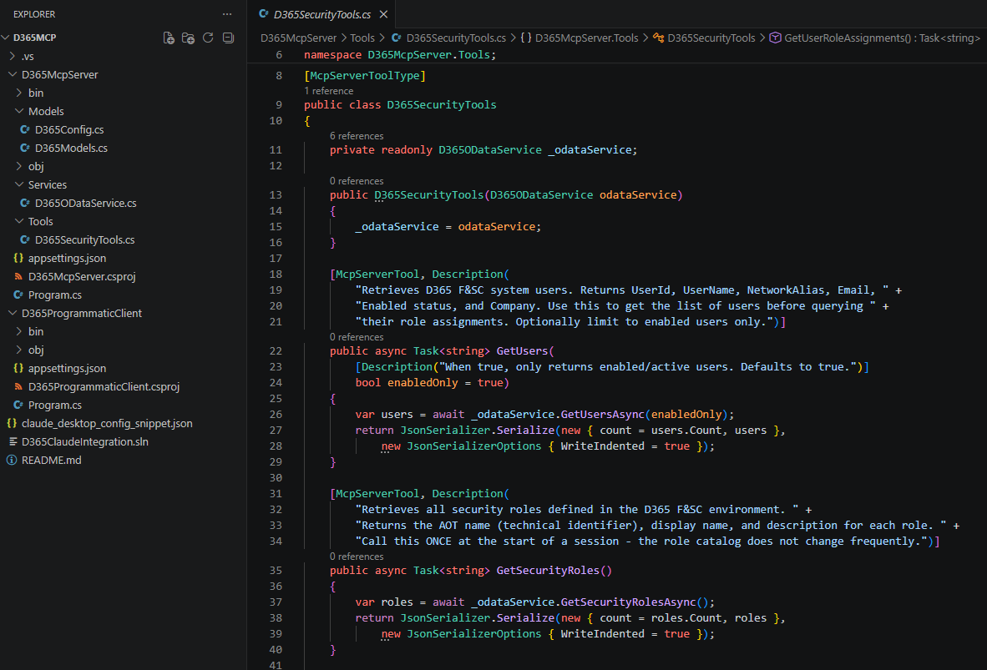
MCP Tool Creation

Slide 50
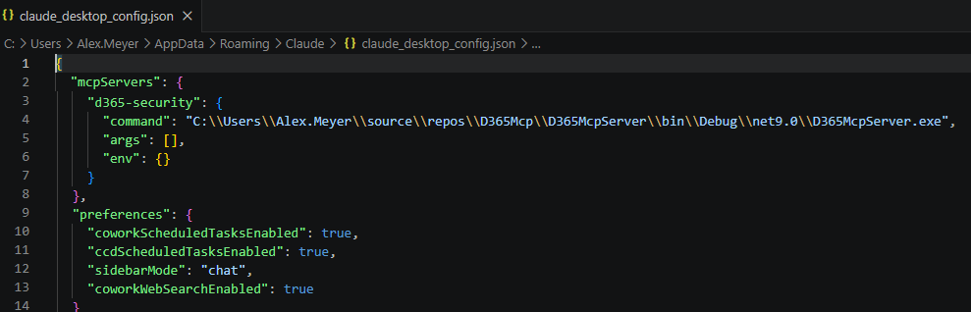
Add MCP Server to Claude Desktop
Update Claude Desktop config to add MCP server

Slide 51
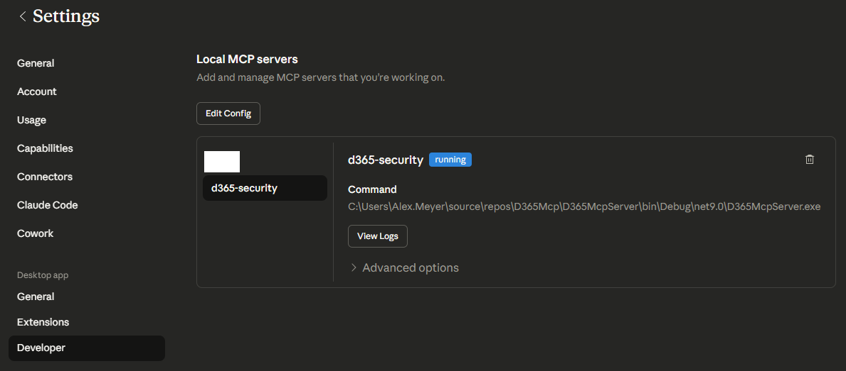
Claude Desktop MCPs

Slide 52
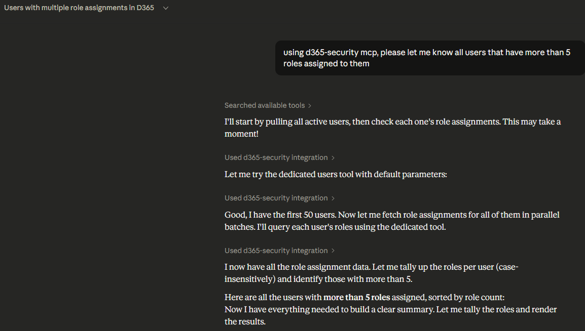
Using the MCP Tool

Slide 53
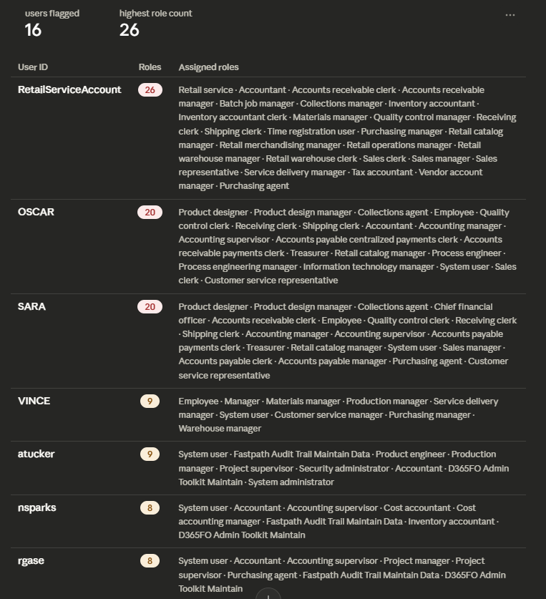
Using the MCP Tool

Slide 54
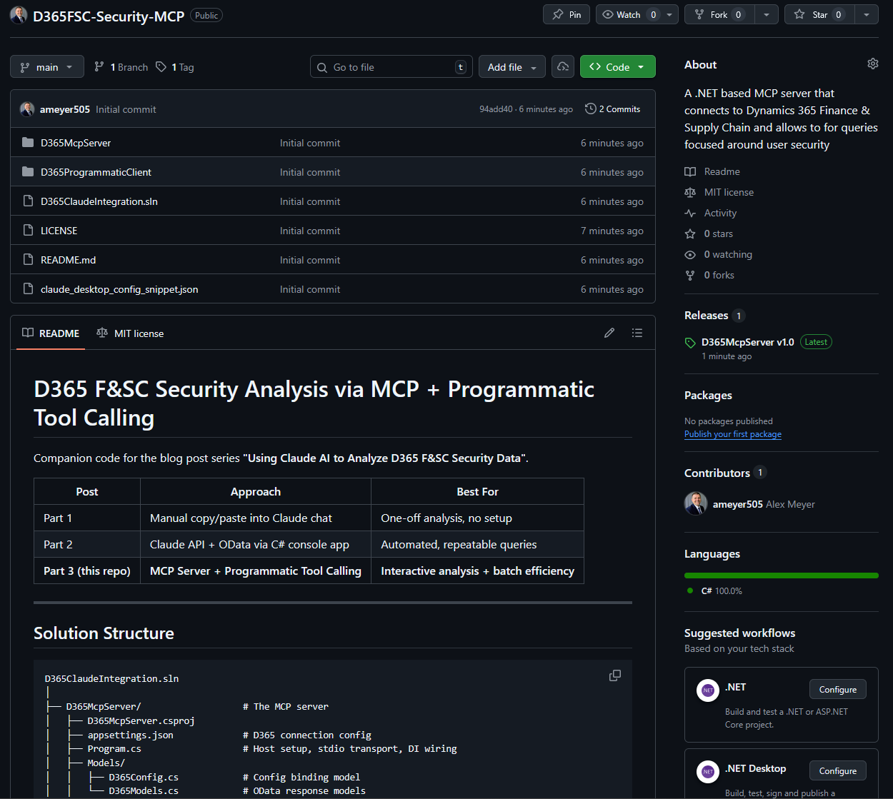
D365FSC-Security-MCP
GitHub link: https://github.com/ameyer505/D365FSC-Security-MCP

Slide 55
Side-By-Side Comparison
 | Manual Data Gathering | Direct API | MCP Server
Setup Effort | None | Medium | Medium
Data Freshness | Snapshot | Real-Time | Real-Time
Interactivity | None | None | High
Repeatability | None | High | Medium
Flexibility | Low | Low | High
Best For | One-Off Exploration | Scheduled Pipelines | Interactive Analysis

Slide 56
Other Scenarios

Slide 57
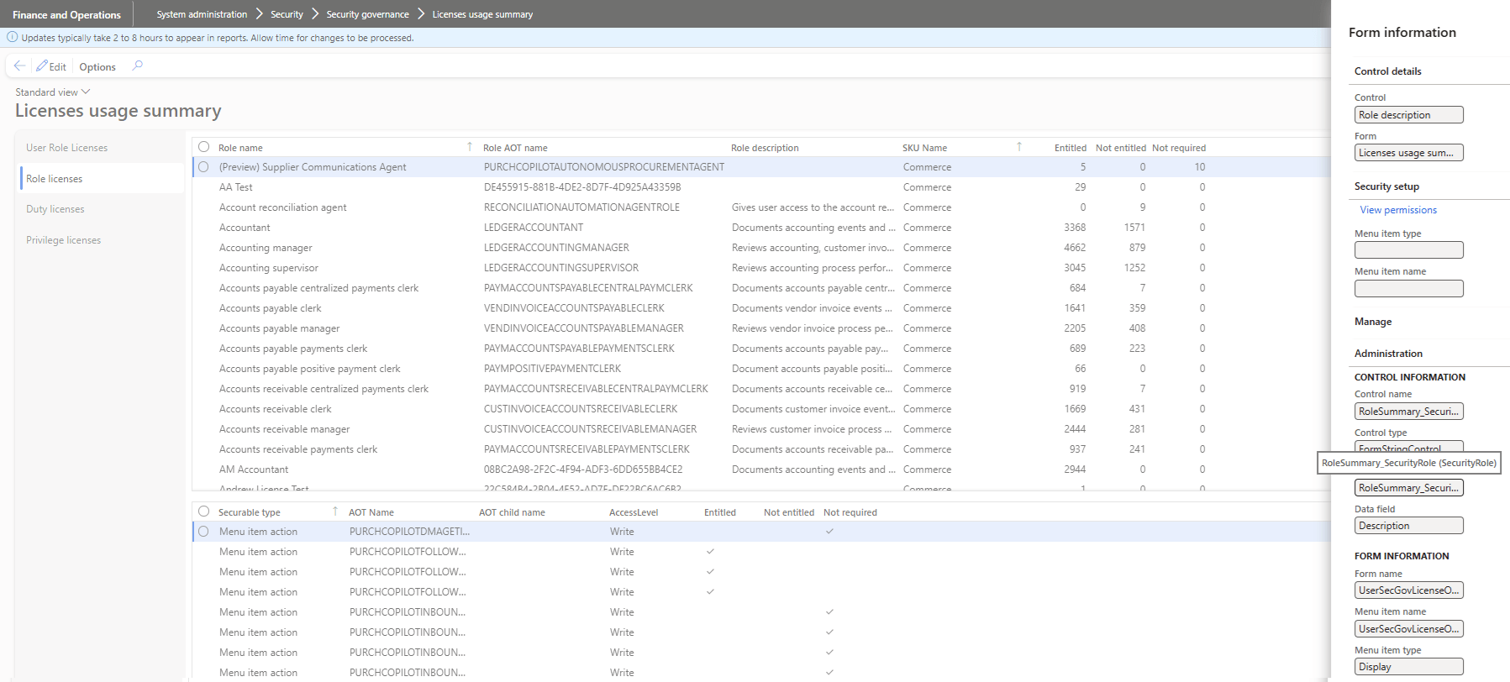
D365FSC License Optimization
Used the License Usage Summary report data

Slide 58
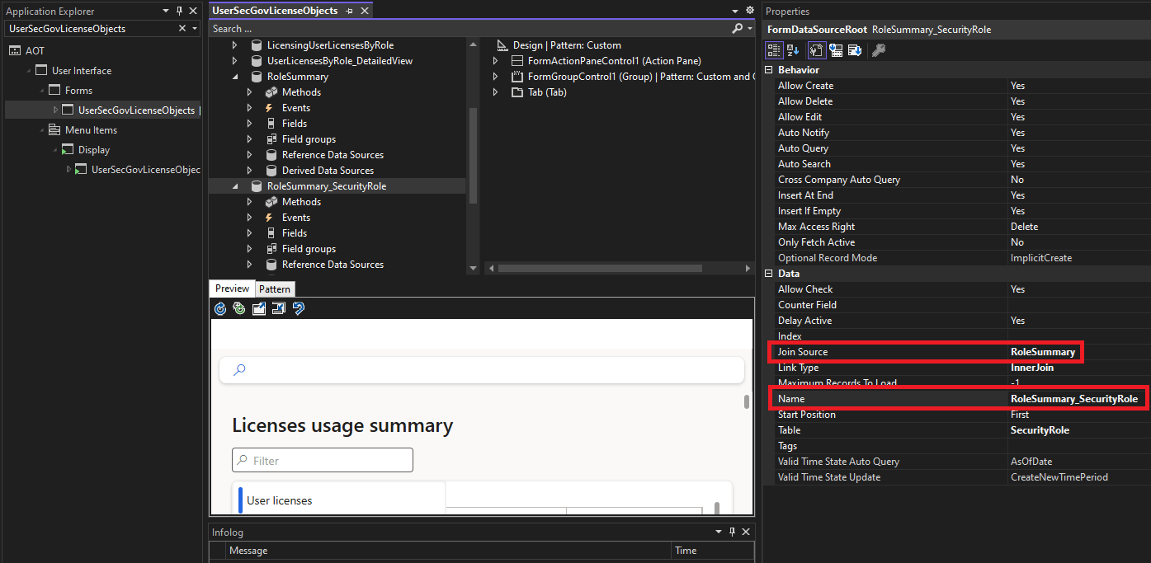
D365FSC License Optimization
Found the form data source in Application Explorer

Slide 59
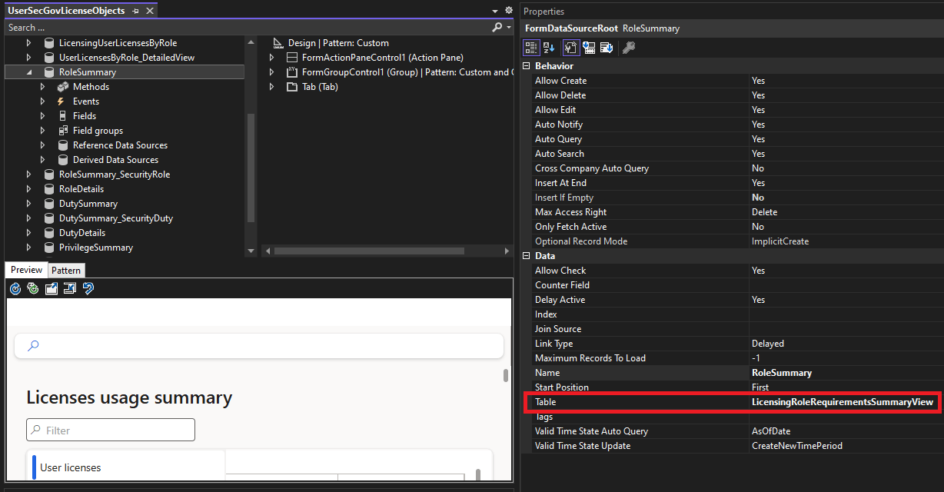
D365FSC License Optimization

Slide 60
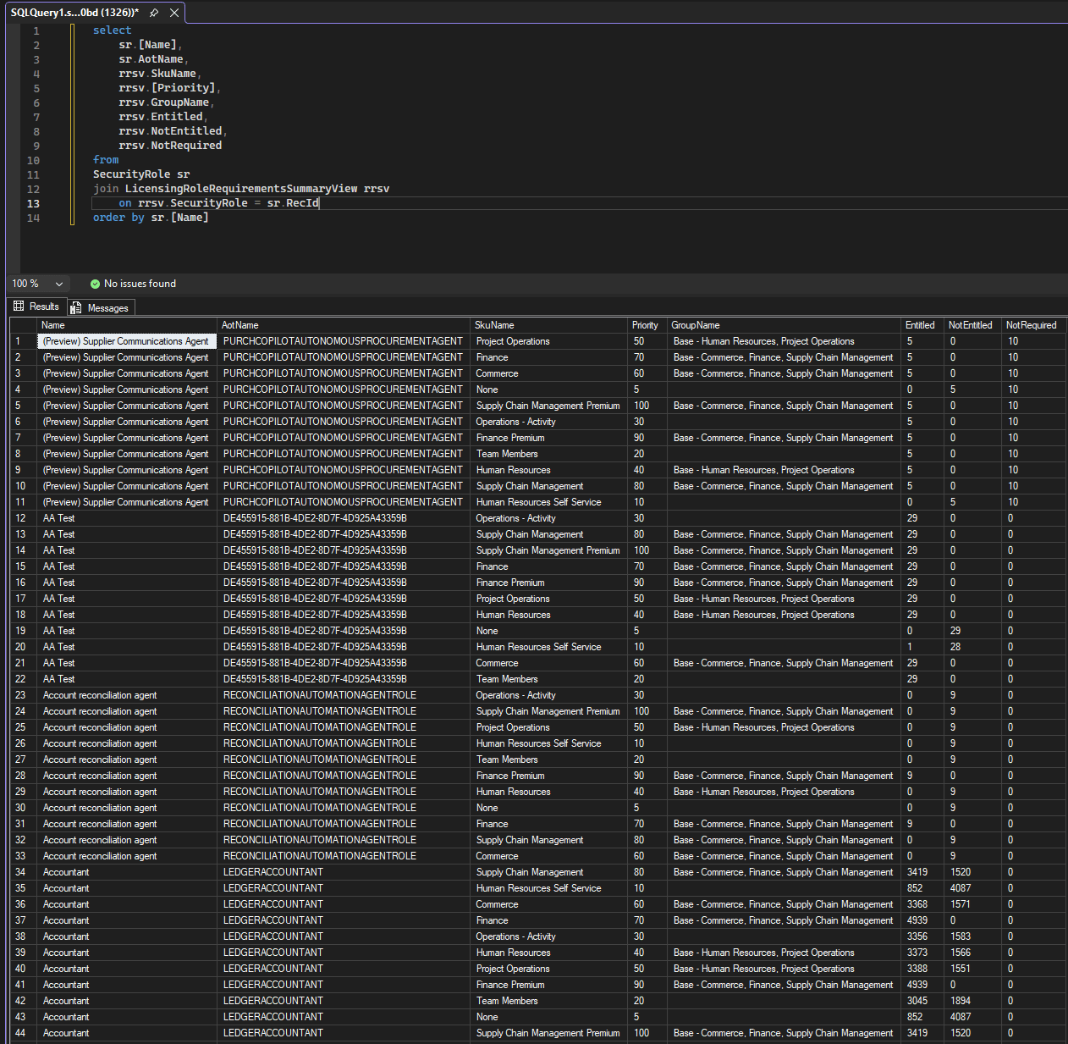
D365FSC License Optimization

Slide 61
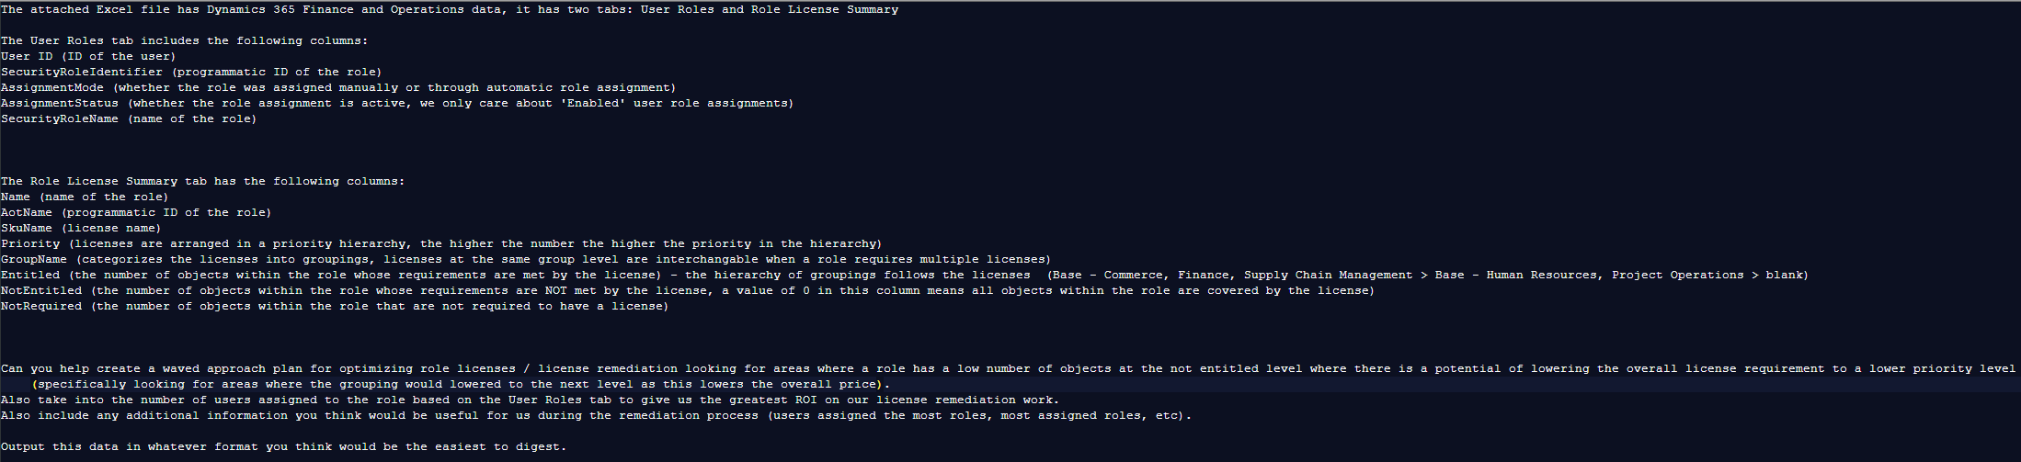
D365FSC License Optimization

Slide 62
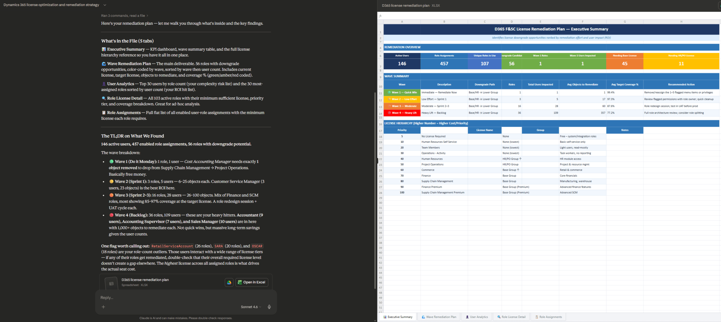
D365FSC License Optimization

Slide 63
D365FSC License Optimization

Slide 64
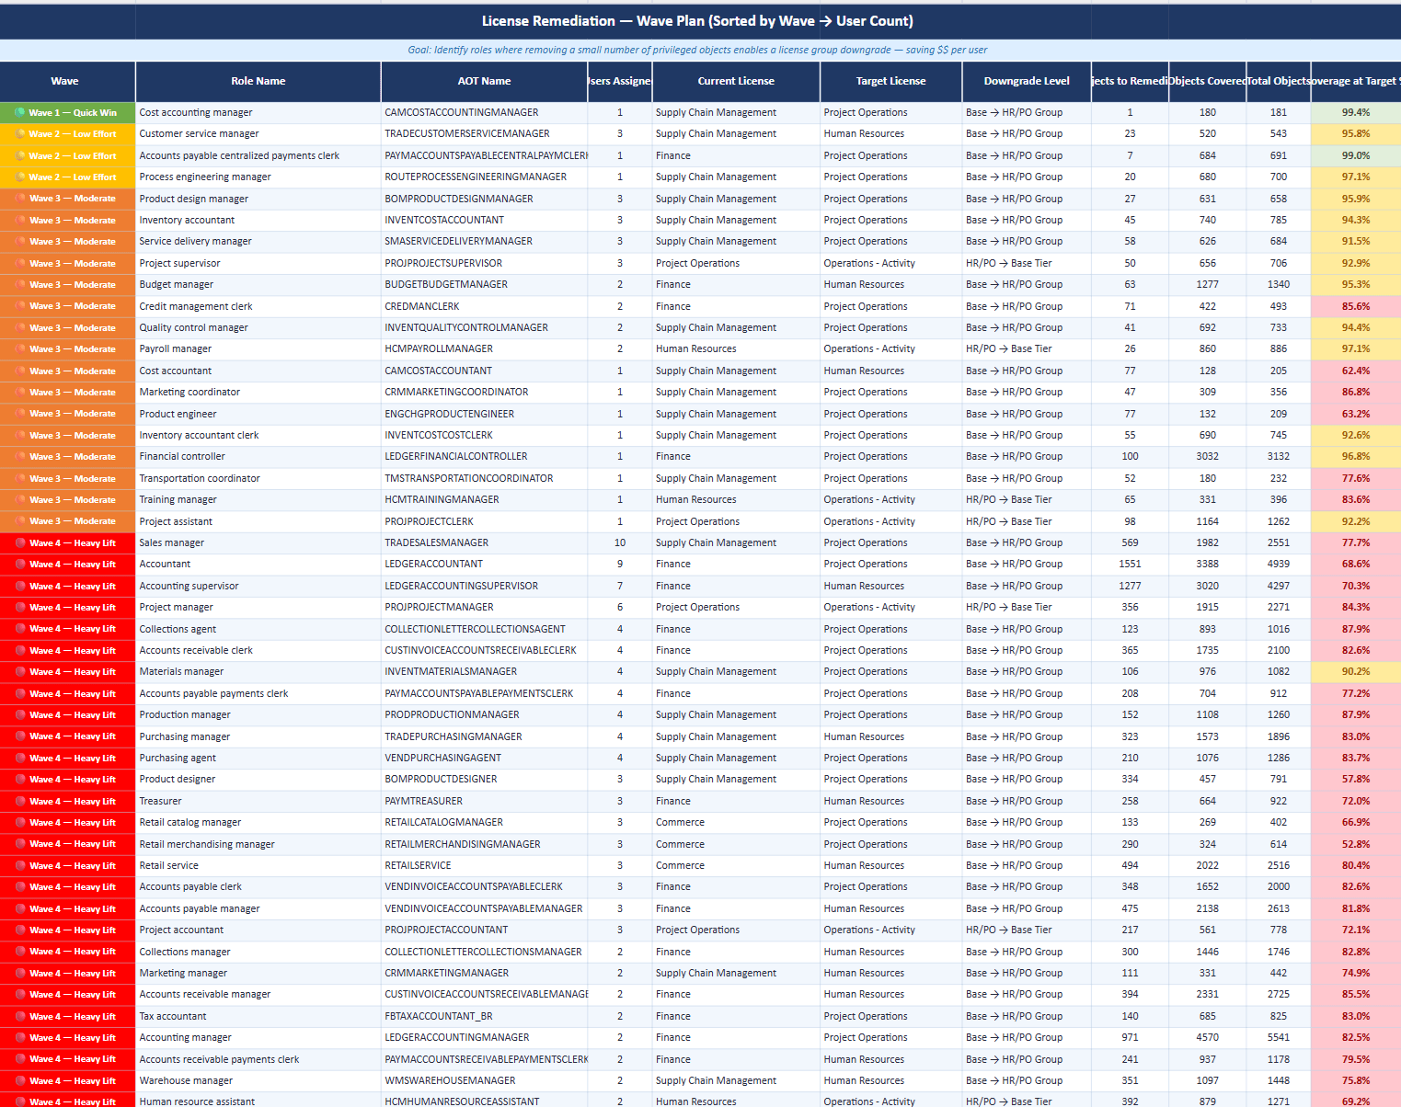
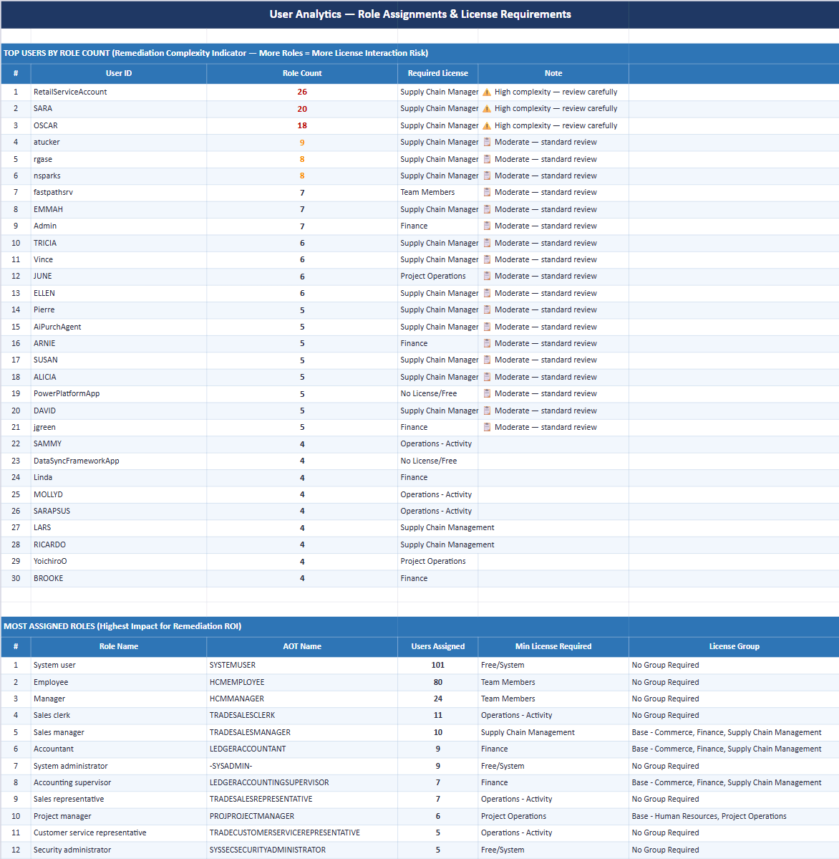
D365FSC License Optimization

Slide 65
Key Takeaways

Slide 66
Takeaways
ALWAYS VERIFY RESULTS – Keep a human in the loop
AI isn’t magic – but it is extremely good at pattern matching (eg: pattern analysis)
Don’t get caught by the ‘AI hammer’
  If a workflow or automation fits better – use AI to help create it
You are not locked into Copilot to be your AI if you are using D365
Vague prompts = vague answers
  Explain the data before asking an AI to analyze it
You don’t need to be a computer / AI expert to use AI to help find optimizations
  Start small, validate process, then get more complex
The best time to clean up your D365 data was during go-live, the next best time is today

Slide 67
Resources
Using AI to Analyze D365FSC Data
Automating AI Data Analysis in D365FSC
Context Rot: Why AI Gets Worse the Longer you Chat
AI Context Windows: Why Bigger Isn’t Always Better
Prompt Best Practices:
Best practices for prompt engineering with the OpenAI API
Getting started with prompts for text-based Generative AI tools
Effective Prompts for AI: The Essentials

Slide 68
Questions?
Email: alex.meyer@delinea.com
Blog: http://d365fscblog.com
GitHub: https://github.com/ameyer505
Twitter: https://twitter.com/alexmeyer_ITGuy
D365FO Security Course: http://d365fosecurity.com
PowerPoint available at: https://alexdmeyer.com/resources/downloads/

Slide 69






Other Fastpath Events at DynamicsCon
Booth: Fastpath - 313
Event Title | Speaker | Date / Time | Location
Demo Station – D365FSC Licensing w / AI | Alex Meyer | Wed 11:30 AM – 12:00 PM | Demo Station Kiosk
Donut Station |  | Wed 2:00 PM – 4:00 PM | Fastpath Booth
Demo Station – Fastpath Solution | Alex Meyer | Wed 4:15 PM – 5:15 PM | Demo Station Kiosk
AI Detective: Uncovering Hidden Optimization Goldmines in Your D365FSC Data | Alex Meyer | Thurs 9:00 AM – 10:00 AM | Capri 6
Securing Your MCP Server – Don’t Forget it When Securing AI Agents | Frank Vukovits | Thurs 1:30 PM – 2:30 PM | Capri 8
Fastpath Partner Showcase | Fastpath | Thurs 11:45 AM – 12:15 PM | Capri 1
The MVP War Room : Saving a D365FO Process Live | Alex Meyer | Thurs 4:00 PM – 5:00 PM | Capri 6
D365BC Security Tips & Tricks | Nick Sparks | Fri 9:00 AM – 10:00 AM | Lazuli 6
D365 Licensing Therapy: Group Session for Confused Admins | Alex Meyer | Fri 12:15 PM – 1:15 PM | Capri 6

Slide 70












NEON ASSETS

Slide 71








NEON ASSETS

