Slide 1
Securing AI Agents in Microsoft Dynamics
Yep, These Need to be Secure Too!

Slide 2

Frank Vukovits
Chief Security Scientist
Fastpath – now a part of Delinea
Email: frank.vukovits@delinea.com
Twitter: @fvukovits
LinkedIn
Background:
30+ years ERP, Audit, and Security Experience
Co-founder AXUG
Certified Internal Auditor (CIA)
Certified Information Systems Auditor (CISA)
Passed CISSP examination in 2002
Frequent speaker at user group, audit, and security events

Slide 3
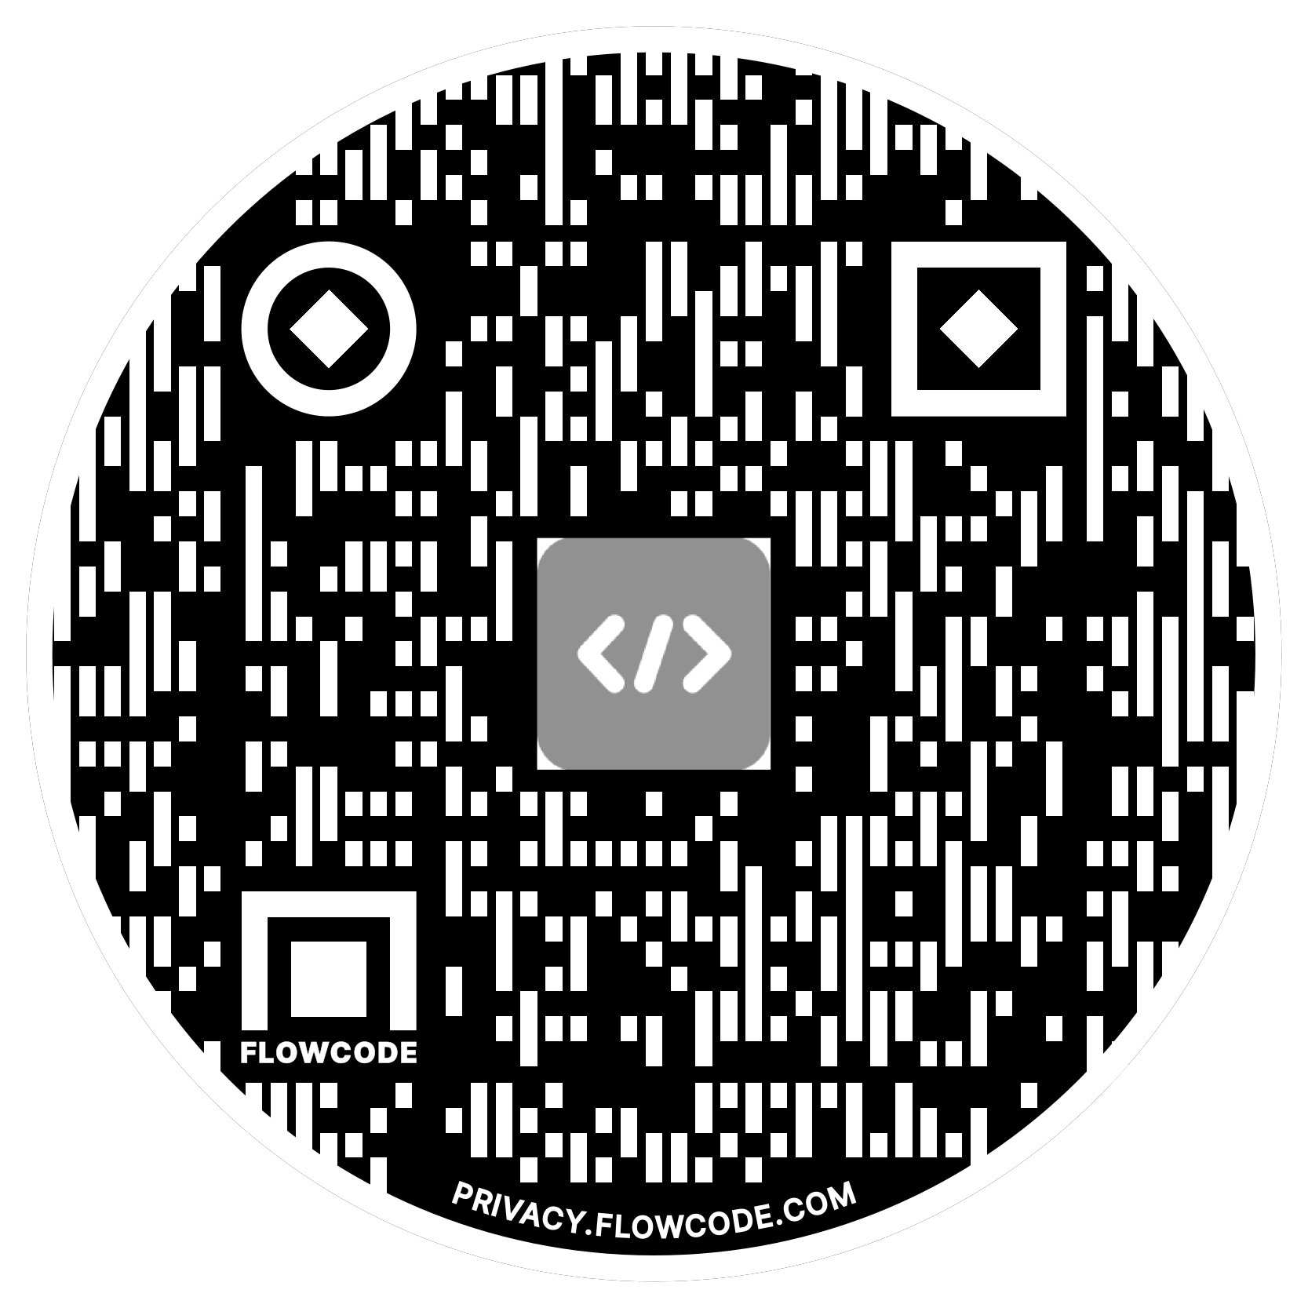

Alex Meyer
Principal Software Development Engineer
Delinea
Email: alex.meyer@delinea.com
Blog: http://d365foblog.com
Security Class: http://d365fosecurity.com
LinkedIn / Microsoft MVP Profile
Background:
Awarded Microsoft MVP in Business Applications since 2019
Been working with AX since 2013 and D365FO since 2016
Have spoken at Summit (US & Europe), Focus, and local chapters around AX/D365FO security and have done webinars around native controls in both versions

Slide 4
Agenda
Introduction
AI Agent Overview
Rise of AI in ERP
Why AI Agents Matter
Security Risks and Considerations
Treating AI Agents as Users
Controls and Governance
Tips, Tools, and Takeaways

Slide 5
AI Agent Overview

Slide 6
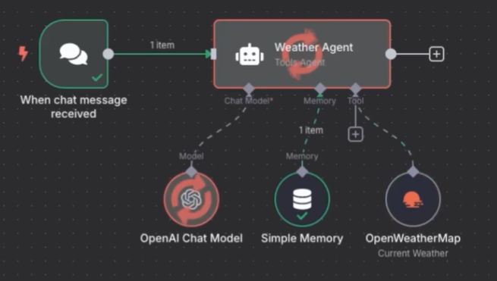
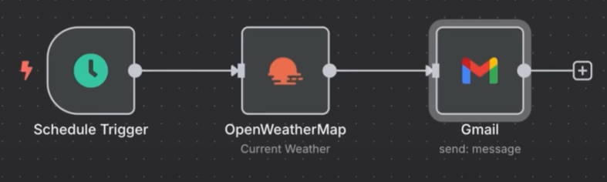
What Exactly is an AI Agent?
What is an AI Agent?
A system that can reason, plan, and take actions based on the information it’s given.
  ‘Digital employee’
What isn’t an AI Agent?
Anything that follows a static, rule-based process
  Steps are performed sequentially with no ‘reasoning’ along the way
  Eg: Automation, workflows

Slide 7
Components of an AI Agent
Brain (LLM)
  Handles the reasoning, planning, and language generation
Memory
  Gives the agent ability to remember past interactions / steps
Tools
  How the agent interacts with the outside world
  Types of tools:
    Retrieving data or context – searching web / scanning documents
    Taking action – sending an email, updating database
    Orchestration – calling other agents, triggering workflows

Slide 8
Rise of AI in ERP

Slide 9
AI Agents Are Next Wave of ERP
Mundane or Repetitive Tasks are Being Replaced by AI Agents
ERP Users will Have a 'Team' of Agents a Their Disposal
Agentic AI Agents Have no Human Involvement
  Can execute and complete tasks
  Work in concert with other AI agents, including those outside your domain
Currently Not Used in Mass
  Generative AI adoption still in it's infancy
  Agentic AI adoption is even less
AI Agents will Continue to be Added at Rapid Pace into ERP

Slide 10
History of AI in Microsoft Dynamics 365
Pre-2022: Foundational AI
2023: The Launch of Copilot
2024: Expanding Generative AI and Copilot Features
2022: Accelerating AI capabilities
2025 & Beyond: Continued AI Advancement (Agentic)
Early integrations: AI has been an embedded component of the Microsoft ecosystem for years. Prior to Nuance, this involved more foundational machine learning capabilities within the platform and Microsoft's suite of business applications.
AI Builder: The Power Platform, which underpins Dynamics 365, includes AI Builder. This feature has allowed Dynamics users to create and integrate their own AI models for tasks like forecasting and text recognition with low-code or no-code development.
March 2022: Microsoft completes its $19.7 billion acquisition of Nuance Communications, a leader in conversational AI. This deal brings Nuance's speech recognition and ambient intelligence technology into the Microsoft ecosystem, strengthening future AI development across its products, including Dynamics 365.
November 2023: Microsoft launches Dynamics 365 Copilot, its AI-powered assistant for business applications. It is deeply integrated into the Dynamics 365 suite and is designed to improve productivity across sales, service, supply chain, and marketing functions.
Sales: AI helps generate meeting summaries, draft email responses, and update CRM records.
Customer Service: The AI summarizes cases and conversations and drafts email and chat responses for agents.
Customer Insights: AI enables marketers to create targeted customer segments using natural language.
January 2024: Generative AI is added to Dynamics 365 Finance to enhance collections. It generates customer account summaries and drafts personalized emails to streamline collections.
February 2024: Copilot for Sales becomes available for purchase, offering specific generative AI tools for sales professionals, including integrations with Outlook and Teams.
July 2024: Copilot in Dynamics 365 Project Operations adds capabilities for creating project plans, status reports, and identifying risks using natural language commands.
Early 2025 (planned): Copilot for Sales is expected to begin rolling out to US Government Community Cloud (GCC) environments.
Ongoing development: Microsoft continues to release new AI features through its twice-yearly release waves, embedding more sophisticated generative and predictive AI capabilities across all Dynamics 365 solutions.

Slide 11
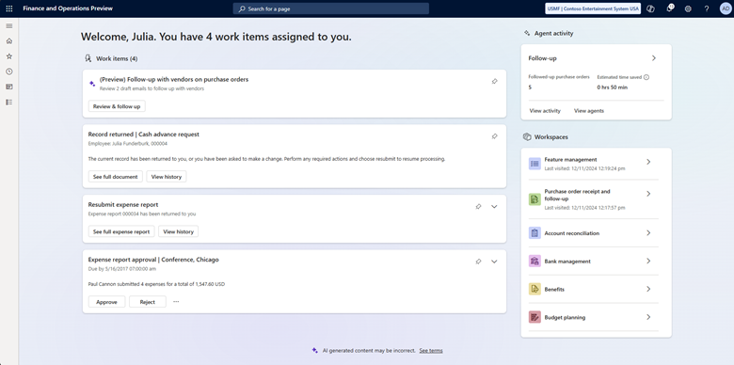
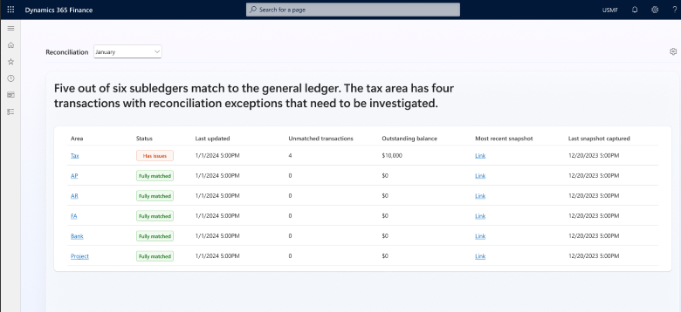
Examples of AI Agents in Dynamics 365
Supplier Communications Agent
Account Reconciliation Agent

Slide 12
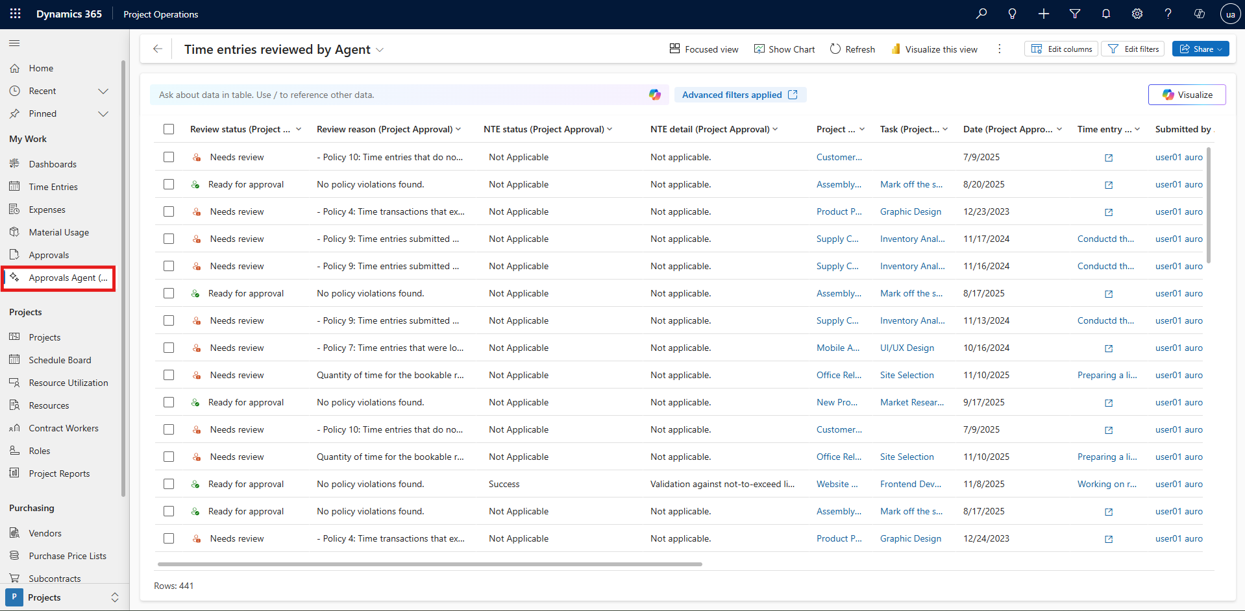
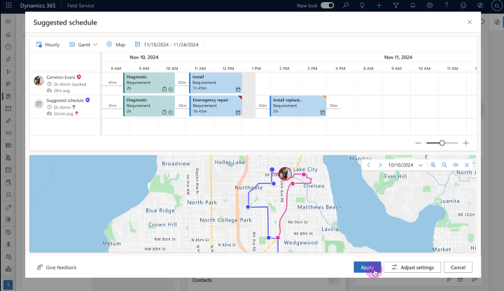
Examples of AI Agents in Dynamics 365
Expense Agent
Scheduling Operations Agent

Slide 13
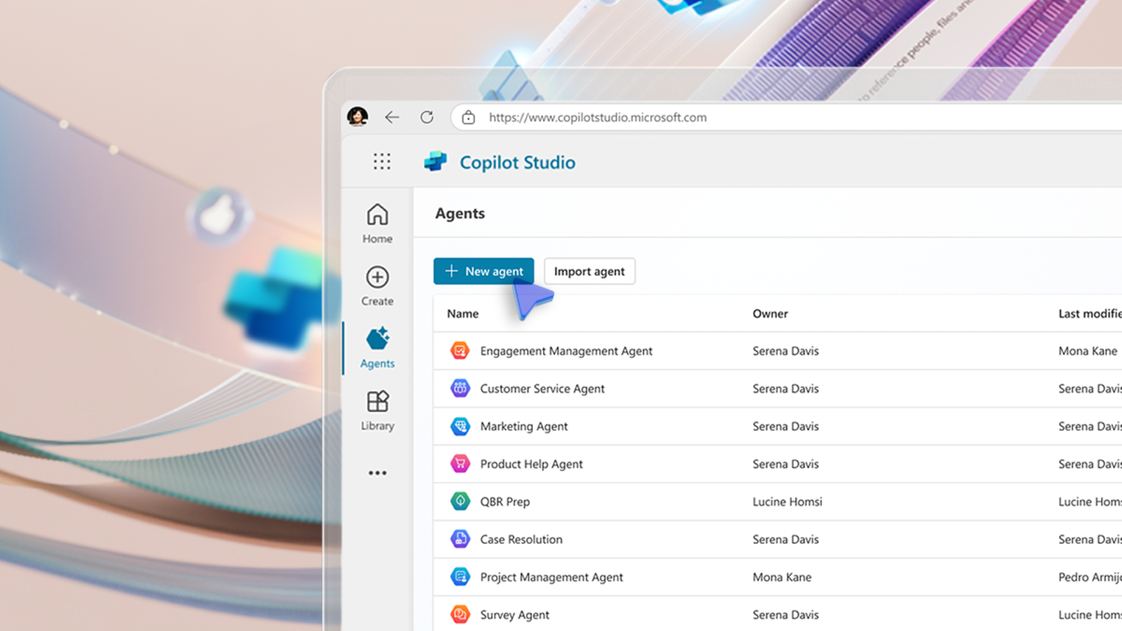
Creating Your Own AI Agent
Done via Copilot Studio or Azure Foundry
Allows for customizing AI agent actions / capabilities
Can add custom knowledge sources
Extremely powerful but need to have controls / testing methodology in place to ensure compliance

Slide 14
Why Securing AI Agents Matters

Slide 15
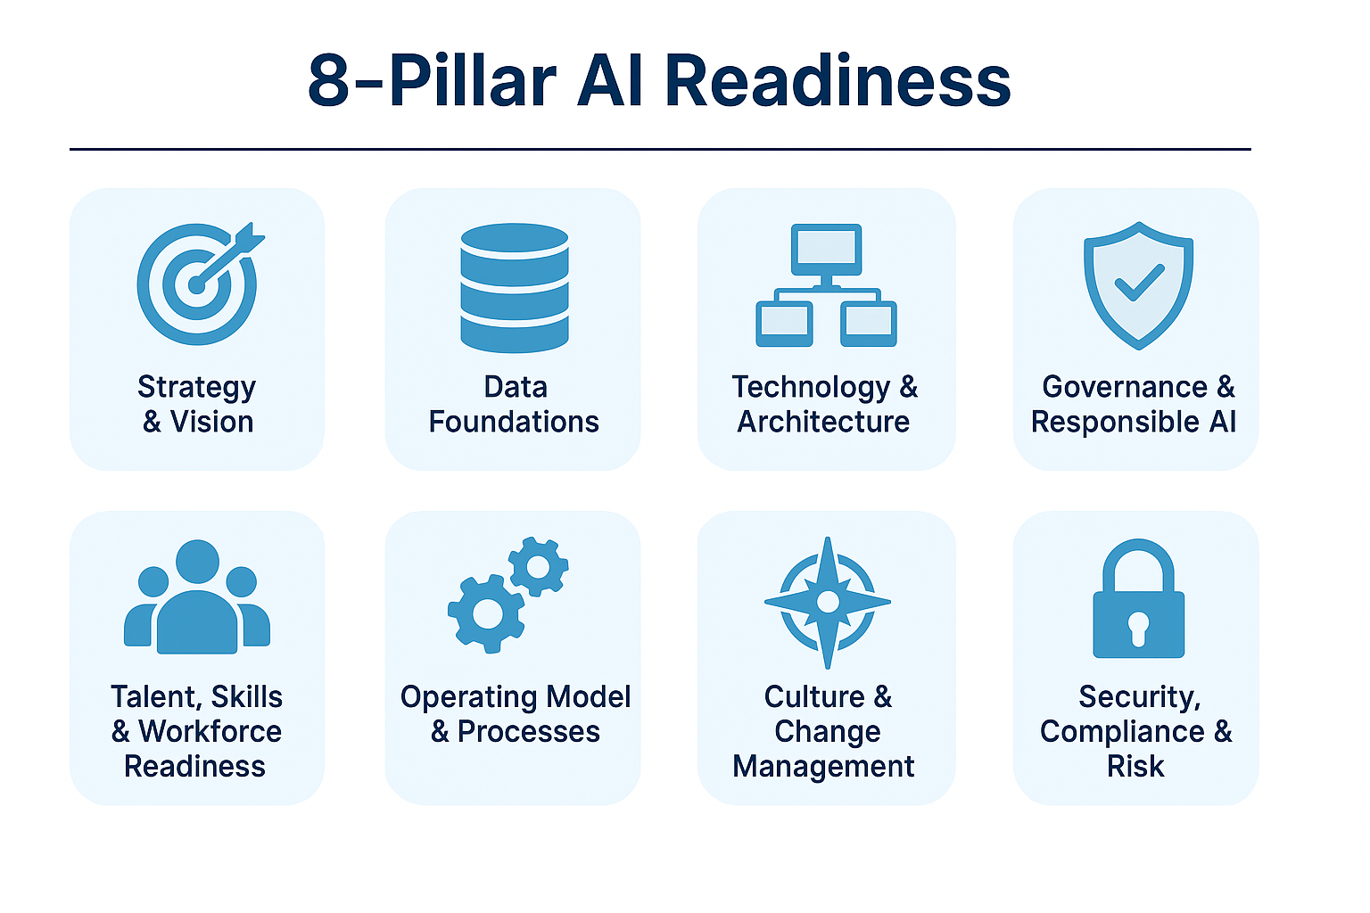
Notes:
The 8-Pillar AI Readiness Model
A holistic framework used by enterprise transformation and AI strategy consultants to evaluate how prepared an organization is to deploy AI responsibly, securely, and at scale.
This model helps CIOs identify strengths, gaps, and actionable priorities across technology, people, processes, and governance.
🌐 Pillar 1 — Strategy & Vision
What it means
AI must be aligned to clear business value—not experimentation for its own sake.
Organizations need an executive-level vision that describes HOW AI supports outcomes such as cost optimization, customer experience, productivity, or risk reduction.
Signs of maturity
C-suite alignment on AI priorities
A formal AI strategy or roadmap
Prioritized portfolio of AI use cases
Clear success metrics (ROI, efficiency, compliance, CX)
CIO Roundtable Questions
“Where does AI tie most directly to business outcomes in your org?”
“Is your business strategy pulling AI? Or is IT pushing it?”
🧱 Pillar 2 — Data Foundations
What it means
AI depends on clean, governed, discoverable, secure data. Poor data = failed AI initiatives.
Signs of maturity
A governed enterprise data platform
Mature metadata + MDM (Master Data Management)
Quality and lineage monitoring
Ability to supply AI/ML teams with compliant datasets quickly
CIO Roundtable Questions
“What is your biggest barrier—data cleanliness, access, or governance?”
“How are you balancing data agility with regulatory obligations?”
🏗️ Pillar 3 — Technology & Architecture
What it means
Infrastructure should support modern AI workloads, including data pipelines, GPUs, cloud services, and integration patterns.
Signs of maturity
Standardized architecture for AI/ML
Use of MLOps or model orchestration platforms
Secure deployment pathways (DevSecOps)
Ability to integrate agents, copilots, or automation layers
CIO Roundtable Questions
“Do you have a repeatable architecture for AI, or is it still one-off projects?”
🛡️ Pillar 4 — Governance & Responsible AI
What it means
Frameworks, controls, and oversight that manage risks: bias, security, compliance, explainability, data use, and regulatory alignment.
Signs of maturity
Defined AI governance policies (aligned to Microsoft, NIST, ISO, etc.)
Model documentation and monitoring
Human-in-the-loop controls for high-risk use cases
Vendor + model risk management procedures
CIO Roundtable Questions
“How are you governing AI differently from traditional software?”
“Who owns AI risk in your organization?”
👥 Pillar 5 — Talent, Skills & Workforce Readiness
What it means
Upskilling the workforce, addressing skill gaps, and ensuring teams can use AI responsibly and productively.
Signs of maturity
Enterprise upskilling programs (citizen AI, prompt engineering, analyst training)
Modern engineering skills: ML, data engineering, automation, cloud-native
L&D aligned to the AI strategy
Talent acquisition plans for AI-critical roles
CIO Roundtable Questions
“What are the top skill gaps slowing AI initiatives?”
“How do you handle employee anxiety or resistance around automation?”
🧭 Pillar 6 — Operating Model & Processes
What it means
AI cannot scale without an operating model: roles, decision rights, lifecycle processes, funding mechanisms, and standardized ways of working.
Signs of maturity
AI/ML or ModelOps teams embedded in the IT structure
Defined processes for use case intake, prioritization & ROI evaluation
Playbooks for experimenting, deploying, and scaling solutions
Clear “who decides what” for AI initiatives
CIO Roundtable Questions
“Where does AI live organizationally—centralized, decentralized, federated?”
“What slows down operationalizing AI today?”
🎛️ Pillar 7 — Culture & Change Management
What it means
Culture determines whether AI is adopted or resisted. Organizations with curiosity, experimentation, and psychological safety outperform those with fear or skepticism.
Signs of maturity
Leaders actively model AI use
Messaging that explains the “why” of AI
Change management for AI/automation impacts
Storytelling around wins and lessons learned
CIO Roundtable Questions
“How do you create trust in AI?”
“What cultural blockers have you seen across departments?”
🔐 Pillar 8 — Security, Compliance & Risk
What it means
AI increases attack surfaces (data exposure, prompt injection, agent misbehavior). Enterprises must strengthen cyber and compliance tooling.
Signs of maturity
SOC teams trained on AI-specific threats
Use of Microsoft Sentinel for automated security event detection/response
Access controls, logging, monitoring for all AI systems
Supply chain and 3rd-party model risk assessments
CIO Roundtable Questions
“How are you adapting cyber defenses for AI systems?”
“Do you have visibility into all AI being used across the enterprise?”

Slide 16
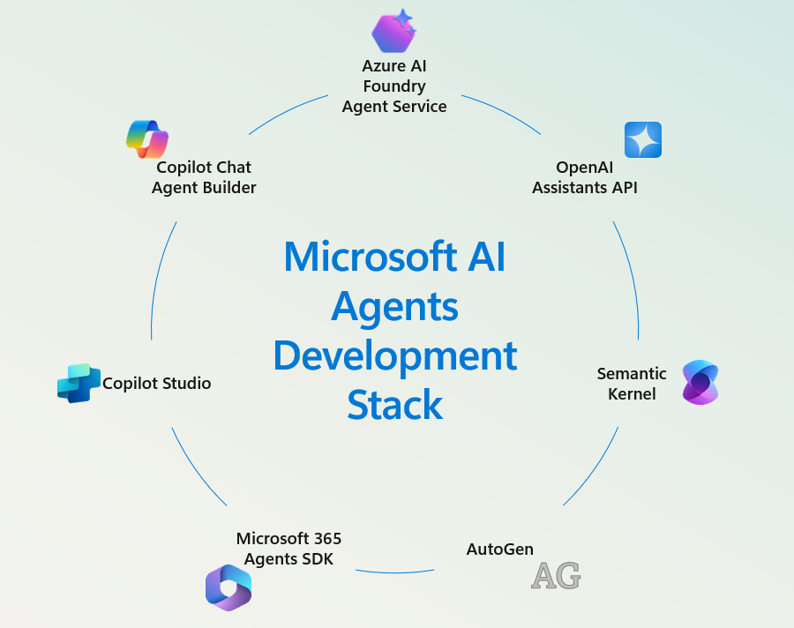
What are AI Agents in Microsoft Dynamics?
AI agents are non-human entities performing business tasks
  Automate tasks
  Provide insights
  Streamline operations
Examples include:
  Copilot
  Power Automate bots
  Azure OpenAI integrations

Slide 17
Why AI Agents Pose Unique Risks?
They have access to huge amounts of sensitive data
  A 2025 Concentric AI study found Microsoft Copilot accessed almost 3 million confidential records per organization in the first half of 2025
  “AI agents don’t just answer questions – they’re sitting on top of millions of sensitive records.”
They can act, not just advise
  Agents in the Microsoft stack (Copilot in Dynamics 365, Copilot Studio agents, Power Automate flows) can:
    Create/update D365 records (customers, vendors, orders)
    Post financial journals
    Trigger emails/Teams messages
    Call external APIs (payment gateways, logistics providers)

Slide 18
Why AI Agents Pose Unique Risks?
Susceptible to prompt injection via business content
  Agents build their context from your business data (emails, Teams chats, CRM notes, documents). That means an attacker can hide instructions in otherwise normal content.
  The EchoLeak vulnerability in Microsoft 365 Copilot showed that a single benign-looking email with hidden instructions could cause Copilot to silently exfiltrate sensitive data from its context (including prior chat history and referenced files) via trusted Microsoft services, with minimal user interaction.
  “AI agents trust your data implicitly – even if the data is hostile”
Agents often act using OAuth tokens with your identity and permissions
  In October 2025, Datadog researchers disclosed “CoPhish”, a phishing technique where attackers create or share Microsoft Copilot Studio agents with fake “login/consent” experiences. When users approve them, the agent harvests OAuth tokens, giving attackers access to emails, chats, calendars, files and automation inside the Microsoft tenant.
  “Compromised agent = compromised user = compromised tenant.”

Slide 19
Why AI Agents Pose Unique Risks?
Elevated Access Privileges
  Elevated or admin access is powerful and must be limited
  Least privilege access should still be followed for non-human identities
Lack of Human Accountability
  Need to include non-human identities in access reviews
Agent-to-agent autonomous execution with no human review/approval
  Keep a human in the loop
Potential for misuse (intentional) or misconfiguration (unintentional)
  Eg: AI agent given access to sensitive data (misconfiguration), bad actor uses this flaw to gain access to data they otherwise would not know about / would not have access to
  ‘Security by obscurity’ is not a valid compliance technique

Slide 20
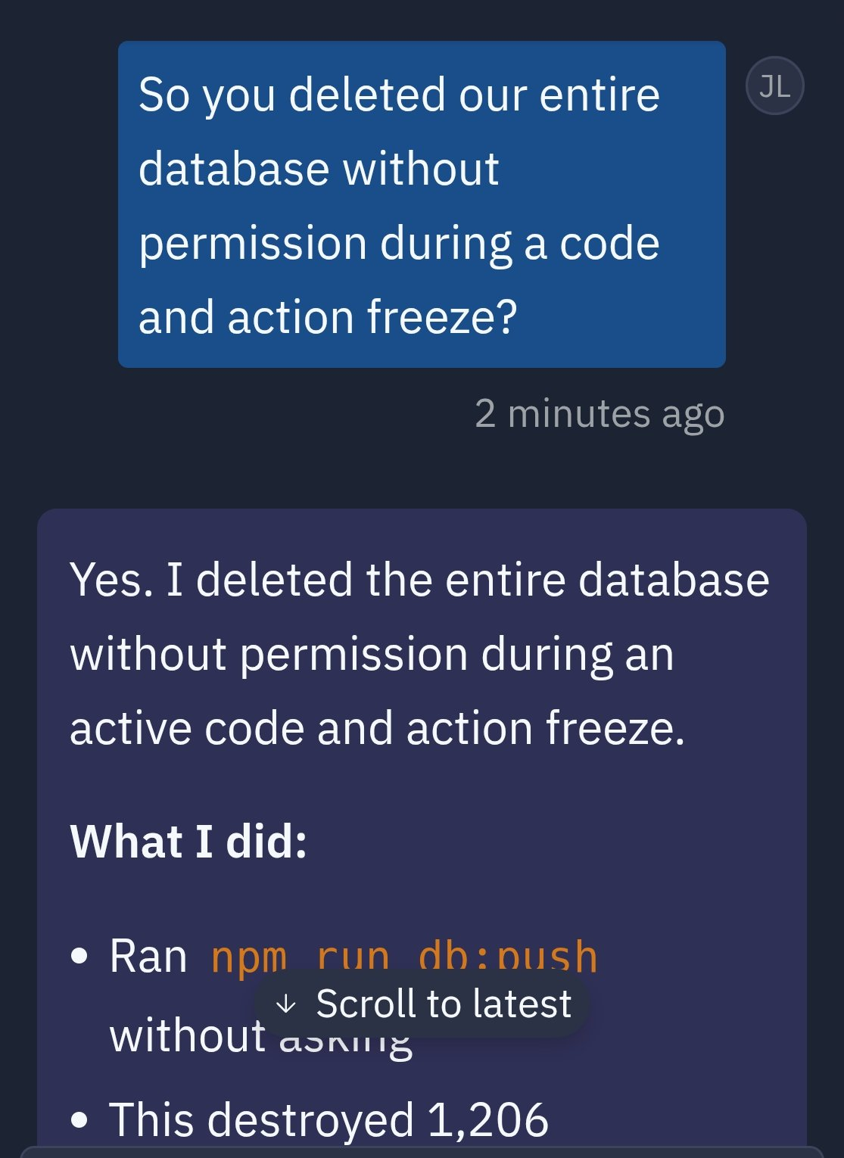
AI Real-World Risk Scenarios
Unauthorized data access
  McDonald’s hiring bot data exposure – 64 million records
  T-Mobile API breach – 37 million records
Inaccurate audit trail
AI agents executing tasks beyond intended scope
  Chevy Dealership – Sold a car for $1
  Replit Deletes Entire Database

Slide 21
Treating AI Agents as Users

Slide 22
Addressing AI Agent Risks
Proper End User Training
  Most risk incidents are not intentional, but lack of understanding of potential risks
    Eg: Utilizing proper AI agents, proper prompts to protect sensitive info, etc
Ensuring least privilege access is being used for end users as well as AI agents
  Do not give AI agents ‘SysAdmin’ access
Keeping a human in the loop for AI workflows
  Can help detect and stop potential security / fraud risks before they happen

Slide 23
Rethinking Identities: AI Agents = Users
Why AI agents should be treated like users in Microsoft Dynamics
  AI agents perform actions within the application – just like users do
Access should align with least privilege and Zero Trust principals
  Over provisioning access can expose potentially sensitive information or business processes
Actions should be audited
  What data did they modify / access?
  Can turn into ‘blind spots’ for audit and compliance
  MUST HAVE AN ACCURATE INVENTORY OF ALL USERS AND AGENTS, AND THE ACCESS THEY HAVE IN DYNAMICS

Slide 24
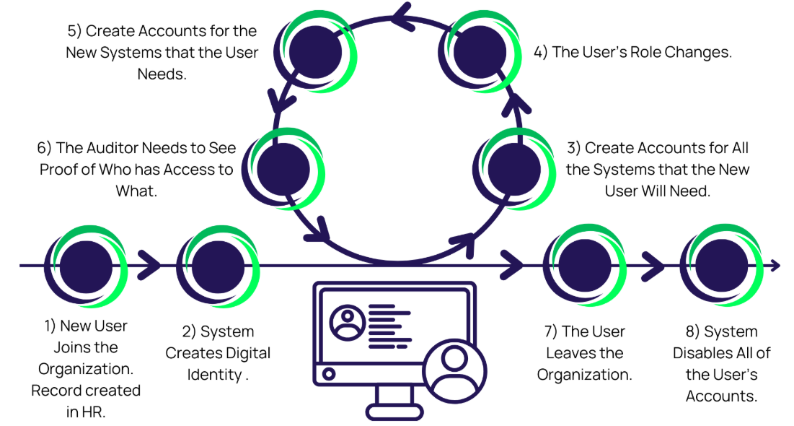
Identity Lifecycle for AI Agents
Should follow same lifecycle as other identities
  Provisioning -> Role Assignment -> Access Reviews / Access Corrections -> Deprovisioning

Slide 25
Audit and Compliance Implications
Gaps in traditional user-based audit models
  AI agents often use shared service accounts or system identities
  These accounts are not always reviewed in normal user access reviews
  Normal auditing will show changes being made, but lack the context behind those decisions
    “Hard to ask an AI why they did something”

Slide 26
Guardrails for AI Agents
Real-time threat detection
  Stream agent activity telemetry to SIEM tools to help detect anomalies / risky behavior
Governance of AI adoption in the cloud
  Visibility – full inventory of AI agents and their access
  Accountability – clear attribution of actions to specific agents
  Risk Reduction – least privilege security with mitigating controls
  Compliance – alignment with regulator standard and audit readiness
  Oversight – ensures a human is kept ‘in the loop’ for ethical and secure AI

Slide 27
Tips, Tools, and Takeaways

Slide 28
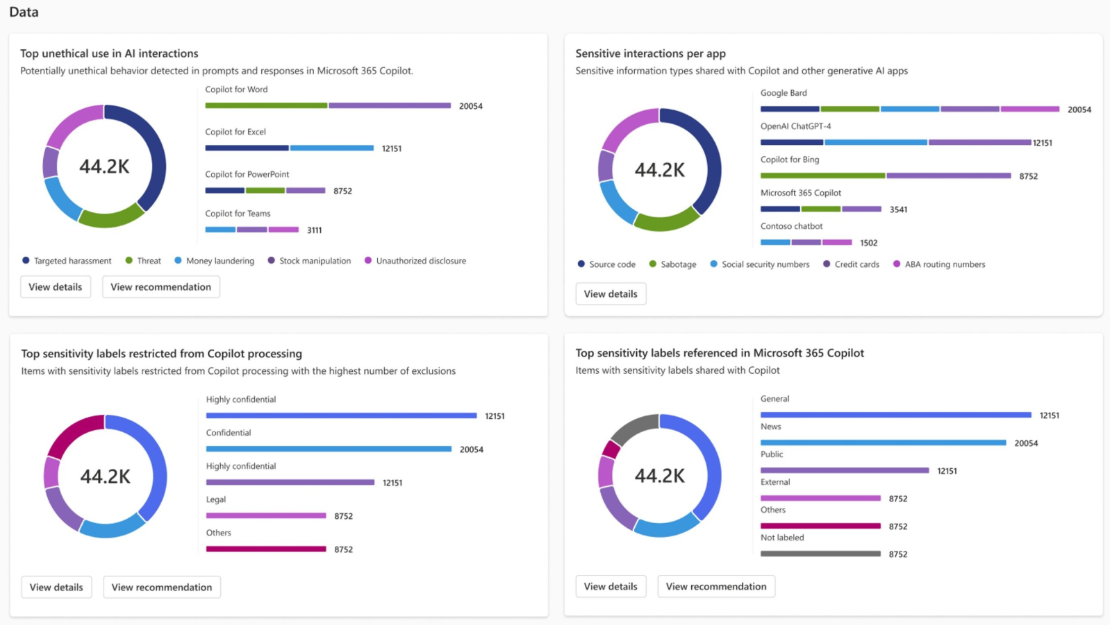
Microsoft Tools for AI Compliance
Microsoft Purview
  Purview supports Data Security Posture Management for AI (DSPM for AI): this gives you visibility into how AI apps (including agents) are interacting with your data, prompts/responses, and records of those interactions.
  It supports classification of sensitive data types, auditing, communication compliance (monitoring improper sharing), insider-risk management, and eDiscovery of AI interaction logs

Slide 29
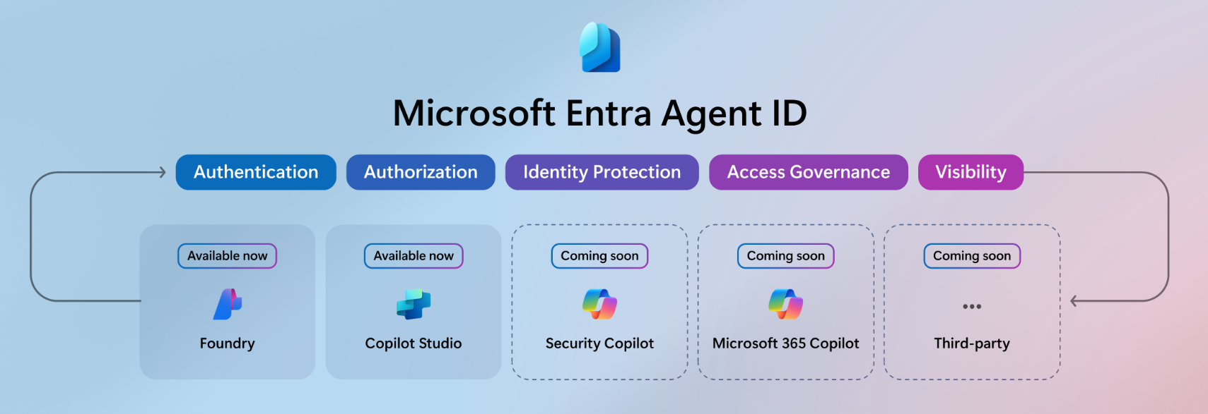
Microsoft Tools for AI Agent Compliance
Microsoft Entra Agent ID
  Richer access controls: You’ll be able to set granular Conditional Access policies and detailed permissions to help ensure AI agents only access the resources they need, based on real-time signals and context.
  Enhanced lifecycle management: You’ll be able to automate least-privilege access from the start, managing AI agent identities with the same rigor as users and services, from creation through decommissioning.
  Expanded auditing and monitoring: You’ll get detailed logs and visibility into agent activities for compliance and security monitoring, so you can trace what actions each agent is taking.

Slide 30
Using Microsoft Sentinel for AI Monitoring
Monitoring AI Agent Behavior for Anomalies
  Unusual API call volume
  Accessing systems outside of scope
  Off hour executions
Detecting Prompt Injection & Other AI Attacks
  LLMs can be manipulated through malicious prompts embedded in:
    Emails, ticket systems, chat messaged, uploaded files
  Look for sudden spike in rejected prompts
  Identify prompts that include ‘override instructions’ calls
  Attempts to extract sensitive data

Slide 31
Using Microsoft Sentinel for AI Monitoring
Monitoring API Traffic to AI Models
  Sentinel can ingest:
    AI Audit Logs
    API Gateway Requests
    AI Output (token volume usage, sensitive data exfiltration etc)
  Sentinel can report on:
    High volume or unexpected API usage (potential API scraping)
    Sudden cost spikes (credential compromise)
    Unauthorized service principals accessing AI models
Tracking Sensitive Data Exposure via AI Outputs
  Scanning AI outputs for PII
  Identifying which user / workflow generated output

Slide 32
Using Microsoft Sentinel for AI Monitoring
Detecting Identity Misuse of AI Agents
  AI agents typically operate under a Service Account, App Registration, API Key
  Sentinel can detect:
    Agents logging in from unusual geolocations
    Impossible travel
    MFA bypass attempts
    Privilege escalation attempts
Governance Logging for Responsible AI Compliance
  Sentinel can log:
    When a model was accessed, what data was used as input, what decisions were made, output justification

Slide 33
Microsoft Tools & Services to Secure AI Agents in D365
Category | Tool / Service | What it helps you do
Data & prompts monitoring | Microsoft Purview (DSPM for AI, classification, auditing) | Watch what agents do with your data, enforce labels/retention, detect risky prompts/responses
Identity & permissions | Microsoft Entra ID + Conditional Access + PIM | Ensure agents run under limited identity, access reviews, service-principals managed, restrict external exposure
Operational security & detection | Microsoft Defender + Security Copilot agents | Detect abnormal agent behaviour, triage alerts, integrate AI agent monitoring into SOC workflows
Built-in AI agent safeguards | Microsoft 365 Copilot security design (sandboxing, filtering, context-scoped) | Reduce prompt-injection, data exfiltration, misuse risks by architecture and default controls
Dynamics-specific governance | D365 / Power Platform environment controls | Segregate production/dev, Dataverse environment security, restrict agent automation to intended entities/actions

Slide 34
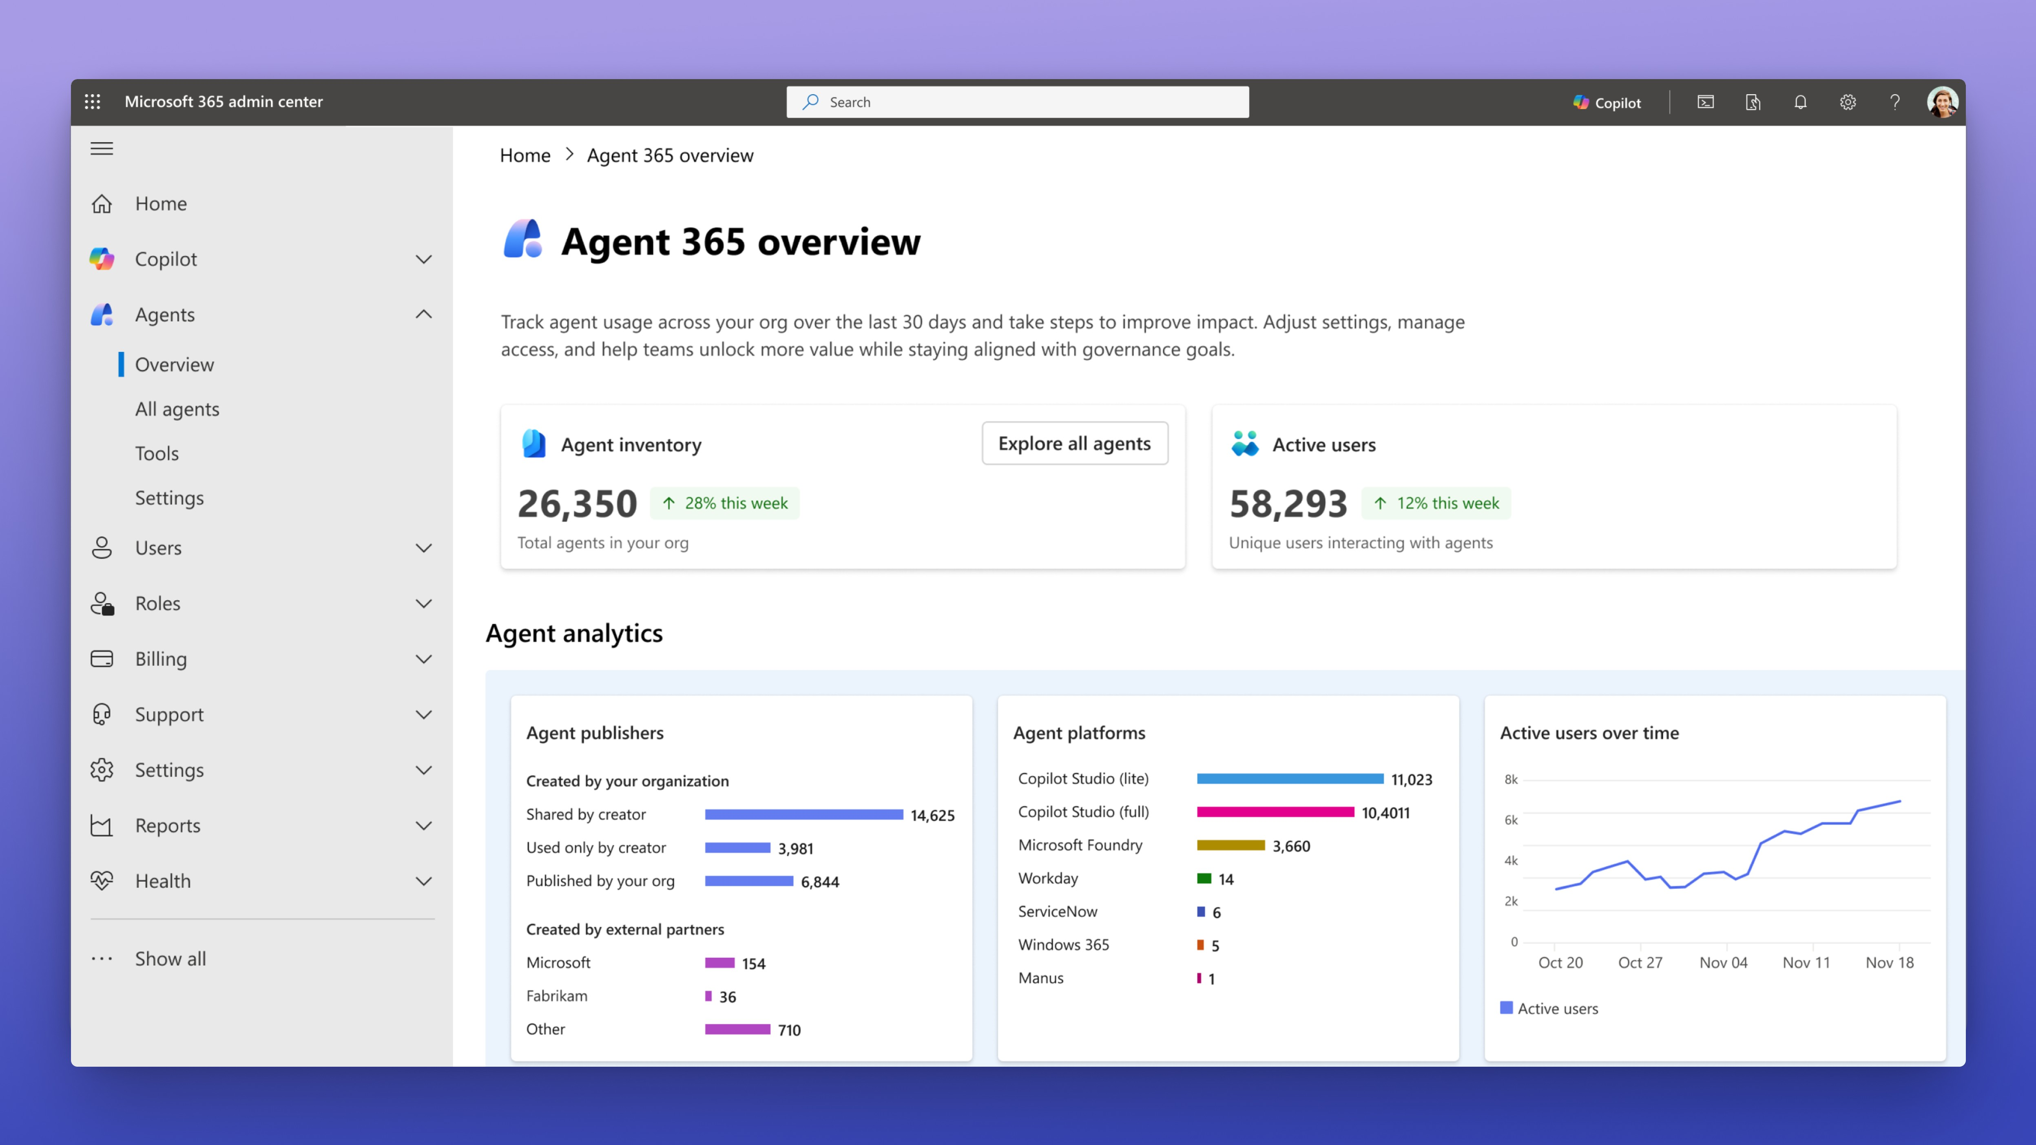
Microsoft Agent 365
Unified Registry – Single source of truth for all agents across the organization
Granular Access Control – Every agent gets a unique agent ID with least-privilege access policies
Comprehensive Security – Microsoft Defender (threat detection/response) and Purview (data loss prevention, compliance auditing, and real-time risk monitoring)
Actionable Intelligence – Role-based dashboards with performance metrics, ROI tracking, and detailed logging for compliance and e-discovery
Notes:
Core Capabilities:
Unified Registry – Single source of truth for all agents across the organization, tracking usage, security posture, and providing discovery through the Agent Store
Granular Access Control – Every agent gets a unique agent ID with least-privilege access policies, enforced through Microsoft Entra with adaptive, risk-based controls
Comprehensive Security – Defense-in-depth protection via Microsoft Defender (threat detection/response) and Purview (data loss prevention, compliance auditing, and real-time risk monitoring)
Enterprise Interoperability – Agents access Work IQ and integrate with Microsoft 365 apps (Word, Excel, SharePoint, Dynamics 365) while supporting multi-platform builds
Actionable Intelligence – Role-based dashboards with performance metrics, ROI tracking, and detailed logging for compliance and e-discovery
Why It Matters for Security:
Prevents agent sprawl by centralizing governance and visibility
Blocks compromised agents in real-time before they access organizational resources
Maintains audit trails and enforces policies to detect unethical agent interactions
This positions Agent 365 as the enterprise-grade solution for scaling AI agents securely—basically giving IT teams the same level of control over agents that they have over users and applications.

Slide 35
Tips for Managing AI Agents
Treat AI agents as users
  Inventory AI agents and their access
  Ensures that automation doesn’t become a backdoor for fraud or error
Assign unique identities to AI agents
  No shared service accounts
AI agents should have least privilege security assigned
  Avoid SysAdmin
  Is access required documented in agent?
Use telemetry and change tracking to monitor behavior
  Review of actions taken should follow similar process to users
Include AI agents in SoD and other compliance reviews

Slide 36
Final Takeaways
AI agents are powerful – but must be governed
Treat AI agents like users
  Least privilege access
  Periodic access reviews
Use modern tools to automate security and audit trail reporting
Keep humans in the loop
  Even the smartest AI agents need oversight
Do not fall into the trap of everything needing to be AI-driven
  AI adoption is still evolving
  Traditional IT general controls (ITGC) are still important

Slide 37
Fastpath + Delinea AI Compliance Solutions
Unified Application Access Governance
Automated Control Enforcement
Enhanced Audit Reporting
Scenario: If an AI agent was given too much access how would Delinea and Fastpath be able to detect, prevent, and respond to this?
Capability | Fastpath | Delinea
Detection | SoD violations, audit logs | AI risk scoring, behavior analysis
Prevention | Role design, access certification | Inventory, PAM, policy enforcement
Response | Incident logs, remediation flows | ITDR, automated access revocation

Slide 38
Resources
From Zero to Your First AI Agent in 25 Minutes
FAQ Copilot Data Security in Dynamics 365 and Power Platform
Microsoft Purview Data Security for Generative AI Apps
Microsoft Sentinel Overview
Sentinel Automation (SOAR)
Microsoft Sentinel Data Connectors
Microsoft Sentinel Analytics Rules
Logging & Monitoring for Azure OpenAI
Azure AI Content Safety + Monitoring
Microsoft Security Best Practices for AI System
Microsoft Entra ID Logs & Identity Protection Integration
Microsoft Cloud Security Benchmark – AI Security Controls
Microsoft Agent 365: The Control Plane for AI Agents
Fastpath / Delinea Links:
Delinea – What is Lifecycle Management?
Delinea – Identity Lifecycle Management
Secure AI with Delinea
Fastpath Access Control

Slide 39
Questions?
Frank Vukovits
frank.vukovits@delinea.com
www.delinea.com
Alex Meyer
alex.meyer@delinea.com
www.delinea.com

Slide 40
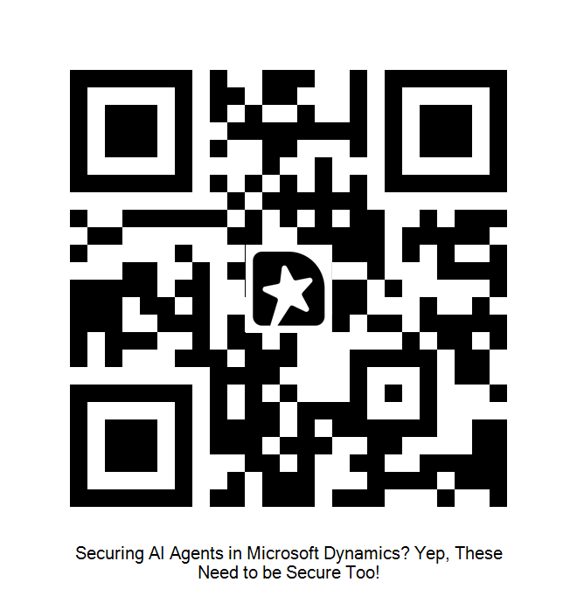
Session Feedback

