Slide 1
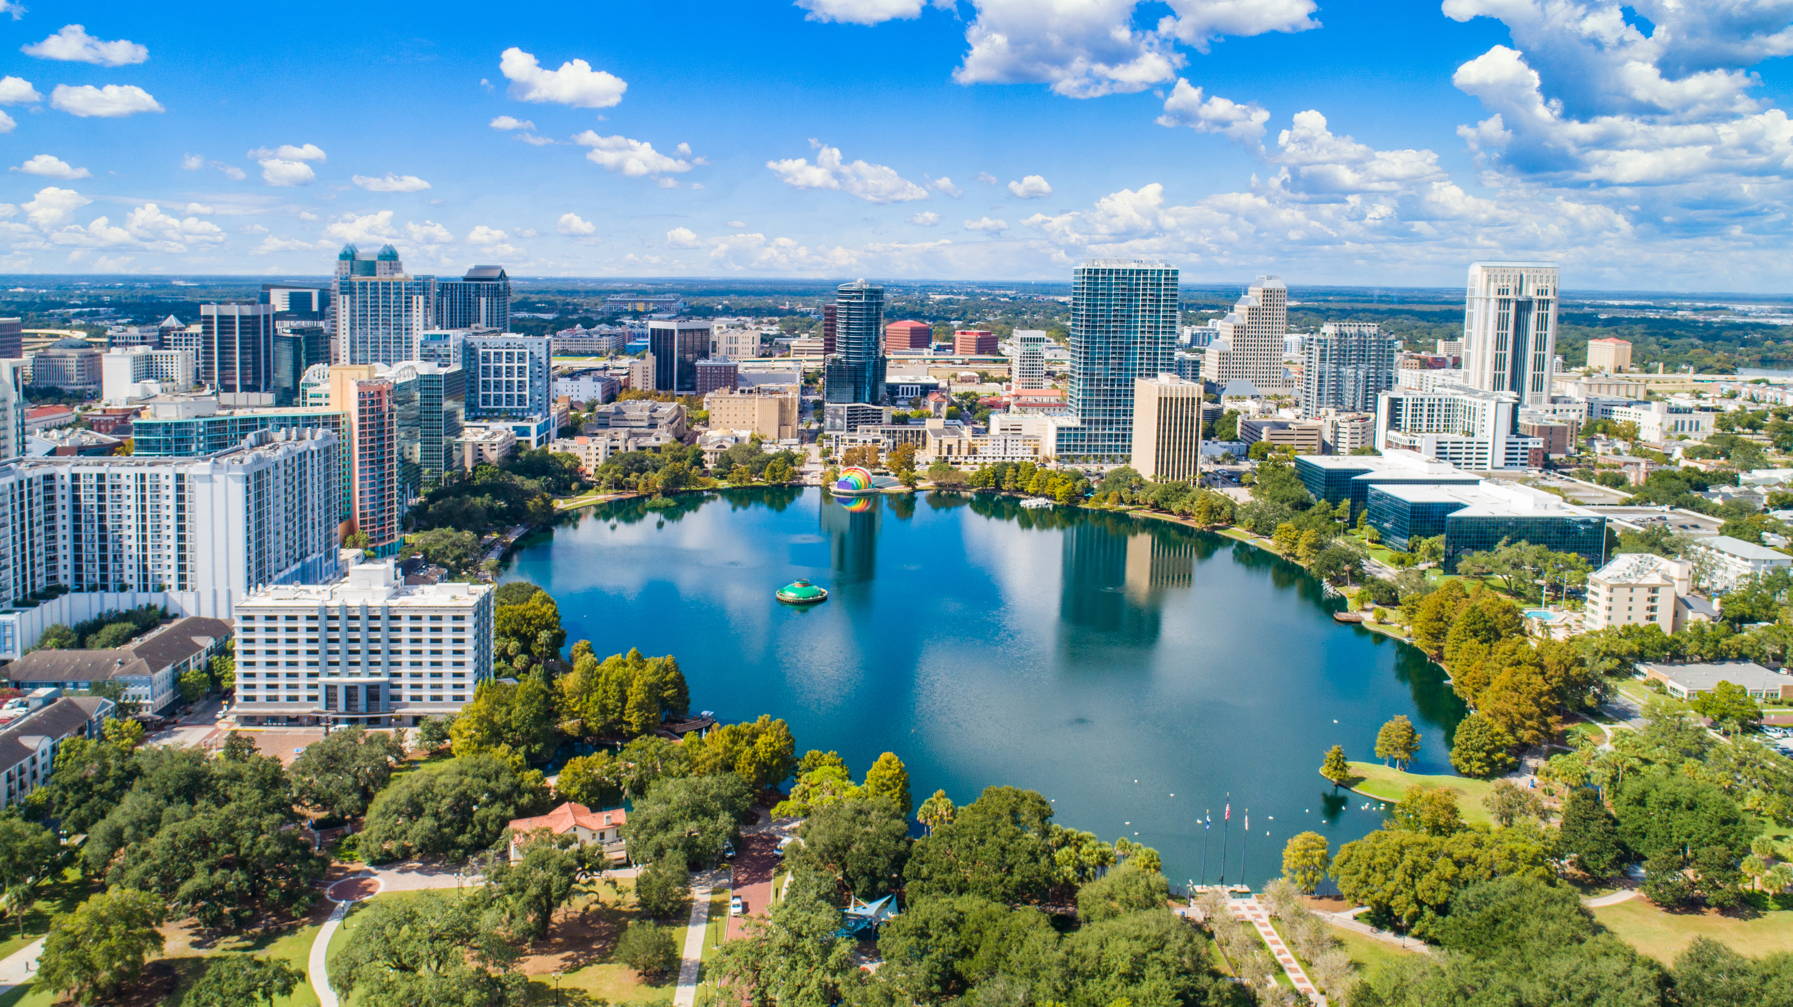
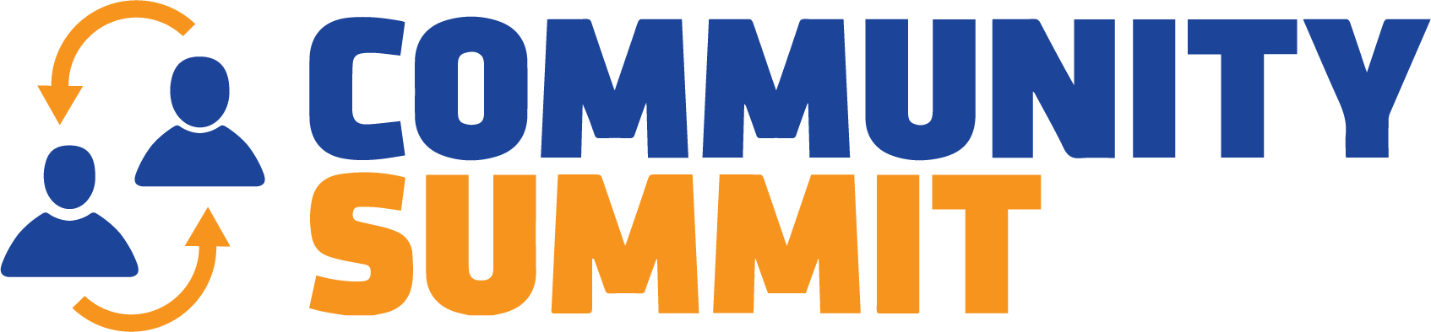
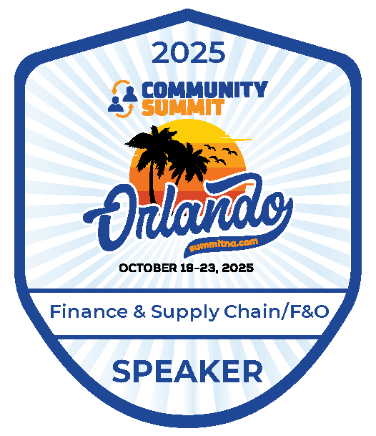
FINANCE &
SUPPLY CHAIN/F&O
Orlando, FL
October 19-23, 2025

Slide 2
D365FO Telemetry & Monitoring Deep Dive

Slide 3
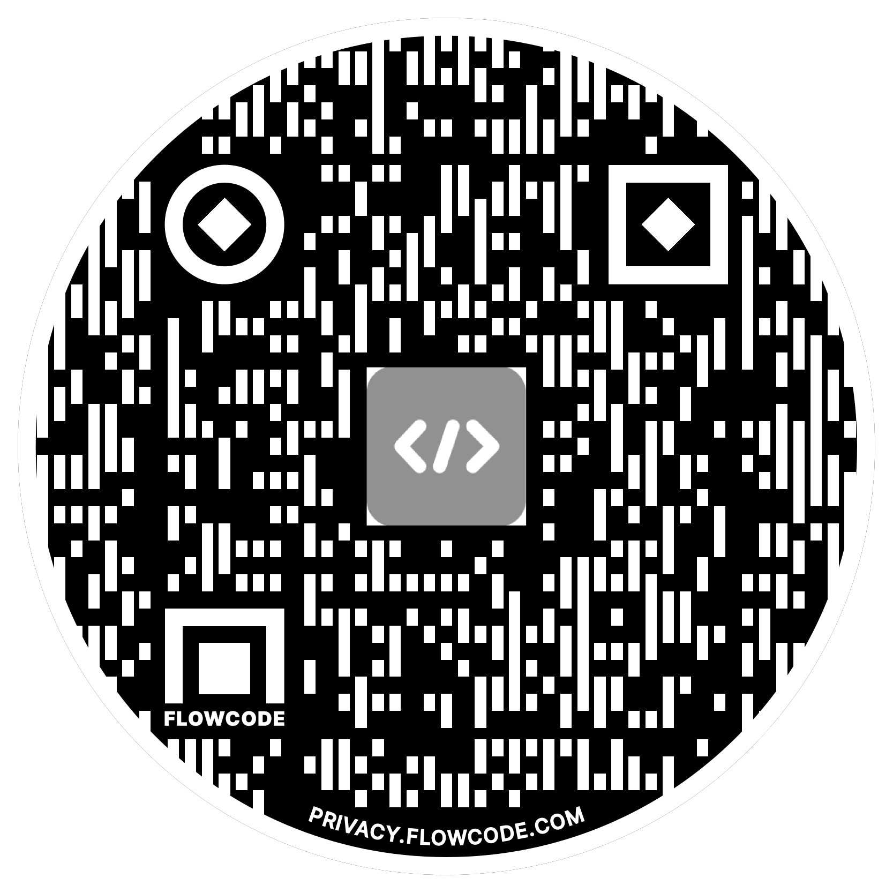

Alex Meyer
Principal Software Development Engineer
Delinea
Email: alex.meyer@delinea.com
Blog: http://d365foblog.com
Security Class: http://d365fosecurity.com
LinkedIn / Microsoft MVP Profile
Background:
Awarded Microsoft MVP in Business Applications since 2019
Been working with AX since 2013 and D365FO since 2016
Have spoken at Summit (US & Europe), Focus, and local chapters around AX/D365FO security and have done webinars around native controls in both versions

Slide 4
Telemetry & Monitoring Prerequisites
Setup / Configuration of Telemetry & Monitoring Feature
View Data in Application Insights
    Form Runs
    Exception Events
    Custom Events
Reporting From PowerBI
Report via Code (.NET / C#)
Using Telemetry Data Within D365FO
App Insights Alerting

Slide 5
Questions We Will Answer Today
What is the architecture of
What is the performance impact of
What is the cost of
How long is data stored for
What custom events can I capture with
What can I do with the data captured by
How can I create alerts around
… the monitoring and telemetry feature within D365FSC?

Slide 6
Telemetry and Monitoring Feature Overview

Slide 7
What is Telemetry and Monitoring
Actions tracked within a source system
Different than Change Tracking
  Captures user interaction events not just when things are changed
In some systems a ‘telemetry’ or ‘monitoring’ feature must be enabled
Select which events to capture, for Microsoft Dynamics the options are:
    Page Views, Exceptions, Custom Events / Metrics, DMF Errors, Warehouse Events
Need to keep in mind storage impacts / data retention policies

Slide 8
Telemetry and Monitoring Feature Architecture

Slide 9
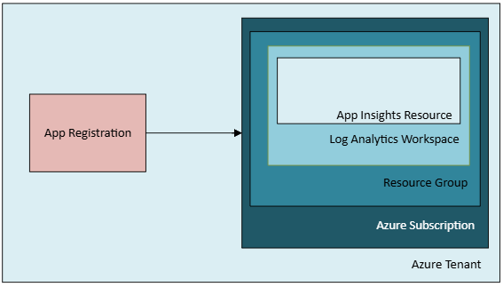
Monitoring and Telemetry Architecture
Utilizes Azure Application Insights
Part of the Azure Monitor suite of solutions

Slide 10
Telemetry and Monitoring Feature Architecture

Slide 11
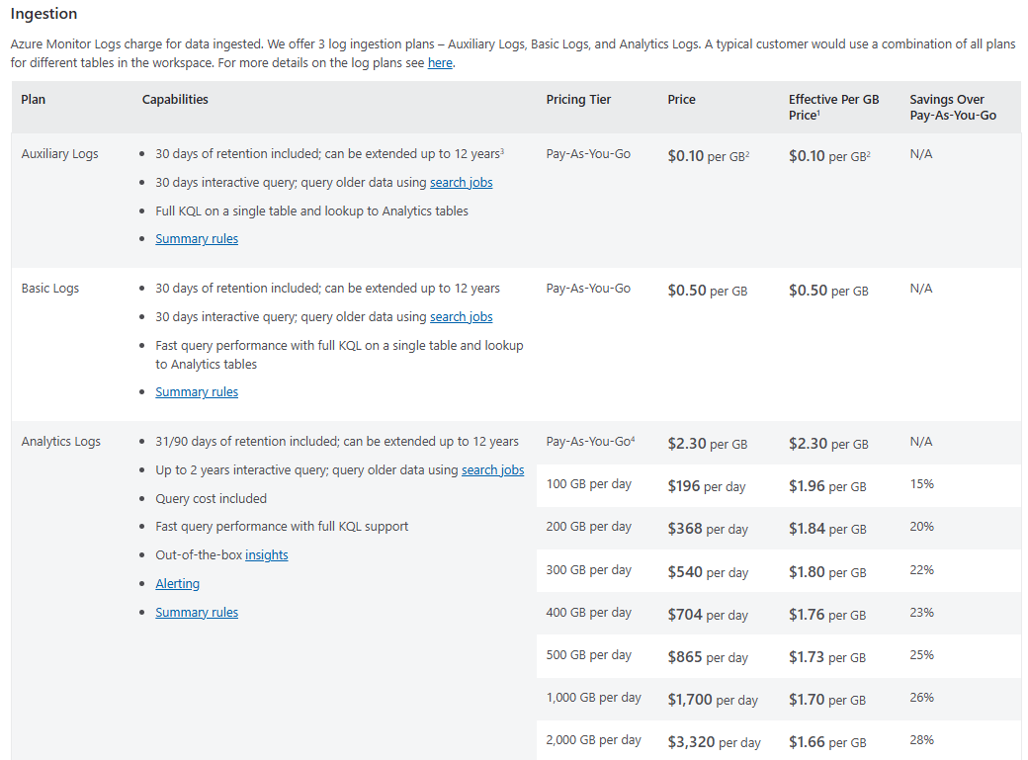
Cost of Telemetry and Monitoring Data
Pricing based on data ingestion type and needed functionality
Price slightly different based on Azure region
Azure Monitor Pricing

Slide 12
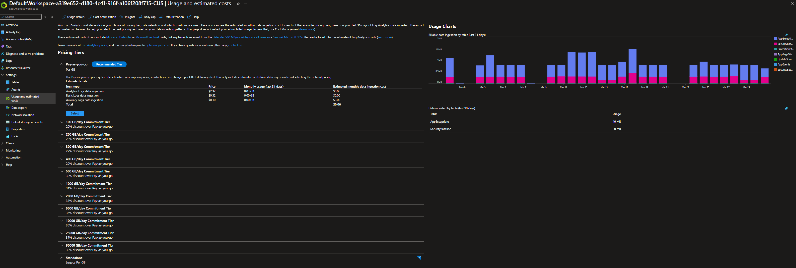
Telemetry Data Pricing - Usage

Slide 13
Telemetry and Monitoring Performance Impact

Slide 14

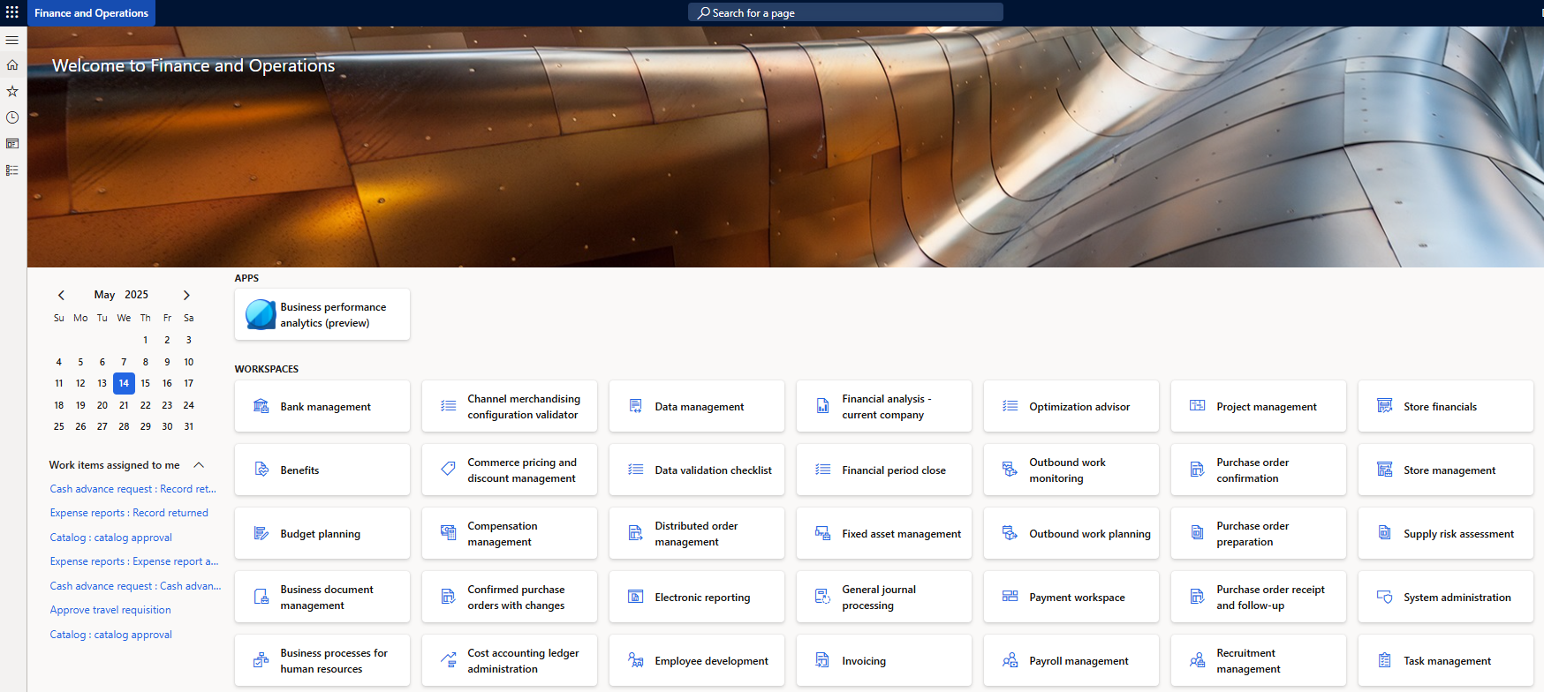

Performance Impact of Telemetry and Monitoring
Microsoft has had their own telemetry for quite a while
  Support tickets
  Licensing renewals
When enabled you are ‘copying’ these events to your App Insights container
Custom event tracking can have an impact on performance if not properly designed

Slide 15
Retention Policy for Monitoring & Telemetry

Slide 16
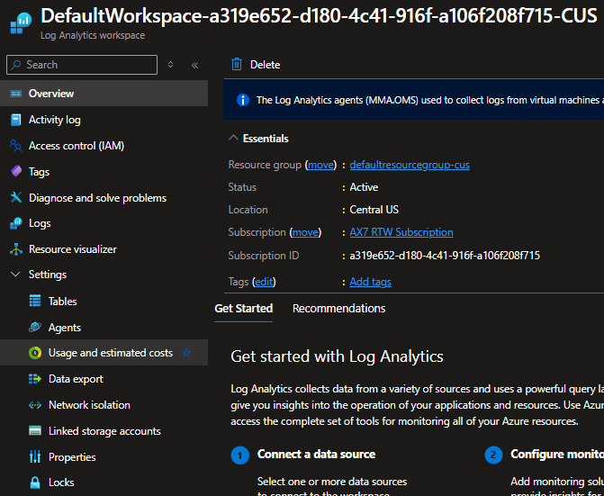
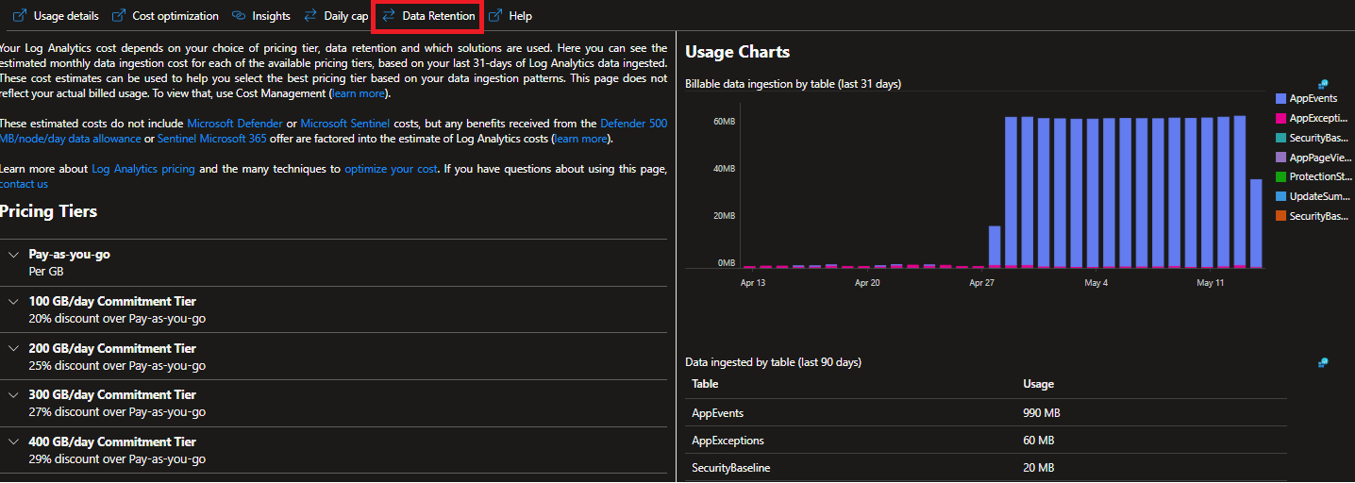
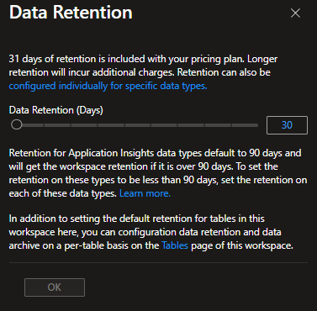
Retention Policy for Monitoring and Telemetry
Retention policy is set at the Log Analytics workspace level
Default is 31 days – can be increased (increasing costs more $$$)

Slide 17
Telemetry and Monitoring Prerequisites

Slide 18
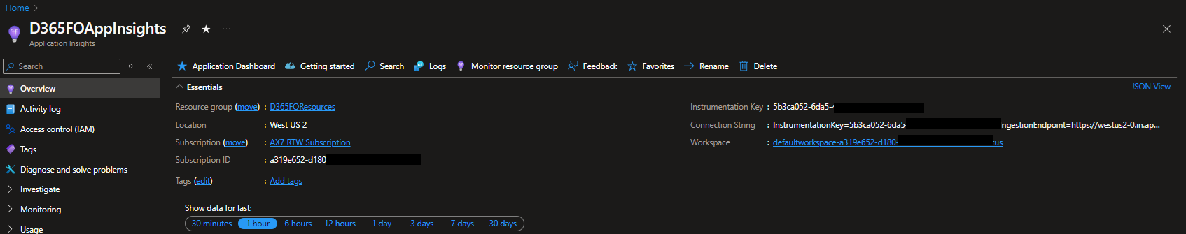
Telemetry & Monitoring Prerequisites
Must be on D365FO 10.0.30 or newer
  Must be on D365FO 10.0.41 or newer for stable version of feature
  GA in 10.0.44 (no need to enable feature in Feature Management)
Must have an Application Insights / Log Analytics resource created within Azure

Slide 19
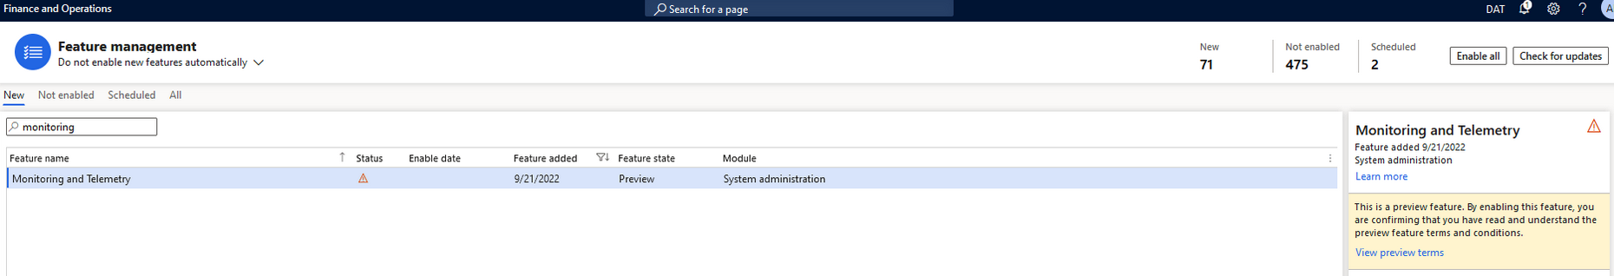
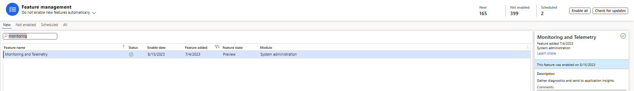
How to Enable Telemetry & Monitoring Feature
Feature Management -> Monitoring and Telemetry

Slide 20
Telemetry and Monitoring Setup & Configuration

Slide 21
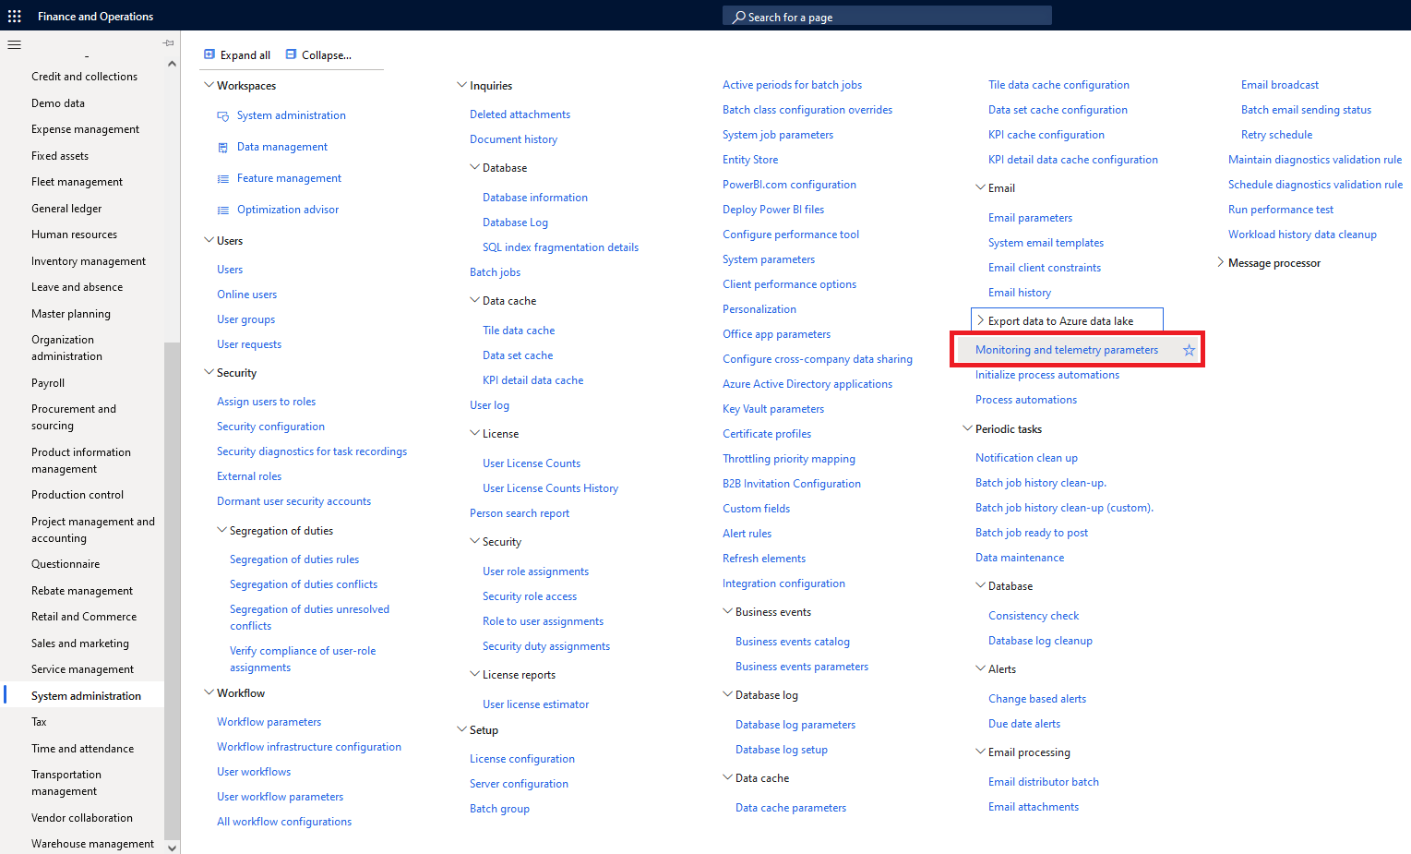
How to Enable Telemetry & Monitoring Feature
Notes:
Now we can navigate to System Administration -> Setup -> Monitoring and Telemetry Parameters.

Slide 22
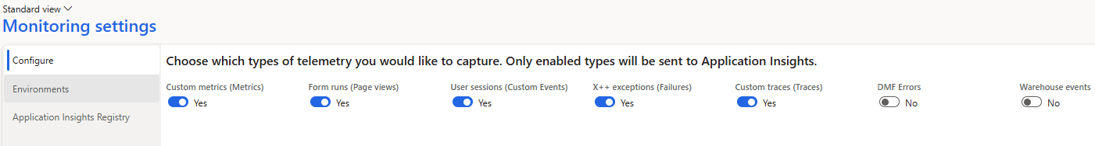
Telemetry & Monitoring Configuration
Form runs – when a user navigates to a form / page
X++ exceptions – when an error occurs
User sessions – misnamed, custom events
Custom metrics / traces – custom created metric or trace events
DMF Errors – data management framework errors
Warehouse events – events pertaining to warehouse operations, including mobile app

Slide 23
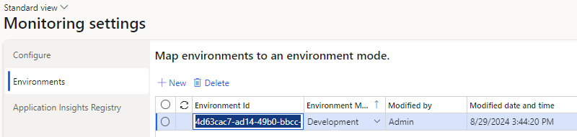
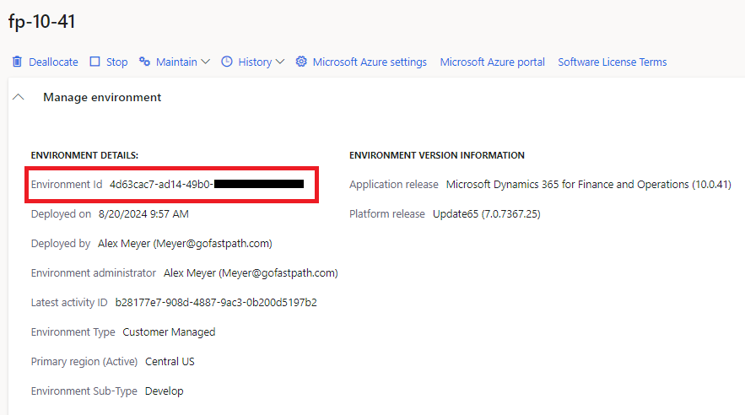
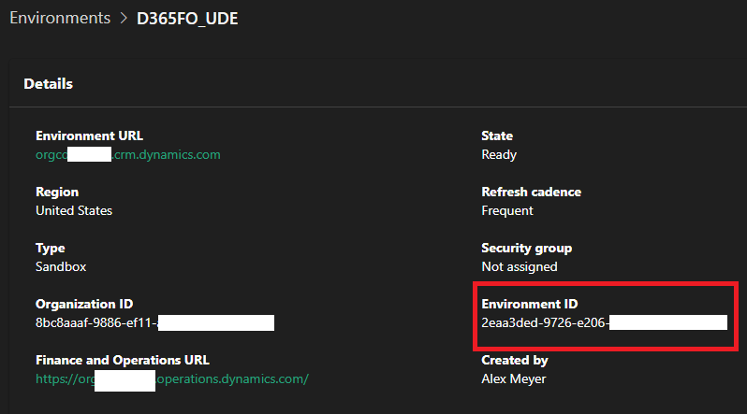
Telemetry & Monitoring Configuration
LCS
PPAC

Slide 24
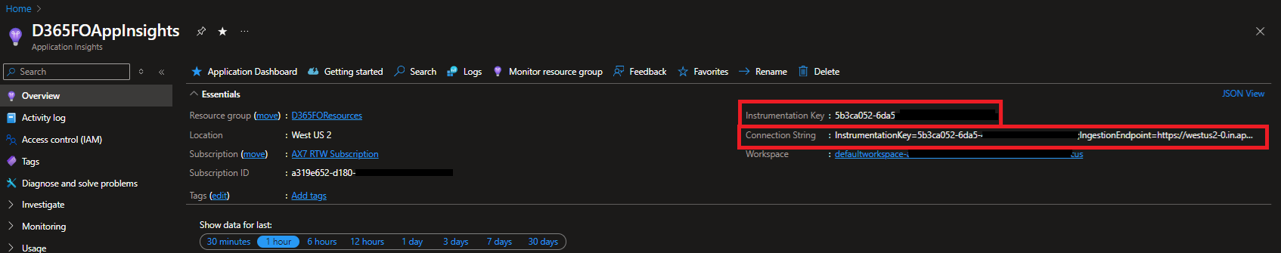
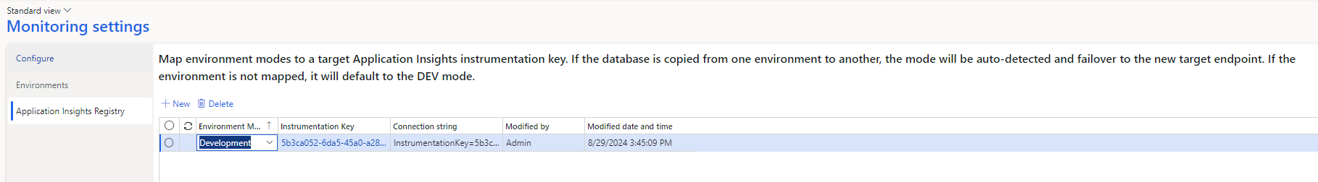
Telemetry & Monitoring Configuration
Notes:
Environment Mode – Development / Test / Producation
Instrumentation Key – From Log Analytics / App Insight resource

Slide 25
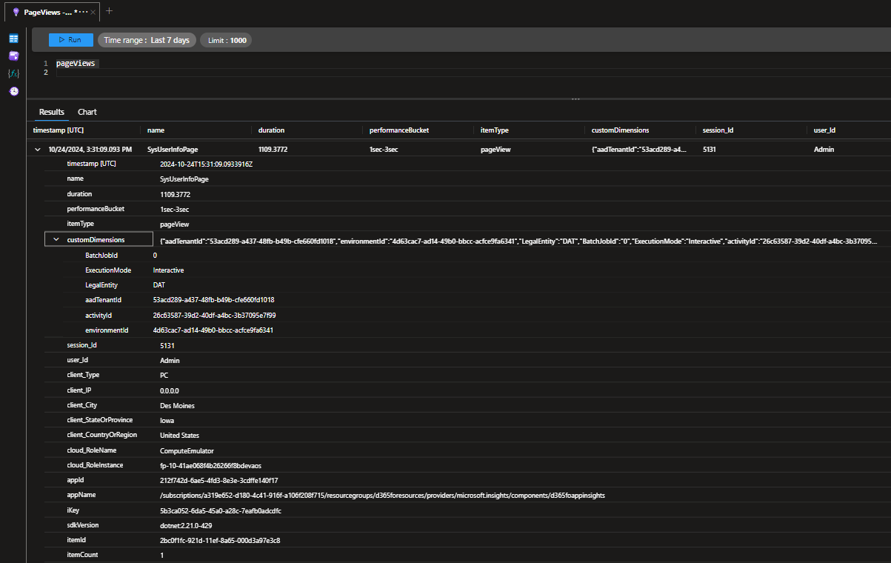
Telemetry Data in Log Analytics
Notes:
Custom Dimensions field is where D365FO specific info is stored:
Legal Entity
AAD Tenant
Environment ID (from LCS)
Cloud_RoleInstance field will store AOS instance in Tier 2 and above – if wanting to query across all AOS instances use Environment ID field from Custom Dimensions

Slide 26
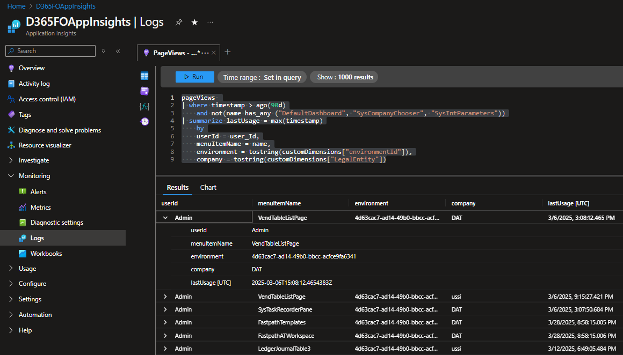
Query Log Analytics Data Using KQL
Log Analytics data can be queried in Azure Portal using Kusto Query Language (KQL)
  Similar to Microsoft SQL

Slide 27
Visualize Data in Power BI

Slide 28
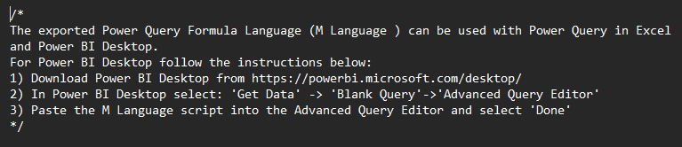
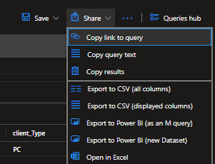
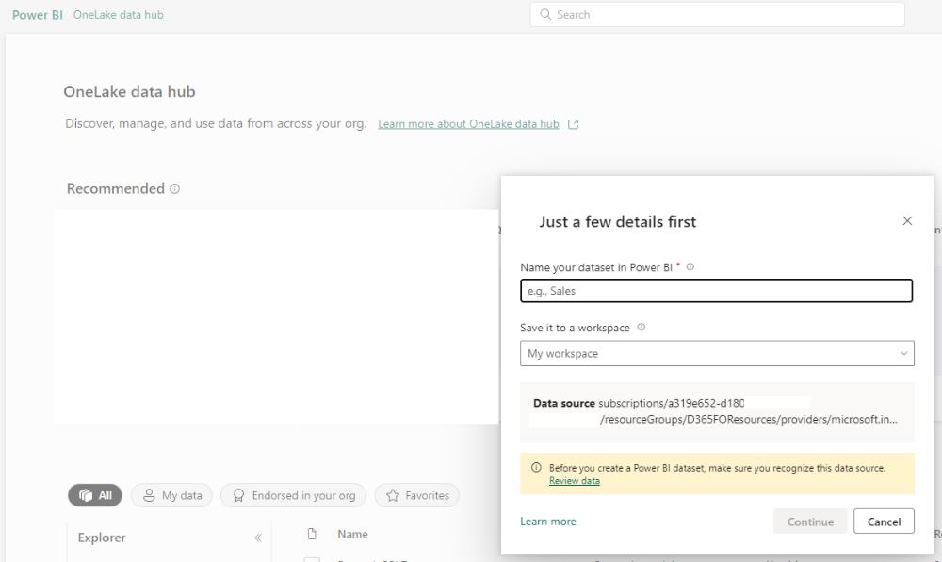
Visualize Data in Power BI
Notes:
Export to Power BI – M Query
Text file with query syntax
Export to Power BI – New Dataset
Launches new Power BI project in browser

Slide 29
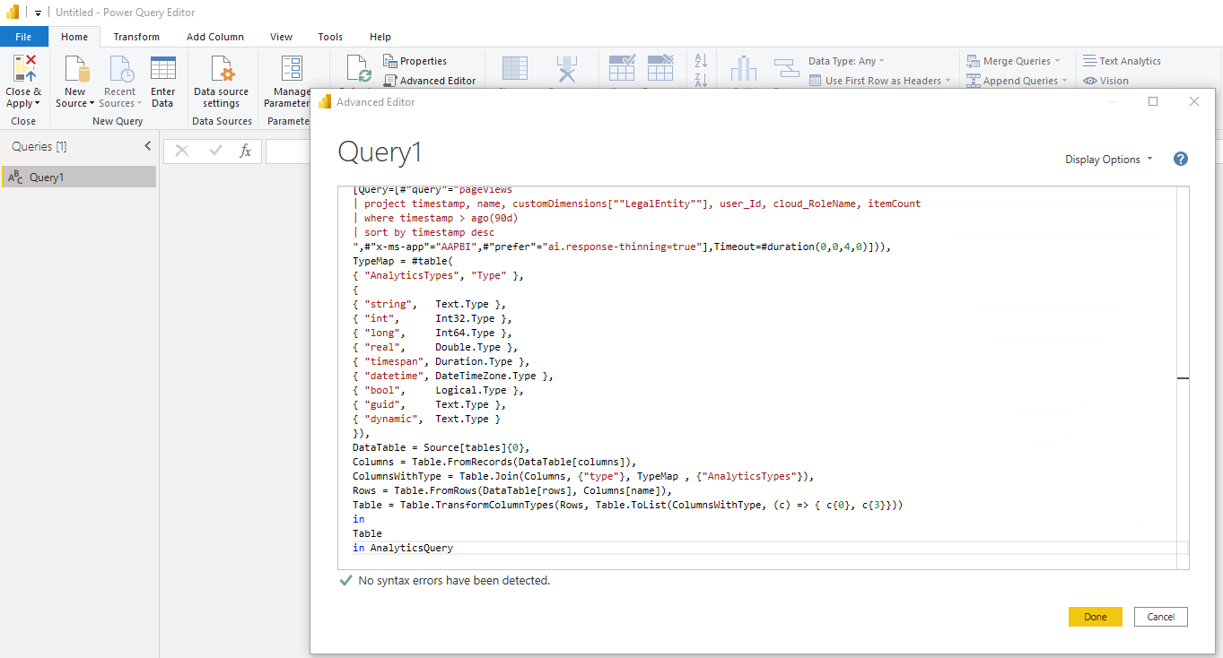
Visualize Data in Power BI – M Query

Slide 30
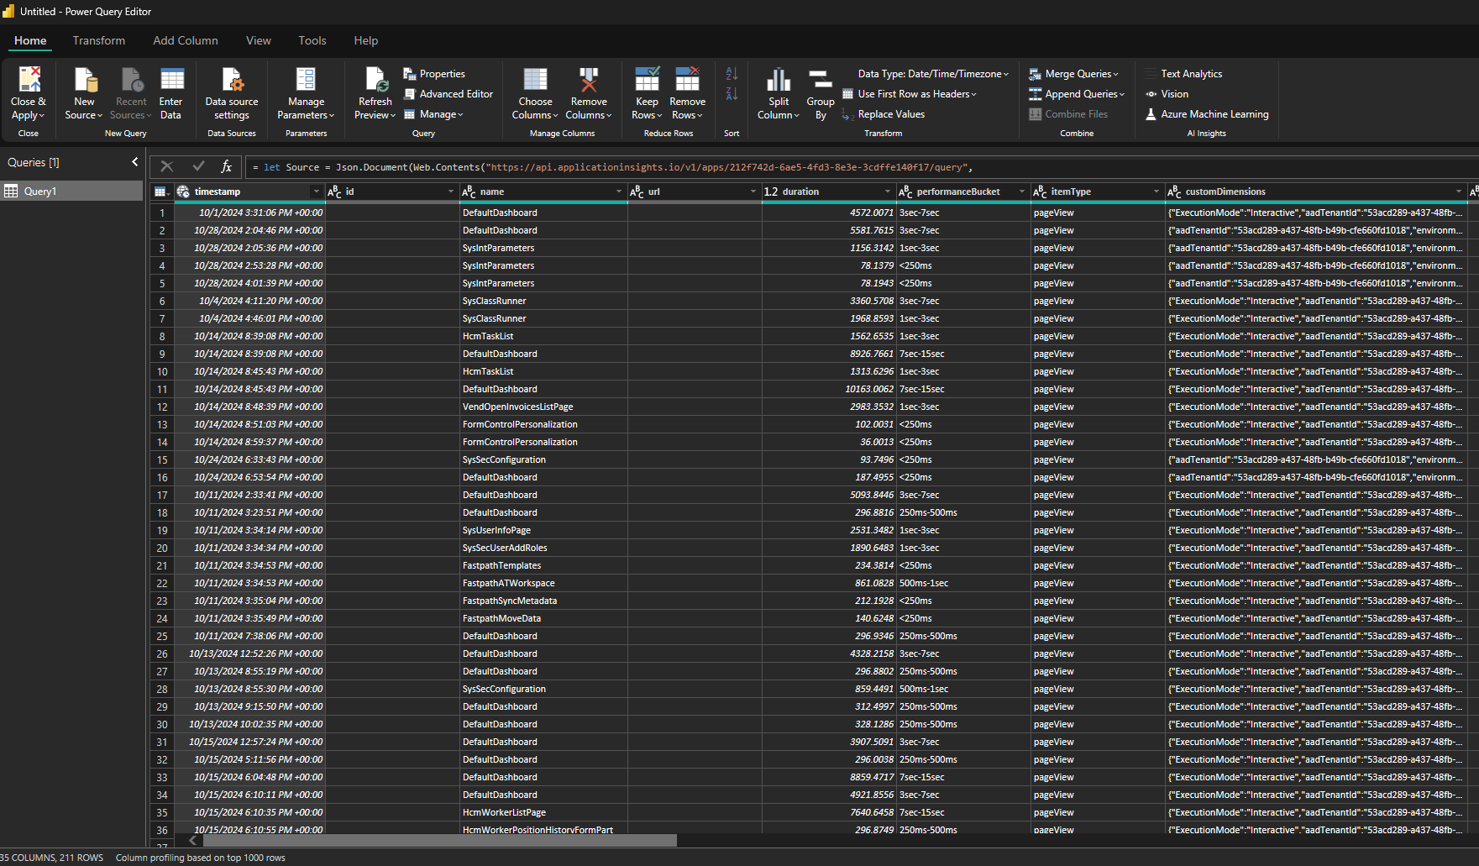
Visualize Data in Power BI – Power Query Editor

Slide 31
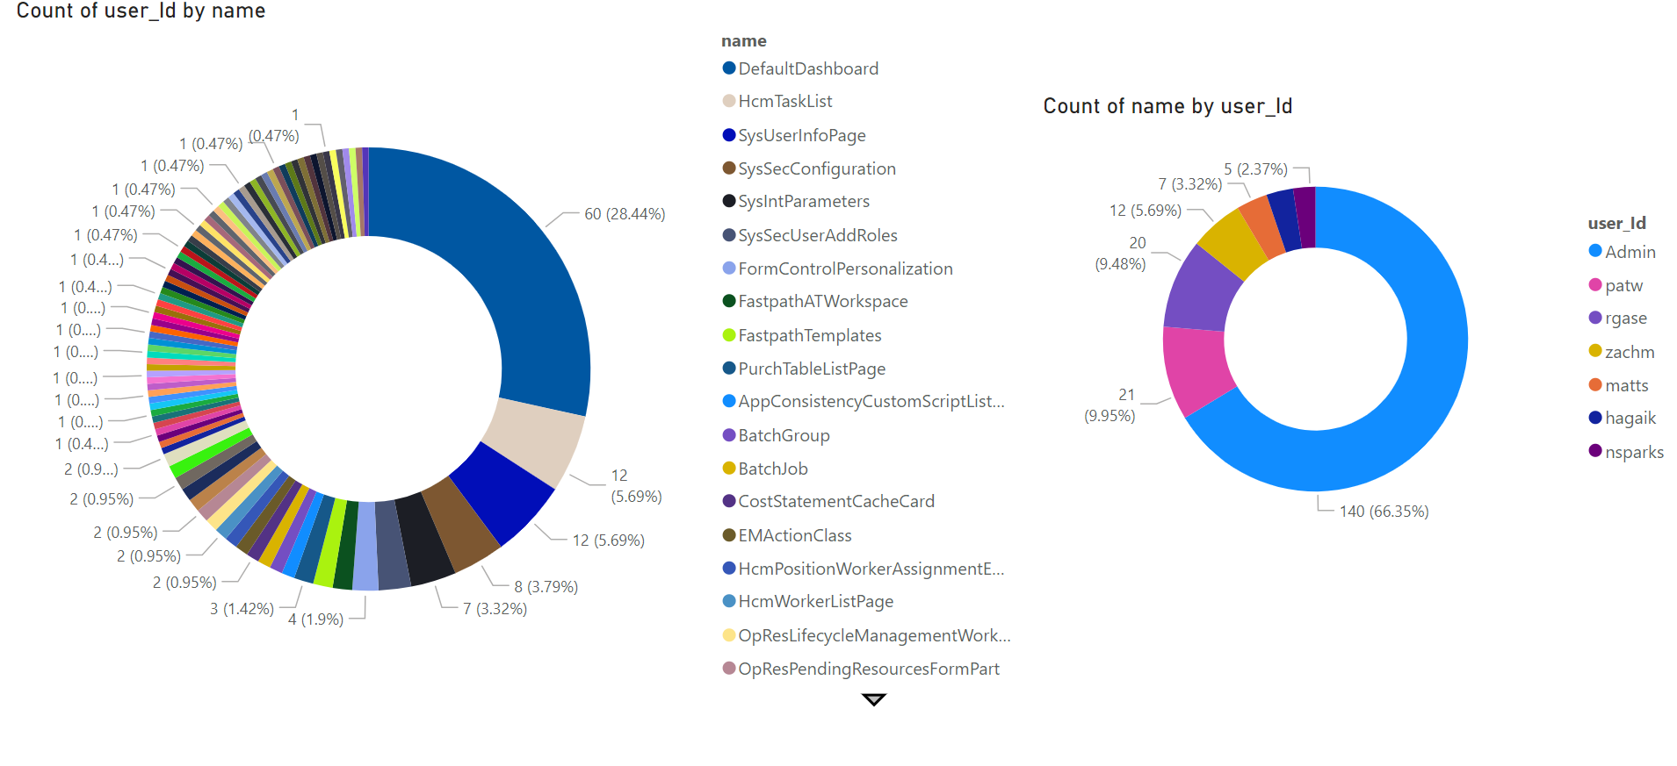
Example Power BI Visualizations

Slide 32
Telemetry Event Types

Slide 33
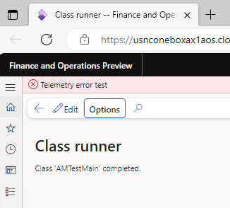
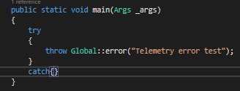
Exception Events

Slide 34
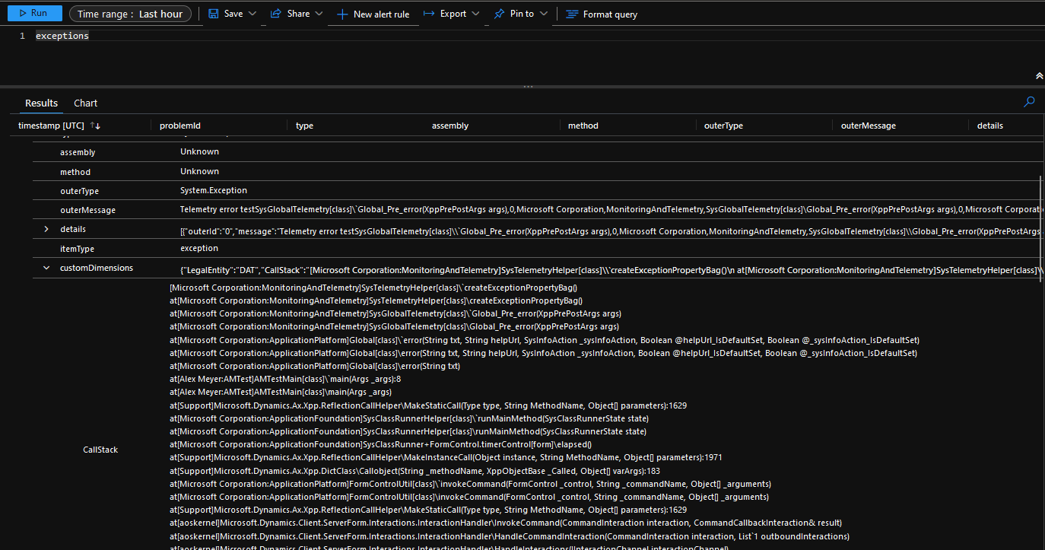
Exception Event Stack Trace

Slide 35
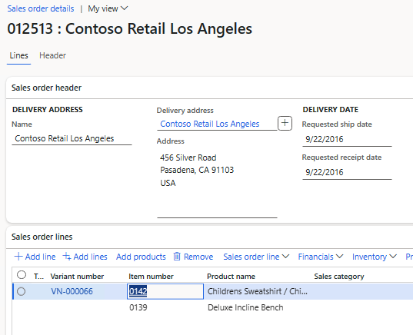
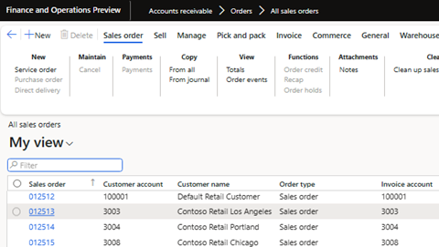
Custom Telemetry Events
Scenario – Want to capture when a user opens a sales order

Slide 36
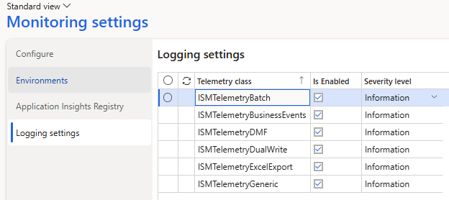
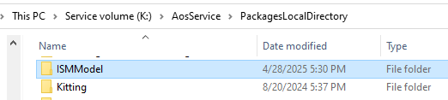
ISM Telemetry for FinOps
GitHub Link

Slide 37
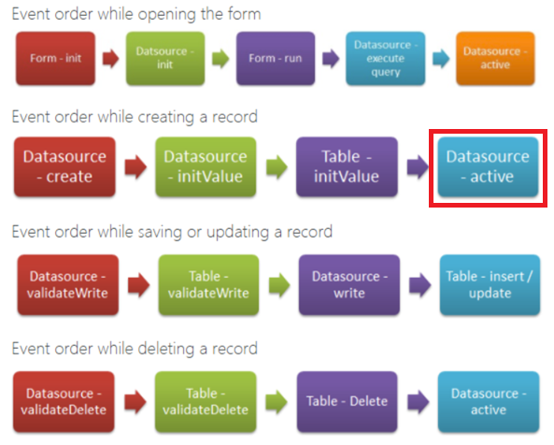
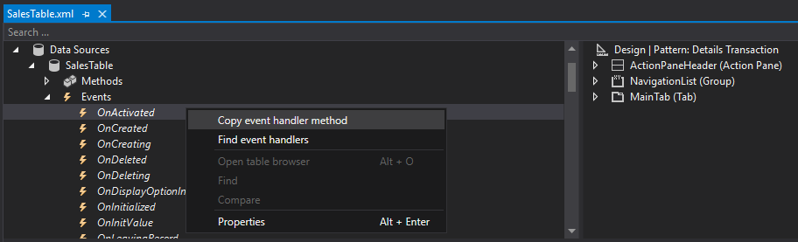
Custom Telemetry Events
Need to find correct event to subscribe to
  Datasource – active
Notes:
https://dynamicsax4u.wordpress.com/2017/08/15/form-event-execution-sequence-in-dynamics-ax/

Slide 38
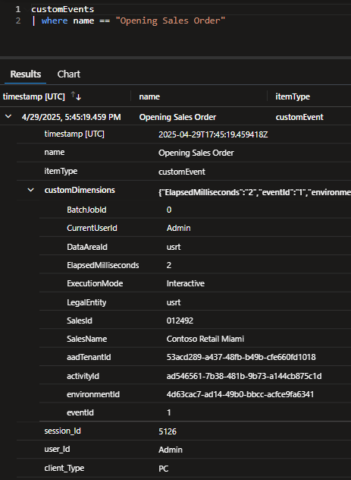
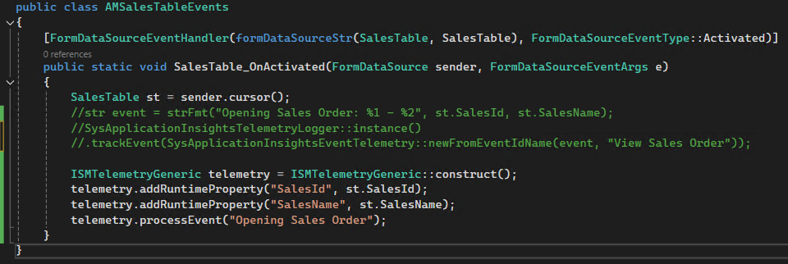
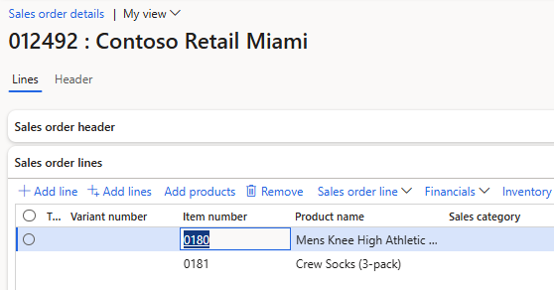
Custom Telemetry Events

Slide 39
Create Solution Using Telemetry Data Within D365FO

Slide 40
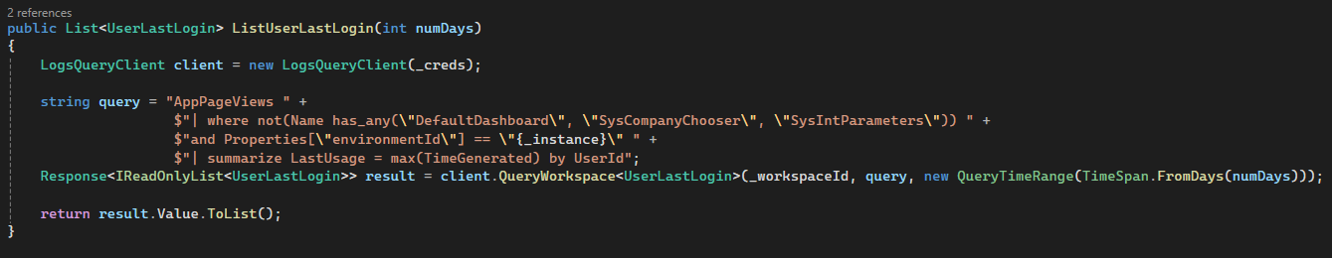
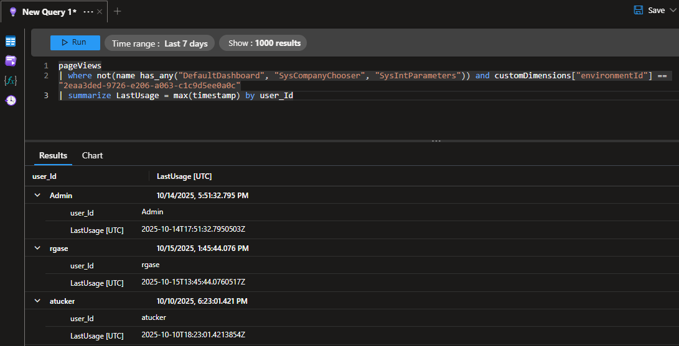
Create Solution Using Telemetry Data
Let’s first create an App Insights KQL query to return the last time a user actually logs into D365FSC

Slide 41
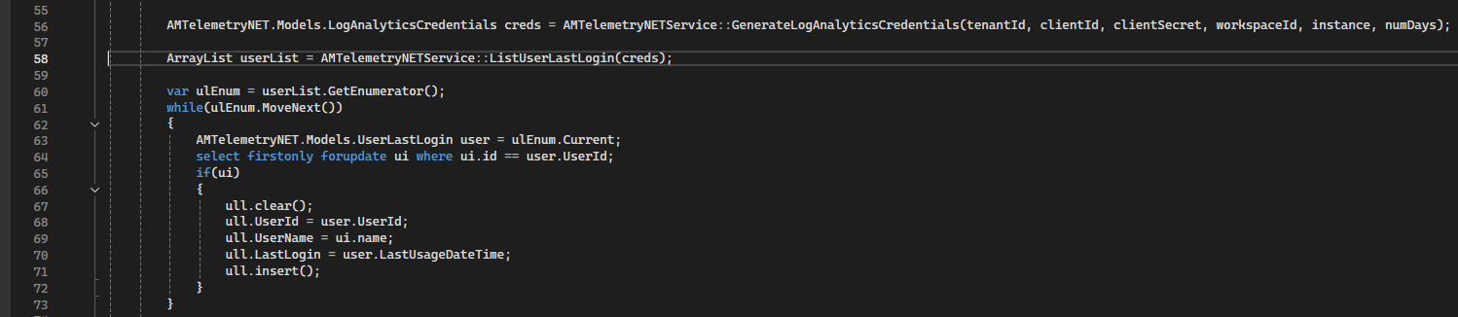
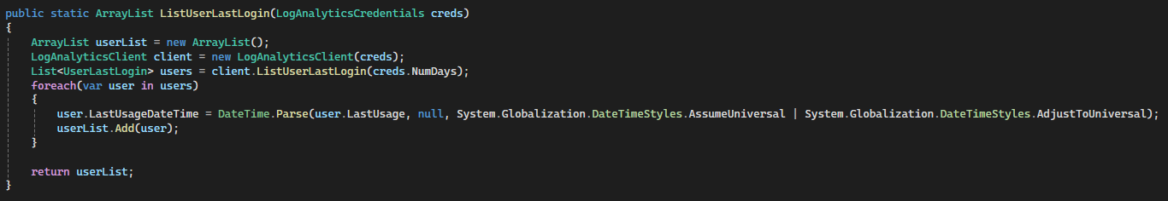
Create Solution Using Telemetry Data

Slide 42
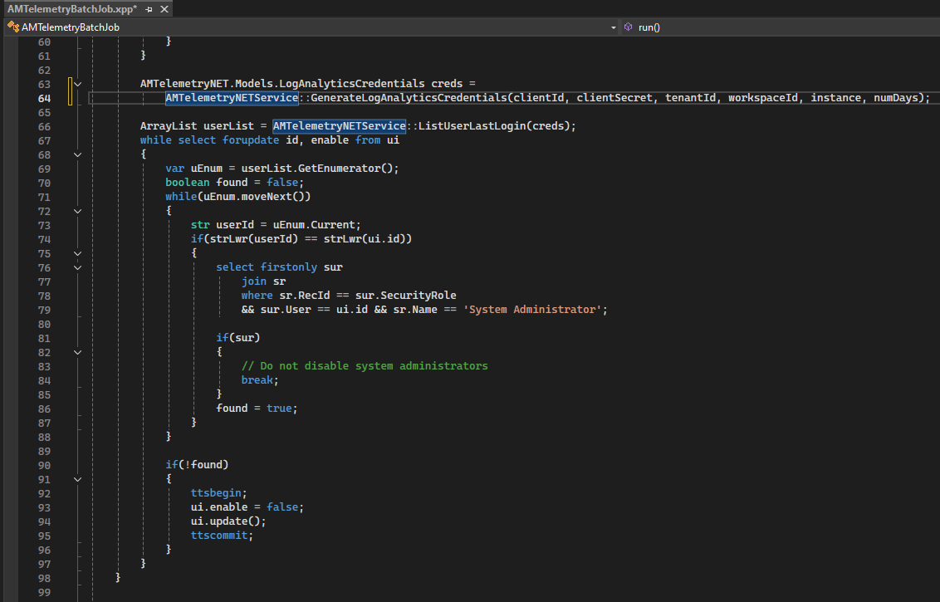
Create Solution Using Telemetry Data
Gets users who have logged in within the last x days
Checks to see if user is assigned SysAdmin before trying to disable user

Slide 43
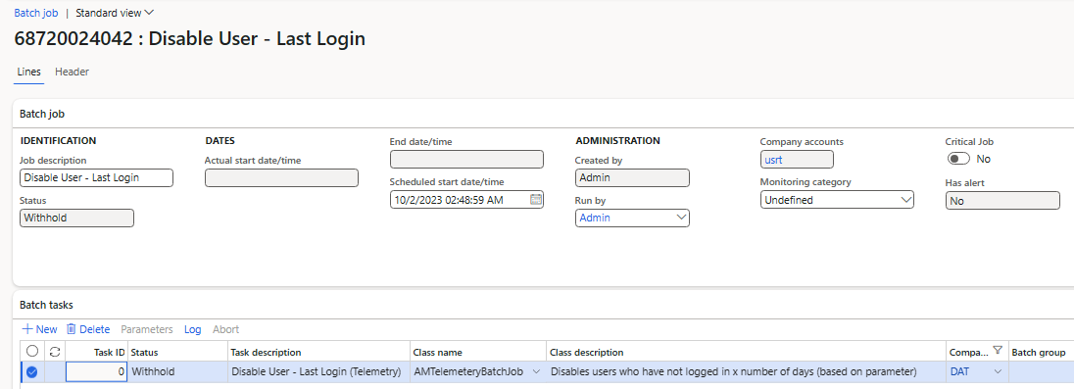
Create Solution Using Telemetry Data

Slide 44
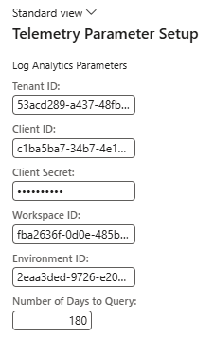
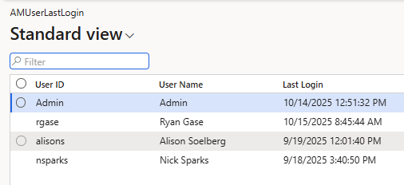

Create Solution Using Telemetry Data
Recreating the ‘User Last Login’ report

Slide 45
Azure App Insights Alerts

Slide 46
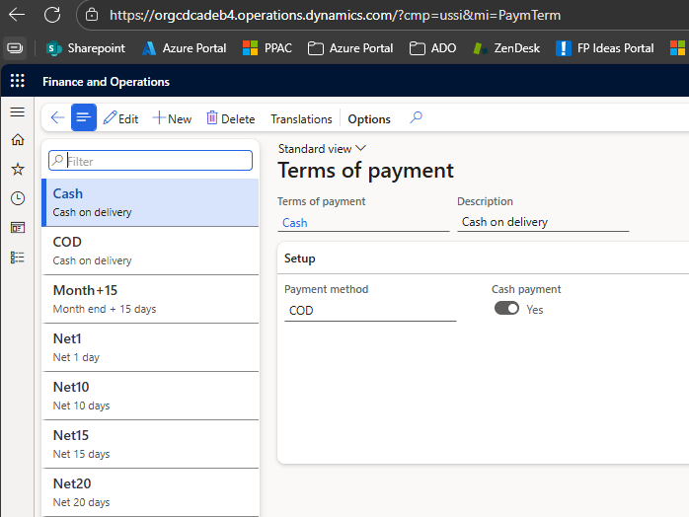

Create an App Insights Alert
Scenario – Want to know when someone accesses customer / vendor terms of payment setup forms

Slide 47


Create App Insights Alert

Slide 48


App Insights Alert Signals

Slide 49

App Insights Create Alert Rule

Slide 50

App Insights Query

Slide 51

App Insights Alert Rule

Slide 52


App Insights Alert Rule Action

Slide 53

App Insights Alert Rule

Slide 54

App Insights Alert

Slide 55

App Insights Alert Response

Slide 56

App Insights Alert Email

Slide 57

App Insights Alert Details

Slide 58
Telemetry & Monitoring Demo

Slide 59
Resources
Overview of Telemetry Data in D365FO
Utilizing Telemetry Data Within D365FO
Using Telemetry Data for Read Auditing in D365FO
D365FO Telemetry Data FAQs
Log Analytics Data Retention
Azure Monitor Pricing
ISM Telemetry for Finance and Operations Overview

Slide 60
Questions?
Email: alex.meyer@delinea.com
Blog: http://d365foblog.com
GitHub: https://github.com/ameyer505
Twitter: https://twitter.com/alexmeyer_ITGuy
D365FO Security Course: http://d365fosecurity.com
PowerPoint available at: https://alexdmeyer.com/resources/downloads/

Slide 62

FINANCE & SUPPLY CHAIN/F&O
© 2025 Dynamic Communities. All rights reserved.

