Slide 1


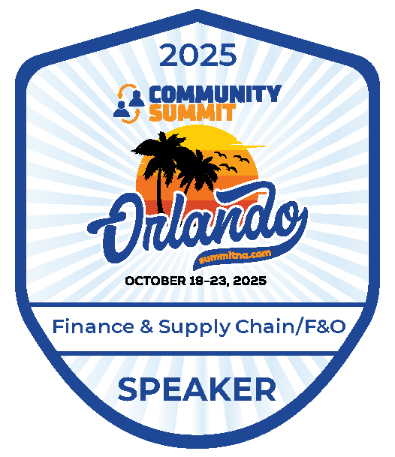
FINANCE &
SUPPLY CHAIN/F&O
Orlando, FL
October 19-23, 2025

Slide 2
D365FO Security & Licensing Made Easy

Slide 3
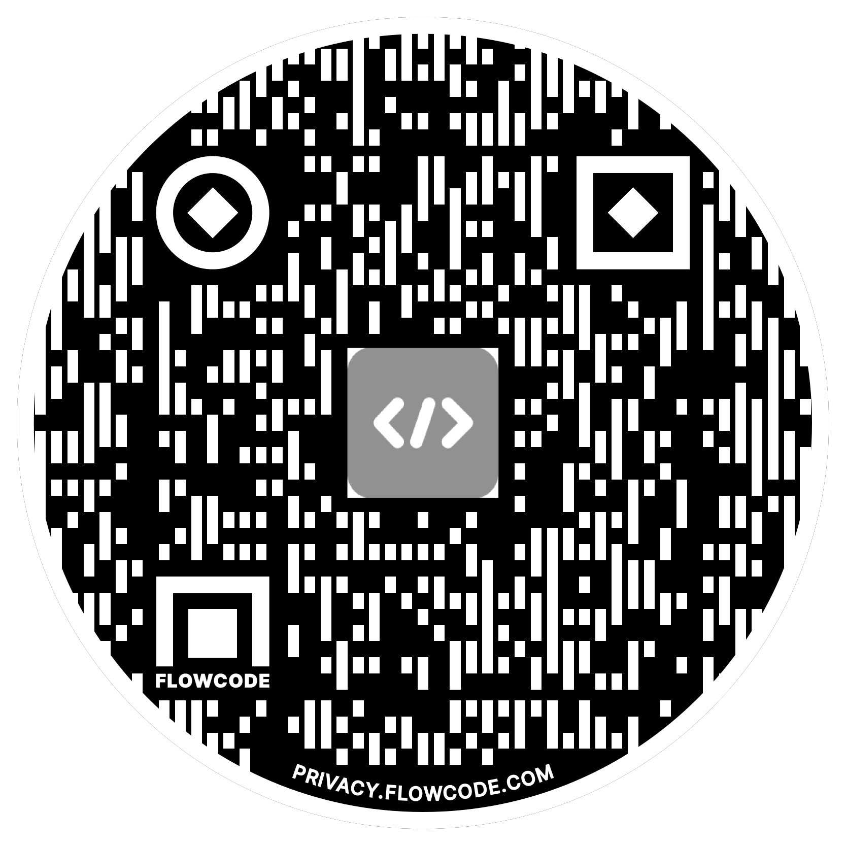

Alex Meyer
Principal Software Development Engineer
Delinea
Email: alex.meyer@delinea.com
Blog: http://d365foblog.com
Security Class: http://d365fosecurity.com
LinkedIn / Microsoft MVP Profile
Background:
Awarded Microsoft MVP in Business Applications since 2019
Been working with AX since 2013 and D365FO since 2016
Have spoken at Summit (US & Europe), Focus, and local chapters around AX/D365FO security and have done webinars around native controls in both versions

Slide 4
Session Agenda
Dynamics 365 FSC Security Model
How Security & Licensing Tie Together
New Licensing Model
License Enforcement
License Reporting
  Power Platform Admin Center
  Lifecycle Services
  User Security Governance

Slide 5
Things to Note
Everything we talk about is accurate as of today – things can change in the future
I do not work for Microsoft
I did not have any input on license changes or the license enforcement
This can be a ‘license therapy’ session if needed
Venting is ok – we are all in this together

Slide 6
D365FSC Security Model

Slide 7
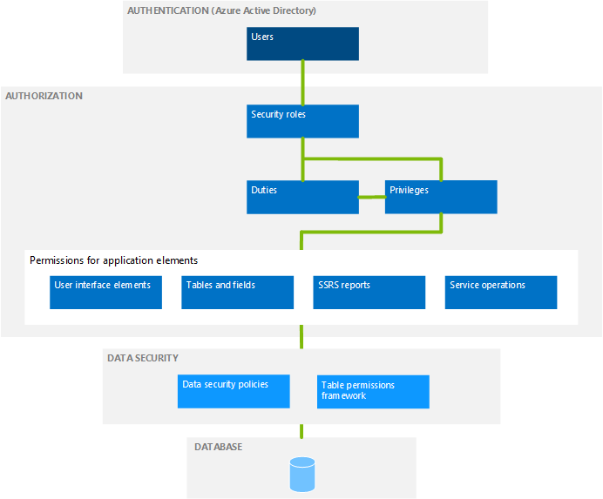
D365FSC Security Model
Role Based Security
Users are assigned one or more roles
Hierarchy based security model
  Groups of securable objects are put within one security layer
  Security layers built on top of each other
Two main categories
  Security Layers
  Securable Objects

Slide 8

Security & Licensing Tied Together
Security
Licensing
What access a user is assigned = what license(s) they are required to have
  Not based on utilization
Over provisioning of user access ->
  Over assignment of user licenses ->
    Higher licensing costs

Slide 9
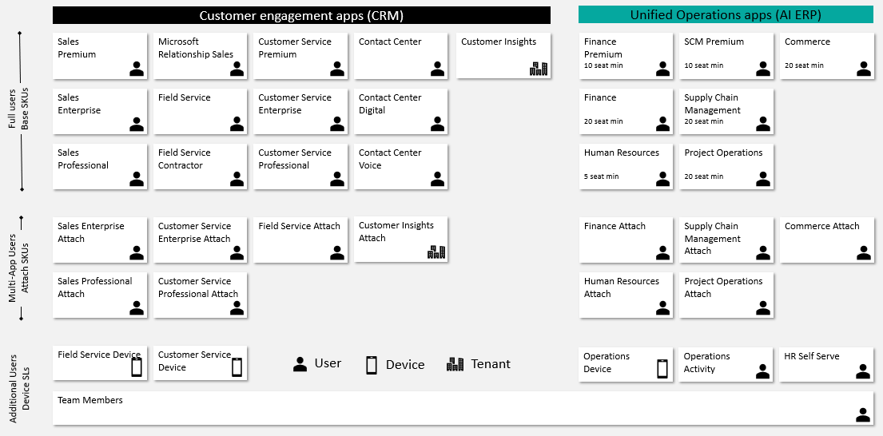
Dynamics 365 Licensing

Slide 10
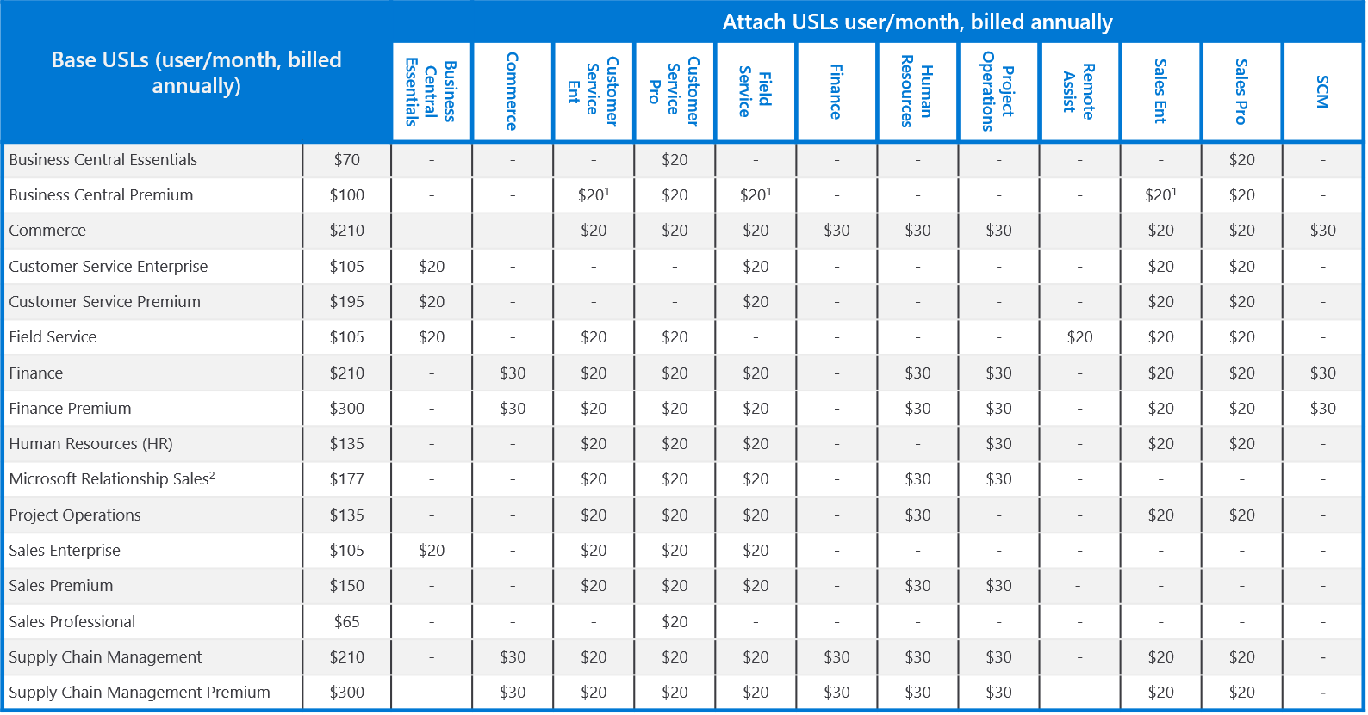
Dynamics 365 Base / Attach Licenses

Slide 11
Updates to D365 Licensing Methodology

Slide 12
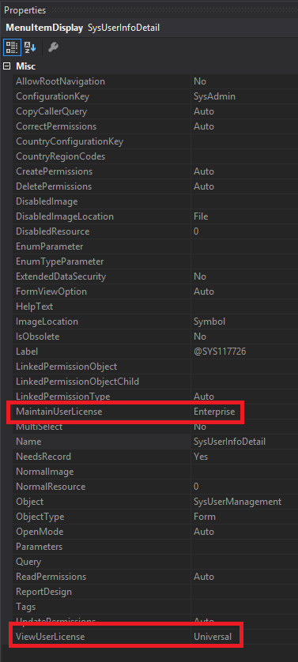
Where Did We Come From?
License requirement came from entry point attributes
  ViewUserLicense
  MaintainUserLicense
Privileges assigned to a user determined license SKU requirements
  Finance, SCM, Commerce, Project Ops, HR

Slide 13
Where Are We Now?
License analysis done at the object level
All license calculation done by Power Platform Admin Center (PPAC)
Data is pushed to other systems D365FSC / LCS / etc
PPAC is source of truth (refreshes every 24 hours)

Slide 14
License Hierarchy
Each license has a ‘Priority’
  The highest priority license of a user access must be the base license
Some have a ‘GroupName’ – which categorizes the license SKUs into groups that are of a similar level
  Dark Blue – Fin, SCM, Comm
  Blue – Proj Ops, HR
  Yellow – No group
SCM Prem
Operations- Activity
Team Member
Finance Prem
SCM
Finance
Commerce
Project Operations
Human Resources
HR Self Service

Slide 15
Licensing Methodology Changes
Objects themselves actually drive all license requirements
License Objects:
  Menu Items
  Service Operations (new)
  Data Entities (new)
  Data Entity Methods (new)
Read permission = Team Member
  Unless ‘EnforceReadPermission’ = 1
Write permission = LicensingElementRequiringEntitlement
  Includes Update, Create, Delete access

Slide 16
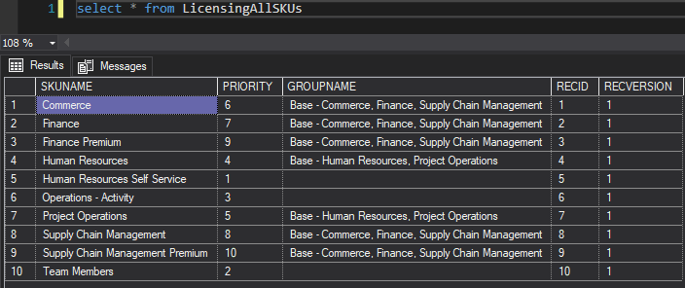
Object Level Analysis
In 10.0.43+, there are new licensing tables that contain detailed information on license requirements
LicensingAllSKUs
  Stores all current licenses and their priority ranking

Slide 17
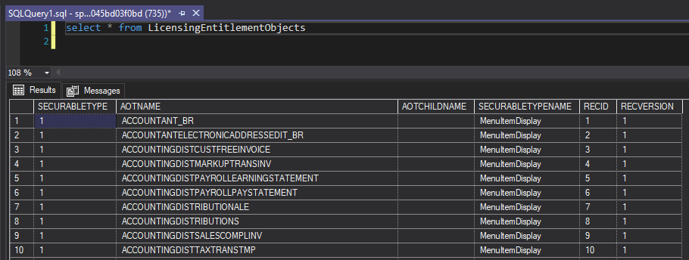
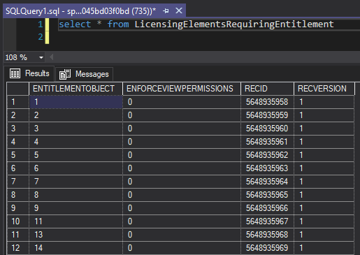
Object Level Analysis
LicensingEntitlementObjects
LicensingElementsRequiringEntitlement

Slide 18
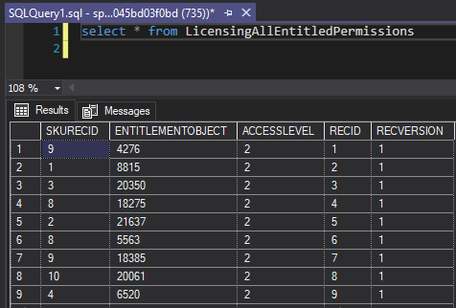
Object Level Analysis
LicensingAllEntitledPermissions

Slide 19
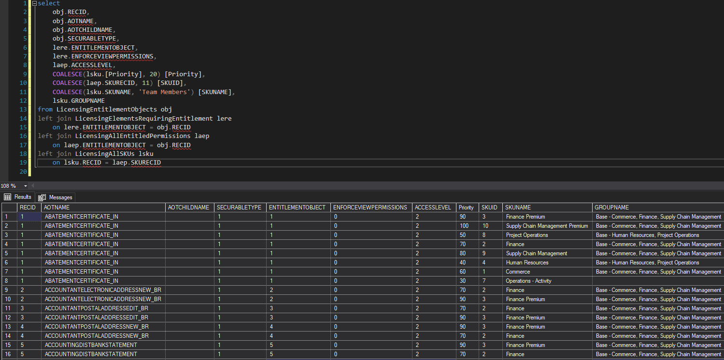
Consolidated Object License Analysis

Slide 20
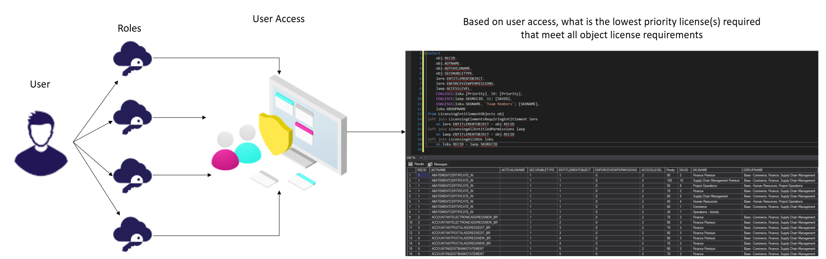
Licensing Overview

Slide 21
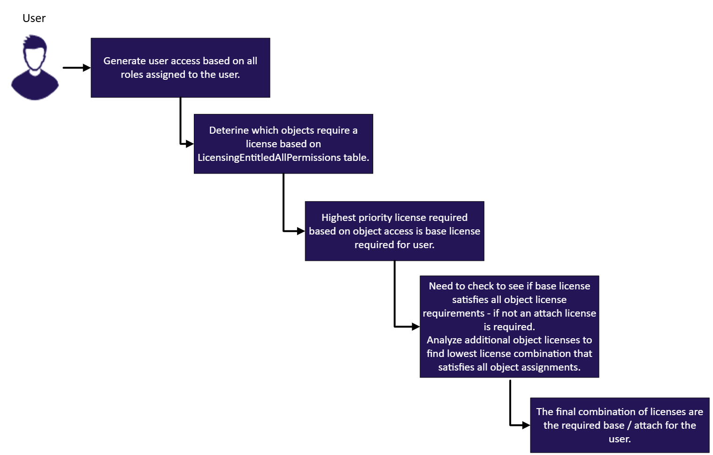
Licensing Overview

Slide 22
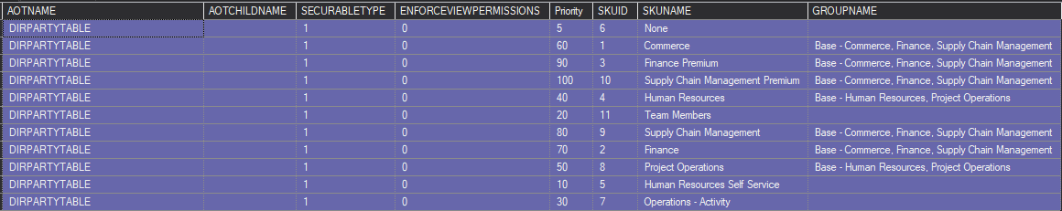
Licensing Example
Read access to either object
  Team Member – EnforceViewPermissions set to 0
Update / Create / Delete to CustTableListPage
  Finance or Supply Chain Management
Update / Create / Delete to DirPartyTable
  Team Member

Slide 23
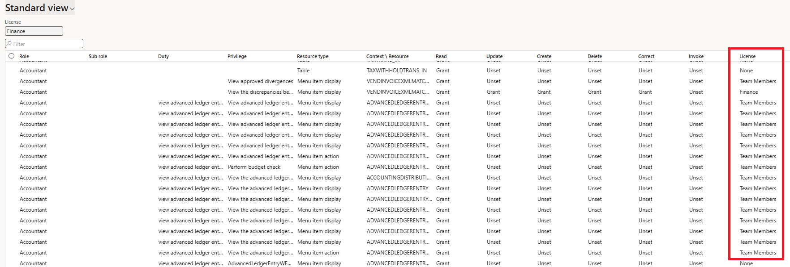
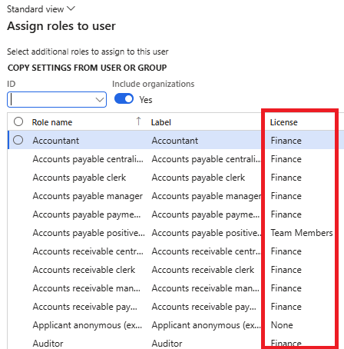
Deprecated License Reports
Microsoft has announced that legacy license reporting within D365 will be deprecated
  View Permissions report
  License shown during user role assignment
  User License Counts
  User License History

Slide 24
License Enforcement

Slide 25
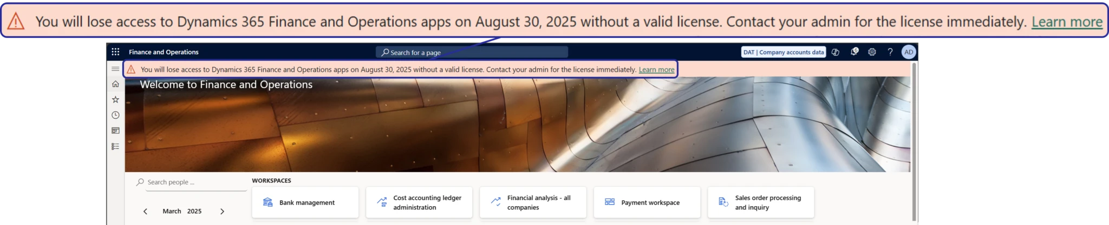
Dynamics 365 License Enforcement
Simplifying License Management For D365FSC
Enforcement starting…
  May 15th 2025
  Nov 1st 2025
  January 15th 2026

Slide 26
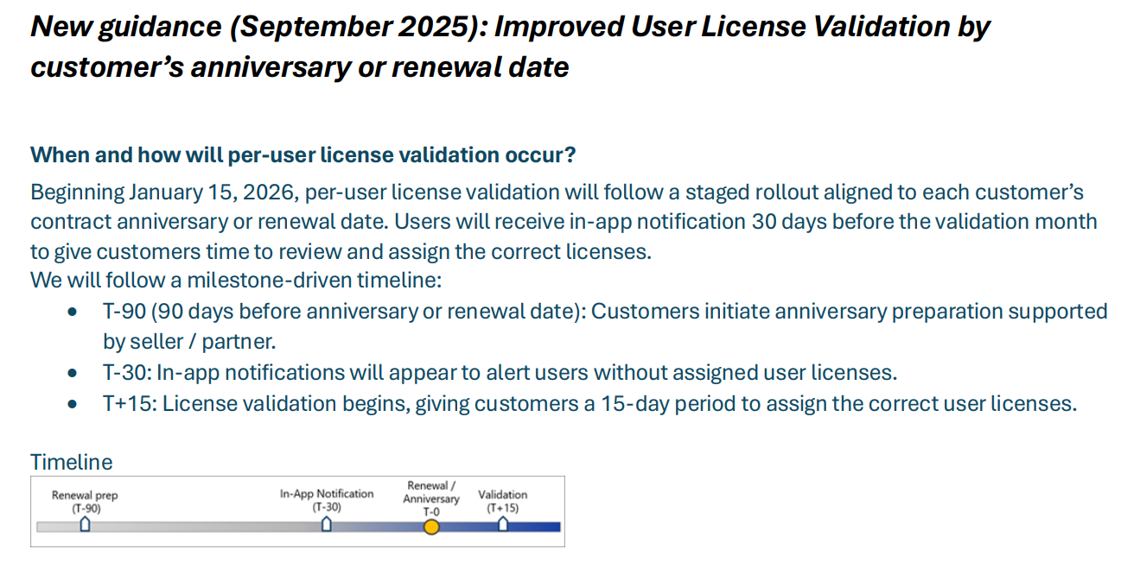
September 2025 Changes

Slide 27
Environment Type Enforcement
Only impacts Microsoft managed production environments
  Does not impact government cloud, China cloud
License enforcement on different environment deployments
Customer Hosted (Not Reported) | Microsoft Managed
VHD / VM images | Unified Developer Environment (managed via PPAC)
Cloud Hosted Environments | Unified Sandbox Environment (managed via PPAC)
Local Business Data (D365 on-prem) | Sandbox Tier 2 / 3 / 4 / 5 (in scope for reporting)
 | Production (managed via LCS or PPAC) In scope for reporting, notification, and enforcement

Slide 28
Other License Enforcement FAQ
B2B guest users must be licensed like any other user – even if they are from another domain / tenant
Users assigned the SysAdmin role do not require a license
Service accounts do not require a license as long as they are not assigned roles that provide ‘interactive or business functionality’.
A separate license must be assigned for each D365 tenants a user accesses
  A separate license is not required for multiple production instances under the same tenant
Multiplexing rules still apply – if an external user accesses D365 data through an application / automation they must be assigned the appropriate license as if they accessed that data within the application itself

Slide 29
License Enforcement Grace Period
If your license renewal falls between
April 1st 2025 – Sept 30th 2025
Receive a ‘grace period’ of 12 months
Grace period does not forgive non-compliance
  Microsoft can back-bill for over usage
At the end of grace period, same enforcement timeline as normal applies
  No Extensions

Slide 30
External Users
External users who access the system through a designated ‘external’ role do not require a license
  Vendor Admin (external)
  Vendor Contact (external)
  Vendor Prospect (external)
  Applicant Anonymous (external)
If you clone these roles to customize them, then the users would require a license based on the access assigned

Slide 31
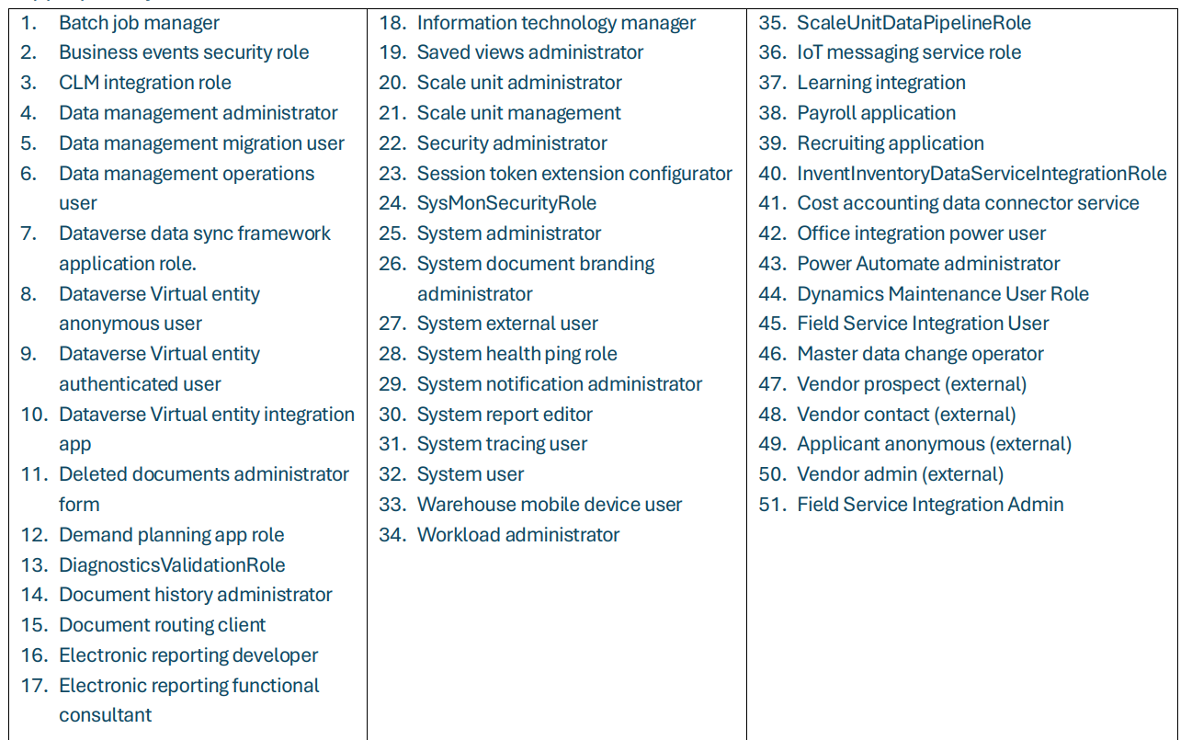
Roles That Do Not Require a License

Slide 32
Known Issues – Sept 2025
License exports from PPAC fail to download
  Clear browser cache and/or wait 24 hours to try download again
Users assigned access via Entra ID group membership are not being reported correctly
  Estimated fix - end of Oct 2025
Tenants that have multiple email domains (eg: @contoso.com and @contososubsidary.com) are not being correctly counted
  Estimated fix – Nov 1st 2025

Slide 33
License Reporting

Slide 34
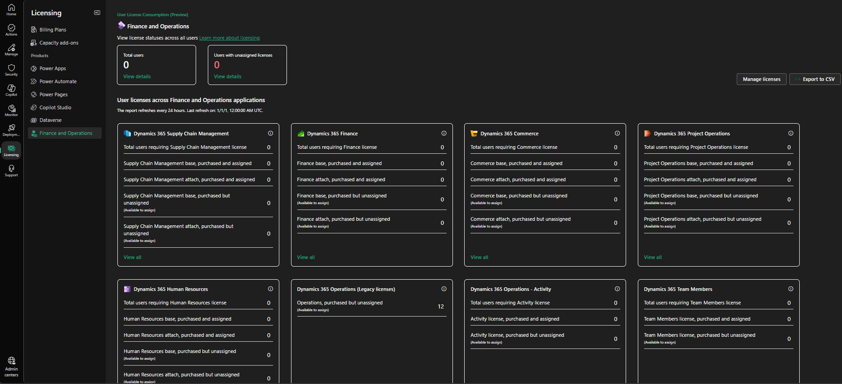
Power Platform Admin Center (PPAC)
PPAC -> Licensing -> Finance and Operations
Breaks out licenses by:
  Type
  Base / Attach vs Purchased
CSV export for detailed analysis (would recommend Excel)

Slide 35
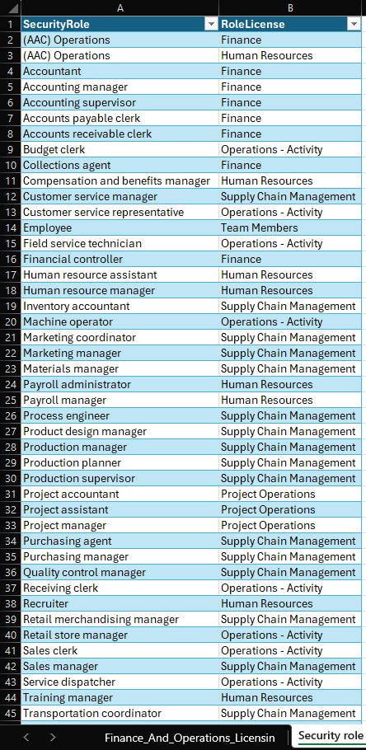
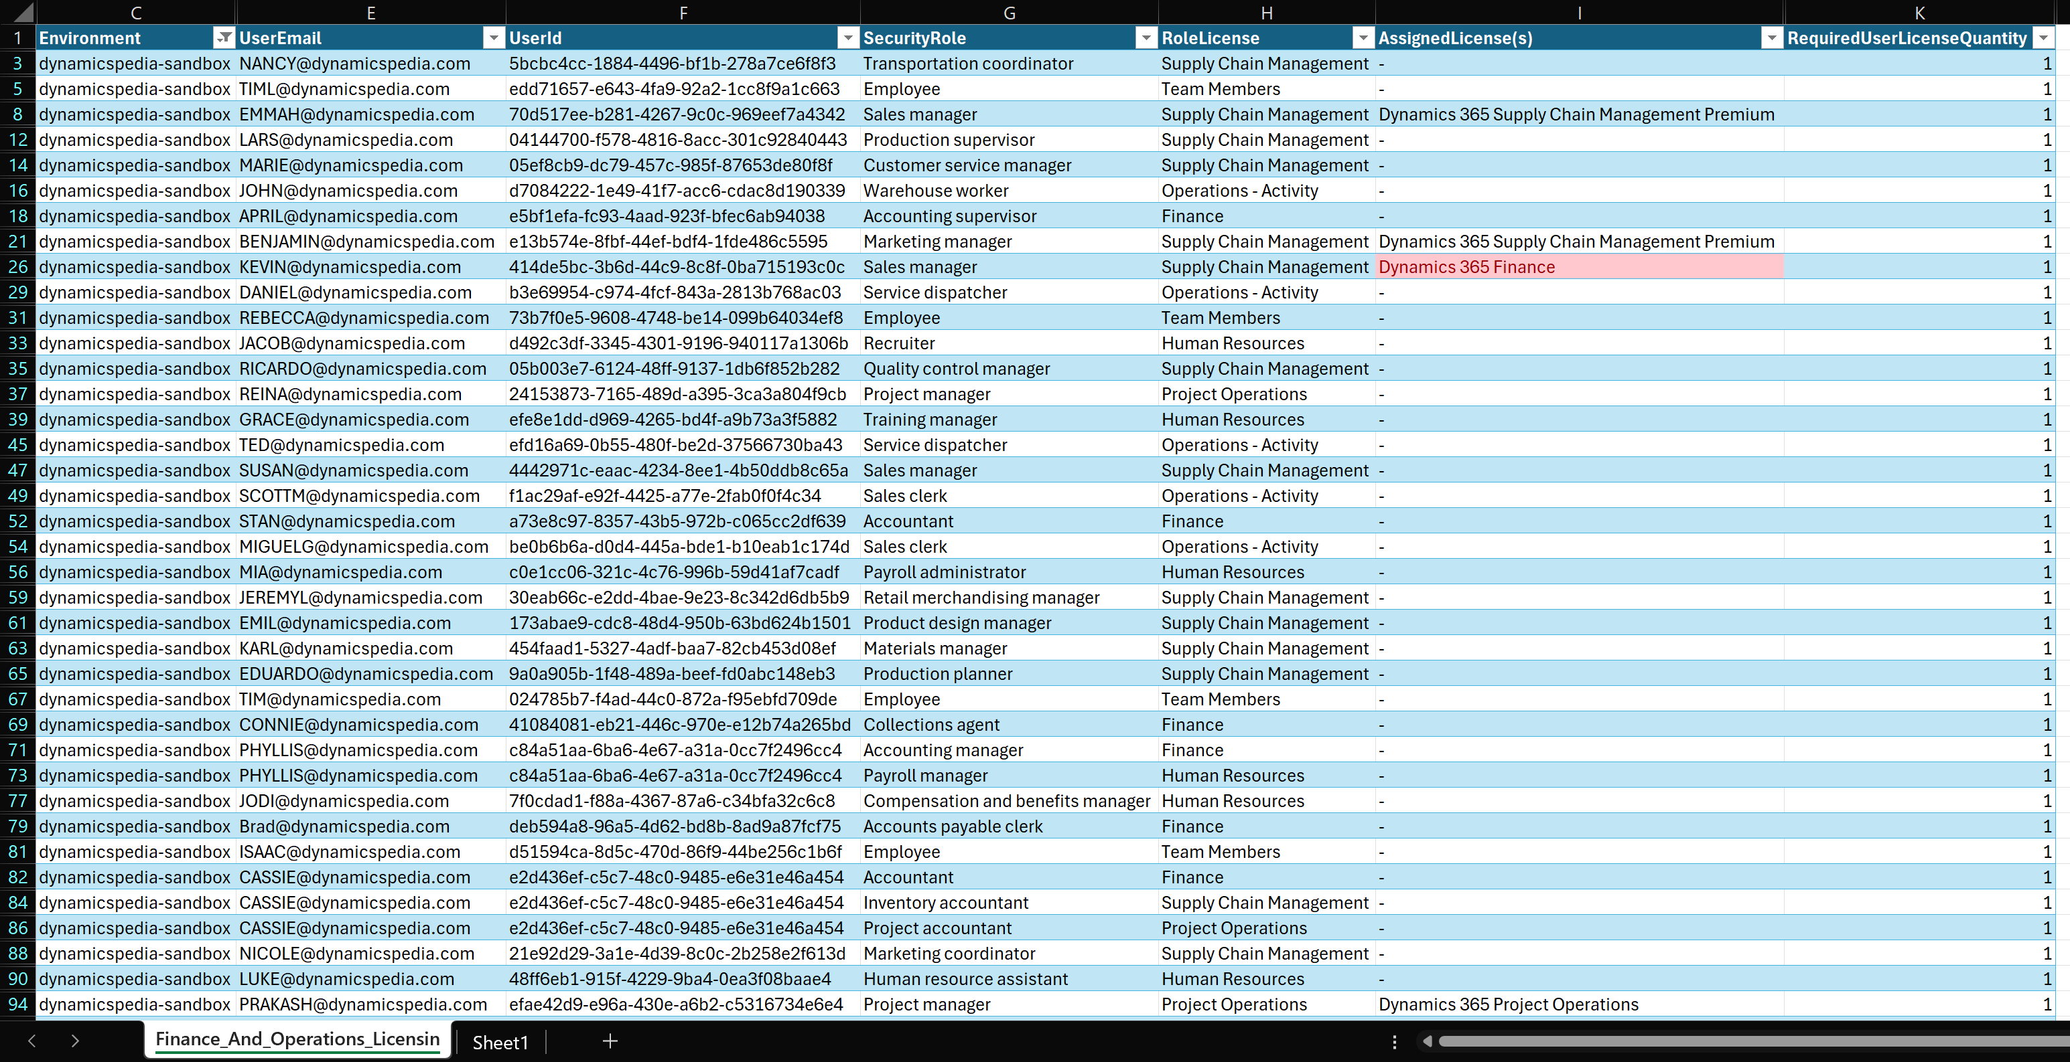
PPAC License CSV in Excel

Slide 36
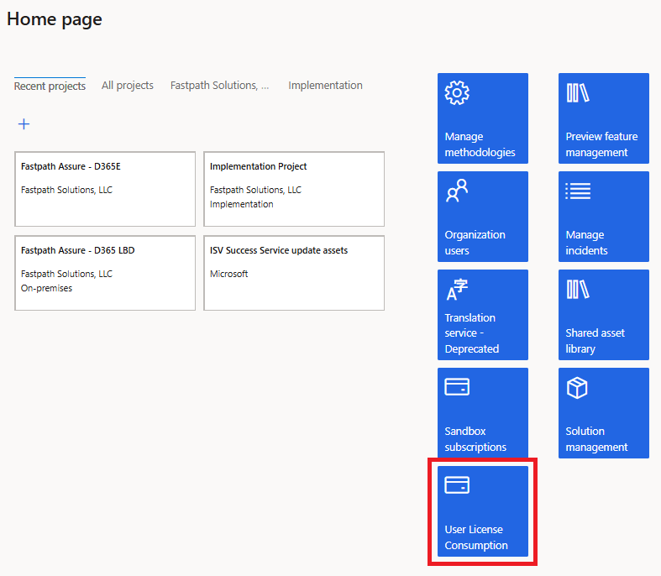
Lifecycle Services (LCS)
User License Consumption report
  Should show the same data as PPAC

Slide 37
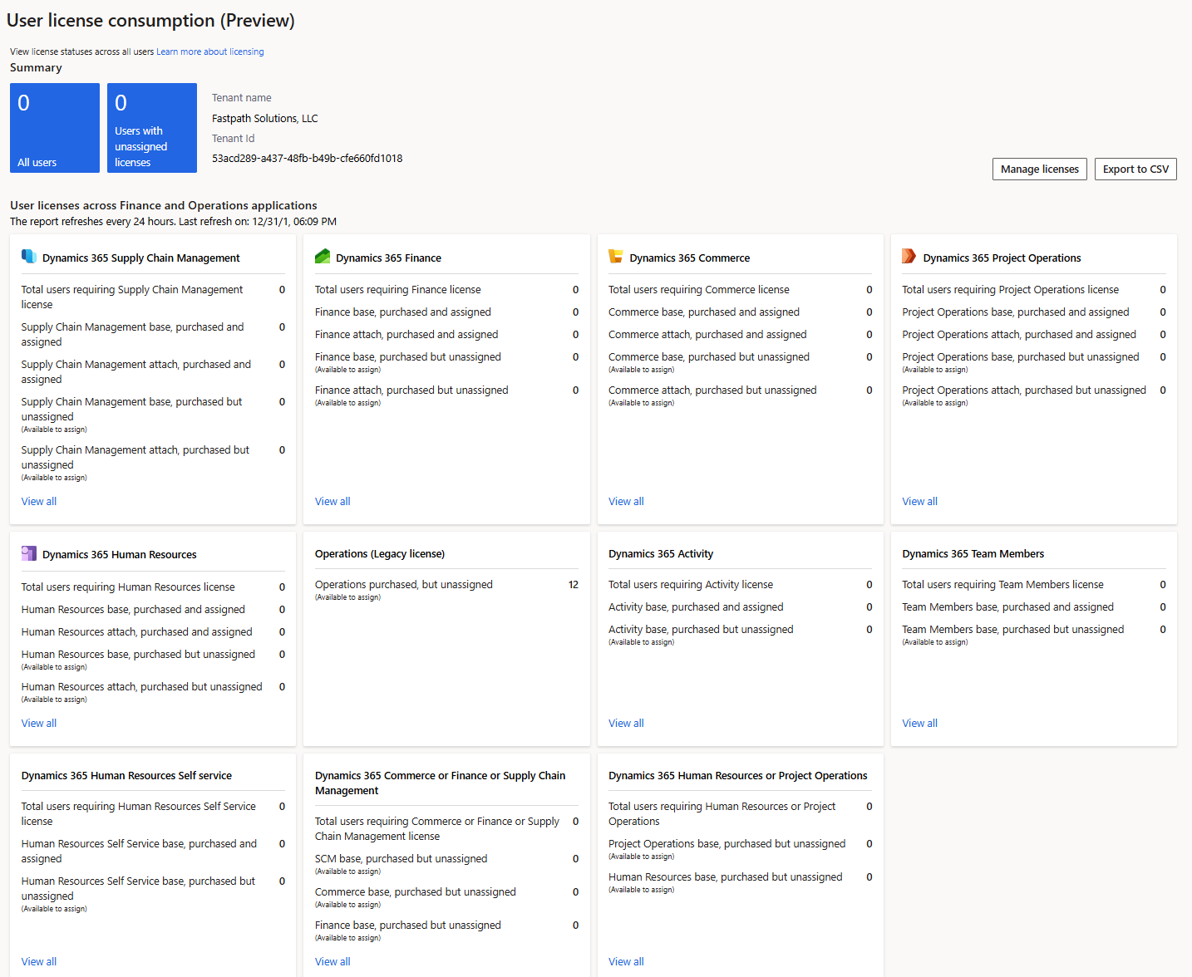
LCS User License Consumption

Slide 38
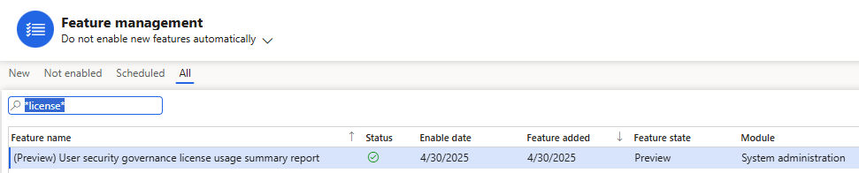
User Security Governance
License Usage Summary report
  Preview feature – will need to be enabled via Feature Management

Slide 39
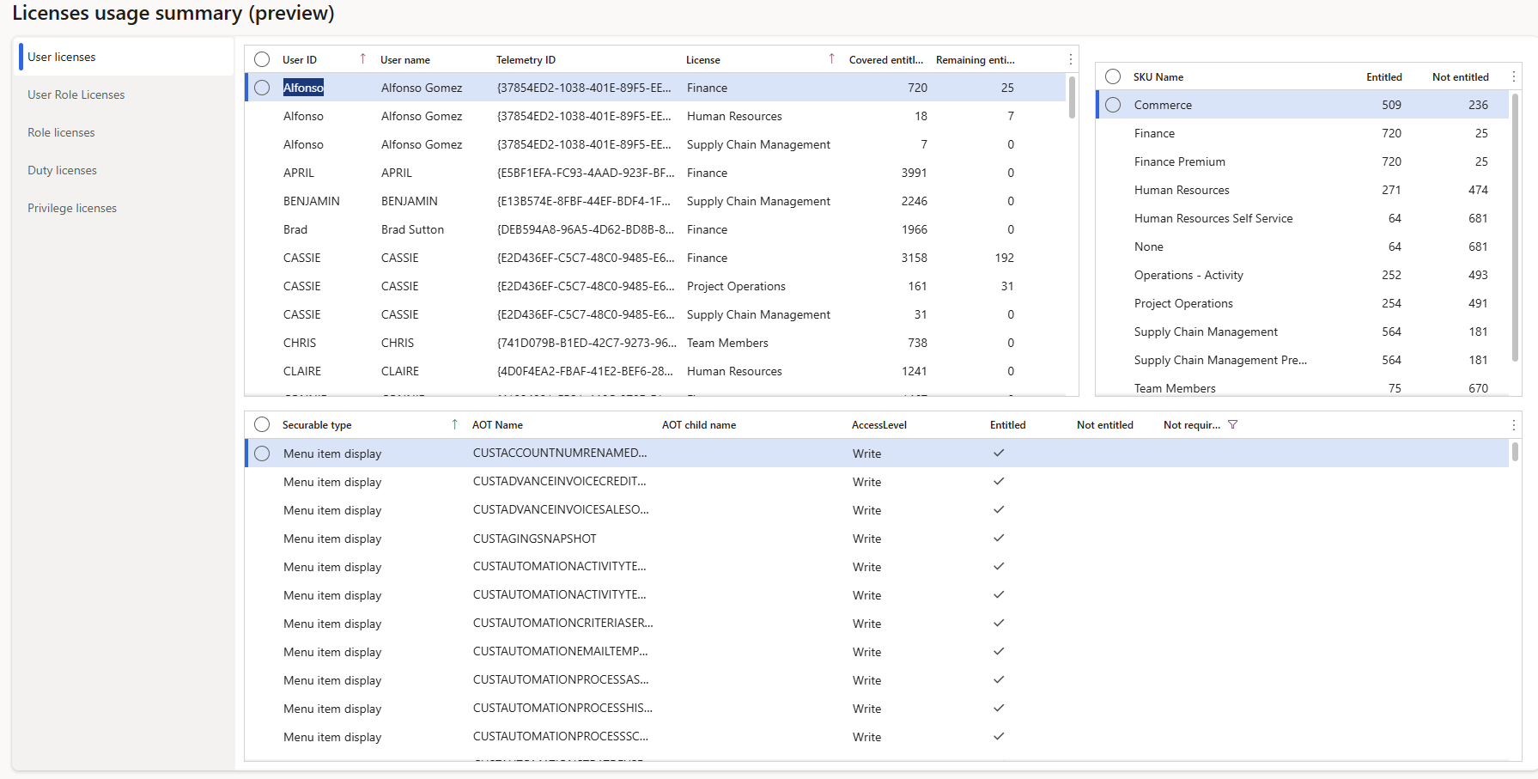
License Usage Summary – User License

Slide 40
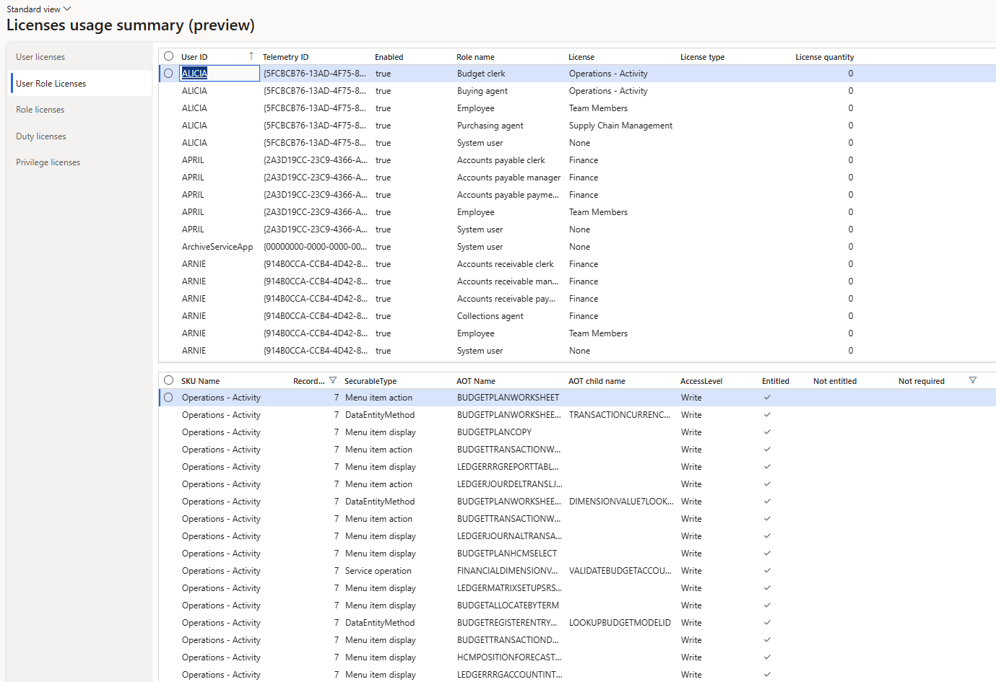
License Usage Summary – User Role License

Slide 41
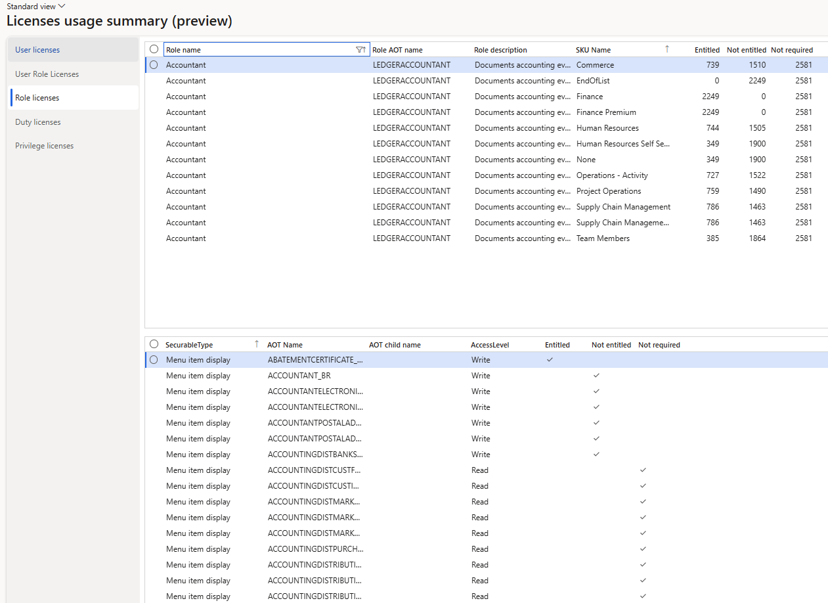
License Usage Summary – Role License

Slide 42
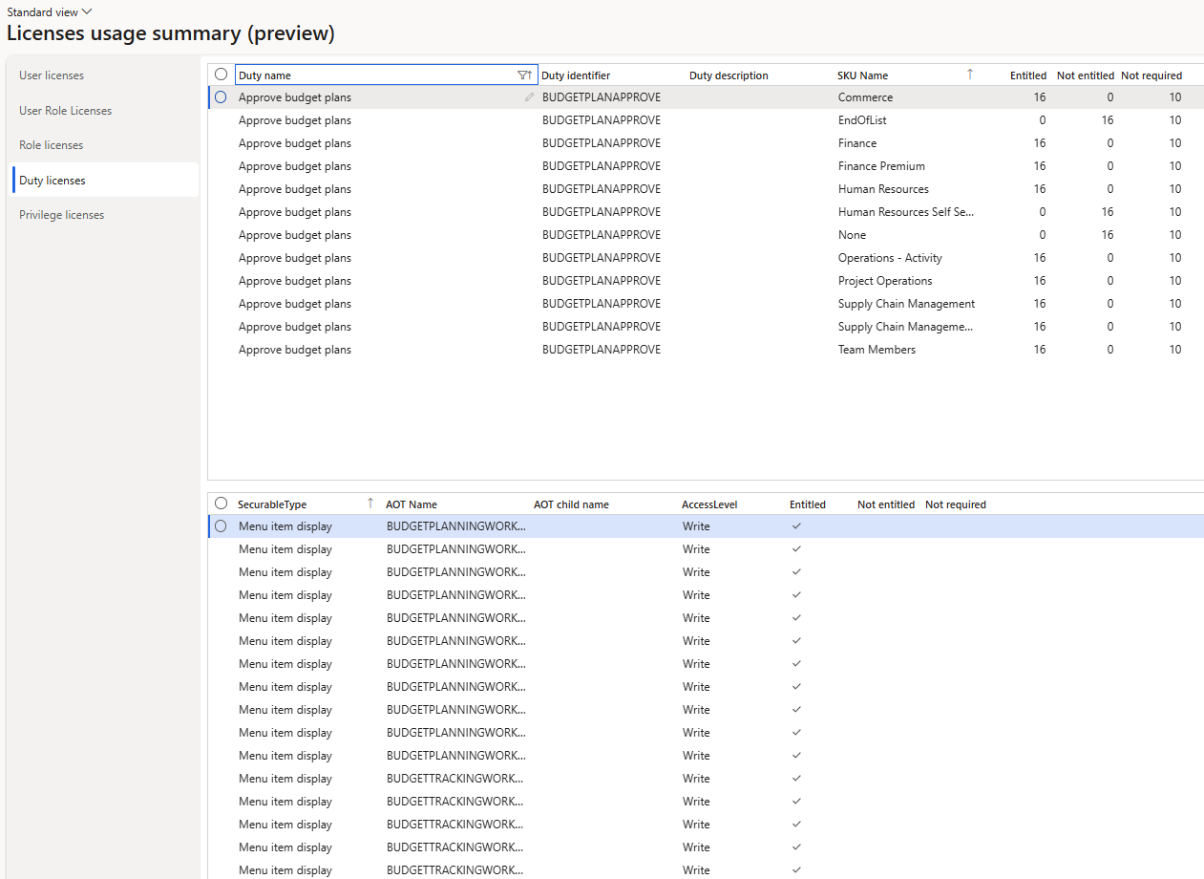
License Usage Summary – Duty License

Slide 43
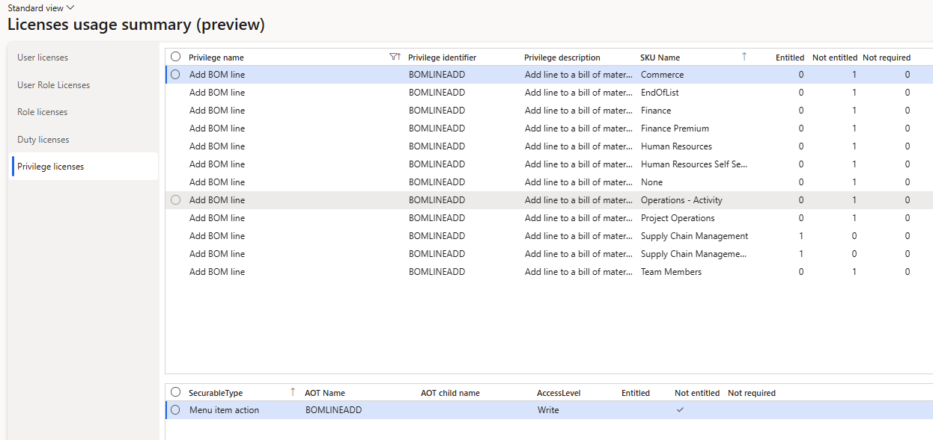
License Usage Summary – Privilege License

Slide 44
Security & Licensing Wrap Up

Slide 45
Key Takeaways
The reviewing of user license assignments is much more important (and ongoing) process now
License enforcement is coming
  Be proactive on ensuring you are compliant – DO NOT WAIT
Should have a process in place to review license impact after:
  User role assignment
  Security role, duty, or privilege change
  Be sure to test all changes in non-prod env first before pushing to prod
Licensing requirements can change with updates to PPAC
  Does not require a D365 update

Slide 46
Resources
Microsoft D365 Licensing Guide
Microsoft Licensing FAQ
D365FSC License Enforcement Overview – Alex Meyer
Updated D365FSC User Licensing in 10.44 – Alex Meyer
Security topics – Dynamicspedia
My First Look at User Security Governance - Dynamicspedia
How to Read and Analyze the Dynamics 365 F&O License Usage Summary Report – A Real-Life Scenario | Fatih DEMİRCİ
Simplifying License Management for Dynamics 365

Slide 47
Questions?
Alex Meyer
Email: alex.meyer@delinea.com
Delinea website: https://delinea.com/
Fastpath website: https://delinea.com/fastpath
My website: https://alexdmeyer.com
Blog: http://d365foblog.com
Security Class: http://d365fosecurity.com

Slide 48
Please complete session evaluations!

Slide 49

FINANCE & SUPPLY CHAIN/F&O
© 2025 Dynamic Communities. All rights reserved.

