Slide 2
Tips and Tricks for Securing D365 F&O

Slide 3

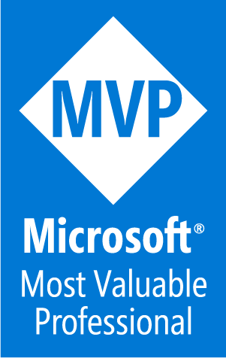
Peter Ramer
Director of Managed Application Services
RSM
Email: peter.ramer@rsmus.com
Blog: http://dynamics365musings.com/
LinkedIn | Microsoft MVP Profile
Background:
Awarded Microsoft MVP in Business Applications since 2022
Been working with AX since 2006 and D365FO since 2016
Have written code that was then purchased and included into the standard F&O product.
Have a blog and YouTube channel that contains lots of technical tutorials.

Slide 4


Alex Meyer
Principal Software Development Engineer
Delinea
Email: alex.meyer@delinea.com
Blog: http://d365foblog.com
Security Class: http://d365fosecurity.com
GitHub: https://github.com/ameyer505
YouTube:
LinkedIn | Microsoft MVP Profile
Background:
Awarded Microsoft MVP in Business Applications since 2019
Been working with AX since 2013
Been working with D365FO since 2016
Have spoken at Summit (US & Europe), Focus, and local chapters around AX/D365FO security and have done webinars around native controls in both versions

Slide 5
Agenda
How to easily import user and role assignments
How to determine what security to assign to a user
How to correctly determine user license requirements
Utilizing telemetry data
How to use the table browser
Executing custom X++ code in production
How to correctly configure JIT access

Slide 6
Assigning User Security

Slide 7
Role Setup & Assignment
Template roles, duties, and privileges are delivered out of the box
Roles, duties, and privileges are system wide (not per company/legal entity)
User role assignments can be restricted by legal entity
By default, when a user is assigned a role, it is assigned to all companies/legal entities in the environment
You can restrict this by explicitly granting a legal entity to the user role assignment
Once one company/legal entity is assigned to a user role assignment, a user only has that role access in the legal entity(ies) they assign to it
SecurityUserRole & OMUserRoleOrganization (SecurityUserRoleCondition) tables

Slide 8
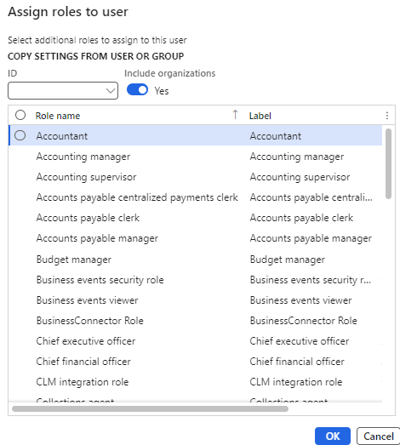
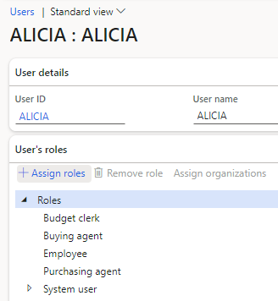
Assigning Roles to User
System Administration -> Users -> Select a user

Slide 9
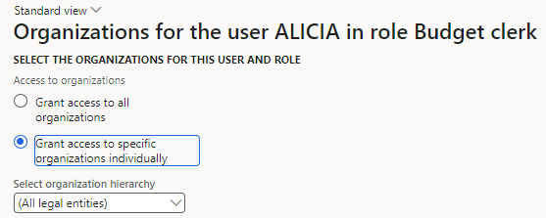
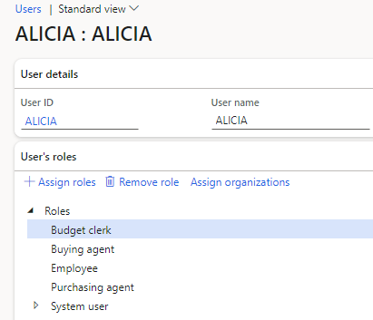
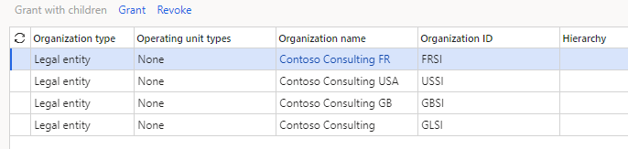
Assign Org Restriction

Slide 10
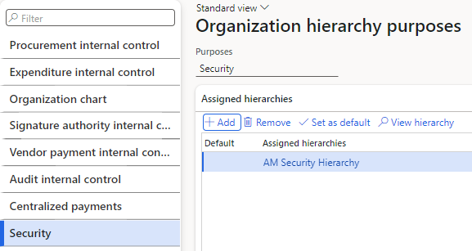
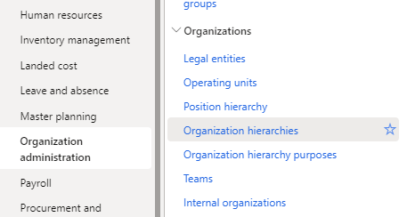
Organization Hierarchies
Allows for mass assignment of organization restrictions to user role assignments based on defined structure

Slide 11
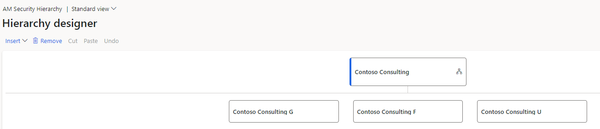
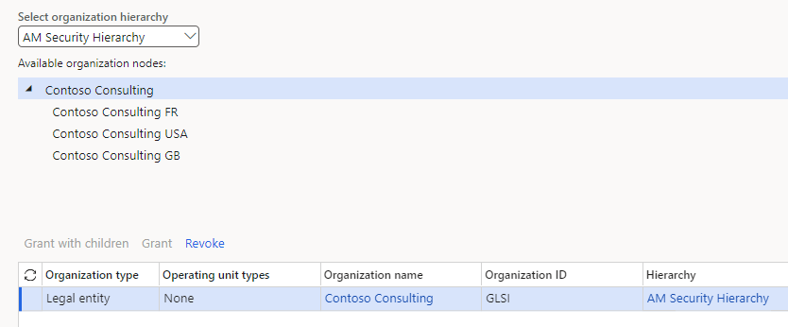
Organization Hierarchy

Slide 12
Export / Import User & Role Assignments

Slide 13
Data Management Framework
Allows for exporting / importing data from a D365FO environment
Utilizes data entities
Users -> SystemUserEntity
User Roles -> SystemSecurityUserRoleAssociationEntity
User Role Organizations -> SystemSecurityUserRoleOrganizationEntity

Slide 14
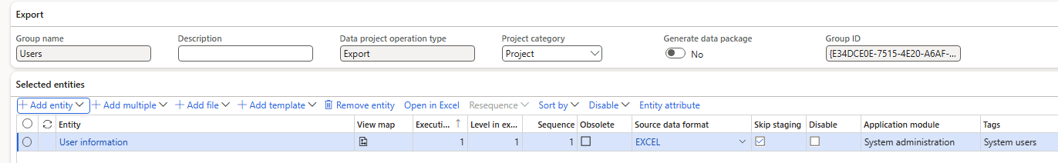
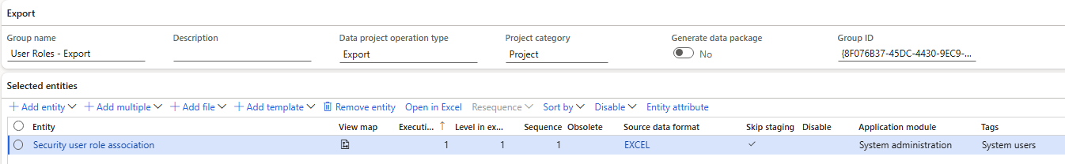
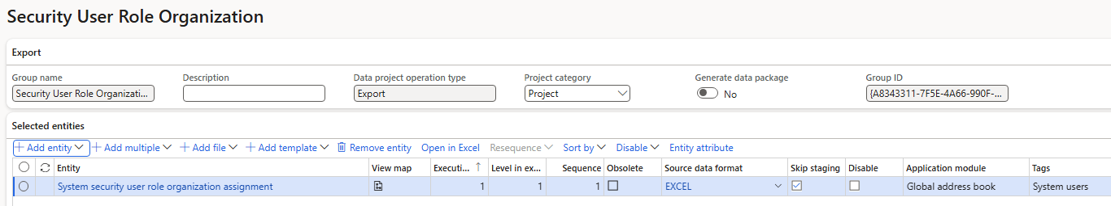
Data Management Project Setup

Slide 15
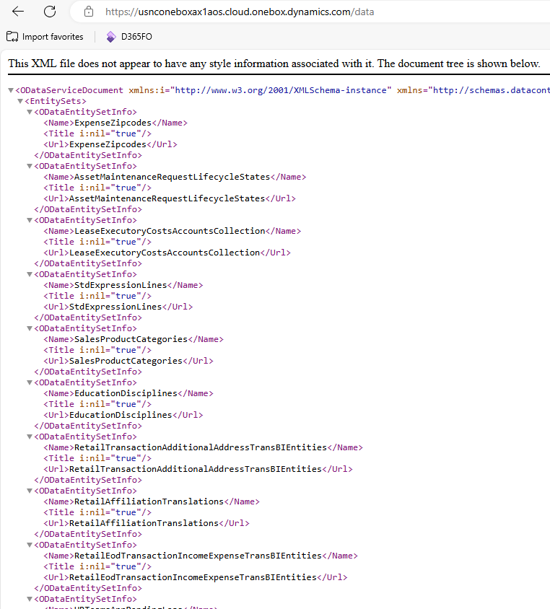
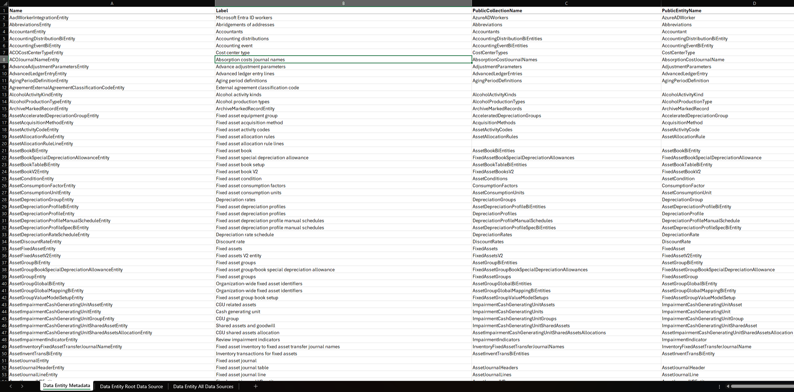
Data Entities Metadata

Slide 16
Determine Security Required

Slide 17
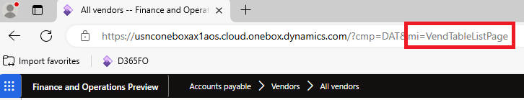
Determine Menu Item Via URL

Slide 18
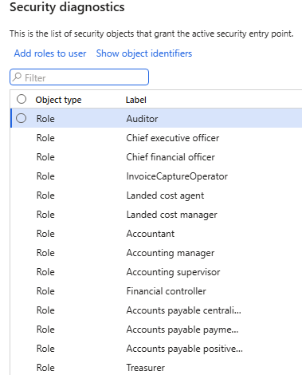
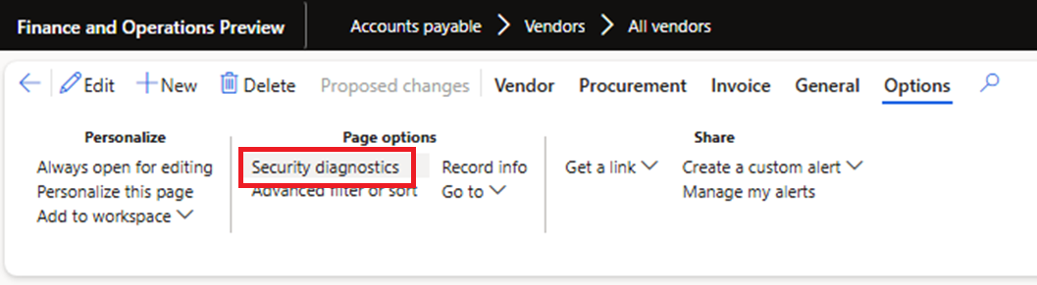
Security Diagnostics

Slide 19
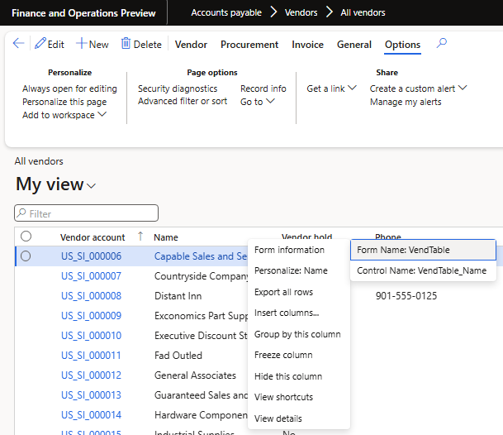
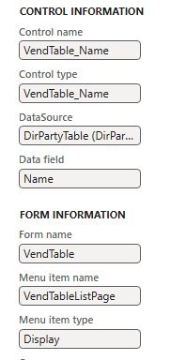
Form Information

Slide 20
User Licensing

Slide 21

Security Tied to Licensing
Security
Licensing

Slide 22
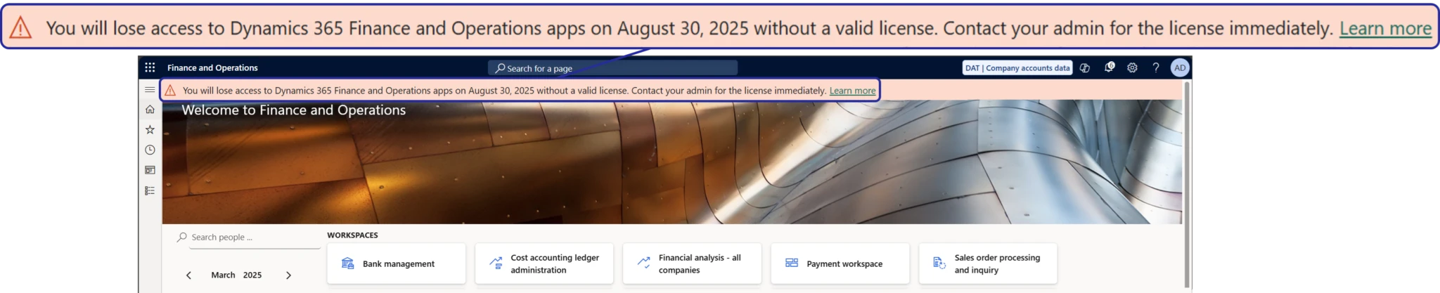
User Licensing Changes in D365FO
Object based licensing
License enforcement
  Soft enforcement – Sept 1st 2025
  Hard enforcement – Nov 1st 2025

Slide 23
License Hierarchy
Each license has a ‘Priority’
  The highest priority license of a user access must be the base license
Some have a ‘GroupName’ – which categorizes the license SKUs into groups that are of a similar level
  Orange – Fin, SCM, Comm
  Green – Proj Ops, HR
  Blue – No group
SCM Prem
Operations- Activity
Team Member
Finance Prem
SCM
Finance
Commerce
Project Operations
Human Resources
HR Self Service

Slide 24
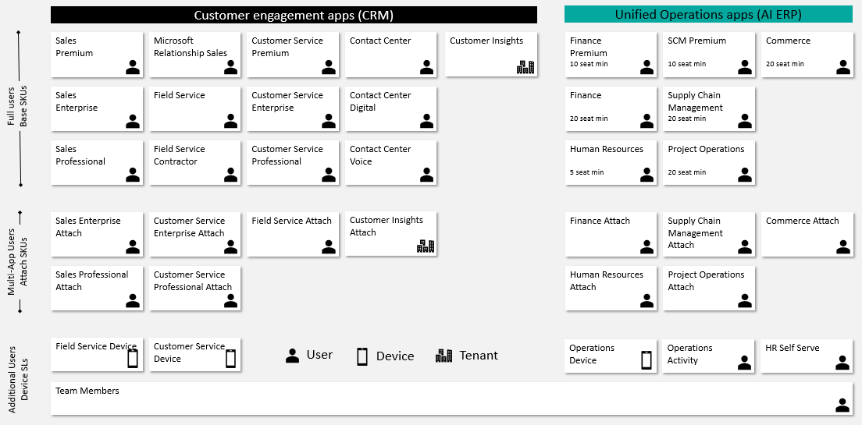
Licensing Model

Slide 25
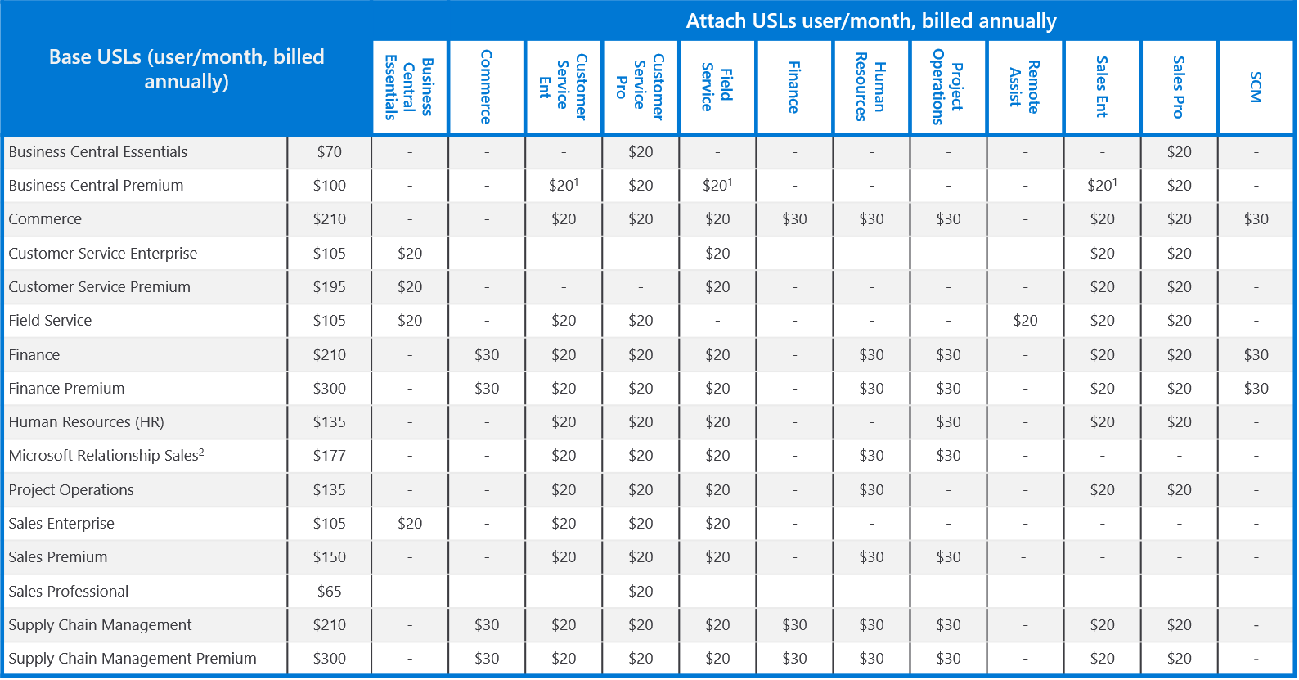
Base / Attach License Pricing

Slide 26
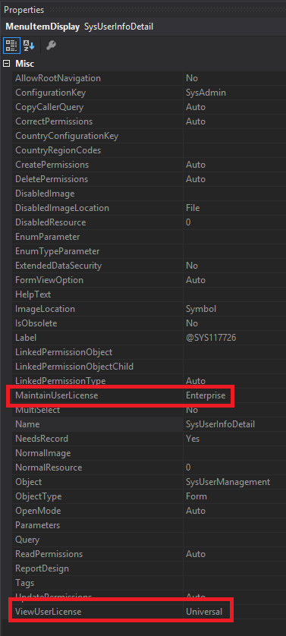
Where Did We Come From?
License requirement came from entry point attributes
  ViewUserLicense
  MaintainUserLicense
Privileges assigned to a user determined license SKU requirements
  Finance, SCM, Commerce, Project Ops, HR

Slide 27
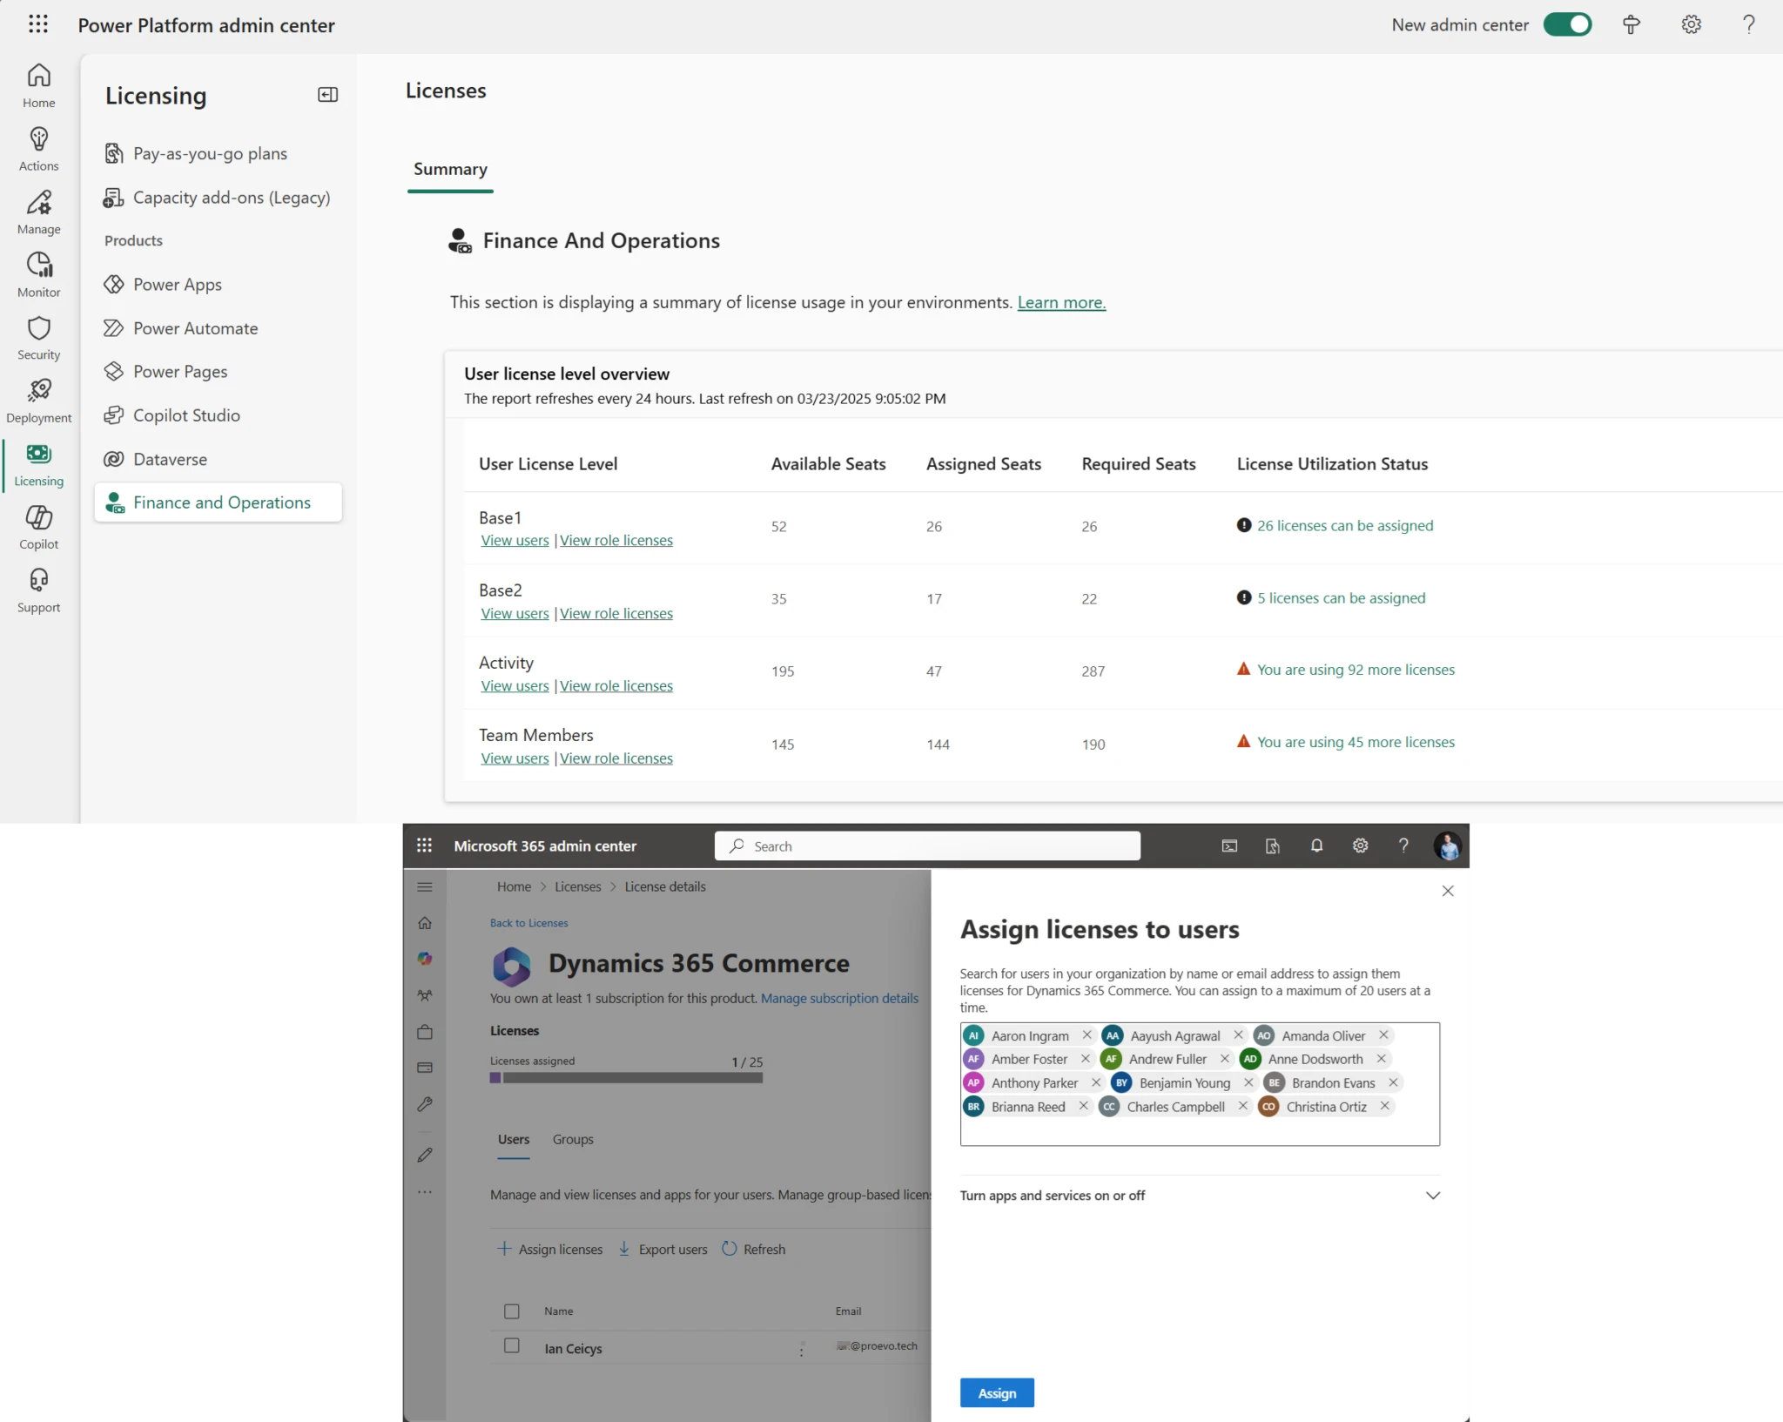
Where Are We Now?
All license calculation is done by Power Platform Admin Center (PPAC)
  Data is pushed to D365F&O and LCS
  PPAC is source of truth
  Current refresh 8 hours

Slide 28
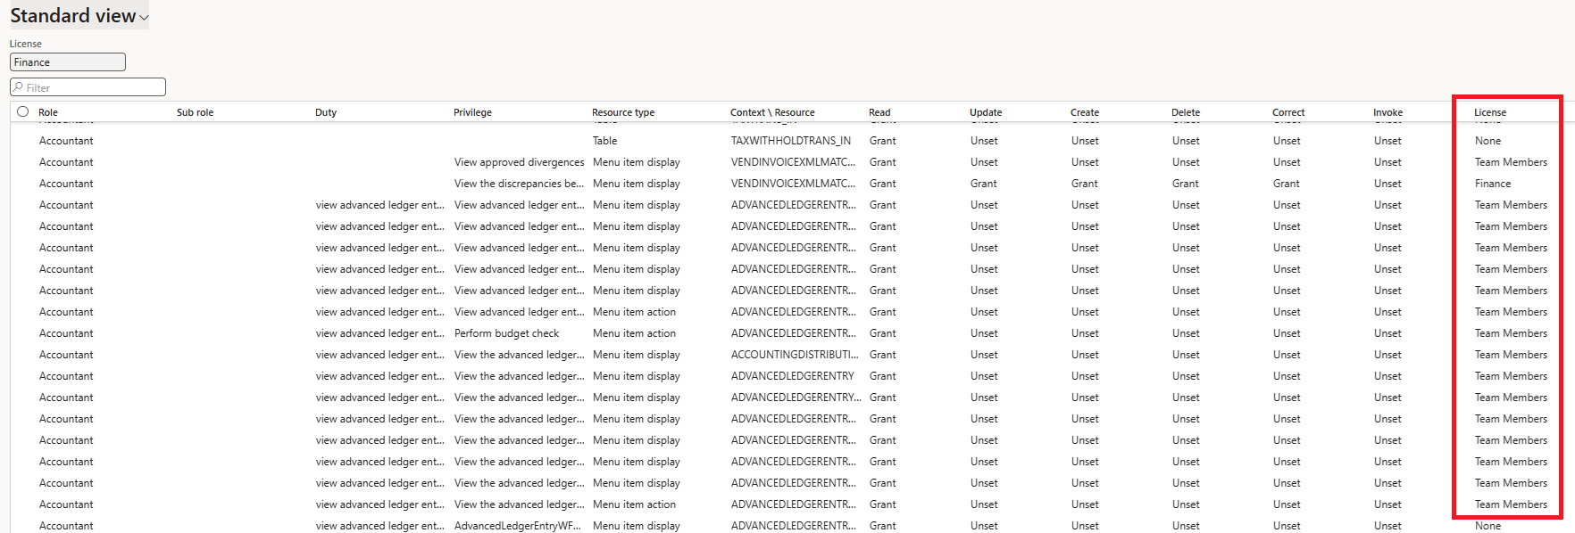
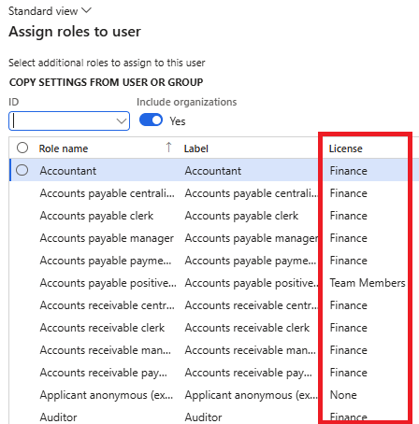
Deprecated Licensing Reports
Microsoft has announced that legacy license reporting within D365 will be deprecated
  View Permissions report
  License shown during user role assignment
  User License Counts
  User License History

Slide 29
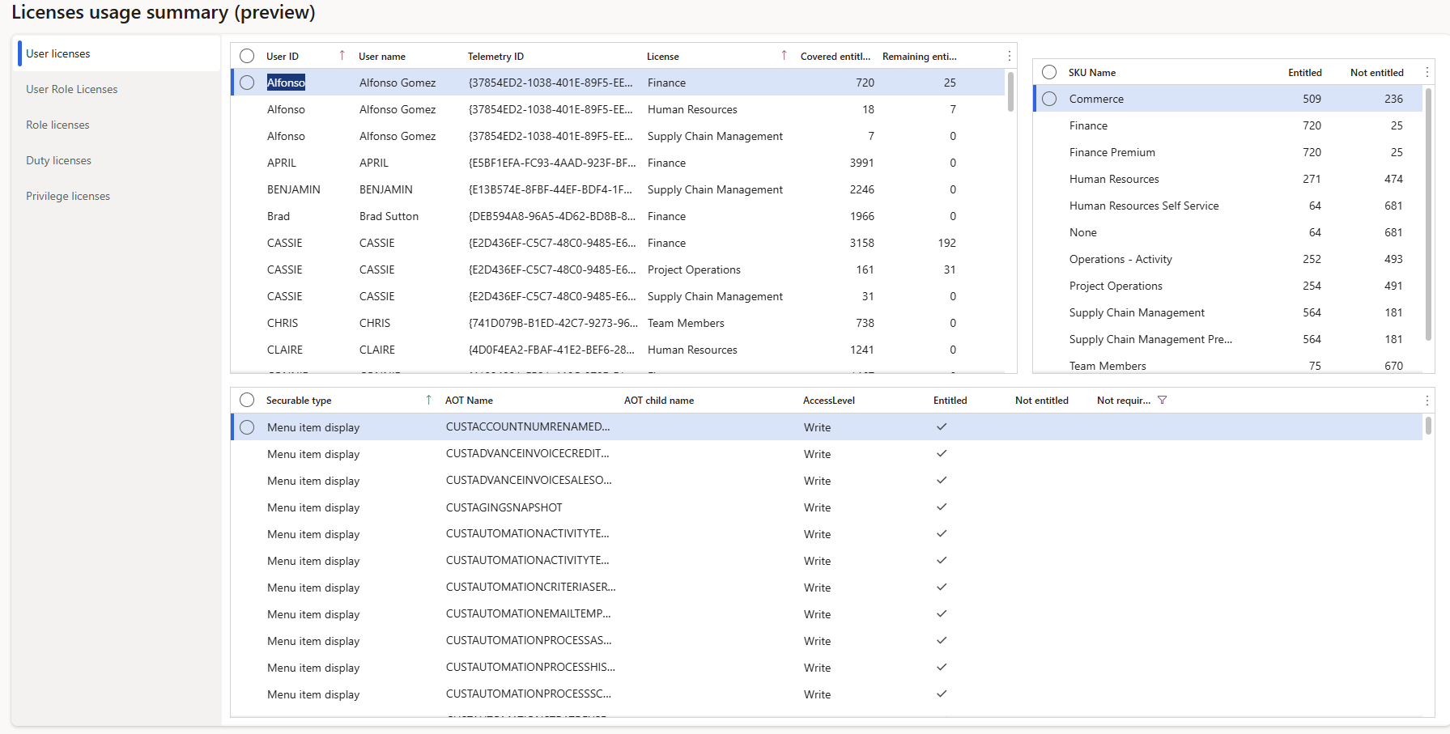
User Security Governance

Slide 30
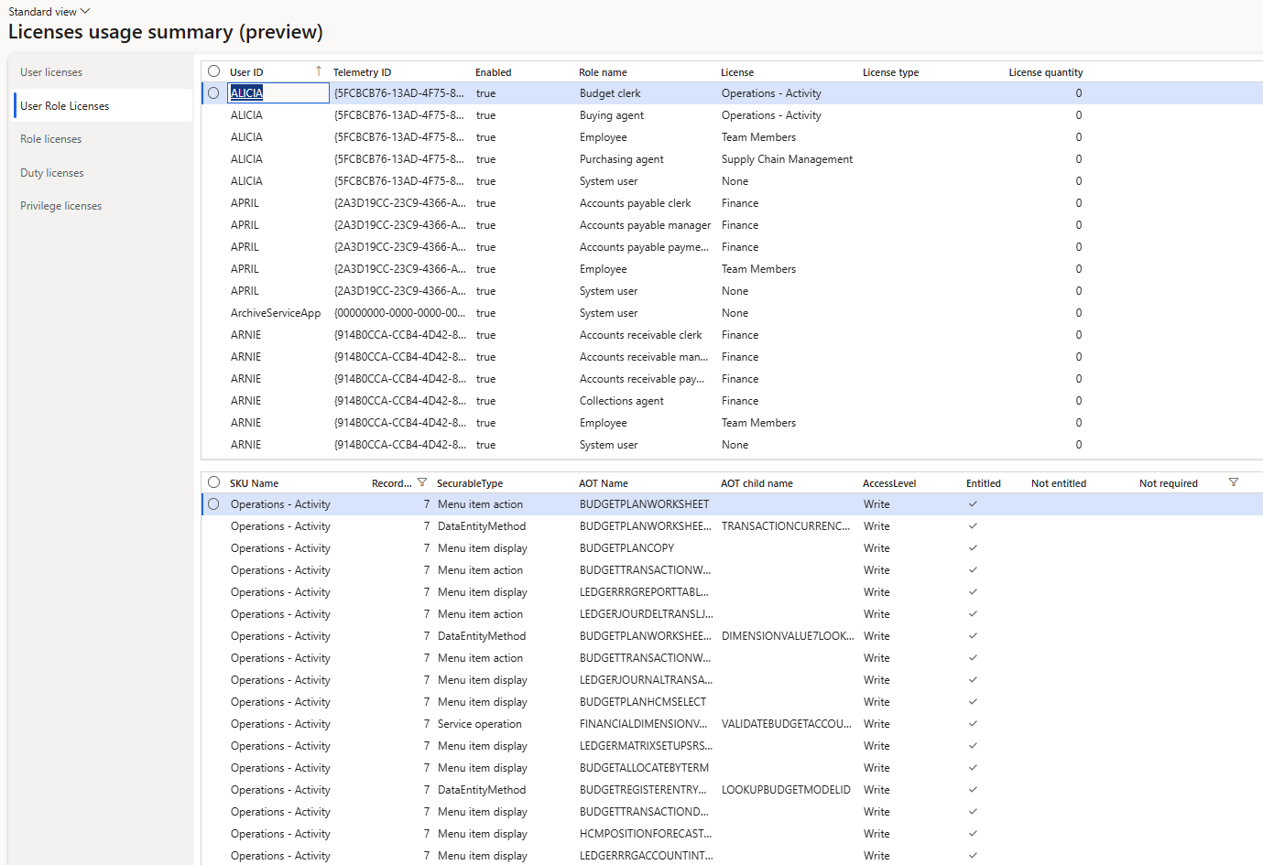
User Security Governance

Slide 31
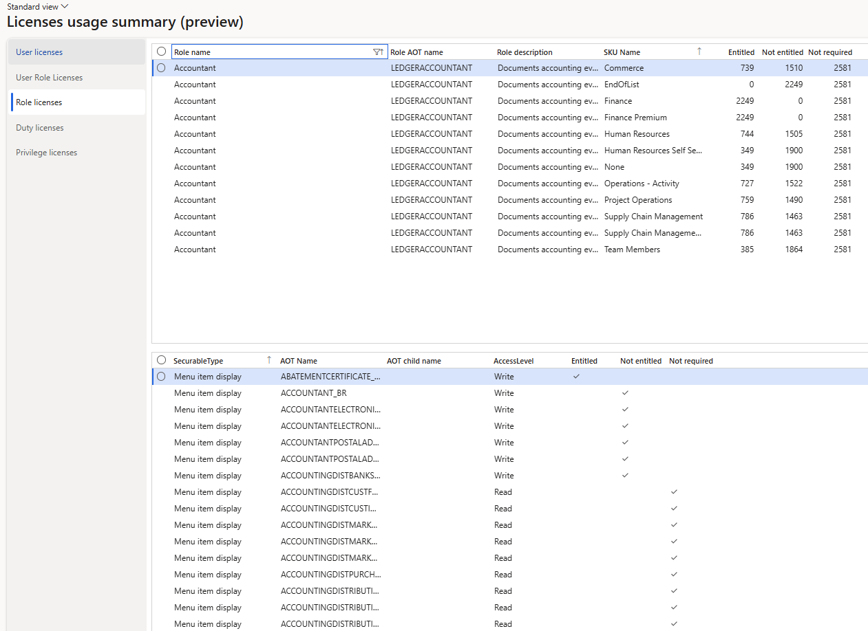
User Security Governance

Slide 32
License Methodology Changes
Objects themselves actually drive all license requirements from Team Member -> Activity -> License SKUs (Finance, SCM, Commerce, etc)
  Menu Items, Service Operations, Data Entities, Data Entity Methods
  We move away from ‘privilege-based licensing’ where the privilege assigned to the user causes certain license SKUs to be required for a user
Trying to find lowest cost license assignments based on ‘license priority’ that will cover all objects assigned to a user
Users assigned SysAdmin role do not require a license

Slide 33
Key Licensing Take Aways
The reviewing of user license assignments is much more important (and ongoing) process now
License enforcement is coming later this year
  Be proactive on ensuring you are compliant – DO NOT WAIT
Should have a process in place to review license impact after:
  User role assignment
  Security role, duty, or privilege change
  Be sure to test all changes in non-prod env first before pushing to prod
Licensing requirements can change with updates to PPAC
  Does not require a D365 update

Slide 34
Telemetry Data

Slide 35
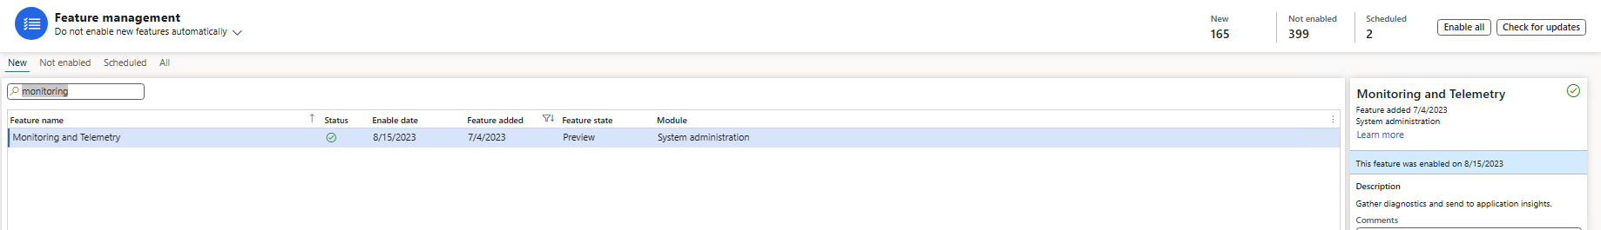
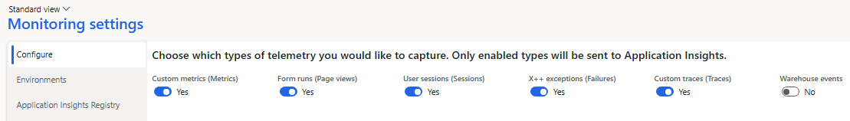
Telemetry Data

Slide 36
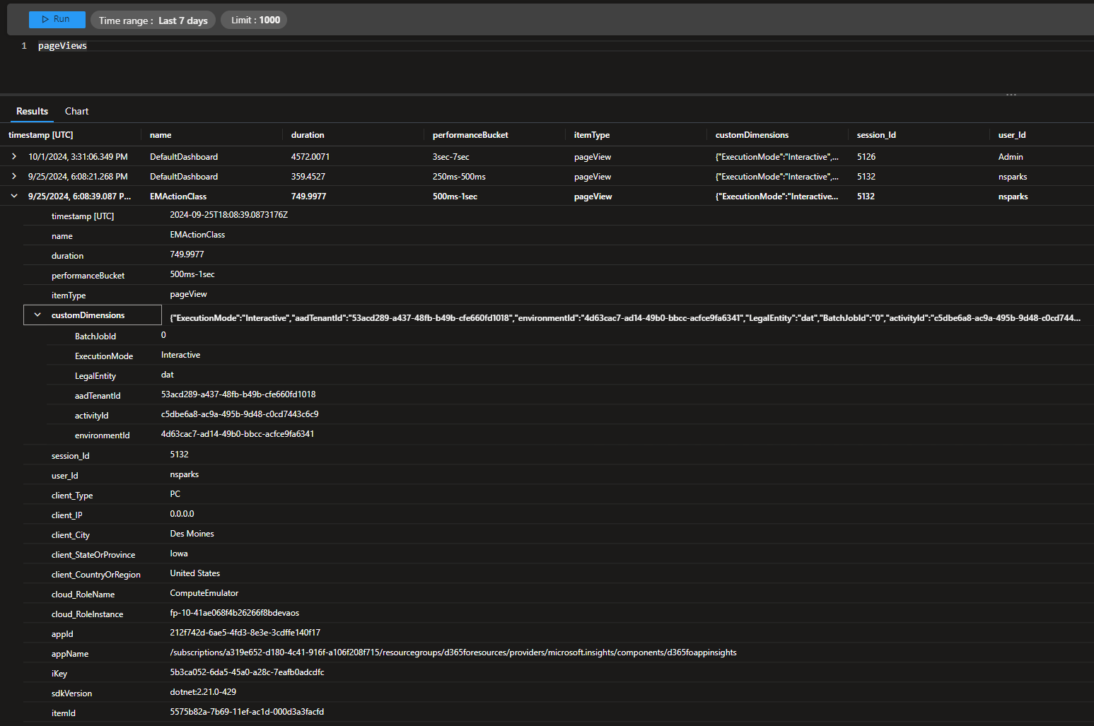
Telemetry Data Reporting

Slide 37
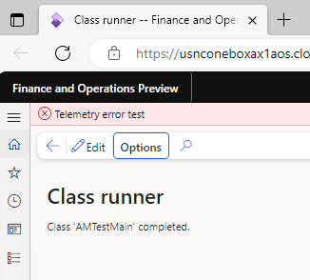
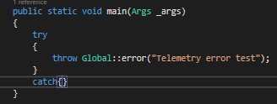
Exception Events

Slide 38
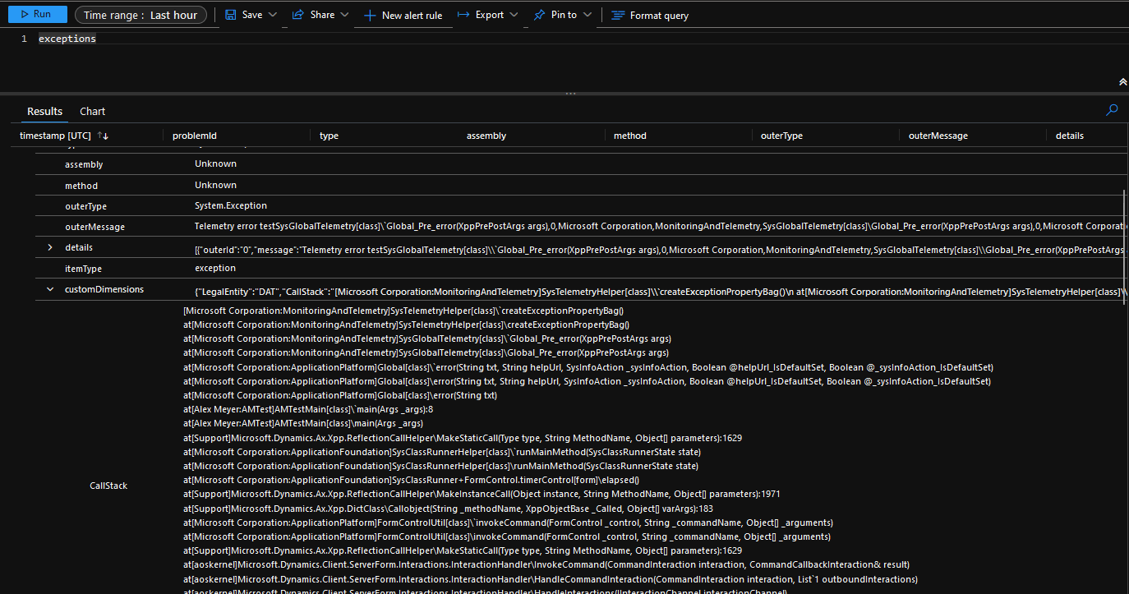
Exception Events Reporting

Slide 40
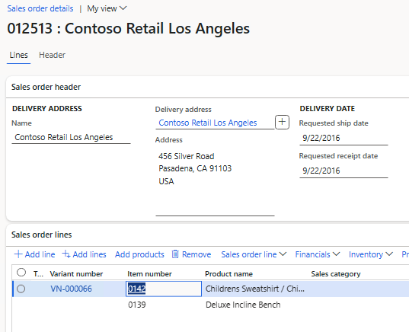
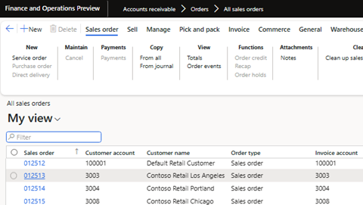
Custom Telemetry Events
Scenario – Want to log when a user opens a sales order

Slide 41
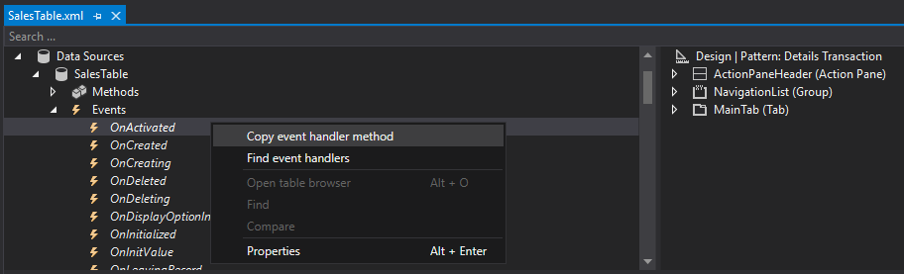
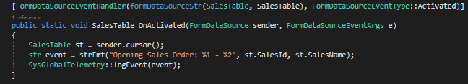
Custom Telemetry Events

Slide 42
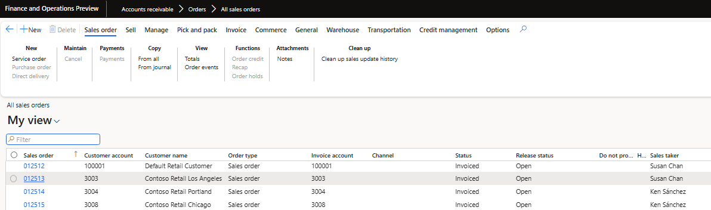
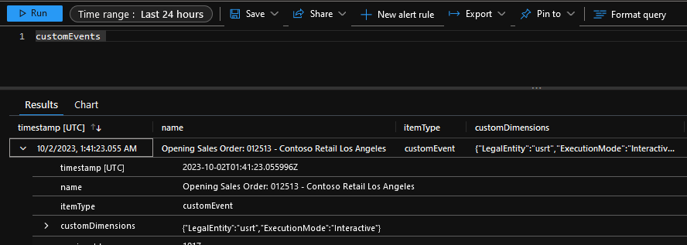
Custom Telemetry Reporting

Slide 43
How to use the table browser

Slide 44
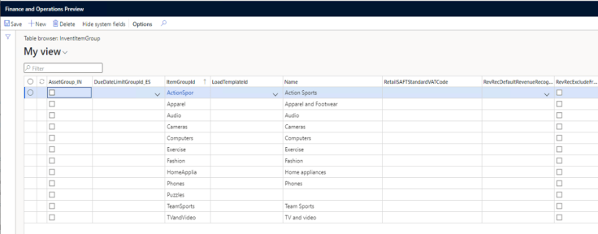

Table Browser - URL
How To Use The D365 Table Browser

Slide 45
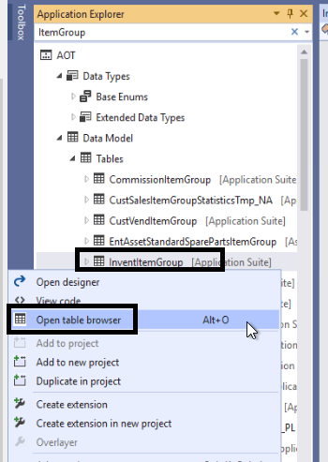
Table Browser – Visual Studio

Slide 46
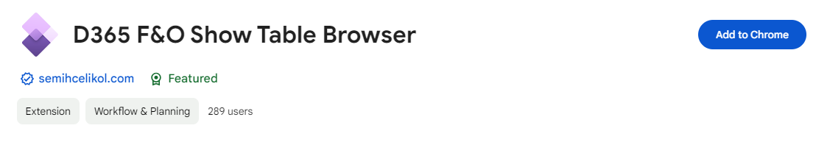
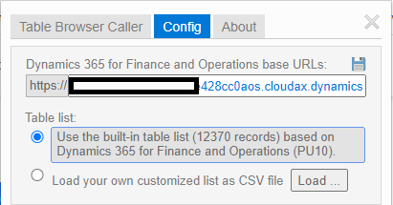
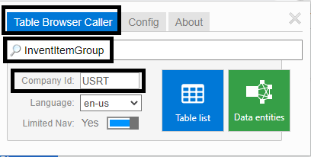
Table Browser – Chrome Extension
https://chromewebstore.google.com/detail/d365-fo-show-table-browse/figcljfgdlbihegdcckegeakgbgdeiil

Slide 47
Executing custom X++ code in production

Slide 48

Run A Custom X++ Script In PROD With Zero Downtime
By Peter Ramer
Notes:
https://dynamics365musings.com/run-a-d365-job/

Slide 49
Run A D365 Job In Production
https://dynamics365musings.com/run-a-d365-job/
https://learn.microsoft.com/en-us/dynamics365/fin-ops-core/dev-itpro/deployment/run-custom-scripts

Slide 50

Why Would You Need To Run A Job In Production?
Make data corrections that you cannot make using the user interface
  Sales order will not invoice or cancel
  Un-editable field
Make mass updates/inserts/deletes that would be time consuming to do by hand

Slide 51

Ways To Run A Custom Script
Deploy a Package (Brings down Prod environment)
  Check Your Job Into An Existing Model, and promote it as part of an all-in-one code package
New Option (No Downtime! But many steps)
  Create a new model
  Create new stand-alone deployable package
  upload it
  approve it
  test it
  run it
Notes:
A D365 job, or custom script as they are sometimes called, can up applied to a Test, Stage, or Production environment in two ways.
The first is to apply the job as part of an all-in-one code package using Life Cycle Services. This option takes fewer steps, however, it requires brining the environment down for potentially several hours. If you are already planning to promote other code to the environment, a D365 runnable job can be included.
The second option is to create a new model, write the job as part of that model, and create a deployable package of just that model. Then, upload that deployable package to the destination environment, approve it, test it, and finally run it. This requires a lot more steps. However, it requires zero downtime. And can be done without delay.

Slide 52
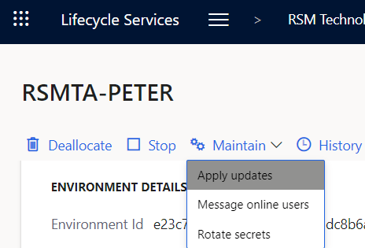
Apply A Deployable Package Through LCS
Write The Job
Run a Build Pipleline
Download the Package from DevOps and Upload to LCS
In LCS, Go to Environment Details page, then select Maintain>Apply Update
Notes:
Before, explaining the new steps, I want to explain the old steps so that you understand the differences, and how great this new feature is. These are the steps to run a job when deploying the code as a package through Life Cycle Services (LCS).
Due to the number of steps, I will save these specific steps for another article. However, I wanted to show that the previous steps to move the code require bringing down Stage and then Production for a period of time. The new steps do not.
First, write the x++ runnable class (job), and then check the code into source control.
Second, run a build pipeline in DevOps to take all of the custom source code and build a deployable package.
Third, download the package from DevOps and upload it to the asset library in Lifecycle Service (LCS). This is located at lcs.dynamics.com.
Fourth, in LCS, navigate to the environment detail page. Then, select Maintain>Apply updates.
Fifth, select your package from the list of software deployable packages. Then click the ‘Apply’ button.

Slide 53


New Way! (Custom Scripts Form)
New Option (No Downtime! But many steps)
  Create a new model
  Create new stand-alone deployable package
  Upload it
  Approve it
  Test it
  Run it

Slide 54

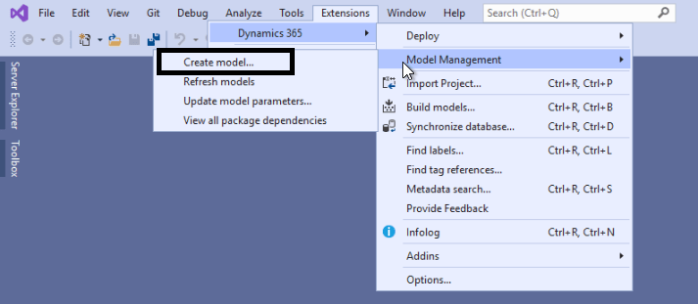
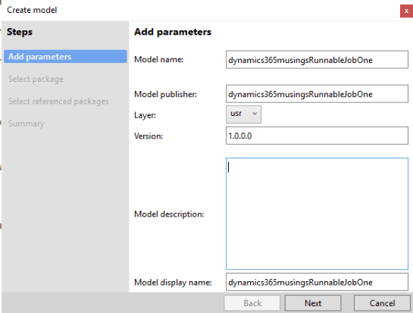
Create A Model In D365
Notes:
Now, there is a process, that while a few more steps, make it so there is zero downtime in PROD.
In order to Run a D365 job in Production without any downtime, there are still a number of steps that need to be performed. To start, below are the steps for creating a new model and writing the x++ job. , and creating a deployable package.
First, even before writing the job, create a new Model for storing our code. This model is different than the Model we store the rest of the custom code. The purpose of this model is to only store our job that we write. See my article: How to Create A Model In D365. I named my project “dynamics365musingsRunnableJobOne“.

Slide 55



Create A Model In D365
Notes:
Now, there is a process, that while a few more steps, make it so there is zero downtime in PROD.
In order to Run a D365 job in Production without any downtime, there are still a number of steps that need to be performed. To start, below are the steps for creating a new model and writing the x++ job. , and creating a deployable package.
First, even before writing the job, create a new Model for storing our code. This model is different than the Model we store the rest of the custom code. The purpose of this model is to only store our job that we write. See my article: How to Create A Model In D365. I named my project “dynamics365musingsRunnableJobOne“.

Slide 56

Common References
ApplicationCommon
ApplicationFoundation
ApplicationPlatform
ApplicationSuite
Calendar
ContactPerson
Currency
Dimensions
Director
FiscalBooks
GeneralLedger
Ledger
PersonnelCore
PersonnelManagement
Retail
RevenueRecognition
SourceDocumentation
SourceDocumentationTypes
Subledger
Tax
TaxEngine
UnitOfMeasure

Slide 57


Create A New Project
Notes:
Secondly, create a new project in Visual Studio, setting the model on that project to the one you created in step one. See my article: How to Create A D365 Project In Visual Studio. First, right click on the project, and select Properties. Then set the ‘Model‘ property to the name of the Model you just created.

Slide 58


Write A D365 Runnable Class
Notes:
Thirdly, write the x++ runnable class (job) using Visual Studio. See the article How to Write a D365 Runnable Class (Job).
For this example, name the job “Dynamics365mustingsRunnableJobOne“. The job name needs to be unique each time.
Next, it is important to say again that this process should typically only be used to modify data that cannot be modified using the user interface. Jobs can sometimes bypass validation which is not desirable. Therefore, you should always use the user interface to make data changes when possible. However, there are some cases where you need to run a D365 job.
In this example, I wrote a job to change the customer group on a particular customer in the ‘USRT’ company. While this can definitely be done using the user interface, I wanted to provide an example that would work on demo data and be easy for everyone to try themselves.

Slide 59

Write A D365 Runnable Class
Notes:
class Dynamics365musingsRunnableJobOne
{
public static void main(Args _args)
{
CustTable custTable;
ttsbegin;
custTable = CustTable::find("004003", true);
if (custTable.CustGroup == "30")
{
custTable.CustGroup = "80";
}
else
{
custTable.CustGroup = "30";
}
custTable.update();
ttscommit;
Info(strFmt("Update customer group on customer %1 to %2", custTable.AccountNum, custTable.CustGroup));
}
}

Slide 60


Create A Deployable Package
In Visual Studio, go to Dynamics 365 > Deploy > Create Deployment Package.
Next, check the checkbox next to the new Model you created for storing this job.
Notes:
After creating the x++ job in a new Model, we need to create a deployable package of just this code.
For this, use Visual Studio to create a Deployable Package of this Model. Typically, deployable packages are created using a build pipeline in DevOps. However, in this case, this model will only be used to store this custom job. Therefore, we can just use Visual Studio directly.
In Visual Studio, go to Dynamics 365 > Deploy > Create Deployment Package. Next, check the checkbox next to the new Model you created for storing this job.
Then, specify a location to save the deployable package file. Finally, click the ‘Create‘ button.
Notice, a file will be created in the Package file location specified.
Feel free to review Microsoft’s documentation on these steps.

Slide 61
Assign Duties To Users
As part of this process, we need two users.
First, one user needs the ‘Maintain custom scripts‘ duty. This duty allows this user to upload the package, test, and run the custom x++ script, or job.
Secondly, a different user needs the ‘Approve custom scripts‘ duty. This duty allows the user to approve a custom x++ script (job) that has been uploaded by the first user.
You can use the System Administration>Security configuration from to add a duty to an existing role.
Then, assign that role to a user
See my article Customize Security in D365 and Security in D365 for more detailed instructions on how to do this.
Notes:
At this time, we have the deployable package. Before we can upload and run a D365 job in Production, we need to provide the required security roles to allow this.
As part of this process, we need two users.
First, one user needs the ‘Maintain custom scripts‘ duty. This duty allows this user to upload the package, test, and run the custom x++ script, or job.
Secondly, a different user needs the ‘Approve custom scripts‘ duty. This duty allows the user to approve a custom x++ script (job) that has been uploaded by the first user.
Note, these are security ‘duties‘ and not roles. Therefore, you will not be able to add them directly on the Users form in D365 by clicking on the ‘assign roles‘ button. However, you can use the System Administration>Security configuration from to add a duty to an existing role. Then, assign that role to a user. See my article Customize Security in D365 for more detailed instructions on how to do this.
After adding the duties to an existing role, go to System Administration>User>Users. Select the user to view the details of that user. Then, click the ‘Assign roles‘ button to add these roles to the user.
See my article Security in D365 for more detailed steps.
Ultimately, the reason for having two separate users is so that no single user can upload and run the job in Production. A different user always has to approve a job before it can be run. This is to minimize the risk of malicious action or accidents. Even if a user is assigned both duties, that user still won’t be able to approve their own scripts.

Slide 62



Upload The Deployable Package
Go to: System administration>Periodic tasks>Database>Custom scripts
Notes:
Next, in order to run a D365 job in Production, we need to upload and run the package in a new form in D365.
Note, the following steps are actually the same for any Tier 2 environment. For example, TEST, STAGE, and Production. Therefore, it is highly recommend you perform these steps first in a TEST or STAGE environment, before performing them in Production. This helps to ensure the job works as expected.
First, go to System adminstration>Periodic tasks>Database>Custom scripts. Note, if you do not see this menu item option, make sure that you are in a Tier 2 environment with the proper security roles.
Second, click the ‘Upload’ button.
Third, click the ‘Browse‘ button and specify the deployable package that you created earlier. Additionally, you must enter text into the ‘Purpose’ box. Finally, click the Upload button on the dialog box.

Slide 63



Approve The D365 Job
A Different User Must Go to: System administration>Periodic tasks>Database>Custom scripts
Notes:
After uploading the deployable package, before you can run a D365 job, you need a user to approve the job. However, this user must be a different user than the user that uploaded the deployable package.
Since jobs can be dangerous to run, the purpose of this approval is to ensure multiple people have approved the job before it is run.
First, go to System adminstration>Periodic tasks>Database>Custom scripts.
Second, select the script to be approved.
Third, click the ‘Details‘ button.
Fourth, click the ‘Process workflow‘ tab. Then, click the ‘Approve‘ button.
Finally, click ‘Yes‘ on the dialog that pops up.
Importantly, if the same user that uploaded the package tries to approve, this error message will be shown.
After the script has been approved, the script must be tested.

Slide 64


Test The D365 Job
First, go to System adminstration>Periodic tasks>Database>Custom scripts.
Second, select the script to be approved.
Third, click the ‘Details‘ button.
Fourth, click the ‘Process workflow‘ tab. Then, click the ‘Run test‘ button.
Finally, push ‘Accept test log’
Notes:
Next, before you can run a D365 job, it must go through a test run. Either the uploader or the approver can run this test.
First, go to System adminstration>Periodic tasks>Database>Custom scripts.
Second, select the script to be approved.
Third, click the ‘Details‘ button.
Fourth, click the ‘Process workflow‘ tab. Then, click the ‘Run test‘ button.
The system will finally run the job, however, it will not commit any changes made by the job. Review the logs and ensure the results are expected. In the ‘Process workflow‘ tab click ‘Accept test log‘ if the job ran as expected. Otherwise, click ‘Abandon‘.
Finally, click ‘Yes‘ on the dialog that pops up.
Importantly, if the same user that uploaded the package tries to approve, this error message will be shown.
After the script has been approved, the script must be tested.

Slide 65


Run The D365 Job
Finally, you can run a D365 job in Production. After the job has been uploaded, approved, and run once as a test, it can be run for real.
Under the ‘Process workflow‘ tab, click the ‘Run‘ button.
Lastly, under the ‘Process workflow‘ tab, click either ‘Purpose resolved‘ or ‘Purpose unresolved‘
Notes:
Finally, you can run a D365 job in Production. After the job has been uploaded, approved, and run once as a test, it can be run for real.
Under the ‘Process workflow‘ tab, click the ‘Run‘ button.
This time the job will be run and any changes will be committed to the database.
Lastly, under the ‘Process workflow‘ tab, click either ‘Purpose resolved‘ or ‘Purpose unresolved‘.
Both options will lock the job, and a user cannot run it again. The difference is that the ‘Purpose resolved‘ will update the event log indicating that the script ran successful. Whereas the ‘Purpose unresolved‘ will update the event log indicating that the script run unsuccessfully.

Slide 66

Resources and References
How To Run A D365 Job In Production
How To Write A D365 Runnable Class (Job)
How To Create A Model In D365
How To Create A D365 Project In Visual Studio
How To Deploy A Package
Customize Security In D365
Security In D365
Microsoft Documentation

Slide 67
How to correctly configure JIT access

Slide 68
How To Connect To A Test Database
https://dynamics365musings.com/how-to-connect-to-a-test-d365-database/

Slide 69

How To Connect To A Test Database

Slide 70



How To Connect To A Test Database

Slide 71


How To Connect To A Test Database
https://docs.microsoft.com/en-us/sql/ssms/download-sql-server-management-studio-ssms?view=sql-server-ver15

Slide 72


How To Connect To A Test Database
<SQL Server>\<Database Name>

Slide 73


How To Connect To A Test Database

Slide 74



How To Connect To A Test Database
https://whatsmyip.com/

Slide 75

How To Connect To A Test Database

Slide 76
Tips & Tricks

Slide 77


D365FO Admin Toolkit
More info here!
Features include:
  User self-service assignment / revoking of SysAdmin
  Auto deprovisioning of SysAdmin role
  SysAdmin assignment logging
  Export / Compare System Configurations
  Auto-disable users

Slide 78
Resources / Other Links
Storing queries in URL
How To Use The D365 Table Browser
How To Continue to Use the Table Browser Functionality
How to Run a D365 Job in Production
Connect to a Test D365FO Database
Run Custom X++ Scripts with Zero Downtime
Overview of Telemetry Data in D365FO
Release of D365FO Environment Comparison Utility
Current State of D365FO User Licensing
Determine Where Form Data is Stored in D365FO

Slide 79
Resources / Other Links
https://dynamics365musings.com/d365-development-learning-playlist/
Security In D365
Customizing Security In D365
Change Security In D365
Create Security In D365
D365 Development Tips and Tricks
X++ Extreme: Boost Your Development Skills With Proven Tips and Tricks
How To Run A D365 Job In Production
How To Use The D365 Table Browser
How To Connect To A Test D365 Database
How To Install A Package In D365

Slide 80
Questions?
Alex Meyer
Email: alex.meyer@delinea.com
Blog: http://d365foblog.com
Security Class: http://d365fosecurity.com
GitHub: https://github.com/ameyer505
YouTube: https://www.youtube.com/@AlexMeyerGeek
LinkedIn | Microsoft MVP Profile
Peter Ramer
Email: peter.ramer@rsmus.com
Blog: http://dynamics365musings.com
YouTube: https://www.youtube.com/@peterramer
LinkedIn | Microsoft MVP Profile

Slide 81


Slide 82


THE ELEMENTS AND BACKGROUNDS ON THE FOLLOWING PAGES CAN BE COPIED AND PASTED INTO YOUR SLIDES.​ VISIT DYNAMICSCON.COM TO DOWNLOAD MORE.

Slide 83











Slide 84







Slide 85



Slide 86








