Slide 2
Decoding D365FSC Security & Licensing
August 27th 2025

Slide 3
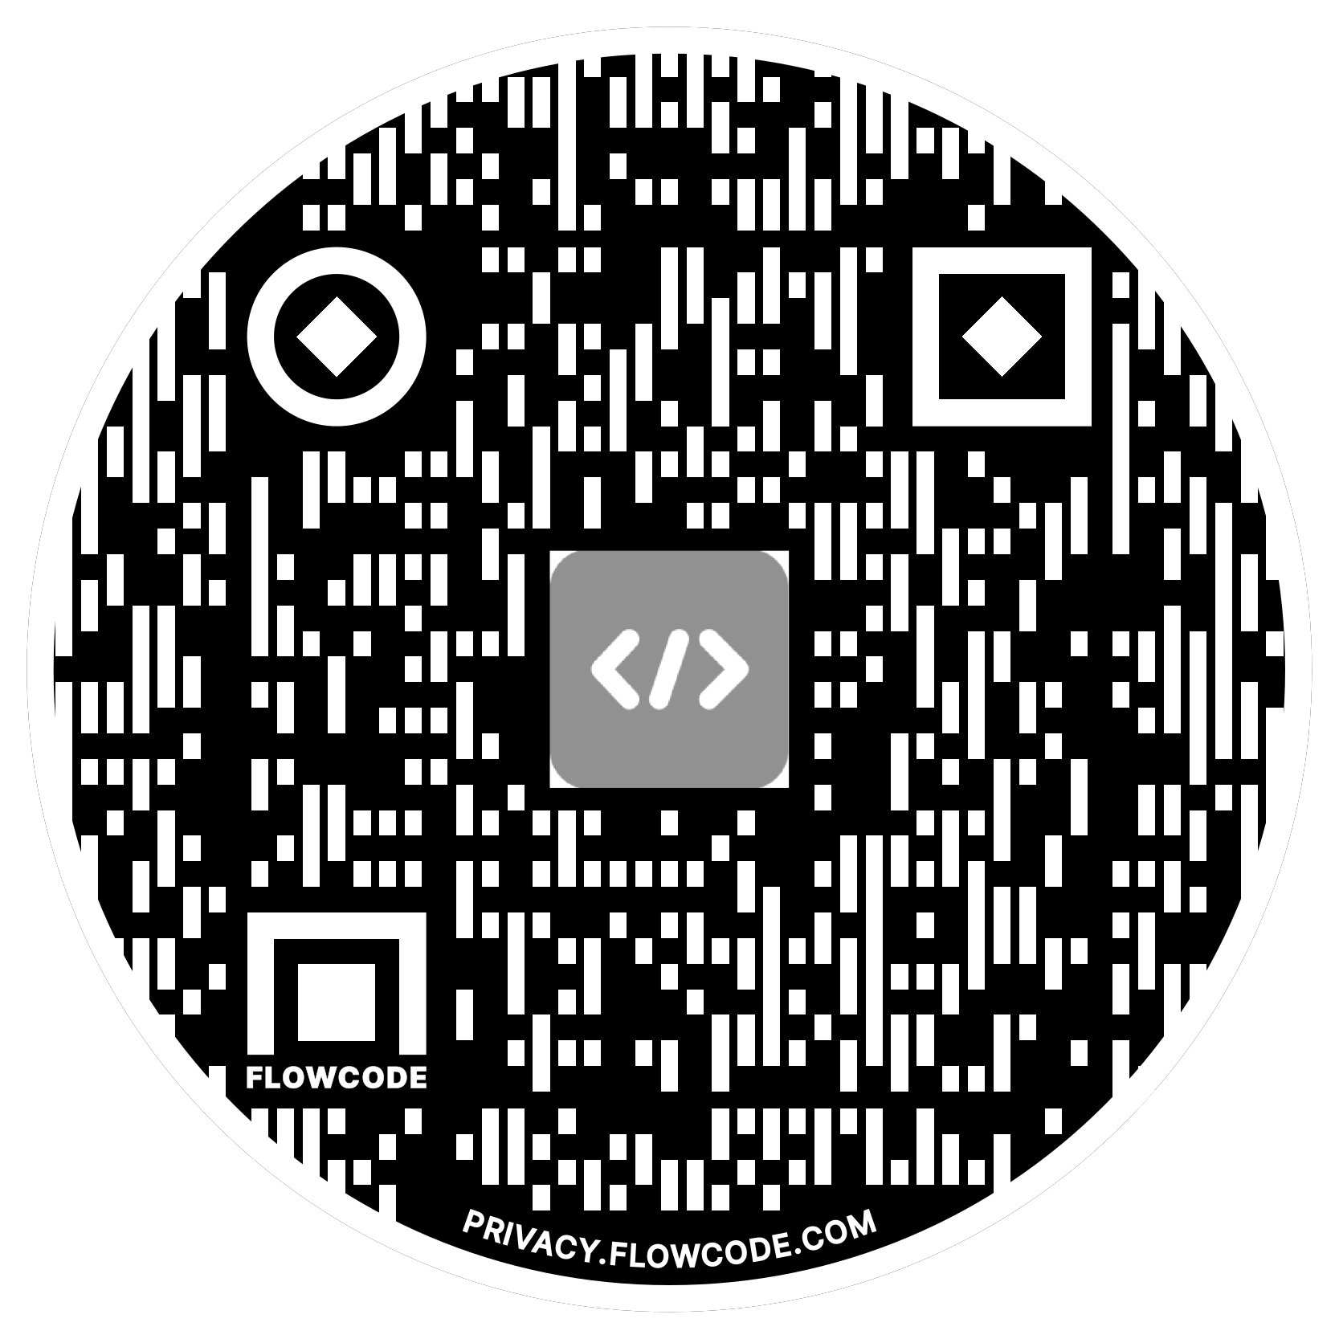

Alex Meyer
Principal Software Development Engineer
Delinea
Email: alex.meyer@delinea.com
Blog: http://d365foblog.com
Security Class: http://d365fosecurity.com
LinkedIn
Microsoft MVP Profile
Background:
Awarded Microsoft MVP in Business Applications since 2019
Been working with AX since 2013 and D365FO since 2016
Have spoken at Summit (US & Europe), Focus, and local chapters around AX/D365FO security and have done webinars around native controls in both versions

Slide 4
Agenda
Dynamics 365 F&O Security Model
How Security & Licensing Tie Together
License Enforcement
New License Model
Power Platform Admin Center / Lifecycle Services
User Security Governance

Slide 5
Things to Note
Everything we talk about today is accurate as of today
  This does not mean that Microsoft cannot change this tomorrow
I do not work for Microsoft
  Please do not get mad at me
  Please do not throw things at me (at least when I’m not looking)
I did not have any input on license changes or enforcement
This can be a ‘license therapy’ session if needed
  Venting is ok – we are all in this together

Slide 6
D365FO Security Model

Slide 7
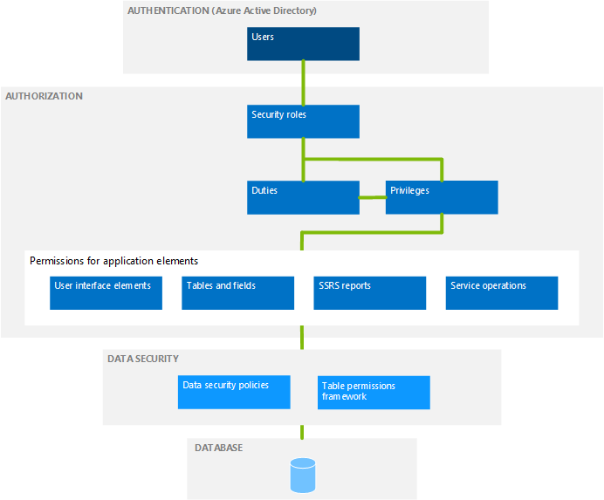
D365FSC Security Model
Role Based Security
Users are assigned one or more roles
Hierarchy based security model
  Groups of securable objects are put within one security layer
  Security layers built on top of each other
Two main categories
  Security Layers
  Securable Objects

Slide 8

Security & Licensing Tied Together
Security
Licensing
What access a user is assigned = what license(s) they are required to have
  Not based on utilization
Over provisioning of user access ->
  Over assignment of user licenses ->
    Higher licensing costs

Slide 9
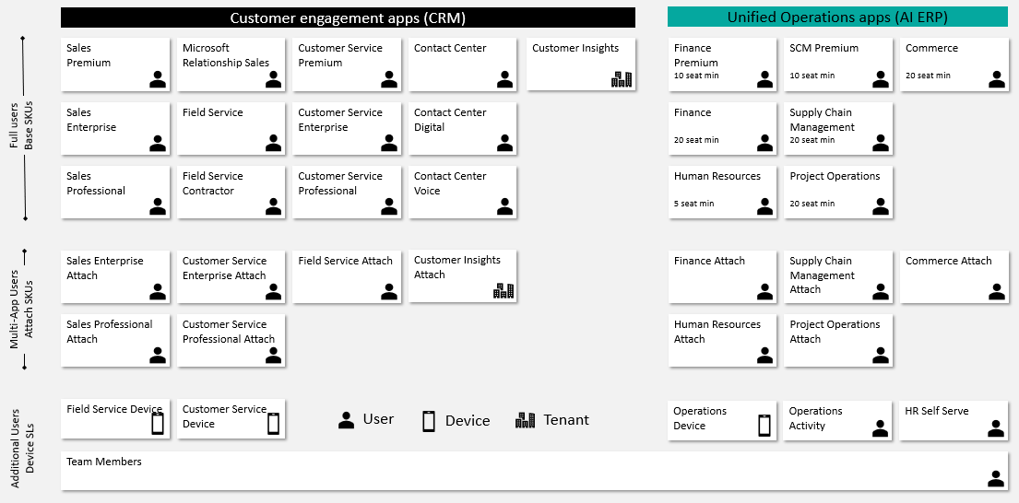
Dynamics 365 Licensing

Slide 10
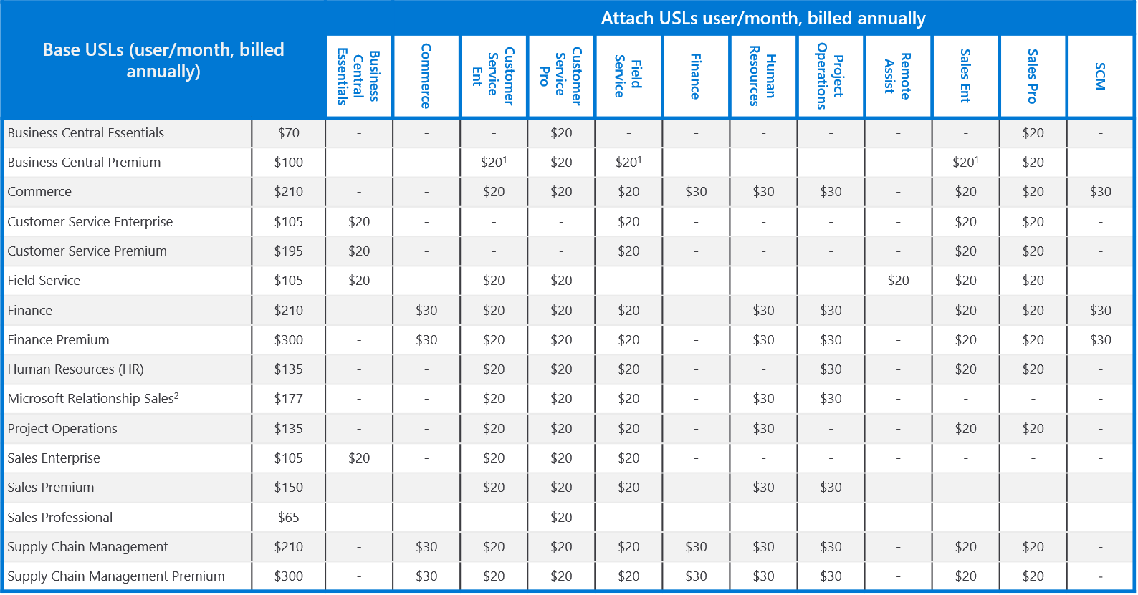
Dynamics 365 Licensing Base / Attach

Slide 11
Updates to D365 Licensing Methodology

Slide 12
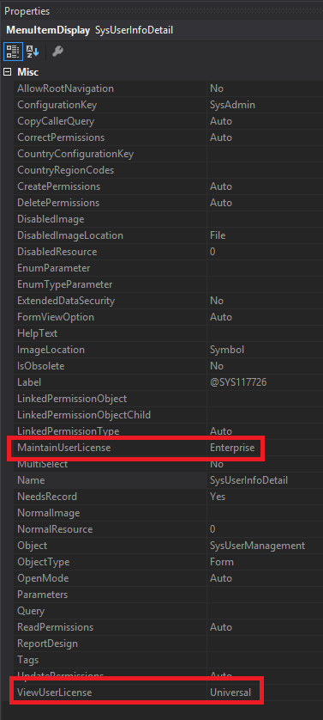
Where Did We Come From?
License requirement came from entry point attributes
  ViewUserLicense
  MaintainUserLicense
Privileges assigned to a user determined license SKU requirements
  Finance, SCM, Commerce, Project Ops, HR

Slide 13
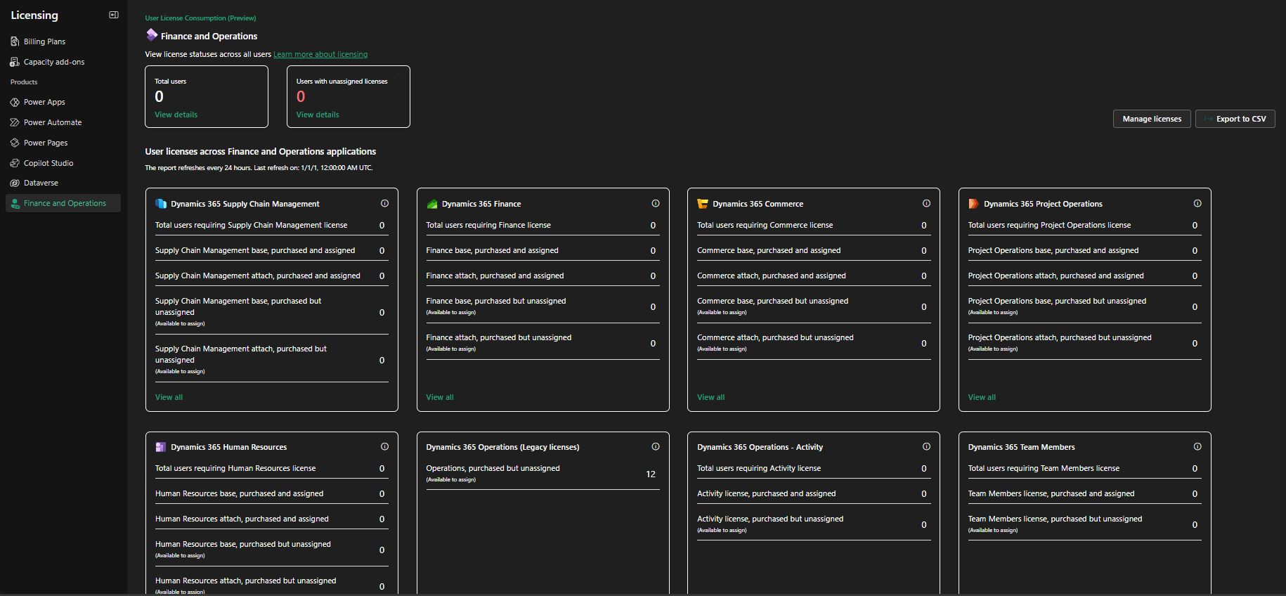
Where Are We Now?
All license calculation is done by Power Platform Admin Center (PPAC)
  Data is pushed to D365F&O and LCS
  PPAC is source of truth
  Current refresh 24 hours

Slide 14
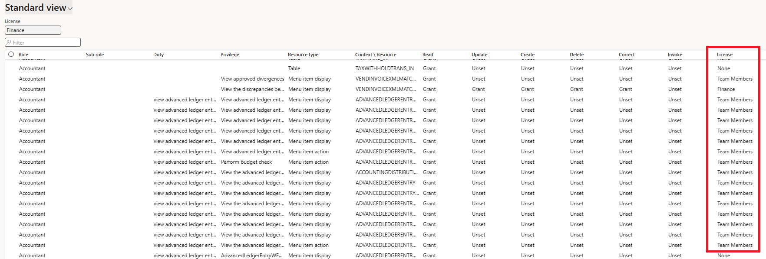
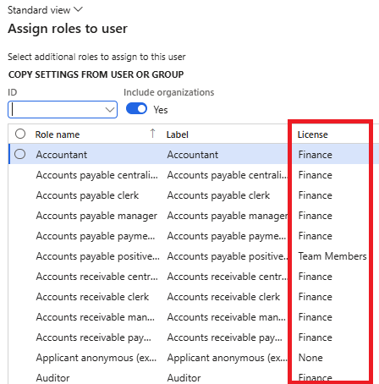
Deprecated License Reports
Microsoft has announced that legacy license reporting within D365 will be deprecated
  View Permissions report
  License shown during user role assignment
  User License Counts
  User License History

Slide 15
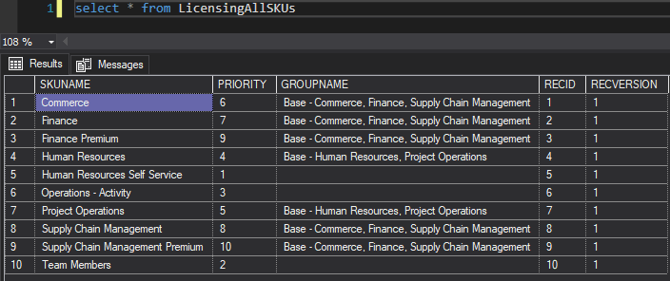
Object Level Analysis
In 10.0.43 and 10.0.44, there are new licensing tables that contain detailed information on license requirements
LicensingAllSKUs
  Stores all current licenses and their priority ranking

Slide 16
License Hierarchy
SCM Prem
Operations- Activity
Team Member
Finance Prem
SCM
Finance
Commerce
Project Operations
Human Resources
HR Self Service
Each license has a ‘Priority’
  The highest priority license of a user access must be the base license
Some have a ‘GroupName’ – which categorizes the license SKUs into groups that are of a similar level
  Orange – Fin, SCM, Comm
  Blue – Proj Ops, HR
  Yellow – No group

Slide 17
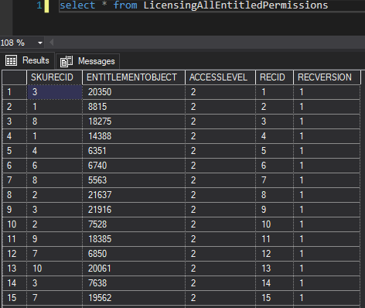
Object Level License Analysis
LicensingAllEntitledPermissions
  Stores association between object -> licenses that meet requirements

Slide 18
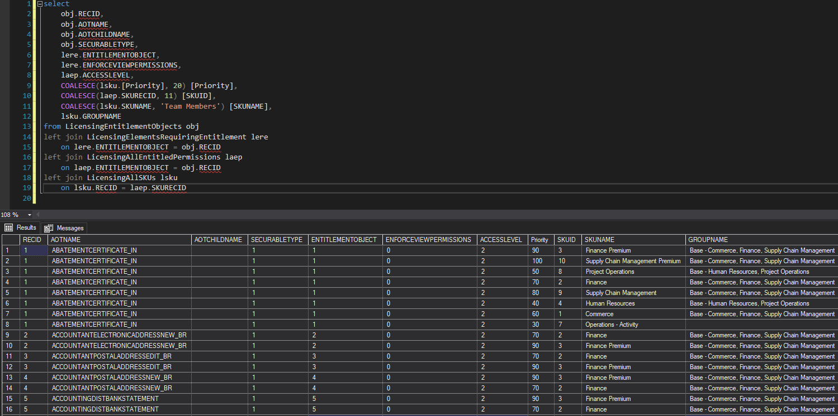
Consolidated Object License Analysis

Slide 19
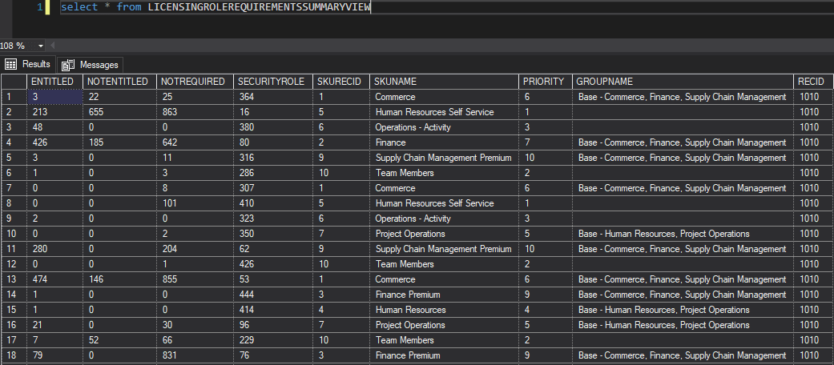
Object Level License Analysis
Licensing<Role>RequirementsSummaryView
  Duty
  Privilege

Slide 20
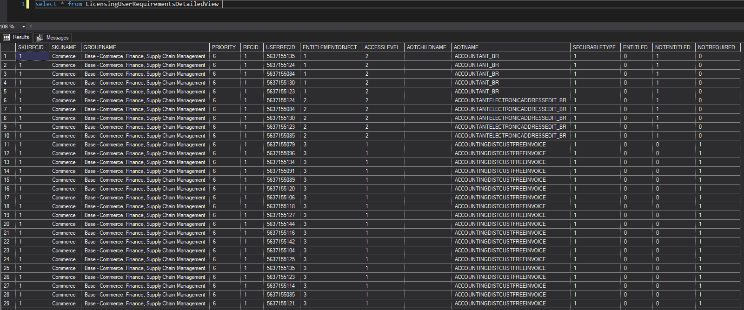
Object Level License Analysis
LicensingUserRequirementsDetailedView

Slide 21
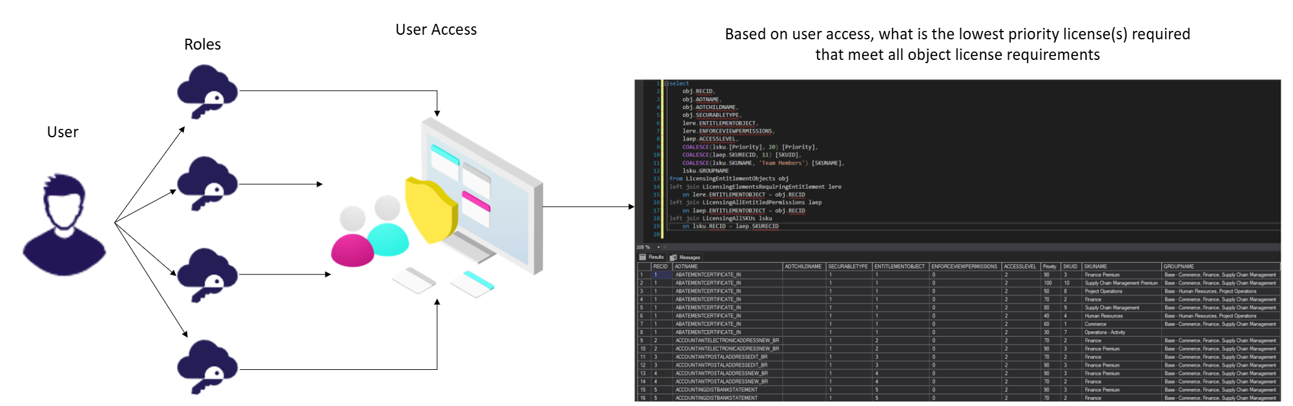
Licensing Overview

Slide 22
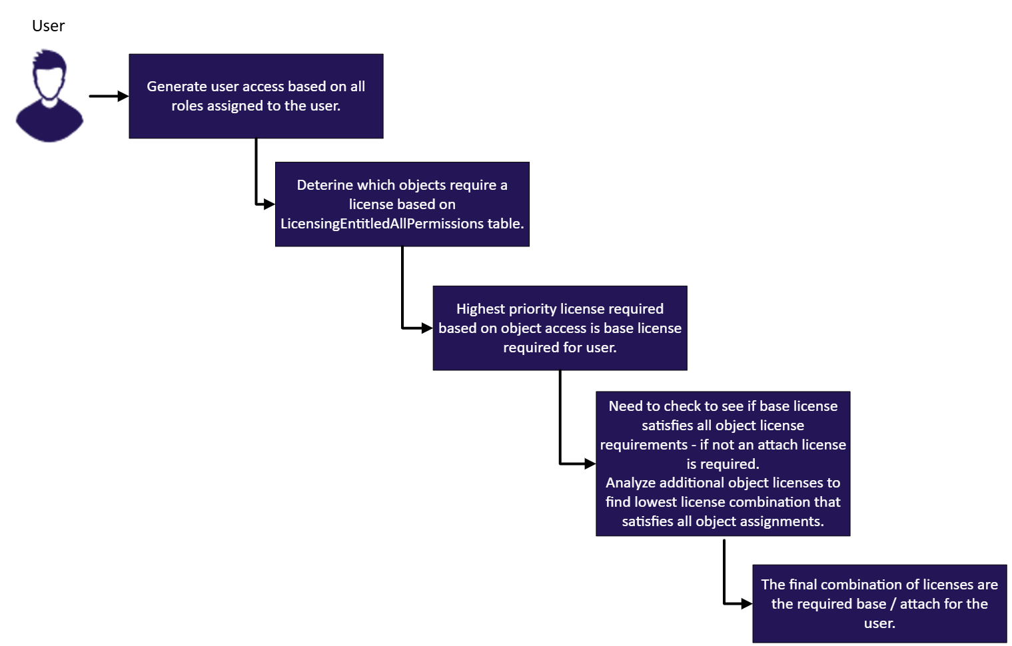

Slide 23
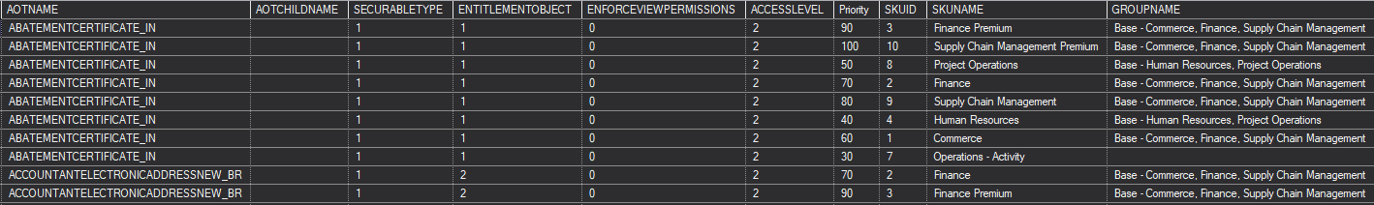
Licensing Example
Read access to either object
  Team Member
Update / Create / Delete access to AbatementCertificate
  Operations – Activity
Update / Create / Delete access to AccountantElectronicAddressNew
  Finance

Slide 24
Licensing Methodology Changes
Objects themselves actually drive all license requirements
License Objects:
  Menu Items
  Service Operations (new)
  Data Entities (new)
  Data Entity Methods (new)
Read permission = Team Member
  Unless ‘EnforceReadPermission’ = 1
Write permission = LicensingElemntRequiringEntitlement
  Includes Update, Create, Delete access

Slide 25
Licensing Methodology Changes
We move away from ‘privilege-based licensing’ where the privilege assigned to the user causes certain license SKUs to be required for a user
Try to find lowest cost license assignments based on ‘license priority’ that will cover all objects assigned to a user

Slide 26
License Enforcement

Slide 27
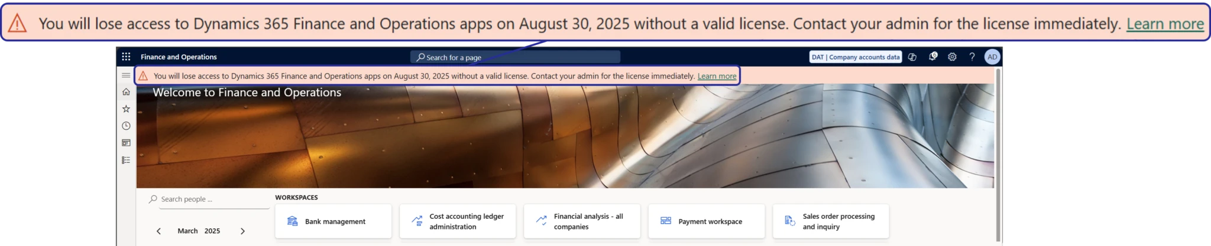
Dynamics 365 License Enforcement
Microsoft starting to perform user license compliance check during sign in
Sept 1st 2025 – soft enforcement
  Users not assigned correct licenses will receive a pop up banner during sign in
Nov 1st 2025 – hard enforcement
  Users not assigned correct licenses will be stopped during sign in to application
License enforcement only impacts production level environments (lower tiers do not have enforcement)

Slide 28
Licensing Changes / Things To Keep In Mind
Users assigned SysAdmin role do not require a license
Disabled users do not require a license
External user do not require a license
  Microsoft has tightened restrictions around what is an ‘external user’
Currently no distinction for ‘integration users’ vs ‘standard users’
Device licensing is a ‘work in progress’

Slide 29
Power Platform Admim Center (PPAC)

Slide 30
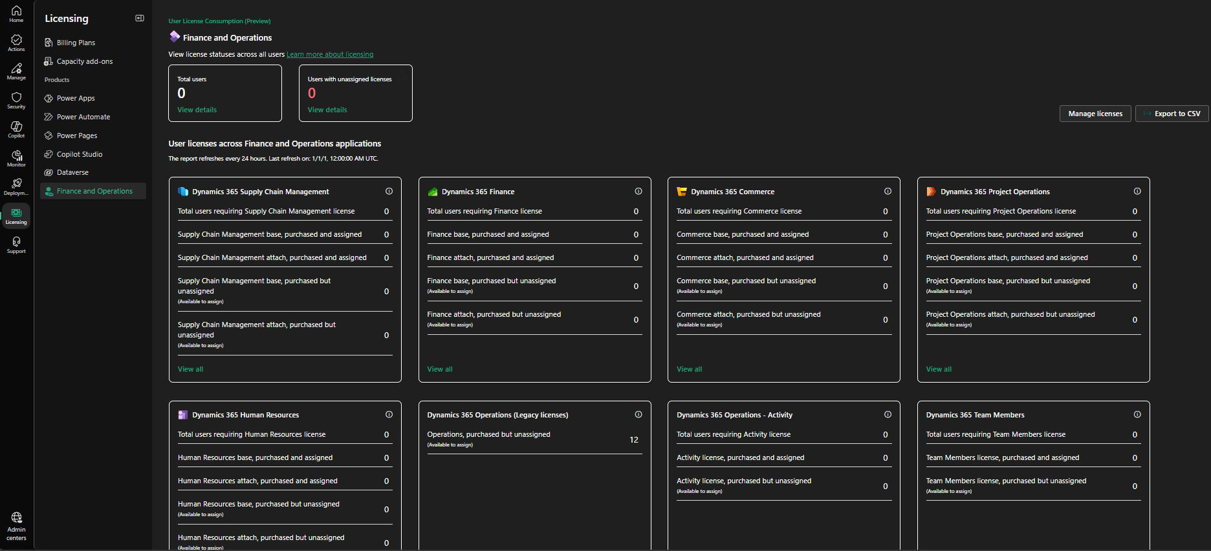
PPAC Reporting
PPAC -> Licensing -> Finance and Operations
Breaks out licenses by:
  Type
  Base / Attach vs Purchased
CSV export for detailed analysis (would recommend Excel)

Slide 31
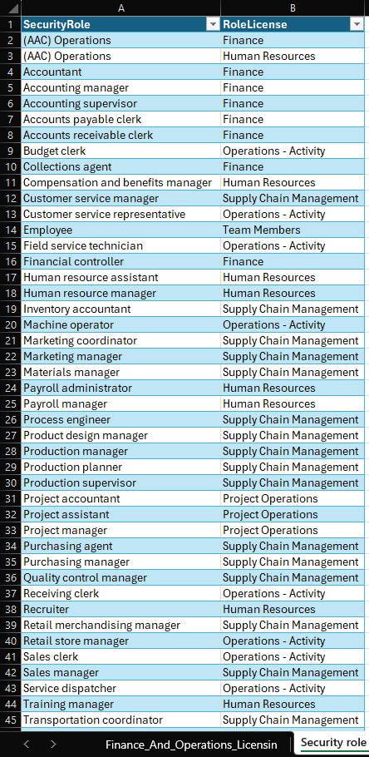
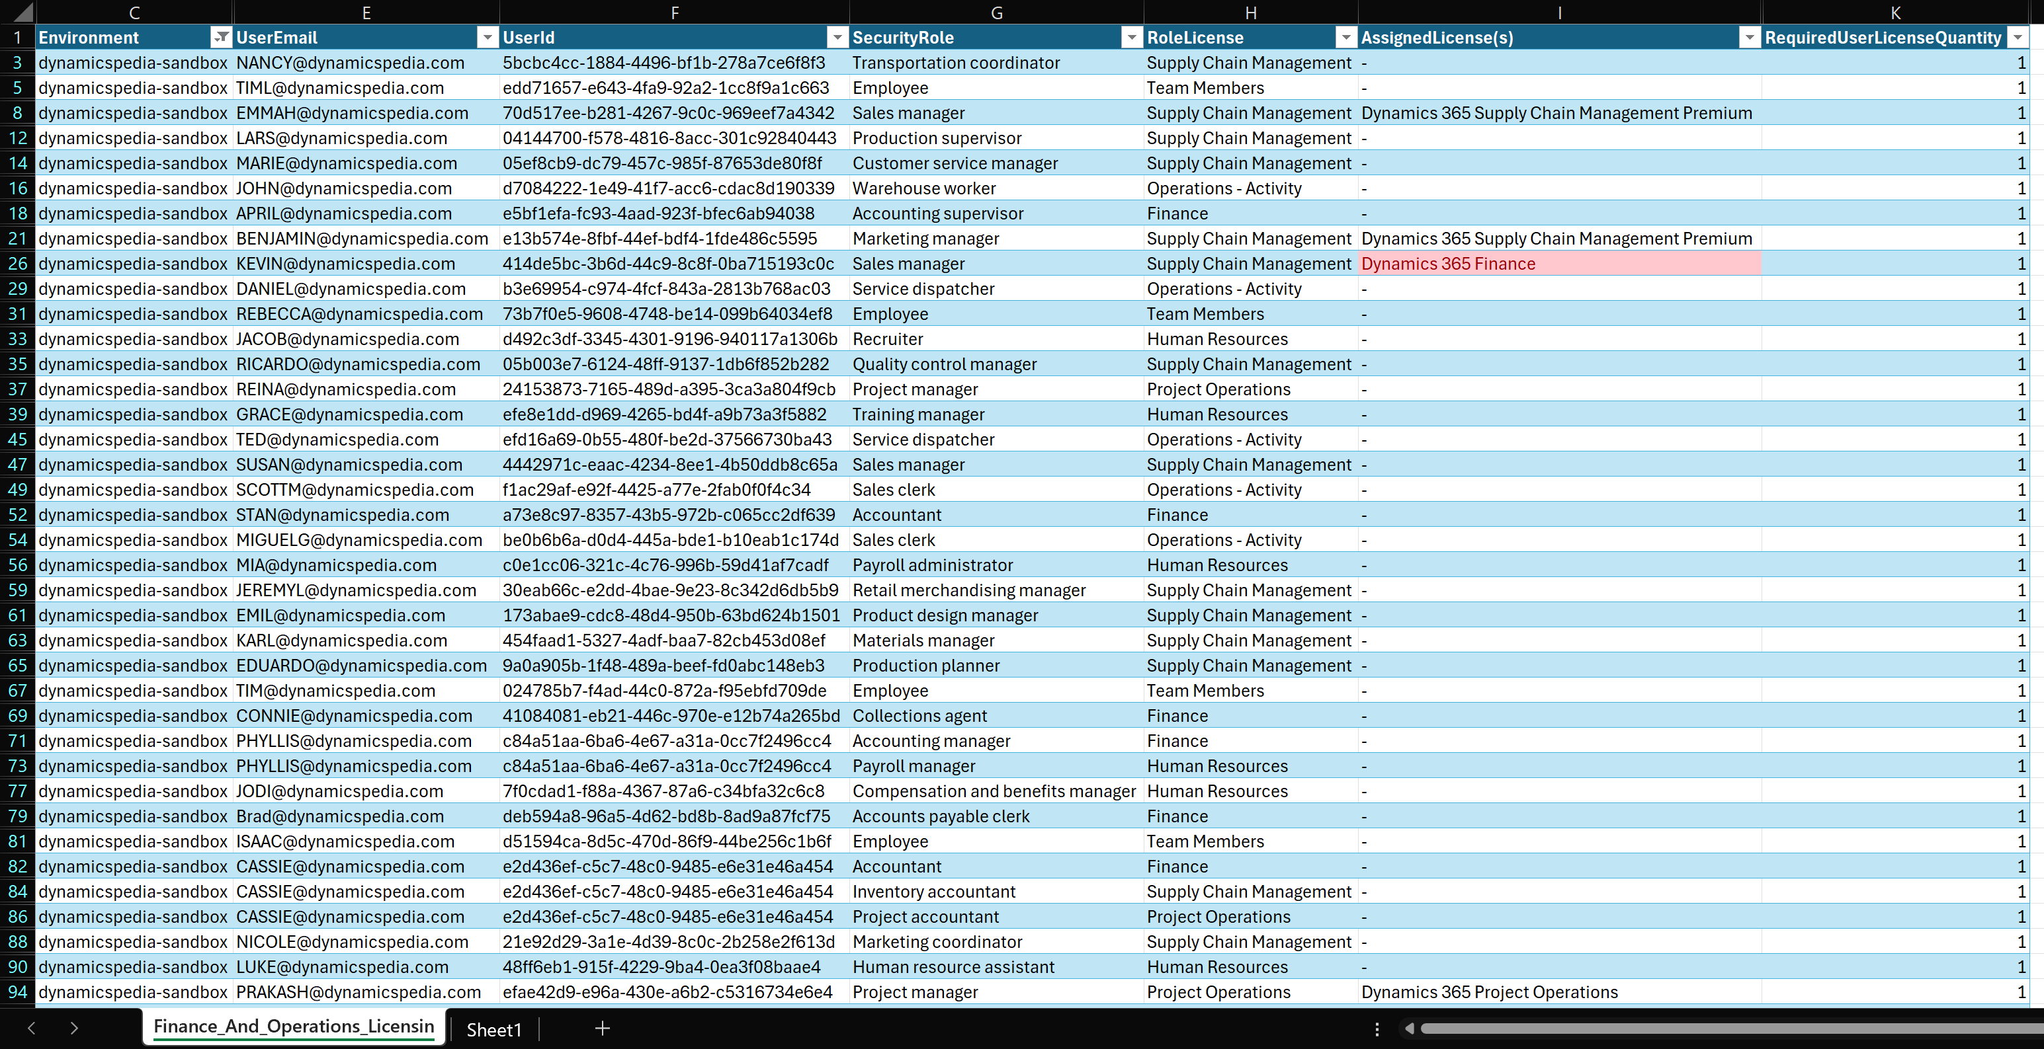
License CSV in Excel

Slide 32
Lifecycle Services (LSC)

Slide 33
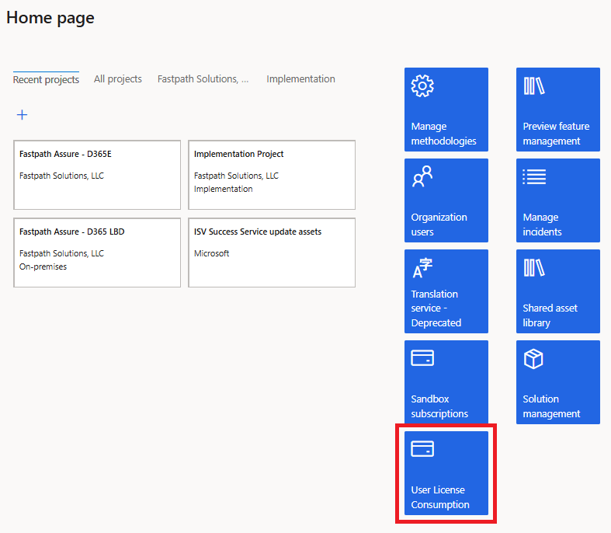
LCS License Reporting
Should show same data as PPAC

Slide 34
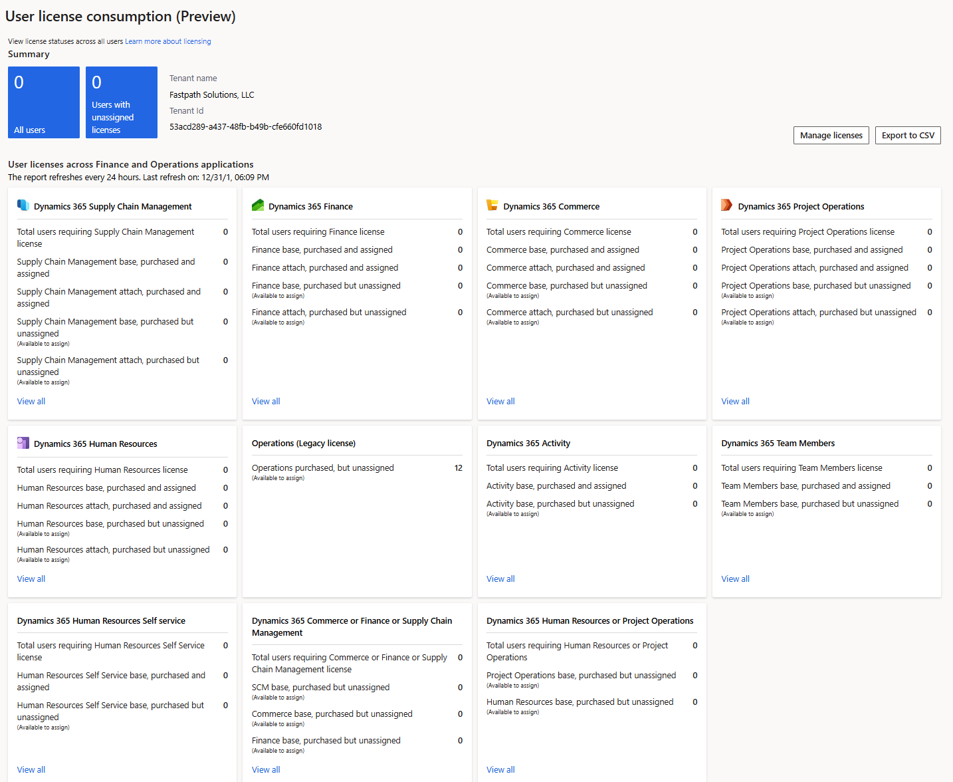
User License Consumption

Slide 35
User Security Governance

Slide 36
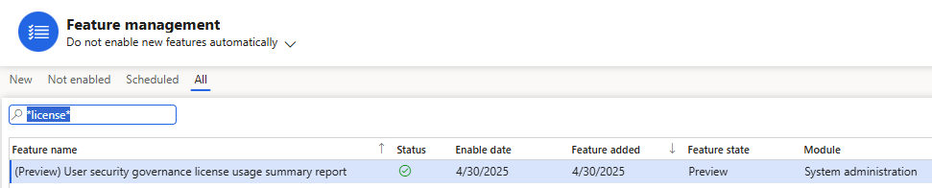
License Usage Summary
Report is ‘preview’ feature – will need to be enabled via Feature Management

Slide 37
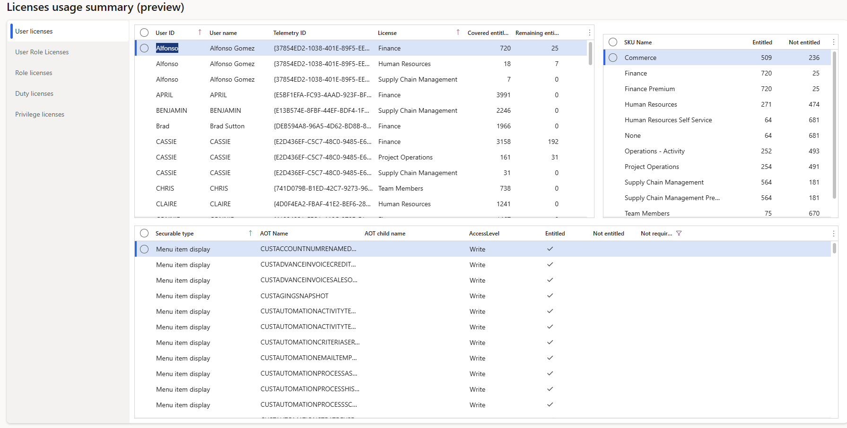
License Usage Summary – User License

Slide 38
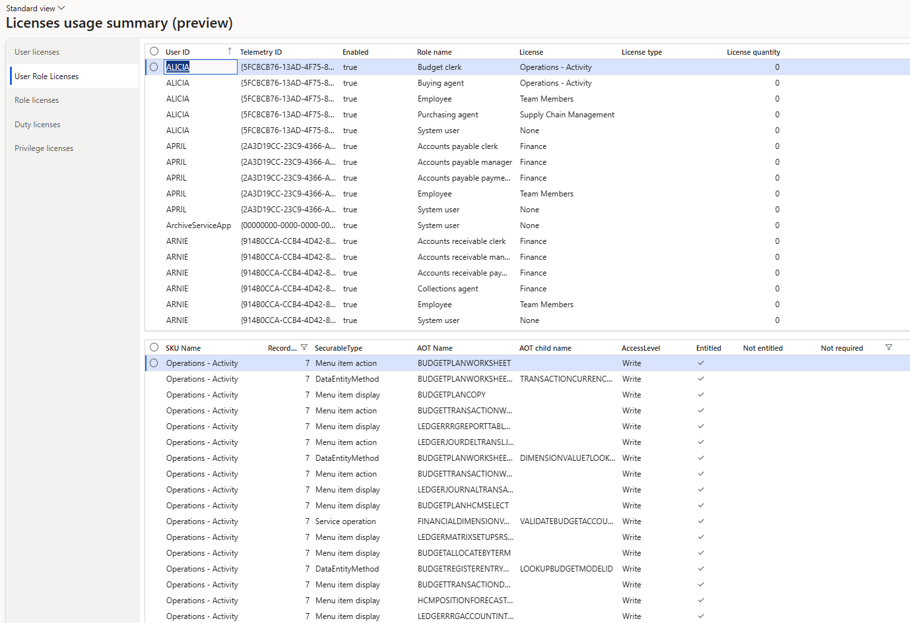
License Usage Summary – User Role License

Slide 39
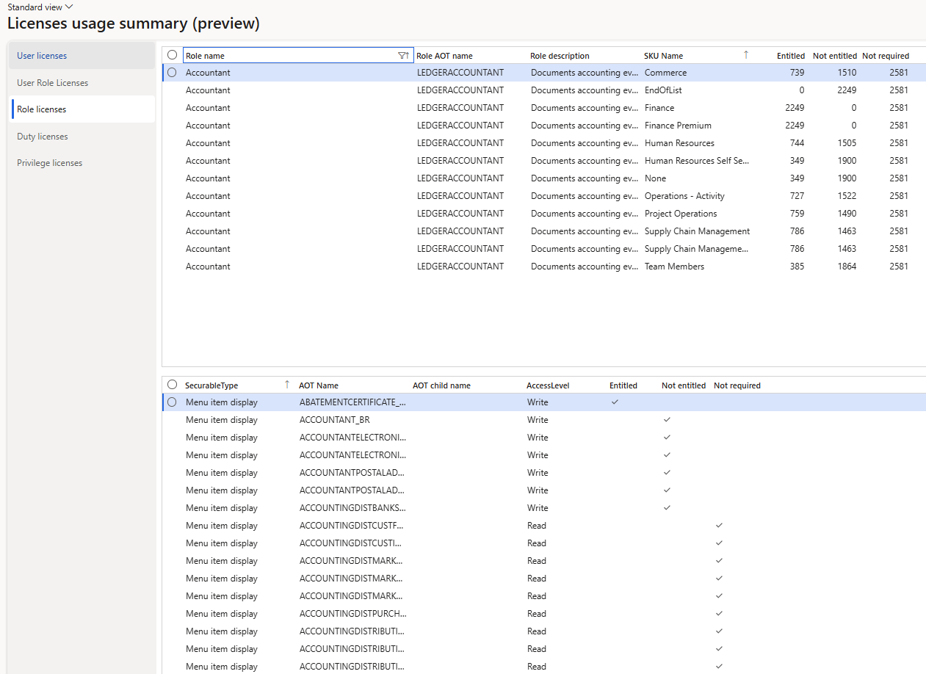
License Usage Summary – Role License

Slide 40
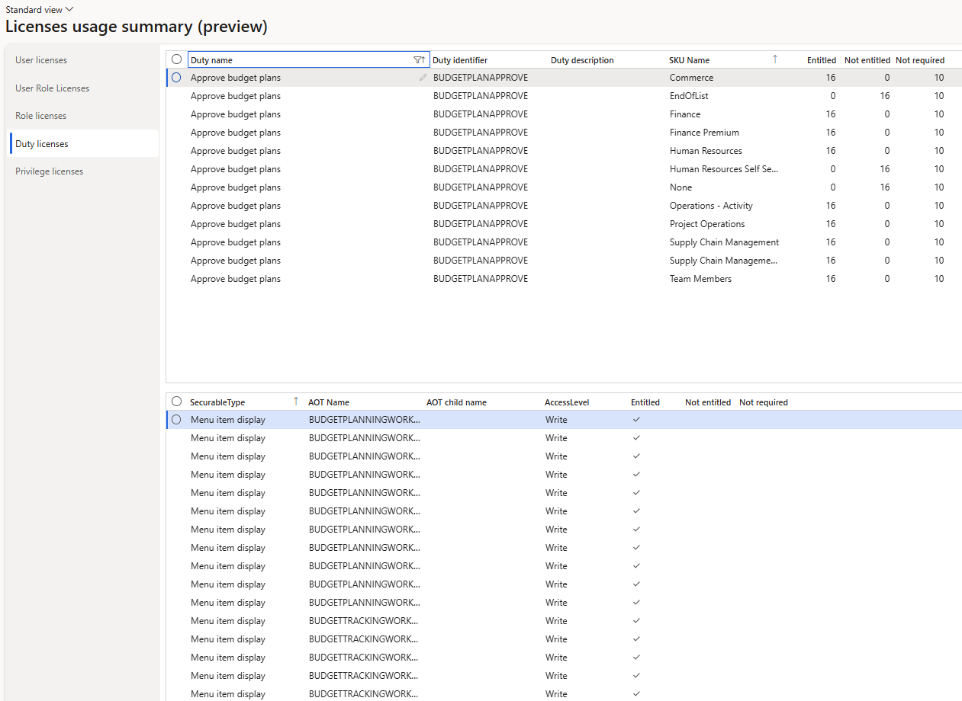
License Usage Summary – Duty License

Slide 41
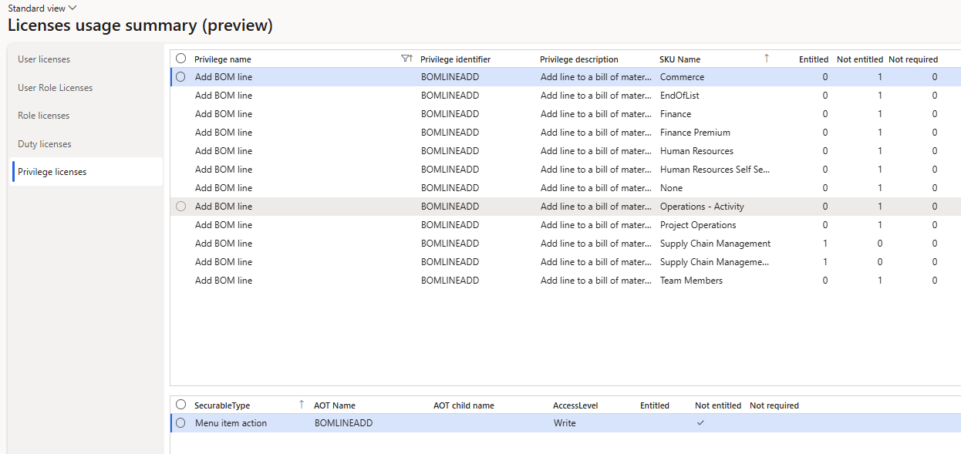
License Usage Summary – Privilege License

Slide 42
License Enforcement / Reporting
License enforcement journey is still a ‘work in progress’
Still have reporting errors, fixes going in frequently
Differences between legacy privilege-based and new object level calculations
  What is correct? Old, new, or both incorrect?
  Review details
  Object requirement versus privilege implementation

Slide 43
Key Takeaways
The reviewing of user license assignments is much more important (and ongoing) process now
License enforcement is coming later this year
  Be proactive on ensuring you are compliant – DO NOT WAIT
Should have a process in place to review license impact after:
  User role assignment
  Security role, duty, or privilege change
  Be sure to test all changes in non-prod env first before pushing to prod
Licensing requirements can change with updates to PPAC
  Does not require a D365 update

Slide 44
Resources
D365FSC License Enforcement Overview – Alex Meyer
Updated D365FSC User Licensing in 10.44 – Alex Meyer
Security topics – Dynamicspedia
My First Look at User Security Governance - Dynamicspedia
How to Read and Analyze the Dynamics 365 F&O License Usage Summary Report – A Real-Life Scenario | Fatih DEMİRCİ
Simplifying License Management for Dynamics 365
FAQ-User-security-role-reporting-and-technical-validation-for-Dynamics-365-finance-and-operations-apps-july25.pdf

Slide 45
Q & A
Alex Meyer
Email: alex.meyer@delinea.com
Delinea website: https://delinea.com/
Fastpath website: https://delinea.com/fastpath
My website: https://alexdmeyer.com
Blog: http://d365foblog.com
Security Class: http://d365fosecurity.com

