Slide 1
















Pakistan User Group – Microsoft Community
USER GROUP
Navigating the 2025 D365 F&O Licensing Changes: What You Need to Know and Do
#PakUGSummit25

Slide 2



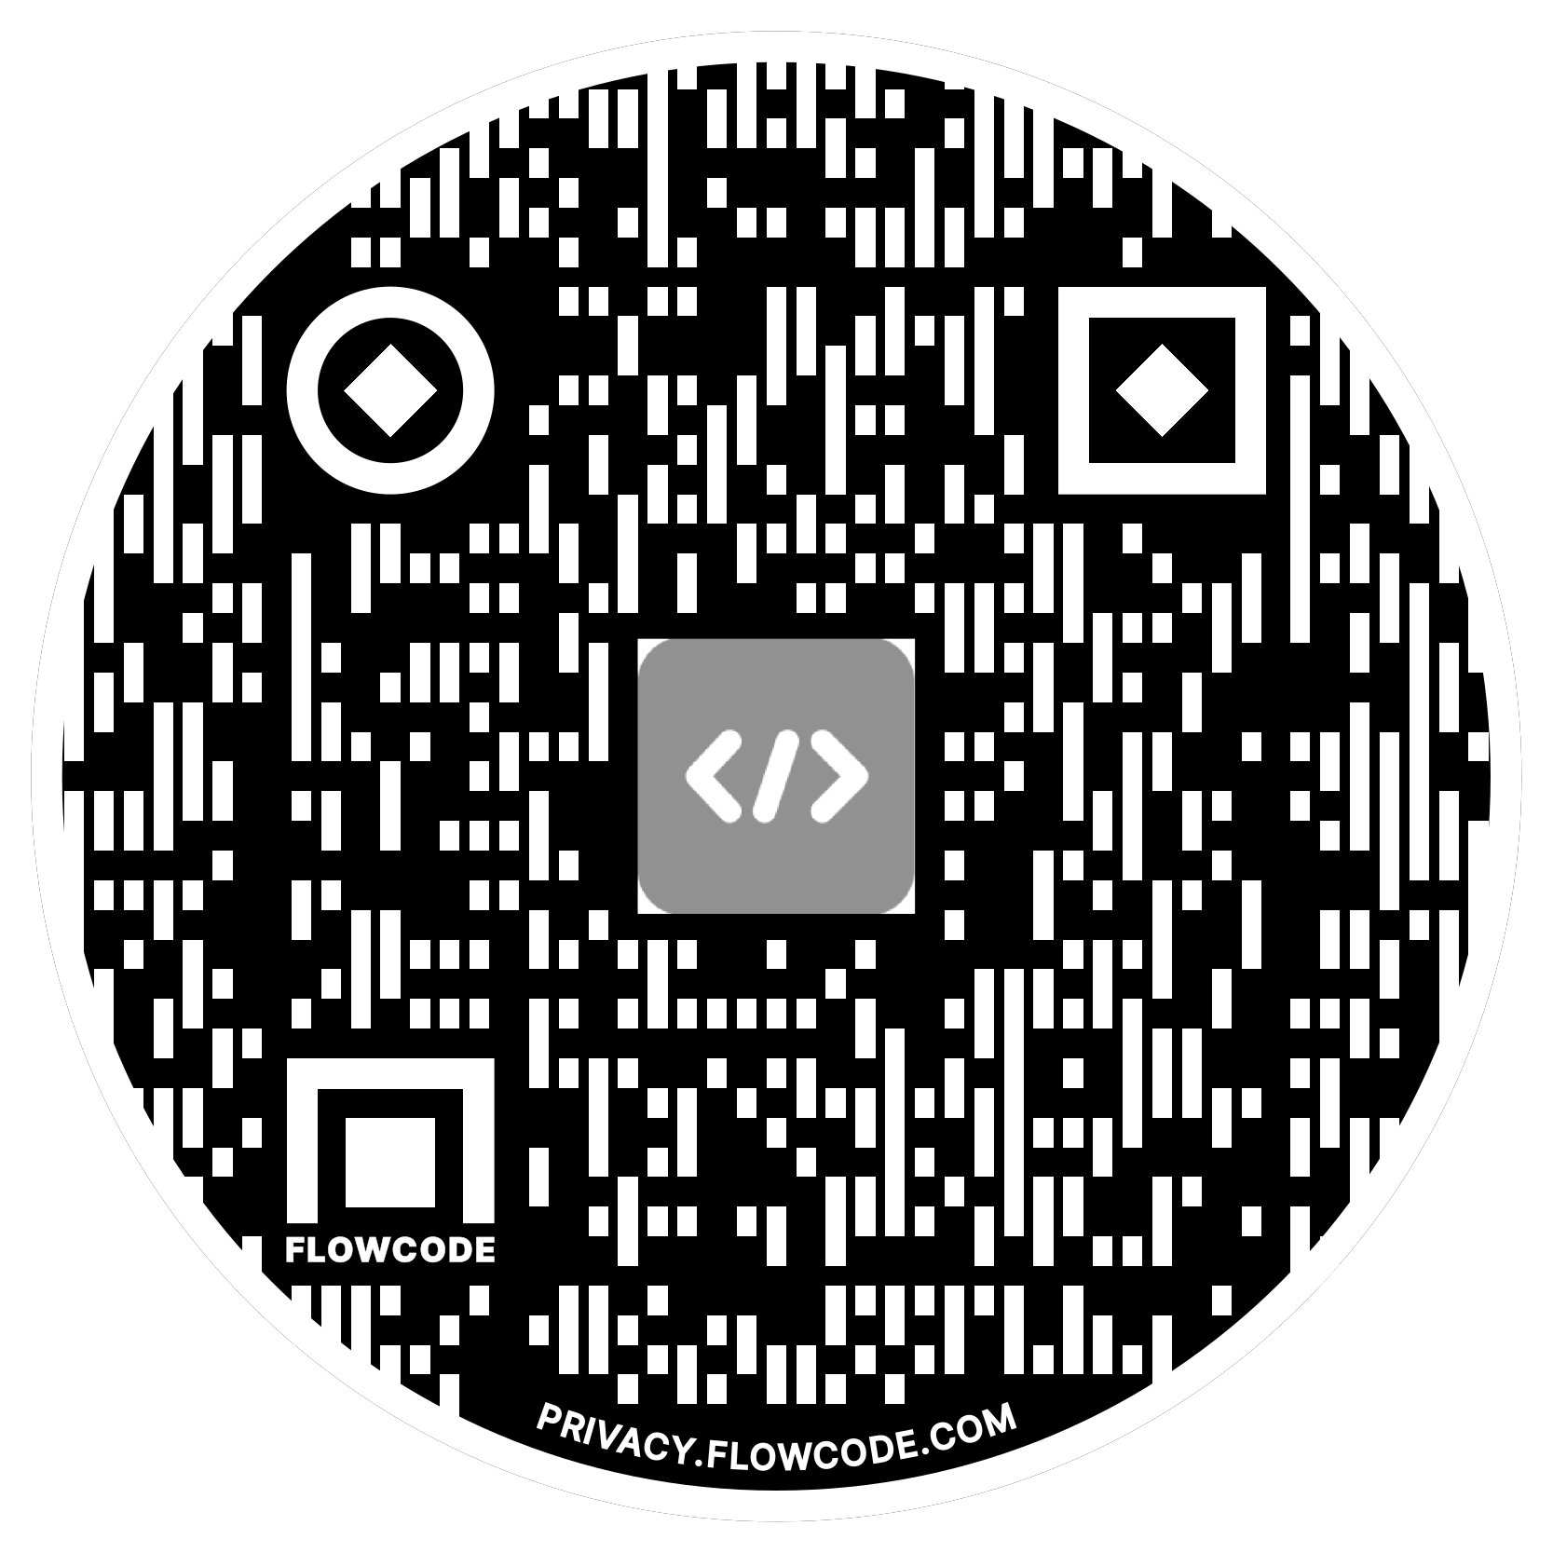

Pakistan User Group – Microsoft Community
Andre Arnaud de Calavon
Managing Partner - Next365
Microsoft MVP
Alex Meyer
Principal Software Engineer – Delinea
Microsoft MVP

Slide 3
Pakistan User Group – Microsoft Community
Agenda
Dynamics 365 F&O Security Model
How Security & Licensing Tie Together
License Enforcement
New License Model
Power Platform Admin Center / Lifecycle Services
User Security Governance

Slide 4

Pakistan User Group – Microsoft Community
D365FO Security Model

Slide 5
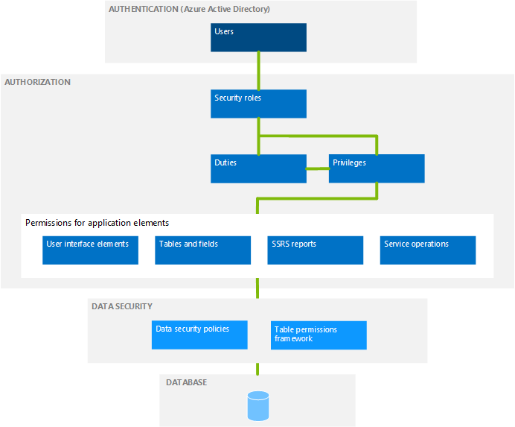
Pakistan User Group – Microsoft Community
D365FSC Security Model
Role Based Security
Users are assigned one or more roles
Hierarchy based security model
  Groups of securable objects are put within one security layer
  Security layers built on top of each other
Two main categories
  Security Layers
  Securable Objects

Slide 6

Pakistan User Group – Microsoft Community
Security & Licensing Tied Together
Security
Licensing
What access a user is assigned = what license(s) they are required to have
  Not based on utilization
Over provisioning of user access ->
  Over assignment of user licenses ->
    Higher licensing costs

Slide 7



Pakistan User Group – Microsoft Community
Dynamics 365 licensing
Customer engagement apps (CRM)
Unified Operations apps (AI ERP)
Sales
Premium
Microsoft Relationship Sales
Customer Service Premium
Contact Center
Customer Insights
Finance
Premium
10 seat min
SCM Premium
10 seat min
Commerce
20 seat min
Full users
Base SKUs
Sales
Enterprise
Field Service
Customer Service Enterprise
Contact Center Digital
Finance
20 seat min
Supply Chain Management
20 seat min
Sales
Professional
Field Service Contractor
Customer Service Professional
Contact Center Voice
Human Resources
5 seat min
Project Operations
20 seat min
Sales Enterprise Attach
Customer Service Enterprise Attach
Field Service Attach
Customer Insights Attach
Finance Attach
Supply Chain Management Attach
Commerce Attach
Multi-App Users
Attach SKUs
Sales Professional Attach
Customer Service Professional Attach
Human Resources Attach
Project Operations Attach
Additional Users
Device SLs
Field Service Device
Customer Service Device
User
Device
Tenant
Operations
Device
Operations
Activity
HR Self Serve
Team Members

Slide 8
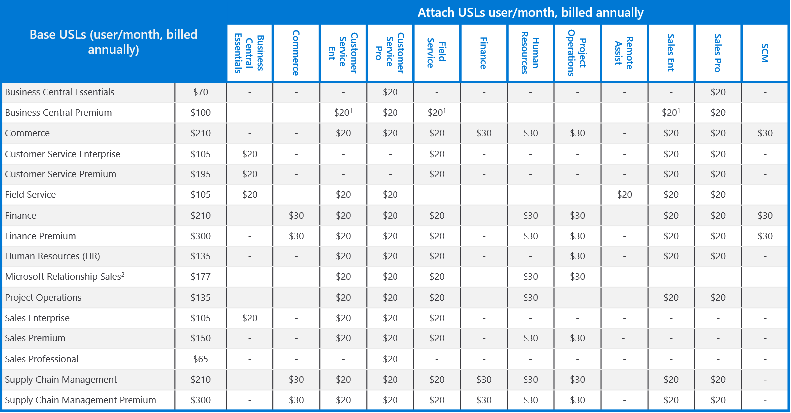
Pakistan User Group – Microsoft Community
Dynamics 365 licensing base vs attach

Slide 9
Pakistan User Group – Microsoft Community
Updates to Licensing Methodology

Slide 10
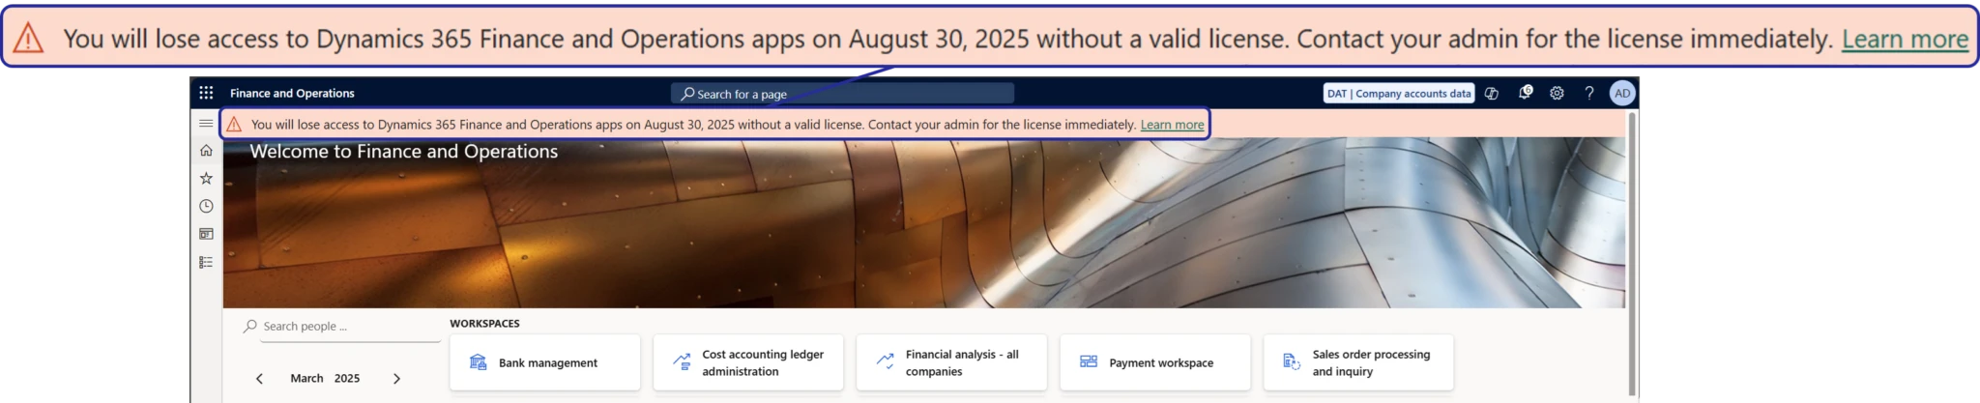
Pakistan User Group – Microsoft Community
Dynamics 365 License Enforcement
Microsoft starting to perform user license compliance check during sign in
Sept 1st 2025 – soft enforcement
  Users not assigned correct licenses will receive a pop up banner during sign in
Nov 1st 2025 – hard enforcement
  Users not assigned correct licenses will be stopped during sign in to application
License enforcement only impacts production level environments (lower tiers do not have enforcement)

Slide 11
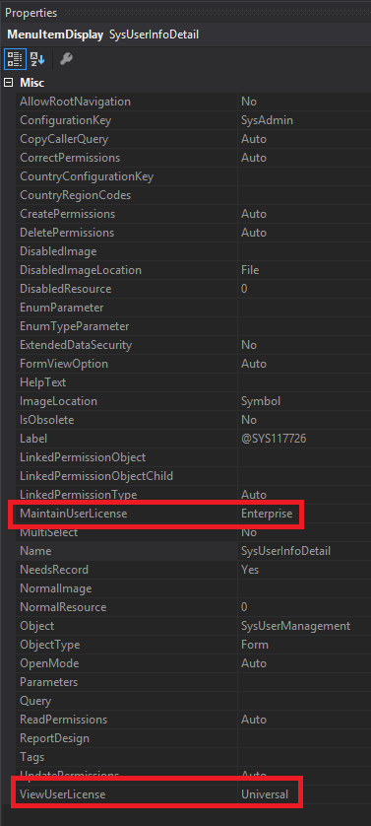
Pakistan User Group – Microsoft Community
Where Did We Come From?
License requirement came from entry point attributes
  ViewUserLicense
  MaintainUserLicense
Privileges assigned to a user determined license SKU requirements
  Finance, SCM, Commerce, Project Ops, HR

Slide 12
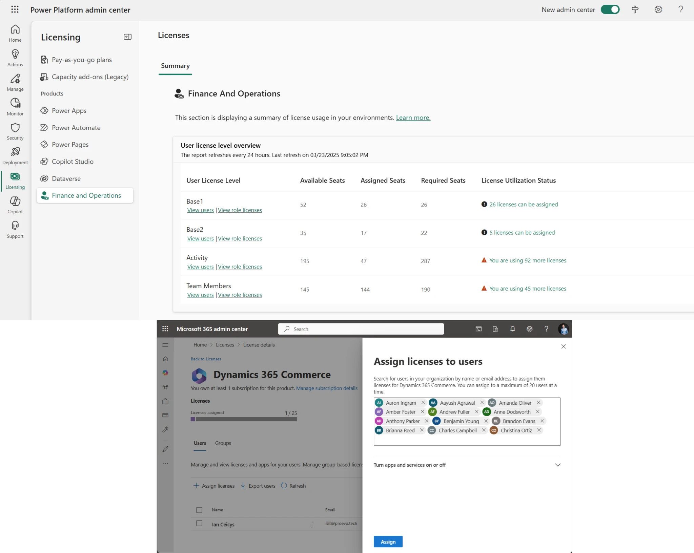
Pakistan User Group – Microsoft Community
Where Are We Now?
All license calculation is done by Power Platform Admin Center (PPAC)
  Data is pushed to D365F&O and LCS
  PPAC is source of truth
  Current refresh 8 hours

Slide 13
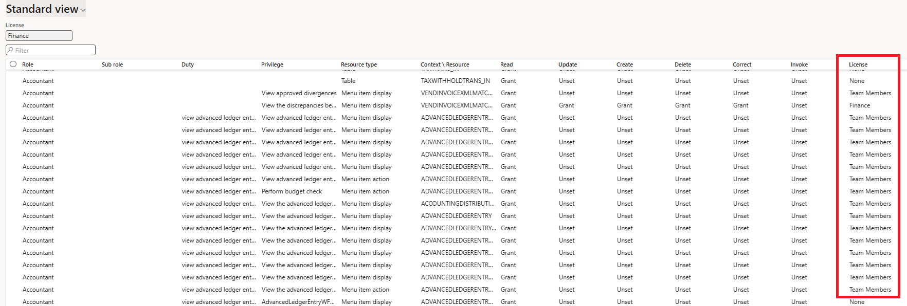
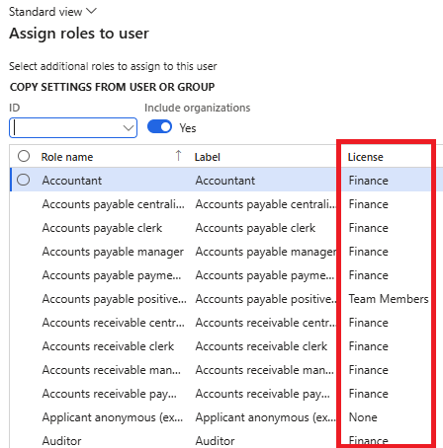
Pakistan User Group – Microsoft Community
Deprecated License Reports
Microsoft has announced that legacy license reporting within D365 will be deprecated
  View Permissions report
  License shown during user role assignment
  User License Counts
  User License History

Slide 14
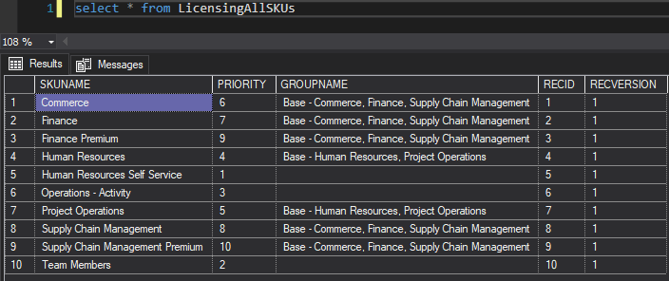
Pakistan User Group – Microsoft Community
Object Level License Analysis
In 10.0.43 and 10.0.44, there are new licensing tables that contain detailed information on license requirements
LicensingAllSKUs
  Stores all current licenses and their priority ranking

Slide 15
Pakistan User Group – Microsoft Community
License Hierarchy
SCM Prem
Operations- Activity
Team Member
Finance Prem
SCM
Finance
Commerce
Project Operations
Human Resources
HR Self Service
Each license has a ‘Priority’
  The highest priority license of a user access must be the base license
Some have a ‘GroupName’ – which categorizes the license SKUs into groups that are of a similar level
  Red – Fin, SCM, Comm
  Blue – Proj Ops, HR
  Purple – No group

Slide 16
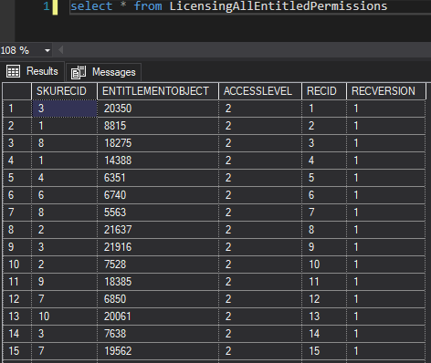
Pakistan User Group – Microsoft Community
Object Level License Analysis
LicensingAllEntitledPermissions
  Stores association between object -> licenses that meet requirements

Slide 17
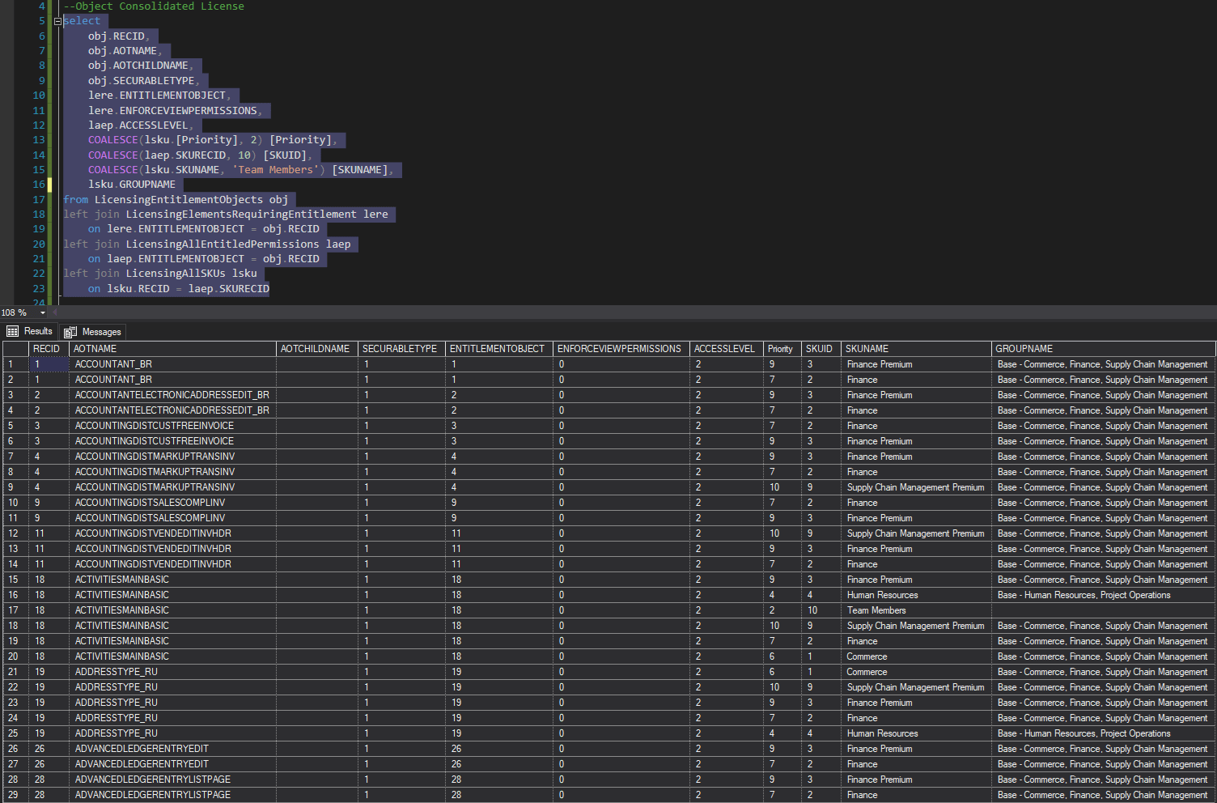
Pakistan User Group – Microsoft Community
Object Level License Analysis
Object License Query

Slide 18
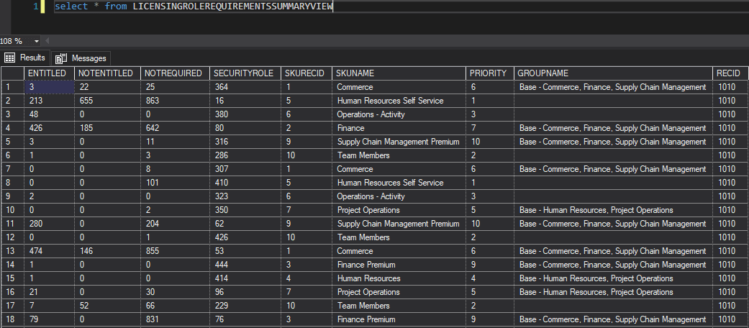
Pakistan User Group – Microsoft Community
Object Level License Analysis
Licensing<Role>RequirementsSummaryView
  Duty
  Privilege

Slide 19
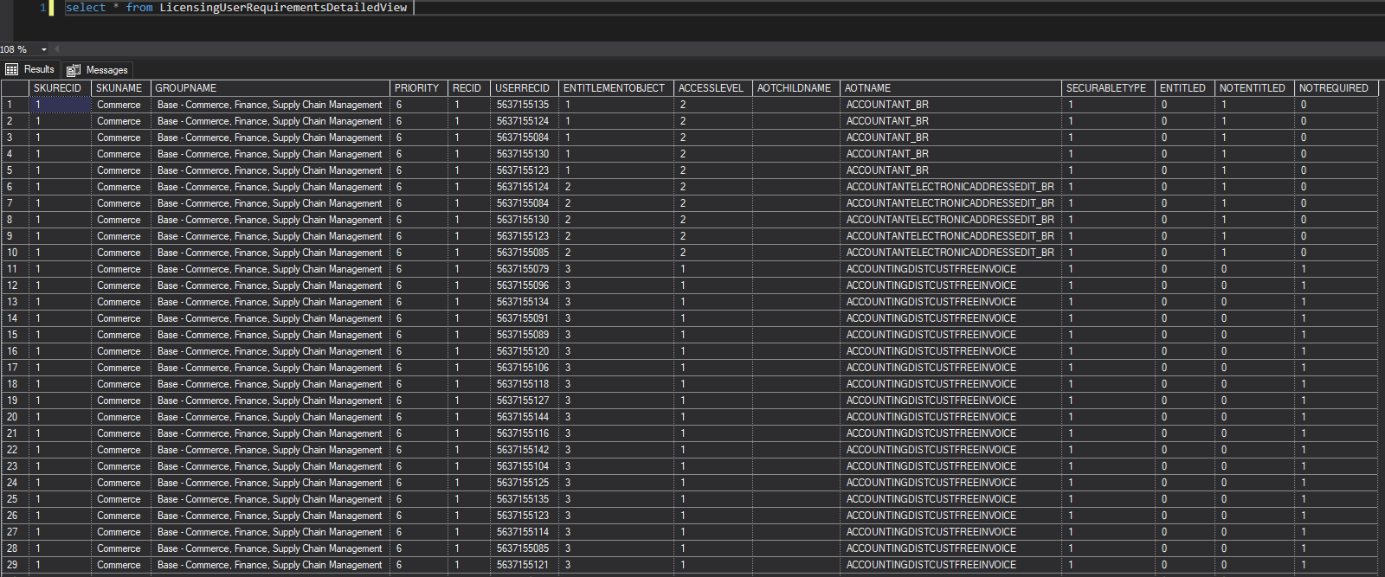
Pakistan User Group – Microsoft Community
Object Level License Analysis
LicensingUserRequirementsDetailedView

Slide 20
Pakistan User Group – Microsoft Community
Licensing Methodology Changes
Objects themselves actually drive all license requirements from Team Member -> Activity -> License SKUs (Finance, SCM, Commerce, etc)
  Menu Items, Service Operations, Data Entities, Data Entity Methods
  We move away from ‘privilege-based licensing’ where the privilege assigned to the user causes certain license SKUs to be required for a user
Trying to find lowest cost license assignments based on ‘license priority’ that will cover all objects assigned to a user
Users assigned SysAdmin role do not require a license

Slide 21
Pakistan User Group – Microsoft Community
Power Platform Admin Center

Slide 22
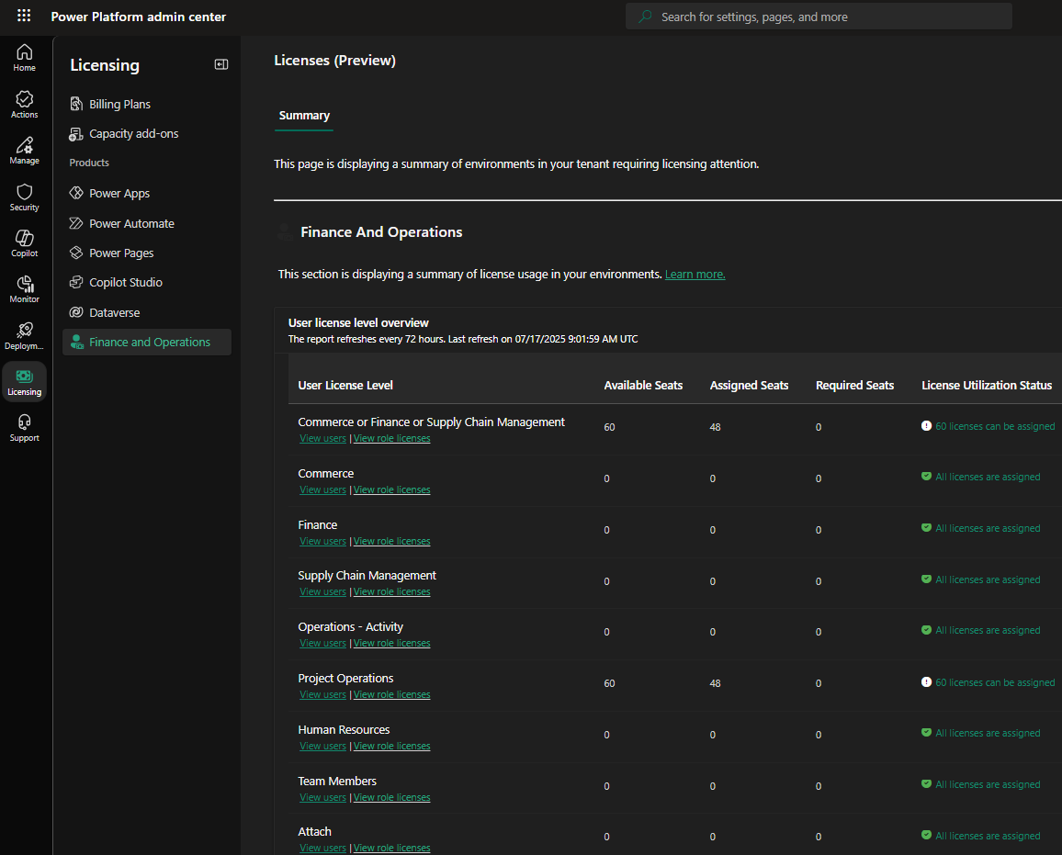
Pakistan User Group – Microsoft Community
PPAC Licensing
PPAC -> Licensing -> Finance and Operations
Lists ‘available’ and ‘assigned’ seats (aka licenses)
CSV export for detailed analysis in e.g. Excel

Slide 23
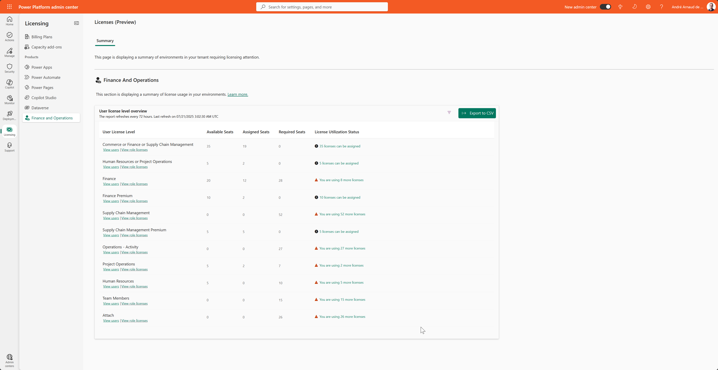
Pakistan User Group – Microsoft Community
PPAC Licensing

Slide 24
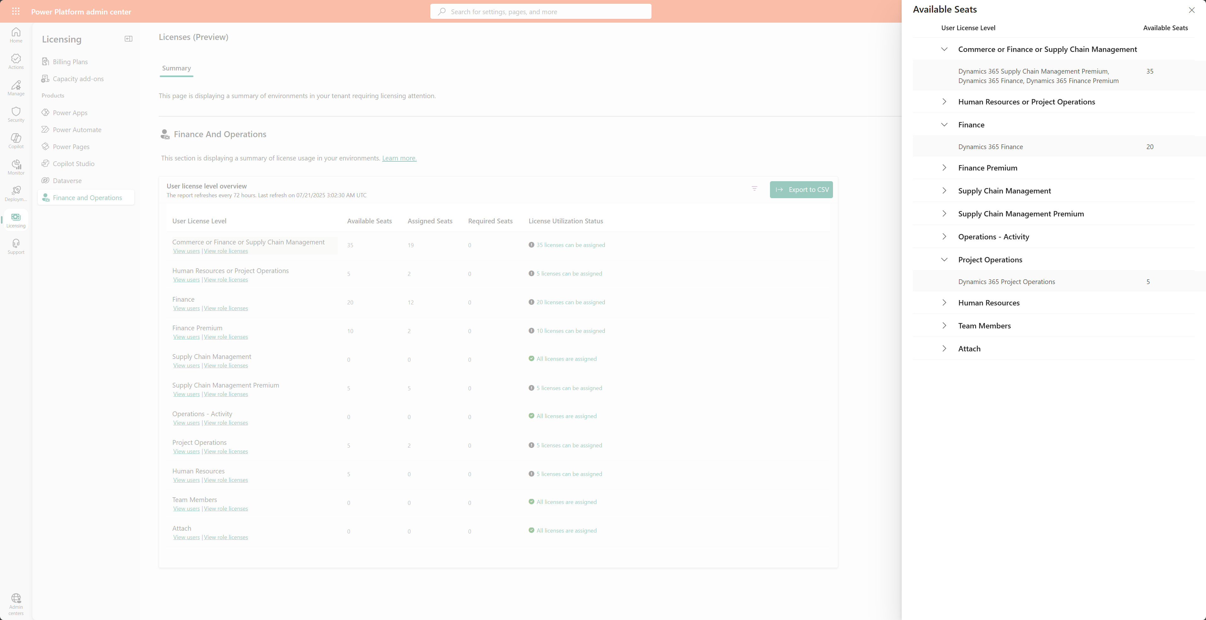
Pakistan User Group – Microsoft Community
PPAC Licensing

Slide 25
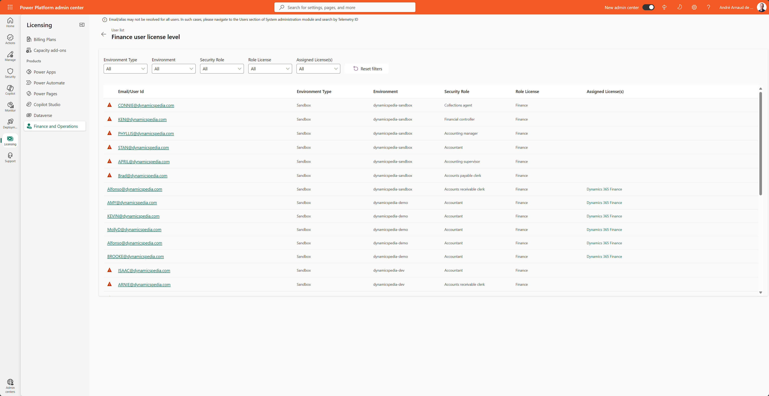
Pakistan User Group – Microsoft Community
PPAC Licensing

Slide 26
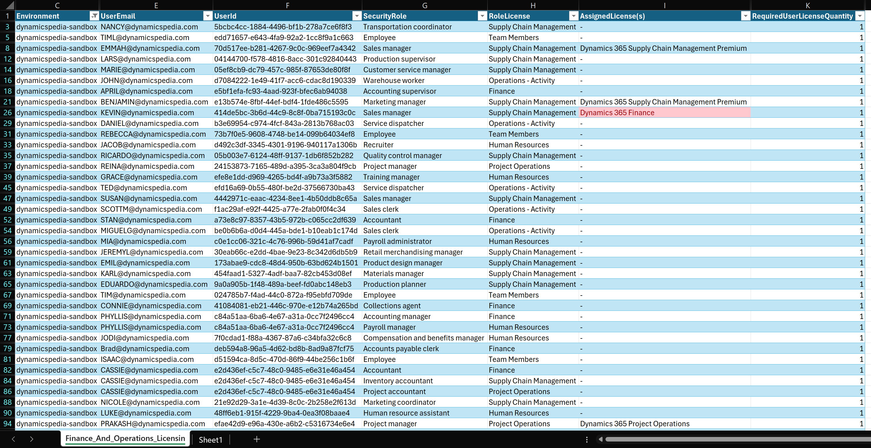
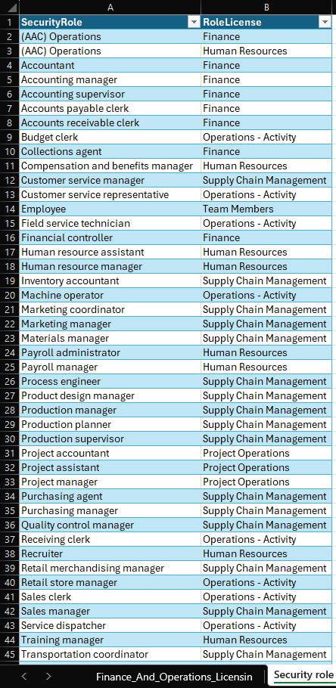
Pakistan User Group – Microsoft Community
Export CSV and create reports in e.g. Excel

Slide 27
Pakistan User Group – Microsoft Community
Lifecycle Services (LCS)

Slide 28
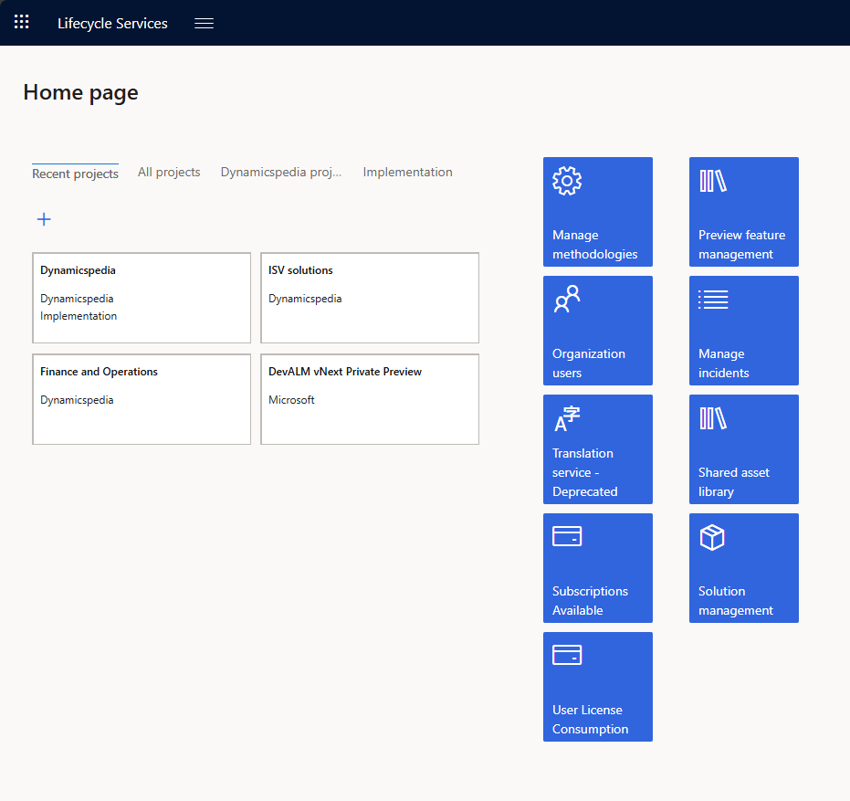
Where to find the data?
Lifecycle Services (LCS) Licensing report
User License consumption
Shows same data as PPAC, via Power Platform API integration.
Available for customers and their partners.
Ability to export to CSV and use pivot table count on “Role License”.
New V2 version of User License Consumption in private preview. Expected for all customers early August.
  Better and clear overview
  Actionable

Slide 29
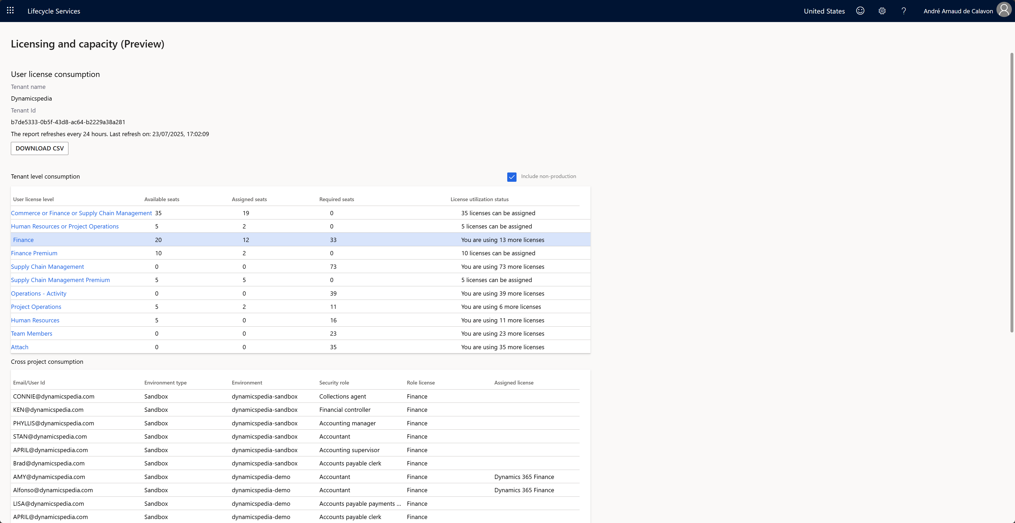

Slide 30
Pakistan User Group – Microsoft Community
User Security Governance

Slide 31
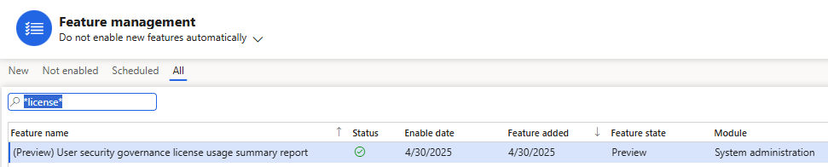
Pakistan User Group – Microsoft Community
License Usage Summary
Report is ‘preview’ feature – will need to be enabled via Feature Management

Slide 32
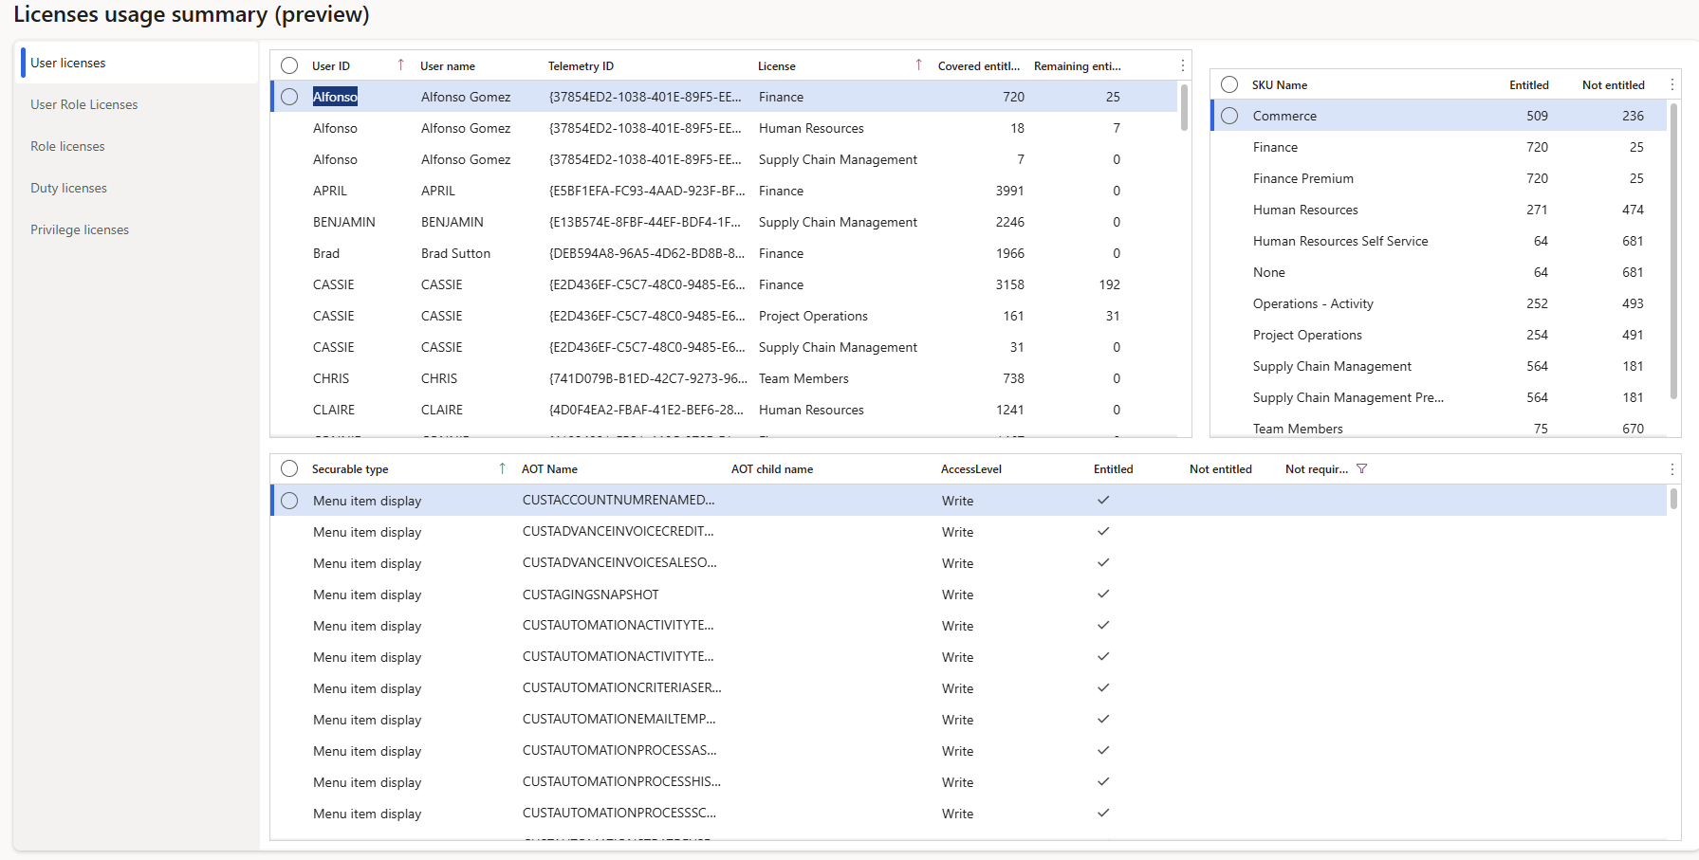
Pakistan User Group – Microsoft Community
License Usage Summary – User License

Slide 33
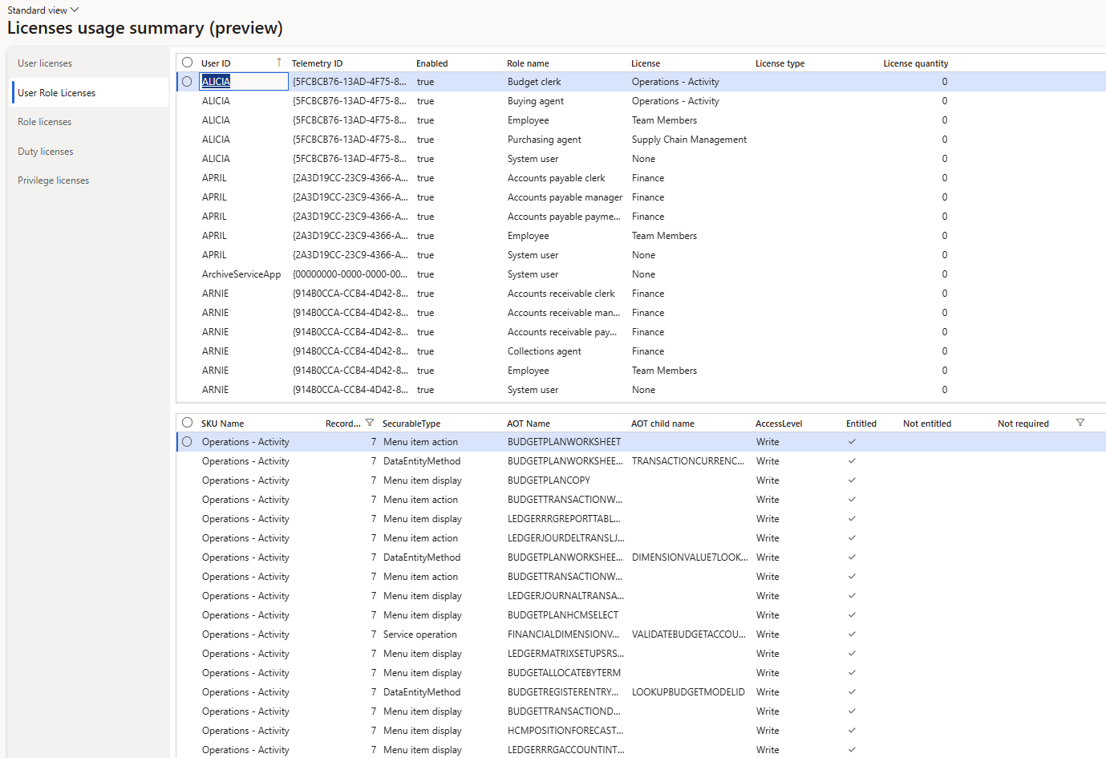
Pakistan User Group – Microsoft Community
License Usage Summary – User Role Licenses
Notes:
Lists the license requirement for each user role assigned
This does not mean the user needs all of the licenses listed, it is up to the end user which combination of licenses the user needs

Slide 34
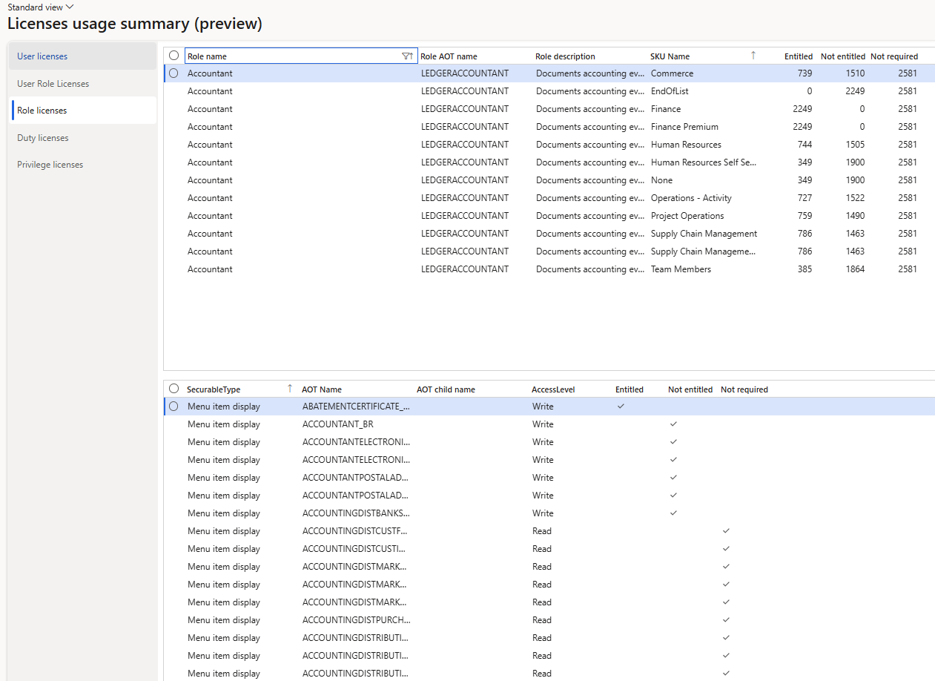
Pakistan User Group – Microsoft Community
License Usage Summary – Role License
Notes:
Shows the license requirement for each role
You will notice that each role is listed for each license type – with the corresponding Entitled / Not Entitled / Not Required
This does not mean that all licenses meet the role license requirement, the system is showing how each license lines up against each role
You will want to look for a role license combination that has 0 ‘Not Entitled’ entries as this means that the license meets the role license requirements

Slide 35
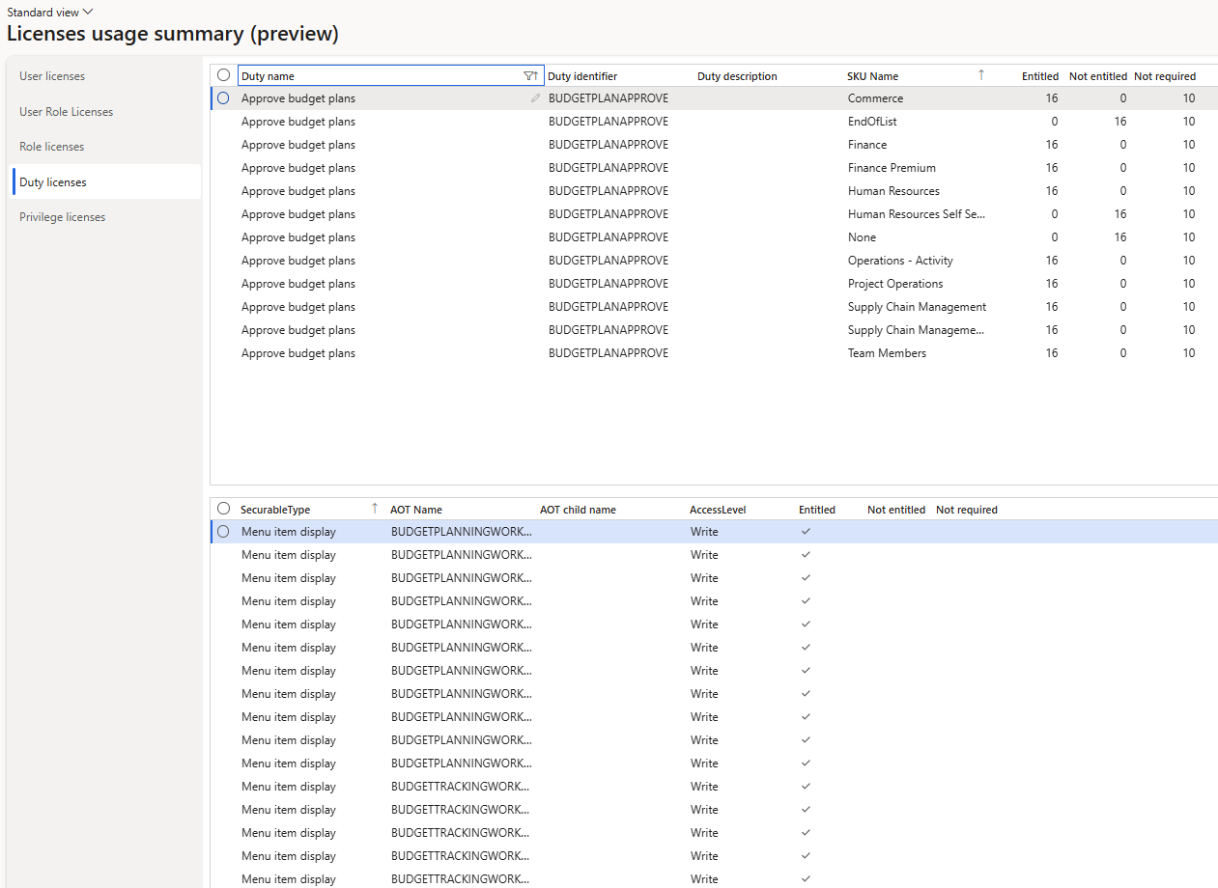
Pakistan User Group – Microsoft Community
License Usage Summary – Duty License

Slide 36
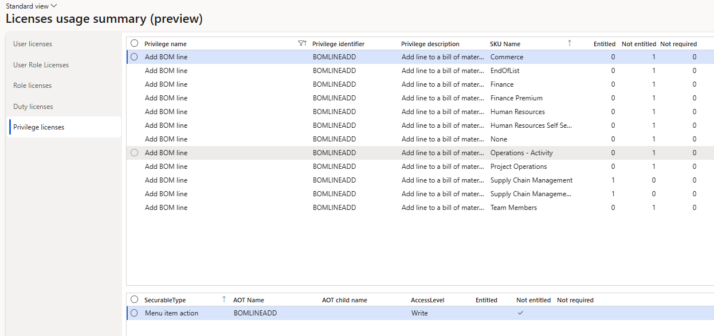
Pakistan User Group – Microsoft Community
License Usage Summary – Privilege License

Slide 37
Pakistan User Group – Microsoft Community
Review license requirements
License enforcement Journey until today hard
Reporting errors, a lot is fixed already
Differences between legacy privilege-based and new object level calculations
  What is correct? Old, new, or both incorrect?
  Review details
  Object requirement versus privilege implementation
DEMO! Pay attention to all the tips...

Slide 38
Pakistan User Group – Microsoft Community
Key Takeaways
The reviewing of user license assignments is much more important (and ongoing) process now
License enforcement is coming later this year
  Be proactive on ensuring you are compliant – DO NOT WAIT
Should have a process in place to review license impact after:
  User role assignment
  Security role, duty, or privilege change
  Be sure to test all changes in non-prod env first before pushing to prod
Licensing requirements can change with updates to PPAC
  Does not require a D365 update

Slide 39
Pakistan User Group – Microsoft Community
Resources
D365FSC License Enforcement Overview – Alex Meyer
Updated D365FSC User Licensing in 10.44 – Alex Meyer
Security topics – Dynamicspedia
My First Look at User Security Governance - Dynamicspedia
How to Read and Analyze the Dynamics 365 F&O License Usage Summary Report – A Real-Life Scenario | Fatih DEMİRCİ
Simplifying License Management for Dynamics 365
FAQ-User-security-role-reporting-and-technical-validation-for-Dynamics-365-finance-and-operations-apps-july25.pdf

Slide 40
Open Q&A
Andre Arnaud de Calavon
Alex Meyer
alex.meyer@delinea.com

Slide 41

Thanks

Slide 42
Pakistan User Group – Microsoft Community
Slide Title
Test
Test
Test

