Slide 1



Innovation.
Education.
Training.

Slide 2




INNOVATION.
EDUCATION.
TRAINING.
Hello
Minneapolis

Slide 3
Tips and Tricks for Securing and Administering D365FO

Slide 4

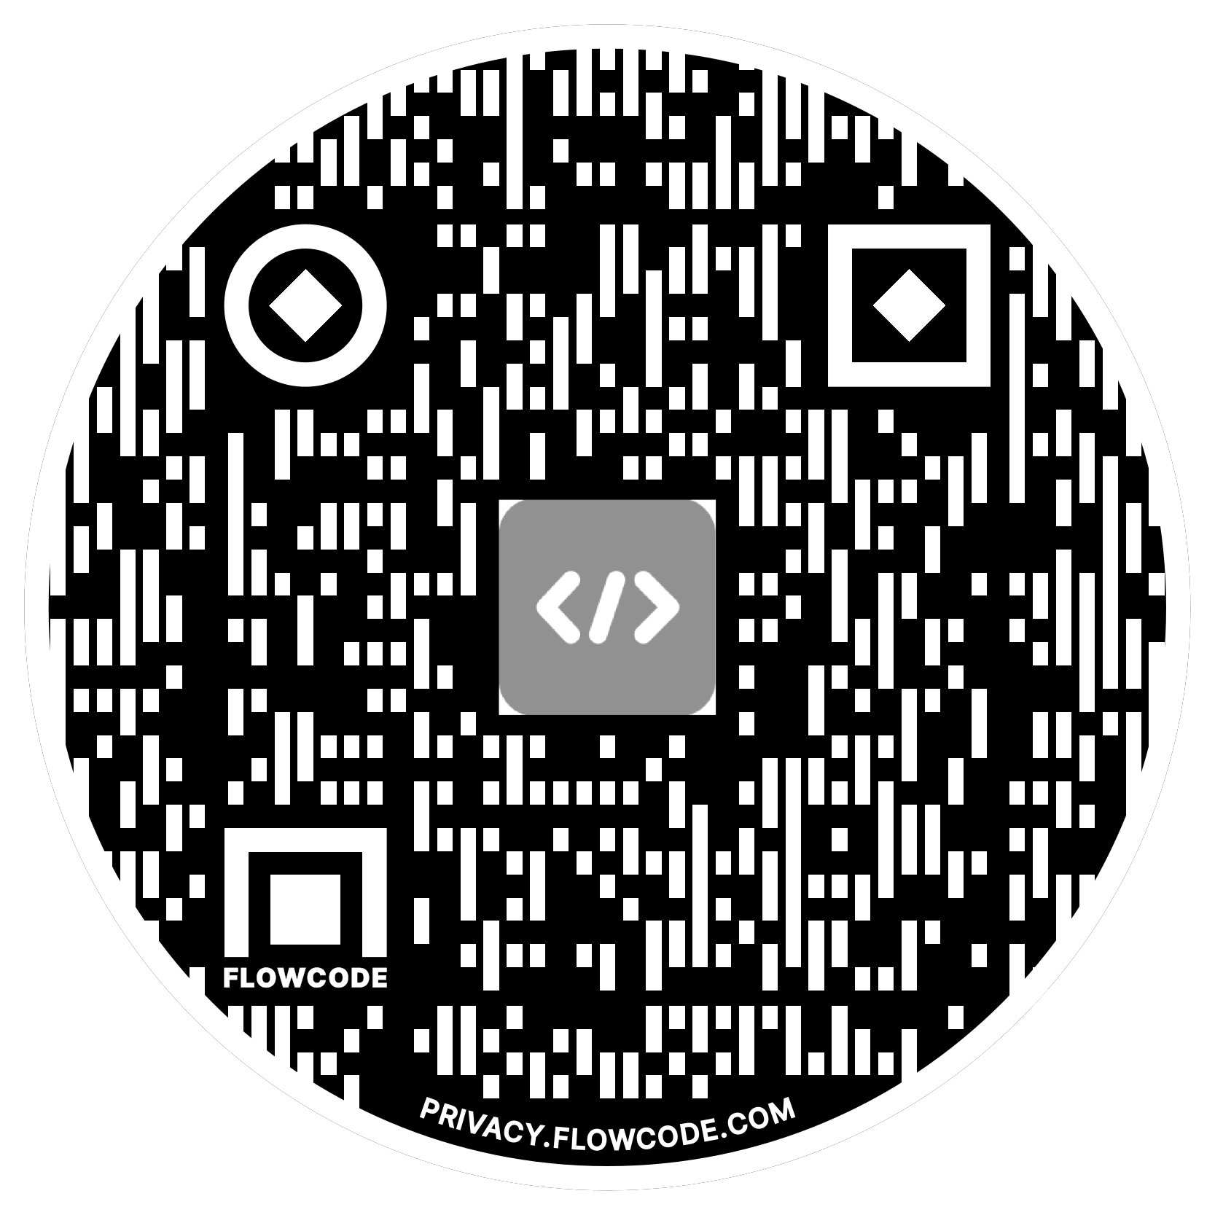

Alex Meyer
Principal Software Development Engineer
Delinea
Email: alex.meyer@delinea.com
Blog: http://d365foblog.com
Security Class: http://d365fosecurity.com
GitHub: https://github.com/ameyer505
YouTube:
LinkedIn | Microsoft MVP Profile
Background:
Awarded Microsoft MVP in Business Applications since 2019
Been working with AX since 2013
Been working with D365FO since 2016
Have spoken at Summit (US & Europe), Focus, and local chapters around AX/D365FO security and have done webinars around native controls in both versions

Slide 5
Session Objectives
What will you learn today?
Understand the core functions for administering and securing D365FO
User security and licensing overview / enforcement
Tips & tricks

Slide 6
Session Agenda
Assigning User Security
Assigning legal entity access
Export / Import User and Role Assignments
Determine Security Required
User Licensing / Enforcement
Telemetry Data
  Usage data
  Error logging
  Custom logging
Tips & Tricks
  User Options
  JIT Access
  Execute X++ in Prod
  Table Browser
  Usage Data / Personalizations
  Debug URL

Slide 7
Assigning User Security

Slide 8
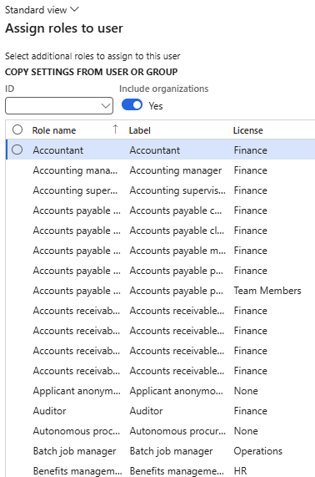
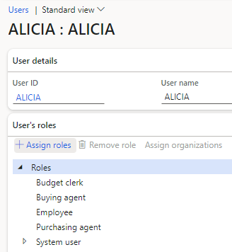
Assign Roles to User
Notes:
To get all role licenses, right click on the ‘Assign roles to user’ grid -> Export all rows

Slide 9
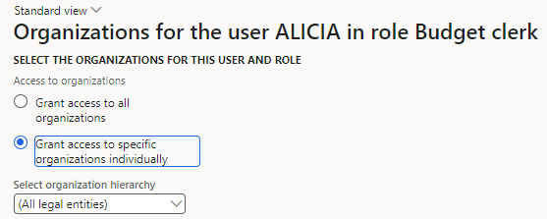
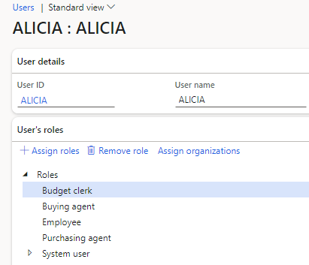
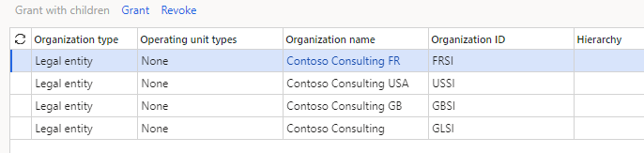
Assign Org Restriction
By default, when you assign a role to a user it is assigned without any organization restriction
Once applied, the user only has this role’s access within the organizations assigned

Slide 10
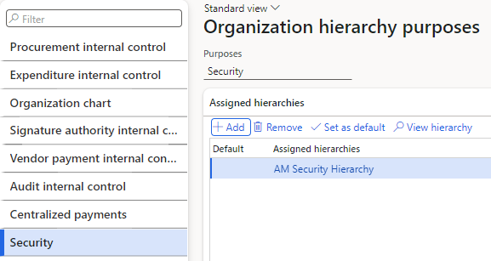
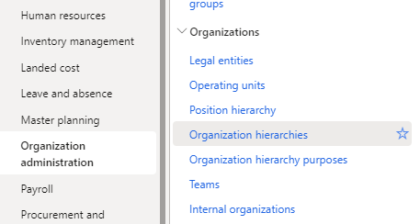
Organization Hierachy
Allows for mass assignment of organization restrictions to user role assignments based on defined structure

Slide 11
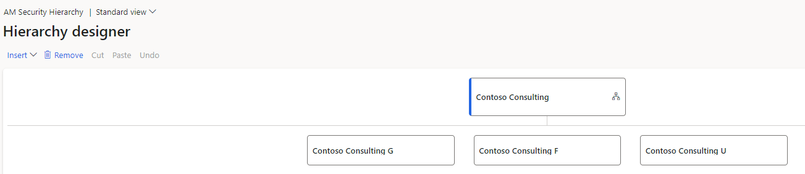
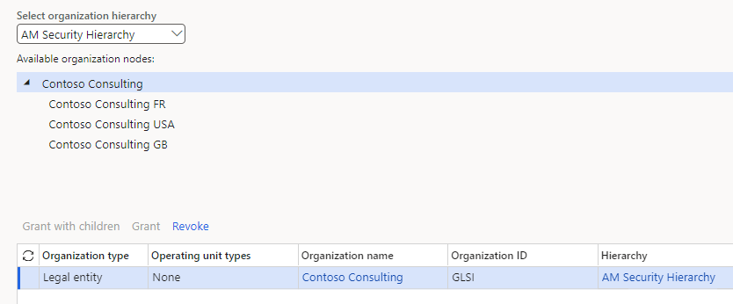
Organization Hierarchy

Slide 12
Export / Import User & Role Assignments

Slide 13
Data Management Framework
Allows for exporting / importing data from a D365FO environment
Utilizes data entities:
  Users -> SystemUserEntity
  User Roles -> SystemSecurityUserRoleAssociationEntity
  User Role Organizations -> SystemSecurityUserRoleOrganizationEntity

Slide 14
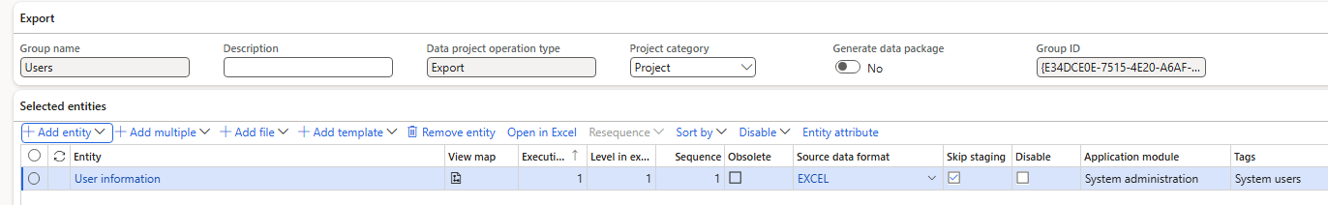
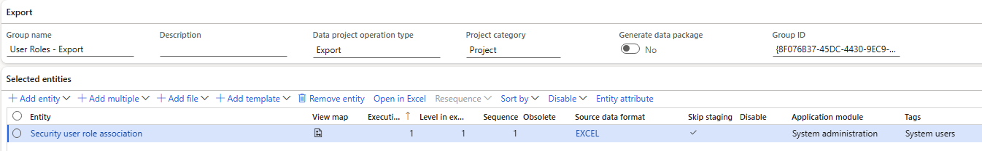
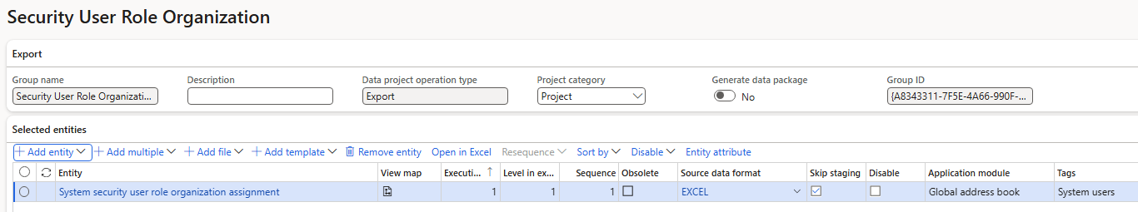
Data Management Project Setup
Notes:
Users
User Roles
User Role Organizations

Slide 15
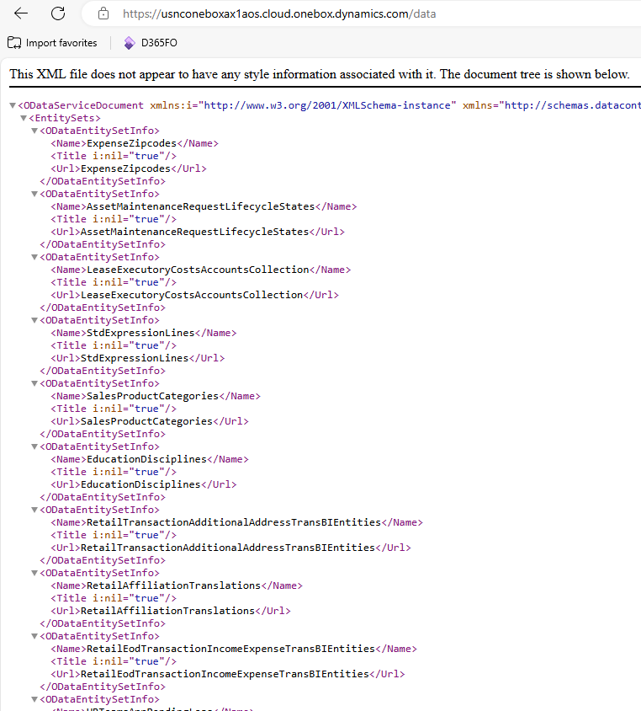
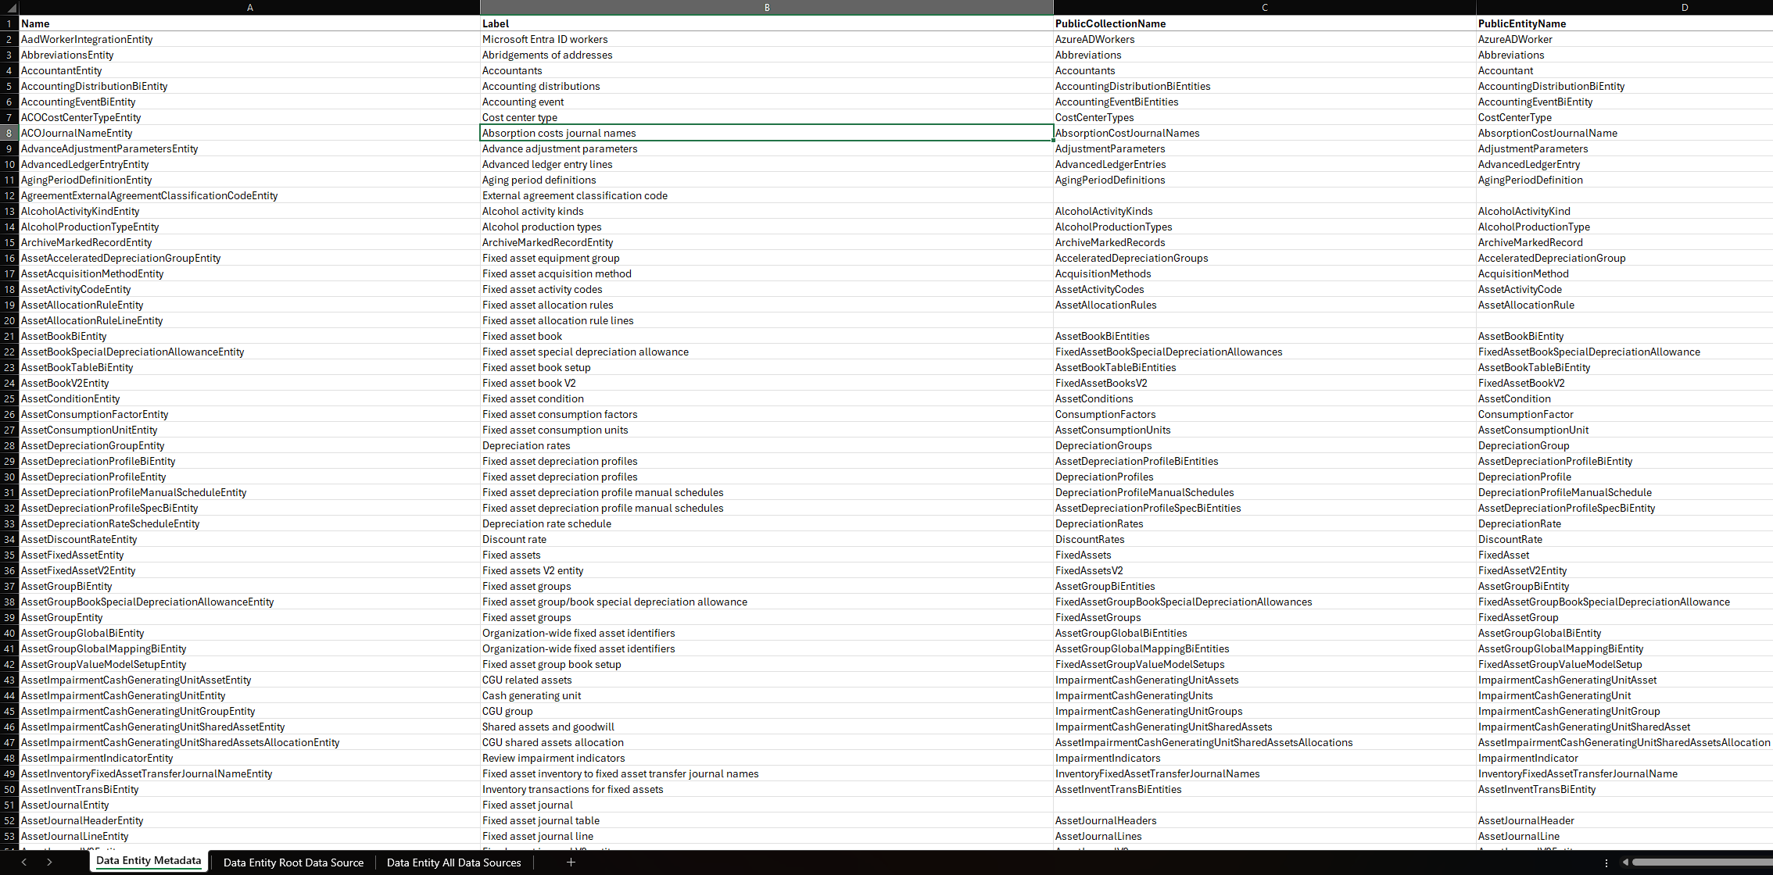
Data Entities Metadata
D365 Version Metadata
Notes:
https://alexdmeyer.com/resources/d365fo-version-metadata/

Slide 16
Determine User Security Required

Slide 17
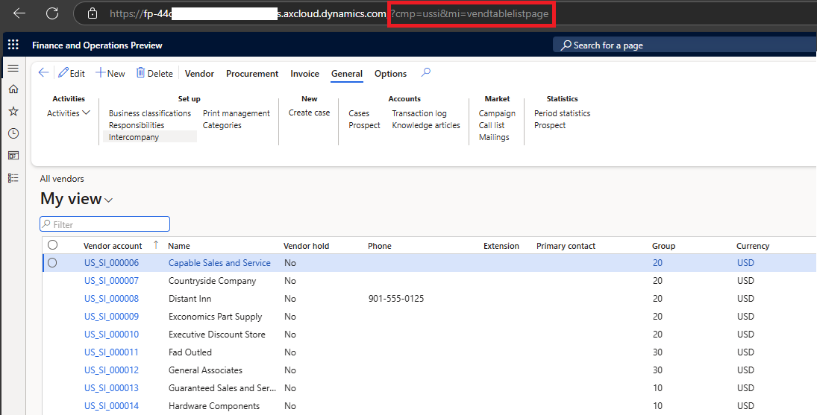
Determine Menu Item via URL

Slide 18
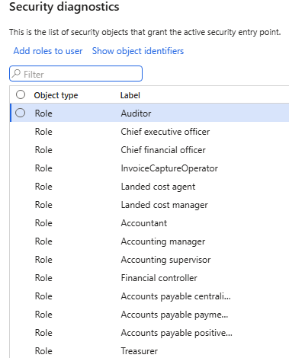
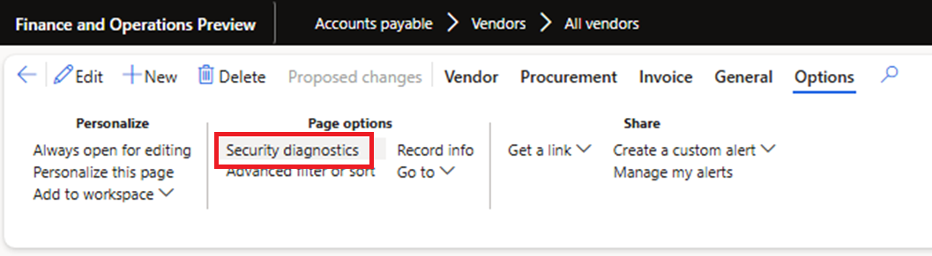
Form -> Security Diagnostics

Slide 19
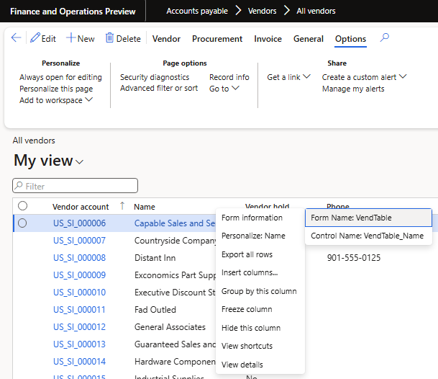
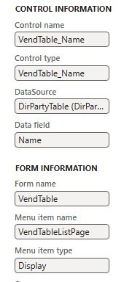
Form Information

Slide 20
Telemetry Data

Slide 21
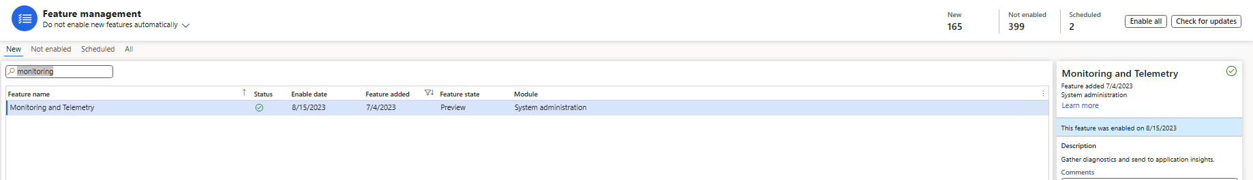
Setup & Configuration
GA in 10.44 – Preview feature in prior versions

Slide 22
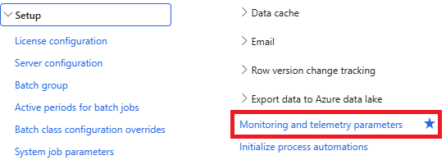
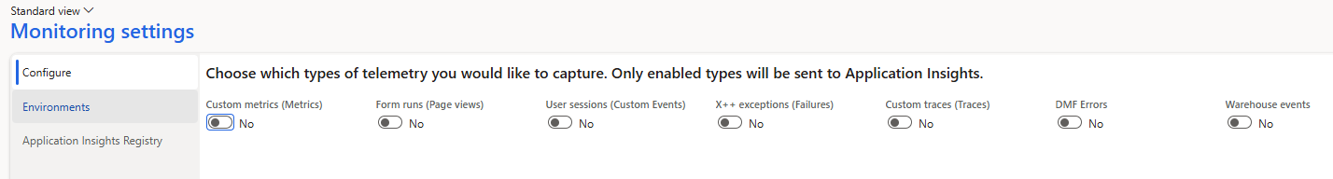
Parameter Setup
System Administration -> Setup -> Monitoring and telemetry parameters

Slide 23
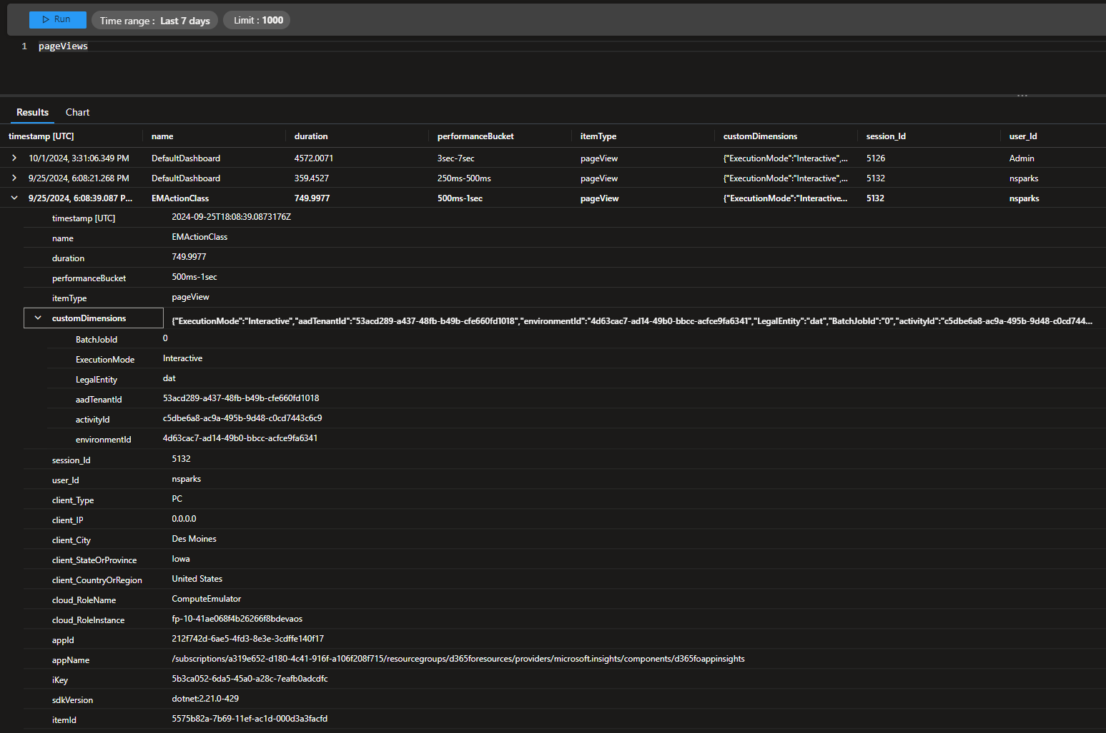
Page View Events

Slide 24
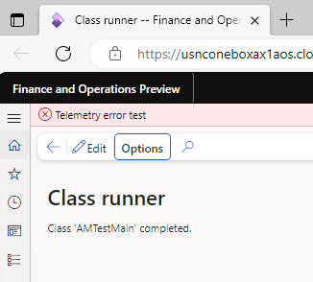
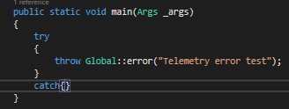
Exception Events

Slide 25
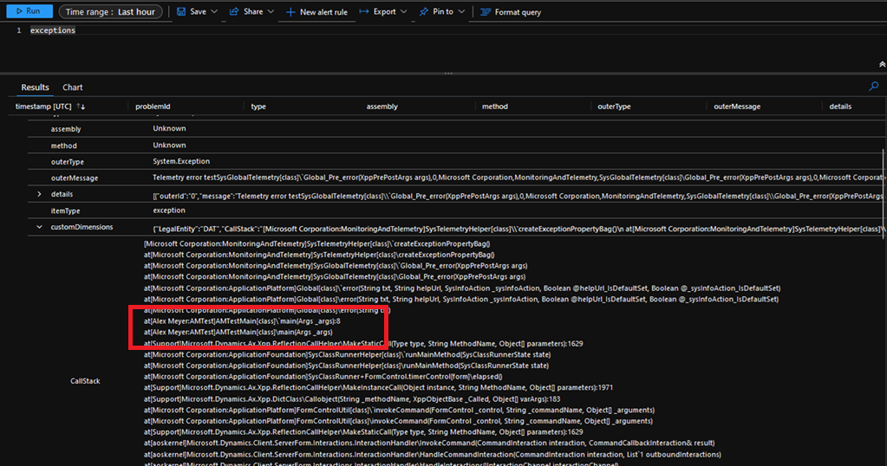
Exception Events

Slide 26
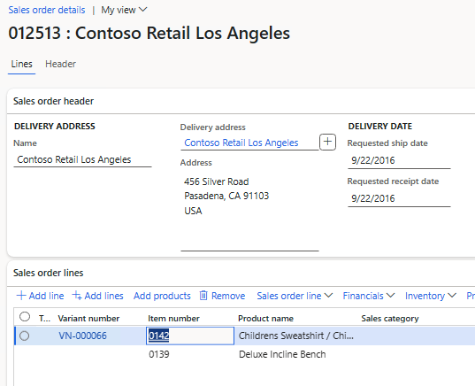
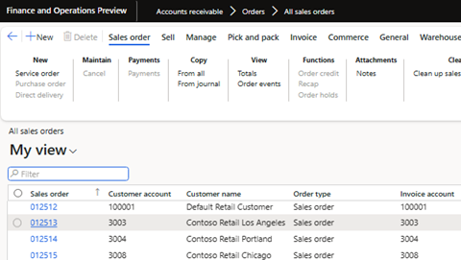
Custom Telemetry Events
Scenario – Want to log when a user opens a sales order

Slide 27
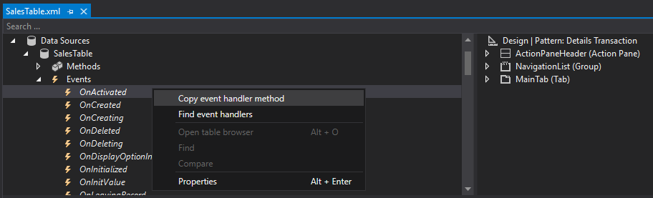
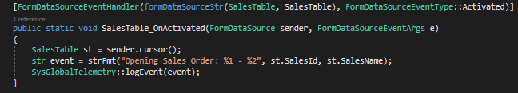
Custom Telemetry Events

Slide 28
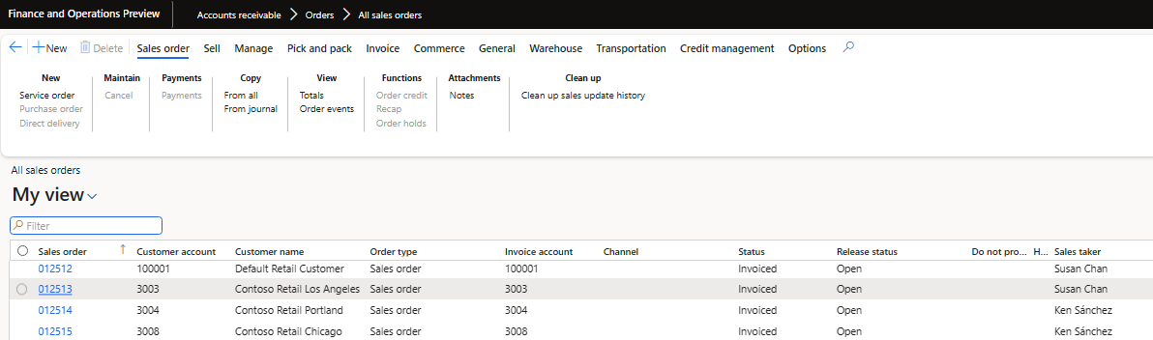
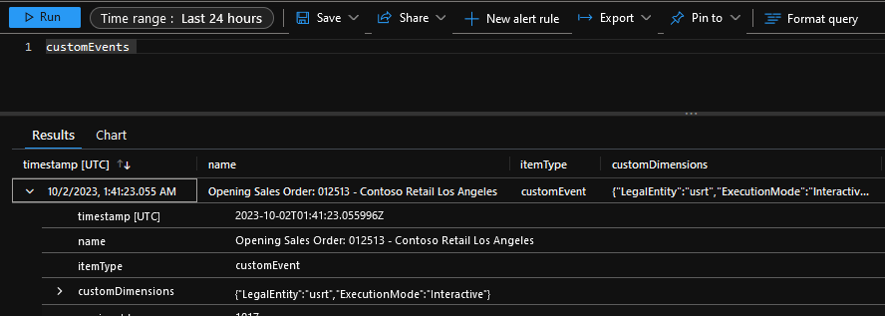
Custom Telemetry Events

Slide 29
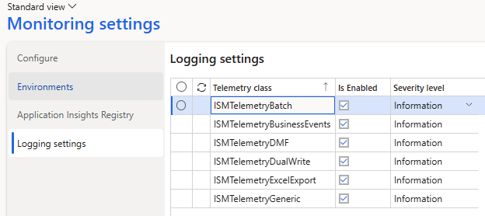
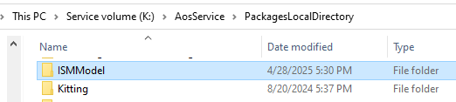
ISM Telemetry for FinOps
GitHub Link

Slide 30
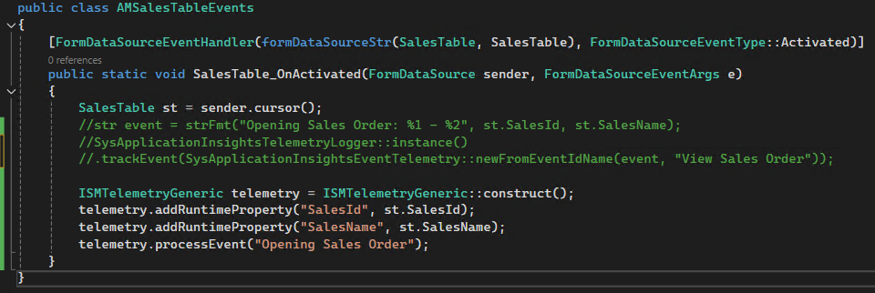
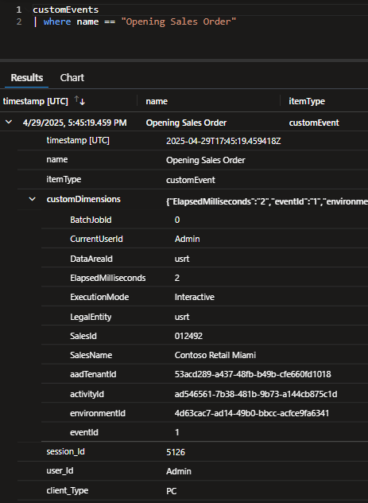
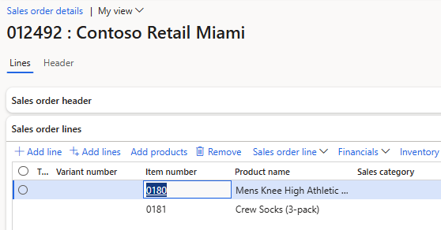
Custom Telemetry Events

Slide 31
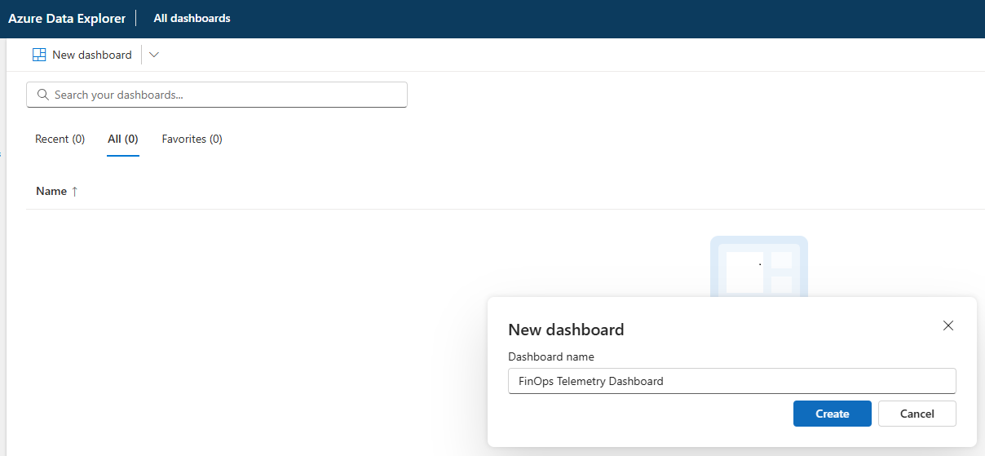
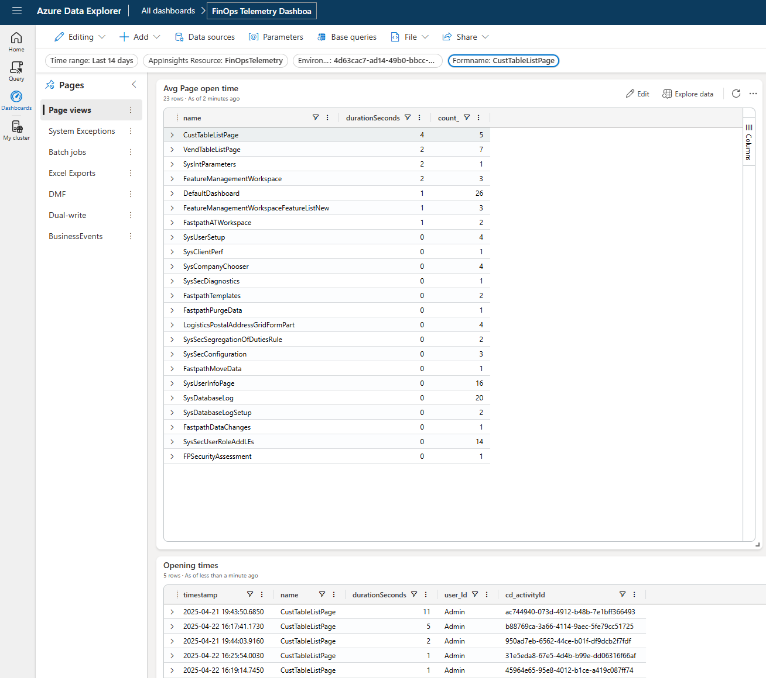
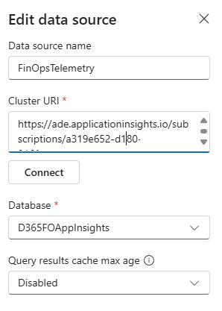
Azure Data Explorer

Slide 32
User Licensing

Slide 33

Security Tied to Licensing
Security
Licensing

Slide 34
User Licensing in D365FO
Based on what a user is assigned, not what a user consumes / utilizes
Three different license types:
  Operations (Finance, Supply Chain Management, Retail, Talent)
  Activity
  Team Member
Two different licensing methodologies currently used
  Entry Point Based Licensing
  Privilege Based Licensing

Slide 35
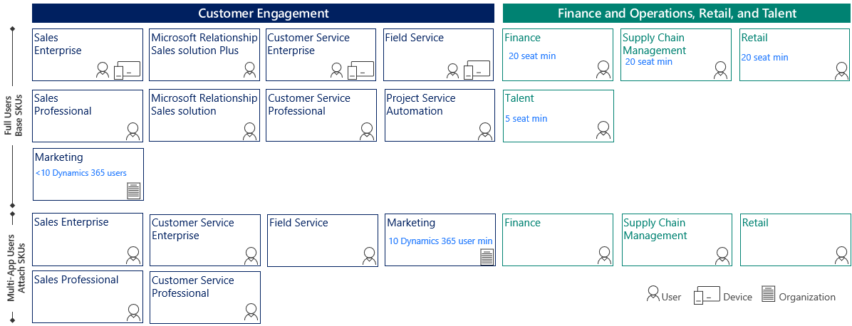
Licensing Model

Slide 36
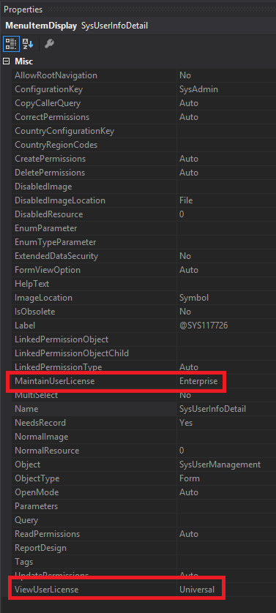
Entry Point Based Licensing
Based on access to entry points (menu items etc)
Each entry point has two parameters
  Maintain User License – used if access is Created, Update, Delete
  View User License – used if access if Read
It only takes one access at a higher license level for the user/role to require that higher license level

Slide 37
Privilege Based Licensing
Categorizes ‘Operations’ license into SKUs:
  Finance
  Supply Chain Management
  Retail
  Project Operations
Based on which privileges a user is assigned

Slide 38
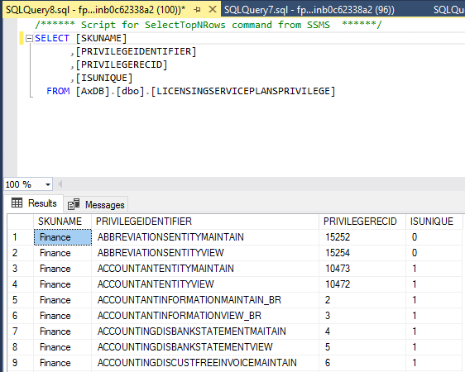
Privilege Based Licensing
Microsoft has designated certain privileges to require a particular license type
Associations can be found in the LicensingServicePlansPrivilege table
If user is assigned a privilege with IsUnique = 1 then that license is required
  If multiple licenses are required will follow a base/attach model
If IsUnique = 0 then any license listed will satisfy license requirement

Slide 39
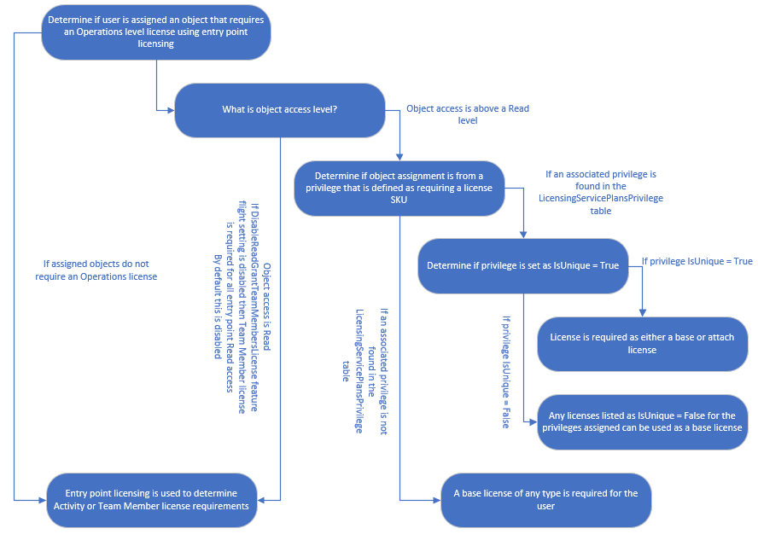
User Licensing Methodology

Slide 40
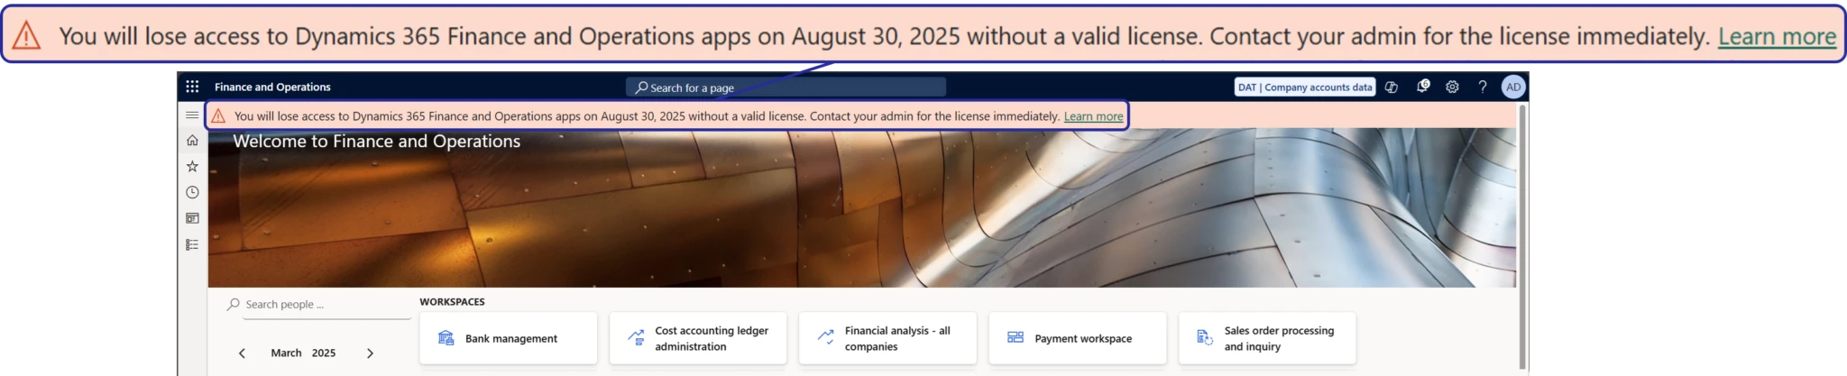
License Enforcement
April 30th May 15th 2025 - soft enforcement
Aug 30th 2025 – hard enforcement

Slide 41
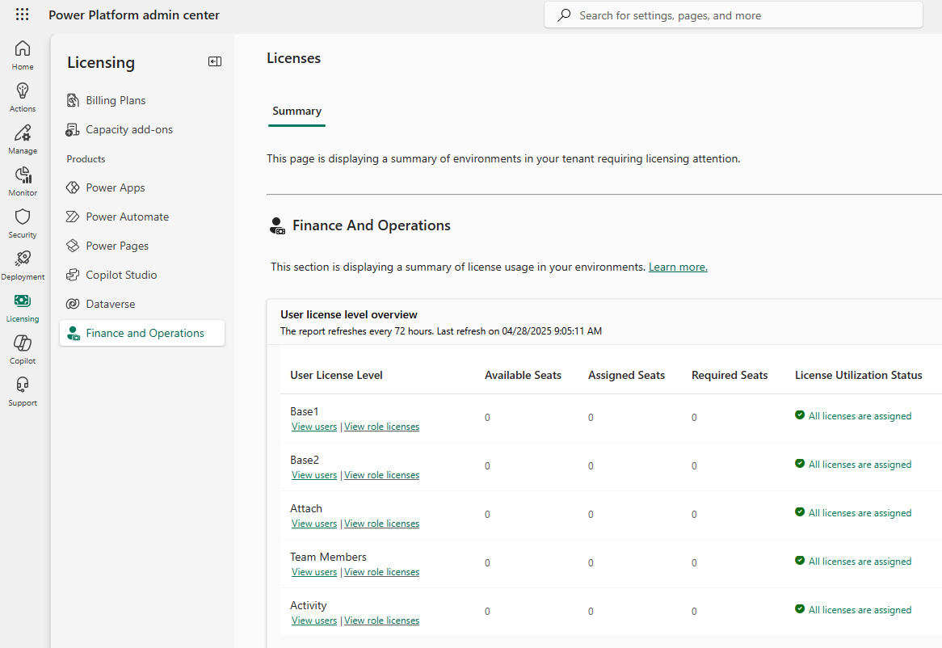
Power Platform Admin Center
Source of Truth

Slide 42
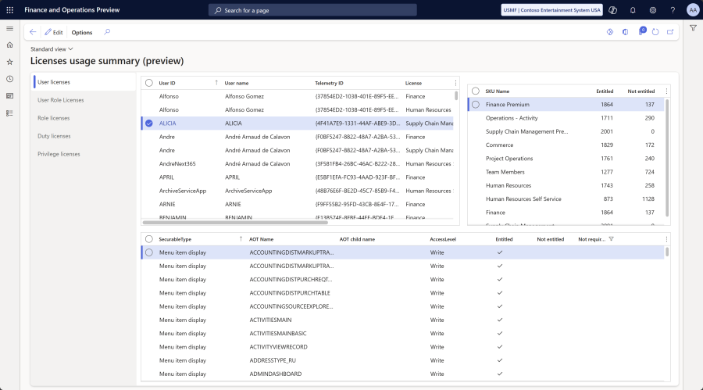
User Security Governance

Slide 43
Tips & Tricks

Slide 44
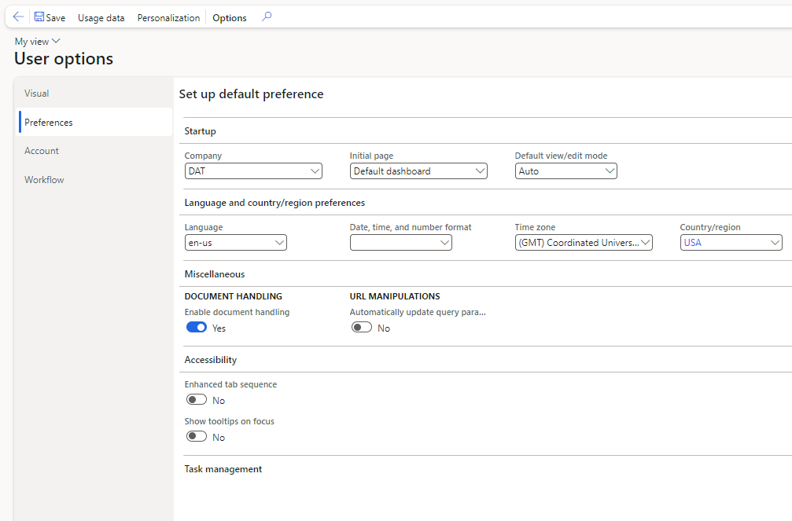
User Options
Notes:
Company – default legal entity for user
Initial Page – first page user sees when logging in
Default View / Edit Mode: whether to open forms in read only mode first or open with highest level of access
Date, time, number format: Allows for configuring how dates should be displayed
Time Zone: date times automatically converted to user timezone
Automatically update query parameters: Allows for storing filtering parameters in URL which can be shared with other users

Slide 45

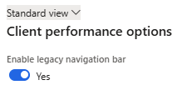

Navigation Breadcrumbs
System Administration -> Setup ->
Client Performance Options
Before
After

Slide 46

Usage Data
Usage Data Overview
Resetting usage data can help in certain scenarios

Slide 47

User Personalizations
Can be useful when troubleshooting data issues, specifically if a user cannot see a certain field
Can reset individual or all personalizations

Slide 48


D365FO Admin Toolkit
More info here!
Features include:
  User self-service assignment / revoking of SysAdmin
  Auto deprovisioning of SysAdmin role
  SysAdmin assignment logging
  Export / Compare System Configurations
  Auto-disable users
  Auto role assignment for Entra ID groups

Slide 49

Compare D365FO
Environment Configurations
Free tool (part of D365FO Admin Toolkit)
Ability to compare:
  Users
  User Roles
  User Role Organizations
  Security
More info on process here!
  Release of D365FO Environment Comparison Utility
  Comparing D365FO Security Between Versions

Slide 50

Debug Parameter in URL

Slide 51

Table Browser
<D365FOUrl>/?mi=SysTableBrowser&tablename=<tablename>&cmp=<companyId>

Slide 52

Table Browser – Visual Studio

Slide 53



Table Browser – Chrome Extension
Notes:
https://chromewebstore.google.com/detail/d365-fo-show-table-browse/figcljfgdlbihegdcckegeakgbgdeiil

Slide 54



Just in Time (JIT) Access

Slide 55




JIT Access – SQL Server

Slide 56




JIT Access – Firewall Rule

Slide 57


Execute X++ Code in Prod
System Administration -> Periodic Tasks
-> Database -> Custom Scripts

Slide 58

Create X++ Code
Must have public static void main(Args _args)
Must not cause any exceptions
Best practices:
  Assert company context
  Assert number of impacted records
  Use unique model names for each script
  Explicitly handle transaction scope
  TEST

Slide 59


Approve Script Execution
Each script must have an approver before executing

Slide 60



Test and Execute Script

Slide 61
Resources
Storing queries in URL
How To Use The D365 Table Browser
How To Continue to Use the Table Browser Functionality
How to Run a D365 Job in Production
Connect to a Test D365FO Database
Run Custom X++ Scripts with Zero Downtime
Overview of Telemetry Data in D365FO
Release of D365FO Environment Comparison Utility
Current State of D365FO User Licensing
Determine Where Form Data is Stored in D365FO
D365FSC License Enforcement Overview
First Look at User Security Governance Feature

Slide 62
Questions?
Alex Meyer
Email: alex.meyer@delinea.com
Blog: http://d365foblog.com
Security Class: http://d365fosecurity.com
GitHub: https://github.com/ameyer505
YouTube: https://www.youtube.com/@AlexMeyerGeek
LinkedIn | Microsoft MVP Profile

