Slide 1

D365FSC License Enforcement Overview
Created by:
Alex Meyer – alex.meyer@delinea.com

Slide 2
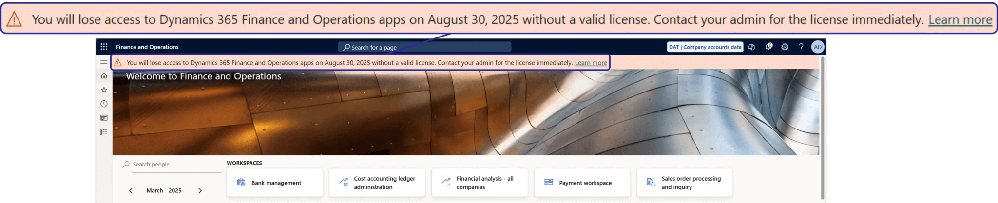
What is ‘license enforcement’ for D365FSC?
Historically Microsoft did not perform ‘real time’ license enforcement for the Dynamics AX / 365 FSC products
‘Enforcement’ only occurred during license renewals
They have now plan on implementing a ‘license check’ during a user’s sign in to the application
Soft Enforcement (message banner at sign in) – May 15th 2025
Hard Enforcement (user login would fail) – Aug 30th 2025

Slide 3
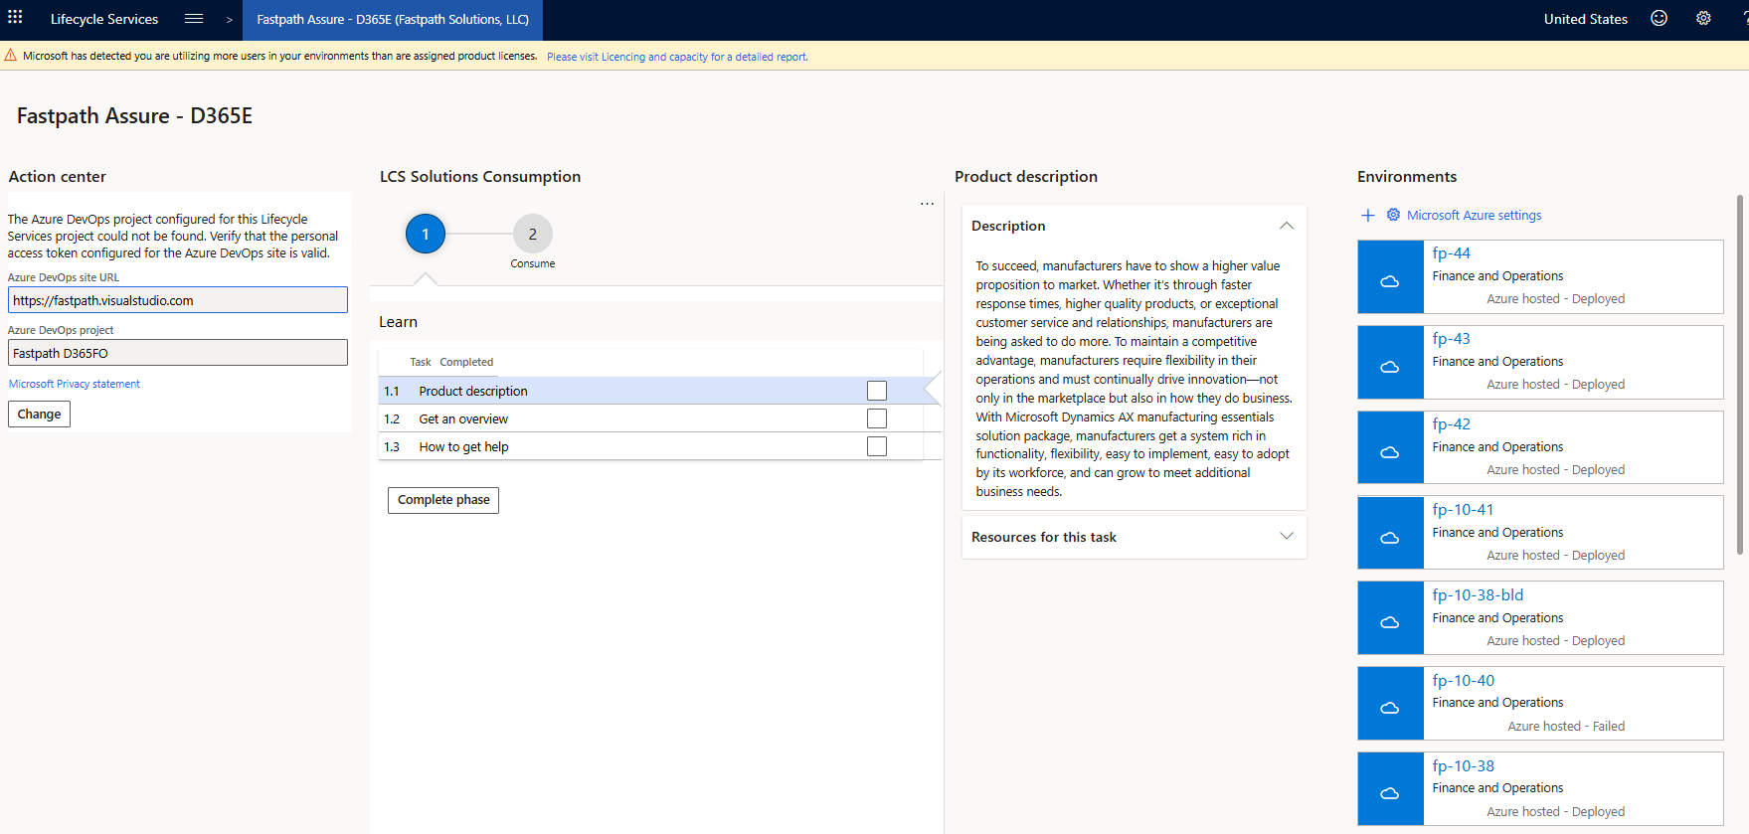
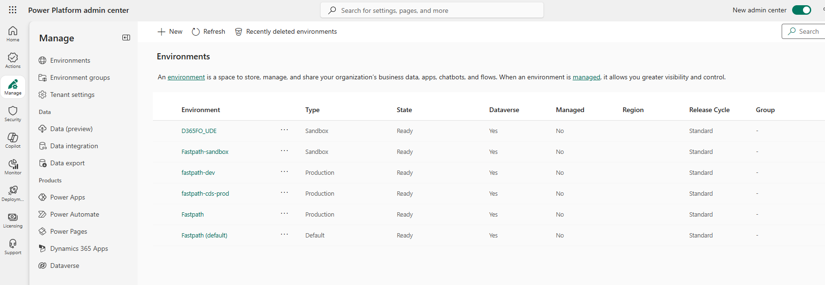
Key Terms
LCS – Life Cycle Services
  Legacy area to manage D365FSC environments
PPAC – Power Platform Admin Center
  Designed to manage Power Platform resources, will also be the new home of D365FSC environment management

Slide 4
License Enforcement Reporting
Currently licensing requirements for D365FSC can be done in LCS, PPAC, or D365FSC itself – each one performs the licensing analysis slightly differently causing deltas which are obviously confusing to clients
PPAC will eventually be the ‘source of truth’ for licensing and push this data to LCS and D365FSC

Slide 5
License Enforcement Key Points
Will apply to all users who authenticate via the D365FSC user interface
  Still are uncertain about accounts that only authenticate via API (eg: service accounts)
Will apply only to production instances of D365FSC, lower tier environments (QA, UAT, TEST, DEV) should not perform license enforcement
The following user types are excluded from license enforcement:
  Users assigned SysAdmin (must only be assigned SysAdmin role)
  External Users
  Devices licensed as ‘Device Licenses’
  Disabled Users

Slide 6
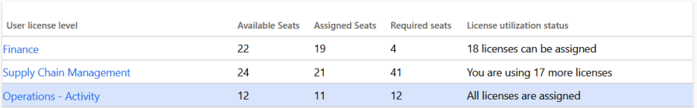
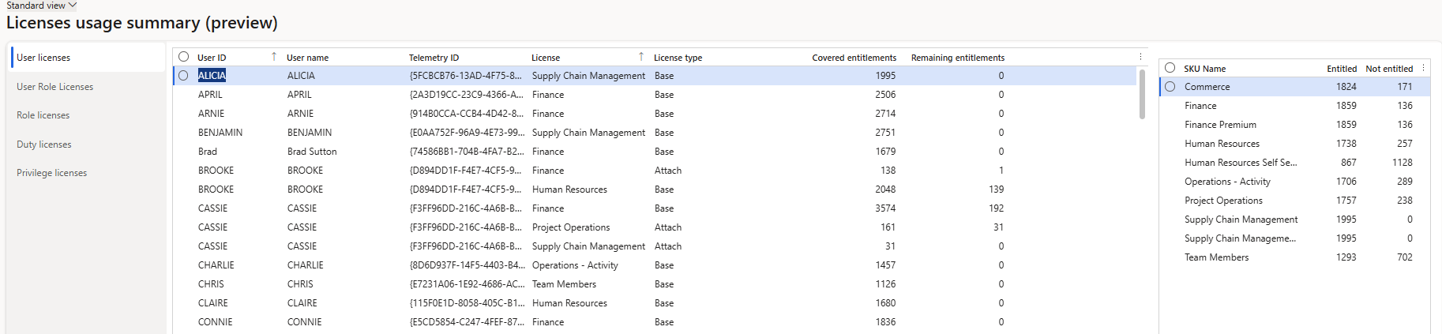
Current Known Issues – Last Updated 5/9/2025
When reporting on ‘non-compliant users’ reports show users from all environment types (PROD, UAT, QA, TEST, DEV)
Disabled users show up on licensing reports
PPAC licenses only update every 72 hours leading to confusion around if updating a user role assignment meets compliance
PPAC license reporting for roles showing a different license than ‘View Permissions’ report within D365FSC
Base / attach license scenarios are not respected and both licenses must be assigned as a base license to meet compliance
Confusing license requirement naming (eg: Base 1 vs Base 2 vs ‘Entitled’ vs ‘Not Entitled’)

Slide 7
Questions?
Are you confident you will be able to make the Aug 30th 2025 deadline for license enforcement?
What is your current plan / what actions are you taking to meet licensing enforcement?
What issues with license enforcement are you currently facing?
What channel(s) are you using to stay up to date with license enforcement news?

Slide 8
Resources
Dynamics 365 Finance & Supply Chain License Enforcement Overview
Optimizing ERP Security Configuration and Licensing within Microsoft Dynamics 365
Simplifying License Management for Dynamics 365 Finance and Operations: Improved User License Validation
User security role reporting and technical validation for finance and operations apps FAQ

Slide 9
Questions?
Alex Meyer – alex.meyer@delinea.com

