Slide 1

Dynamics 365 Finance & Operations Telemetry and Monitoring Overview
DynamicsCon 2025

Slide 2
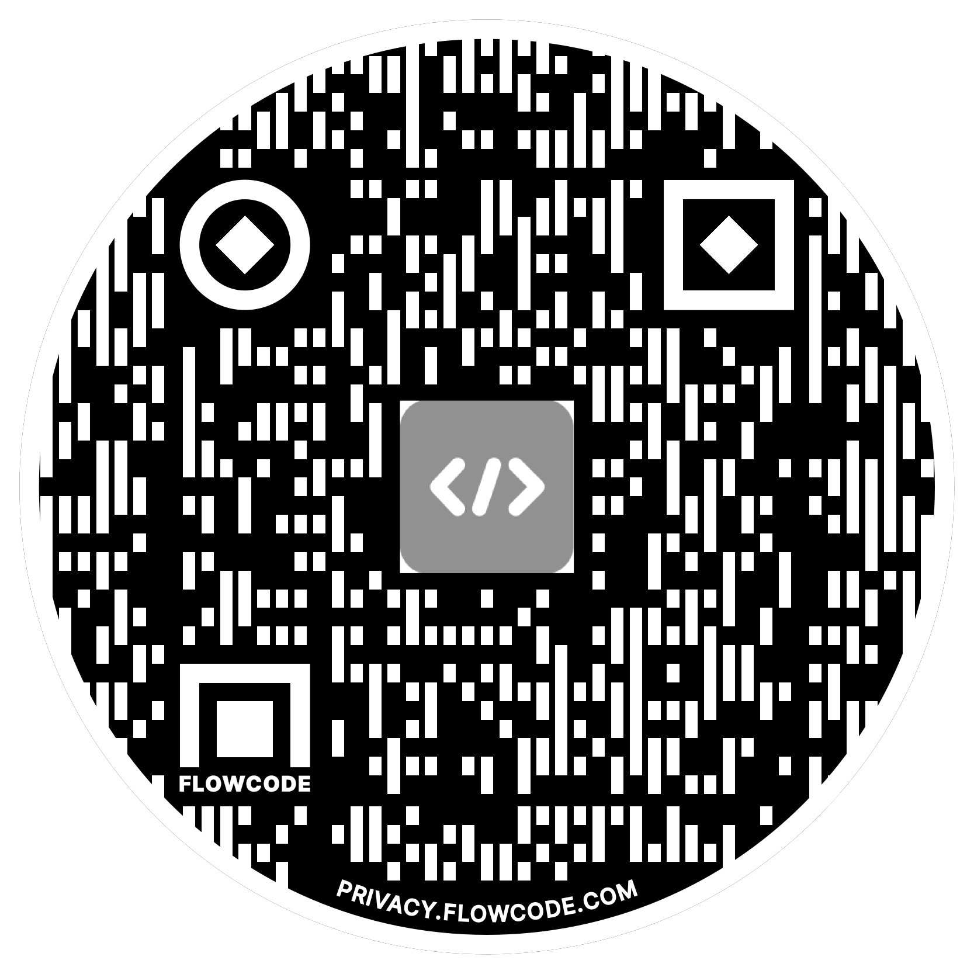
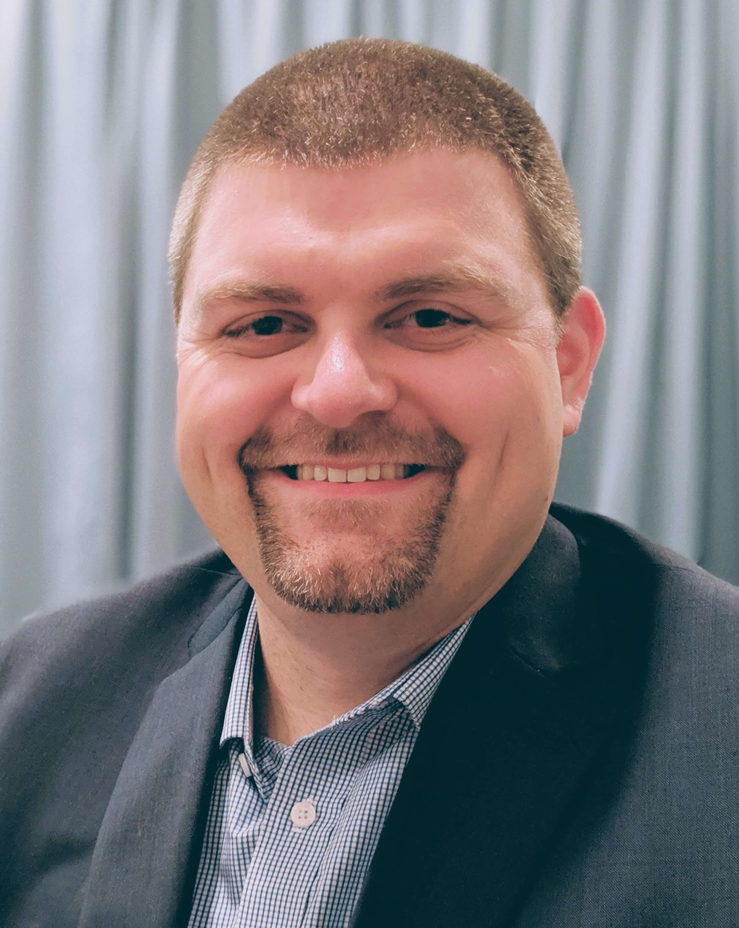
Alex Meyer
Principal Software Development Engineer
Delinea
Email: alex.meyer@delinea.com
Blog: http://msftcloudblogs.com
Security Class: http://d365fosecurity.com
Podcast: https://www.gofastpath.com/podcast
LinkedIn
Microsoft MVP Profile
Background:
Awarded Microsoft MVP in Business Applications since 2019
Been working with AX since 2013 and D365FO since 2016
Have spoken at Summit (US & Europe), Focus, and local chapters around AX/D365FO security and have done webinars around native controls in both versions

Slide 3

Agenda
Telemetry & Monitoring Prerequisites
Setup / Configuration of Telemetry & Monitoring Feature
View Data in Application Insights
    Form Runs
    Exception Events
    Custom Events
Reporting From PowerBI
Report via Code (.NET / C#)
Using Telemetry Data Within D365FO

Slide 4
Questions We Will Answer Today
What is
What is the architecture of
What is the performance impact of
What is the cost of
How long is data stored for
What custom events can I capture with
… the monitoring and telemetry feature within D365FSC

Slide 5
Telemetry and Monitoring Feature Overview

Slide 6
What is Telemetry and Monitoring
Actions tracked within a source system
Different than Change Tracking
  Captures user interaction events not just when things are changed
In some systems a ‘telemetry’ or ‘monitoring’ feature must be enabled
Select which events to capture
  For Microsoft Dynamics the options are:
    Page Views, Exceptions, Custom Events
Need to keep in mind storage impacts / data retention policies

Slide 7
Telemetry and Monitoring Feature Architecture

Slide 8
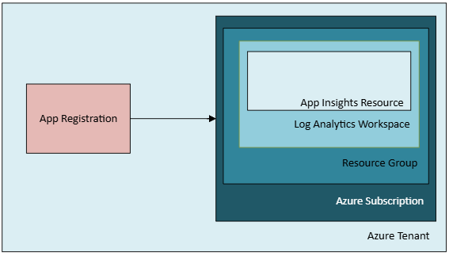
Monitoring and Telemetry Architecture
Utilizes Azure Application Insights
Part of the Azure Monitor suite of solutions

Slide 9
Telemetry and Monitoring Cost

Slide 10
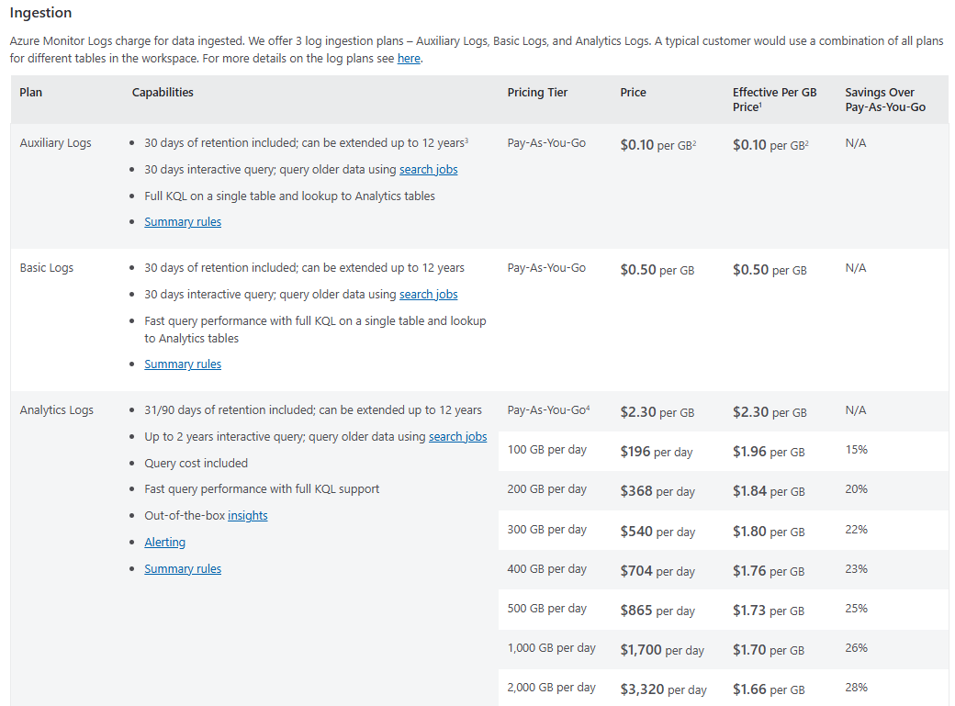
Cost of Telemetry and Monitoring Data
Pricing based on data ingestion type and needed functionality
Price slightly different based on Azure region
Azure Monitor Pricing

Slide 11
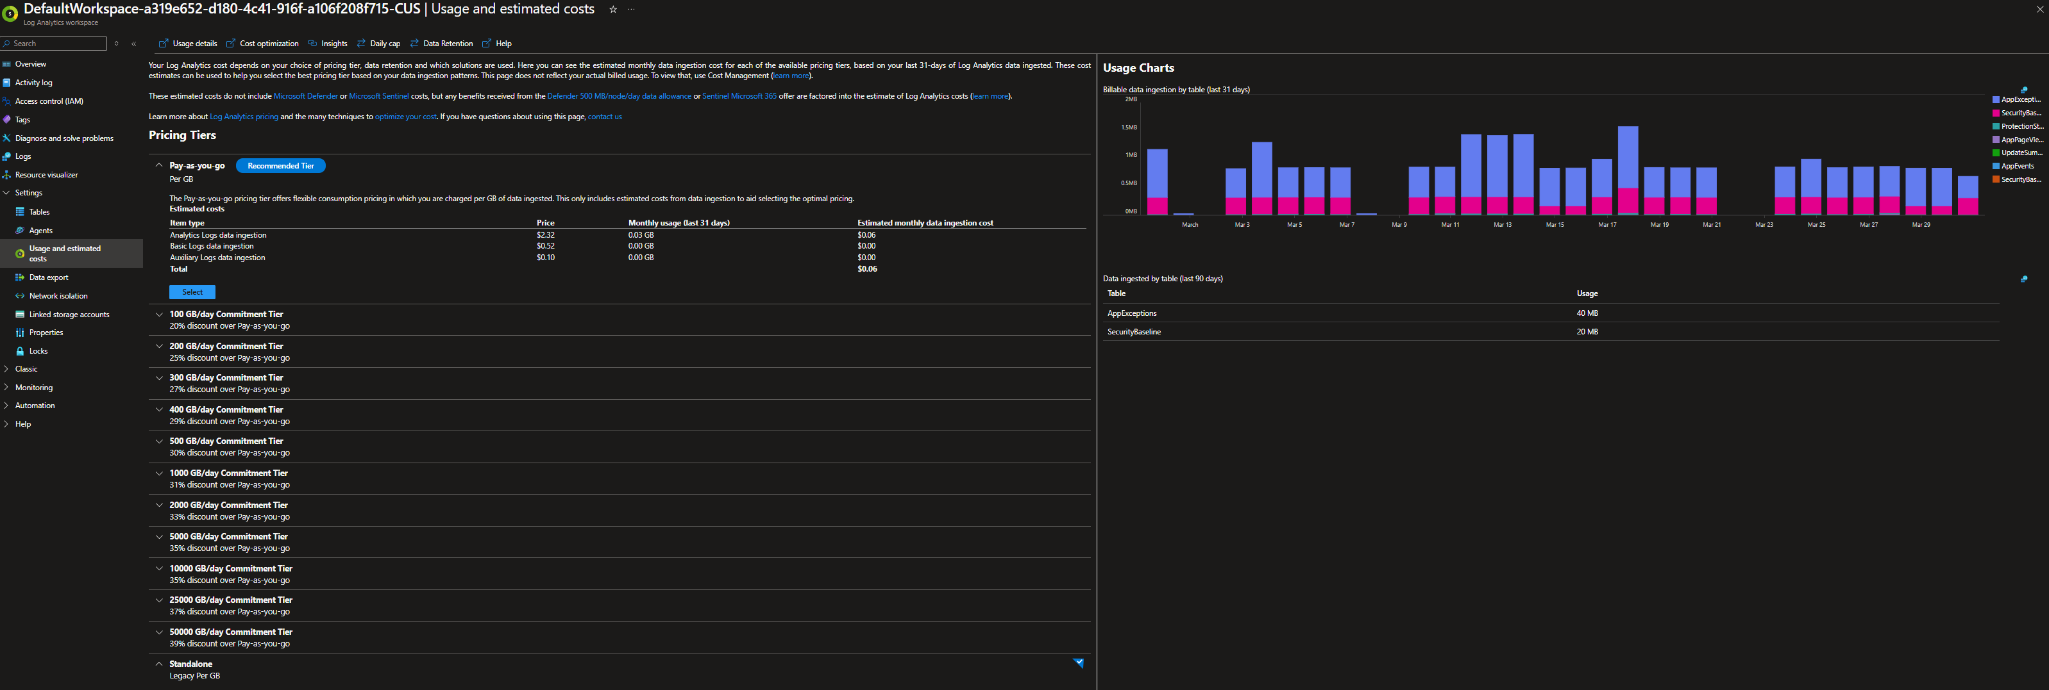
Telemetry Data Pricing - Usage

Slide 12
Telemetry and Monitoring Performance Impact

Slide 13
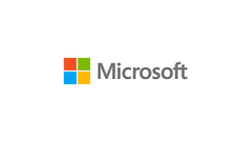
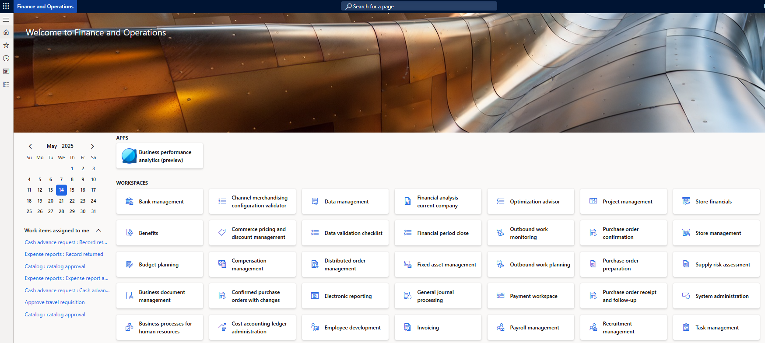
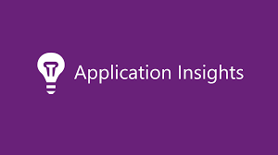
Performance Impact of Telemetry and Monitoring
Microsoft has had their own telemetry for quite a while
  Support tickets
  Licensing renewals
When enabled you are ‘copying’ these events to your App Insights container
Custom event tracking can have an impact on performance if not properly designed

Slide 14
Retention Policy for Monitoring & Telemetry

Slide 15
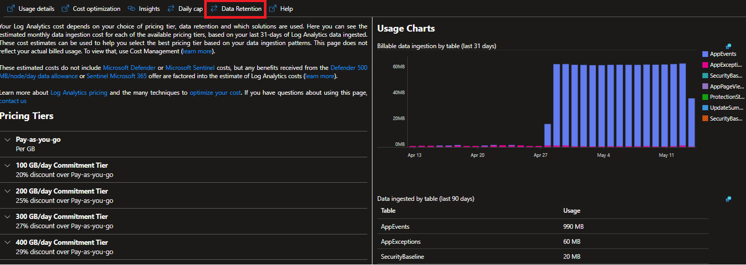
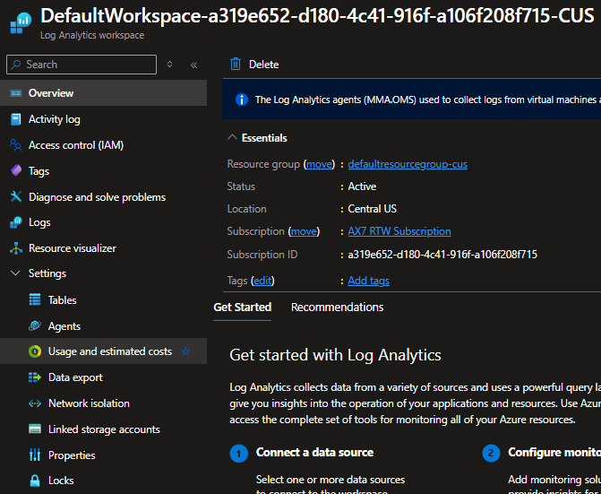
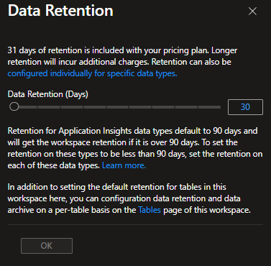
Retention Policy for Monitoring and Telemetry
Retention policy is set at the Log Analytics workspace level
Default is 31 days – can be increased (increasing costs more $$$)

Slide 16
Telemetry and Monitoring Prerequisites

Slide 17
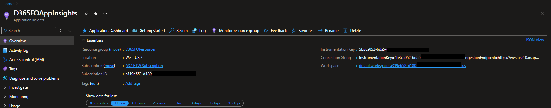
Telemetry & Monitoring Prerequisites
Must be on D365FO 10.0.30 or newer
  Must be on D365FO 10.0.41 or newer for stable version of feature
  GA in 10.0.44 (no need to enable feature in Feature Management)
Must have an Application Insights / Log Analytics resource created within Azure
Notes:
Note the Instrumentation Key as we will need that in subsequent steps.

Slide 18
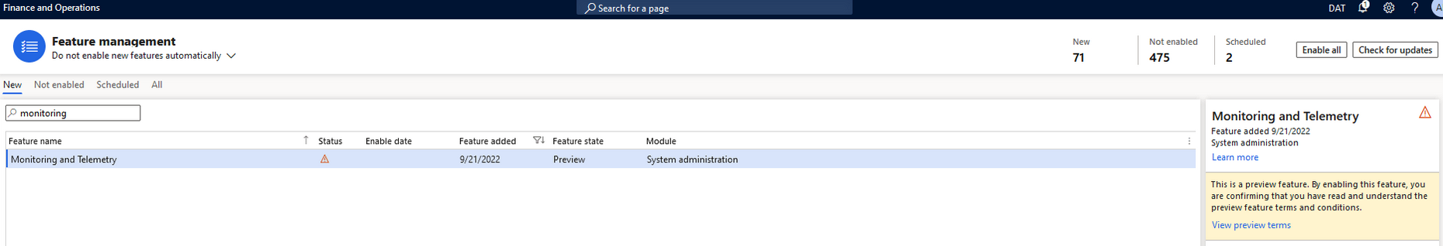
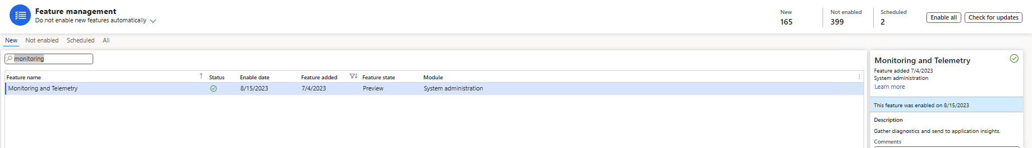
How to Enable Telemetry & Monitoring Feature
Feature Management -> Monitoring and Telemetry
Notes:
First and foremost, this feature is labeled as a ‘preview feature’ so it is not enabled by default so we have to navigate to System Administration -> Workspaces -> Feature Management and search for ‘monitoring and telemetry’. You can see the Status below is marked as the yellow triangle with exclamation point, indicating it is not enabled.
After enabling the feature, you can see the Status change to the green check mark.

Slide 19
Telemetry and Monitoring Setup & Configuration

Slide 20
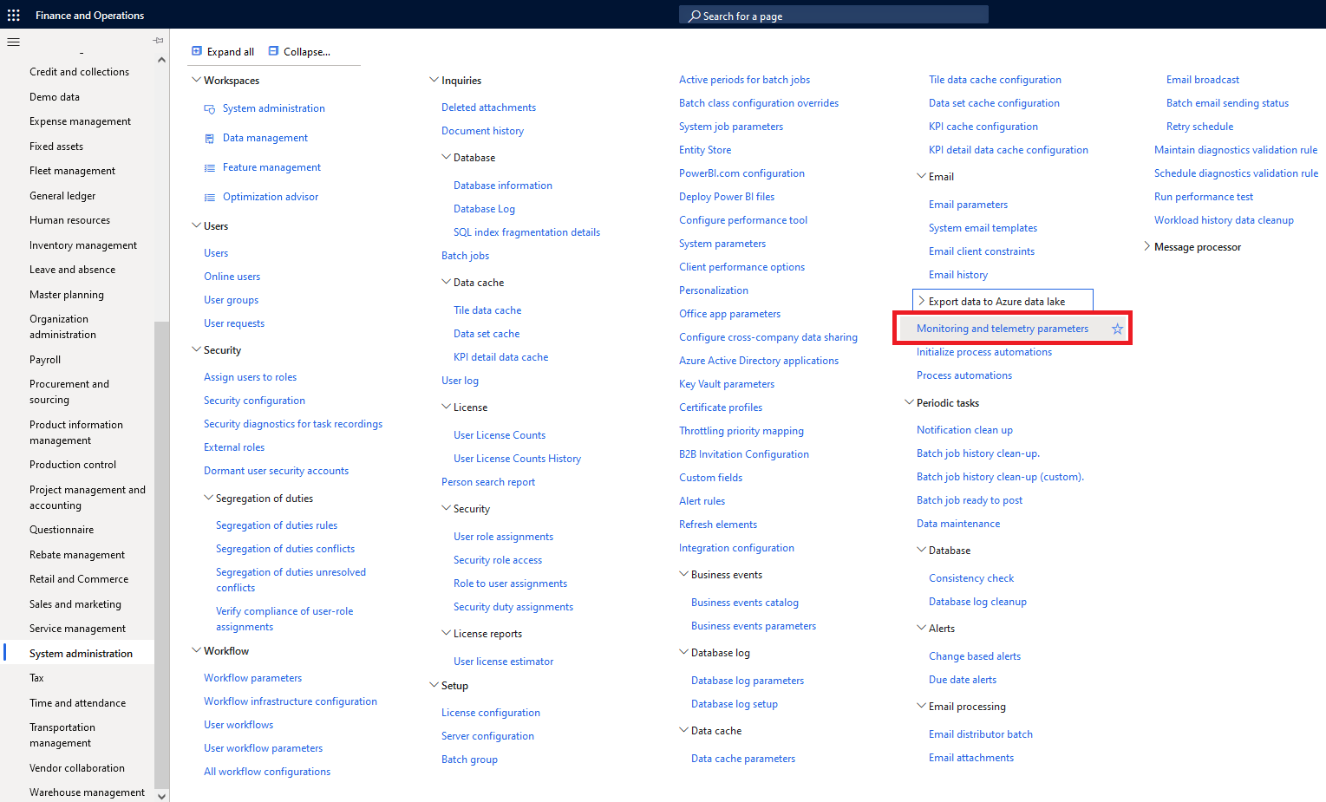
How to Enable Telemetry & Monitoring Feature
Notes:
Now we can navigate to System Administration -> Setup -> Monitoring and Telemetry Parameters.

Slide 21
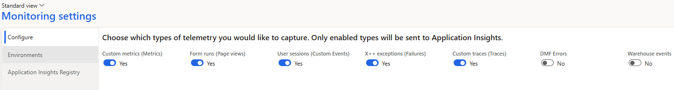
Telemetry & Monitoring Configuration
Form runs – when a user navigates to a form / page
X++ exceptions – when an error occurs
User sessions – misnamed, custom events
Custom metrics / traces – custom created metric or trace events
DMF Errors – data management framework errors
Warehouse events – events pertaining to warehouse operations, including mobile app
Notes:
We can now configure which events we want to enable in the Configure tab, specifically for our case we want to enable the Form Runs, User Sessions, X++ exceptions, and custom metrics/traces.
https://alexdmeyer.com/2025/03/19/d365fo-telemetry-data-faqs/

Slide 22
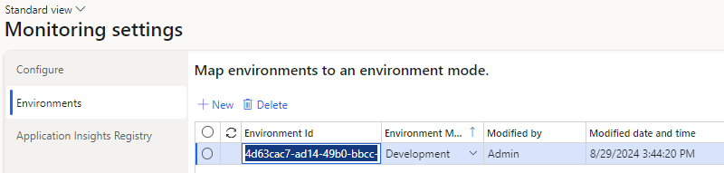
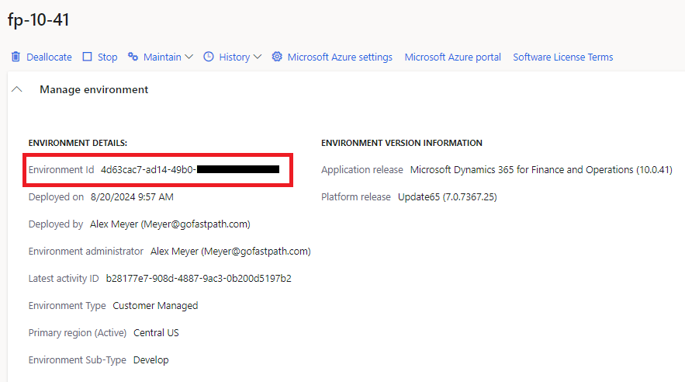
Telemetry & Monitoring Configuration
Notes:
Environment ID – From LCS environment metadata
Environment Mode – Development / Test / Production

Slide 23
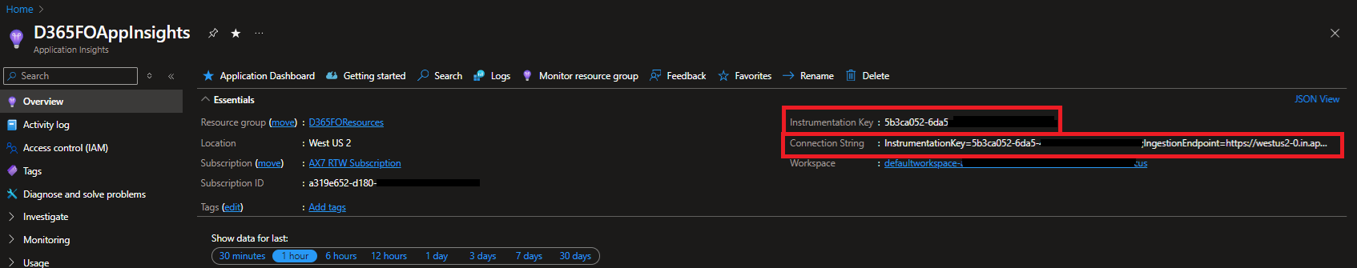
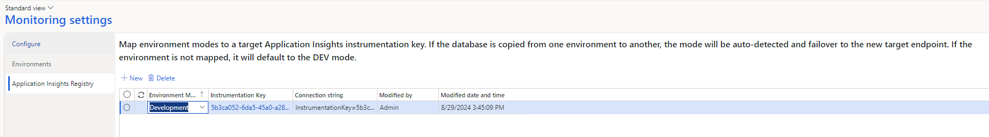
Telemetry & Monitoring Configuration
Notes:
Environment Mode – Development / Test / Producation
Instrumentation Key – From Log Analytics / App Insight resource

Slide 24
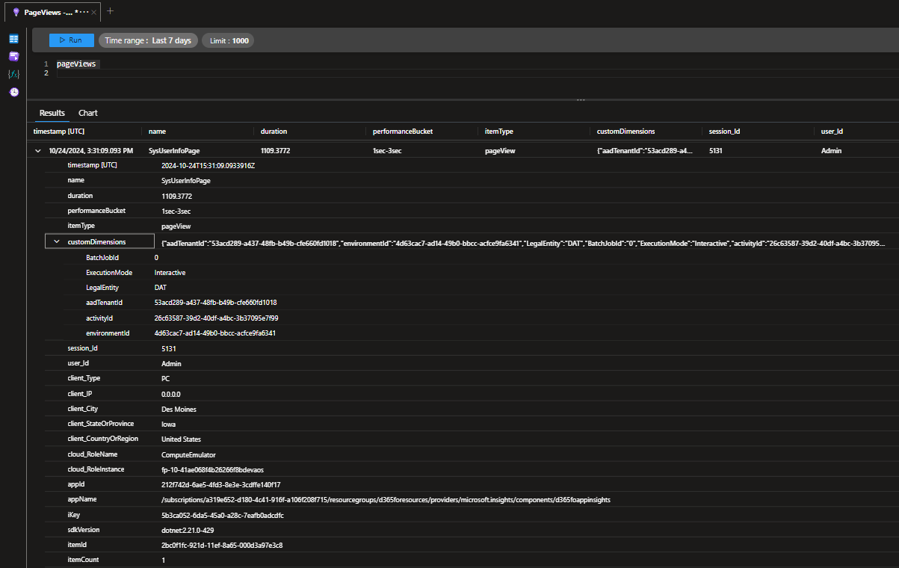
Telemetry Data in Log Analytics
Notes:
Custom Dimensions field is where D365FO specific info is stored:
Legal Entity
AAD Tenant
Environment ID (from LCS)
Cloud_RoleInstance field will store AOS instance in Tier 2 and above – if wanting to query across all AOS instances use Environment ID field from Custom Dimensions

Slide 25
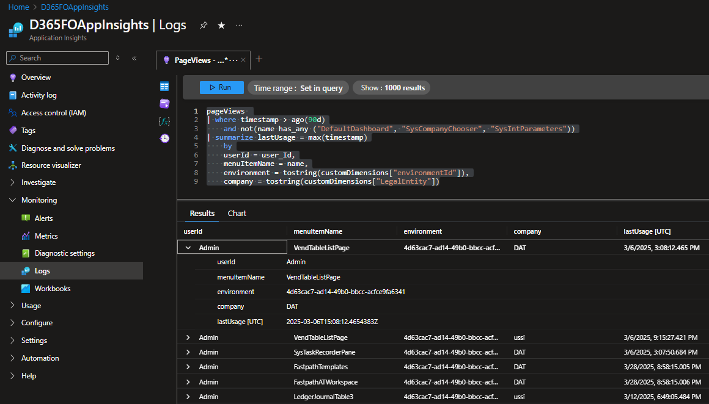
Query Log Analytics Data Using KQL
Log Analytics data can be queried in Azure Portal using Kusto Query Language (KQL)
  Similar to Microsoft SQL

Slide 26
Visualize Data in Power BI

Slide 27
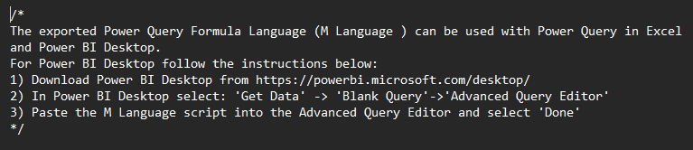
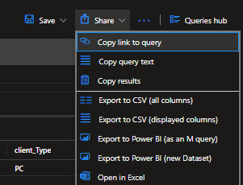
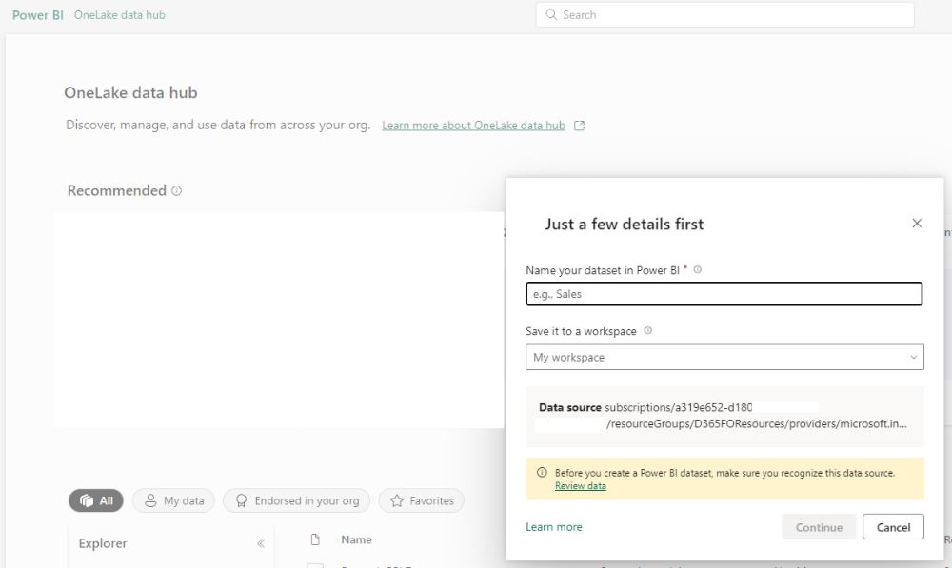
Visualize Data in Power BI
Notes:
Export to Power BI – M Query
Text file with query syntax
Export to Power BI – New Dataset
Launches new Power BI project in browser

Slide 28
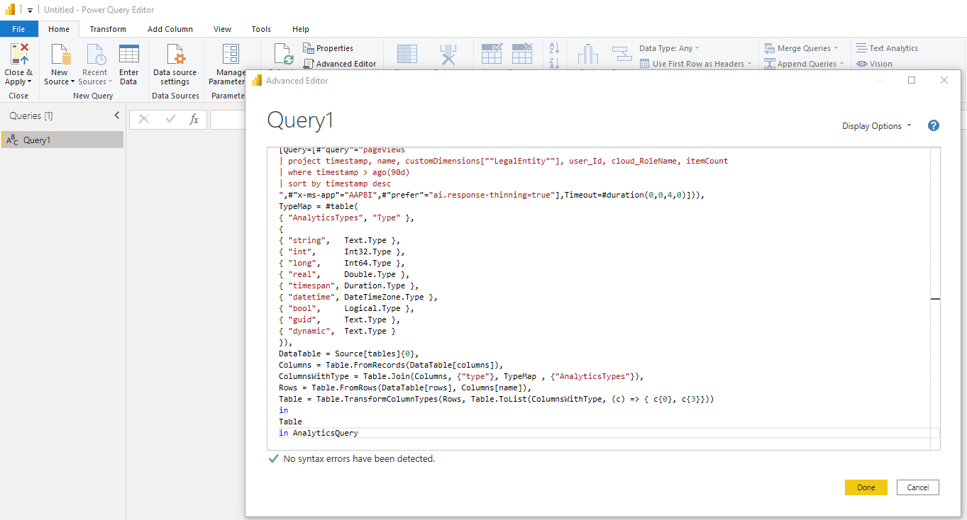
Visualize Data in Power BI – M Query

Slide 29
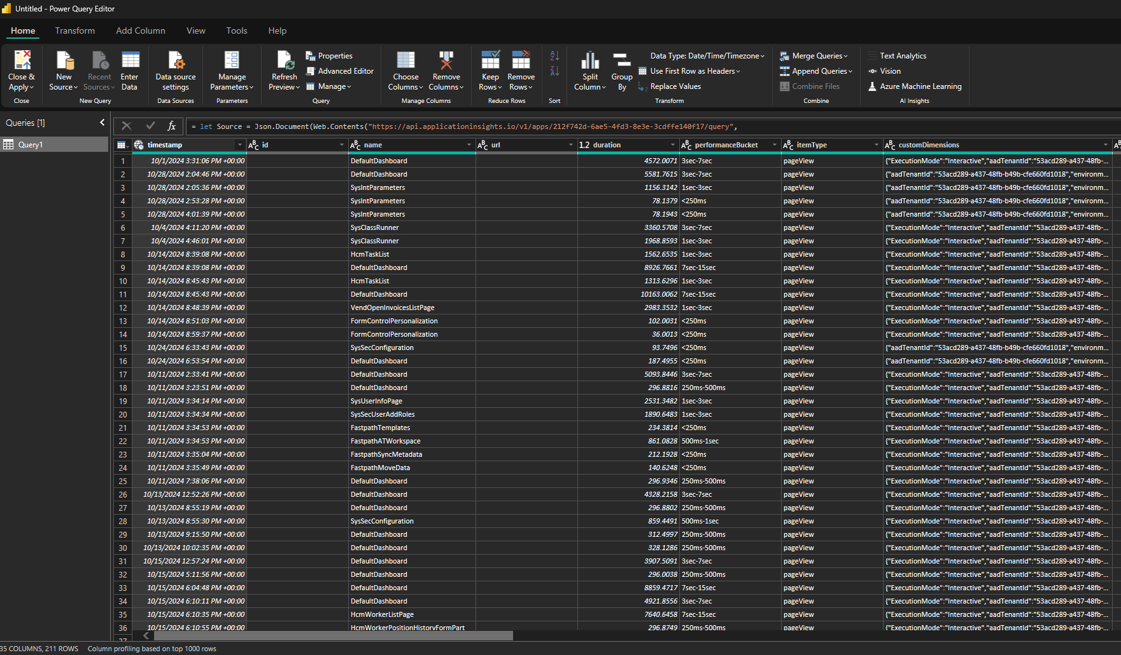
Visualize Data in Power BI – Power Query Editor

Slide 30
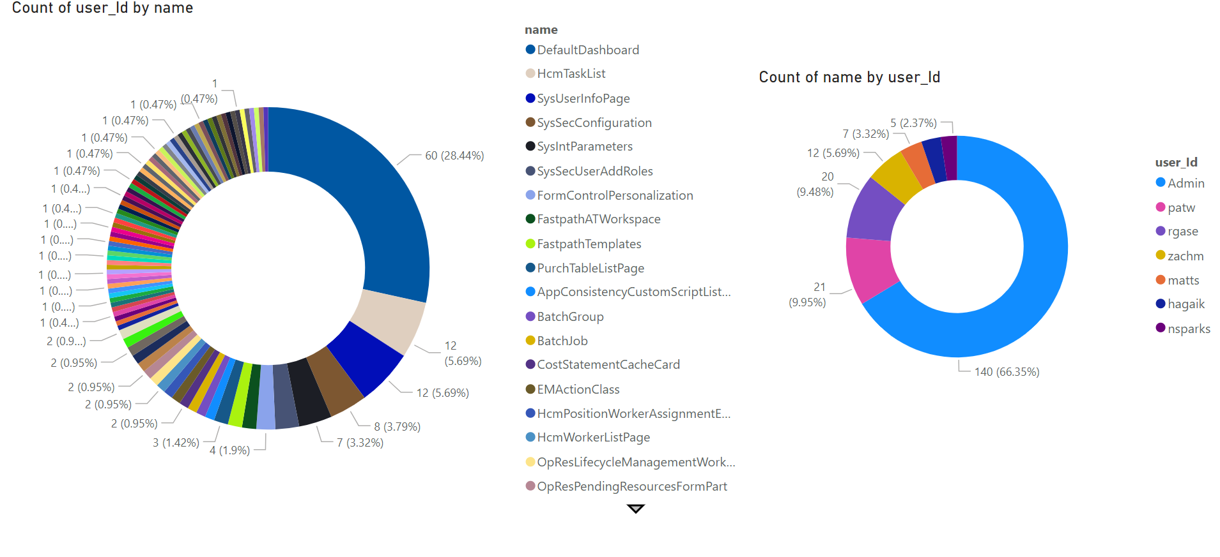
Example Power BI Visualizations

Slide 31
Telemetry Event Types

Slide 32
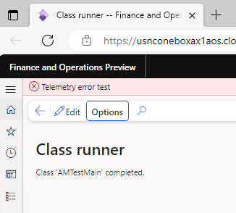
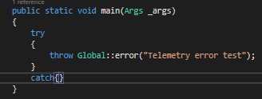
Exception Events

Slide 33
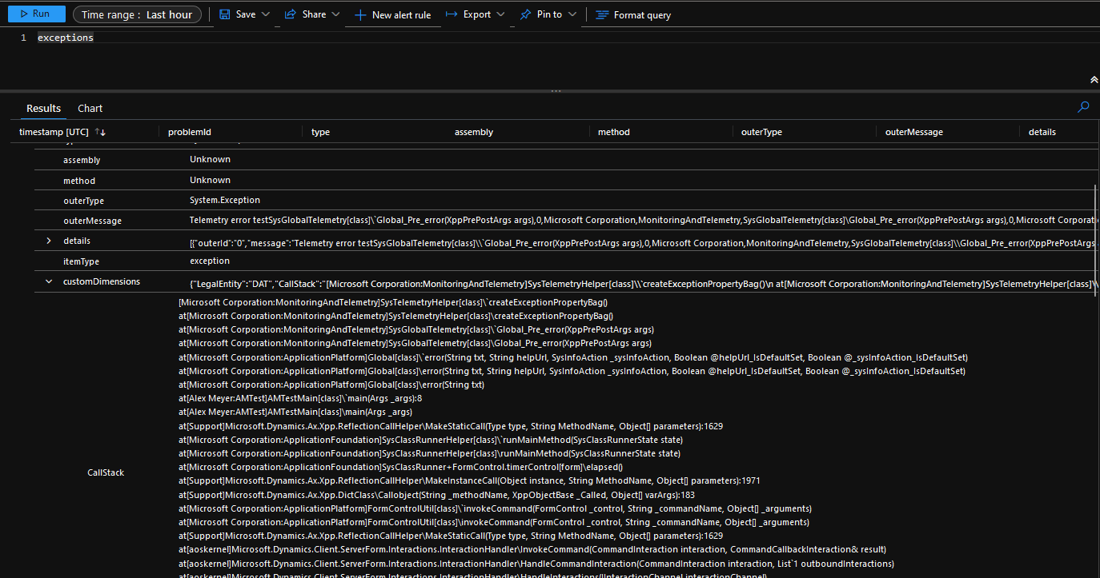
Exception Event Stack Trace

Slide 34
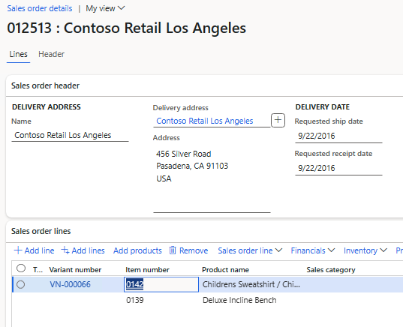
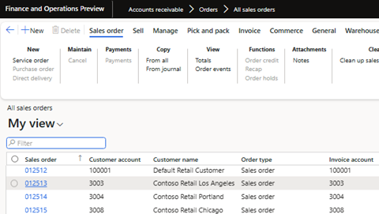
Custom Telemetry Events
Scenario – Want to capture when a user opens a sales order

Slide 35
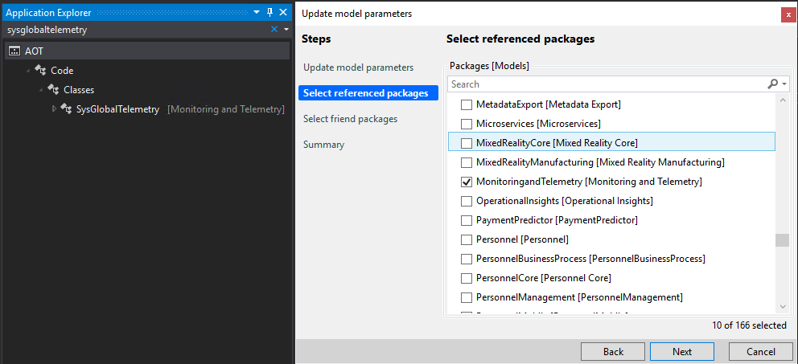
Custom Telemetry Events
Need to reference ‘MonitoringandTelemetry’ model
  SysGlobalTelemetry class

Slide 36
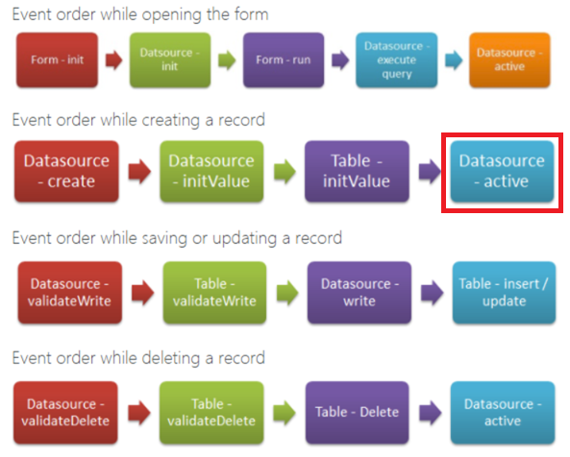
Custom Telemetry Events
Need to find correct event to subscribe to
  Datasource – active
Form Event Execution Sequence
Notes:
https://dynamicsax4u.wordpress.com/2017/08/15/form-event-execution-sequence-in-dynamics-ax/

Slide 37
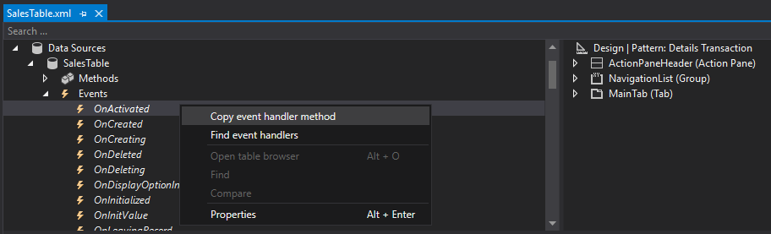
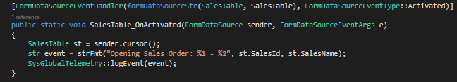
Custom Telemetry Events
Find SalesTable form -> Go to SalesTable datasource -> Copy event handler for ‘OnActivated’
Notes:
This is somewhat confusing because the form name is ‘SalesTable’ and the datasource name is also ‘SalesTable’

Slide 38
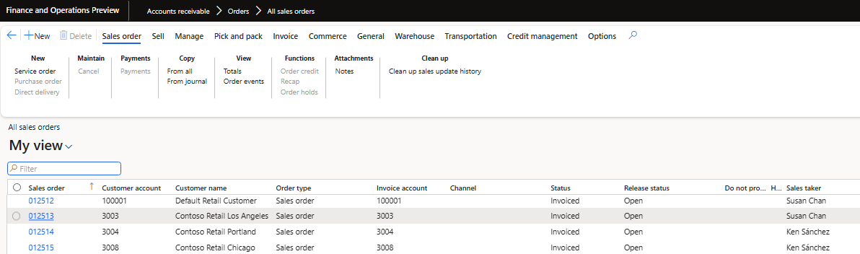
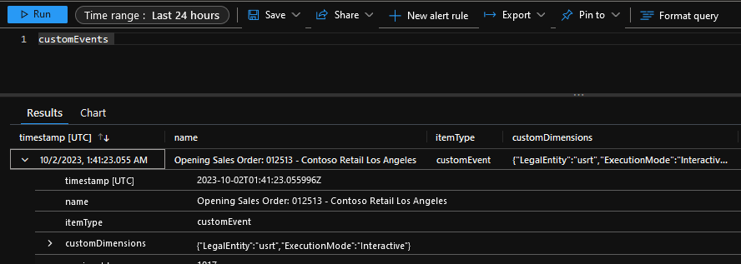
Custom Telemetry Events
Now if I open a sales order, the event is captured in the ‘customEvents’ log

Slide 39
Query Telemetry Data via Code

Slide 40
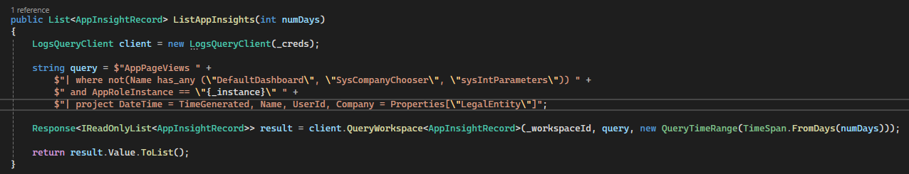
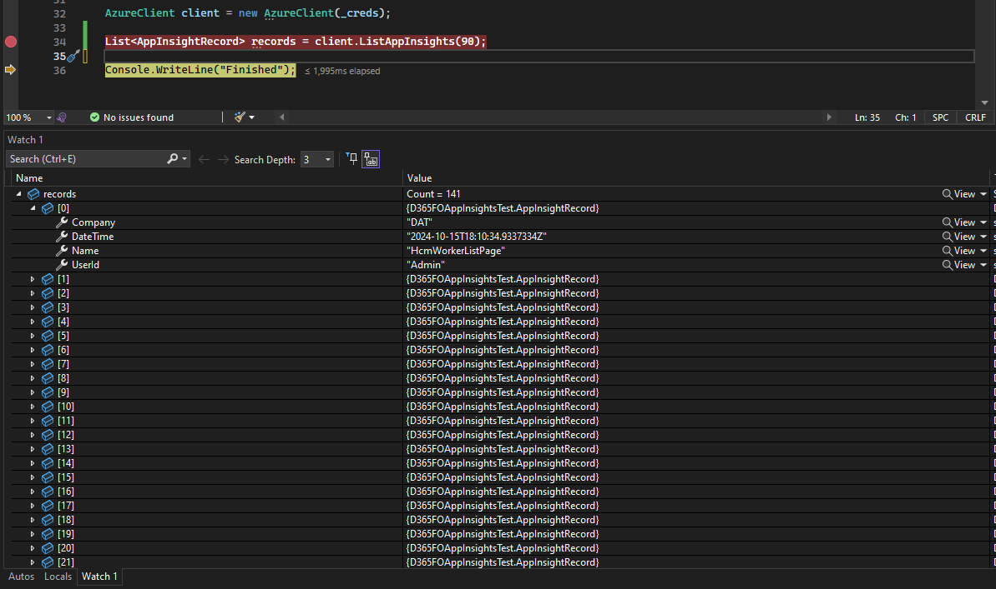
Query Telemetry Data via Code
AppPageViews Documentation
AppPageViews Example Queries

Slide 41
Create Solution Using Telemetry Data Within D365FO

Slide 42
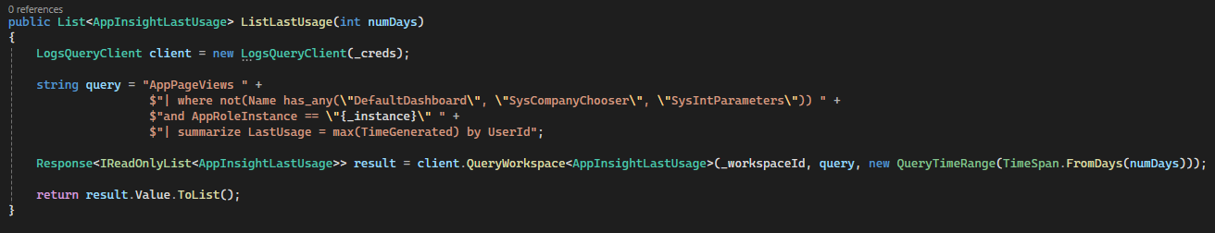
Create Solution Using Telemetry Data
Let’s create a solution to disable a user that does not log in within a set timeframe

Slide 43
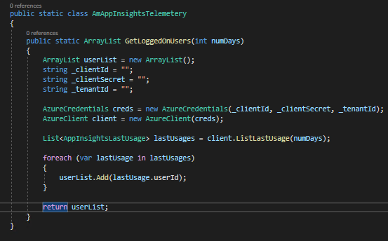
Create Solution Using Telemetry Data
Using .NET SDK to query Log Analytics makes process easier
Created .NET class for X++ to call
Note: Not best practice to store secrets in code

Slide 44
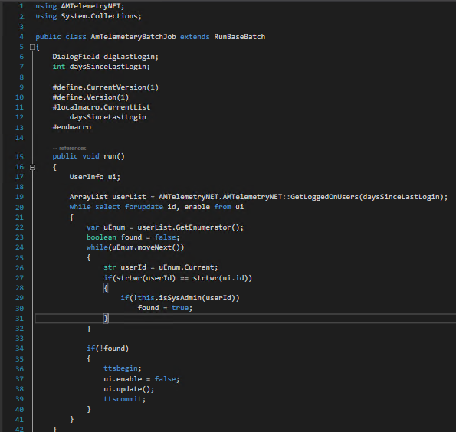
Create Solution Using Telemetry Data
Gets users who have logged in within the last x days
Checks to see if user is assigned SysAdmin before trying to disable user
Added to D365FO Admin Toolkit
Notes:
In this case, the batch job I created allows for a parameter input of the number of days we want to execute this process for. By default we are looking to find any user that has accessed the system within the last 90 days.
Once this set of users are found we compare that to all of the users within the UserInfo table, if a user exists in the UserInfo table but does not exist in the user result set from the telemetry data, we disable the user and commit that to the database.

Slide 45
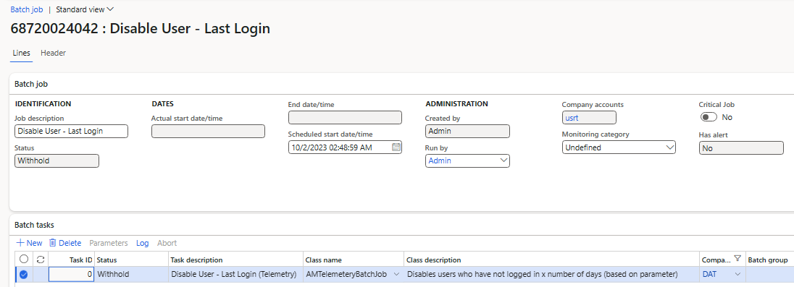
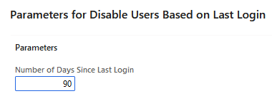
Create Solution Using Telemetry Data

Slide 46
ISM Telemetry for FinOps

Slide 47
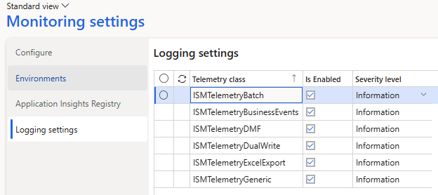
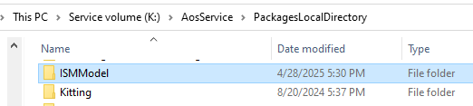
ISM Telemetry for FinOps
GitHub Link

Slide 48
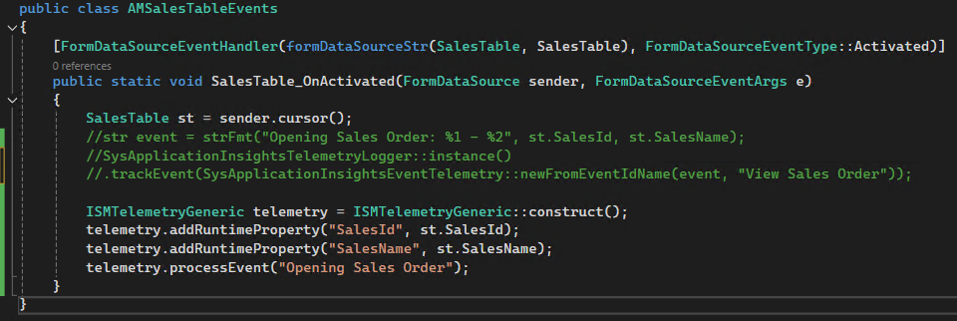
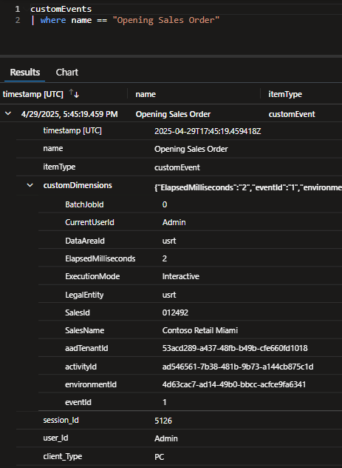

Custom Telemetry Events

Slide 49



Azure Data Explorer

Slide 50
Telemetry & Monitoring Demo

Slide 51
Resources
Overview of Telemetry Data in D365FO
Utilizing Telemetry Data Within D365FO
Using Telemetry Data for Read Auditing in D365FO
D365FO Telemetry Data FAQs
Log Analytics Data Retention
Azure Monitor Pricing
ISM Telemetry for Finance and Operations Overview

Slide 52
Questions?
Email: alex.meyer@delinea.com
Blog: http://d365foblog.com
GitHub: https://github.com/ameyer505
Twitter: https://twitter.com/alexmeyer_ITGuy
D365FO Security Course: http://d365fosecurity.com
PowerPoint available at: https://alexdmeyer.com/resources/downloads/

Slide 53
Fastpath, now part of Delinea, Sessions at DynamicsCon 2025
Thursday
D365FO Telemetry & Monitoring Overview
9:45 – 10:45 am, Grand Ballroom MN-East Tower
Securing Data and Identities in Microsoft Dynamics and Beyond
12:30 – 1:00 pm, Crystal Ballroom B-West Tower
Fight Fraud — Real Life Lessons to Keep Your Company Safe
1:15 – 2:15 pm, Crystal Ballroom B-West Tower
The Best and Worst of 2024 — Insights from Microsoft MVPs
1:15 – 2:15 pm, Grand Ballroom K-East Tower
Embracing Responsible AI: Ethics and Best Practices
3:30 – 4:30 pm, Columbian-West Tower
Ask the Experts: Dynamics 365 Supply Chain Management
3:30 – 4:30 pm, Grand Ballroom L-East Tower

Slide 54


