Slide 2
D365FO Telemetry and Monitoring Overview
DynamicsCon Virtual 2024

Slide 3

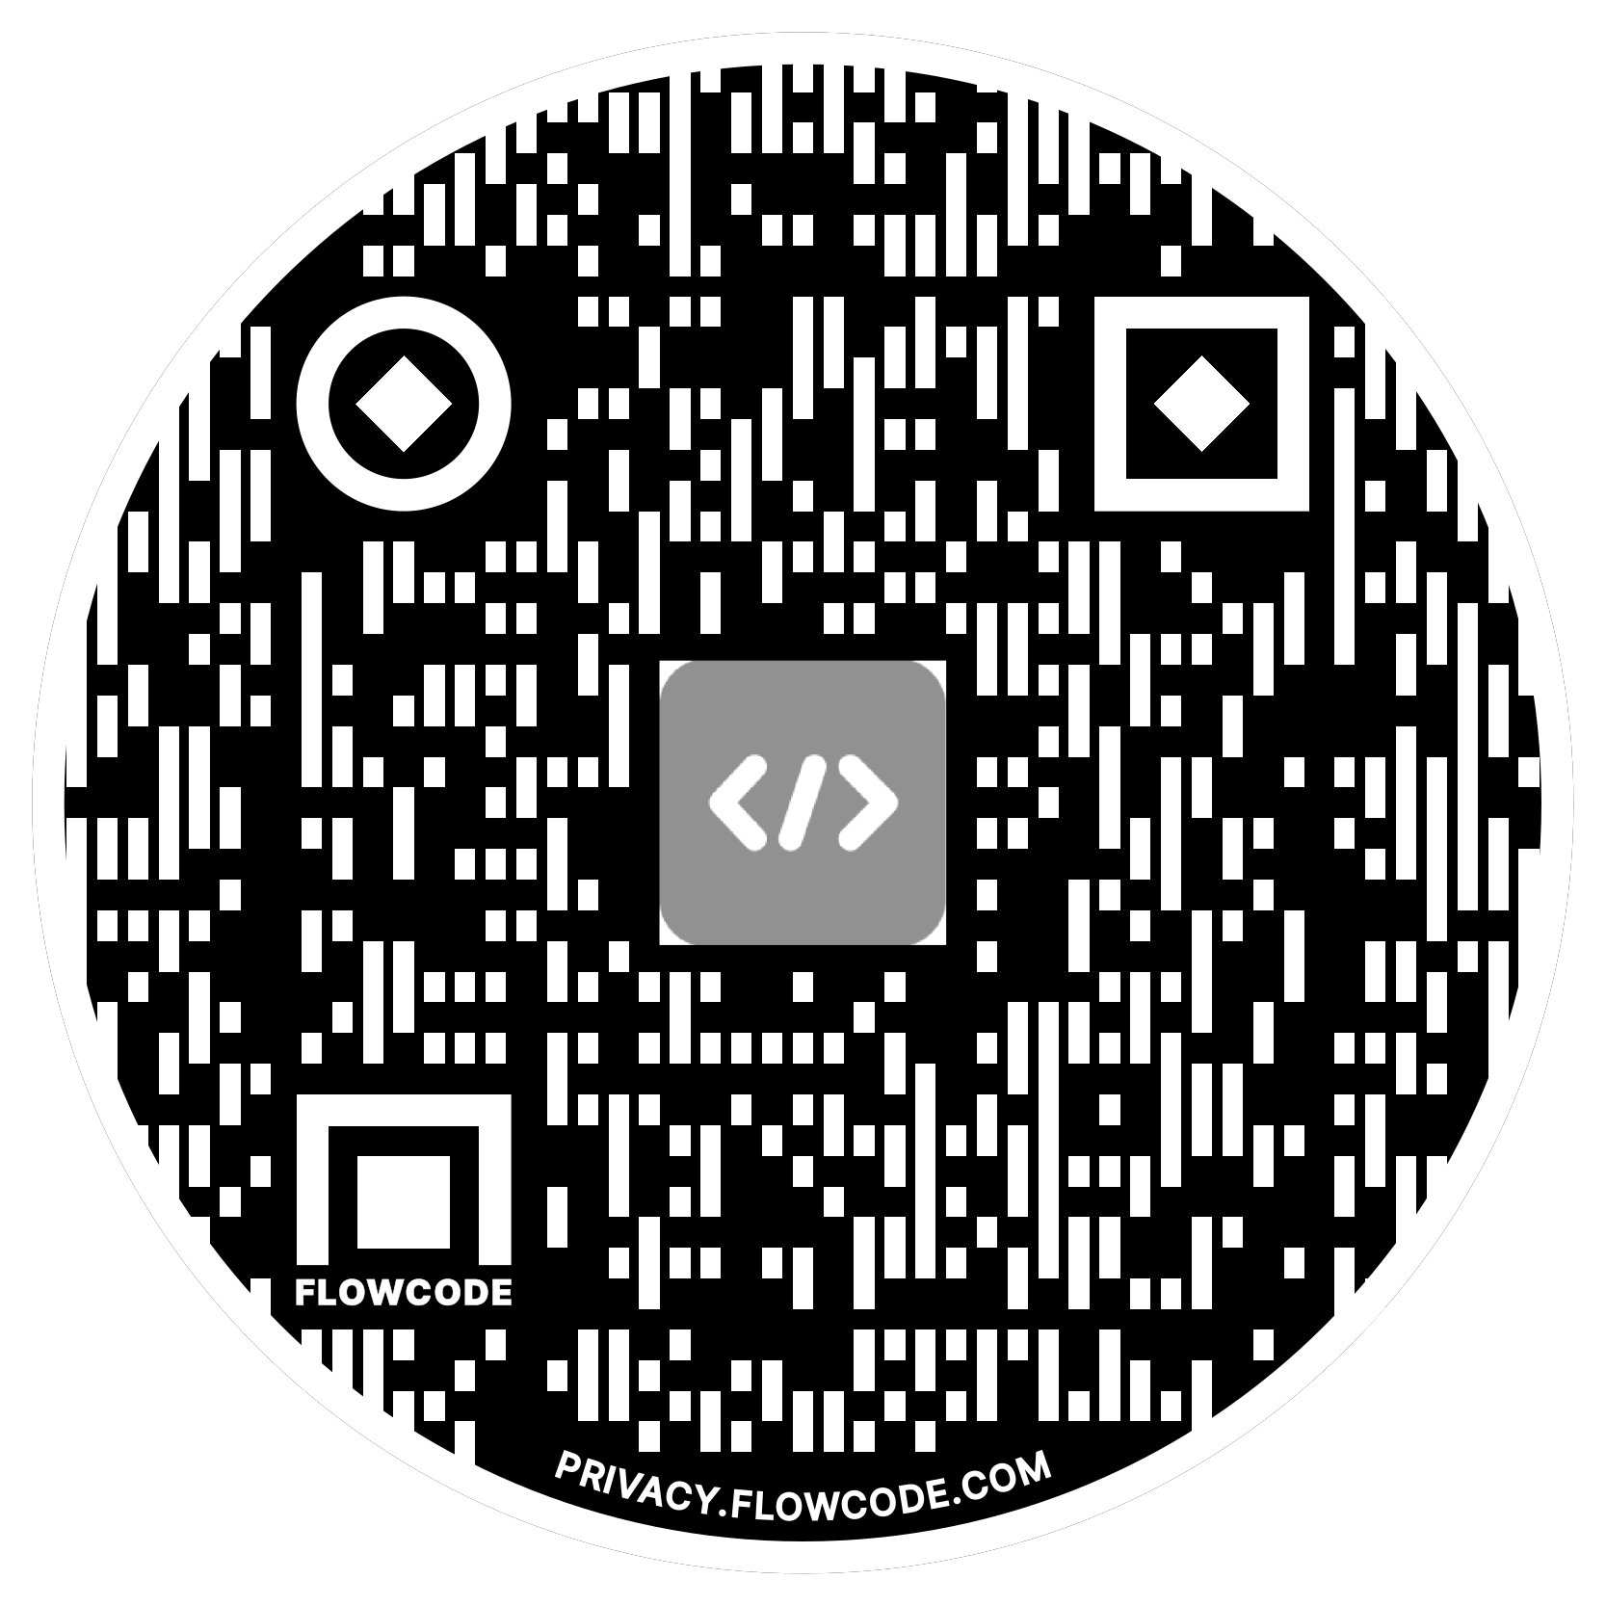
Alex Meyer
Principal Software Development Engineer
Delinea
Email: alex.meyer@delinea.com
Blog: http://msftcloudblogs.com
Security Class: http://d365fosecurity.com
Podcast: https://www.gofastpath.com/podcast
LinkedIn
Microsoft MVP Profile
Background:
Awarded Microsoft MVP in Business Applications
Been working with AX since 2013
Been working with D365FO since 2016
Have spoken at Summit (US & Europe), Focus, and local chapters around AX/D365FO security and have done webinars around native controls in both versions

Slide 4
Agenda
Telemetry Prerequisites
How to Enable Telemetry
View Data in Application Insights
  Form Runs
  Exception Events
  Custom Events
Reporting From PowerBI
Report via Code (.NET / C#)
Using Telemetry Data Within D365FO

Slide 5

How to Enable Telemetry & Monitoring Feature

Slide 6
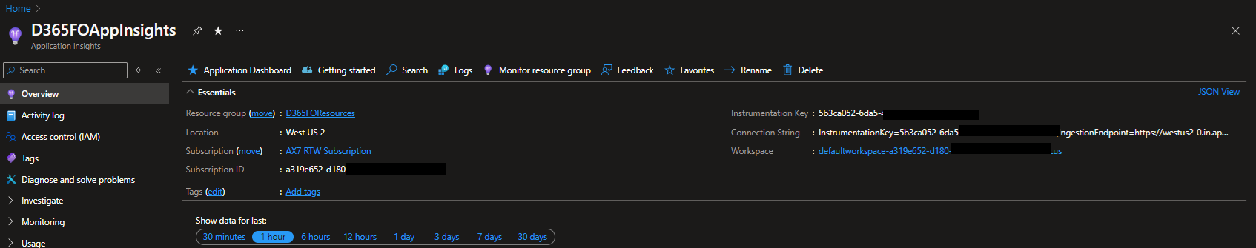
Telemetry & Monitoring Prerequisites
Must be on D365FO 10.0.30 or newer
Must have an Application Insights / Log Analytics resource created within Azure
Notes:
Note the Instrumentation Key as we will need that in subsequent steps.

Slide 7
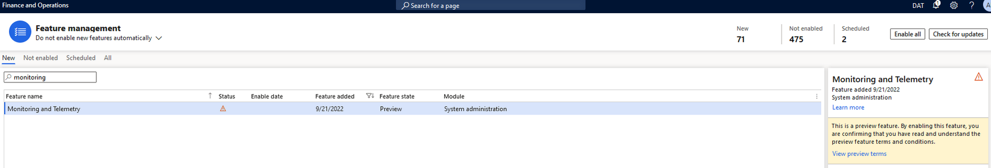
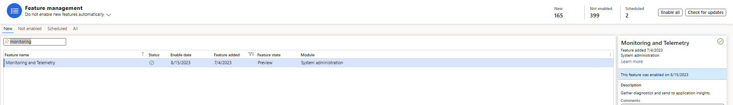
How to Enable Telemetry & Monitoring Feature
Notes:
First and foremost, this feature is labeled as a ‘preview feature’ so it is not enabled by default so we have to navigate to System Administration -> Workspaces -> Feature Management and search for ‘monitoring and telemetry’. You can see the Status below is marked as the yellow triangle with exclamation point, indicating it is not enabled.
After enabling the feature, you can see the Status change to the green check mark.

Slide 8
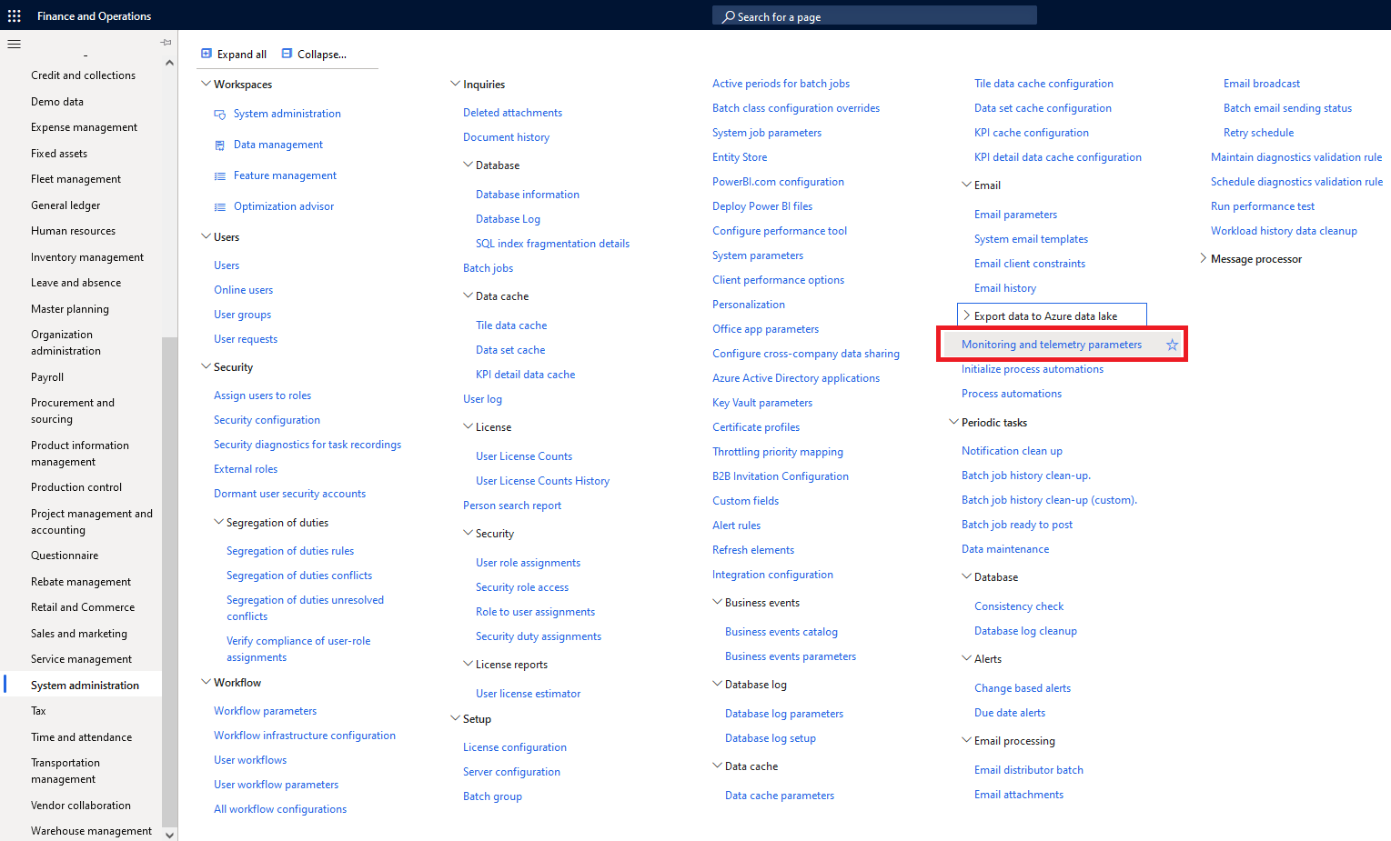
How To Enable Telemetry & Monitoring Feature
Notes:
Now we can navigate to System Administration -> Setup -> Monitoring and Telemetry Parameters.

Slide 9
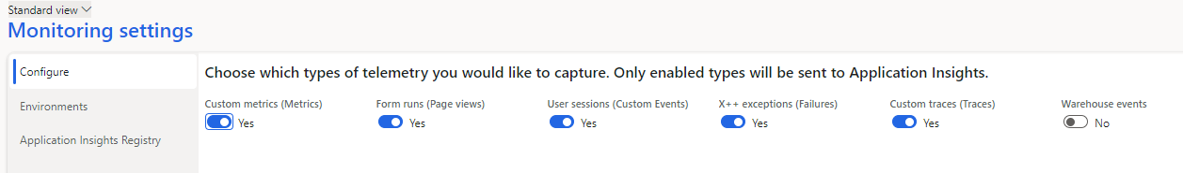
Telemetry & Monitoring Configuration
Notes:
We can now configure which events we want to enable in the Configure tab, specifically for our case we want to enable the Form Runs, User Sessions, X++ exceptions, and custom metrics/traces.

Slide 10
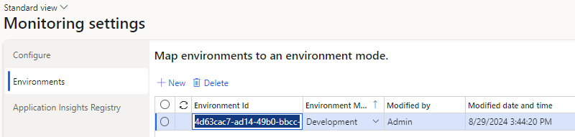
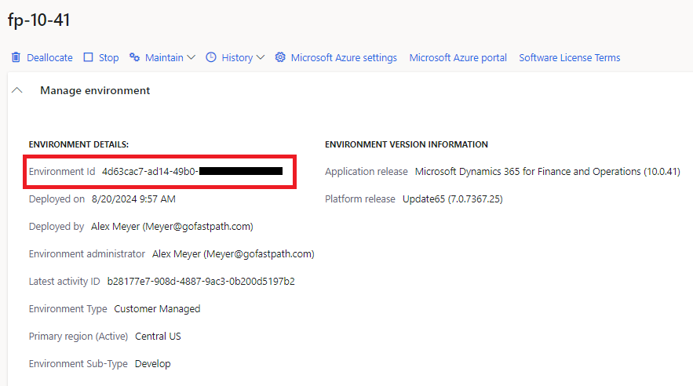
Telemetry & Monitoring Configuration
Notes:
Environment ID – From LCS environment metadata
Environment Mode – Development / Test / Production

Slide 11
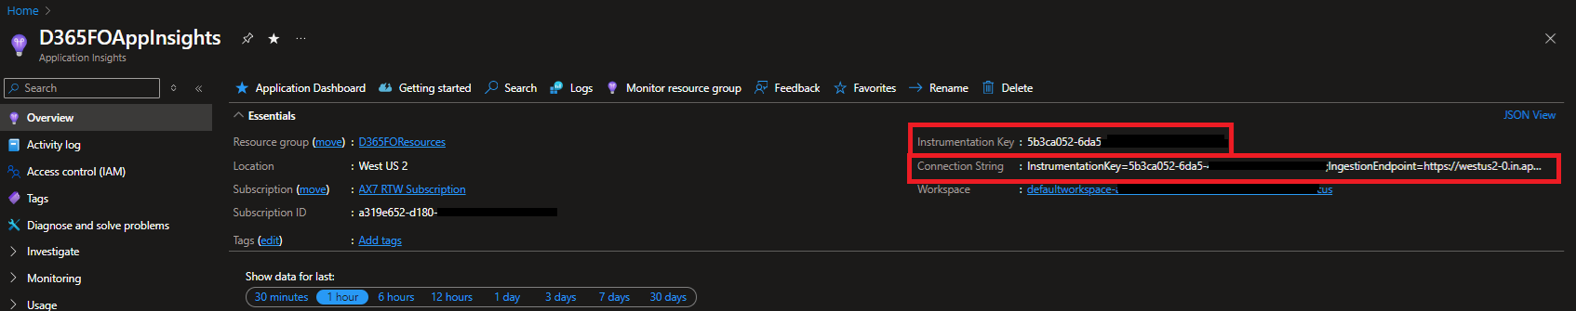
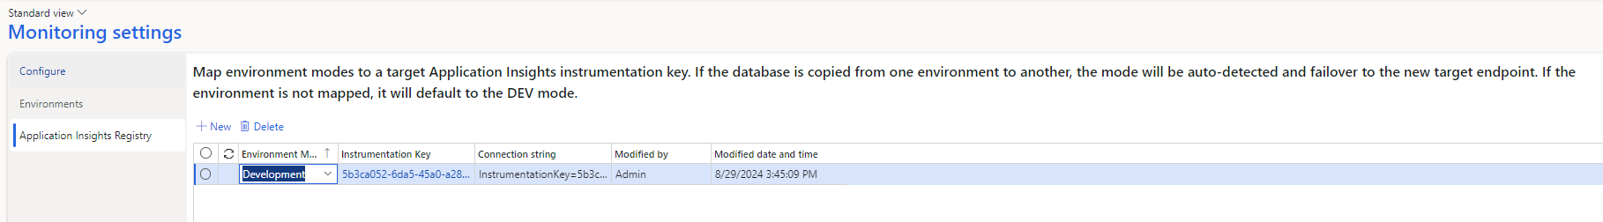
Telemetry & Monitoring Configuration
Notes:
Environment Mode – Development / Test / Producation
Instrumentation Key – From Log Analytics / App Insight resource

Slide 12
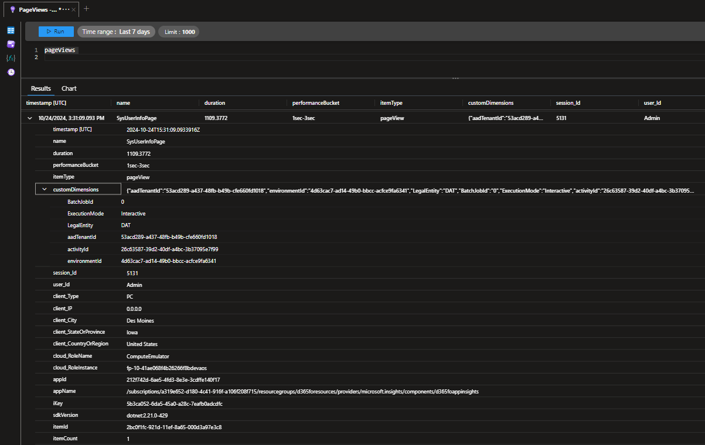
Telemetry Data in Log Analtics

Slide 13
View Data in Power BI

Slide 14
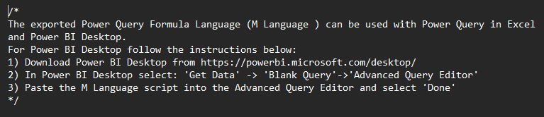
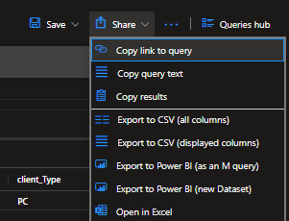
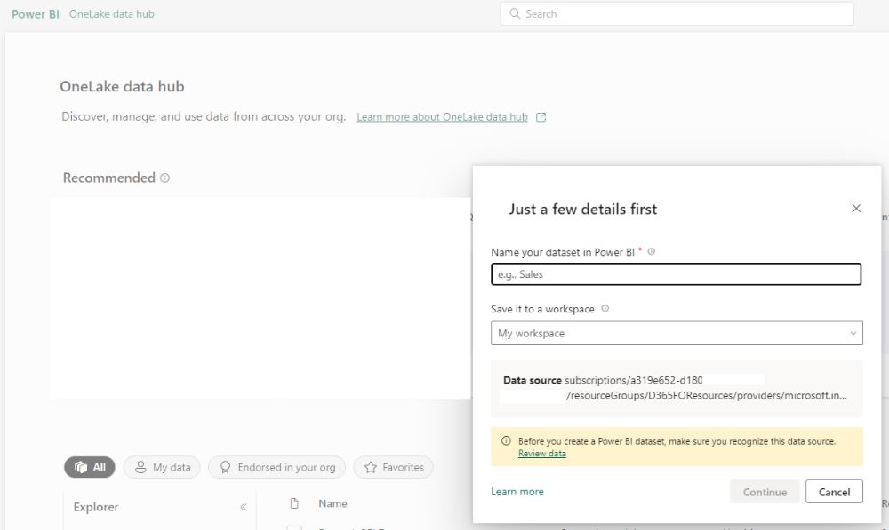
Export Data to Power BI
Notes:
Export to Power BI – M Query
Text file with query syntax
Export to Power BI – New Dataset
Launches new Power BI project in browser

Slide 15
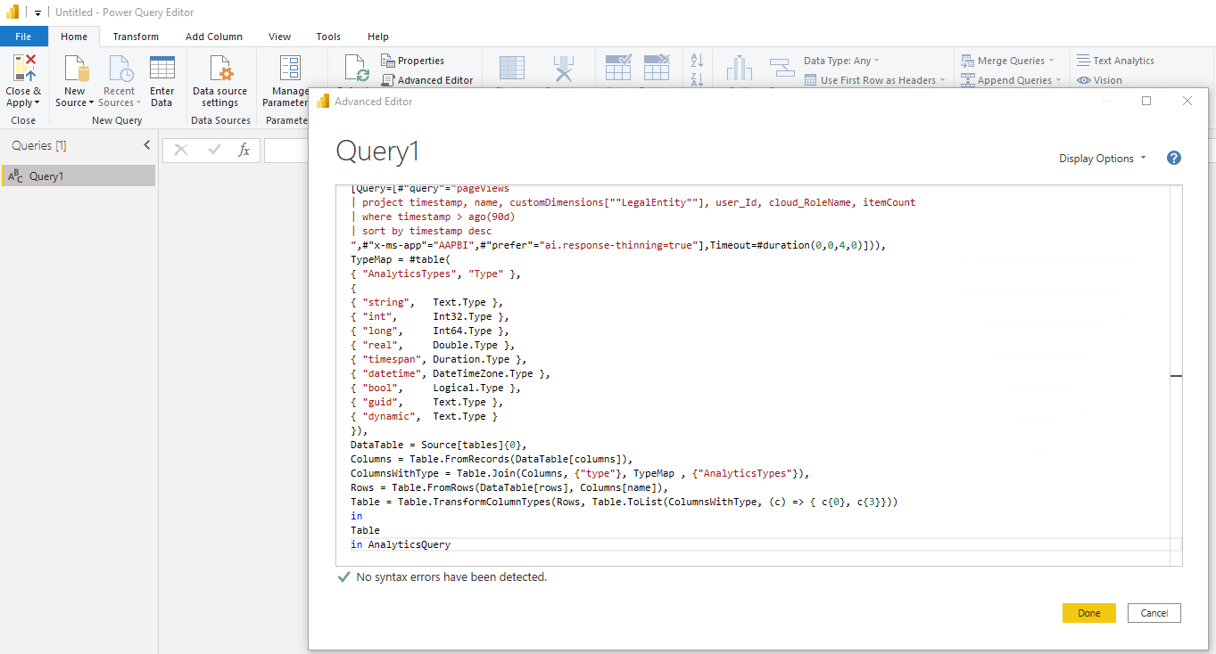
Export to Power BI – M Query
Notes:
Export to Power BI – M Query
Text file with query syntax
Export to Power BI – New Dataset
Launches new Power BI project in browser

Slide 16
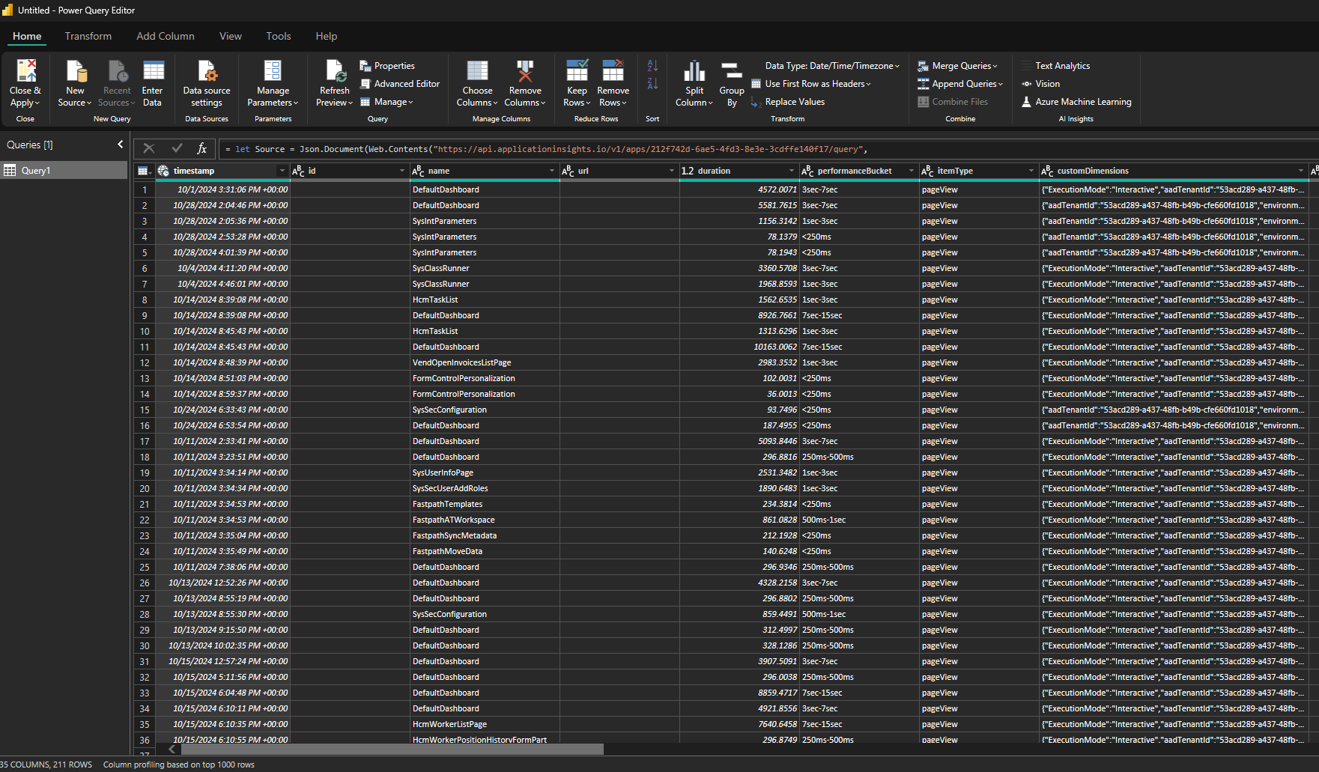
Power BI Data
Notes:
Export to Power BI – M Query
Text file with query syntax
Export to Power BI – New Dataset
Launches new Power BI project in browser

Slide 17
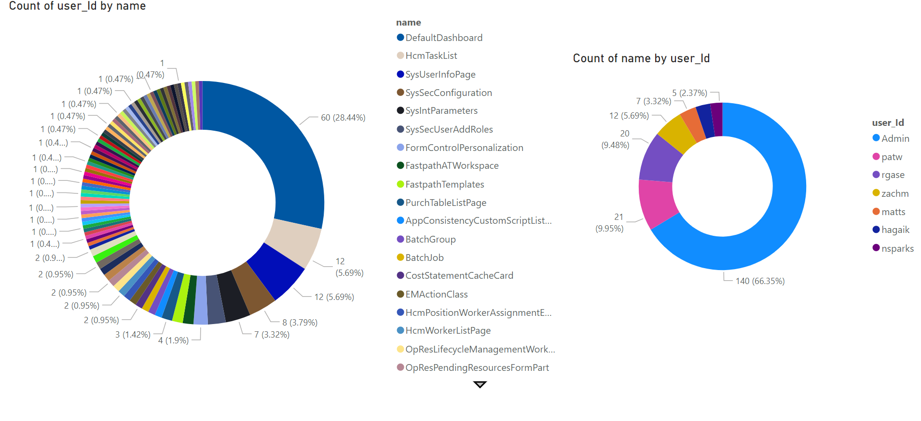
Example Power BI Visualizations
Notes:
Export to Power BI – M Query
Text file with query syntax
Export to Power BI – New Dataset
Launches new Power BI project in browser

Slide 18
Exception Events

Slide 19
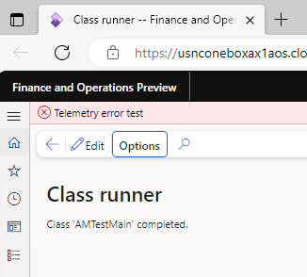
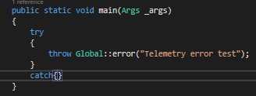
Exception Events

Slide 20
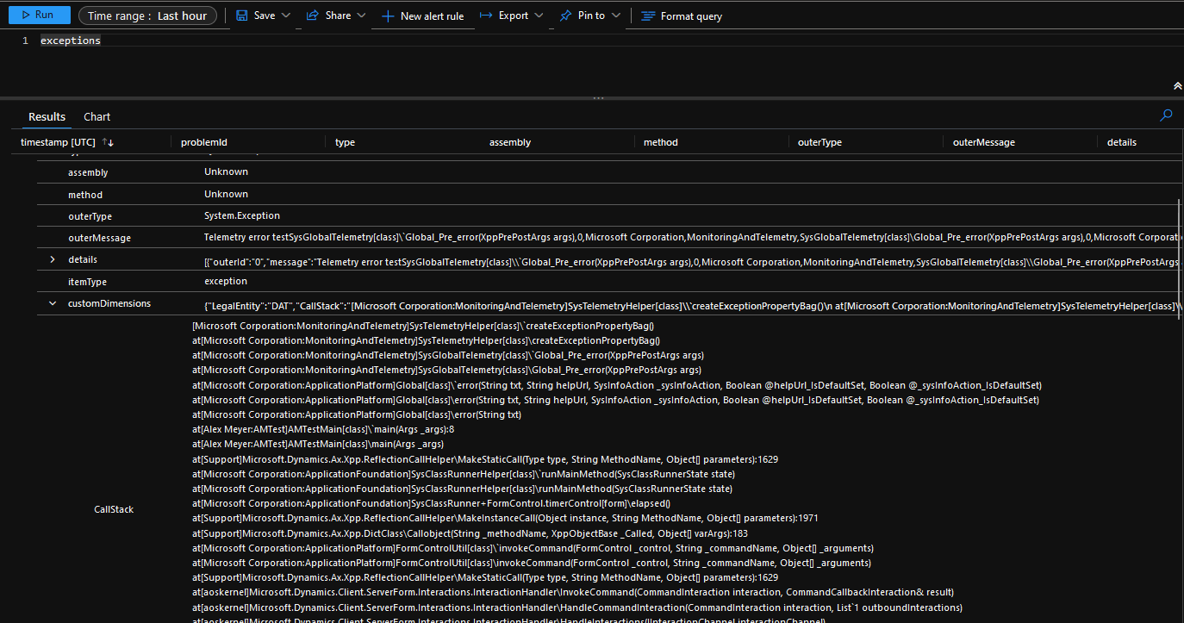
Exception Stack Trace

Slide 21
Custom Telemetry Events

Slide 22
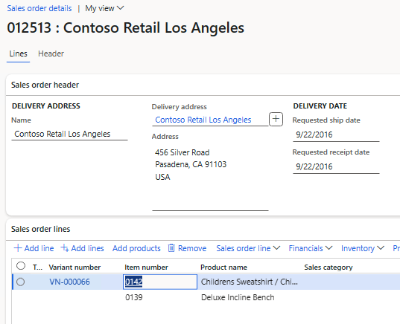
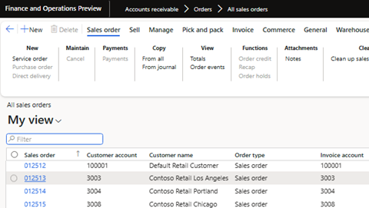
Custom Telemetry Events
Scenario – Want to log when a user opens a sales order
Notes:
https://alexdmeyer.com/2023/10/03/using-telemetry-data-for-read-auditing-in-d365fo/

Slide 23
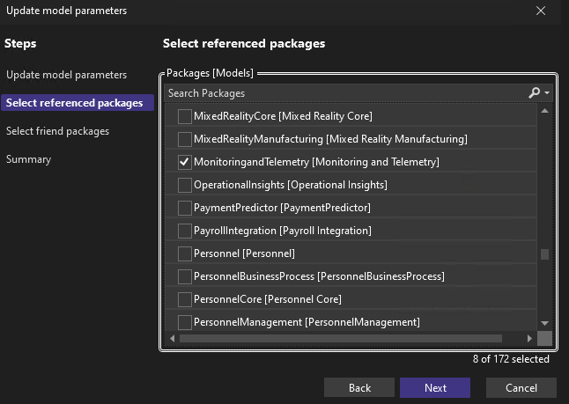
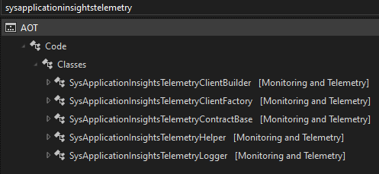
SysApplicationInsightsTelemetryLogger

Slide 24
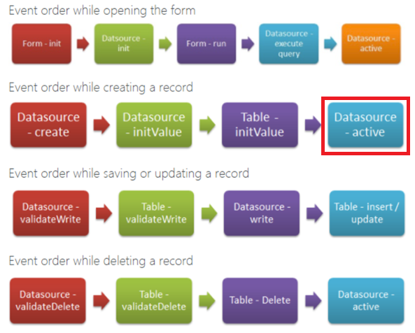
Form Event Lifecycle in D365FO
Notes:
https://dynamicsax4u.wordpress.com/2017/08/15/form-event-execution-sequence-in-dynamics-ax/

Slide 25
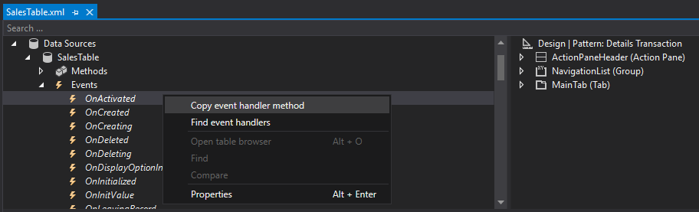
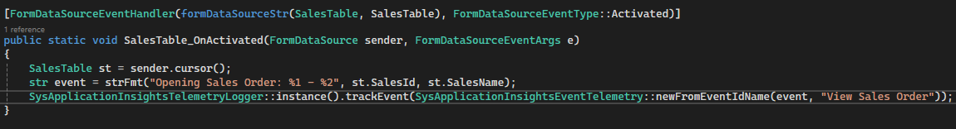
Custom Telemetry Events

Slide 26
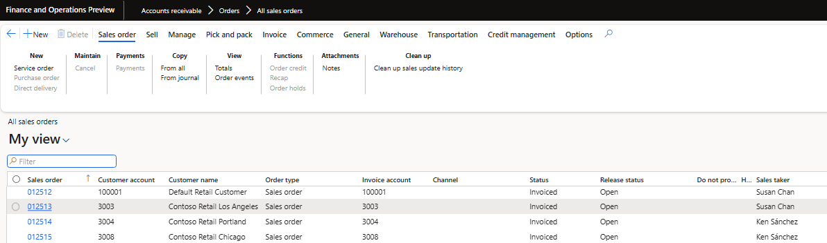
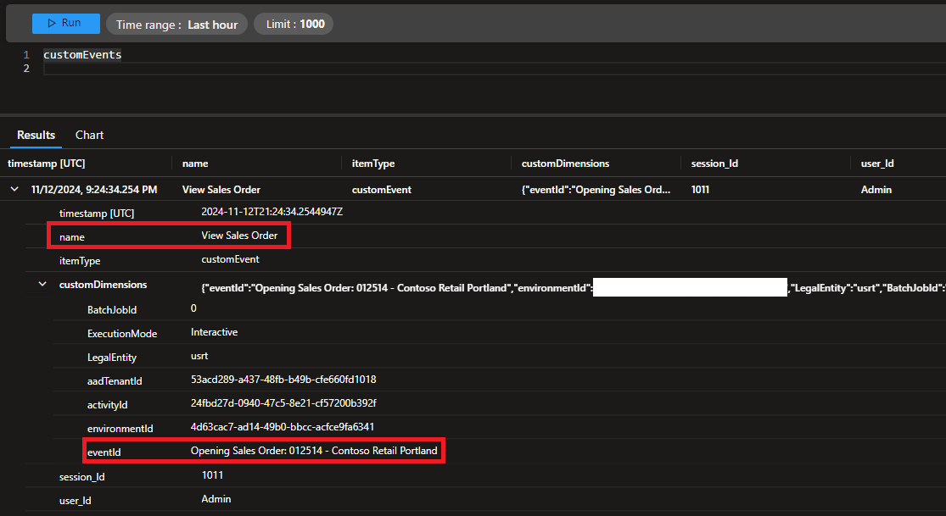
Custom Telemetry Events

Slide 27
Query Telemetry Data via Code

Slide 28
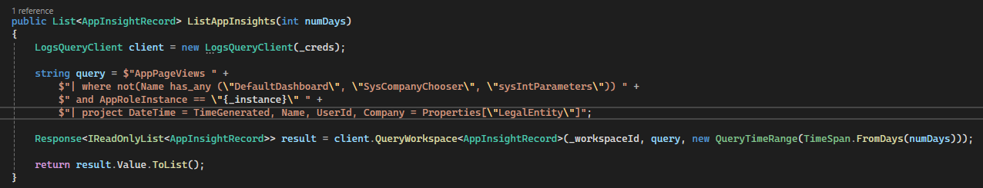
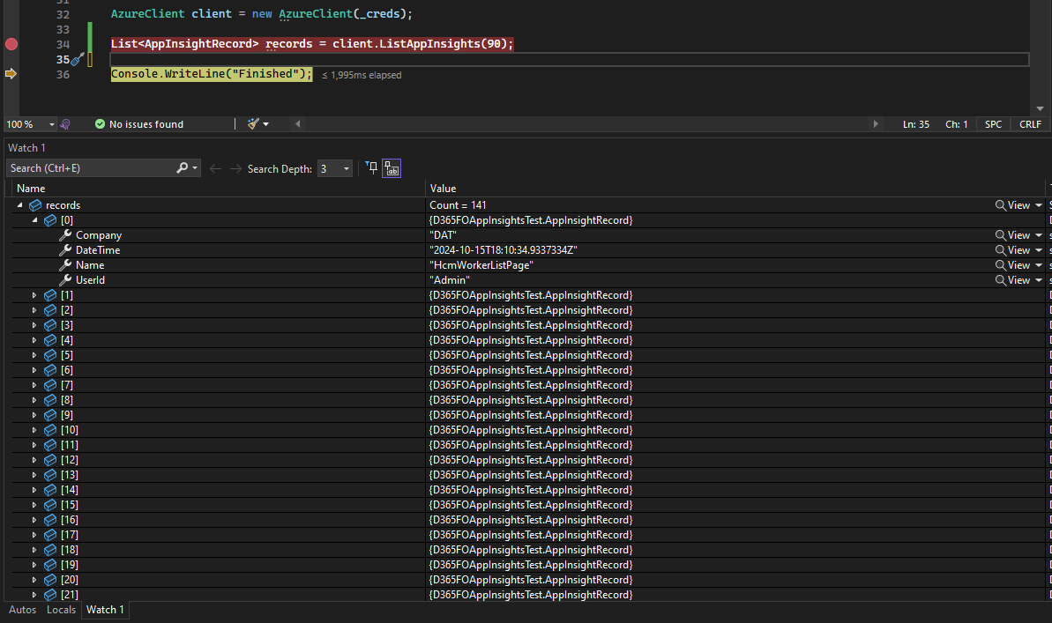
Telemetry Data in Log Analytics

Slide 29
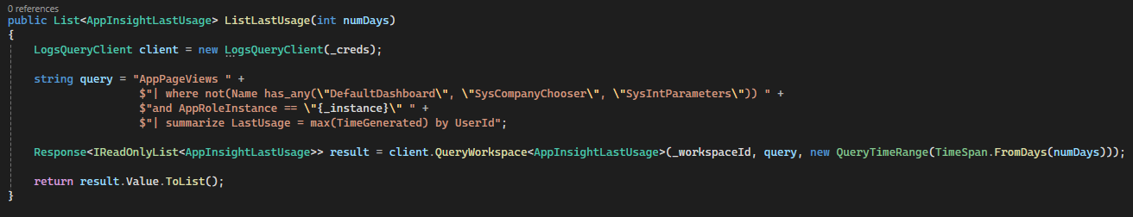
Use Telemetry Data Within D365FO
Let’s create a solution to disable a user that does not log in within a set timeframe
Notes:
.NET

Slide 30
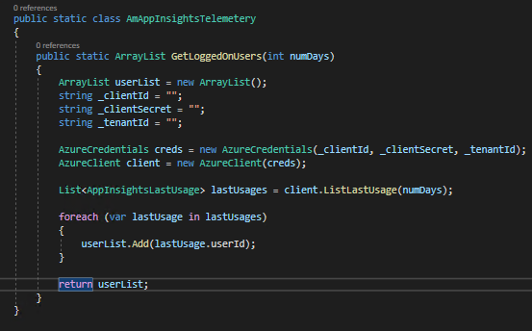
Use Telemetry Data Within D365FO
.NET class for X++ to call
Not best practice to store secrets in code

Slide 31
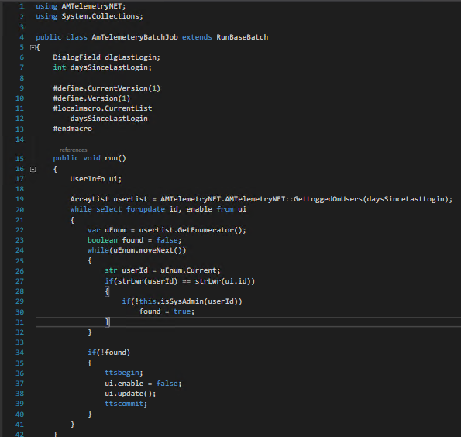
X++ Batch Job Setup
Gets users who have logged in within the last x days
Checks to see if user is assigned SysAdmin before trying to disable user
Will be added to D365FO Admin Toolkit shortly
Notes:
In this case, the batch job I created allows for a parameter input of the number of days we want to execute this process for. By default we are looking to find any user that has accessed the system within the last 90 days.
Once this set of users are found we compare that to all of the users within the UserInfo table, if a user exists in the UserInfo table but does not exist in the user result set from the telemetry data, we disable the user and commit that to the database.

Slide 32
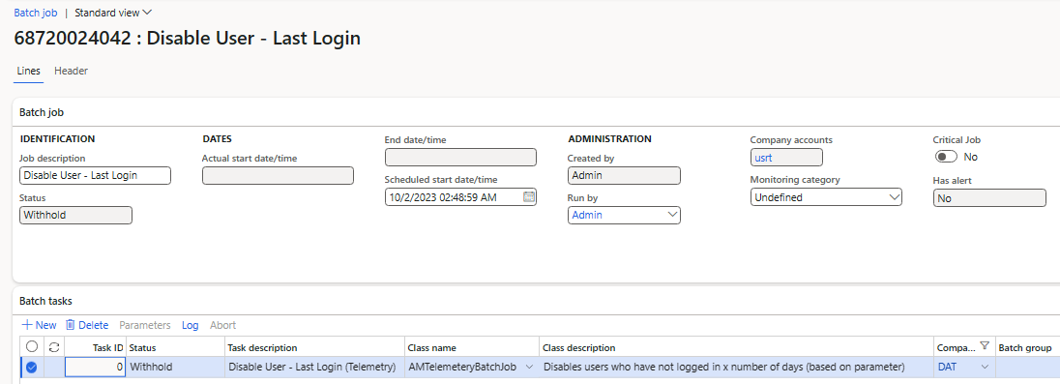
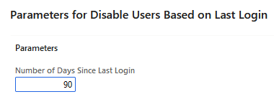
Disable Users Based on Last Login

Slide 33
DEMO

Slide 34
Resources
Monitoring and Telemetry Using Application Insights
Overview of Telemetry Data in D365FO
Utilizing Telemetry Data Within D365FO
Using Telemetry Data for Read Auditing in D365FO
D365FO Admin Toolkit
Fastpath Assure

Slide 35
Questions?
Email: alex.meyer@delinea.com
Blog: http://d365foblog.com
GitHub: https://github.com/ameyer505
Twitter: https://twitter.com/alexmeyer_ITGuy
D365FO Security Course: http://d365fosecurity.com
PowerPoint available at: https://alexdmeyer.com/resources/downloads/

