Slide 2
How to Create Content that Pops and Boosts Your Social Media Presence

Slide 3


Peter Ramer
Contact Info:
Email: alex.itguy@outlook.com
Blog: http://d365foblog.com
Security Course: http://d365fosecurity.com
Book: Security and Audit Field Manual: Dynamic 365 for Finance & Operations
LinkedIn
Microsoft MVP Profile
Background:
Awarded Microsoft MVP in Business Applications in November 2019
Have worked with AX since 2013
Have worked with D365FO since 2016
Have spoken at Summit (US & Europe), Focus, and local chapters around AX/D365FO security and have done webinars around native controls in both versions
Director of Managed Application Services, Senior Analyst
Contact Info:
Email: peter.ramer@rsmus.com
Blog: https://dynamics365musings.com
LinkedIn
Microsoft MVP Profile
Background:
Awarded Microsoft MVP in Business Applications in November 2022
Have worked with AX since 2006
Have worked with D365FO since 2016

Slide 4


Alex Meyer
Contact Info:
Email: alex.itguy@outlook.com
Blog: http://d365foblog.com
Security Course: http://d365fosecurity.com
Book: Security and Audit Field Manual: Dynamic 365 for Finance & Operations
LinkedIn
Microsoft MVP Profile
Background:
Awarded Microsoft MVP in Business Applications in November 2019
Have worked with AX since 2013
Have worked with D365FO since 2016
Have spoken at Summit (US & Europe), Focus, and local chapters around AX/D365FO security and have done webinars around native controls in both versions
Senior Manager – Business Application Solutions
Contact Info:
Email: alex.itguy@outlook.com
Blog: http://d365foblog.com
Security Course: http://d365fosecurity.com
Book: Security and Audit Field Manual: Dynamic 365 for Finance & Operations
LinkedIn
Microsoft MVP Profile
Background:
Awarded Microsoft MVP in Business Applications in November 2019
Have worked with AX since 2013
Have worked with D365FO since 2016
Have spoken at Summit (US & Europe), Focus, and local chapters around AX/D365FO security and have done webinars around native controls in both versions

Slide 5
Audience Questions
How many of you currently have content published?
  Blog
  YouTube
  Podcast
For those that don’t, what’s the biggest thing holding you back?
  Don’t know where to start
  Time commitment
  Fear

Slide 6
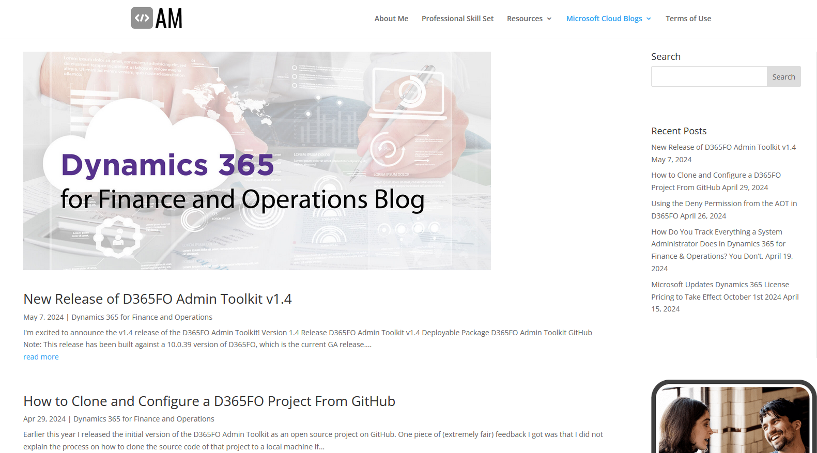
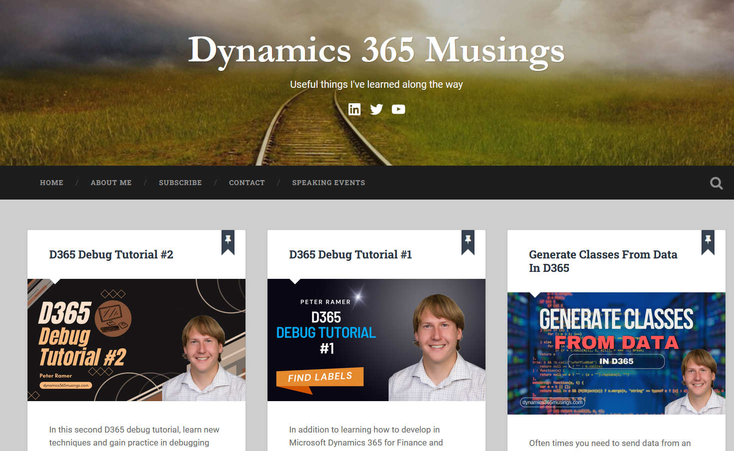
Content Creation Options
Blog
  Free / paid hosting
Whitepaper
YouTube
Podcast
Book
Other examples?

Slide 7
Content Ideas
End user issues / errors
No clear instructions currently for process
Versus / Comparisons
Reviews of application / feature
Best in class (Top 5 / Top 10)
‘Rule of Two’

Slide 8
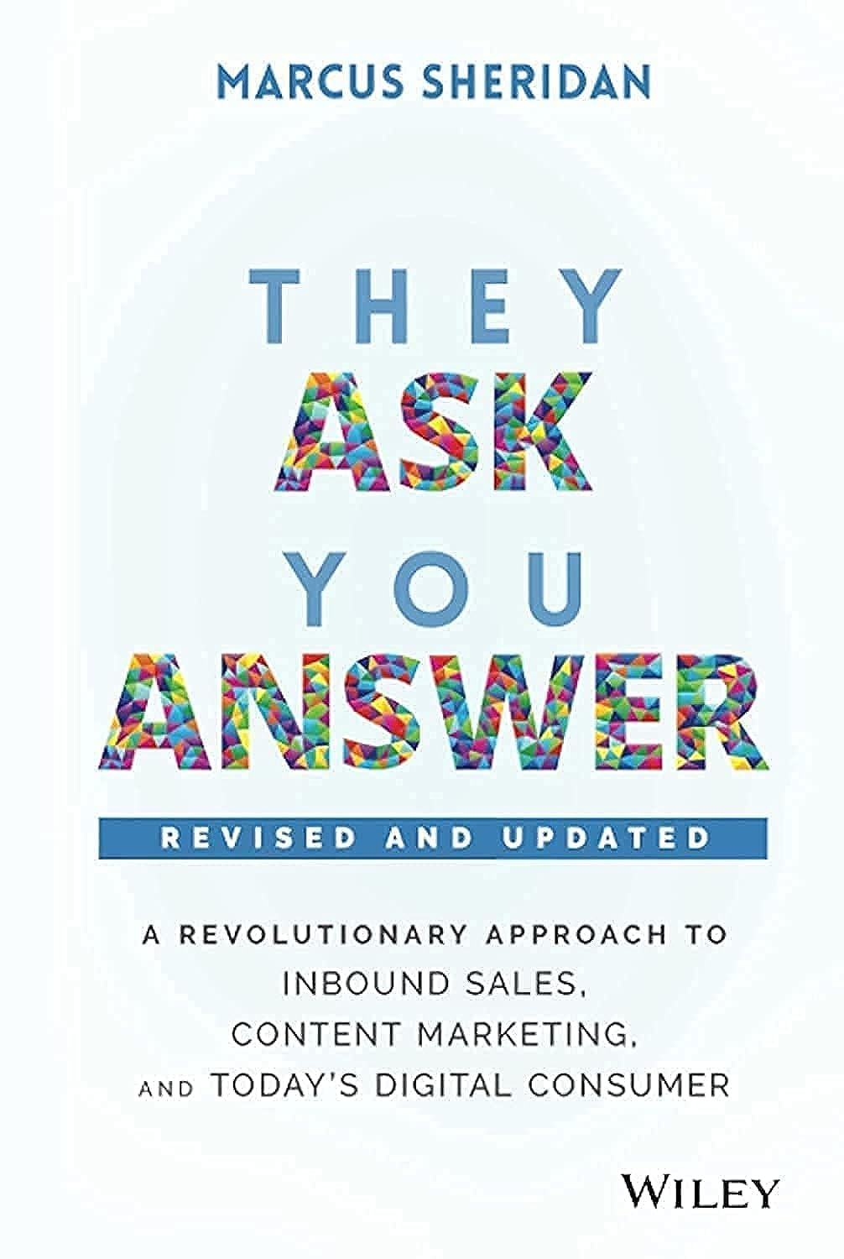
Methodology
‘Don’t be an ostrich’
  Knowledge should not be hidden
  Some orgs will resist – takes a leap of faith
Be the subject matter expert in your area
  Be a result in Google search
Offer educational content (not focused on sales)
Content never sleeps – builds client trust
Notes:
https://www.amazon.com/They-Ask-You-Answer-Revolutionary/dp/1119610141

Slide 9
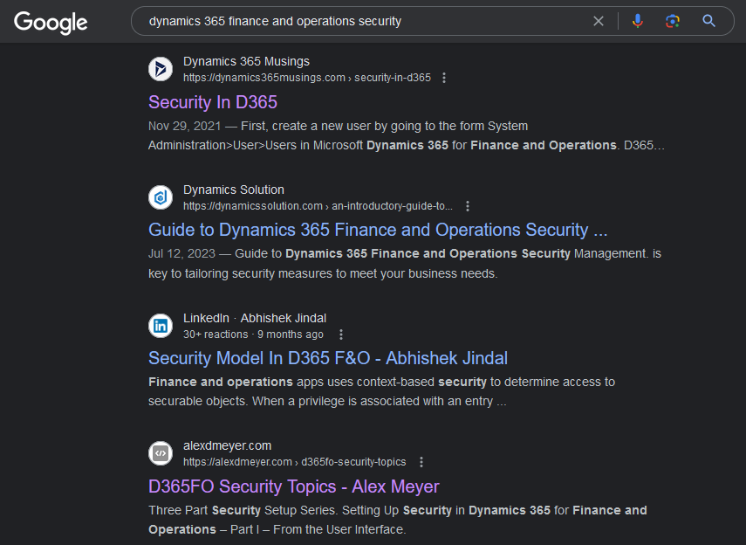
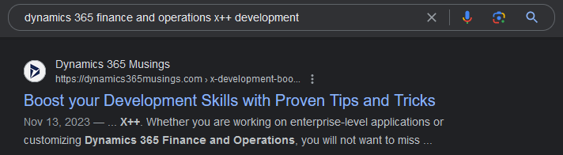
Examples of Methodology In Use

Slide 10
Blog - Hosted
Dedicated URL
  https://dynamics365musings.com/
  https://alexdmeyer.com/dynamics-365-for-finance-and-operations-blog/
Gives more control over look and feel of website
Things to do:
  Hosting provider
  Custom URL
  SSL Cert
Can be done for under $100 / year

Slide 11
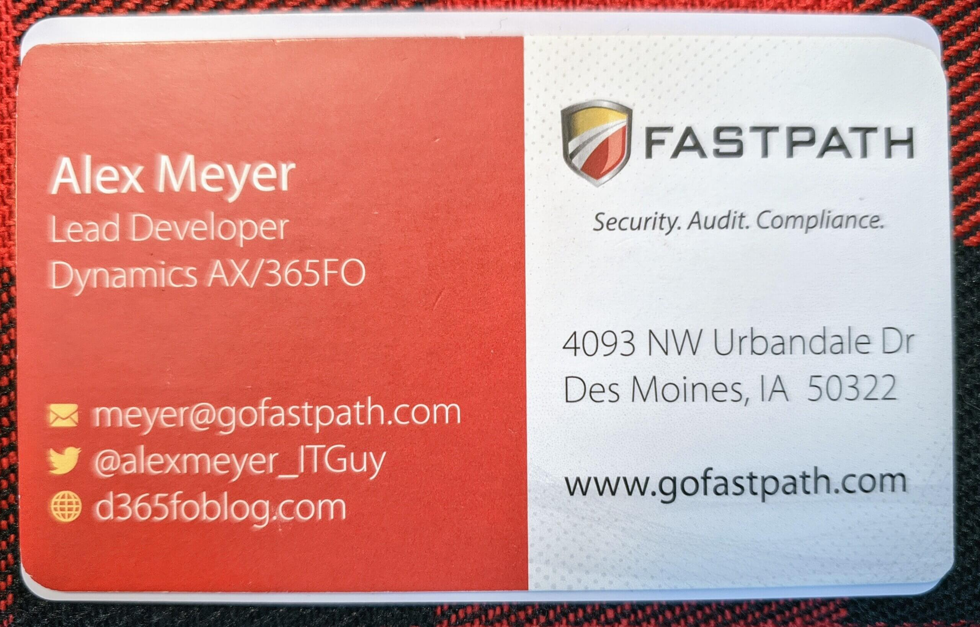
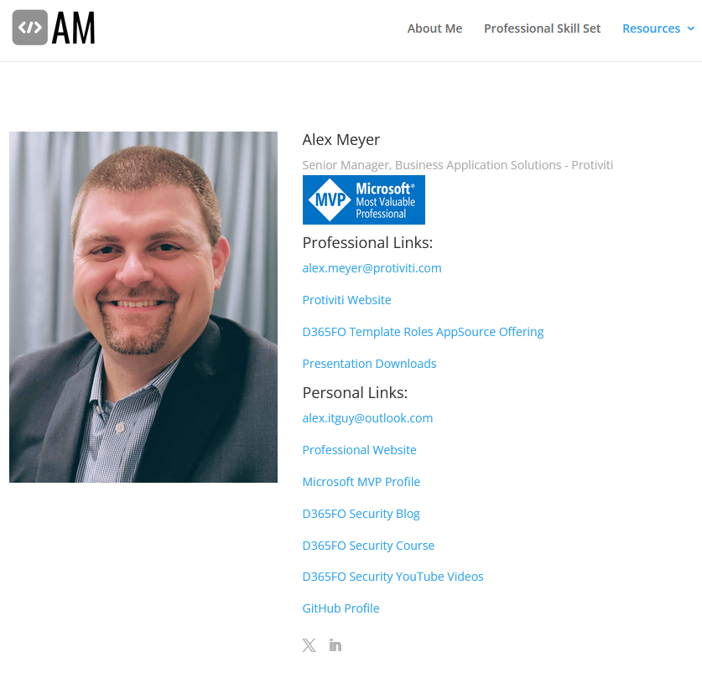
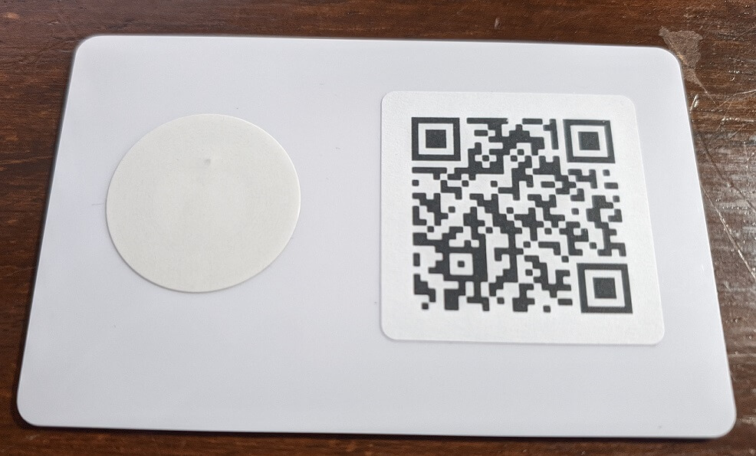
Ease of Use Items
Bio Page
QR Code
NFC tag
All items available on Amazon / Etsy
  Can be done for less than $25
Notes:
https://alexdmeyer.com/2021/01/04/creating-a-custom-digital-business-card/

Slide 12
Other Content Considerations
Where do you post content?
  LinkedIn
  X (Twitter)
  User Groups
  Microsoft Dynamics Forums
Who is your audience?
  C-suite, Decision Makers, Tech Professionals etc
When do you post content?
  Post when your largest audience is online

Slide 13
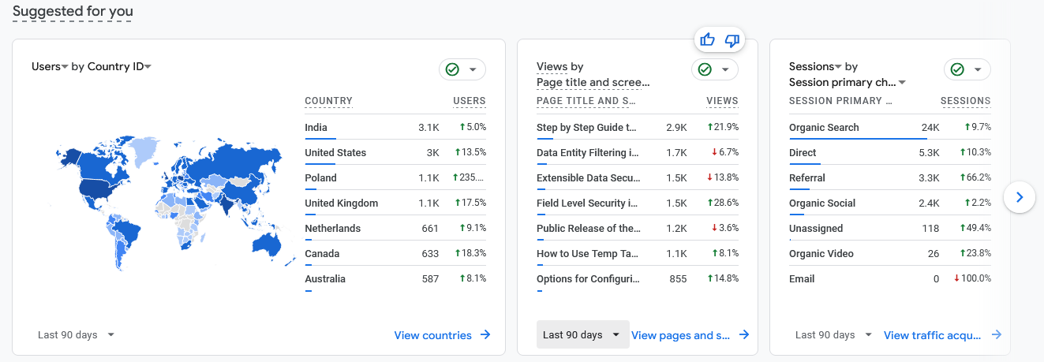
Content Analytics
Google Analytics
Notes:
https://wordpress.com/support/google-analytics/

Slide 14
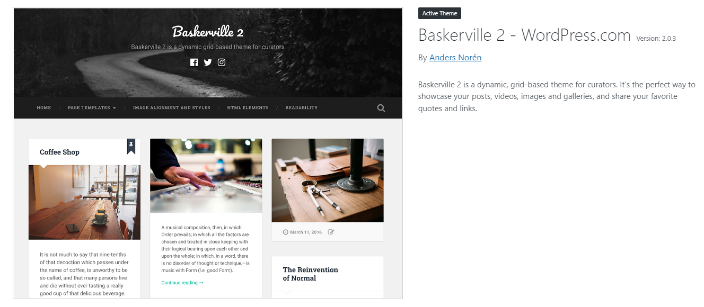
WordPress Set Up
BlueHost.com to host my site. WordPress as the engine.
WordPress has LOTS of free theme’s, making building a site easy.
Baskerville 2

Slide 15
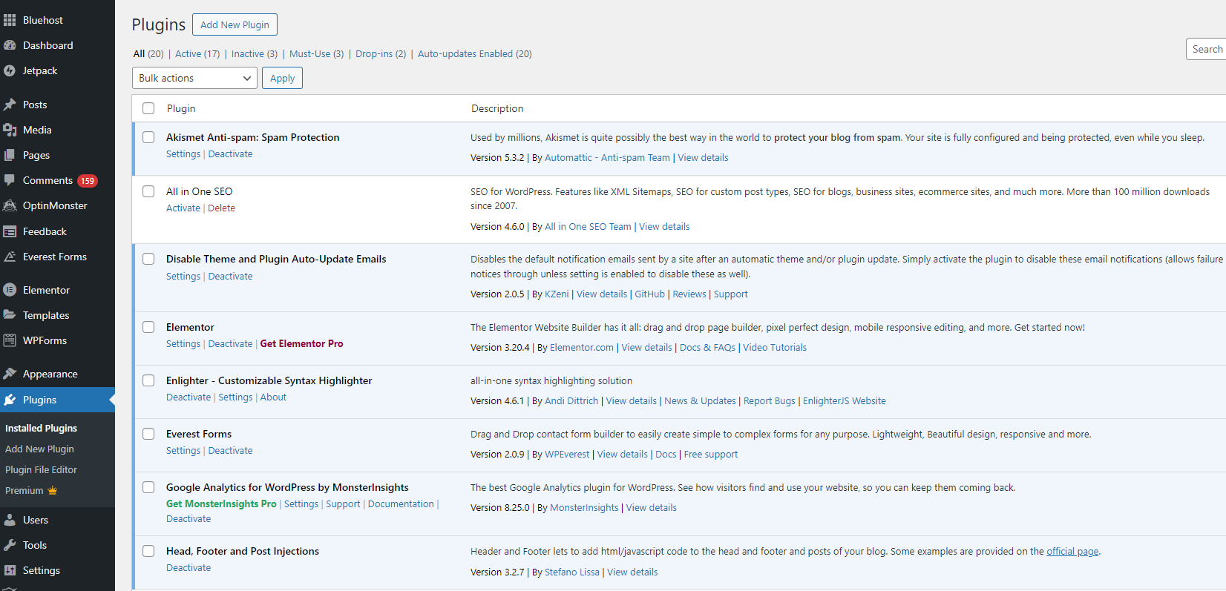
Helpful WordPress Plugns
Notes:
Akismet Anti-spam ensures you don’t get a lot of spam in your comments.
Everest forms allows people to send you a message, but I do get a lot of spam on the forms.
Google Analytics is very important for monitoring and reporting your impact.

Slide 16
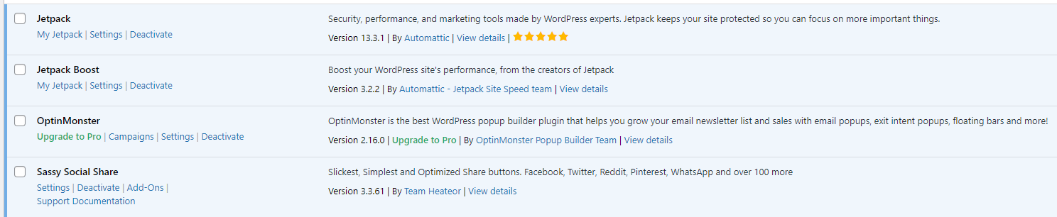
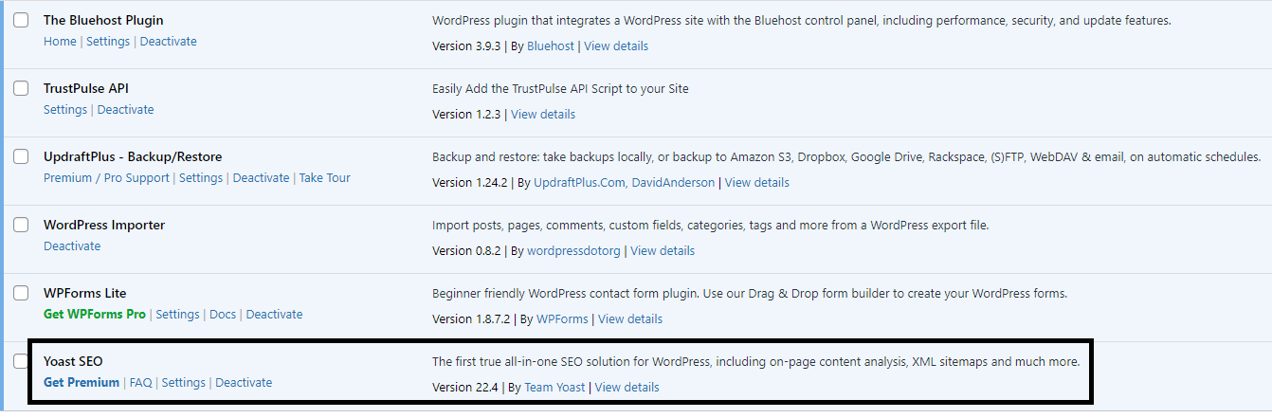
Helpful WordPress Plugins

Slide 17
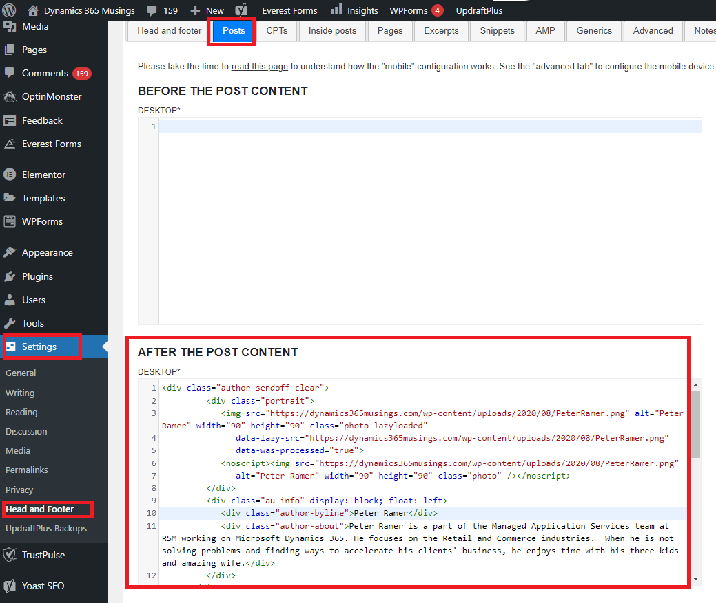
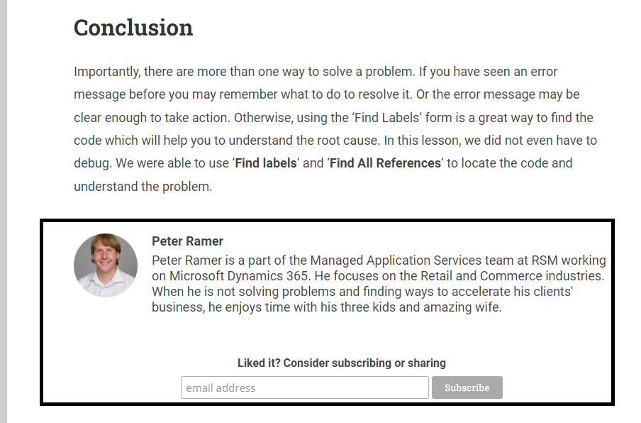
Header, Footer, and Post Injections
<div class="author-sendoff clear"> <div class="portrait"> <img src="https://dynamics365musings.com/wp-content/uploads/2020/08/PeterRamer.png" alt="Peter Ramer" width="90" height="90" class="photo lazyloaded" data-lazy-src="https://dynamics365musings.com/wp-content/uploads/2020/08/PeterRamer.png" data-was-processed="true"> <noscript><img src="https://dynamics365musings.com/wp-content/uploads/2020/08/PeterRamer.png" alt="Peter Ramer" width="90" height="90" class="photo" /></noscript> </div> <div class="au-info" display: block; float: left> <div class="author-byline">Peter Ramer</div> <div class="author-about">Peter Ramer is a part of the Managed Application Services team at RSM working on Microsoft Dynamics 365. He focuses on the Retail and Commerce industries. When he is not solving problems and finding ways to accelerate his clients' business, he enjoys time with his three kids and amazing wife.</div> </div> </div><!-- Begin Mailchimp Signup Form --><link href="//cdn-images.mailchimp.com/embedcode/horizontal-slim-10_7.css" rel="stylesheet" type="text/css"><style type="text/css"> #mc_embed_signup{background:#fff; clear:left; font:14px Helvetica,Arial,sans-serif; width:100%;} /* Add your own Mailchimp form style overrides in your site stylesheet or in this style block. We recommend moving this block and the preceding CSS link to the HEAD of your HTML file. */</style><div id="mc_embed_signup"><form action="https://dynamics365musings.us17.list-manage.com/subscribe/post?u=0a80d483946e2374c9bad8c8b&id=cb3a77a65e" method="post" id="mc-embedded-subscribe-form" name="mc-embedded-subscribe-form" class="validate" target="_blank" novalidate> <div id="mc_embed_signup_scroll"> <label for="mce-EMAIL">Liked it? Consider subscribing or sharing</label> <input type="email" value="" name="EMAIL" class="email" id="mce-EMAIL" placeholder="email address" required> <!-- real people should not fill this in and expect good things - do not remove this or risk form bot signups--> <div style="position: absolute; left: -5000px;" aria-hidden="true"><input type="text" name="b_0a80d483946e2374c9bad8c8b_cb3a77a65e" tabindex="-1" value=""></div> <div class="clear"><input type="submit" value="Subscribe" name="subscribe" id="mc-embedded-subscribe" class="button"></div> </div></form></div><!--End mc_embed_signup-->

Slide 18
Jetpack and Google Analytics
Shows you view per day
Shows you what articles are being view
Compare visitors vs Unique Page Views
Both have mobile apps that allow you to check on your phone

Slide 19
MailChimp
Add MailChimp popup to allow users to subscribe to email updates when your site posts new articles
Customize your Subject to add more than just text!

Slide 20
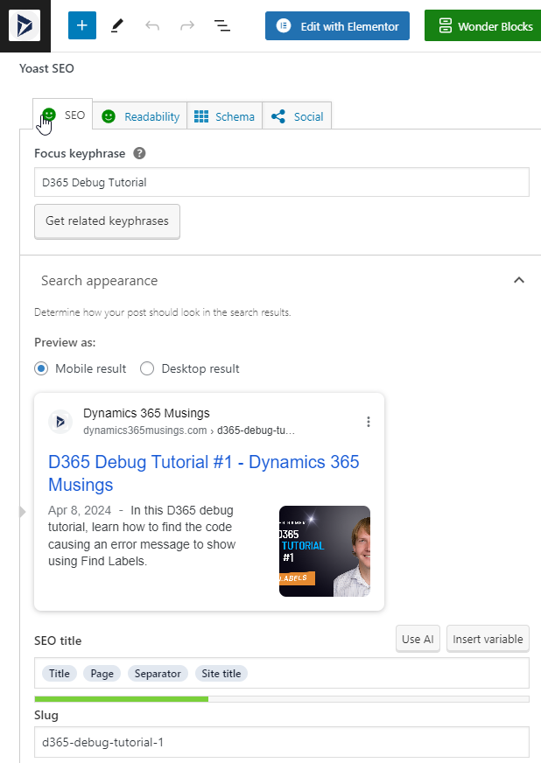
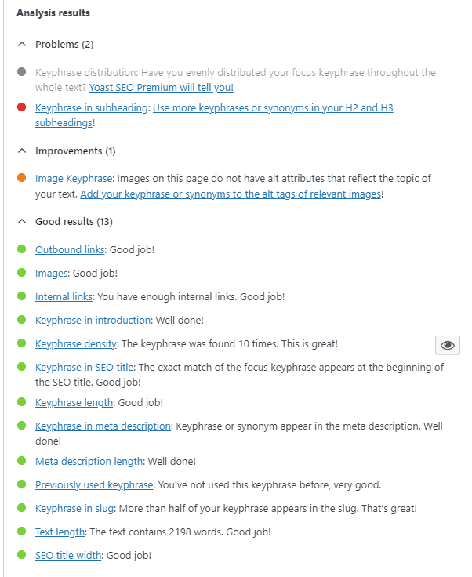
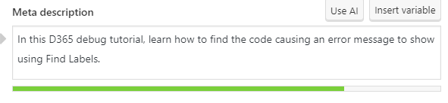
Yoast SEO
Posts>Add New Post
Decide Focus keyphrase – Use in title, and multiple times throughout article.
Use active voice
Use internal and external links
No more than 300 words per header

Slide 21
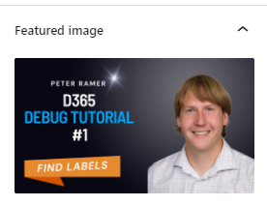
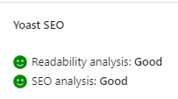
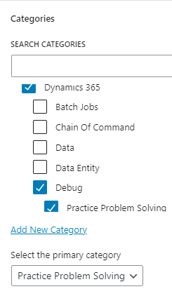
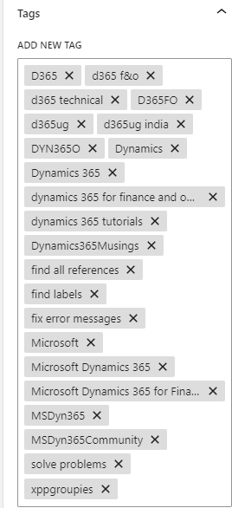
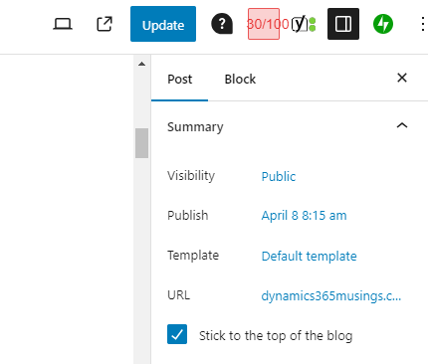
Blog Writing Checklist
Decide Focus Keyword
Write article. Consider re-writing intro and conclusion.
Validate you get two smiles faces from Yoast for Readability and SEO analysis.
Set a Category
Set Tags
Set Featured image (more on that later)
Schedule post date/time

Slide 22
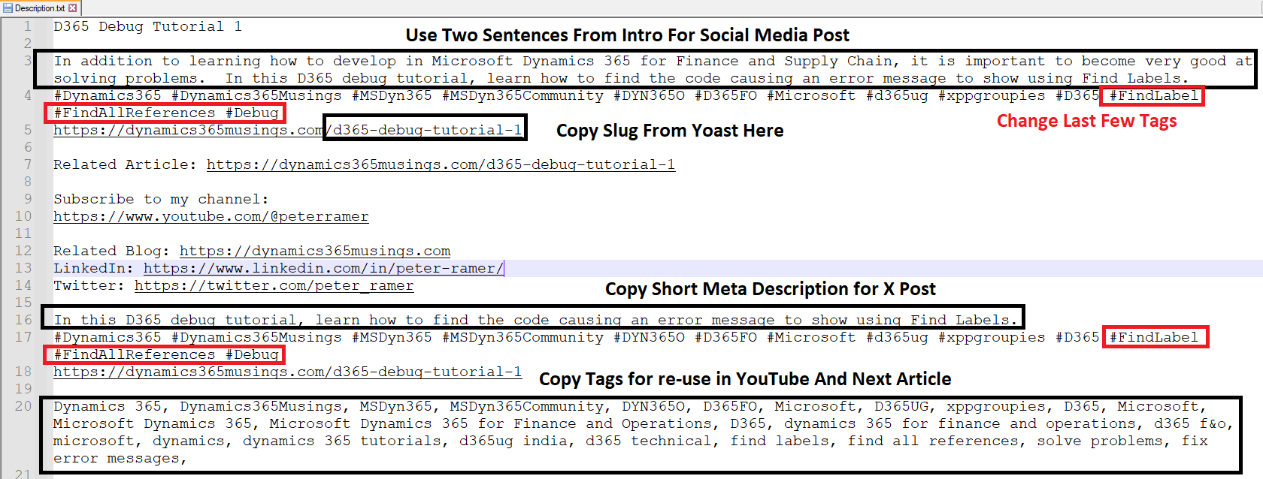
Save Information For Next Post

Slide 23
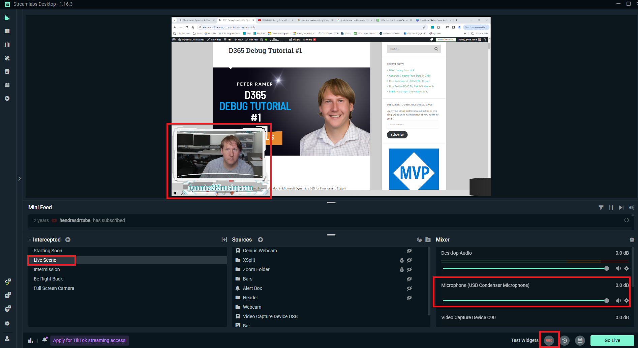
Video Recording Process
Record Screen and optionally your WebCam as well
Streamlabs OBS, ClipChamp, Camtasia, ect.
Condenser Mic
Webcam (Logitech or Elgato)

Slide 24
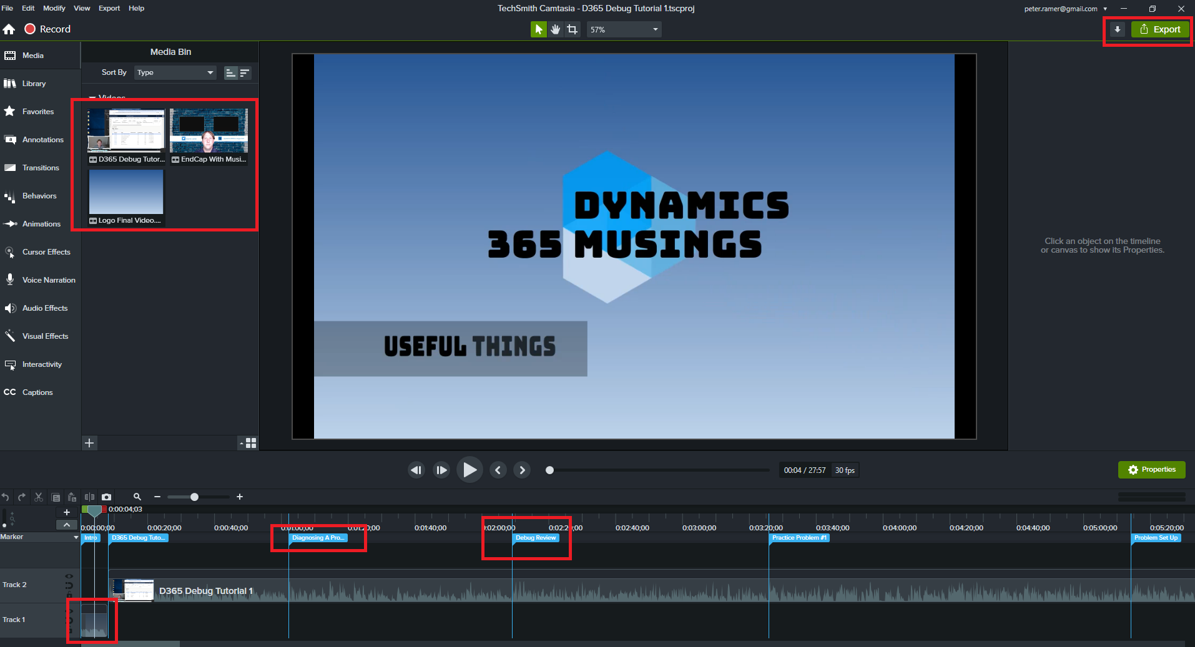
Video Editing Process
Camtasia lets you add tags/bookmarks to your video (shift-m) that will export as a YouTube Timeline
I use Camtasia to add a very short 9 second ‘Intro’, and 22 second end-screen ‘Outro’ to every video.
I put my intro, captured video, outro, Saved Off information, and Thumbnail file into a OneDrive folder, so it all gets backed up.
Export from Camtasia straight to YouTube

Slide 25
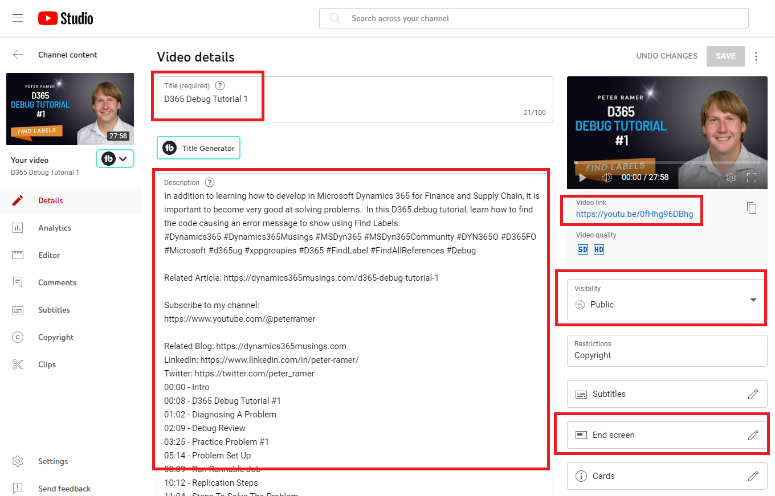
YouTube Studio Checklist
Go to YouTube>Your profile>YouTube Studio to see or upload videos.
Copy ‘Description’ from Saved Off file. Camtasia will create ‘TimeLine’.
Set the Video Thumbnail
Set PlayList
Copy ‘Tags’ from ‘Saved off’ file.
Schedule Post

Slide 26
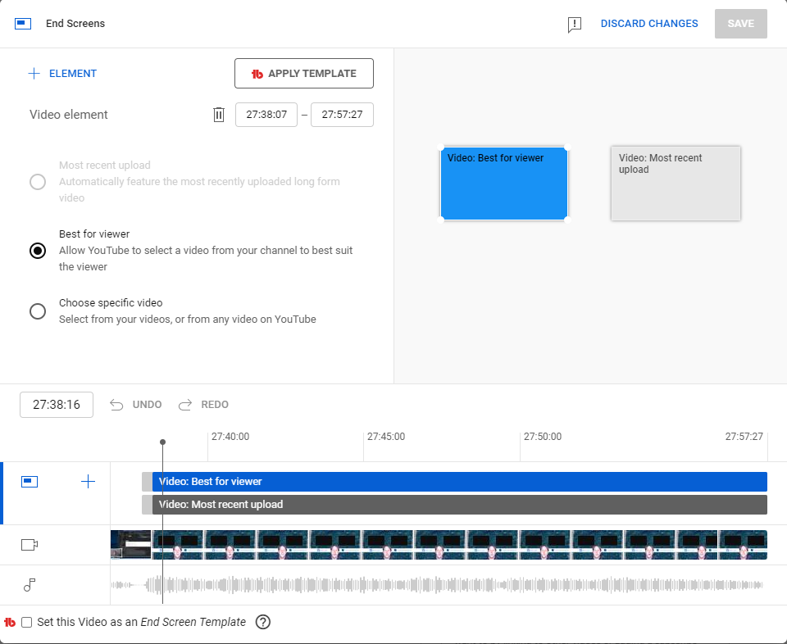
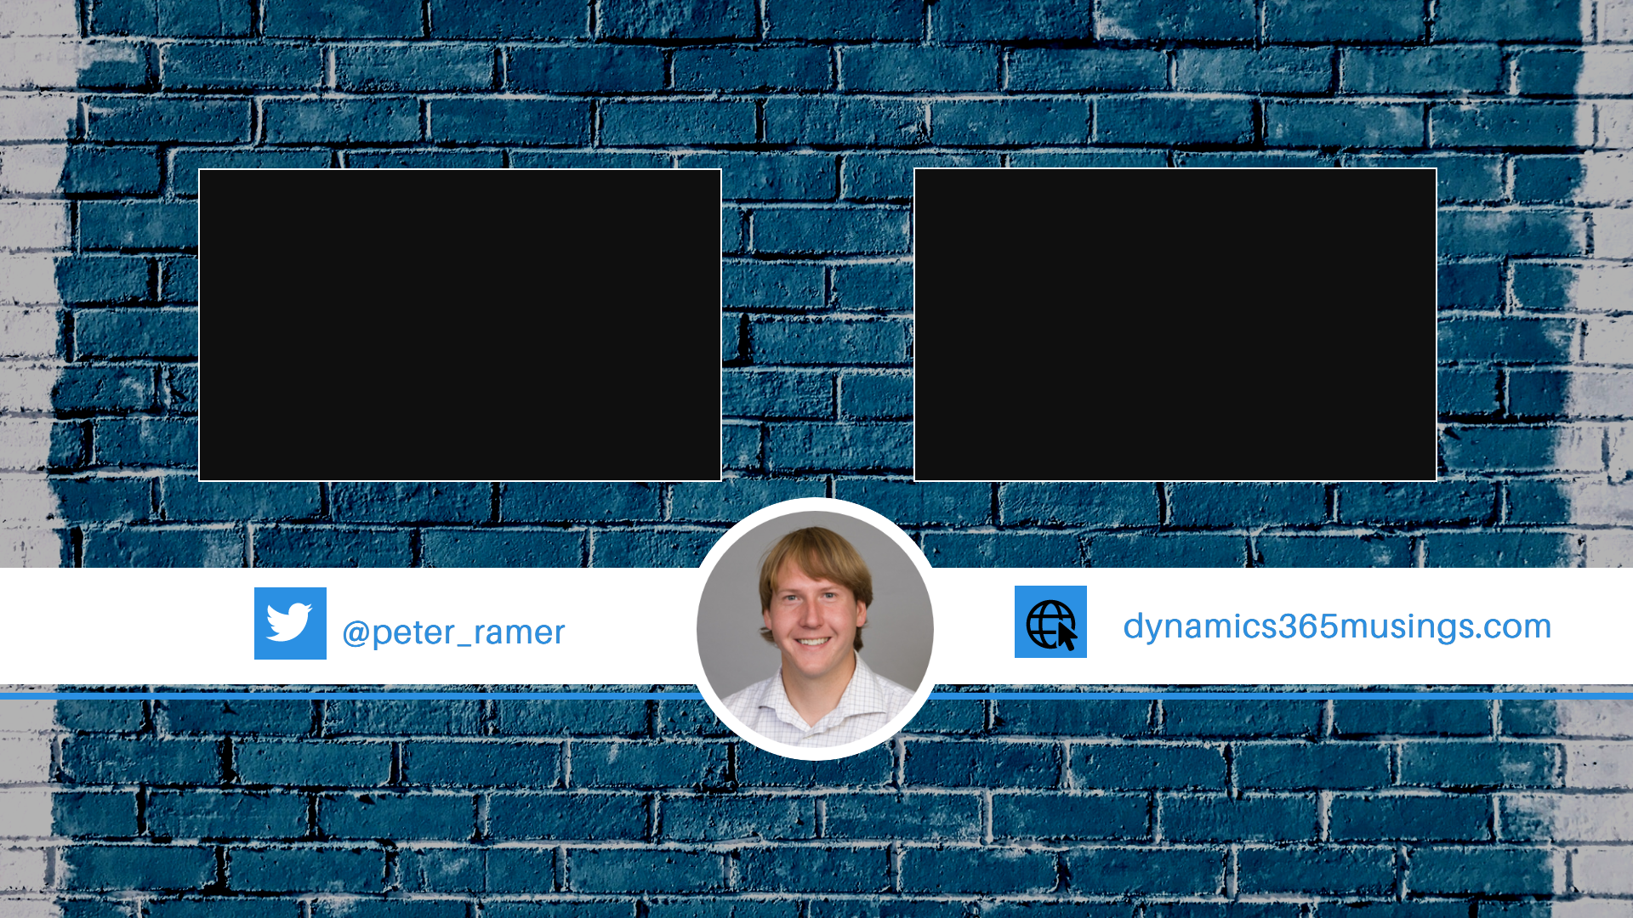
YouTube Studio End Screen
Click ‘End Screen’ and set the two thumbnails to show at the right spot in the timeline. (The last 22 seconds)
Build and end screen video using Canva.com

Slide 27
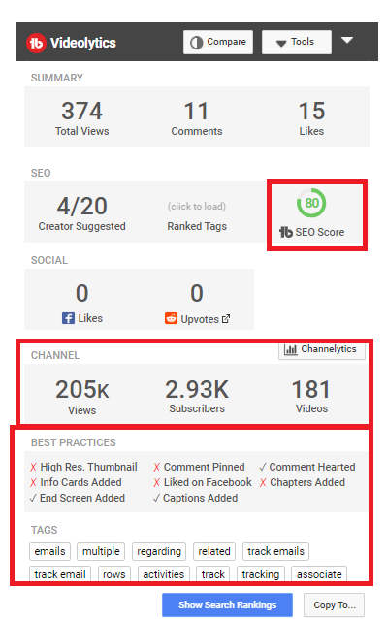
YouTube Studio Tips
YouTube Studio has Analytics too! Export a Report. Download App on your Phone.
Install TubeBuddy Chrome extension to see Views on any other video.

Slide 28
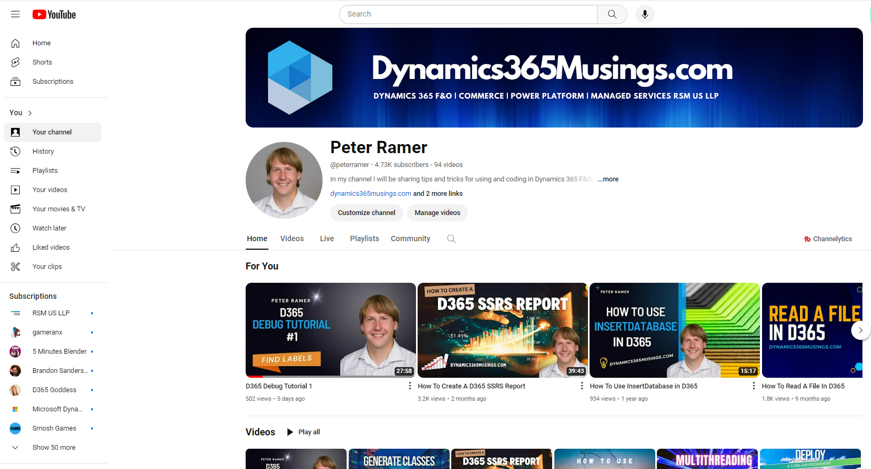
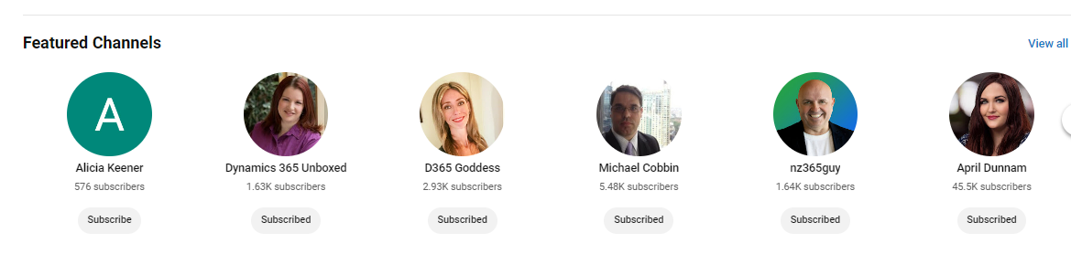
YouTube Studio Tips
Populate your YouTube channel page.
Add banner image.
Ask others to list you in their ‘featured channels.
Like and Love comments people make on your videos.

Slide 29
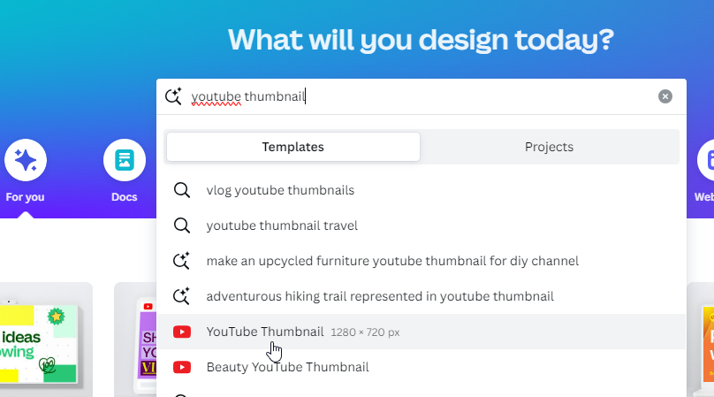
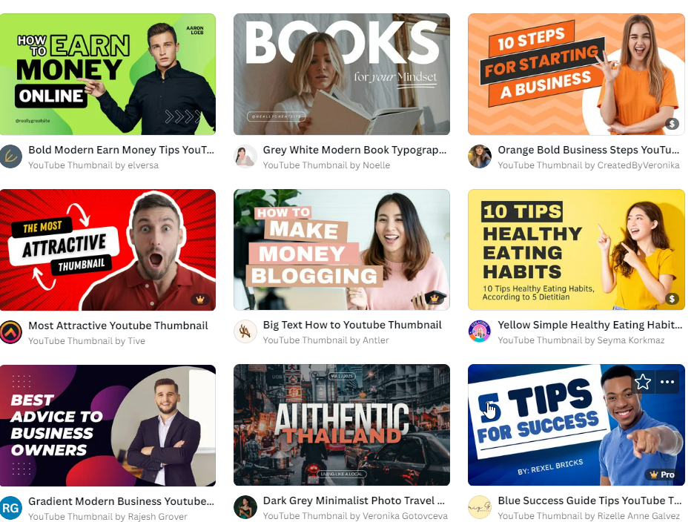
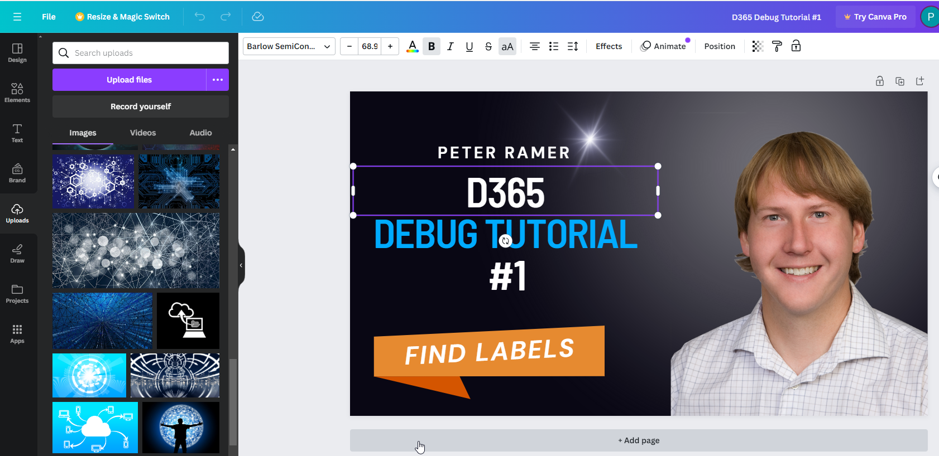
Create Thumbnail Image For Article And YouTube
Use Canva.com to find free templates, then modify them.
Add your picture
Replace the background. Use pixabay.com to find free images
Change the Text
Download the png
Use it as your featured image and YouTube thumbnail

Slide 30
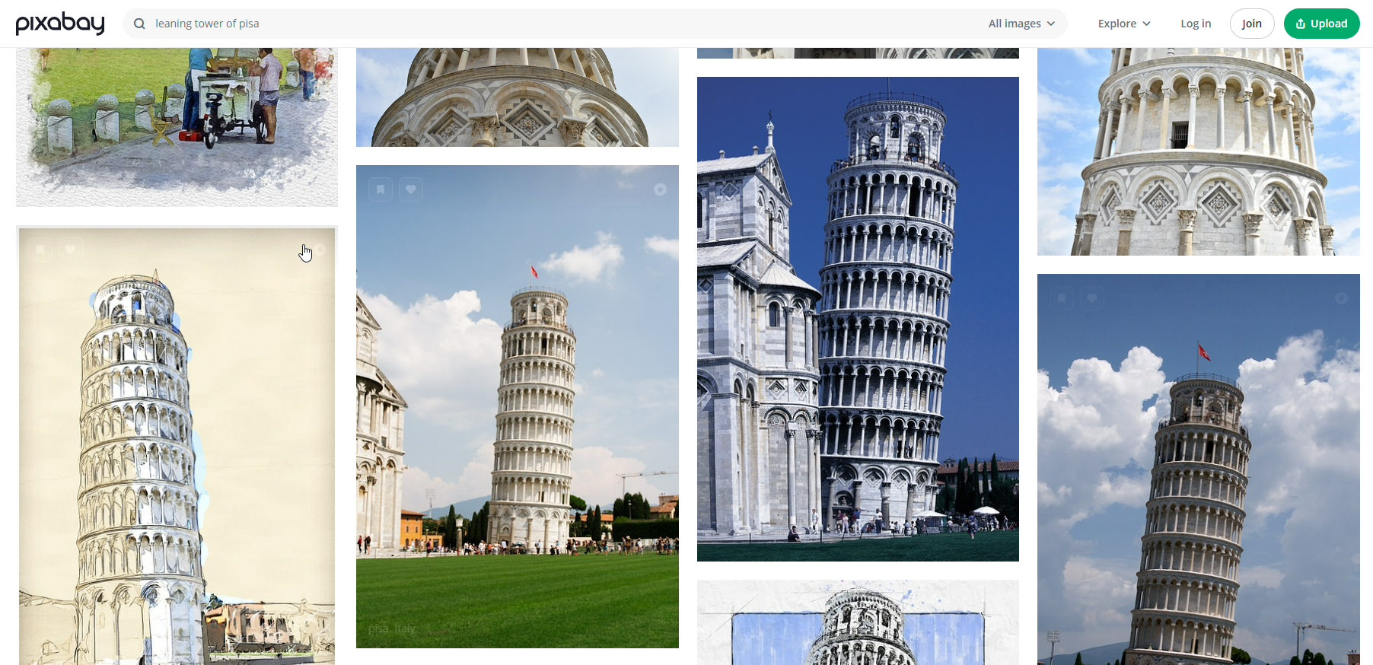
Find Royalty Free Images
Use pixabay.com and other sites to find free images.
Don’t forget that Copilot can also create images

Slide 31
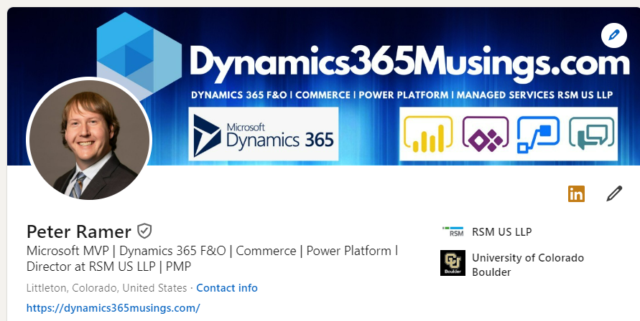
Make Your Profiles Stand Out
Fill out the information on your LinkedIn Profile, add background.
Change the profile ‘URL’ to just be your name, and not some numbers.
Get your connections above 2000.

Slide 32
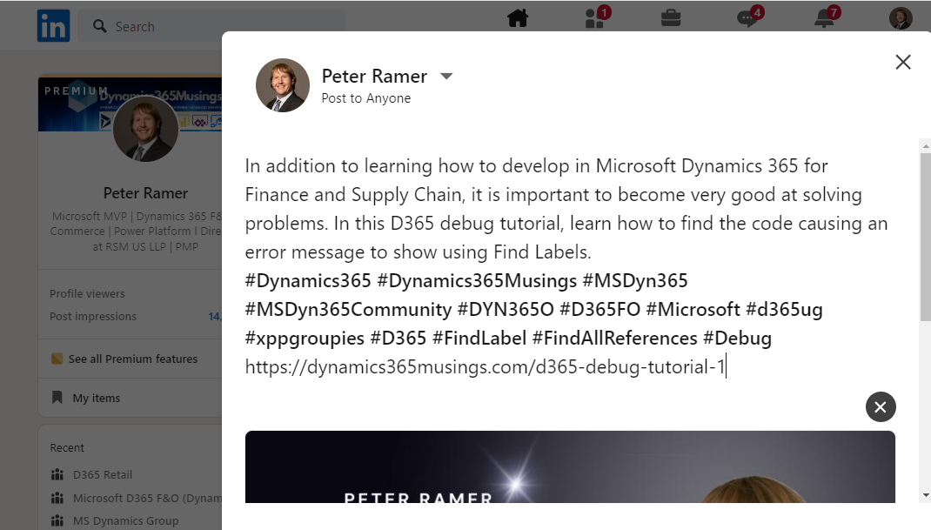
Post Article/Video on Social Media
Embed YouTube video in your Article post, after it goes live.
Post to LinkedIn, Facebook, X, TechSocial
The link will bring in the thumbnail.

Slide 33

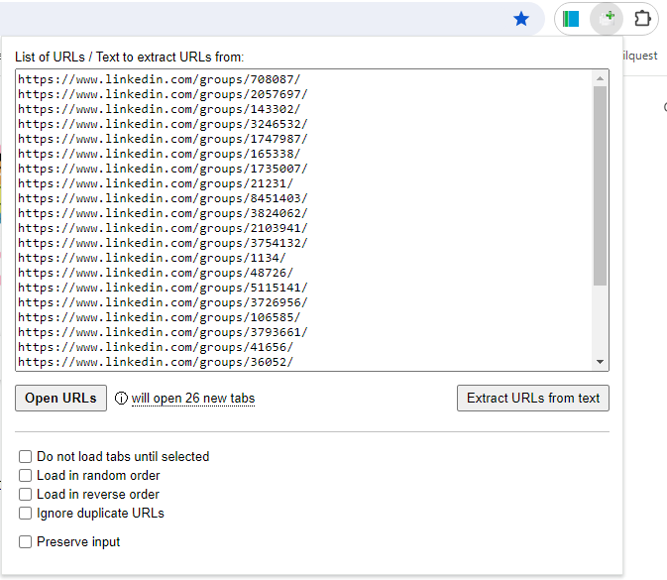
Re-Post In Multiple Groups
Use the Chrome Extension named ‘Open Multiple URLS’ to quickly open several LinkedIn and Facebook groups for reposting.
Post a link to the original post. (https://www.linkedin.com/posts/peter-ramer_d365-debug-tutorial-1-dynamics-365-musings-activity-7183106458937405440-TteP?utm_source=share&utm_medium=member_desktop)

Slide 34

Takeaways From Session
Don’t let ‘perfection’ hold you back
The book ‘The Creative Act’ points to “The Leaning Tower of Piza”: If it were perfect, it would not be famous
SEO is important
Work to increase the number of people who see your content through social media posts

Slide 35

Takeaways from Session
Content never sleeps
Let your user interactions help drive your content creation
Consistency is just as important as content
Release content on multiple platforms / content types
Be active on forums / LinkedIn groups
Have a ‘teacher’s mentality’

Slide 36
Questions?

Slide 37
Thank you for attending!
Peter Ramer
Email: peter.ramer@rsmus.com
Blog: https://dynamics365musings.com
YouTube: https://www.youtube.com/@peterramer LinkedIn: https://www.linkedin.com/in/peter-ramer/ Twitter/X: https://twitter.com/peter_ramer
Mastodon: https://techhub.social/@peter_ramer
Alex Meyer
Email: alex.itguy@outlook.com
Blog: http://d365foblog.com
YouTube: https://www.youtube.com/@AlexMeyerGeek
Security Course: http://d365fosecurity.com
Book: Security and Audit Field Manual: Dynamic 365 for Finance & Operations
LinkedIn: https://www.linkedin.com/in/alex-meyer-b6338837/

