Slide 2
D365FO Security and Licensing
Made ‘Easy’

Slide 3


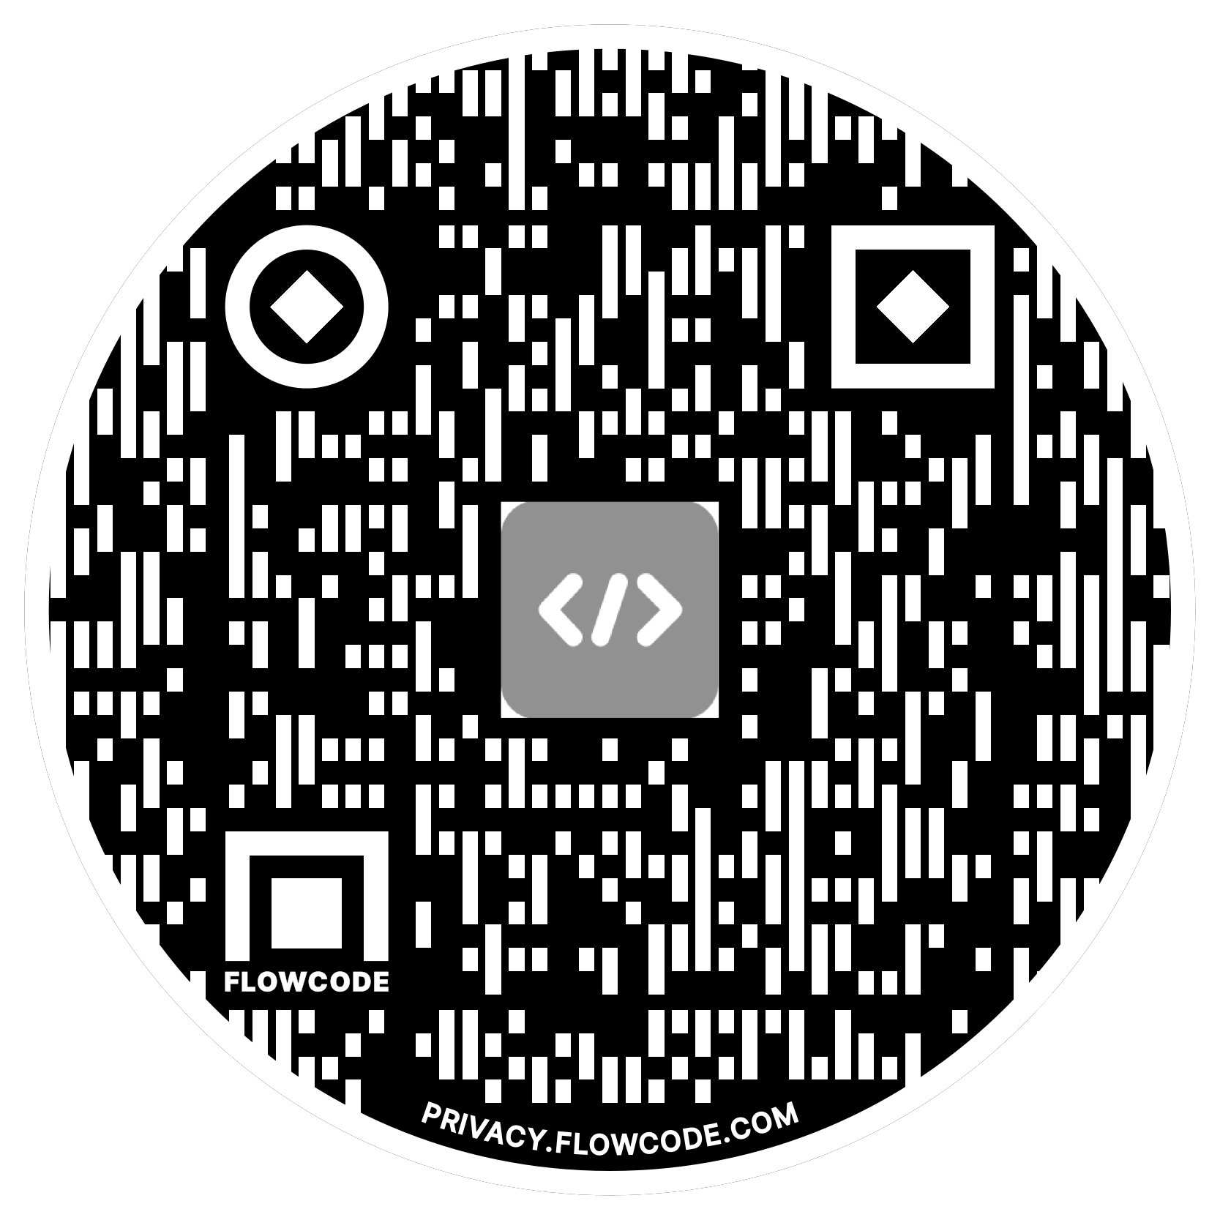
Alex Meyer
Contact Info:
Email: alex.itguy@outlook.com
Blog: http://d365foblog.com
Security Course: http://d365fosecurity.com
Book: Security and Audit Field Manual: Dynamic 365 for Finance & Operations
LinkedIn
Microsoft MVP Profile
Background:
Awarded Microsoft MVP in Business Applications in November 2019
Have worked with AX since 2013
Have worked with D365FO since 2016
Have spoken at Summit (US & Europe), Focus, and local chapters around AX/D365FO security and have done webinars around native controls in both versions
Senior Manager – Business Application Solutions
Contact Info:
Email: alex.itguy@outlook.com
Blog: http://d365foblog.com
Security Course: http://d365fosecurity.com
Book: Security and Audit Field Manual: Dynamic 365 for Finance & Operations
LinkedIn
Microsoft MVP Profile
Background:
Awarded Microsoft MVP in Business Applications in November 2019
Have worked with AX since 2013
Have worked with D365FO since 2016
Have spoken at Summit (US & Europe), Focus, and local chapters around AX/D365FO security and have done webinars around native controls in both versions

Slide 4
Agenda
Role Based Security
Security Layers
Securable Objects
Security Layer Hierarchy
Security Setup in UI & AOT
User Role Assignment & Setup
User Licensing
Tools to Help

Slide 5
Security Model Overview

Slide 6
Role Based Security
Users are assigned to one or more roles
Pessimistic security model
Hierarchy based security model
  Groups of securable objects are put within one security layer
  Security layers built on top of each other
Two main categories
  Security Layers
  Securable Objects

Slide 7
Security Layers
Roles
  Broadest security layer
  Represent a job function a user would perform
  Account, Account Payable, etc
  Made up of any number of sub-roles, duties, or privileges
Duties
  Middle security layer
  Represents a general task a user would perform
  Approve customer invoices, maintain budget plan, etc
  Made up of any number of privileges
Privileges
  Most granular security layer, where object assignment occurs
  Represents a very specific process a user would perform
  Add a BOM Line, Edit Customer, etc

Slide 8
Securable Objects
Menu Items
  Displays – linked to forms within D365FO, pages user goes to in UI
  Outputs – reports users can export
  Actions – actions users can perform (posting a PO/JE, cutting a check)
Tables
  Refers to SQL tables, where data is actually stored
Data Entities
  Combines multiple SQL tables to encapsulate a business concept (purchase orders, users, etc)
  Allows for CRUD operations from external services
  Does not require X++ knowledge to utilize / consume
Service Operations
  Externally facing API endpoints that can be used by external services
  Requires X++ knowledge to utilize / consume

Slide 9
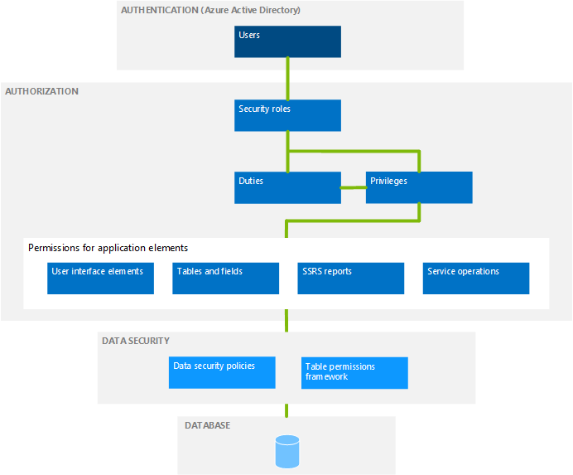
Hierarchy Based Security Model

Slide 10
Role Setup & Assignment
Template roles, duties, and privileges are delivered out of the box
Roles, duties, and privileges are system wide (not per company/legal entity)
User role assignments can be restricted by legal entity
  By default, when a user is assigned a role it is assigned to all companies/legal entities in the environment
  You can restrict this by explicitly granting a legal entity to the user role assignment
  Once one company/legal entity is assigned to a user role assignment, a user only has that role access in the legal entity(ies) they assign to it
  SecurityUserRole & OMUserRoleOrganization (SecurityUserRoleCondition) tables

Slide 11
Setting Up Security from User Interface

Slide 12
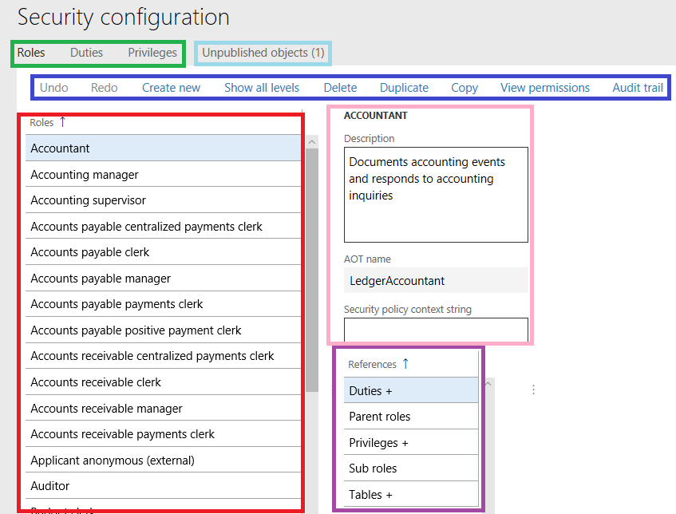
Setting Up from the UI
System Administration ->Security ->Security Configuration
Notes:
Green box – Allows you to switch between roles, duties, and privileges
Blue box – Has a number of different options for performing against the currently selected role/duty/privilege
Undo/Redo – undo/redo customizations applied to this security layer
Create new – create a new security layer
Show all levels – by default D365FO will only show 4 levels of fly-outs in the navigation, this option will force it to show a horizontal scroll bar to fit all fly-out levels
Delete – remove the current security layer
Duplicate – create a clone of the currently selected security layer, allows you to give it a new name
Copy – copies the current security
View Permissions – shows an entire hierarchy of security for the currently selected security layer
Audit Trail – shows the history of all changes made to an object either from user interface or through AOT
Red box – listing of all current objects in selected security layer
Pink box – shows details about currently selected security layer object including Description and AOT name
Purple box – shows all of objects that are either assigned to this security layer or that this security layer is assigned to, the plus icon (+) designates that there are objects already there. So in this case this role has duties, privileges, and tables assigned to it but does not have any sub roles or parent roles.
Light blue – all changes made in the user interface must be ‘published’ before they go live, this object lists all of the changes that are not currently published yet

Slide 13
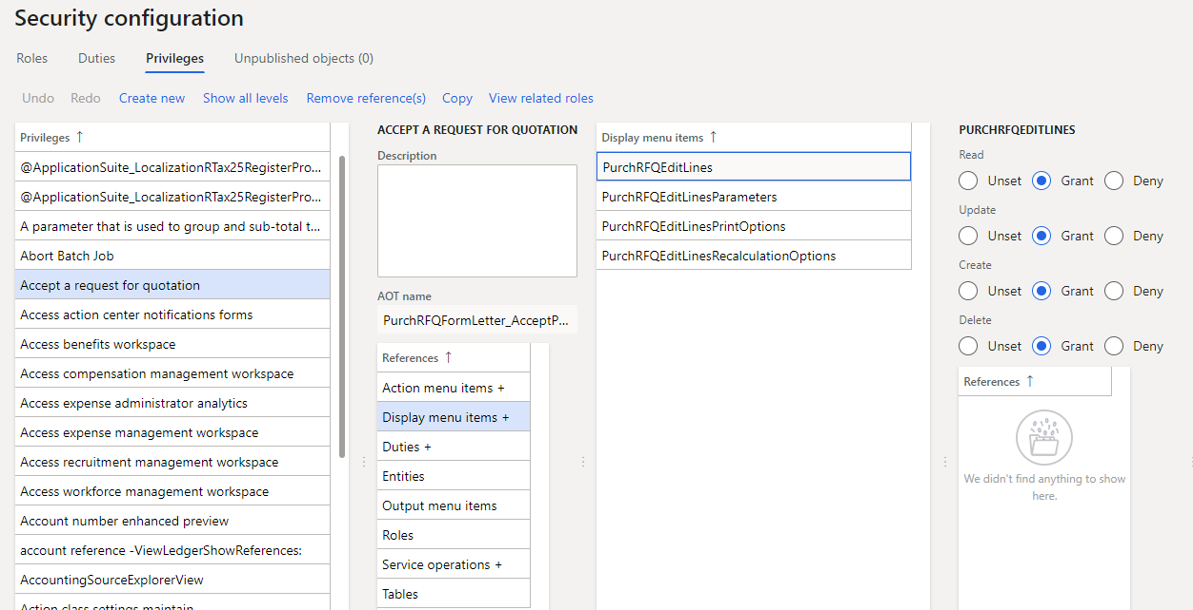
UI – Security Object Access
Object assignment occurs mostly in the privileges area
Find the privilege you would like to modify, select the object type, the finally the object itself to modify its access

Slide 14
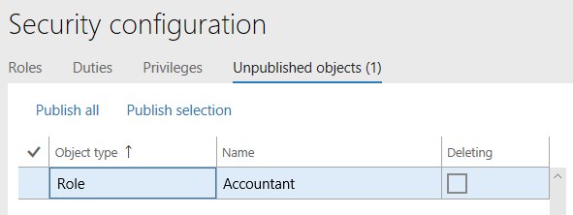
Unpublished Objects
When making a security change, is not immediately active
Goes to an ‘Unpublished Objects’ area for review before publishing

Slide 15
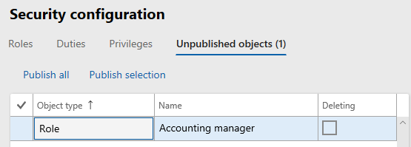
Where are Security Changes Stored?
Security changes made in UI are stored as data in the database
Notes:
If you create/customize a role, duty, or privilege in the UI, a ‘security delta’ is created in database
Roles -> SecurityRoleCustomizeDiskObject
Duties -> SecurityDutyCustomizeDiskObject
Privileges -> SecurityPrivilegeCustomizeDiskObject
Customizations done in the UI are not ‘development artifacts’ (code) in that they do not exist in the design time
- This is a big deal because if you want to move roles between environments (dev/test -> prod) you need your security to be in the design time(code) to be able to create a deployable package to move
- Best advice, is to create all role, duties, and privileges in your design time environment (Visual Studio) so all of your security changes are captured and can be applied to other environments.

Slide 16
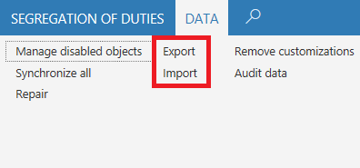
How to Migrate Security Changes?
Security changes can be exported/imported via an XML file
Found in System Administration -> Security Configuration -> Data tab -> Import/Export

Slide 17
Setting Up Security from AOT

Slide 18
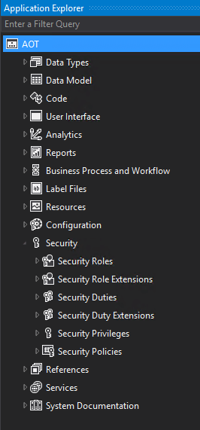
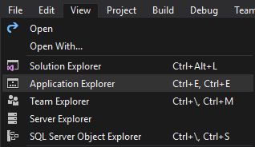
How to Access AOT
Can be found in development environment
by RDP-ing to it (if hosted in Azure) or a local VM
  Will have modified version of Visual Studio
  Go to View -> Application Explorer

Slide 19
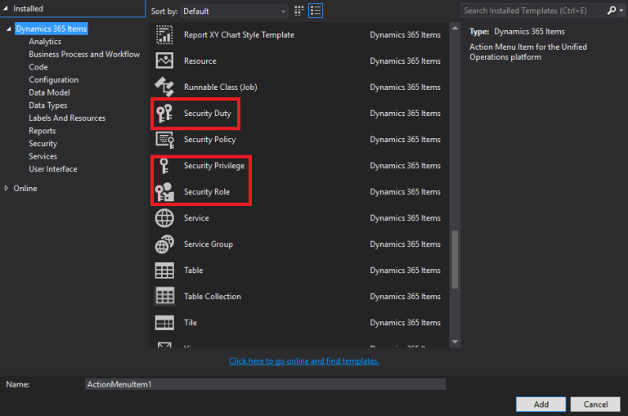
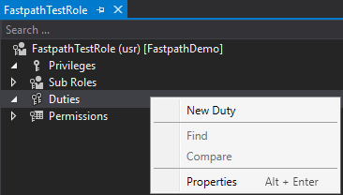
AOT – Create Security
Creating a role/duty/privilege

Slide 20
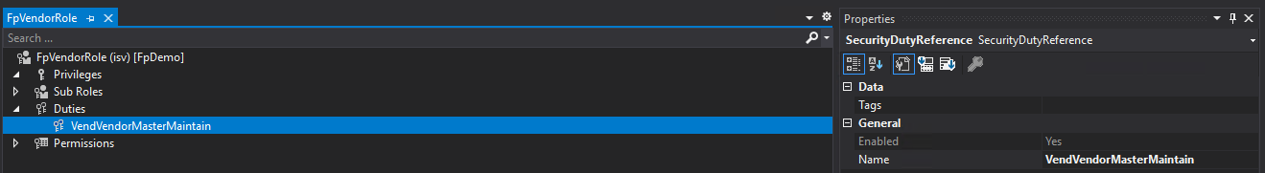
AOT – Associate Security Layers
Associating duty -> role

Slide 21
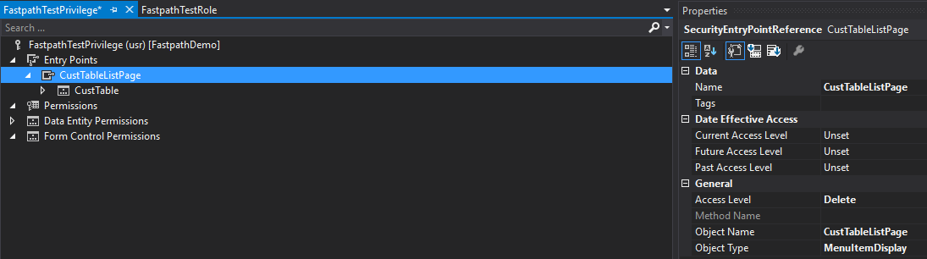
AOT – Object Access
At privilege level, Properties window will change for object access

Slide 22
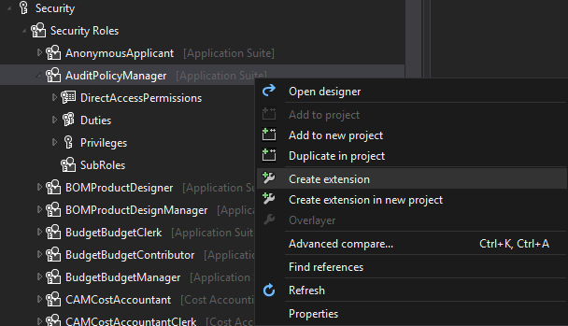
Overlayer vs Extension
You are unable to directly modify out of box security (overlayering) due to Microsoft’s locking of models
Instead, you must create an ‘extension’

Slide 23
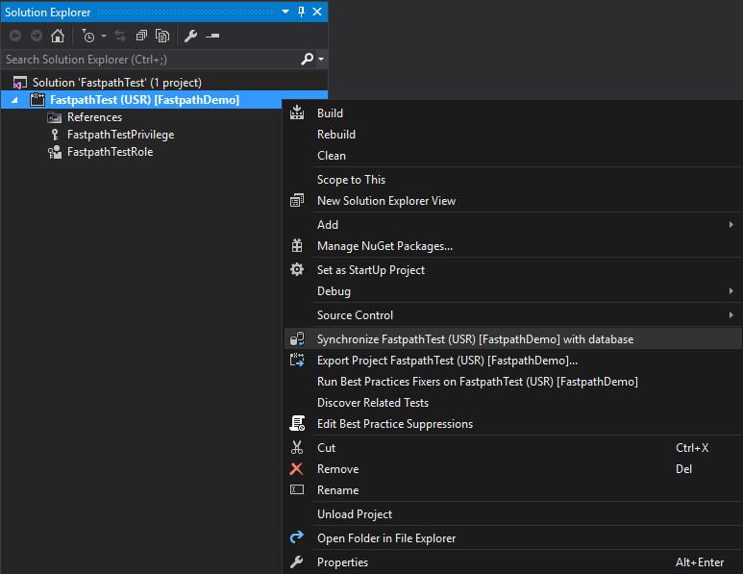
AOT – Synchronize Database
Changes made to security in AOT do not go live immediately
You must ‘synchronize’ the changes at the project level

Slide 24
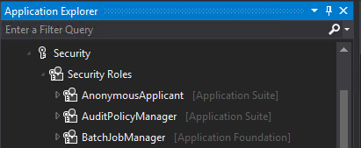
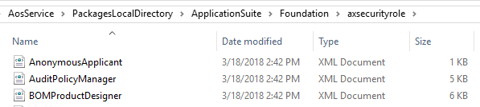
Where are Security Changes Stored?
Stored as ‘development artifacts’
XML files

Slide 25
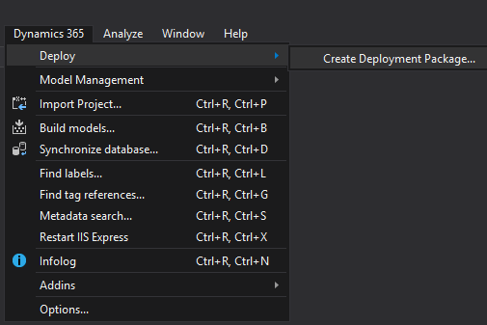
Security Code Build
Best practice is to use ALM model of the build server and code promotion
Since security changes in AOT are code artifacts you can build a deployable package with the changes and move these to another environment

Slide 26
D365FO User Licensing

Slide 27

Security
Licensing

Slide 28
User Licensing in D365FO
Based on what a user is assigned, not what a user consumes / utilizes
Three different license types:
  Operations (Finance, Supply Chain Management, Retail, Talent)
  Activity
  Team Member
Two different licensing methodologies currently used
  Entry Point Based Licensing
  Privilege Based Licensing

Slide 29
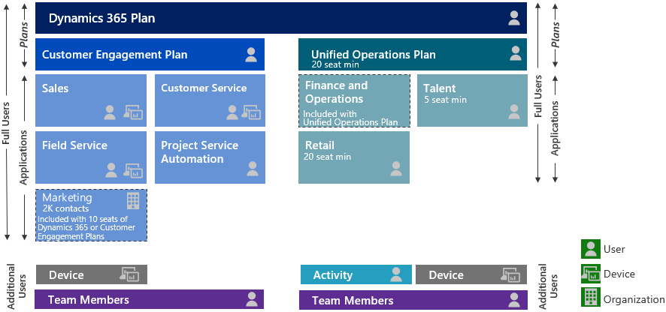
Pre-October 2019 Licensing Model

Slide 30
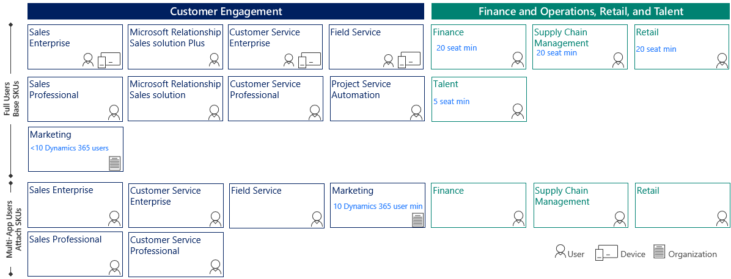
Post-October 2019 Licensing Model

Slide 31
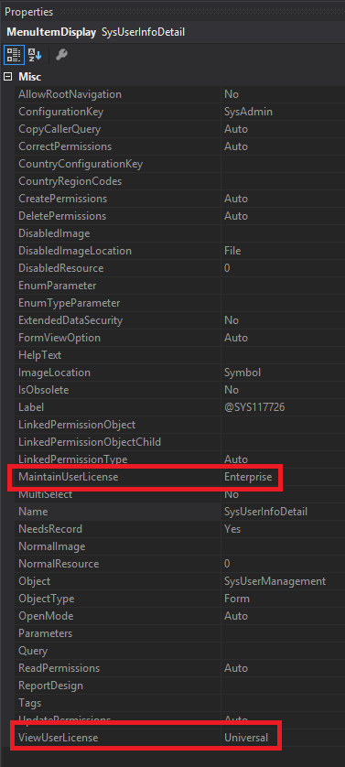
Entry Point Based Licensing
Based on access to entry points (menu items etc)
Each entry point has two parameters
  Maintain User License – used if access is Created, Update, Delete
  View User License – used if access if Read
It only takes one access at a higher license level for the user/role to require that higher license level

Slide 32
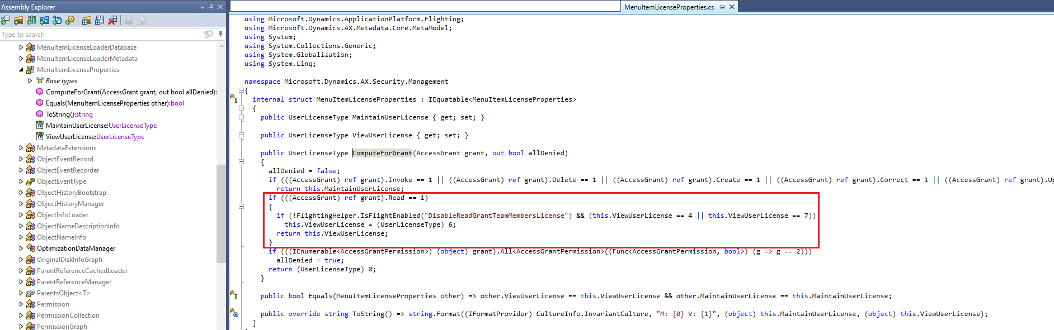
Licensing Change in 10.0.34
In 10.0.34 new feature flag introduced
  DisableReadGrantTeamMemberLicense
Forces all Read logic to require ‘Team Member’ license
Notes:
https://alexdmeyer.com/2023/11/06/hidden-feature-flag-changing-how-user-licensing-is-performed-in-d365fo/

Slide 33
Privilege Based Licensing
Categorizes ‘Operations’ license into SKUs:
  Finance
  Supply Chain Management
  Retail
  Project Operations
Based on which privileges a user is assigned

Slide 34
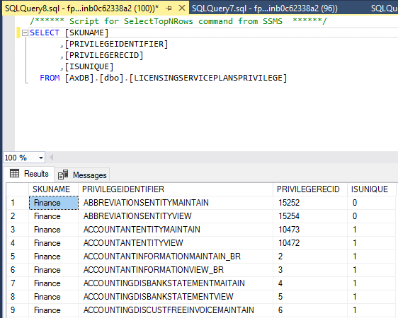
Privilege Based Licensing
Microsoft has designated certain privileges to require a particular license type
Associations can be found in the LicensingServicePlansPrivilege table
If user is assigned a privilege with IsUnique = 1 then that license is required
  If multiple licenses are required will follow a base/attach model
If IsUnique = 0 then any license listed will satisfy license requirement

Slide 35
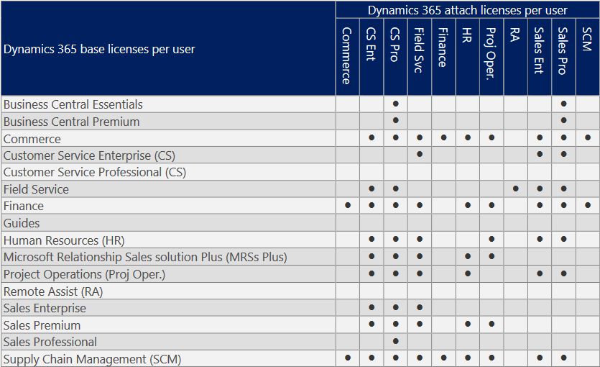
Base / Attach Licensing Combinations

Slide 36
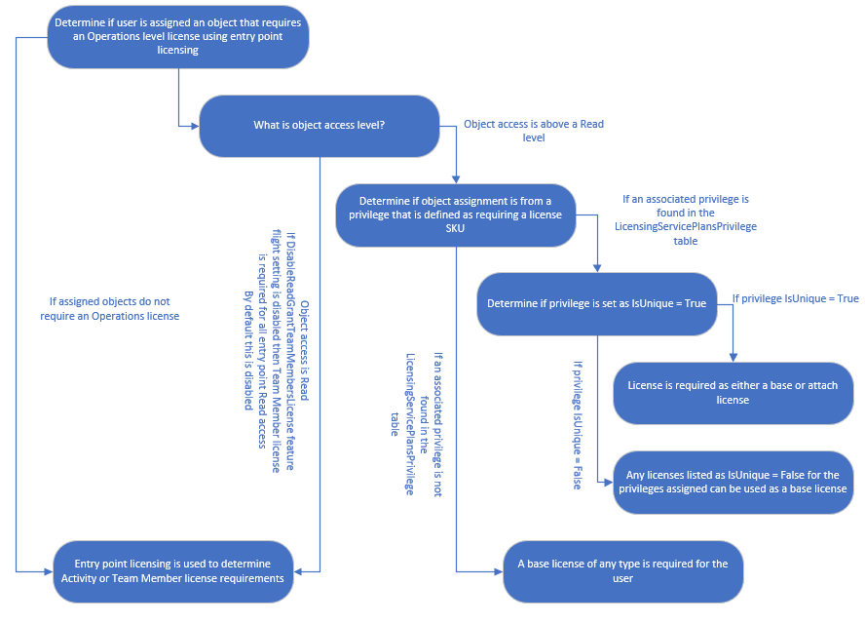
User Licensing Methodology

Slide 37
License Reporting

Slide 38
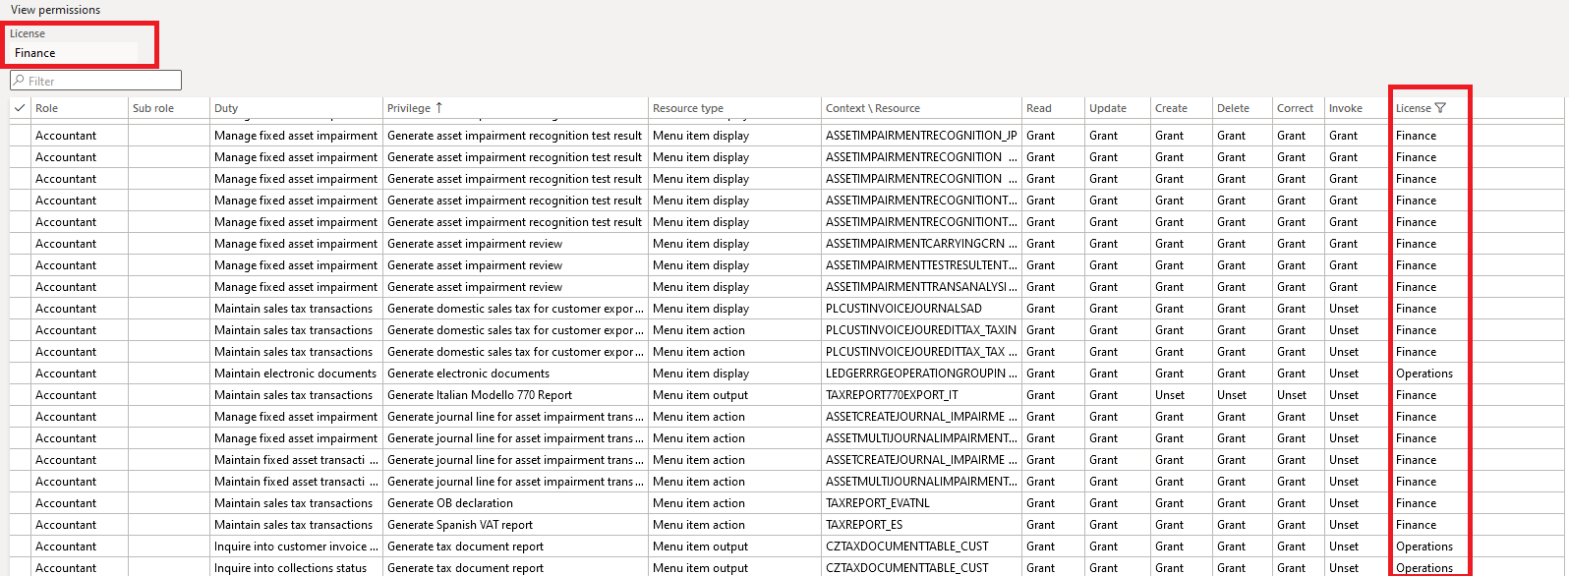
View Permissions Report
Notes:
System Administration -> Security -> Security Configuration -> Go to a Role/Duty/Privilege -> View Permissions
An entry marked as ‘Operations’ requires the user to be assigned any base license

Slide 39
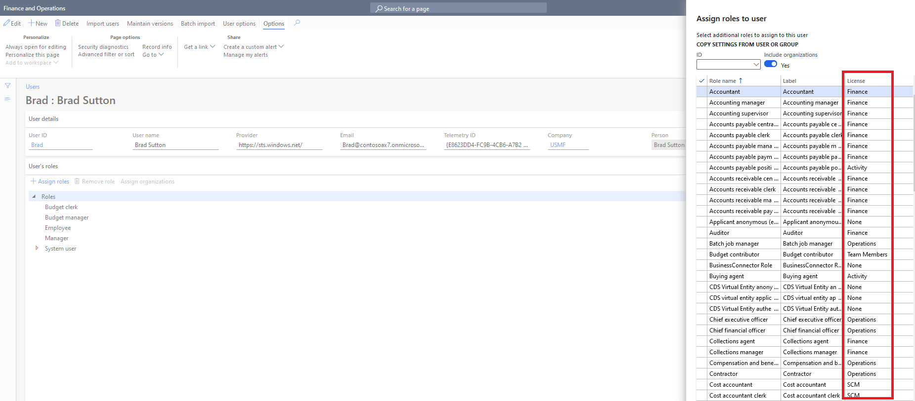
Licenses During User Role Assignment
Notes:
System Administration -> Users -> Users -> Select a User -> Assign Roles
A role marked as ‘Operations’ requires the user to be assigned any base license

Slide 40
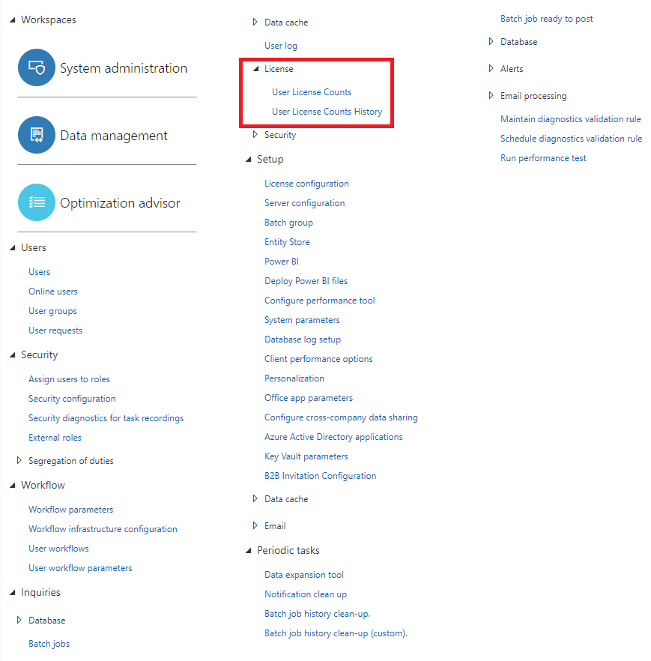
User License Counts Reports

Slide 41
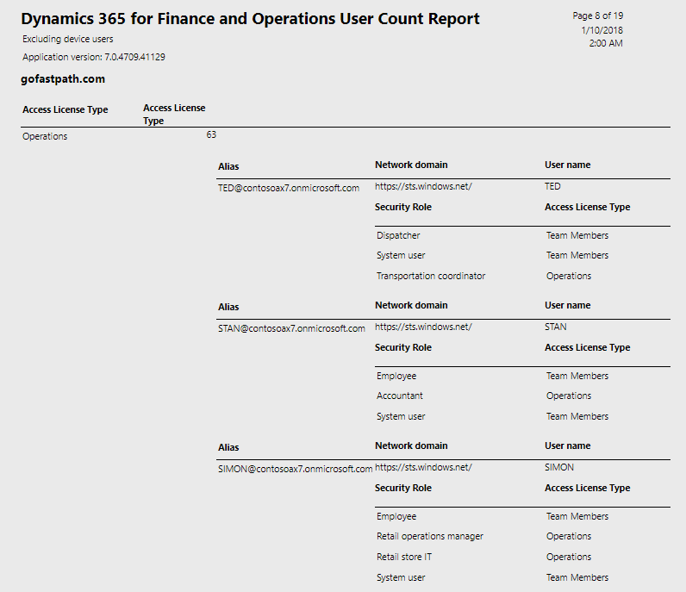
User License Counts Report
Notes:
Both the User License Counts and User License Counts History show the same data:
User
Role
License
The User License Counts report will show the licenses consumed on a particular day, the history report will allow you to see the historical consumption of licenses

Slide 42
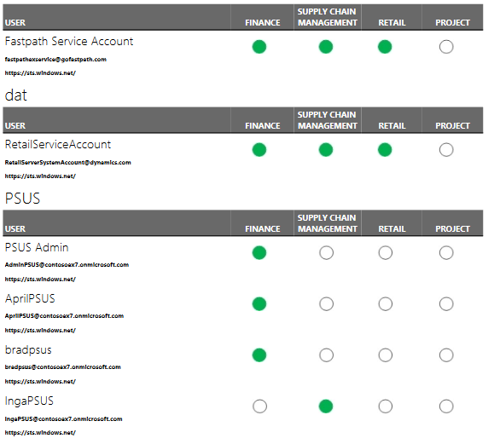
User License Estimator Report
Notes:
System Administration -> Inquiries -> License Reports -> User License Estimator

Slide 43
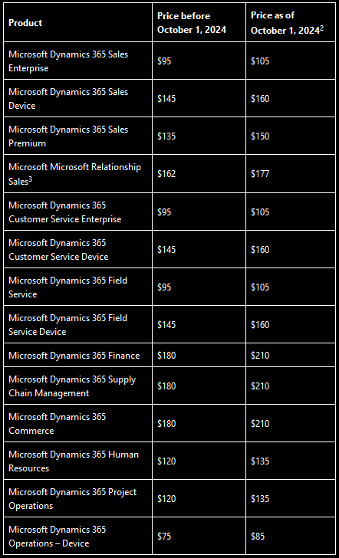
Licensing Price Update
Takes effect October 1st 2024
Does not impact Activity, Team Member
Does not impact license minimums
Notes:
https://alexdmeyer.com/2024/04/15/microsoft-updates-dynamics-365-license-pricing-to-take-effect-october-1st-2024/

Slide 44
Tools / Services to Help

Slide 45
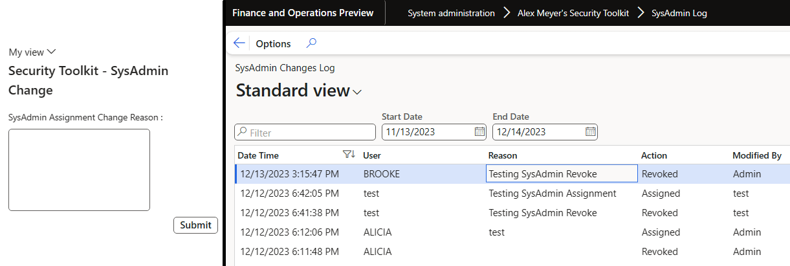
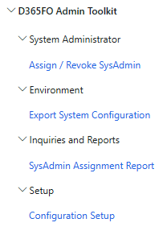
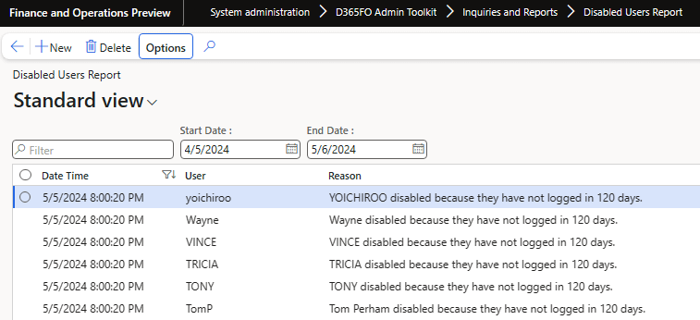
Free Tools – D365FO Admin Toolkit
More info here!
Features include:
  User self-service assignment / revoking of SysAdmin
  SysAdmin assignment logging
  Export System Configuration
  Auto-disable users

Slide 46



Security and Licensing Help
ISVs
  Fastpath / Delinea
  XPLUS
Consulting
  Protiviti
    D365FO Template Roles
    Microsoft Consulting Solutions
    Security Risk Analysis
    Security Implementations / Redesigns
    User License Analysis
    D365FO Implementation Help

Slide 47
Resources

Slide 48
Resources
D365FO Role-based Security
Introduction to Microsoft Dynamics 365 licensing
Security Roles & Licensing Whitepaper‎
Determining User Licenses in D365FO
Privilege License Excel File
Hidden Feature Flag Changing How User Licensing is Performed in D365FO
Setting Up Security in Dynamics 365 for Finance and Operations – Part I – From the User Interface
Setting Up Security in Dynamics 365 for Finance and Operations – Part II – From the AOT
Blog Posts:
  Current State of D365FO User License December 2020
  Current State of D365FO User Licensing October 2020
  Current State of D365FO User Licensing August 2020
  Current State of D365FO User Licensing July 2020
  Current State of D365FO User Licensing May 2020
  October 2019 User License Update to D365FO
  Current State of User Licensing in D365FO PU31

Slide 49
Thank You / Questions?
Contact Info:
Email: alex.itguy@outlook.com
Blog: http://d365foblog.com
Security Course: http://d365fosecurity.com
Book: Security and Audit Field Manual: Dynamic 365 for Finance & Operations
LinkedIn
Microsoft MVP Profile

Slide 50

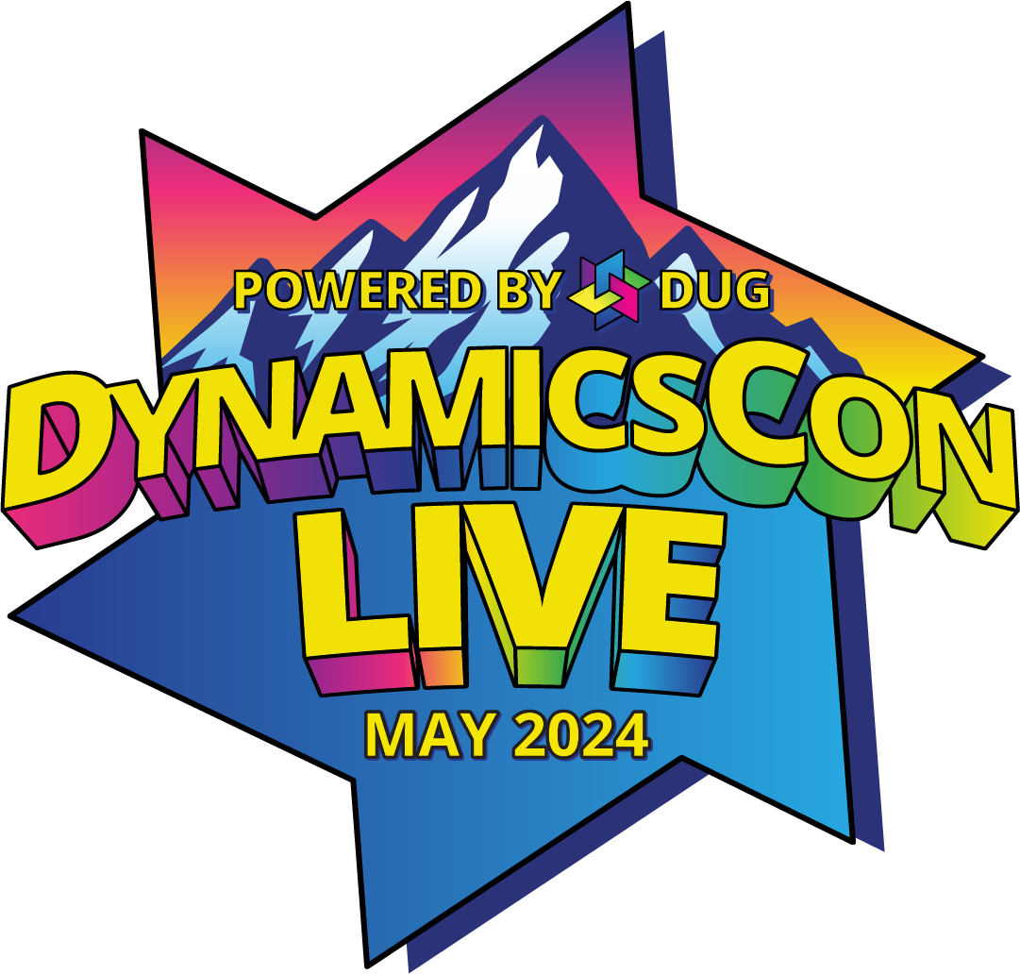
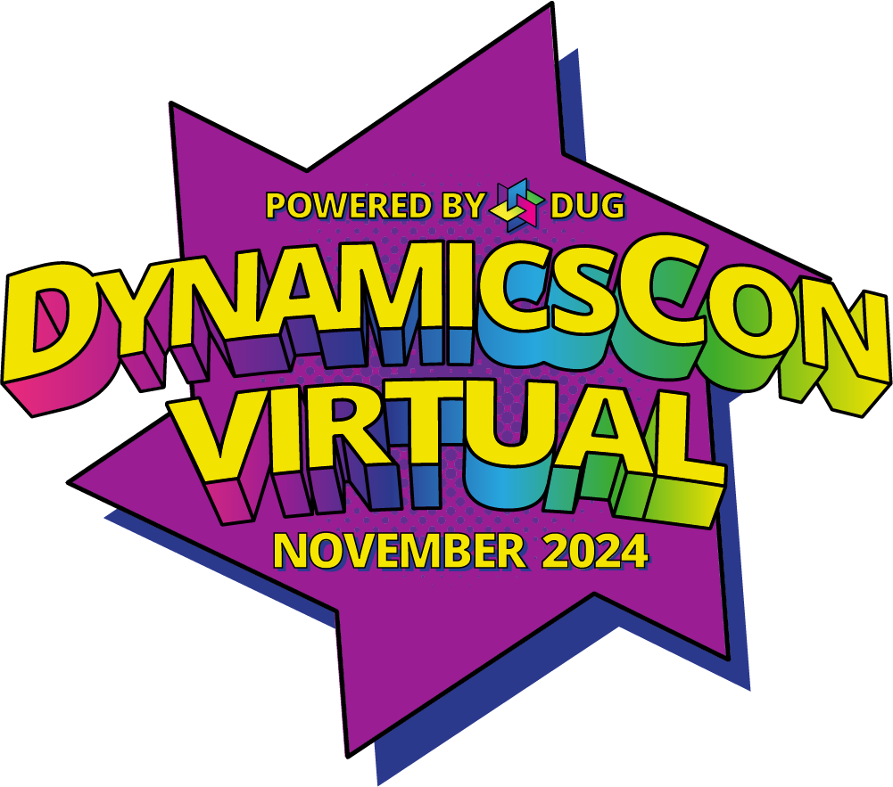
CONTINUE TO CONNECT
dynamicsusergroup.com
live.dynamicscon.com
dynamicscon.com

