Slide 1

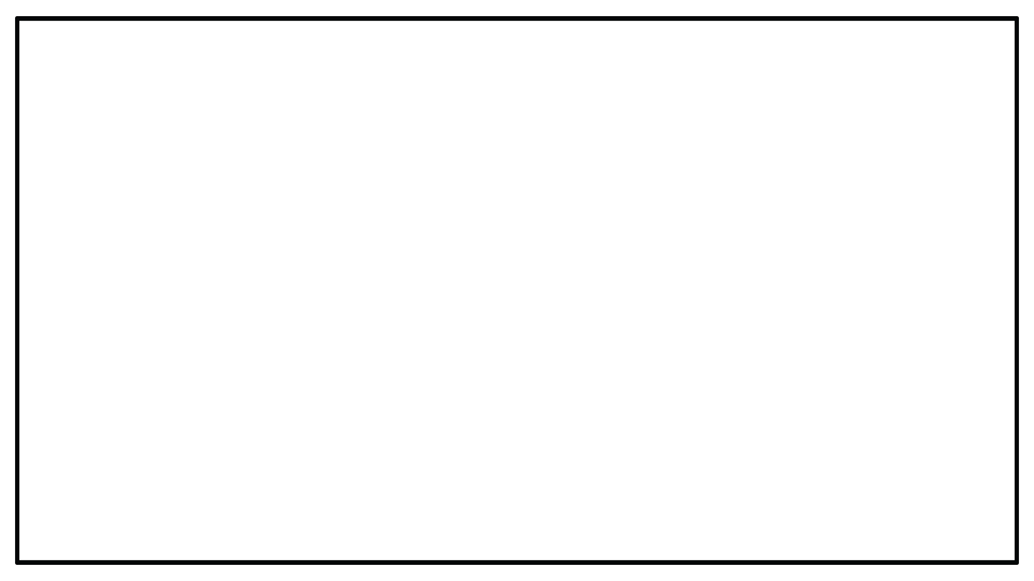




DYNAMICSCON PRESENTATION
10-11 Nov 2021
DynamicsCon.com

Slide 2
Successfully Navigate D365FO Security and Licensing
Alex Meyer - Fastpath

Slide 3

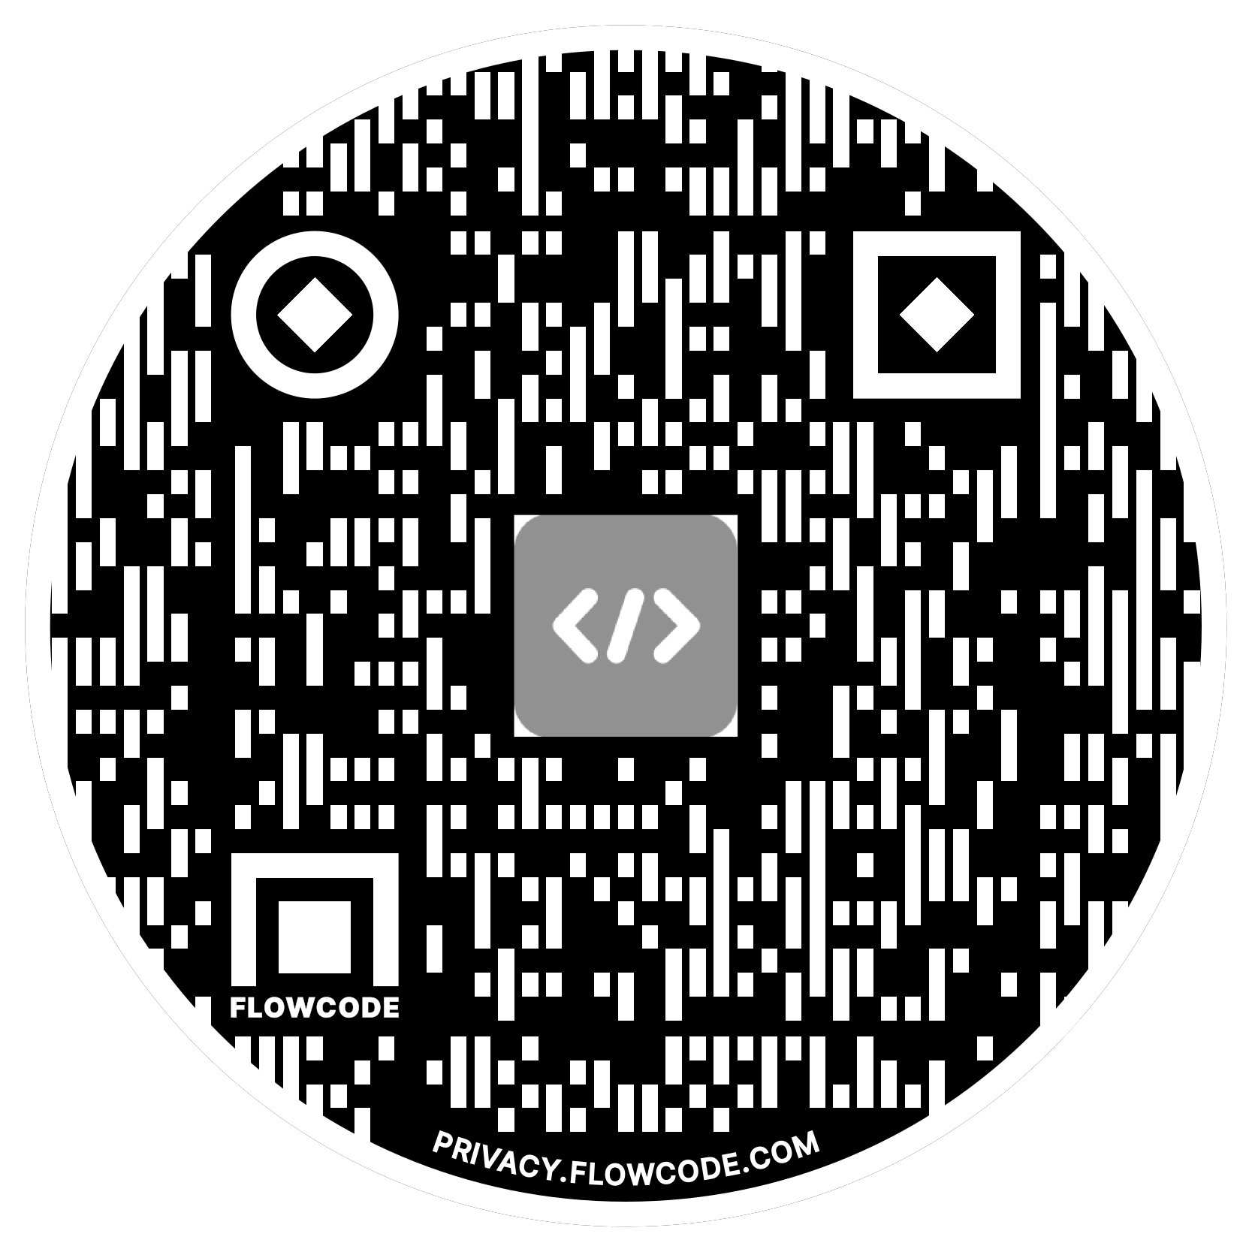
Alex Meyer
Director of Microsoft Cloud Development
Fastpath
Email: meyer@gofastpath.com
Blog: http://msftcloudblogs.com
GitHub: https://github.com/ameyer505
Twitter: https://twitter.com/alexmeyer_ITGuy
D365FO Security Course: http://d365fosecurity.com
Worked in AX/D365FO for 8+ years, specifically
around security, audit, and compliance functionality and reporting

Slide 4
Agenda
Security Model
Security Features
Security Design & Management
User Licensing
(Free) Resources

Slide 5
D365FO Security Model

Slide 6
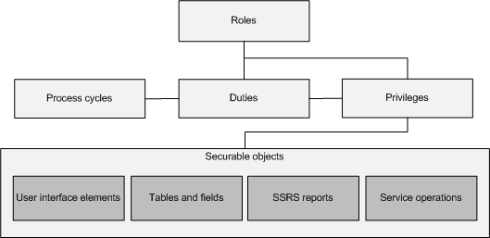
D365FO Security Model
Role based (users assigned one or more roles)
Pessimistic security model
Security Layers
  Role
  Duty
  Privilege
Securable Objects
  Menu Items
  Tables
  Data Entities
  Service Operations

Slide 7
D365FO Security Layers
Roles
  Broadest security layer
  Represent a job function a user would perform
  Account, Account Payable, etc
  Made up of any number of sub-roles, duties, or privileges
Duties
  Middle security layer
  Represents a general task a user would perform
  Approve customer invoices, maintain budget plan, etc
  Made up of any number of privileges
Privileges
  Most granular security layer, where object assignment occurs
  Represents a very specific process a user would perform
  Add a BOM Line, Edit Customer, etc

Slide 8
D365FO Securable Objects
Menu Items
  Displays – linked to forms within D365FO, pages user goes to in UI
  Outputs – reports users can export
  Actions – actions users can perform (posting a PO/JE, cutting a check)
Tables
  Refers to SQL tables, where data is actually stored
Data Entities
  Combines multiple SQL tables to encapsulate a business concept (purchase orders, users, etc)
  Allows for CRUD operations from external services
  Does not require X++ knowledge to create
Service Operations
  Externally facing API endpoints that can be used by external services
  Requires X++ knowledge to create

Slide 9
D365FO Security Features

Slide 10
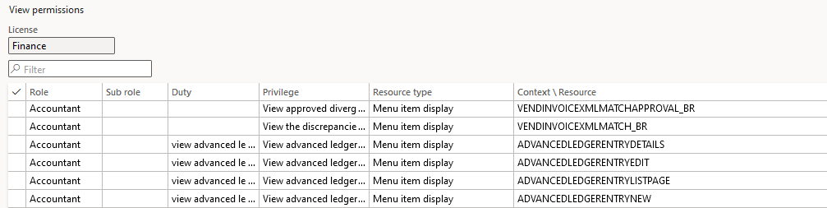
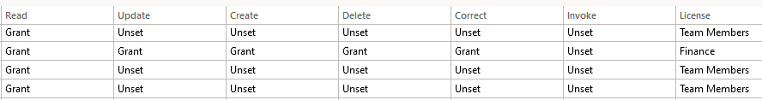
Security Reporting – User Interface
System Administration -> Security Configuration -> View Permissions

Slide 11
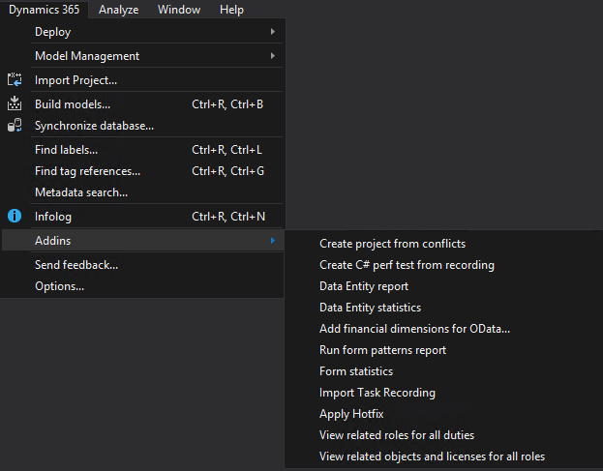
Security Reporting - AOT
  AOT -> Visual Studio -> Dynamics 365 -> Addins ->
  View related objects and licenses for all roles
Notes:
Exports a report with two tabs:
License Information – shows license tied to all roles, duties, and privileges in environment
View Related Objects – shows all role -> duty -> privilege -> object name and type -> object access and license (if applicable) in environment (very large report, 200k+ rows)

Slide 12
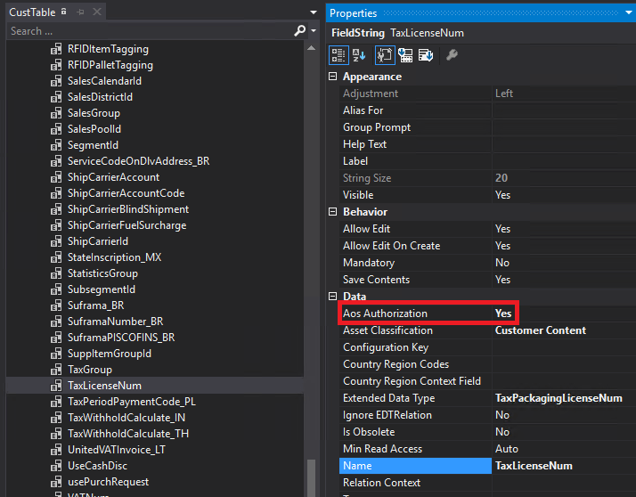
Table Permission Framework (TPF)
Can be applied to either:
  Table
  Table Field
Additional layer of security
Normally used for high business impact data
  SSN, Credit Card Numbers, etc
User must be assigned explicit access
  Menu item access alone will not be enough
Notes:
https://alexdmeyer.com/2019/01/24/table-permission-framework-in-d365fo/
https://alexdmeyer.com/2021/10/27/using-tpf-to-protect-sensitive-data-in-grid-columns-for-d365fo/

Slide 13
Extensible Data Security (XDS)
Allows for the securing of data in shared tables such that users have access to only the part of the table that is allowed by the enforced policy.
Basically is like placing a WHERE or ON statement to the SQL that gets ran during Selects, Inserts, Updates, and Deletes
Example XDS policies
    Secure sales order by customer group
    Secure customers by salesperson geographical region
    Secure assets and checks by vendor
Notes:
Allows for the securing of data in shared tables such that users have access to only the part of the table that is allowed by the enforced policy.
Example XDS policy: secure all sales orders based on customer group
Constrained table – table that is being filtered based on policy query
In example, Sales Order table would be the constrained table
Primary table – used to secure content of related constrained table
In example, Customer table would be the primary table
Policy query – used to secure the constrained tables in an XDS policy. This query will return the data from a primary table that is used to secure the contents of the constrained table
Context – piece of information that controls whether a give policy is applicable or not. If context is not set, then the policy if not enforced, even if it is enabled.
Context comes in two types:
Role Context – enables policy application based on the role(s) the user is assigned
Application Context – enables policy application based on information set by the application
Developing an extensible data security policy
Model the query on the primary table
Create the policy
Add the constrained table(s) and view(s)
Set the context
Note: Before beginning, it is critical to know the relationship between the constrained and primary tables, relative size of each table, as well as the indexes on each. All of these will impact the future performance of the application once the XDS policy is enabled.
https://kaya-consulting.com/extensible-data-security-examples/
https://alexdmeyer.com/2019/02/20/extensible-data-security-xds-framework-in-d365fo/

Slide 14
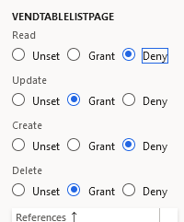
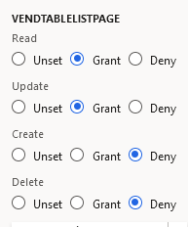
Deny Permission
Explicit Deny
  Overrides any grants to object
Can only deny entire object from AOT
In UI, be sure to keep valid hierarchy
Don’t Do This
Like This Instead
Notes:
https://alexdmeyer.com/2019/09/03/how-to-utilize-the-deny-permission-in-dynamics-365-for-finance-operations/

Slide 15
Environment Differences Impact on Security
AX 2012
  Design time and runtime
  live in same environment
D365FO
  Design time is on development VM,
  runtime is on web app in Azure
Security Development Tool
Design Time
AOT/MorphX
Runtime
AOS/AX Application
Security Development Tool
Design Time
AOT/Visual Studio
Runtime
AOS/IIS
Notes:
Design Time: Where code is developed and customized
Runtime: Where application is actually ran
D365FO
Design Time: Visual Studio environment
Runtime: Azure

Slide 16
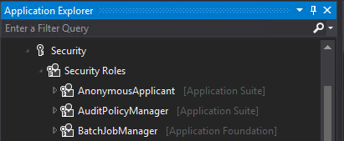
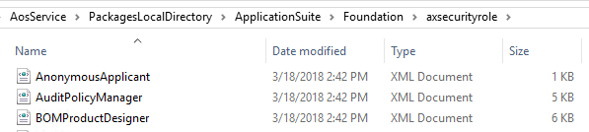
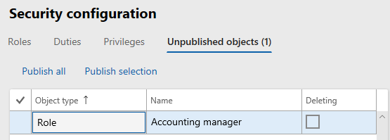
Environment Differences Impact on Security
AOT
User Interface
Notes:
If you create/customize a role, duty, or privilege in the UI, a ‘security delta’ is created in database
Roles -> SecurityRoleCustomizeDiskObject
Duties -> SecurityDutyCustomizeDiskObject
Privileges -> SecurityPrivilegeCustomizeDiskObject
Customizations done in UI override any changes done in AOT
Customizations done in the UI are not ‘development artifacts’ (code) in that they do not exist in the design time
- This is a big deal because if you want to move roles between environments (dev/test -> prod) you need your security to be in the design time(code) to be able to create a deployable package to move

Slide 17
Audience Questions
Do you use out of the box security or create custom?
Do you make security changes in the AOT, the Security Configuration area, or both?
How do you manage security changes?

Slide 18
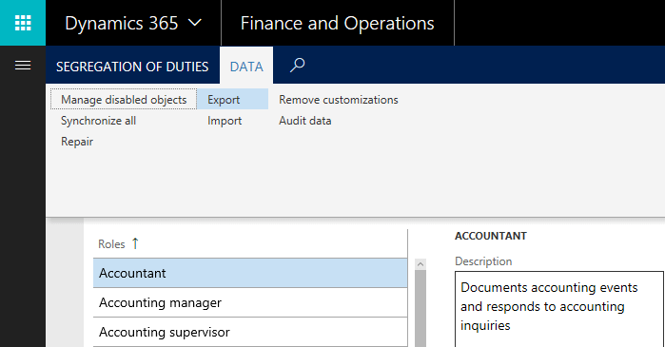
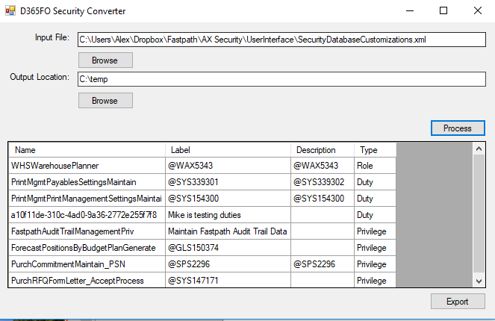
D365FO Security Converter
Tool to help move security created in user interface to AOT compatible files
Blog post: Converting D365FO User Interface Security Customizations Export to AOT Security XML Files
Available on my GitHub: D365FO Security Converter Project
Notes:
Follow up blog post on entire process of exporting user interface security customizations and converting it to AOT security:
https://alexdmeyer.com/2018/10/08/moving-d365fo-security-from-user-interface-to-aot/

Slide 19
Security Design & Management

Slide 20
Designing Least Privilege Security
Least privilege is method by which you assign the least amount of access needed for a user to perform their day-to-day operations
Has several benefits:
  Stops users from inadvertently/intentionally making changes to environment that they shouldn’t
  Helps eliminate user SOD and associated costs of mitigating
  Helps with limiting user licensing costs
Takes longer than using out of box roles
Need to have a balance between least privilege and least effort
Notes:
Why is utilizing least privilege it important?
Environment Risk – if a user has more access than needed, they may intentionally or inadvertently perform actions that could put your company at risk
User Licensing – since licensing is tied to user access, ensuring least privilege access is followed could save your company money on licensing costs
Segregation of Duties – following the same idea as environment risk, if a user has more access than needed, they may have unnecessary segregation of duties violations that go unaddressed.
Different design approaches when developing security:
Top-down
Bottom-up (least privilege)
Hybrid

Slide 21
Steps for Implementing Least Privilege Security
  1) Determine tasks a user will perform, making sure to not overprovision
    This D365FO Security Matrix from Fastpath may assist with this process
  2) Isolate menu items from process/task
    Task Recorder – perform the task the user will need to do while recording it using the task recorder function
    Use the Task Recorder Parser or Security Diagnostic for Task Recordings in D365FO to extract menu items consumed during task recording
  3) Determine correct permissions for menu items
    For D365FO, remember that menu item security is honored at table level
    If you would like additional help, the Fastpath Security Designer module will provide this information
  4) If necessary (esp. for AX 2012), modify table level access to allow/restrict access to certain tables/fields
  5) Test and validate – always be sure to test solution prior to deployment
    Users will not complain about having too much access
Notes:
Whitepaper: https://www.gofastpath.com/hubfs/Develop%20and%20Implement%20Least%20Privilege%20Security%20for%20Dynamics%20365.pdf
Youtube Video: https://www.youtube.com/watch?v=TSMPpMCUgM4&list=PLf9B7vmjpEjXNMjnVZ272mmzVVLpbzcBK&index=14
How to use Task Recorder Parser: https://alexdmeyer.com/2018/10/24/obtain-menu-items-from-dynamics-ax-2012-and-dynamics-365fo-task-recordings/

Slide 22
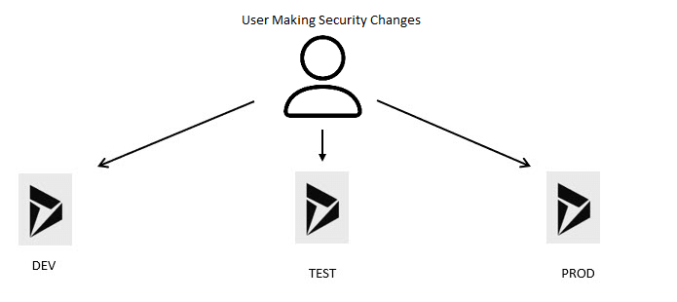
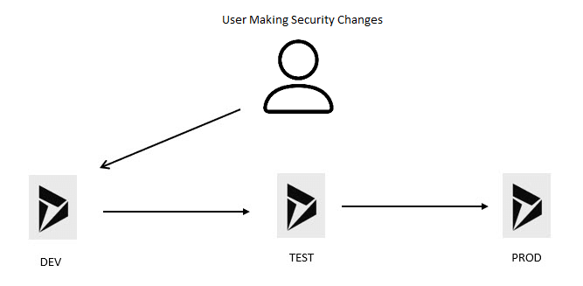
Follow ALM Process for Deploying Security
Do not deploy security like this…
Instead, follow the same process as code
Notes:
No security changes directly in production
Security should follow the same promotion process as code
ALM Story:
https://daxmusings.codecrib.com/p/alm-tfs.html

Slide 23
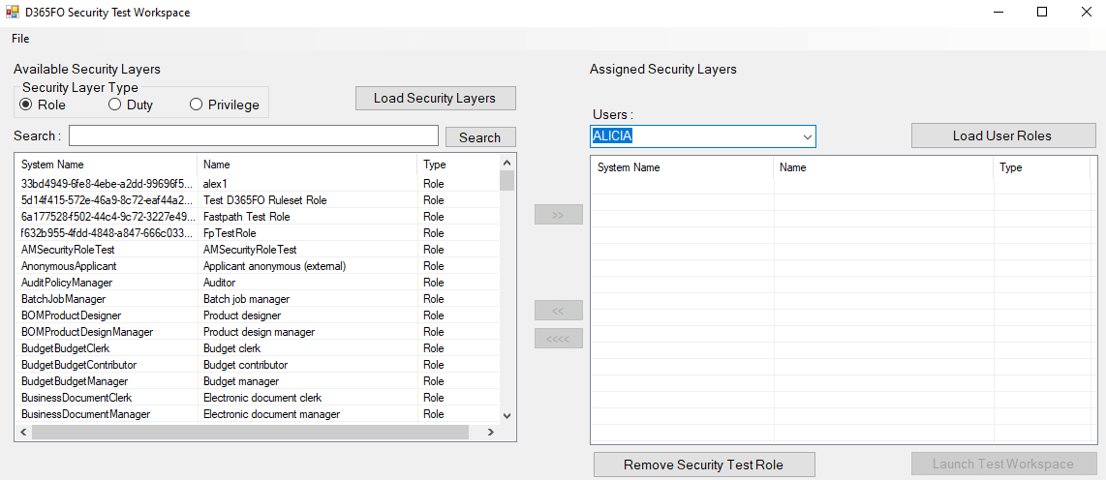
Testing Security
Security Test Workspace
Notes:
- Able to test any combination of role, duty, privilege
- Copy roles from user
Youtube: https://www.youtube.com/watch?v=EWtbI-Z9UuE
Blog: https://alexdmeyer.com/2021/05/19/beta-release-of-d365fo-security-role-test-workspace/

Slide 24
User Licensing

Slide 25
Licensing Directly Tied to Security
The security a user is assigned determines what license(s) they are required to have
  Changes to security can impact a user’s licensing requirements
  Need to have a way to analyze security changes for potential licensing impact
Least privilege security = lowest licensing costs
  If we can limit what a user is assigned, we can ensure their licensing costs are minimal
The above is not a trivial exercise but can produce LARGE returns
  Have instances where companies are saving multiple $100k+ per year on licensing costs

Slide 26
Audience Questions
What is your current process for determining user licensing?
Do security changes get analyzed for licensing impact before being implemented?
Do you perform any sort of licensing analysis to see if you can reduce licensing costs?

Slide 27
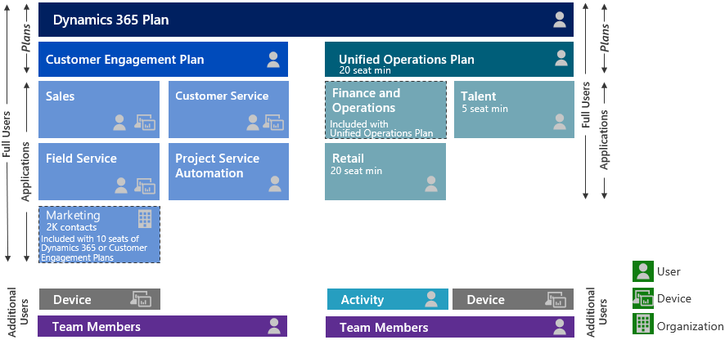
Old D365FO Licensing (pre-Oct 2019)

Slide 28
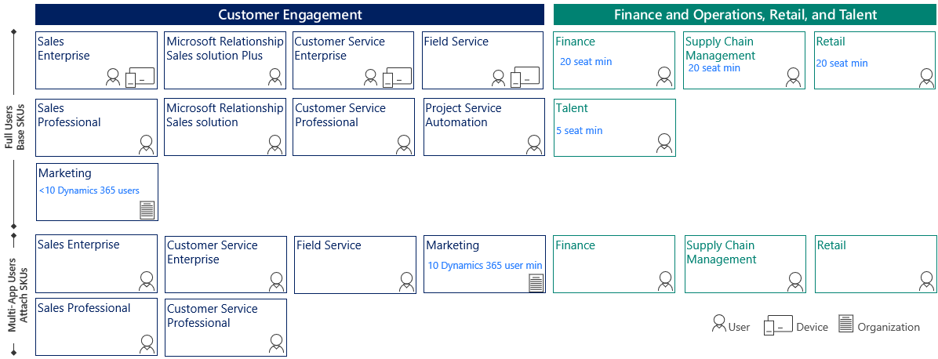
D365FO User Licensing

Slide 29
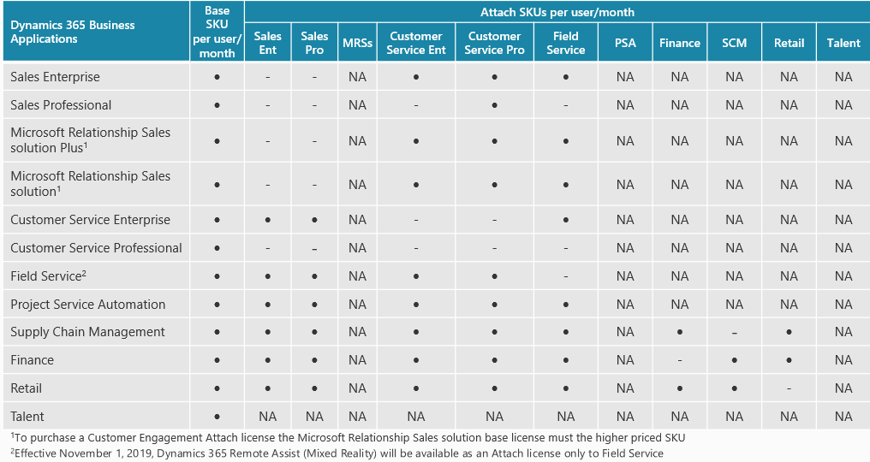
Base / Attach Combinations

Slide 30
D365 User Licensing Mechanisms
Two licensing mechanisms:
  Entry Point Based
  Privilege Based
Entry Point Licensing
  Three license types
    Operations
    Activity
    Team Member
Privilege Based Licensing
  Breaks Operations level license down into different module SKUs
    Finance
    Supply Chain Management
    Commerce
    Project Operations
  If user requires multiple licenses, then additional licenses can be ‘attached’ at a reduced price
  User must be assigned a ‘base’ license before any ‘attach’ licenses can be used

Slide 31
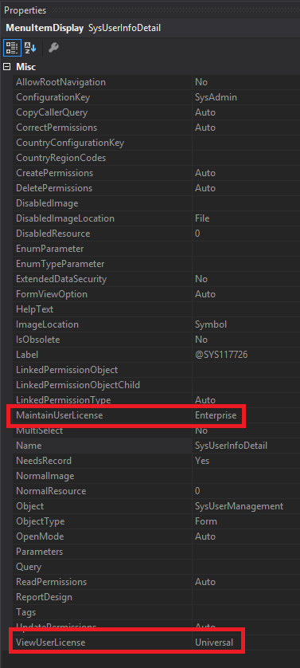
Entry Point Based Licensing
Based on access to entry points (menu items etc)
Each entry point has two parameters
  MaintainUserLicense – used if access is Created, Update, Delete
  ViewUserLicense – used if access if Read
It only takes one access at a higher license level for the user/role to require that higher license level

Slide 32
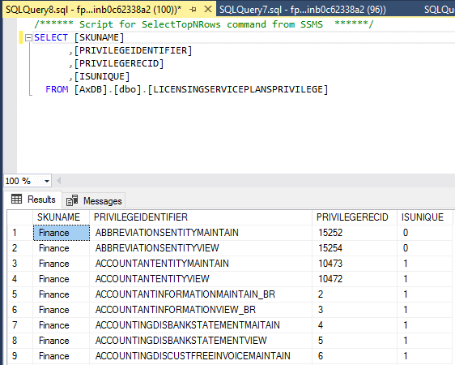
Privilege Based Licensing
Microsoft has designated certain privileges to require a particular license type
Associations can be found in the LicensingServicePlansPrivilege table
If user is assigned a privilege with IsUnique = 1 then that license is required
  If multiple licenses are required will follow a base/attach model
If IsUnique = 0 then any license listed will satisfy license requirement

Slide 33
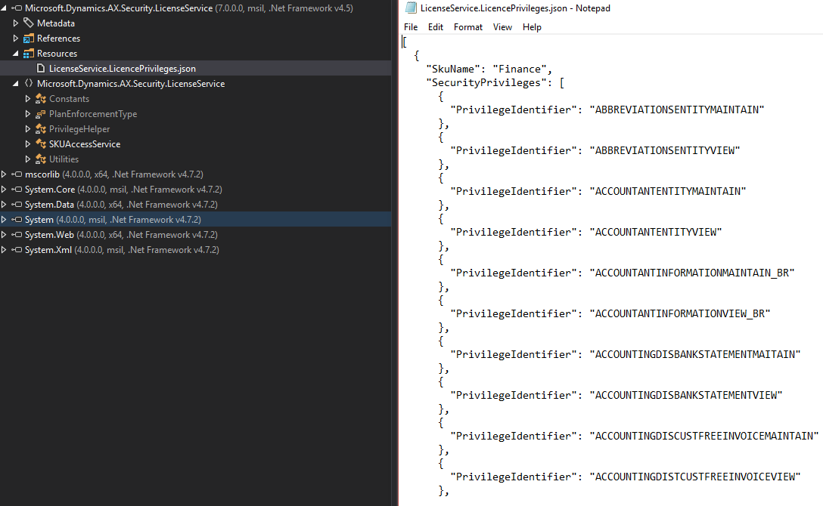
Privilege Based Licensing
How is the LicensingServicePlansPrivilege table populated?
  Executing the User License Estimator Report
  Populated by a static .json file that is stored in a DLL

Slide 34
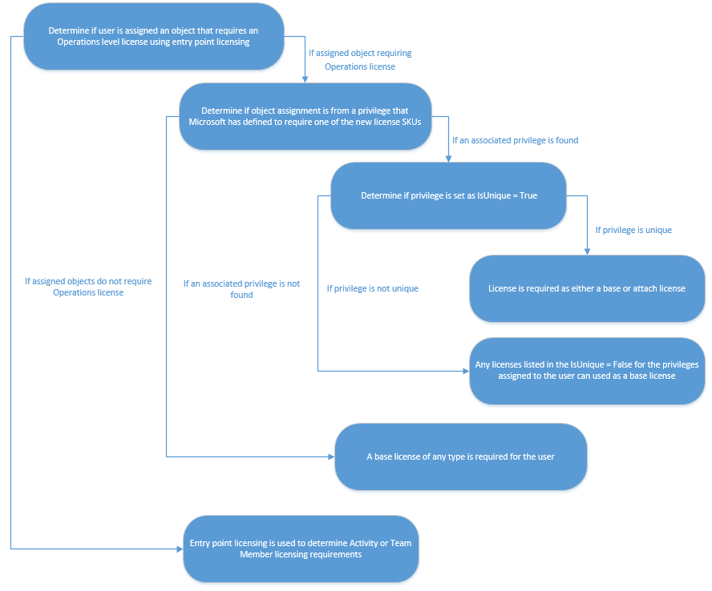
How Do We Bring These Licensing Models Together?
Notes:
https://alexdmeyer.com/2021/01/25/current-state-of-d365fo-user-licensing/

Slide 35
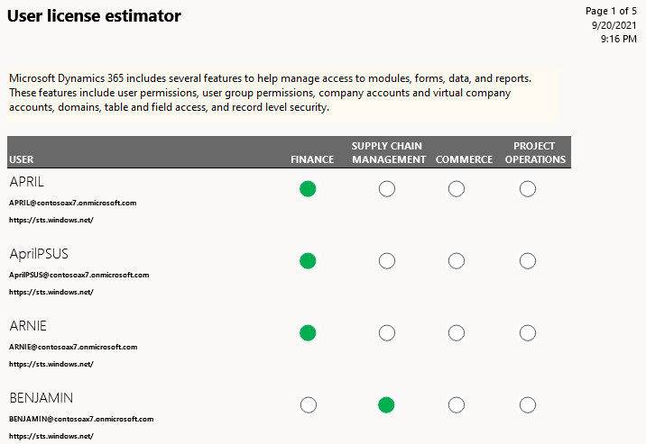
User License Estimator Report
Located at System Administration ->
Inquiries -> License Reports ->
User License Estimator
Historically has had many issues and may show
Incorrect results (PU31-PU36 all have some
bug/issue with them)
Current licenses (as of 10.0.21 are):
  Finance
  Supply Chain Management
  Commerce
  Project Operations

Slide 36
Manual Reporting Option
Need to first determine user access to entry points
Determine highest level of license required
If Operations level license required, need to determine privileges assigned to user
Reference data from LicensingServicePlansPrivilege table to determine required licenses
D365FO Security Layer Licensing Excel File
AX 2012 -> D365FO Licensing Comparison Excel File

Slide 37
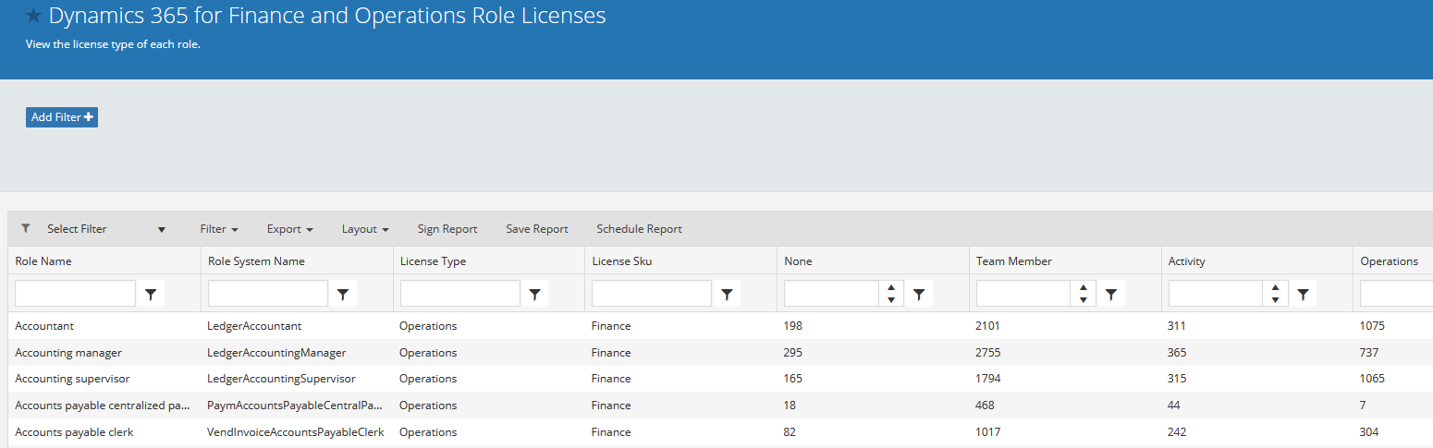
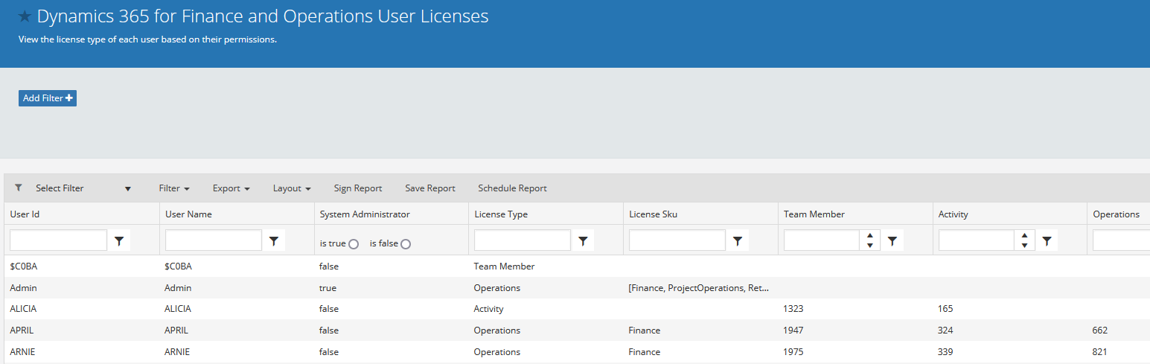
Automated Solutions
Fastpath Licensing Reports

Slide 38
Steps to Save Money on Licensing Costs
Ensure current license assignments match user’s requirements based on security
Implement least privilege security for users
  Take a risk-based approach to implementing
Look for instances where users or roles are over provisioned and either:
  Remove offending access
  Create a new role with correct security

Slide 39
Resources
Security and Audit Field Manual: D365FO
D365FO Blog
YouTube Channel
Develop and Implement Least Privilege Security for D365FO
Current State of D365FO User Licensing
Security Matrix
    AX 2012
    D365FO
D365FO Security Test Workspace
D365FO Security Converter
AX 2012/D365FO Task Recorder Parser

Slide 40
Resources
D365 Wiki
Task Recorder in Microsoft Dynamics 365 for Operations
Security Development Tool User Guide
Microsoft Dynamics AX 2012 R3 Licensing Guide
Introduction to Microsoft Dynamics 365 licensing
Dynamics AX Server Team Blog
Role-based Security Use Patterns for Developers
Developing Extensible Data Security Policies
Security Roles & Licensing Whitepaper‎
Table Permissions Framework
Transparent Data Encryption
Understanding Security in Microsoft Dynamics AX 2009

Slide 41
Questions?
Alex Meyer
Email: meyer@gofastpath.com
Blog: http://msftcloudblogs.com
GitHub: https://github.com/ameyer505
Twitter: https://twitter.com/alexmeyer_ITGuy
D365FO Security Course: http://d365fosecurity.com
PowerPoint available at:
https://alexdmeyer.com/resources/downloads/

